Slide 1
Request for Input from B0.10 on Potential D5800 Revision
June 26, 2017
Boston, MA

Slide 2
Background
ASTM D5800 is owned by D02.06
D02.B0.07 monitors bench tests relevant to automotive specifications, such as D5800
Due to a long-standing concern about test severity, the Volatility SP under D02.B0.07 implemented an LTMS system for D5800
Enabled use of severity adjustments (SA’s) for D5800 results for relevant automotive claims

Slide 3
Background
This is a unique situation and can cause confusion
Severity adjustments were previously limited to engine tests under SC B
D5800 is the only monitored bench test with SA’s
Methods with SA’s include language on TMC monitoring and use of SA’s
No language in D5800 for TMC monitoring and use of SA’s

Slide 4
Proposed Revision
Goal of revision: Inclusion of requirement for TMC instrument calibration and application of severity adjustments for API registration of fully formulated engine oils (ONLY)
No impact on other aspects of method for any other applications (e.g. base oil, ATF, other)
Revision would include standard TMC wording which would likely need to be modified for this situation

Slide 5
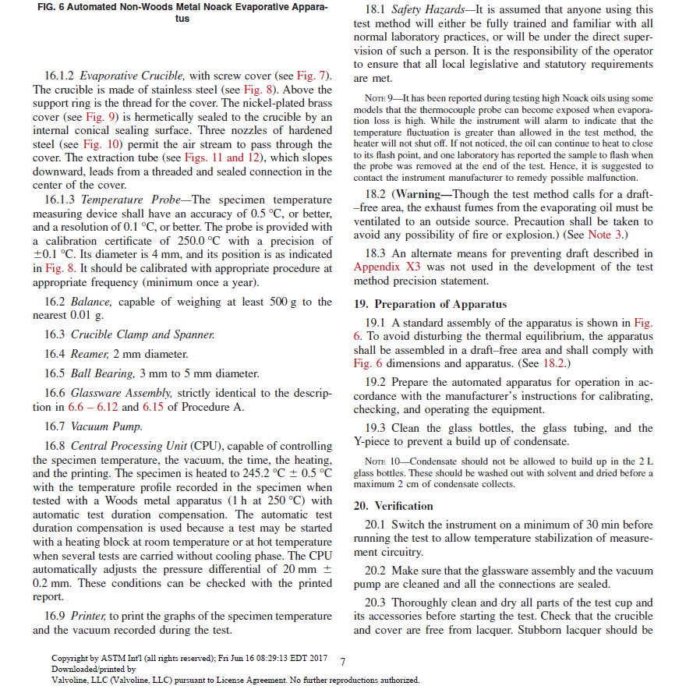
Draft Example
16.10 TMC Calibration of the apparatus is required for results used in API registration of fully formulated engine oils. The calibration procedure is defined in the Lubricant Test Monitoring System (LTMS) document that is maintained by the Test Monitoring Center (TMC), and that is governed by the D02.B0.07 Volatility Surveillance Panel. Severity adjustments shall be calculated and applied to results used in API registration of fully formulated engine oils (section 22.2.1).

Slide 6
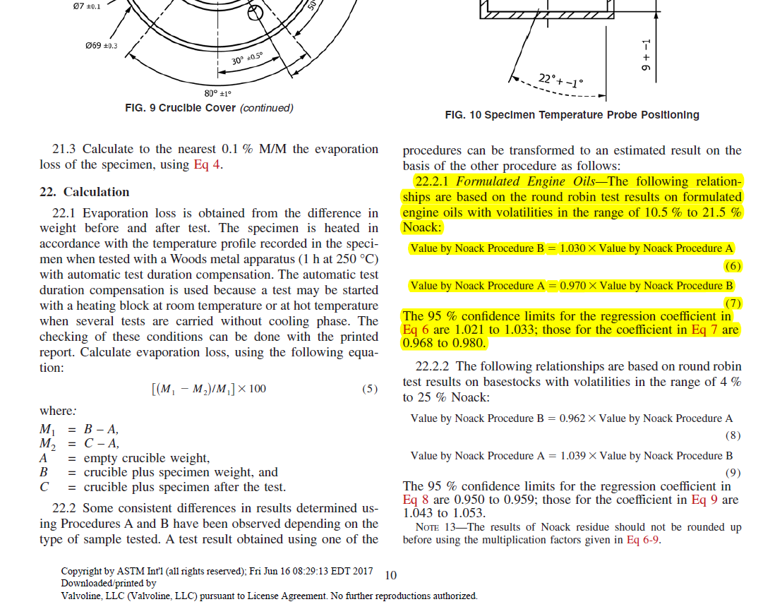
Where results are utilized for API registration of fully formulated engine oils, a Severity Adjustment (SA) shall be added to the final result in equation (5). The Severity Adjustment is determined from the TMC calibration procedure, as mandated in section 16.10.

Slide 7
Objective of Request
Given this situation, this is a request for support from B0.10 for a future revision to D5800 which would clarify use of SA’s in D5800 results
Work item to be requested at D02.06B meeting on Tuesday morning
Request for
Comments on potential wording
Comments on potential sections in method
Possible resource during year to provide additional feedback as the draft revision progresses to ballot

