Slide 1
D02.B.07 Engine Oil Volatility SP
Telecon / WebEx Meeting
February 19th, 2015

Slide 2
Agenda
Roll call, membership changes?
Vote on addition of the firmware revision level to the D5800 data dictionary (current version attached in multiple forms)
Review of data from VOLD14 round robin
  First, some related considerations
  Discussion of next steps
Other business?

Slide 3
Roll call

Slide 4
D5800 data dictionary

Slide 5
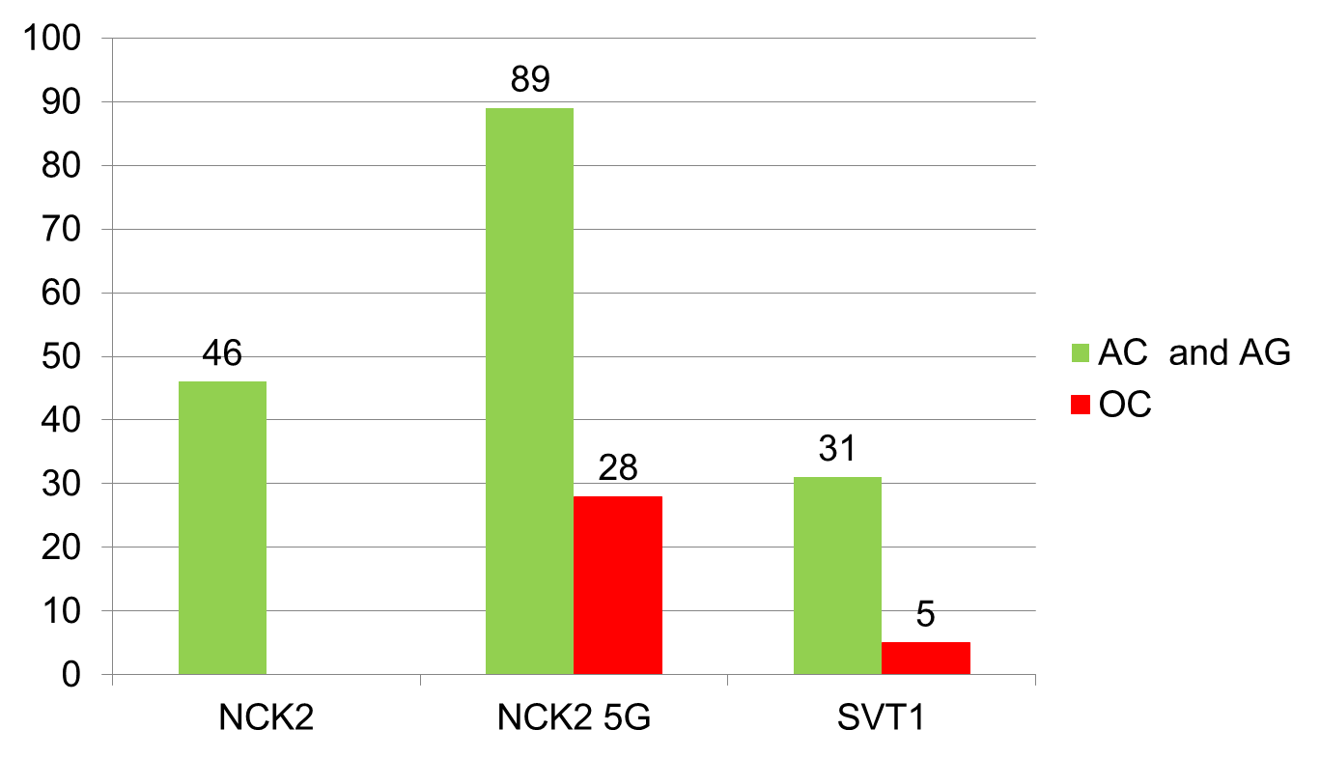
From December ASTM Meeting
Roughly 1 out of 4 NCK2 5G runs is “OC”

Slide 6
NCK2 5G Firmware
Manufacturer of NCK2 5G instrument has indicated that firmware update might improve instrument variability
Currently not a way to track firmware revision in TMC D5800 data
  Would be nice to know if firmware updates are improving variability

Slide 7
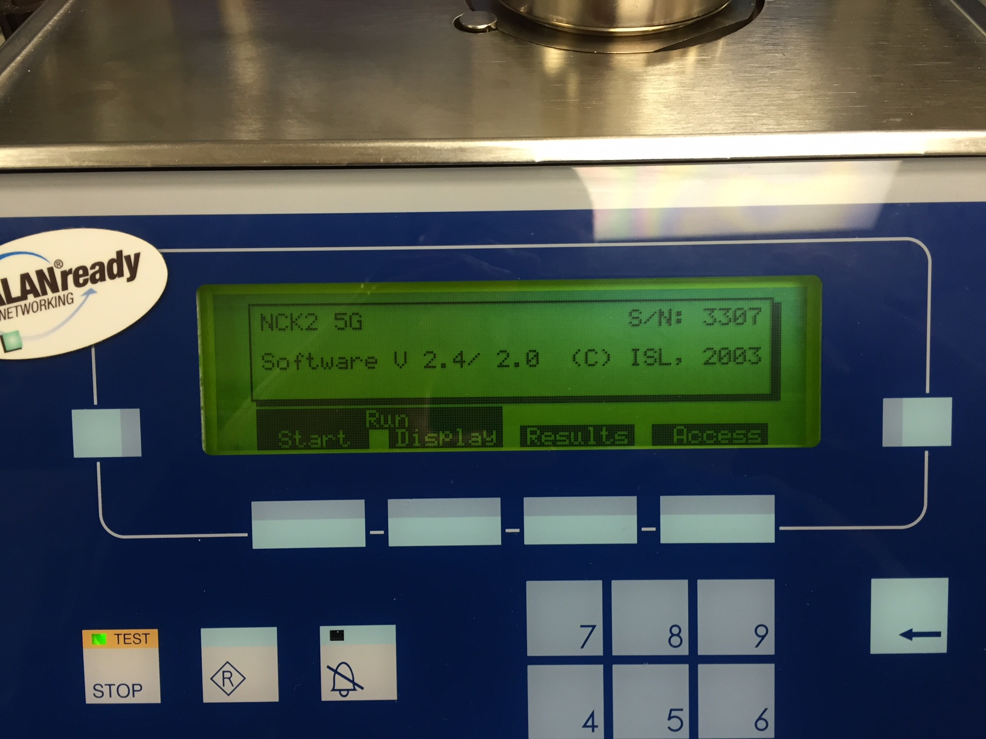
Proposal
Add the field “FIRMWARE” to the data dictionary for D5800
  For NCK2-5G format is “Vx.x/y.y” (e.g. V2.5/2.0)
  For NCK2 or for Method C, value is “N/A”

Slide 8
vote

Slide 9
vold14

Slide 10
VOLD14 Round Robin Statistics
33 measurements
  (2) NCK2 instruments
  (13) NCK2-5G instruments
  (4) SVT1 / SNV1 instruments
 | VOLD14 | VOLD12
Mean | 12.99 | 12.52
Std. Dev. | 0.62 | 0.52

Slide 11
Questions
Relevance of a round robin IF the procedure is out of control?
What is our duty as a Surveillance Panel if the procedure is “out of control”?
What is the definition of “out of control”?
Out of Control Document.pdf
LTMS program.pdf

Slide 12
Industry Z_{i} and Q_{i} Charts
(λ = 0.2, 2013 - present)
Severity EWMA: Z_{i} = λ*Y_{i} + (1 – λ)*Z_{i-1}
Precision EWMA: Q_{i} = λ*R_{i} + (1 – λ)*Q_{i-1}
Both charts have triggered alarms for the test.

Slide 13
Next Steps Regarding Control Question
Submit data for review by broader group of industry statisticians
  Same people evaluating matrices for PC-11 and GF-6
Reconvene surveillance panel to review their conclusions and recommendations (March/April timeframe)

Slide 14
Back to VOLD14: Interim Proposal
Institute VOLD14 as a mandatory daily check oil for TMC labs
  Mean of 12.99, UCL of 14.2 and LCL of 11.8
In parallel, evaluate control status of procedure
If we conclude that the procedure is out of control, then re-run round robin(s) once procedure is deemed back in control

Slide 15
Vote?

Slide 16
Other business

Slide 17

Notes:
Open meeting for additional discussion and questions/answers.

