Slide 1
GF-7 LDEOC Data Analysis
March 15, 2024
By: Todd Dvorak & Travis Kostan

Slide 2
Target Summary
Recommend targets for each parameter are shown below:

Slide 3
VOLFNL Parameter Analysis
Data Highlights:
  Six labs (A, B, E1, G, I, V) with 2 baths ran 5 tests - with elastomers: ACM2, AEM2, AEM3, and FKM3 (n = 120)
  For elastomer AEM3, Lab I - bath 2 data appears to exhibit a higher variability
    Data will be omitted from analysis dataset
  Plot of data shown below:

Slide 4
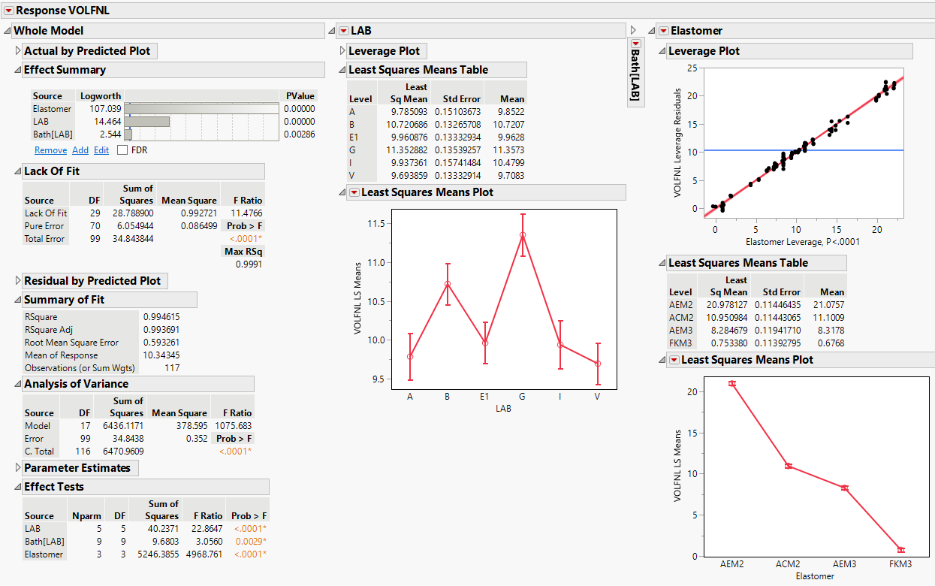
VOLFNL Parameter Analysis
VOLFNL parameter analyzed with elastomer, lab, and bath nested within lab
Results:
  Significant differences between Labs and elastomers
  For Lab I, significant difference between baths within a lab
  Elastomer targets and analysis summary are shown below:

Slide 5
HARFNL Parameter Analysis
Data Highlights:
  Six labs (A, B, E1, G, I, V) with 2 baths ran 5 tests - with elastomers: ACM2, AEM2, AEM3, and FKM3 (n = 120)
  For elastomers AEM3 & FKM3, Lab I - bath 2 data appears to exhibit a higher variability
    Data will be omitted from analysis dataset
  Plot of data shown below:

Slide 6
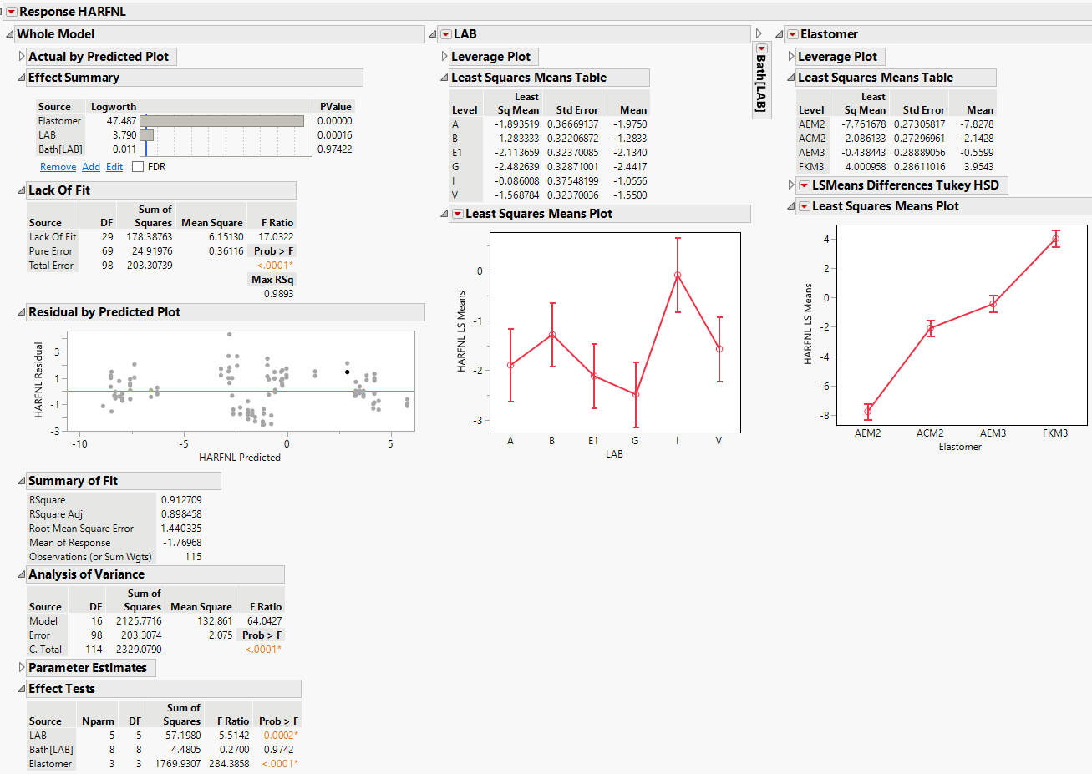
HARFNL Parameter Analysis
HARFNL parameter analyzed with elastomer, lab, and bath nested within lab
Results:
  Significant differences between Labs and elastomers
  Elastomer targets and analysis summary are shown below:

Slide 7
HARFNL Change Parameter Analysis
Data Highlights:
  Six labs (A, B, E1, G, I, V) with 2 baths ran 5 tests - with elastomers: ACM2, AEM2, AEM3, and FKM3 (n = 120)
  For elastomers AEM3 & FKM3, Lab I - bath 2 data appears to exhibit a higher variability
    Data will be omitted from analysis dataset
  Plot of data shown below:

Slide 8
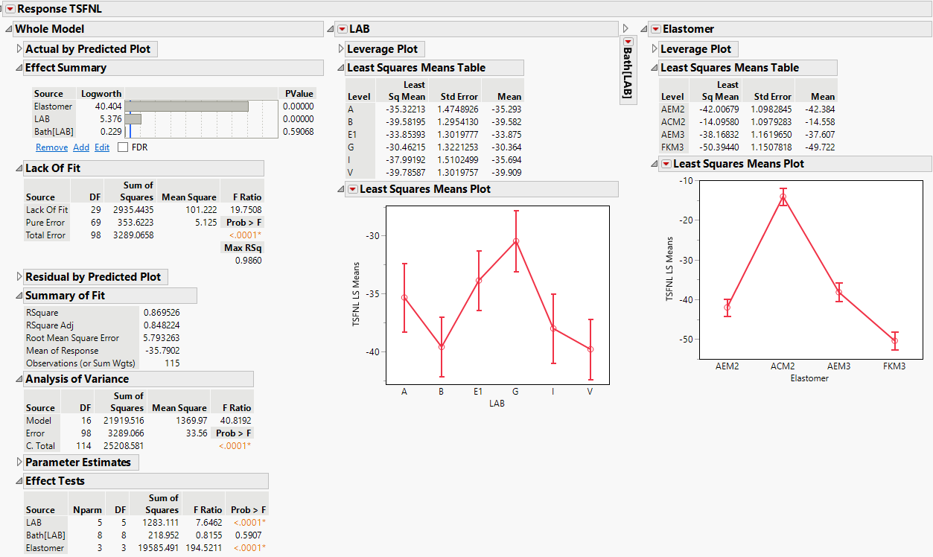
TSFNL Parameter Analysis
TSFNL parameter analyzed with elastomer, lab, and bath nested within lab
Results:
  Significant differences between Labs and elastomers
  Elastomer targets and analysis summary are shown below:

Slide 9
Appendix

Slide 10
Random Effects Model Variance Components
Y | Elastomer | Random Effect | Var Ratio | Var Component | Pct of Total | Std. Dev. |  | Y | Elastomer | Random Effect | Var Ratio | Var Component | Pct of Total | Std. Dev. |  | Y | Elastomer | Random Effect | Var Ratio | Var Component | Pct of Total | Std. Dev.
VOLFNL | AEM2 | LAB | 6.3162468 | 1.049022 | 82.696 |  |  | HARFNL | AEM2 | LAB | 2.681413 | 1.276305 | 71.516 |  |  | TSFNL | AEM2 | LAB | 0.98529 | 7.63043 | 49.63
VOLFNL | AEM2 | Bath[LAB] | 0.3216431 | 0.05342 | 4.211 |  |  | HARFNL | AEM2 | Bath[LAB] | 0.067976 | 0.032355 | 1.813 |  |  | TSFNL | AEM2 | Bath[LAB] | -0.16289 | -1.26145 | 0
VOLFNL | AEM2 | Residual |  | 0.166083 | 13.093 |  |  | HARFNL | AEM2 | Residual |  | 0.475982 | 26.671 |  |  | TSFNL | AEM2 | Residual |  | 7.74435 | 50.37
VOLFNL | AEM2 | Total |  | 1.268525 | 100 | 1.126288 |  | HARFNL | AEM2 | Total |  | 1.784643 | 100 | 1.335905 |  | TSFNL | AEM2 | Total |  | 15.37478 | 100 | 3.921069
VOLFNL | ACM2 | LAB | 7.5909982 | 0.130296 | 25.873 |  |  | HARFNL | ACM2 | LAB | 2.958975 | 1.843418 | 67.699 |  |  | TSFNL | ACM2 | LAB | 2.099464 | 9.60308 | 67.736
VOLFNL | ACM2 | Bath[LAB] | 20.748687 | 0.356143 | 70.719 |  |  | HARFNL | ACM2 | Bath[LAB] | 0.411813 | 0.256556 | 9.422 |  |  | TSFNL | ACM2 | Bath[LAB] | -0.28007 | -1.28108 | 0
VOLFNL | ACM2 | Residual |  | 0.017165 | 3.408 |  |  | HARFNL | ACM2 | Residual |  | 0.622992 | 22.879 |  |  | TSFNL | ACM2 | Residual |  | 4.574063 | 32.264
VOLFNL | ACM2 | Total |  | 0.503604 | 100 | 0.70965 |  | HARFNL | ACM2 | Total |  | 2.722966 | 100 | 1.650141 |  | TSFNL | ACM2 | Total |  | 14.17714 | 100 | 3.765255
VOLFNL | AEM3 | LAB | 9.2524918 | 1.225135 | 86.903 |  |  | HARFNL | AEM3 | LAB | 28.97172 | 5.995034 | 95.671 |  |  | TSFNL | AEM3 | LAB | 6.03403 | 31.00519 | 85.783
VOLFNL | AEM3 | Bath[LAB] | 0.3944826 | 0.052234 | 3.705 |  |  | HARFNL | AEM3 | Bath[LAB] | 0.311093 | 0.064374 | 1.027 |  |  | TSFNL | AEM3 | Bath[LAB] | -0.07533 | -0.38706 | 0
VOLFNL | AEM3 | Residual |  | 0.132411 | 9.392 |  |  | HARFNL | AEM3 | Residual |  | 0.206927 | 3.302 |  |  | TSFNL | AEM3 | Residual |  | 5.138388 | 14.217
VOLFNL | AEM3 | Total |  | 1.40978 | 100 | 1.187342 |  | HARFNL | AEM3 | Total |  | 6.266335 | 100 | 2.503265 |  | TSFNL | AEM3 | Total |  | 36.14358 | 100 | 6.011953
VOLFNL | FKM3 | LAB | -0.078967 | -0.00283 | 0 |  |  | HARFNL | FKM3 | LAB | 4.302002 | 0.47919 | 61.489 |  |  | TSFNL | FKM3 | LAB | 44.34338 | 131.5751 | 97.677
VOLFNL | FKM3 | Bath[LAB] | 4.8005533 | 0.171867 | 82.76 |  |  | HARFNL | FKM3 | Bath[LAB] | 1.694386 | 0.188734 | 24.218 |  |  | TSFNL | FKM3 | Bath[LAB] | 0.054726 | 0.162381 | 0.121
VOLFNL | FKM3 | Residual |  | 0.035801 | 17.24 |  |  | HARFNL | FKM3 | Residual |  | 0.111388 | 14.293 |  |  | TSFNL | FKM3 | Residual |  | 2.967186 | 2.203
VOLFNL | FKM3 | Total |  | 0.207668 | 100 | 0.455706 |  | HARFNL | FKM3 | Total |  | 0.779312 | 100 | 0.882786 |  | TSFNL | FKM3 | Total |  | 134.7046 | 100 | 11.60623

