Slide 1
ROBO Surveillance Panel Meeting
August 8, 2019
Justin Mills

Slide 2
Agenda
Welcome, ASTM statement
Review membership of SP
Review and approve minutes from previous meetings (see attachment)
Review and follow-up on actions from June 20th meeting
TMC 438-2
TMC 434-3
Dilute nitrogen dioxide – Drafting alternative procedure
Method housekeeping
Additional topics, if any
Set next meeting

Slide 3
ASTM Antitrust and Recording Policy
ASTM International is a not-for-profit organization and developer of voluntary consensus standards. ASTMs leadership in international standards development is driven by the contributions of its members: more than 30,000 technical experts and business professionals representing 135 countries.
The purpose of antitrust laws is to preserve economic competition in the marketplace by prohibiting, among other things, unreasonable restraints of trade. In ASTM activities, it is important to recognize that participants often represent competitive interests. Antitrust laws require that all competition be open and unrestricted.
It is ASTMs policy, and the policy of each of its committees and subcommittees, to conduct all business and activity in full compliance with international, federal and state antitrust and competition laws. The ASTM Board of Directors has adopted an antitrust policy which is found in Section 19 of ASTM Regulations Governing Technical Committees. All members need to be aware of and compliant with this policy. The Regulations are accessible on the ASTM website http://www.astm.org/COMMIT/Regs.pdf).
Electronic recording of ASTM meetings is prohibited.

Slide 4
Membership
Ace Glass | Dave Lawrence
Afton | Shelia Thompson, Jeff Yang, Todd Dvorak
ASTM TMC | Tom Schofield
BASF | Mary Dery, Bridgett Rakestraw
Chevron Oronite | Man Hon Tsang, Robert Stockwell
ExxonMobil | Dennis Gaal
Infineum | Andy Richie, Sapna Eticala
Intertek | Joe Franklin, Matt Schlaff
Lubrizol | Mike Faile, Aimee Shinhearl, Rick Hartman
PetroChina | Li Shaohui , Sun Ruihua, Peng Wang, Xiaogang Li, Xu Li
Evonik Oil Additives | Justin Mills, Bruce Zweitzig, Joan Souchik, John Maxwell, Justin Kontra
Vanderbilt Chemicals | Al Filho, Ron Hiza
SwRI | Becky Grinfield, Joe De La Cruz, Mike Birke, Yong-Li McFarland
Valvoline | Amol Savant, Kevin Figgatt, Steve Lazzara
Koehler Instruments | Raj Shah, Vincent Colantuini
Tannas/Savant | Greg Miller, Ted Selby
General Interest | Alan Flamberg
Summary of changes:

Slide 5
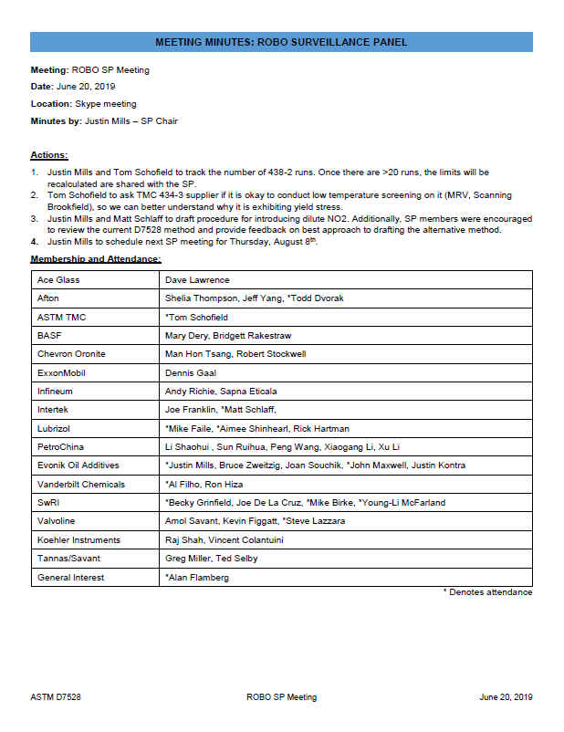
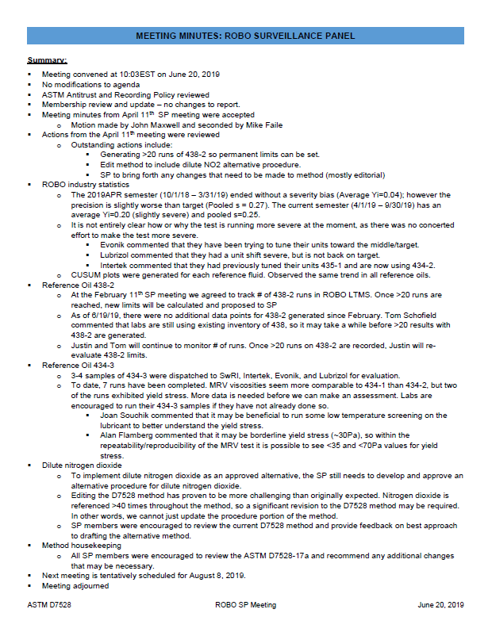
Motion to accept June 20, 2019 meeting minutes

Slide 6
Actions from June 20th meeting
☐
Justin Mills and Tom Schofield to track the number of 438-2 runs. Once there are >20 runs, the limits will be recalculated are shared with the SP.
Tom Schofield to ask TMC 434-3 supplier if it is okay to conduct low temperature screening on it (MRV, Scanning Brookfield), so we can better understand why it is exhibiting yield stress.
Justin Mills and Matt Schlaff to draft procedure for introducing dilute NO2. Additionally, SP members were encouraged to review the current D7528 method and provide feedback on best approach to drafting the alternative method.
Justin Mills to schedule next SP meeting for Thursday, August 8th.
☐
☐
☒

Slide 7
ROBO Industry Statistics
Period | N-size | Degrees of Freedom | Pooled s | Mean Δ/s | Comments
Current Targets | 49 | 46 | 0.1945 | ------
10/1/15 through 3/31/16* | 92 | 89 | 0.4115 | -0.10 | Period statistics with and without one extreme result included
10/1/15 through 3/31/16* | 91 | 88 | 0.3661 | -0.20
4/1/16 through 9/30/16 | 74 | 71 | 0.3152 | -0.53
10/1/16 through 3/31/17 | 78 | 75 | 0.2771 | -0.91
4/1/17 through 9/30/17 | 99 | 95 | 0.2220 | -0.76
10/1/17 through 3/31/18** | 90 | 86 | 0.2376 | -0.91 | Period statistics with and without seven suspect results from two rigs
10/1/17 through 3/31/18** | 83 | 79 | 0.2076 | -0.74
4/1/18 through 9/30/18 | 126 | 122 | 0.2184 | -0.49 | Period statistics with and without one extreme result included
4/1/18 through 9/30/18 | 125 | 121 | 0.1958 | -0.53
10/1/18 through 3/31/19 | 100 | 96 | 0.2738 | 0.04
4/1/19 through 9/30/19 | 58 | 54 | 0.2326 | -0.12
Updated 08/06/19

Slide 8
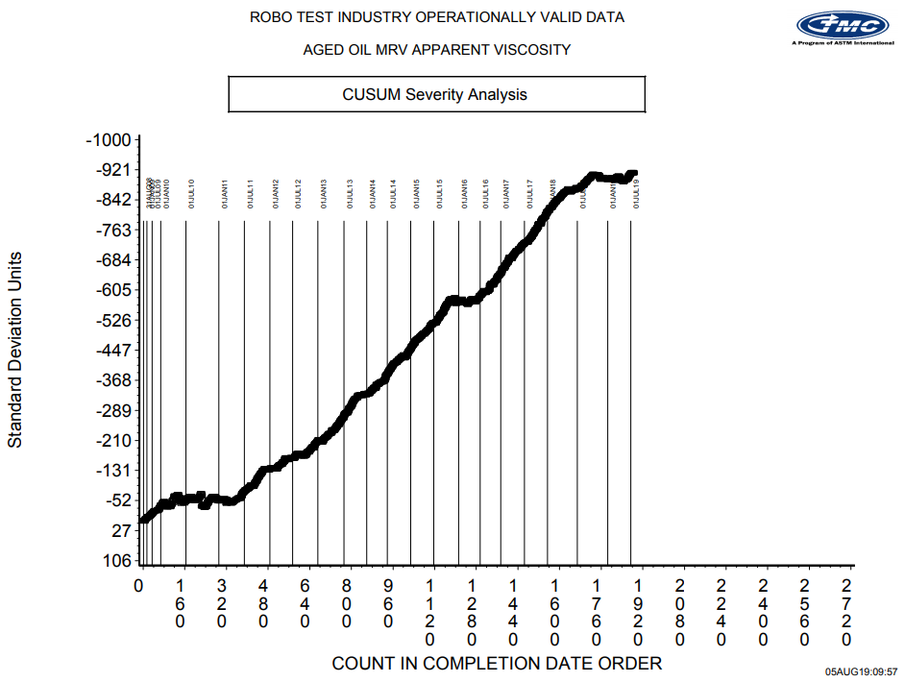
CUSUM severity analysis

Slide 9
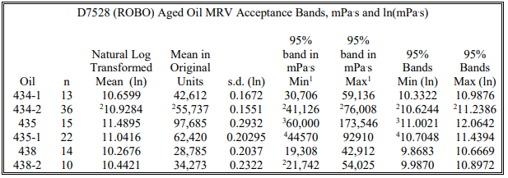
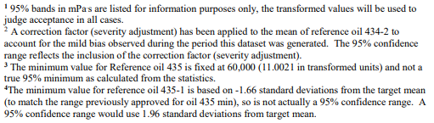
TMC 438-2
At the April SP meeting we agreed to track # of 438-2 runs in ROBO LTMS. Once >20 runs are reached, new limits will be calculated and proposed to SP
  Only 3 new data points for 438-2 since February 1, 2019 → Total of 13 runs
  Will continue to monitor # of runs.
Source: http://www.astmtmc.cmu.edu/ftp/docs/ltms/ltms.pdf 04-2019 version

Slide 10
TMC 434-3 approval
TMC 434-2 levels are critically low
METHOD | IND | TESTKEY | DTCOMP | APPARATS | MRVTEMP | MRVYSEOT | MRV | MRVti | VAL | VOLEOT | PVIS
ROBO | 434-3 | 145027-ROBO | 20190502 | A 11 | -30 | <70 | 47300 | 10.7643 | RG | 47 | 83.4
ROBO | 434-3 | 145003-ROBO | 20190503 | B 2 | -30 | <35 | 51900 | 10.8571 | AG | 49 | 93.7
ROBO | 434-3 | 145005-ROBO | 20190505 | B 2 | -30 | <35 | 50800 | 10.8357 | AG | 49 | 96.3
ROBO | 434-3 | 145004-ROBO | 20190508 | B 4A | -30 | <35 | 43100 | 10.6713 | AG | 46 | 75.7
ROBO | 434-3 | 145006-ROBO | 20190519 | B 4A | -30 | <35 | 39600 | 10.5866 | AG | 44 | 66.7
ROBO | 434-3 | 145028-ROBO | 20190531 | A 5 | -30 | <70 | 43100 | 10.6713 | AG | 43 | 72.6
ROBO | 434-3 | 145021-ROBO | 20190607 | AM 4 | -30 | <35 | 55700 | 10.9277 | AG | 48 | 97.2
ROBO | 434-3 | 145029-ROBO | 20190627 | A 3 | -30 | <35 | 42800 | 10.6643 | AG | 47 | 84.1
ROBO | 434-3 | 145051-ROBO | 20190630 | G 1 | -30 | <35 | 58000 | 10.9682 | AG | 49 | 125.4
ROBO | 434-3 | 145053-ROBO | 20190717 | G 6 | -30 | <35 | 51800 | 10.8551 | AG | 44 | 99.4
MRV viscosities seem more comparable to 434-1 than 434-2, but issue of yield stress needs to be resolved.
More data is still required for analysis

Slide 11
TMC 434-3 approval
Alignment with previous versions

Slide 12
Dilute nitrogen dioxide
Next steps
Path forward to implement dilute NO2 as an alternative to pure NO2 is the following:
    Demonstrate equivalence to the SP → Based on the available data, SP feels confident that dilute NO2 and concentrated NO2 yield comparable results?
    Develop a procedure for dilute NO2 → Due to difficulty drafting an alternative procedure, an ASTM facilitator has been requested to provide support.
    Approve by SP → Seek approval after procedure is written.
    Issue information letter allowing use of dilute NO2 as an alternative
    Ballot the recommended changes at ASTM
☒
☐
☐
☐
☐

Slide 13

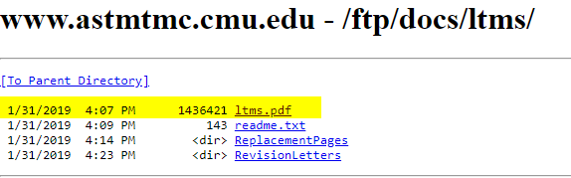
Method housekeeping
9. New and Existing Test Stand Calibration needs to be updated.
  ROBO no longer has stand-alone calibration requirements and is now included in LTMS. As such, the reference in the method is no longer valid
  Suggest we also update Section 9 calibration requirements and reference the LTMS for calibration requirements.
Any other changes?

Slide 14
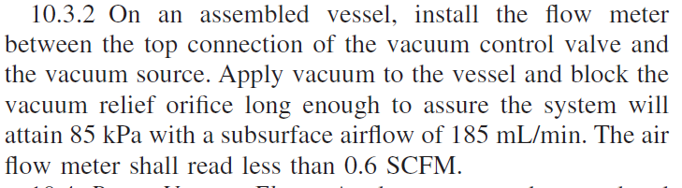
Method housekeeping
Feedback from Mike Faile and Aimee Shinhearl
“For method housekeeping, we do have a proposed change regarding the acrylic block air flow meter readings. We would like to have the level in 10.3.2.1 changed to 1.0 SCFM. We realize that 0.6 is ideal, but this is difficult to always achieve. Even with the Edwards pump trials that we ran in the past and now are currently trialing again, we have not always achieved the 0.6 level but did achieve passing results on some of those runs.”

Slide 15
Any Additional Topics?

Slide 16
Additional topics from Mike Faile and Aimee Shinhearl
The NO2 vial – with the increments being 0.1 mL and the goal to dose at 0.167 per hour, it makes it difficult. We were wondering if anyone ever investigated a different vial that had smaller increments to better help track the flow with pure NO2.
For historical understanding, why was it decided to start the NO2 flow right away rather than waiting for the reactor to reach the 170 °C test temperature? Would results be more severe if it was introduced after test temperature was reached?

Slide 17
Next Meeting
Suggestions for next SP meeting?
  Thursday, September 26th?
  Thursday, October 3rd?

Slide 18
Dilute nitrogen dioxide
Comparison between concentrated and dilute
TMC 435-1
TMC 434-2
TMC 438
OG
OG
All operationally valid data included for both concentrated and dilute NO₂.
Dilute NO₂ shows same trend as concentrated NO₂.

Slide 19
Dilute nitrogen dioxide
Available data
IND | TESTKEY | APPARATS | VAL | PVIS | MRVTEMP | MRVYSEOT | MRV | Current limits | MRV | Current limits
435-1 | 116911-ROBO | AM3 | NN | 162.5 | -30 | <35 | 72,200 | 44,570 – 92,910 | 11.1872 | 10.7048 - 11.4394 (s.d. ln) = 0.20295
435-1 | 140615-ROBO | AM3 | NN | 145 | -30 | <35 | 61,700 |  | 11.0300
435-1 | 137372-ROBO | AM 3 | NN | 148.3 | -30 | <35 | 74,300 |  | 11.2159
435-1 | 135714-ROBO | G 8 | AG | 193.3 | -30 | <35 | 81,000 |  | 11.3022
435-1 | 138779-ROBO | G 8 | AG | 136.2 | -30 | <35 | 55,400 |  | 10.9223
435-1 | 138781-ROBO | G 8 | LG | 252 | -30 | <70 | 223,100 |  | 12.3154
 |  |  |  |  |  | AVG | 68,920 | AVG | 11.1315
 |  |  |  |  |  | STDEV | 10,254 | STDEV | 0.1528
438 | 83467-ROBO | AM3 | NN | 197 | -30 | <35 | 51,000 | 19,308 – 42,912 | 10.8396 | 9.8683 - 10.6669 (s.d. ln) = 0.2037
438 | 119646-ROBO | AM3 | NN | 156.5 | -30 | <35 | 34,500 |  | 10.4487
438 | 137387-ROBO | AM 3 | NN | 144.9 | -30 | <35 | 32,900 |  | 10.4012
438 | 135716-ROBO | G 8 | AG | 189.7 | -30 | <35 | 40,800 |  | 10.6164
438 | 135717-ROBO | G 8 | OG | 229.1 | -30 | <35 | 63,200 |  | 11.0541
438 | 138795-ROBO | G 8 | AG | 160.7 | -30 | <35 | 35,200 |  | 10.4688
 |  |  |  |  |  | AVG | 42,933 | AVG | 10.6381
 |  |  |  |  |  | STDEV | 11,933 | STDEV | 0.2587
434-2 | 119643-ROBO | AM3 | NN | 144.3 | -30 | <35 | 65,100 | 41,126 – 76,008 | 11.0837 | 10.6244 - 11.2386 (s.d. ln) = 0.1551
434-2 | 113304-ROBO | AM3 | NN | 151 | -30 | <35 | 65,500 |  | 11.0898
434-2 | 142329-ROBO | AM 3 | NN | 117.5 | -30 | <35 | 50,900 |  | 10.8376
434-2 | 138766-ROBO | G 8 | AG | 105.4 | -30 | <35 | 43,100 |  | 10.6713
434-2 | 138767-ROBO | G 8 | OG | 178.7 | -30 | <35 | 76,700 |  | 11.2477
434-2 | 142038-ROBO | G 8 | LG | 146.1 | -30 | <35 | 69,200 |  | 11.1448
 |  |  |  |  |  | AVG | 60,260 | AVG | 10.9860
 |  |  |  |  |  | STDEV | 13,259 | STDEV | 0.2290

