Slide 1
COAT Test Analysis of TMC 1005-5
Elisa Santos, Jim Gutzwiller and David Brass
May 17, 2021

Slide 2
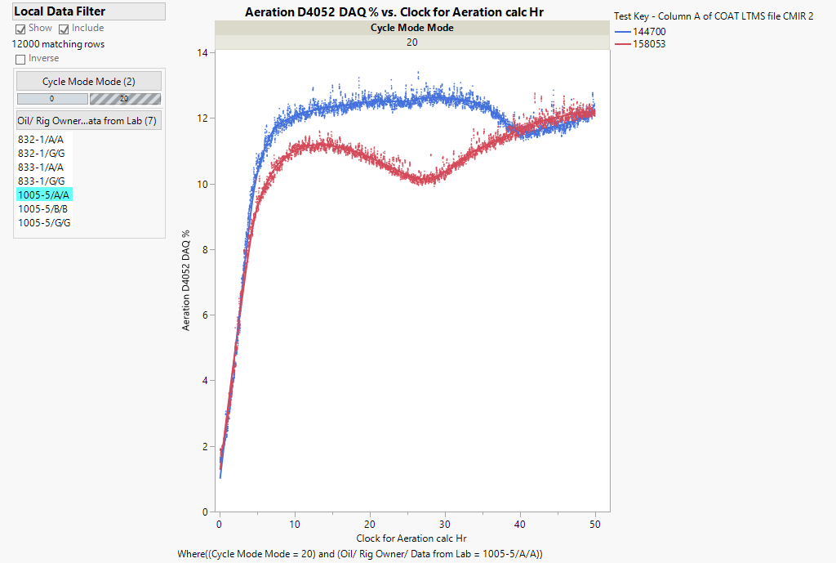
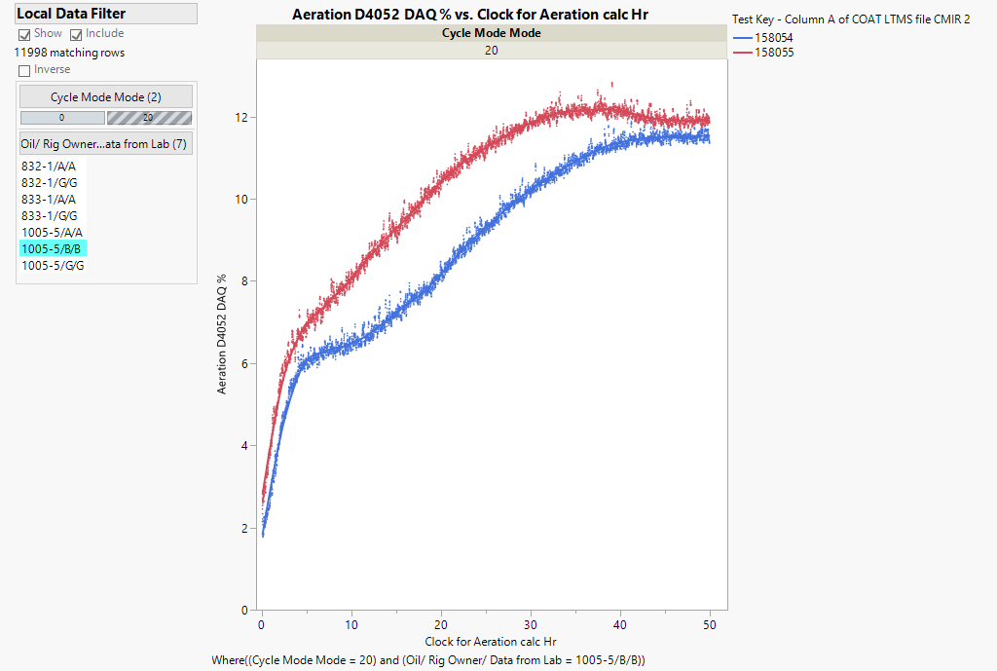
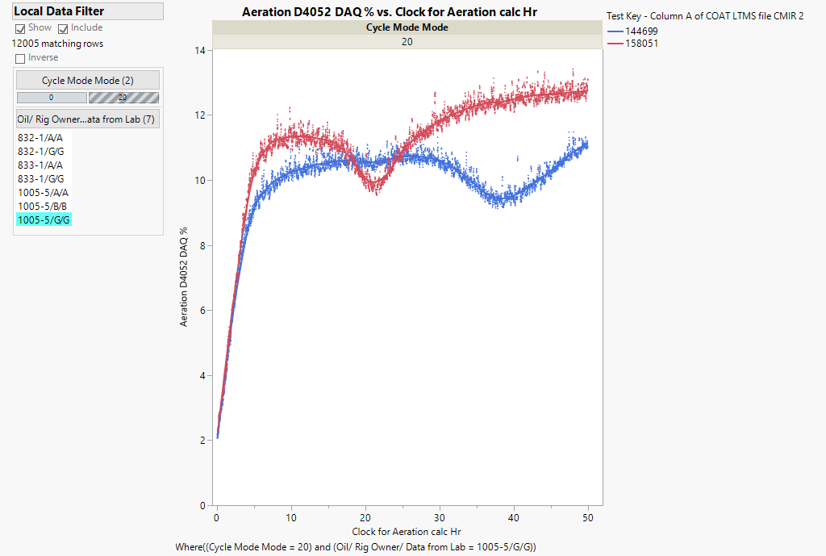
Testing of TMC 1005-5
Lab A
Lab B
Lab G
12.2% at 50 hours
12.2% at 37 hrs
11.9% at 50 hours
12.7% at
50 hours
11.51% at
50 hours
11% at
50 hours
11.6% at 41 hours
10.1% at 27 hours
9.95% at 21 hours
9.40% at 38 hours
There is concern about the drop in aeration in the middle of these tests
These tests did not have enough time to establish stable aeration values
Unknown cause of air being evacuated from oil needs to be investigated

Slide 3
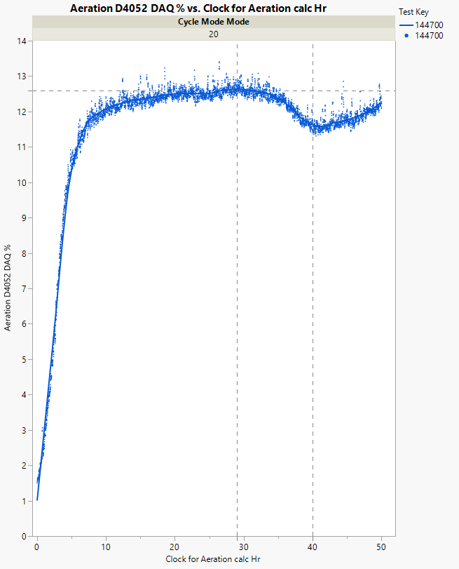
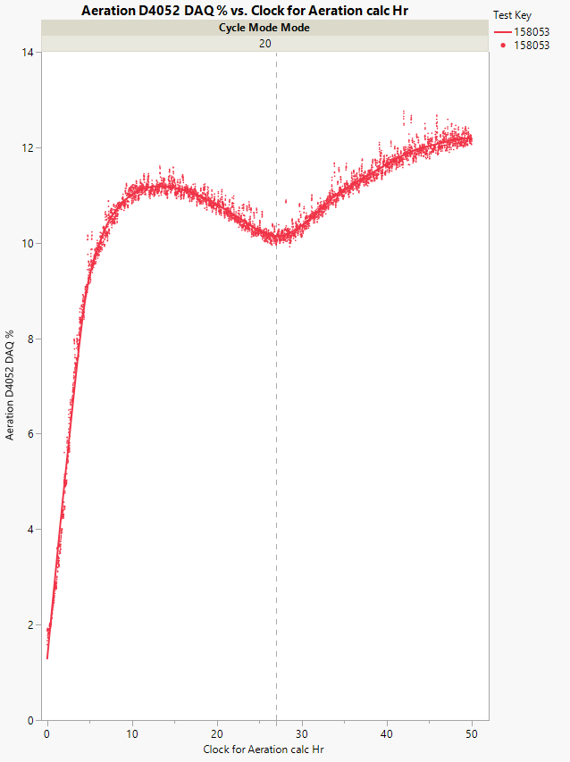
Effect of Dip in Aeration Value – Lab A
12.2% at 50 hours
12.2% at 50 hours
12.6% at 29 hours
11.6% at 41 hours
10.1% at 27 hours
AAVE4050 = 11.81%
A continued flat line after 30 hours would correspond to a final aeration value closer to 12.6% (consider a lower bound if we assume that aeration is still rising at 30 hrs.)
AAVE4050 = 12%
Aeration level is still rising through end of test

Slide 4
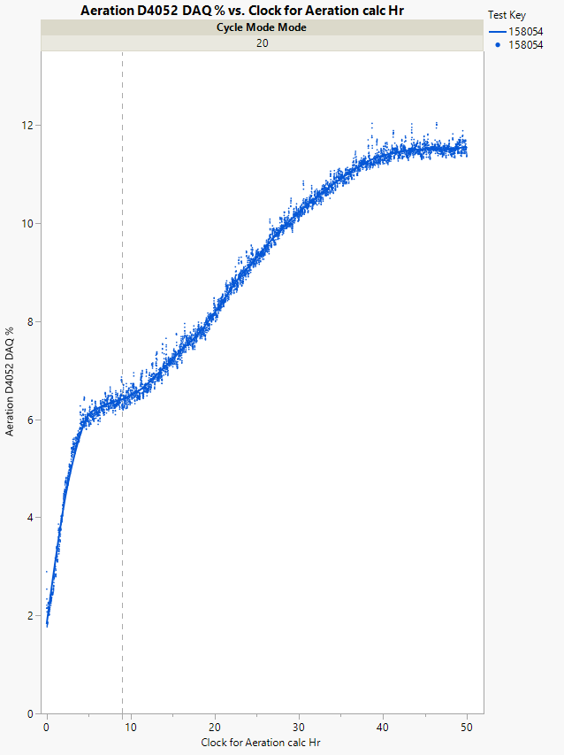
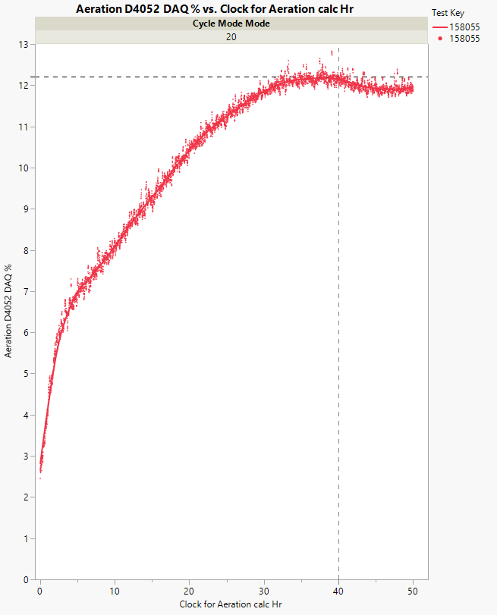
Effect of Dip in Aeration Value – Lab B
11.9 % at
50 hours
12.2% at 40 hrs. and it goes down
11.51 % at
50 hours
AAVE4050 = 11.97%
If aeration level remained flat after 40 hours the final value would have been 12.2%. At 40 hours there was still a rise in aeration
AAVE4050 = 11.49%
Inflection points in middle of tests are atypical, what impact is this having on the final aeration?
Inflection around 9 hrs.

Slide 5
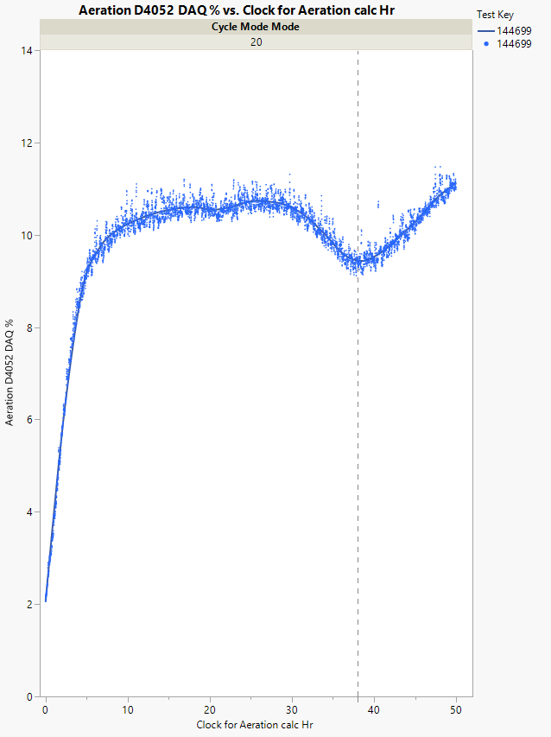
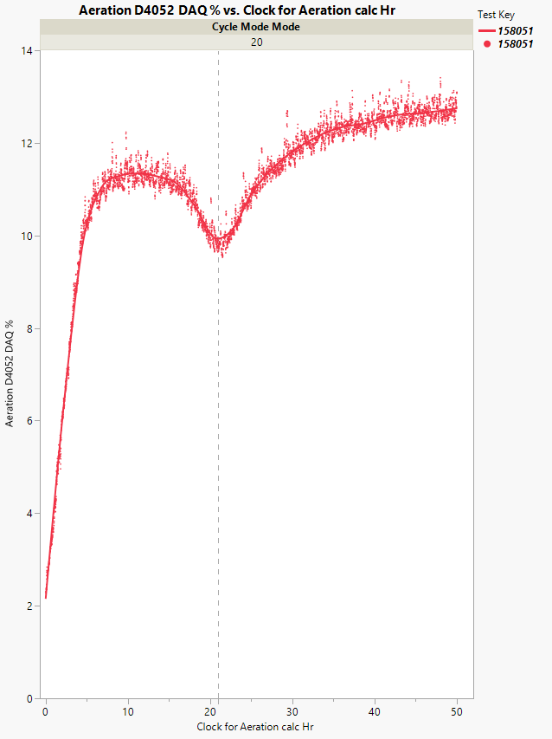
Effect of Dip in Aeration Value – Lab G
12.7% at
50 hours
11% at
50 hours
9.40% at 38 hours
9.95% at 21 hours
AAVE4050 = 10.31%
Sharp sloped rise during the last 12 hours of the test
AAVE4050 = 12.64%
Aeration level is still rising slowly through end of test

Slide 6
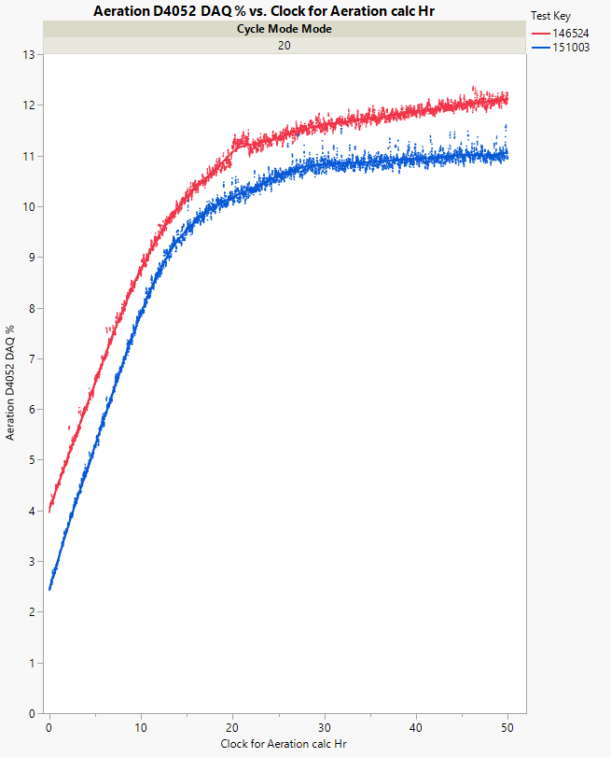
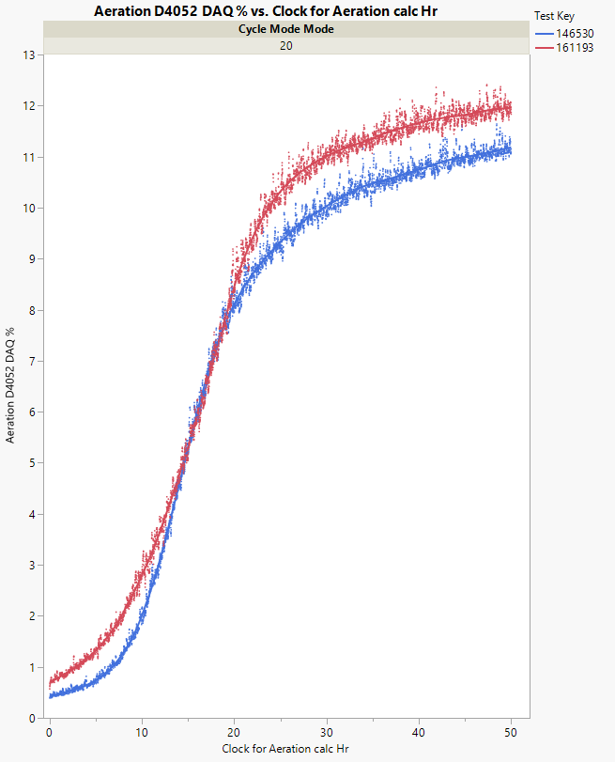
Recent Test Results of 832-1 and 833-1
Lab A
Lab G
Aeration plot shapes appear to be similar within a lab for both reference oils
Large deviations in aeration were not noticed in these tests.
833-1
833-1
832-1
832-1

Slide 7
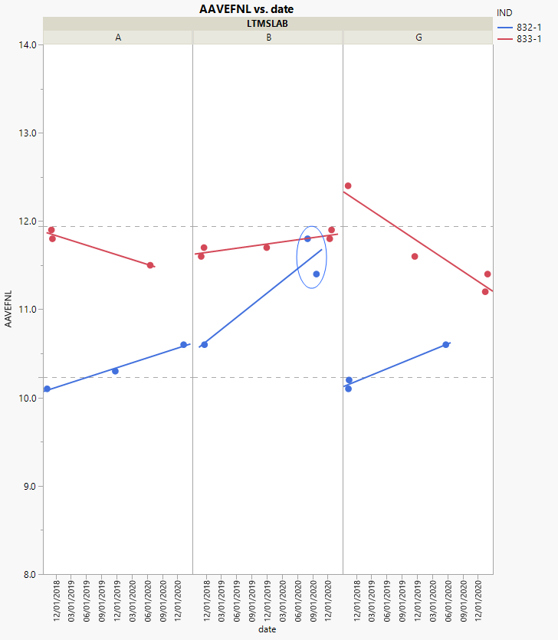
Reference Oils 832-1 and 833-1: Trend over time by Lab, limited data, new MM only
The two high tests results from Lab B led to the adoption of rules for stirring fresh oils (10/29/2020 SP meeting)
Lab B (3Q 2020):
Fresh Oil Stirring rules implemented as a result
11.94%
Discrimination between reference oils: OK
10.23%

Slide 8
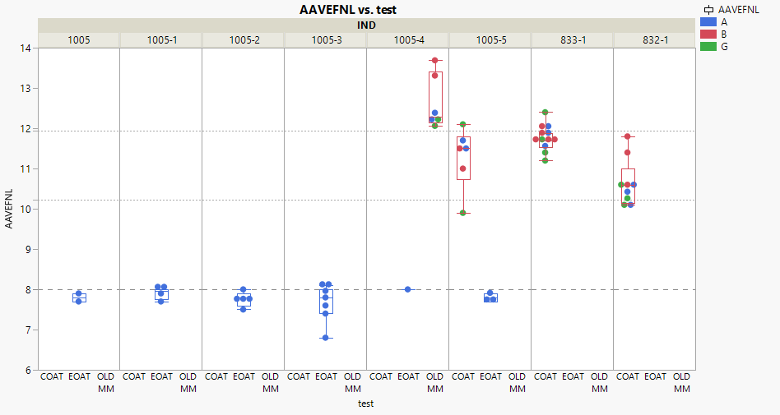
Connecting EOAT and COAT: Plot below shows Aeration % by test type, Oil and Lab
EOAT 1005-5 results as expected
COAT 1005-5 test aeration profiles show dips and at EOT aeration clearly still rising.
Lab G results highlighted below. 1005-5 test results differ by ~ 8 std deviations
Discrimination between 832-1 and 833-1: OK
Old MM
New MM
12.1%
Two high tests led to change in stirring rules
9.9%
Discrimination between 832-1 and 833-1: OK

Slide 9
1005-5 aeration profiles Operational Data (1005-5): selected correlations

Slide 10
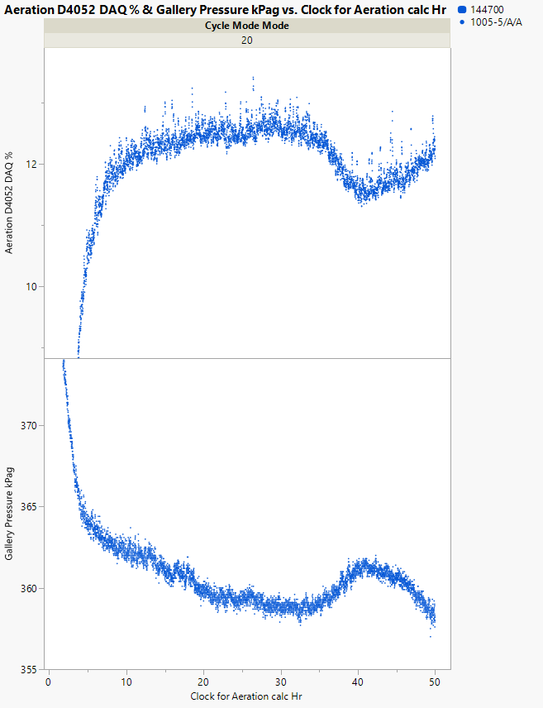
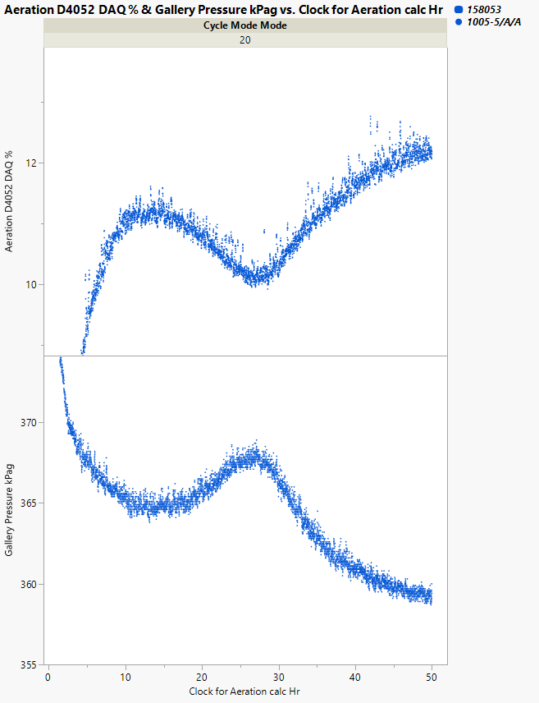
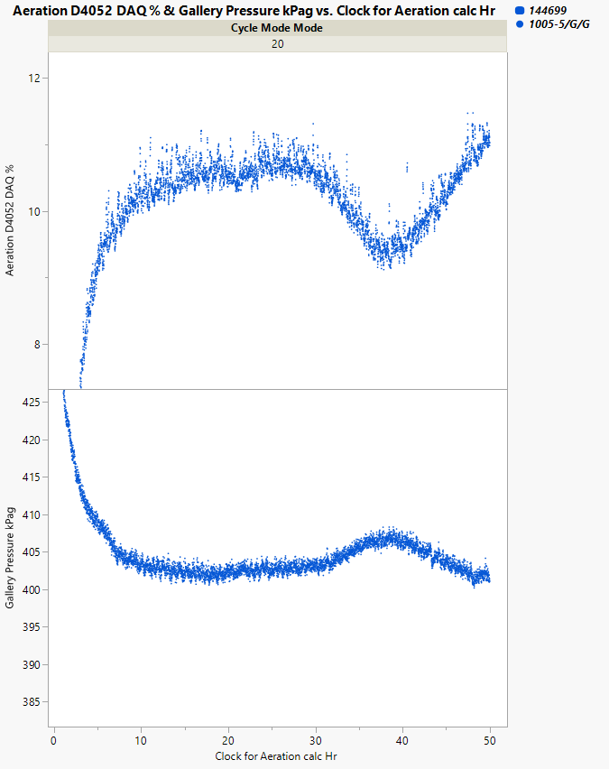
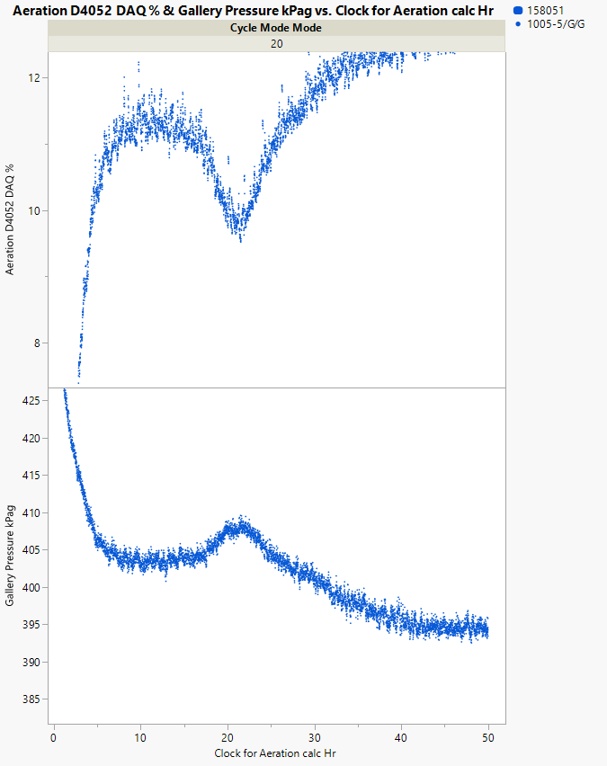
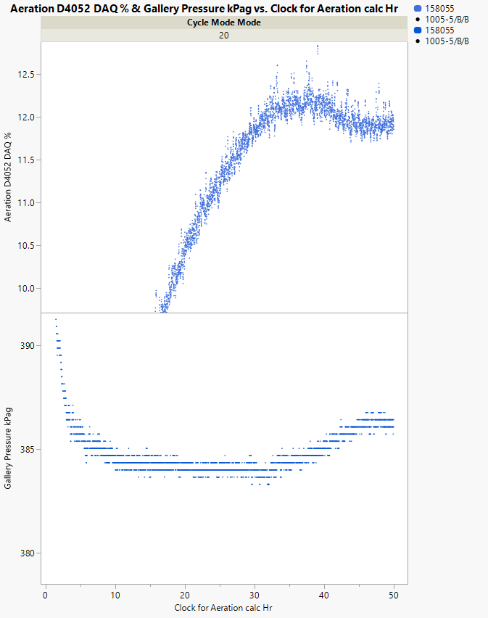
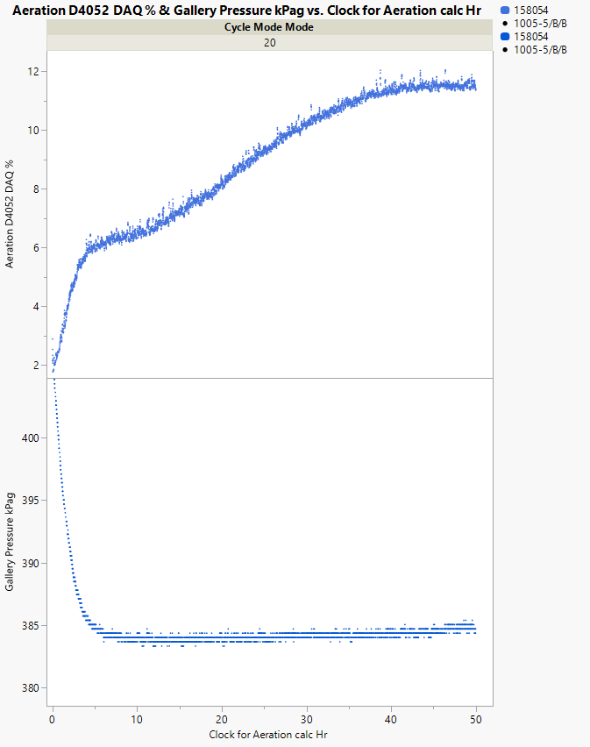
Gallery Pressure
1005-5 Aeration profile is on the top panel and Gallery Pressure is on the lower panel
Lab A
Aeration
Lab G
Gallery
Pressure
Lab B

Slide 11
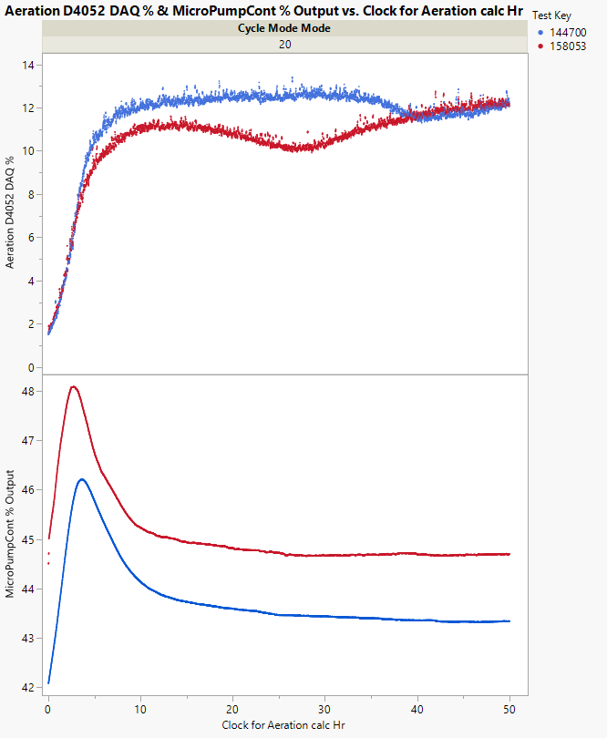
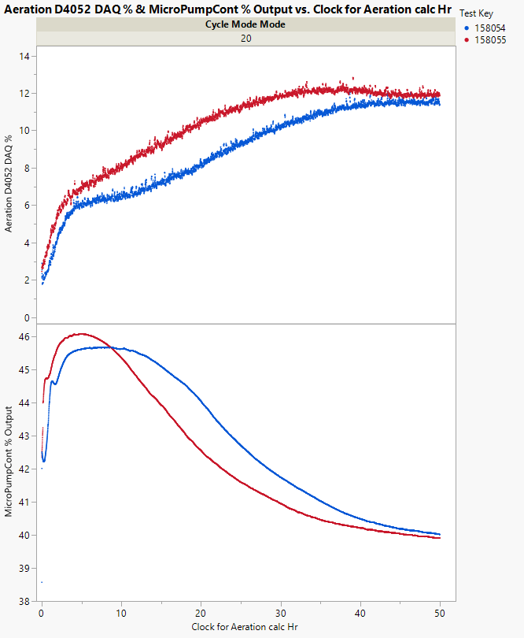
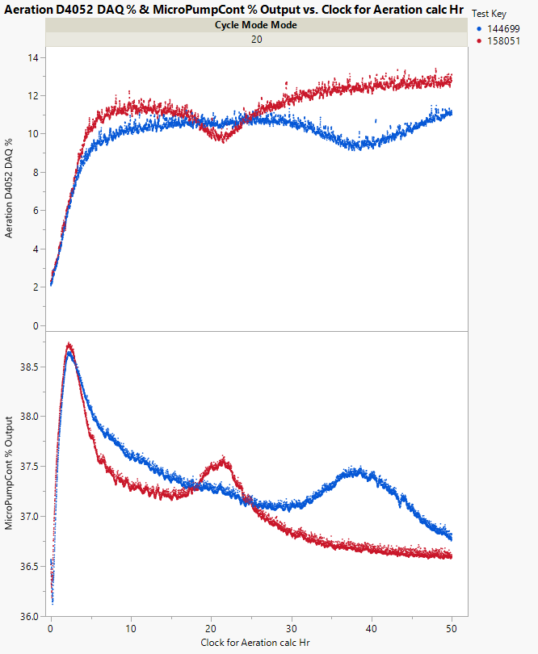
MicroPumpCont% Output
1005-5 Aeration profile is on the top panel and MicroPumpCont % Output is on the lower panel
Lab A
Lab B
Lab G

Slide 12
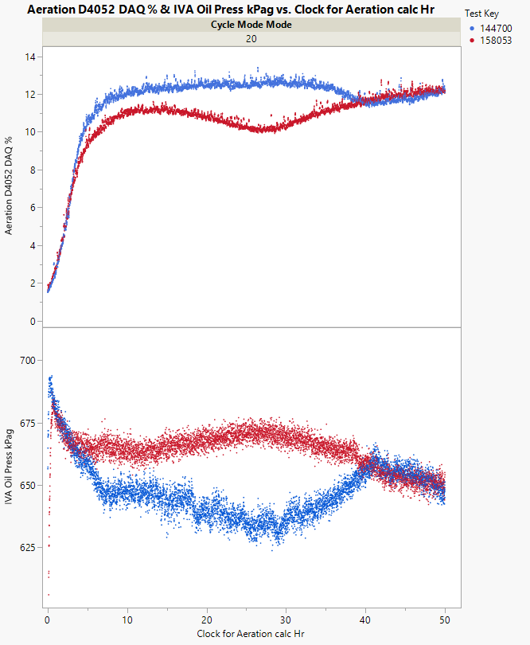
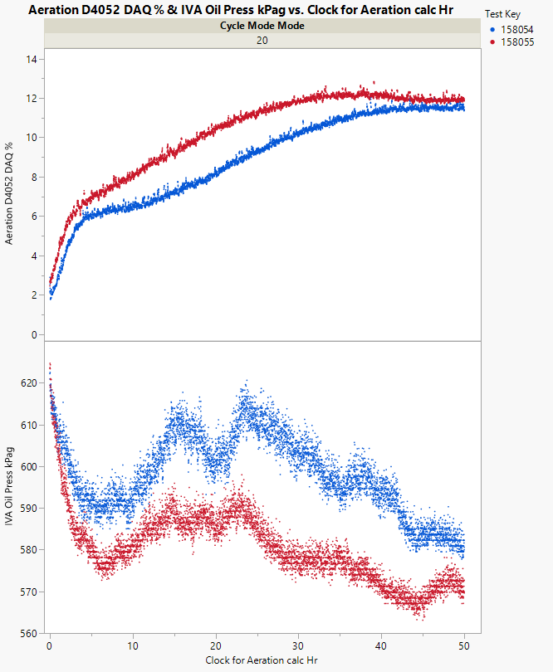
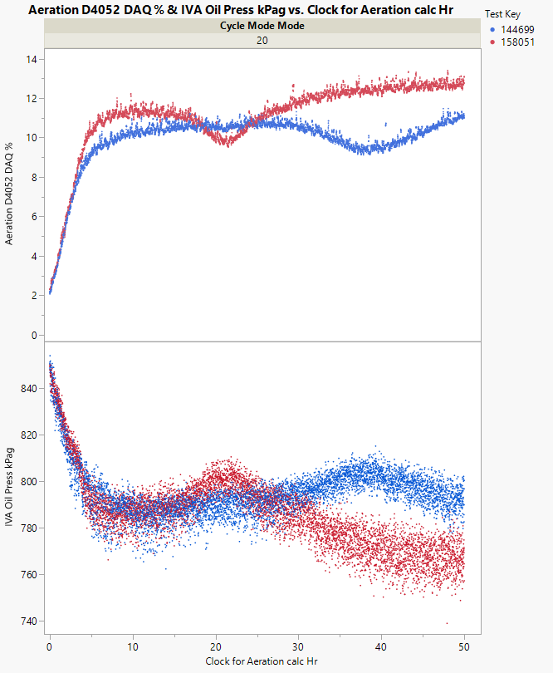
IVA Oil Press kPag
1005-5 Aeration profile is on the top panel and IVA Oil Press kPag is on the lower panel
Lab A
Lab B
Lab G

Slide 13
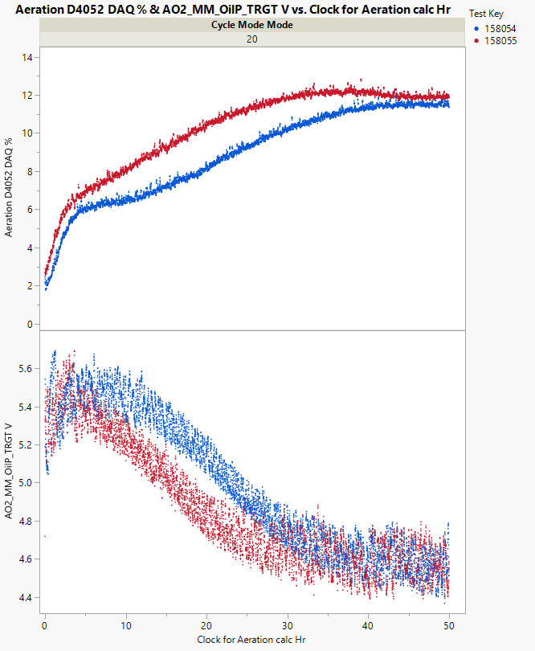
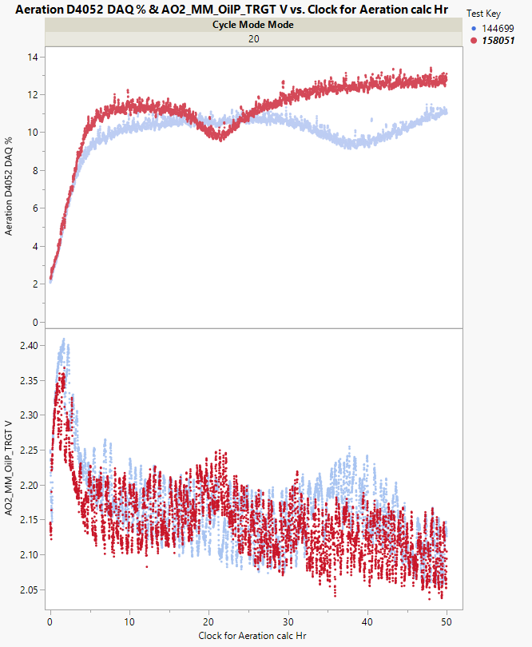
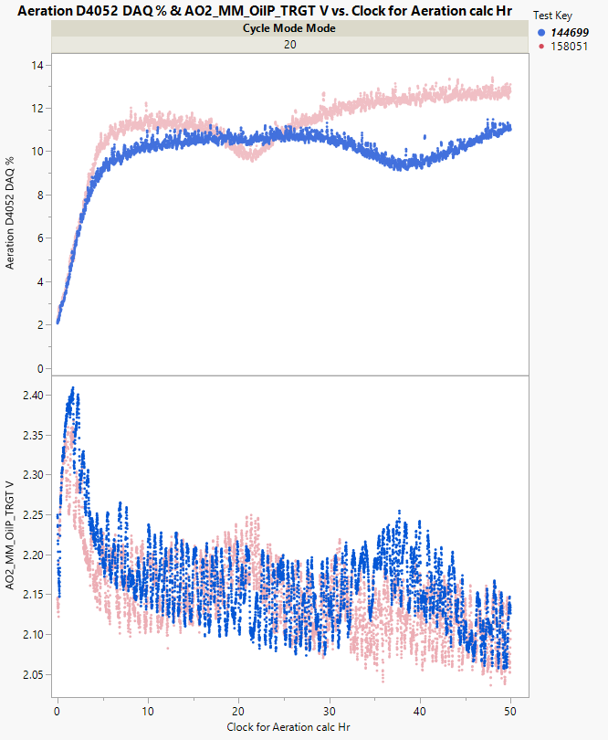
MM_OilP Target V
1005-5 Aeration profile is on the top panel and MM_OilP Target V is on the lower panel
Lab B 158054 and 158055
Lab G 158051
Lab G 144699

Slide 14
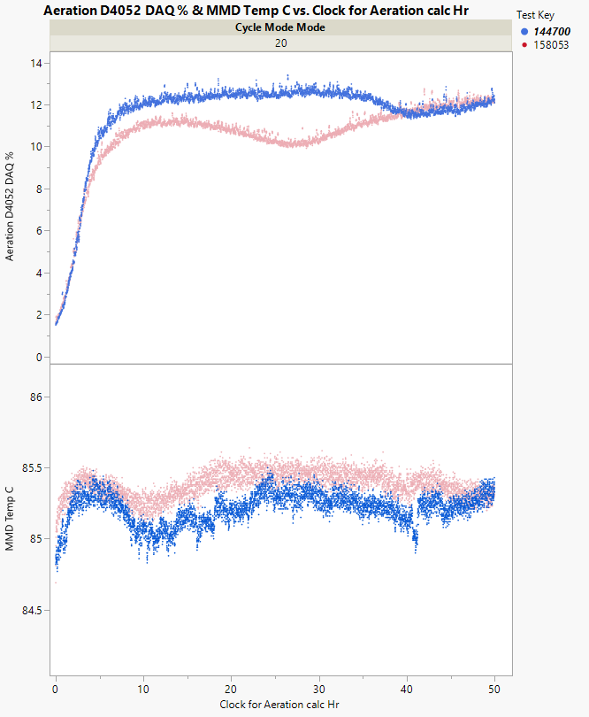
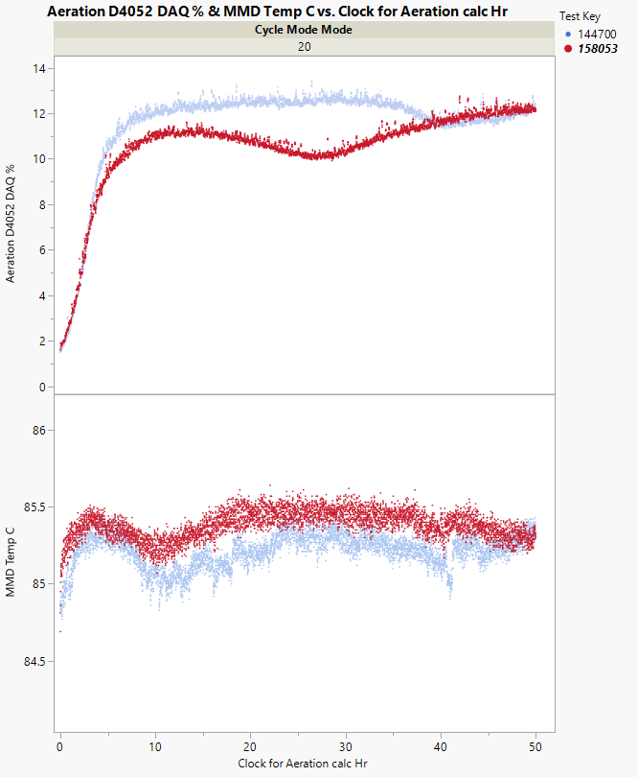
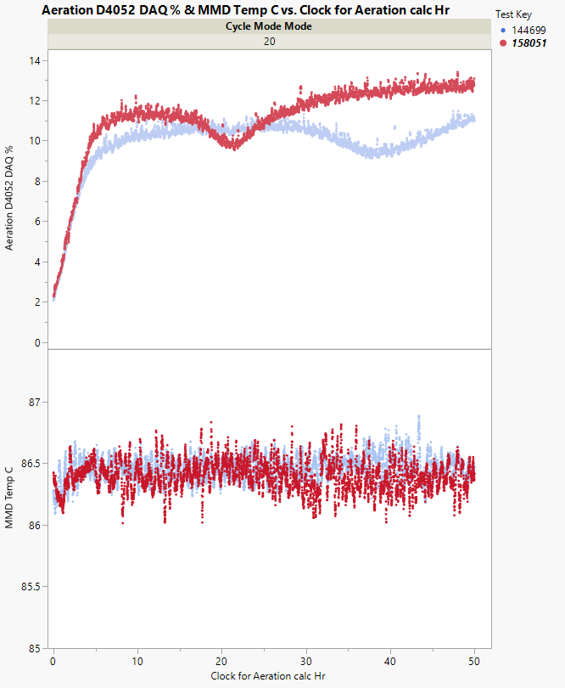
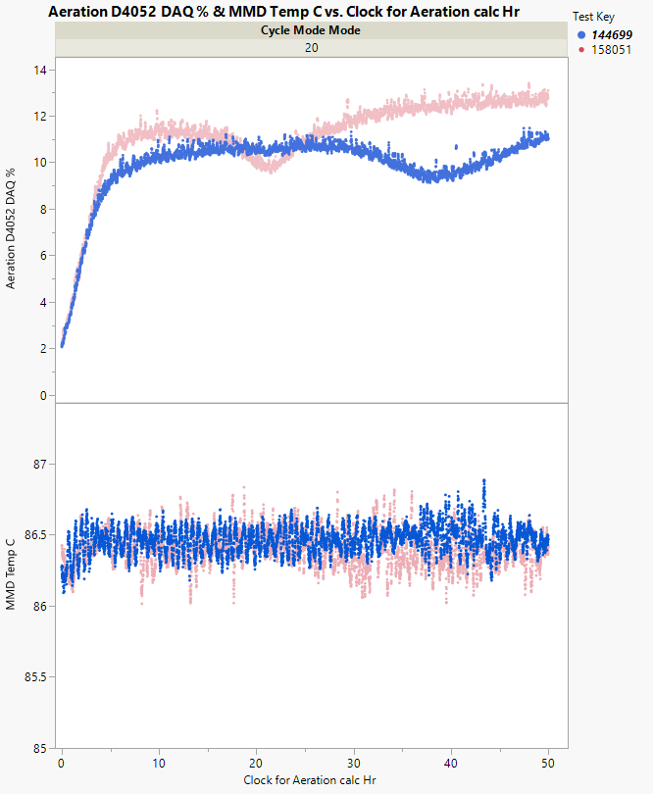
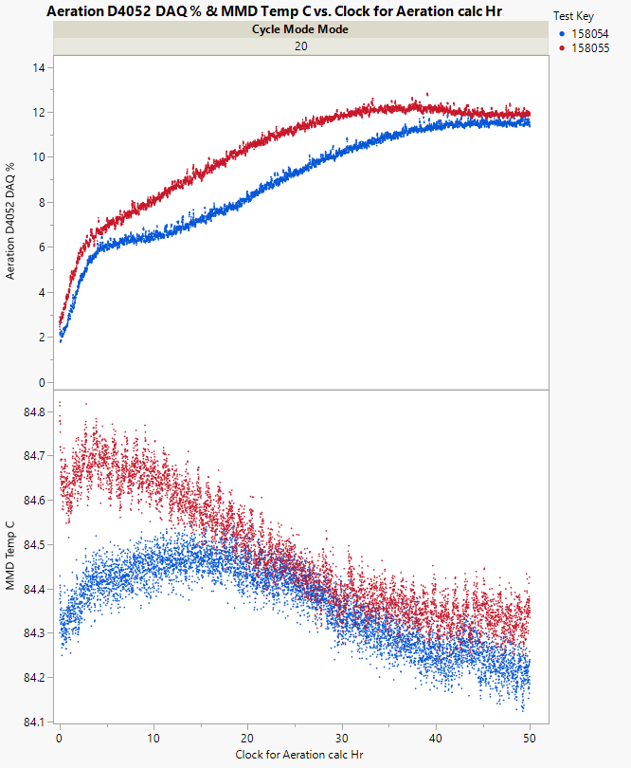
MMD Temp C
Lab B 158054 and 158055
Lab A 144700
Lab A 158053
Lab G 158051
Lab G 144699
1005-5 Aeration profile is on the top panel and MMD Temp C is on the lower panel

Slide 15
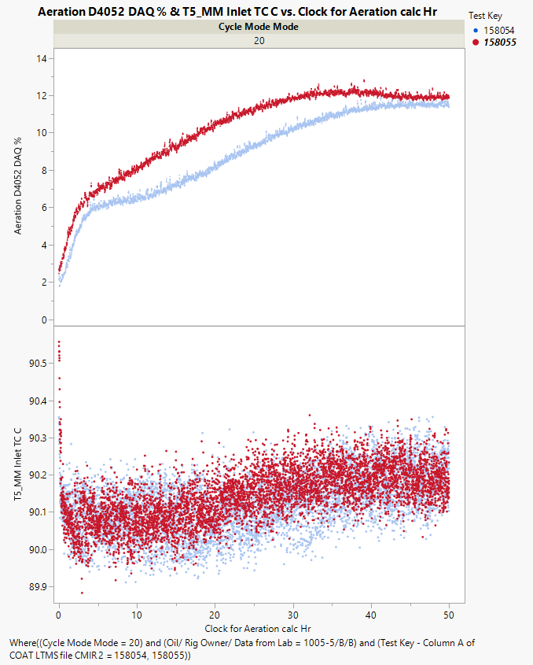
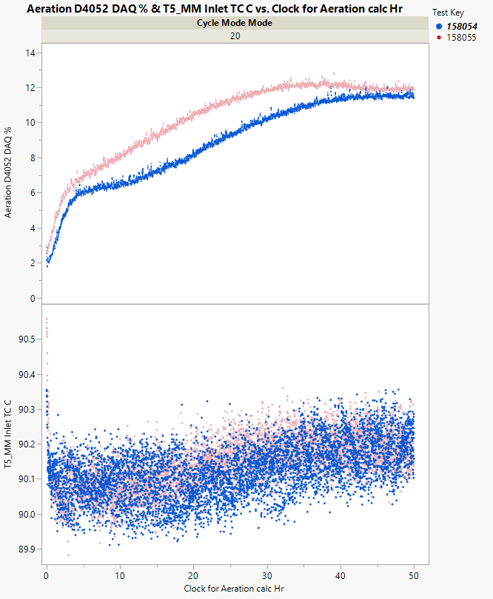
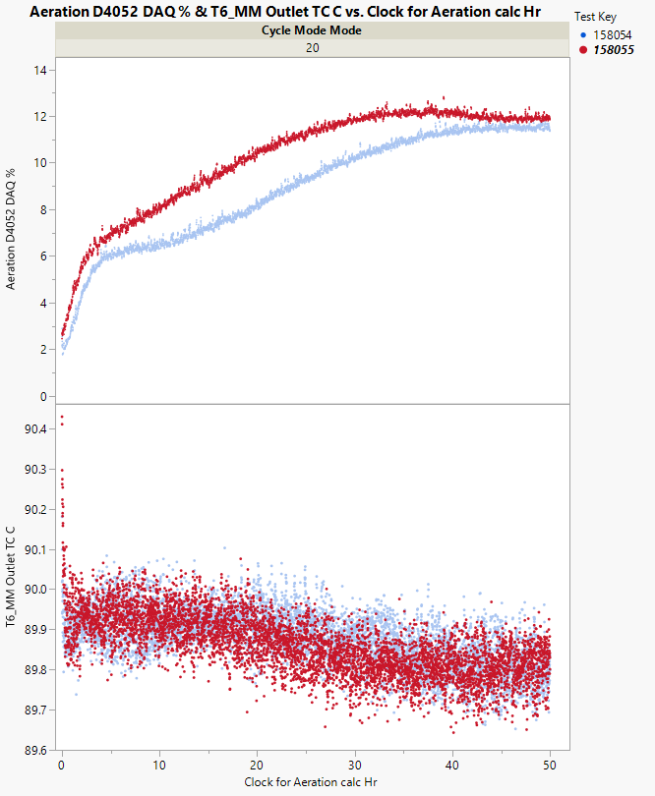
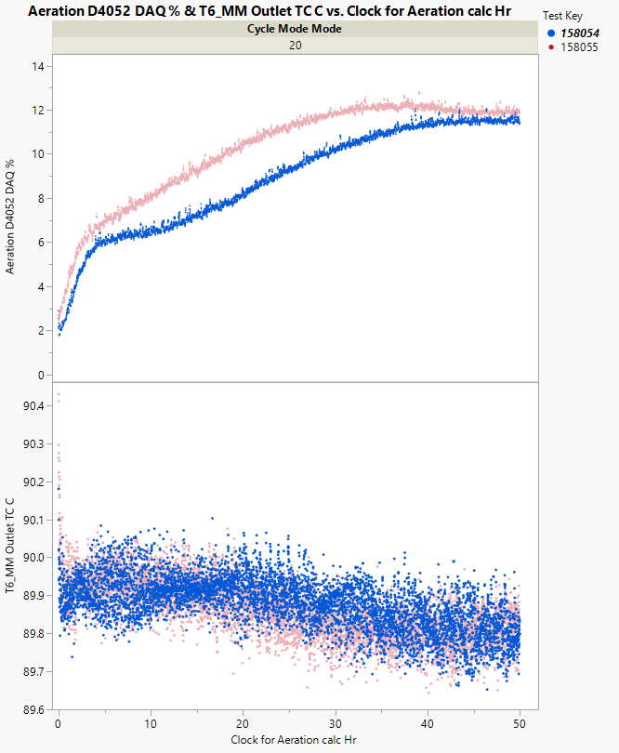
1005-5 Aeration profile is on the top panel and T5 and T6 is on the lower panel
Lab B
Lab B
T5_MM Inlet TC C
T6_MM Outlet TC C

Slide 16
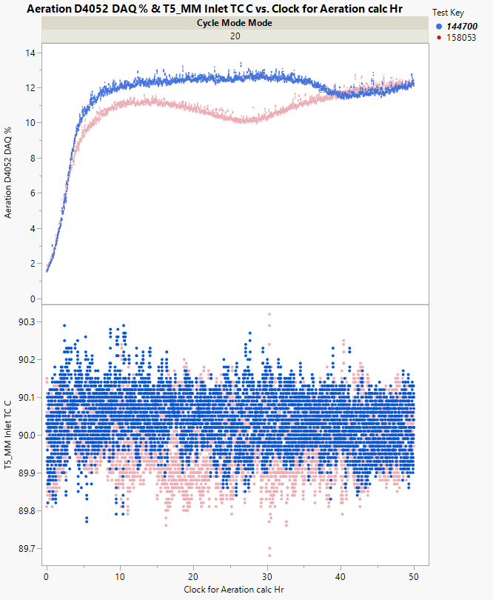
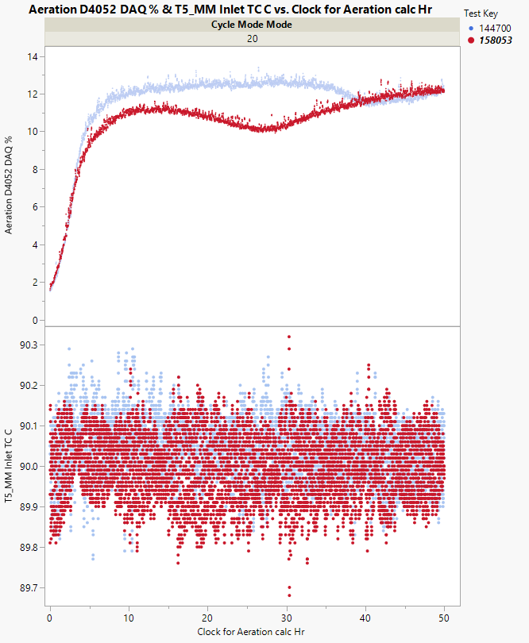
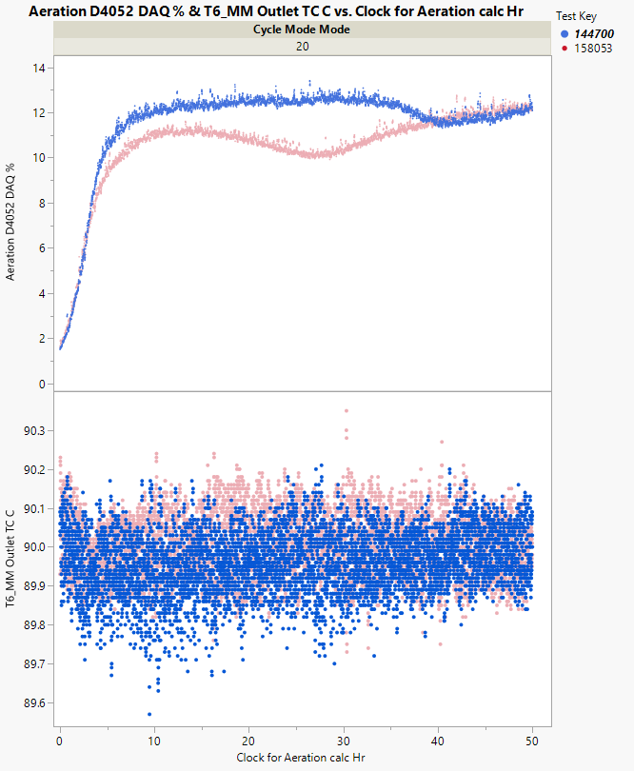
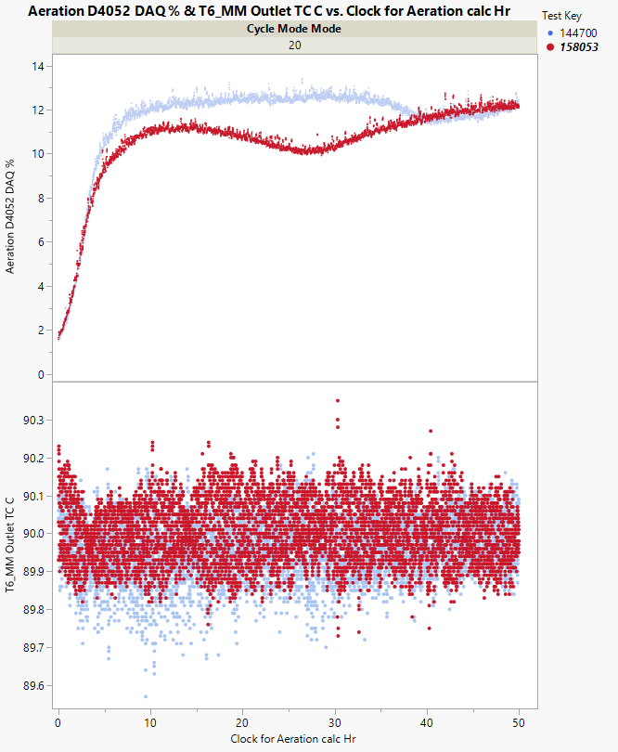
1005-5 Aeration profile is on the top panel and T5 and T6 is on the lower panel
Lab A
Lab A
T5_MM Inlet TC C
T6_MM Outlet TC C

Slide 17
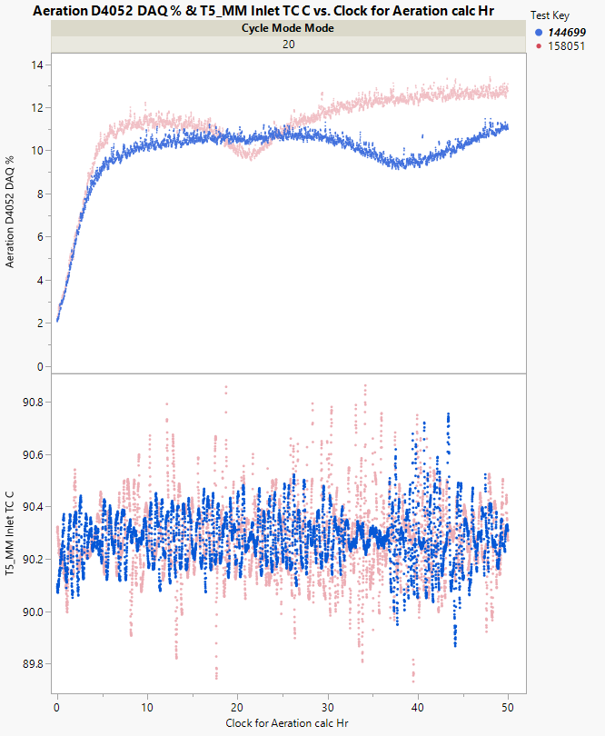
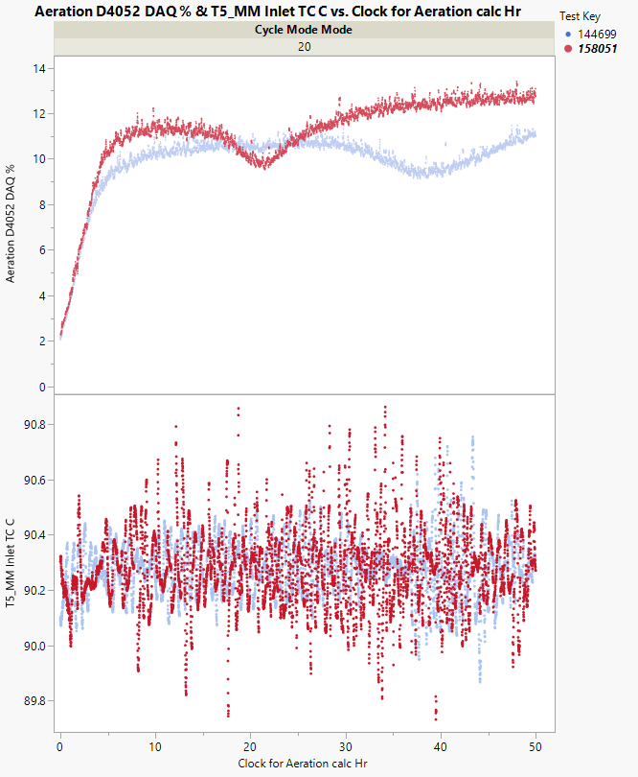
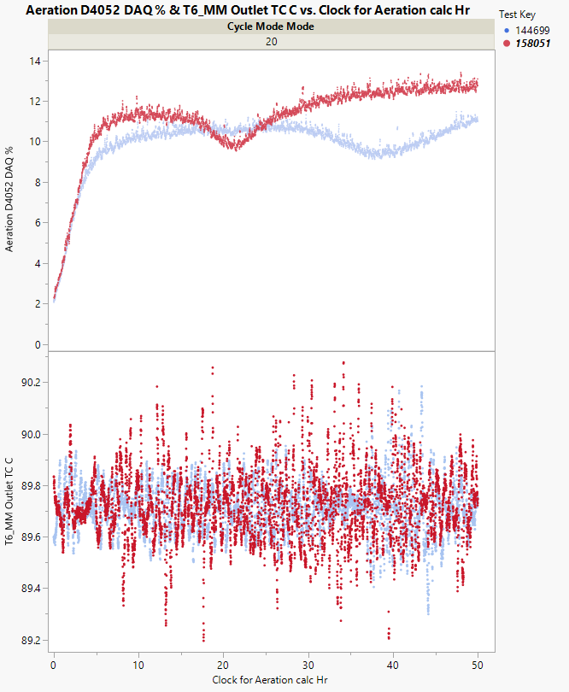
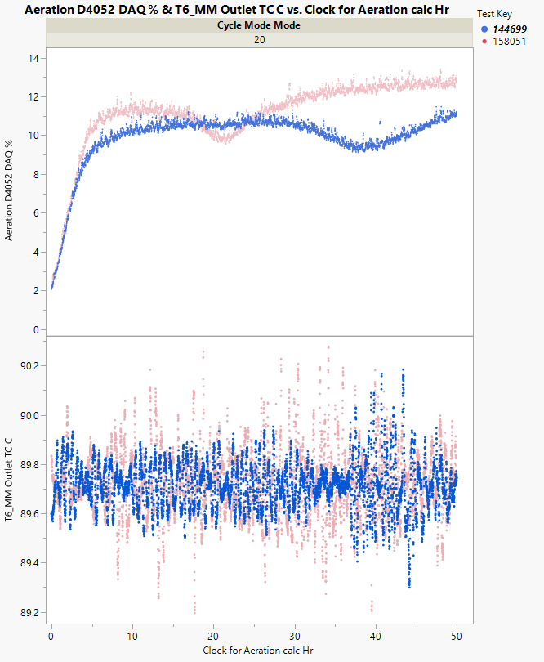
1005-5 Aeration profile is on the top panel and T5 and T6 is on the lower panel
Lab G
Lab G
T5_MM Inlet TC C
T6_MM Outlet TC C

Slide 18
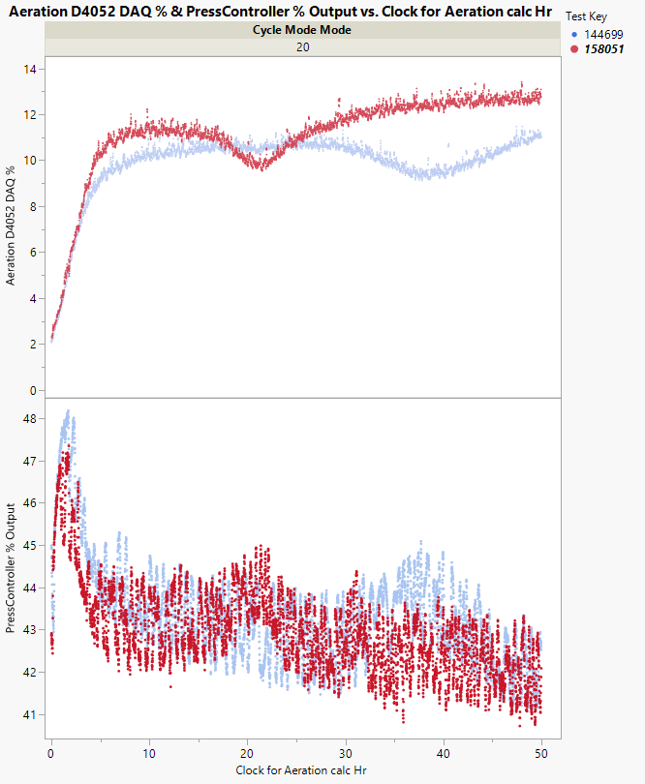
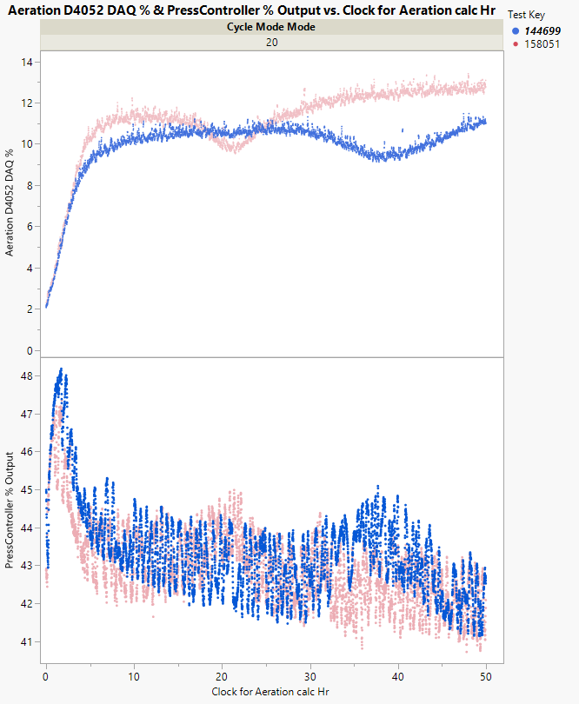
Lab G PressController % Output

Slide 19
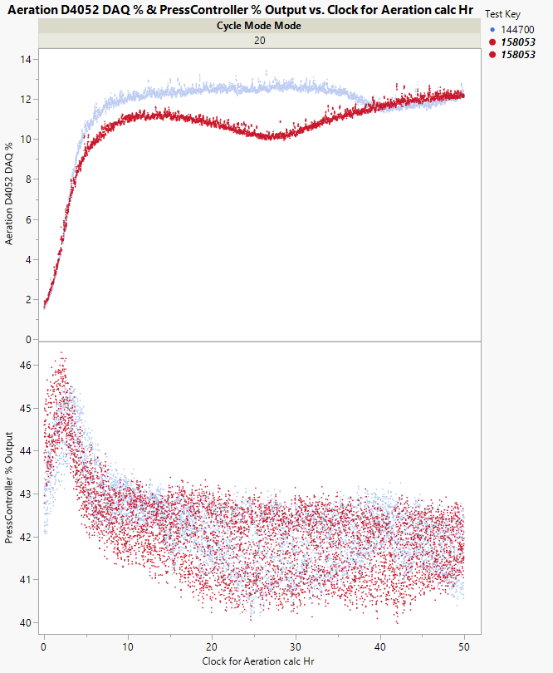
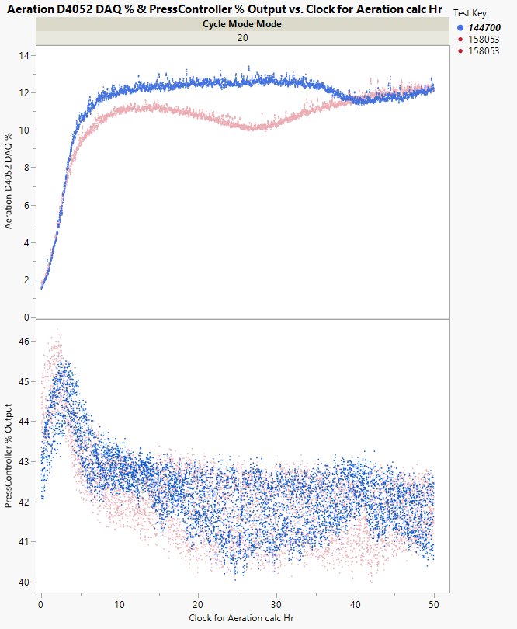
Lab A PressController % Output

Slide 20
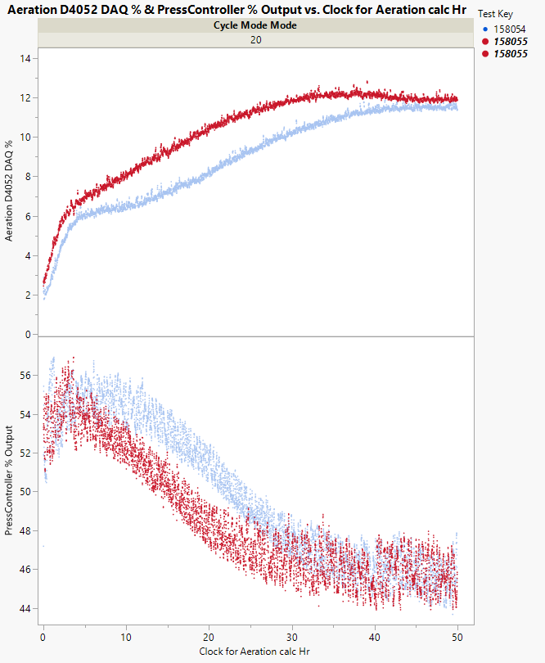
Lab B PressController % Output

Slide 21
Lab A Oil Pre Filter_Pres kPag
Lab B
Lab G

Slide 22
Lab G
Lab A
Lab B

Slide 24
1- Old MM Data

Slide 25
40 to 50 hr. Aeration % by Oil and Lab: ordered from highest to lowest oil mean
Data before New MM
COAT controlled to a target pressure

Slide 26
1005 Aeration Profile by Lab based on old MM
Data from OLD MM

