Slide 1
Cat Aeration Task Force
Additional Prove Out Testing Proposal
PC-11 Statisticians Task Force
July 1, 2014

Slide 2
Testing:
Demonstrate repeatability, reproducibility and discrimination in the
Cat Aeration test
  Demonstration does not imply acceptance
  The level of rigor used to investigate precision and discrimination is
  up to the task force
  Task force (and ultimately API, ACC and EMA) will have to agree whether test results support adequate precision and discrimination
Assess engine hours effect even though effect not expected to be observed over
~100 to ~250 engine hours
Prior to start of testing:
  Labs will have broken in their engines using the same procedure
  Engines will have been used approximately the same amount of hours
  (~75 to 100 hrs; TBD)
The same test procedure will be used to conduct testing
Task force indicated there is enough oil for:
  Four 1005 tests
  Five High Aeration tests

Slide 3
Testing:
Two of the MOA requirements for test acceptance:
  “Each oil used to demonstrate discrimination has a minimum of two valid test results in the most current test procedure. The Test Development Task Force must approve these results.”
  “Each Matrix Lab has run at least two operationally valid tests (shakedown runs are eligible) using the Test Matrix procedure. Shakedown runs are full-length, operationally valid runs on oils such as potential candidate or research oils. The Test Development Task Force will determine if these test results are satisfactory in terms of precision, Lubricant Test Monitoring System (LTMS) impact, and reasonable agreement among the results from each lab.”

Slide 4
Proposed Testing Protocol:
Each lab tests one of the oils twice for repeatability
Each lab tests both oils for discrimination
Each oil tested at all three labs to evaluate reproducibility

Slide 5
Comments:
Oil selection:
  Using the low aeration (LA) oil and high aeration (HA) oil:
    Better chance of supporting test discrimination
      This is based on 1 test result per oil which may not be true indication of its performance
    Evaluates test repeatability over a wider range of Aeration
  Given this set of testing is likely to be the last, using oils we have more experience with (like 1005) may provide less risk.
  Three oils (HA, 1005 and LA) could be used to balance the tradeoffs, but 4 tests per stand would be preferred.

Slide 6
More Comments:
Ultimately, it is up to the task force (and subsequently ACC, EMA and API) to accept whether or not the test results demonstrate a satisfactory level of repeatability, reproducibility and discrimination.
Even though these tests have been put together as best as possible to assess repeatability, reproducibility, discrimination and an engine hours effect, a statistical analysis of this data will need to be used with caution.
  Discrimination oil is only run once at each lab
  Repeatability is based on 2 tests at each lab
    Within lab, repeatability is affected by
    any engine hours effect

Slide 7
More Comments:
Less testing would meet bare minimum requirements with less statistical rigor.
More testing will improve the statistical analysis, but it’s a balance of:
  Timing
  Oil quantities
  Level of data needed to accept test into the Matrix vs. the rigor of the Matrix
  Amount of hours on engines going into the Matrix
A benefit of the proposed design is the ability to augment it if needed.
  A 4th and even 5th test per lab will help the statistical analysis if desired.
  Additional testing can be decided upon review of the first 3 tests per lab.
  Example:
STOP:
Review results & decided if more testing desired
STOP:
Review results & decided if more testing desired
A third oil could be included in test 4 or 5 depending on test results of prior data

Slide 8
Questions?
Comments?

Slide 9
Appendix

Slide 10
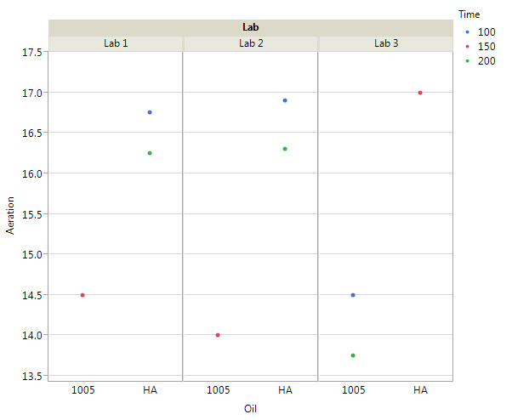
Repeatability
Approx. Engine Hours at Start of Test
Made Up Aeration Data
Each lab tests one of the oils twice

Slide 11
Reproducibility
Approx. Engine Hours at Start of Test
Made Up Aeration Data
Each oil tested across labs

Slide 12
Discrimination
Approx. Engine Hours at Start of Test
Made Up Aeration Data
Each oil tested at each lab

