Slide 1
Cummins ISB
Soot Effects?
Presented to Cummins Surveillance Panel
17 November 2010
Jim Rutherford

Slide 2
Background
I finished this too late to share with LTMS TF STG. I had missed the cam batch email.
As STG said, the data are confounded. In this situation, significance tests don’t mean much. An alternate approach is regression trees. The idea is to find the first split of data that has the most impact on the result. Within that split, look for the next one. Continue on until some stopping rule is met.
This isn’t definitive either but is another heuristic. I use the decision tree, then look for corroboration in pictures of the data.

Slide 3
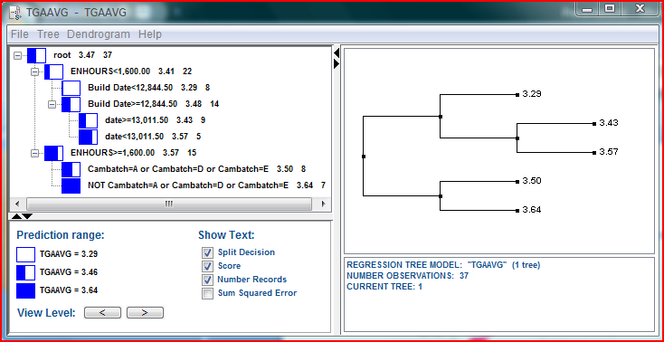
TGAAVG
The first splitting variable is engine hours -- >= 1600 hours associated with higher soot.
At higher engine hours, cam batch was a player – batches A, D, and E lower soot; B and C higher soot.
At lower engine hours, build date then test date were selected.
Engine hours looks fairly solid. The rest seems down in the muck of confounding.

Slide 4
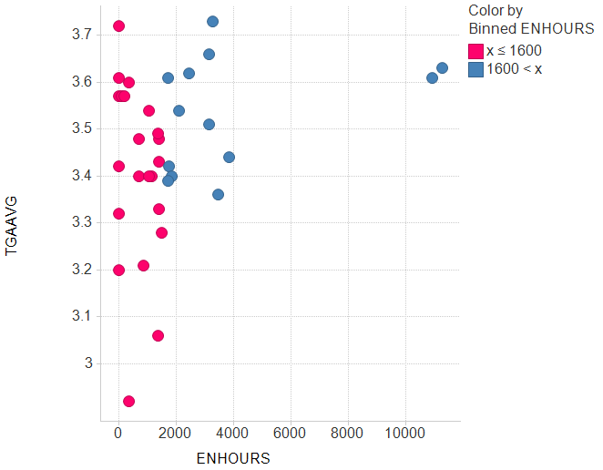
TGA = f(enhours)

Slide 5
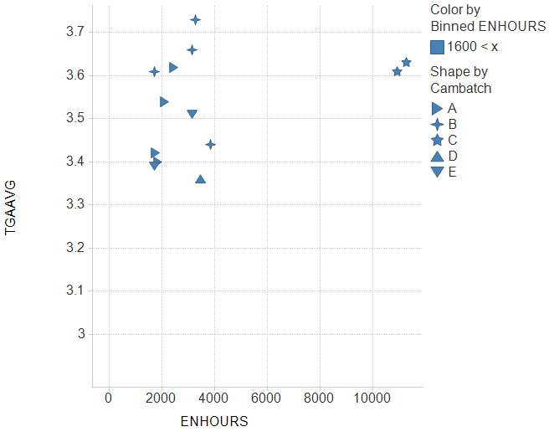
TGA = f(cambatch|enhours>1600)

Slide 6
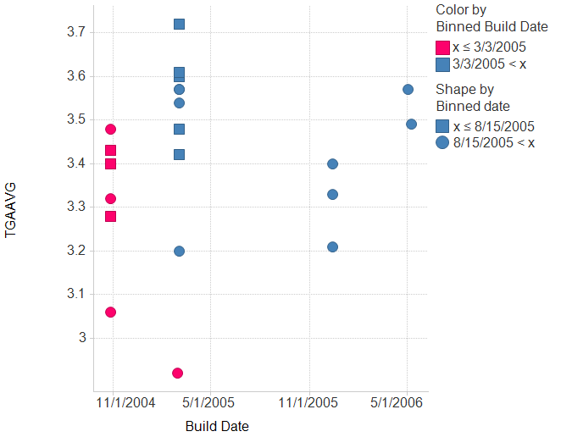
TGA = f(build date, date|enhours<1600)
Binned ENHOURS: (x ≤ 1600)

Slide 7
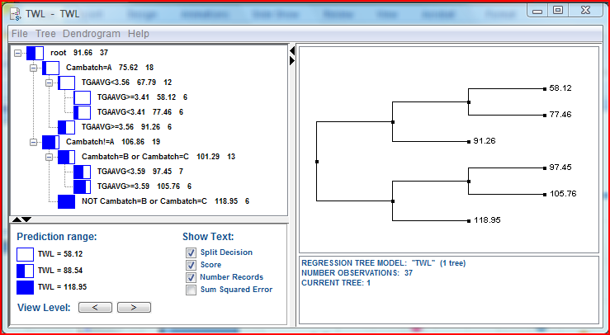
TWL
The first splitting variable is cam batch – A was lower than all others; D and E higher than B and C.
Within cam batches other than D and E, soot was a player.
Although not proven, this explanation is believable and would support soot adjustment that varies over time, maybe by cam batch, maybe something else.

Slide 8
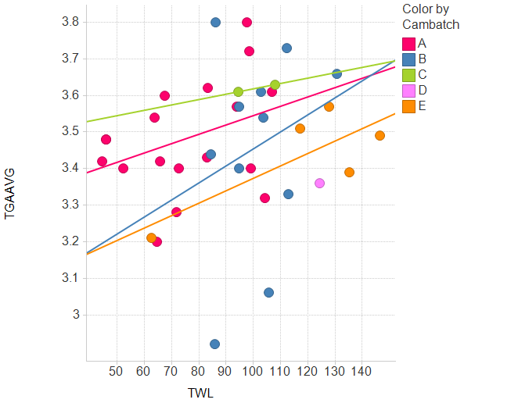
TWL = f(cam batch, TGAAVG)

Slide 9
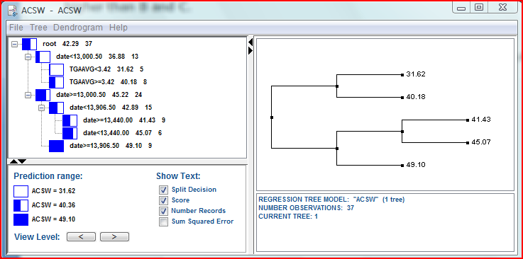
ACSW
The first splitting variable is test date – more recent tests have higher wear.
For the earliest tests, higher soot was associated with higher wear.
The date splits do not seem to directly correspond with cam batches or build date.
Our historical lack of soot adjustment for ACSW does not seem disputed.

Slide 10
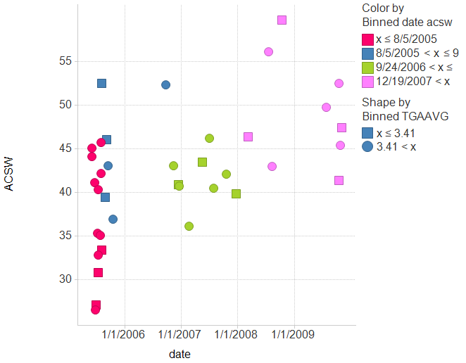
ACSW = (date, TGAAVG)

Slide 11
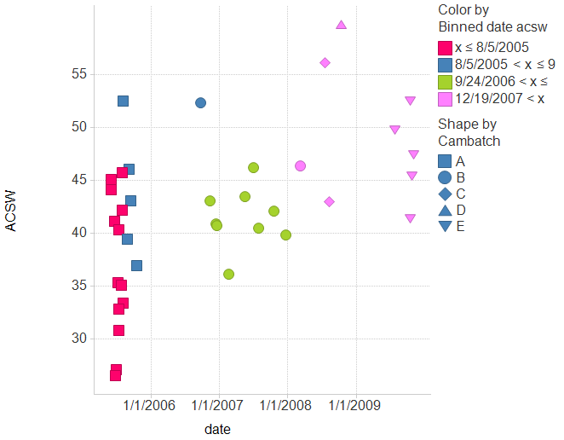
ACSW = (date‡cambatch)

Slide 12
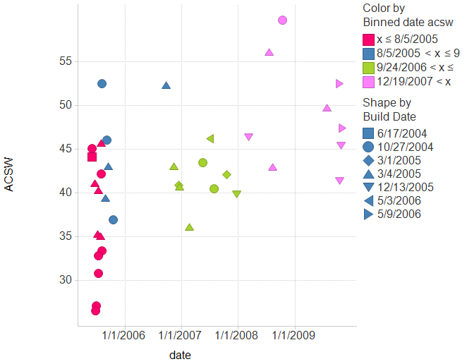
ACSW = (date‡build date)

