Slide 1
TGA and Build and Engine hours and… in the Cummins ISB
a quick draft for you to think about.
I’ll try not to think too much about it this weekend.

Slide 2
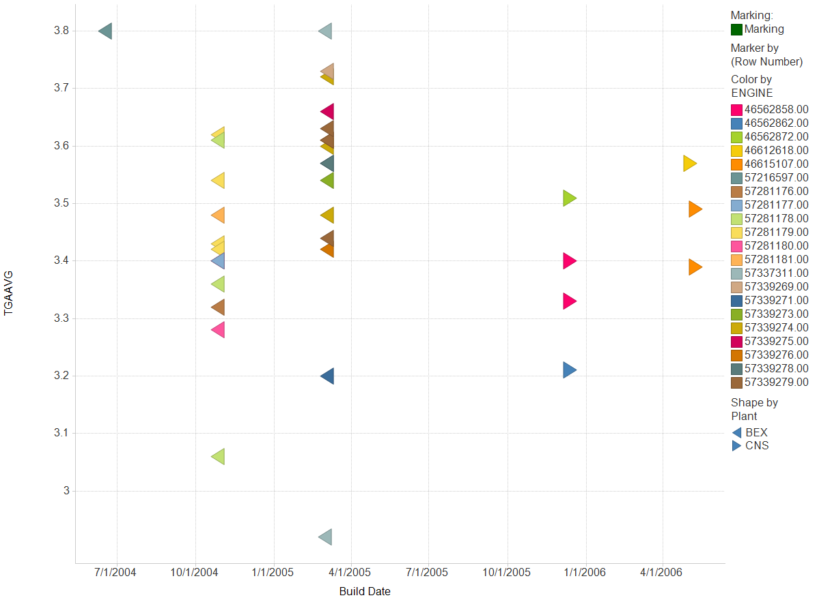
TGAAVG is a function of?

Slide 3
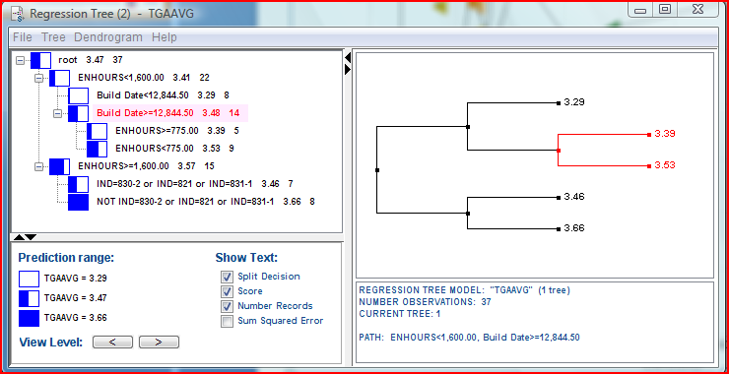
TGAAVG is a function of?

Slide 4
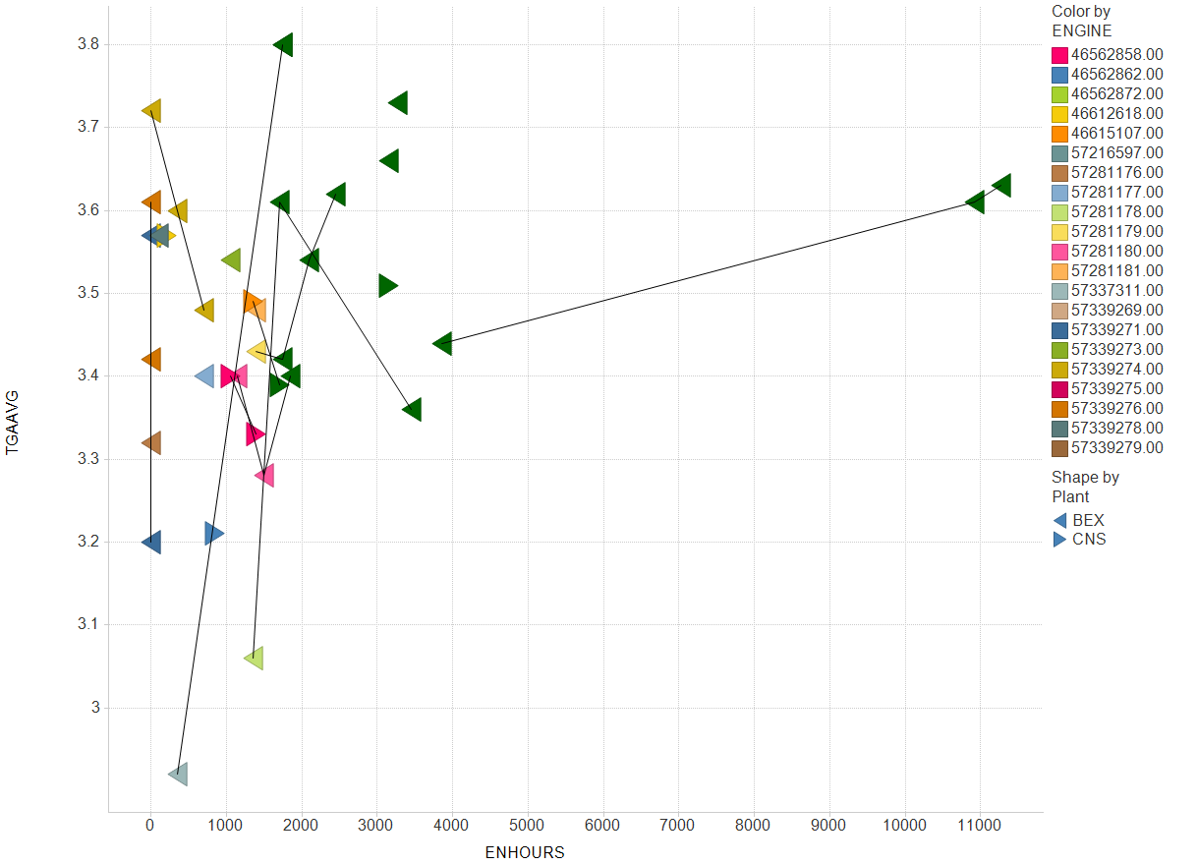
TGAAVG is a function of?

Slide 5
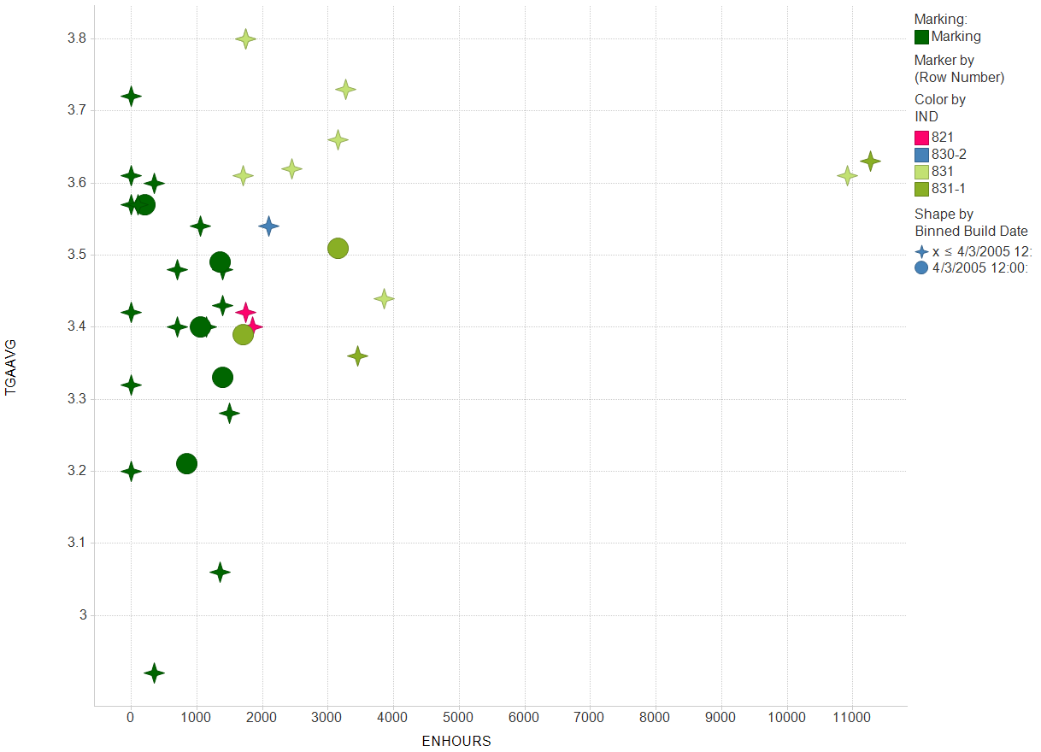
TGAAVG is a function of?

Slide 6
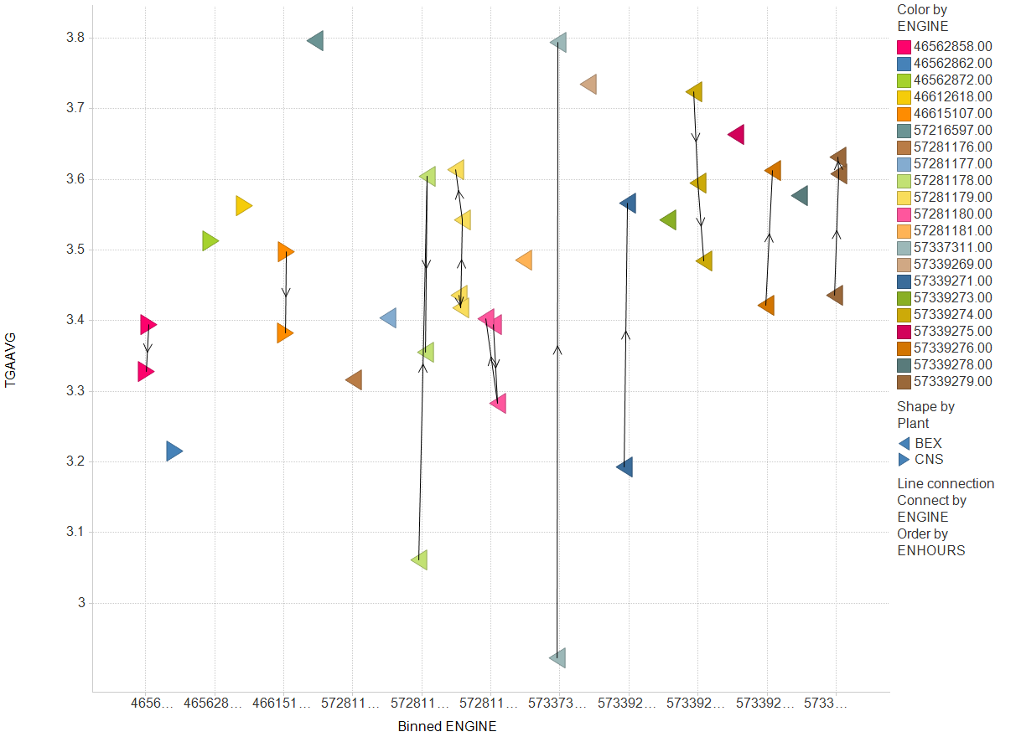
TGAAVG is a function of?

Slide 7
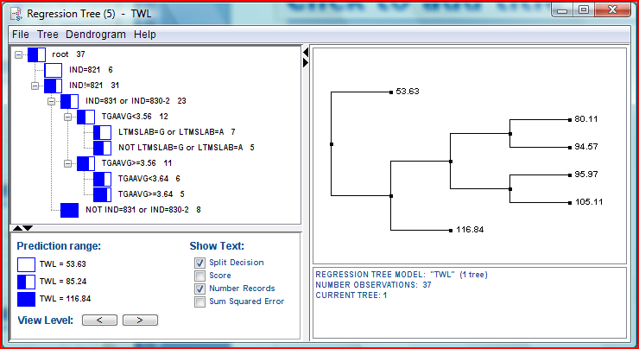
Tappet weight loss is a function of?

Slide 8
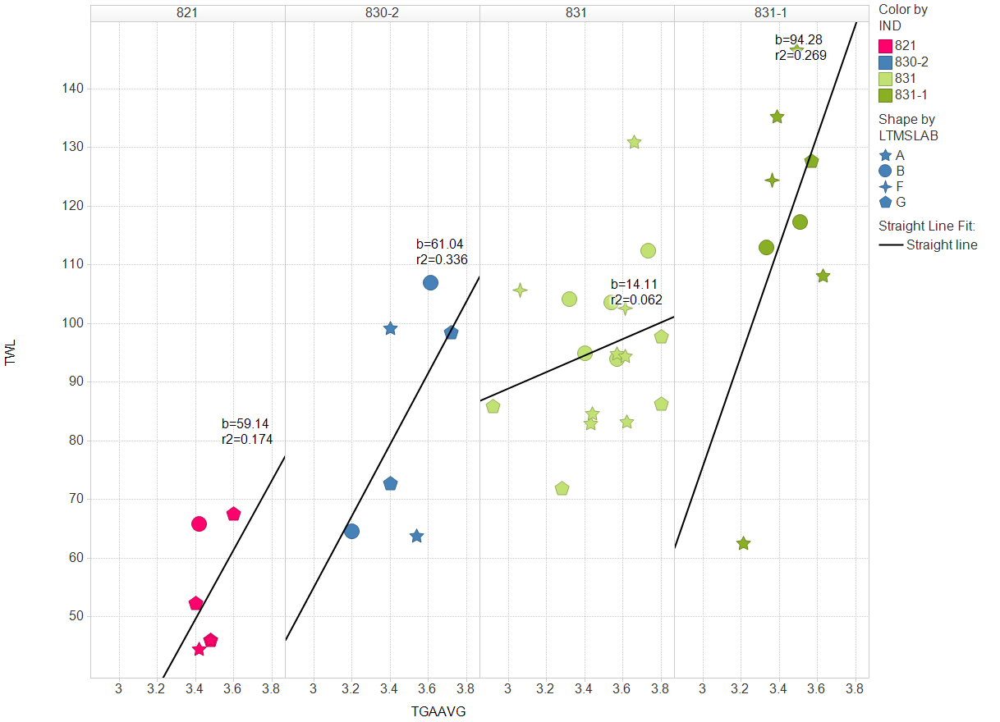
Tappet weight loss is a function of?

Slide 9
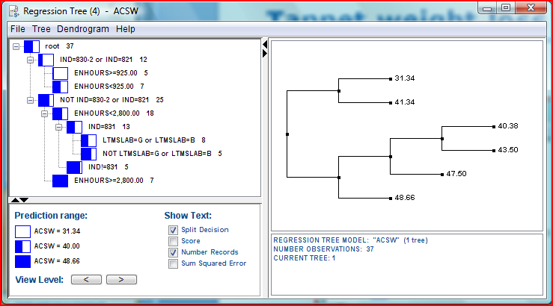
Cam wear is function of?

Slide 10
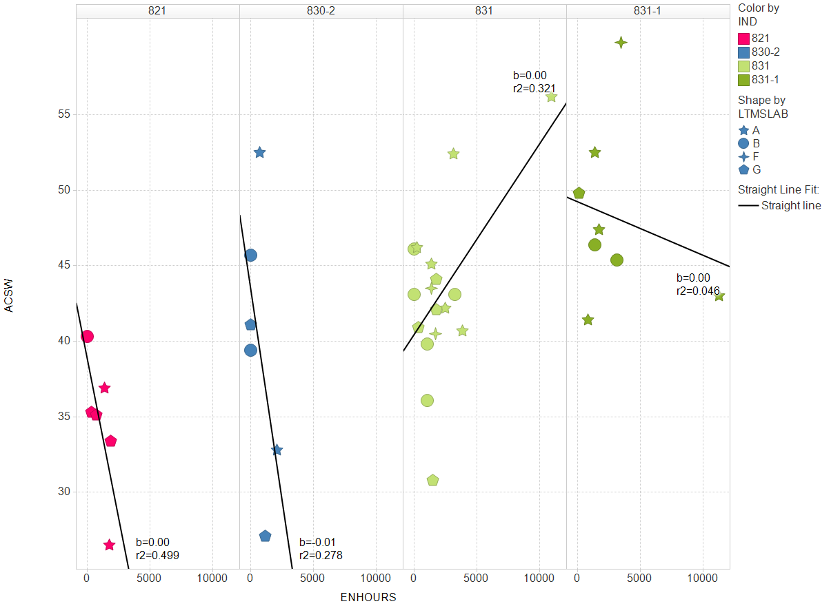
Cam wear is function of?

Slide 11
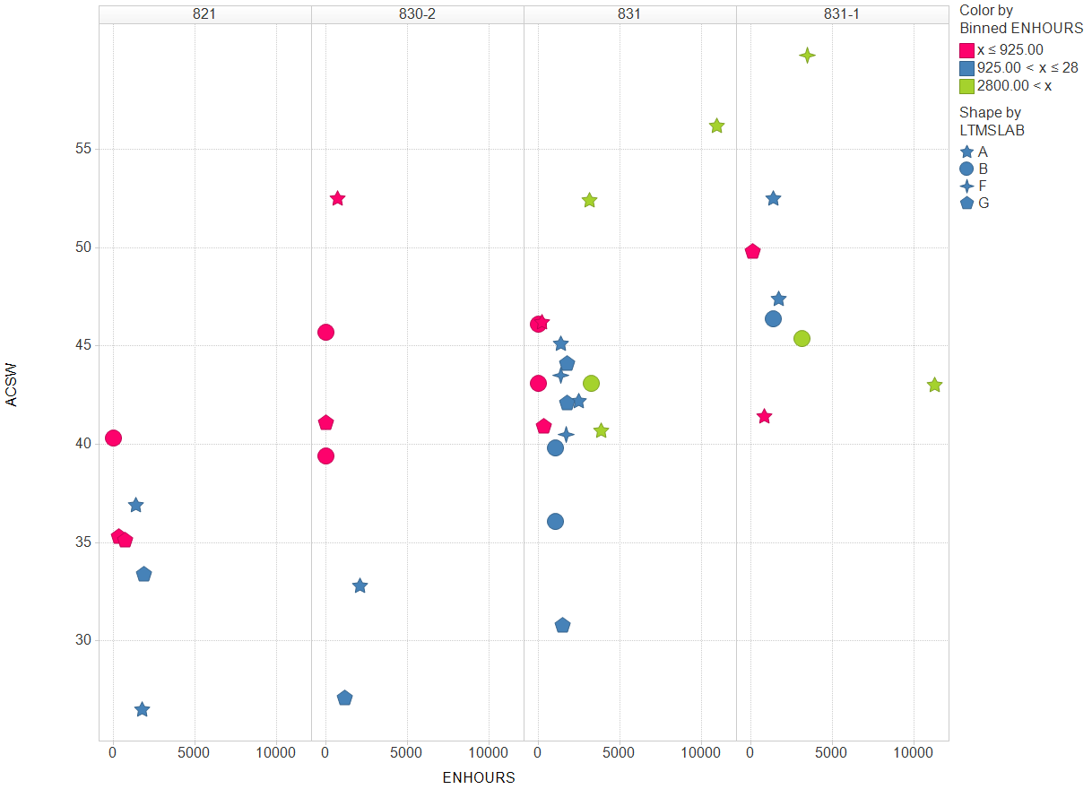
Cam wear is function of?

