Slide 1
ISB Data Review
Presented to Cummins
Surveillance Panel
Addendum 1
Jim Rutherford
March 16, 2011

Slide 2
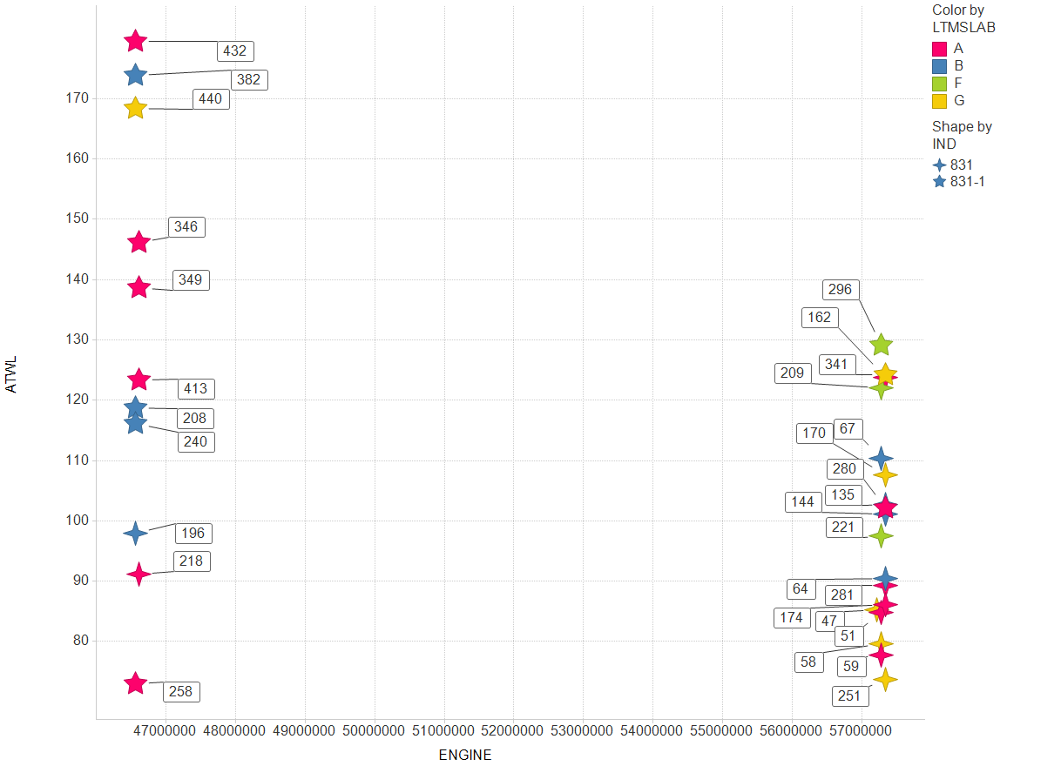
Labels are engine kit numbers

Slide 3
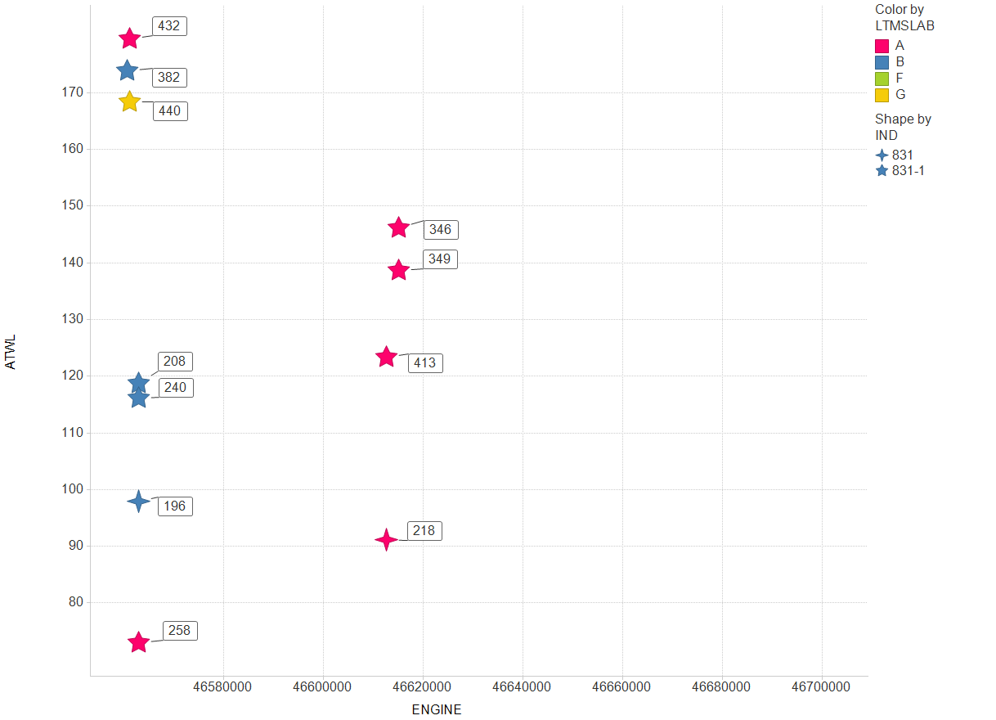
Labels are engine kit numbers

