Slide 1
ISB Data Review
Presented to Cummins
Surveillance Panel
Addendum 2
Jim Rutherford
March 16, 2011

Slide 2
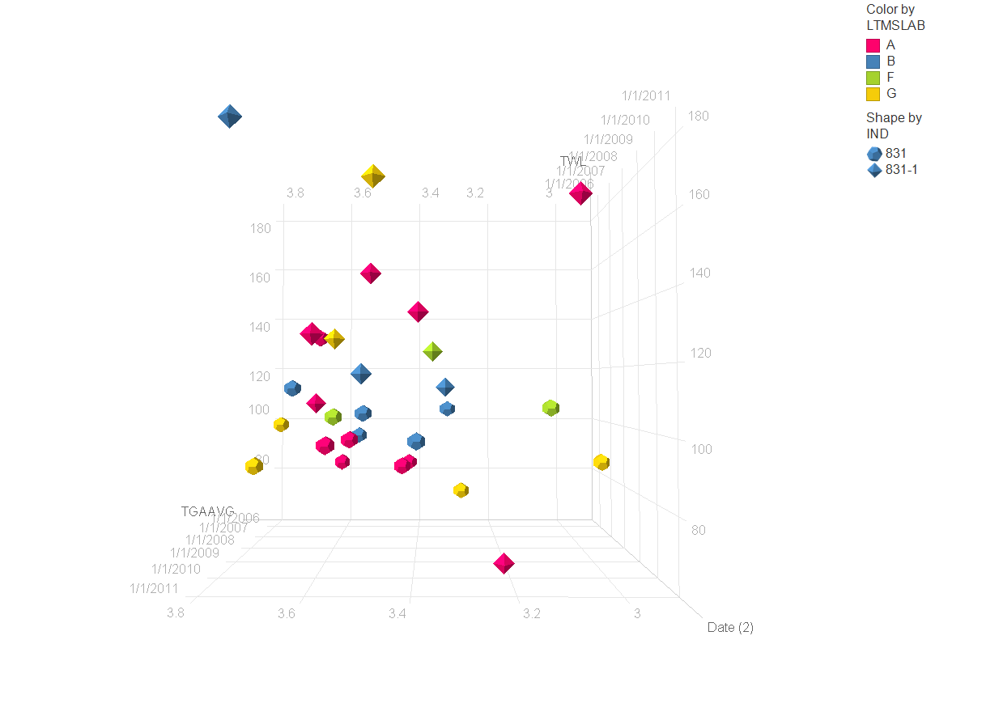

Slide 3
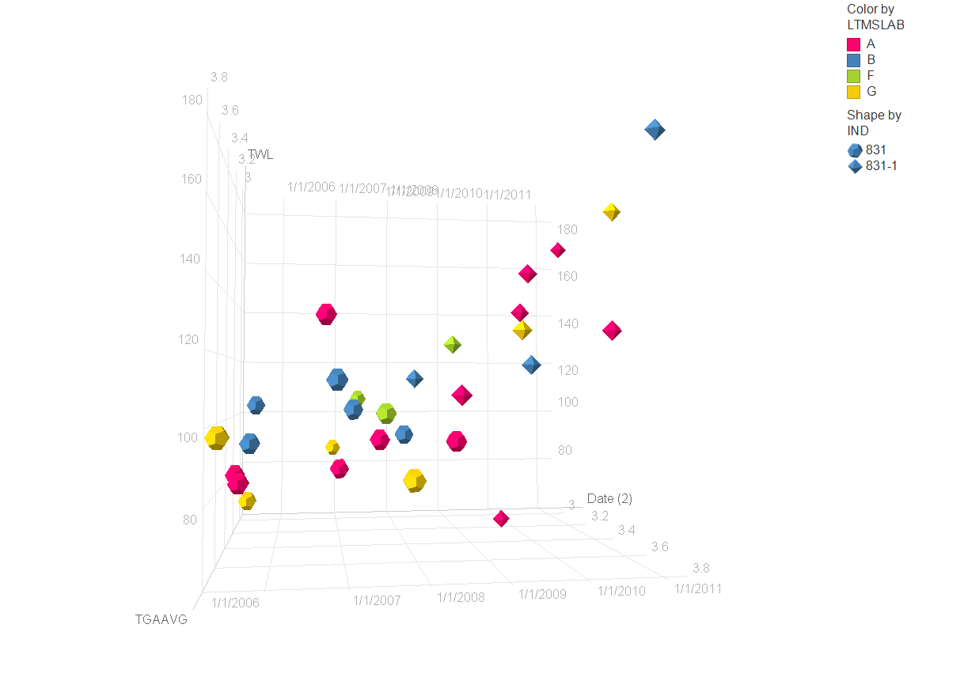

Slide 4
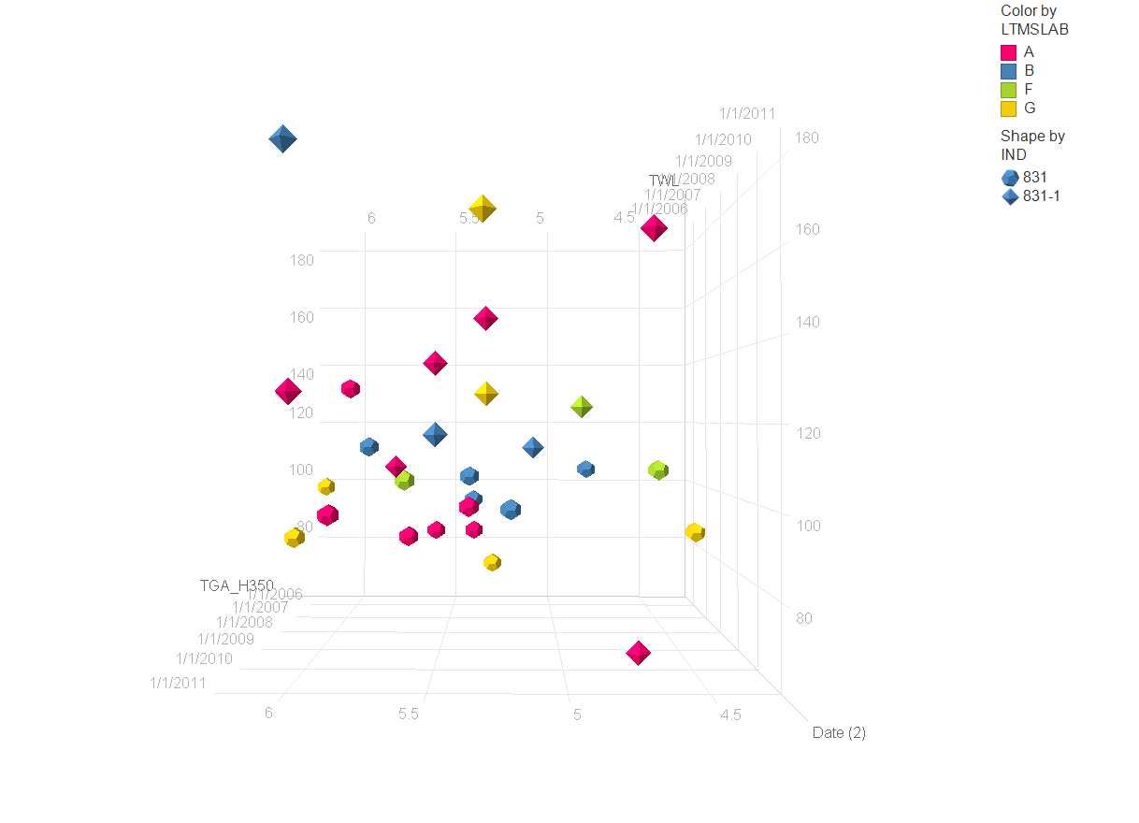

Slide 5
