Slide 1
ISB Data Review
Presented to Cummins
Surveillance Panel
Jim Rutherford
March 16, 2011

Slide 2
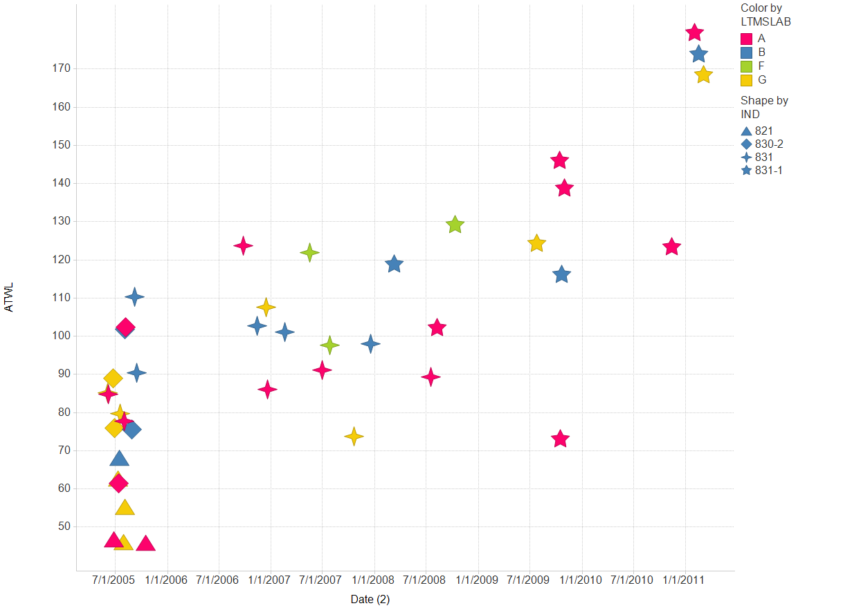

Slide 3
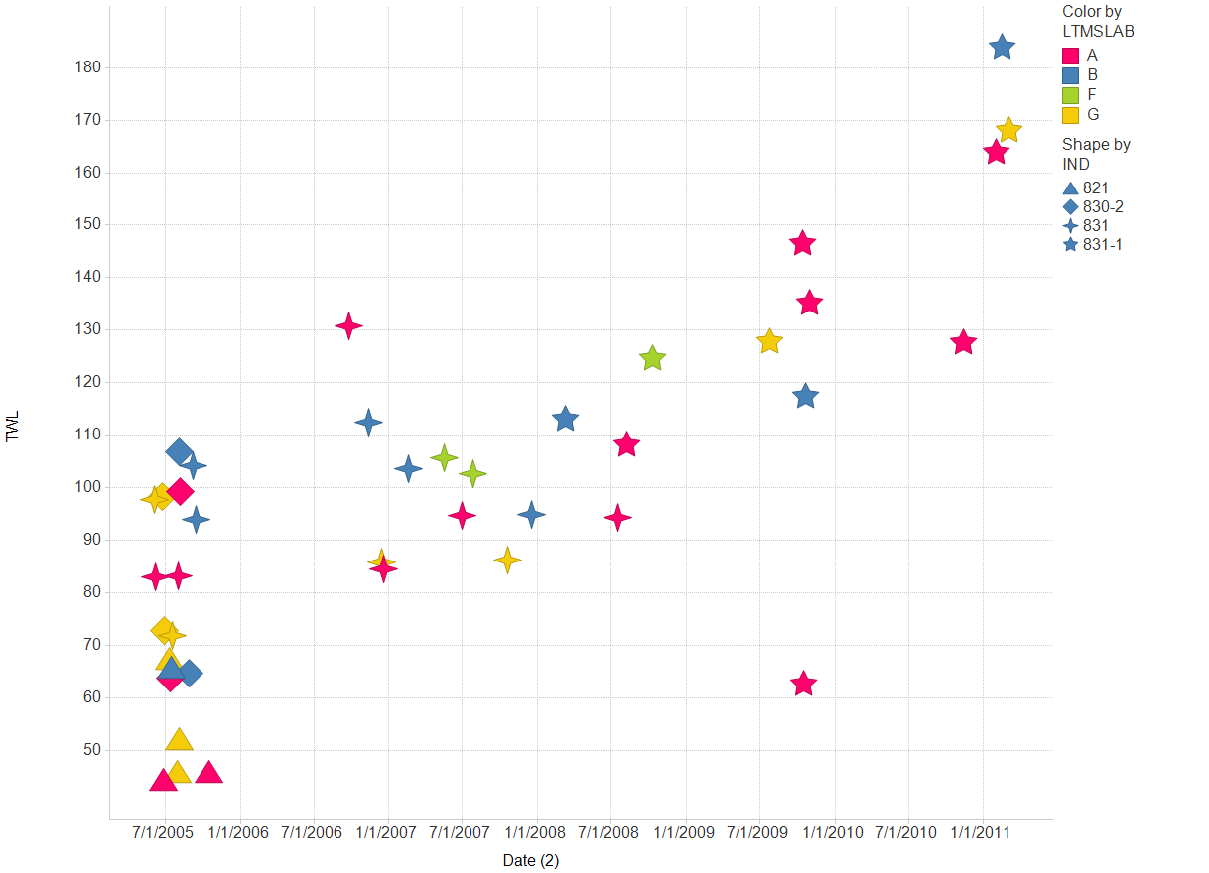

Slide 4
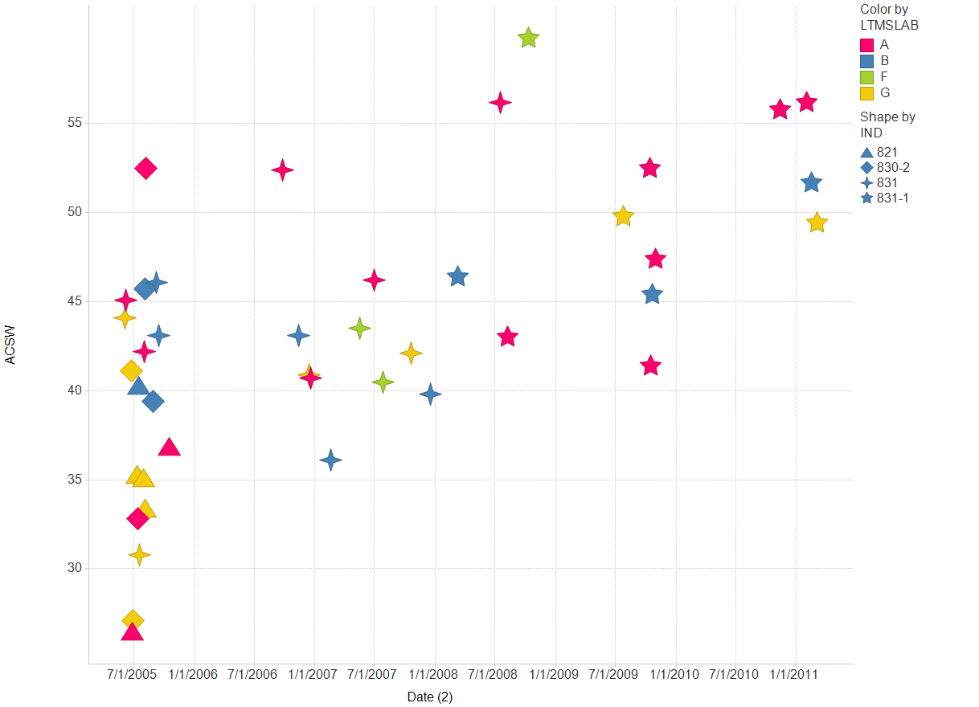

Slide 5
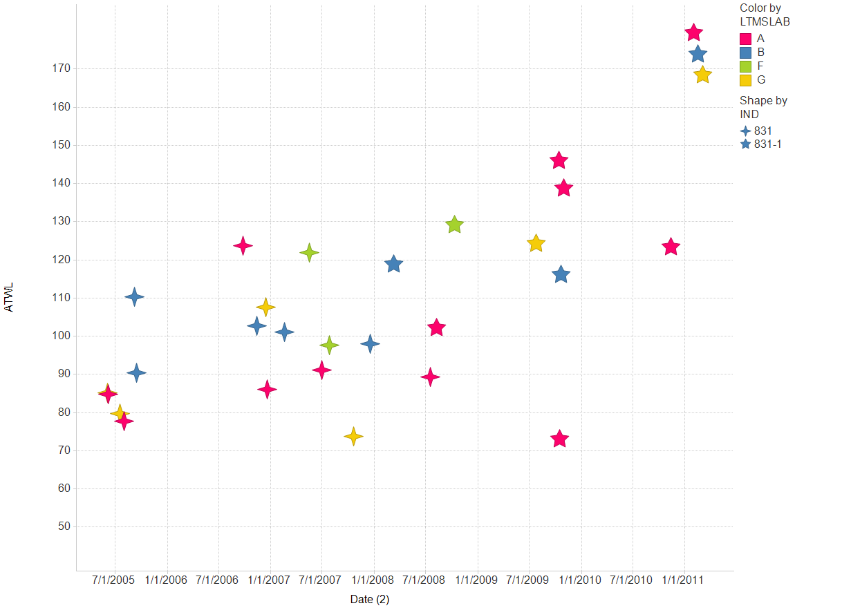

Slide 6
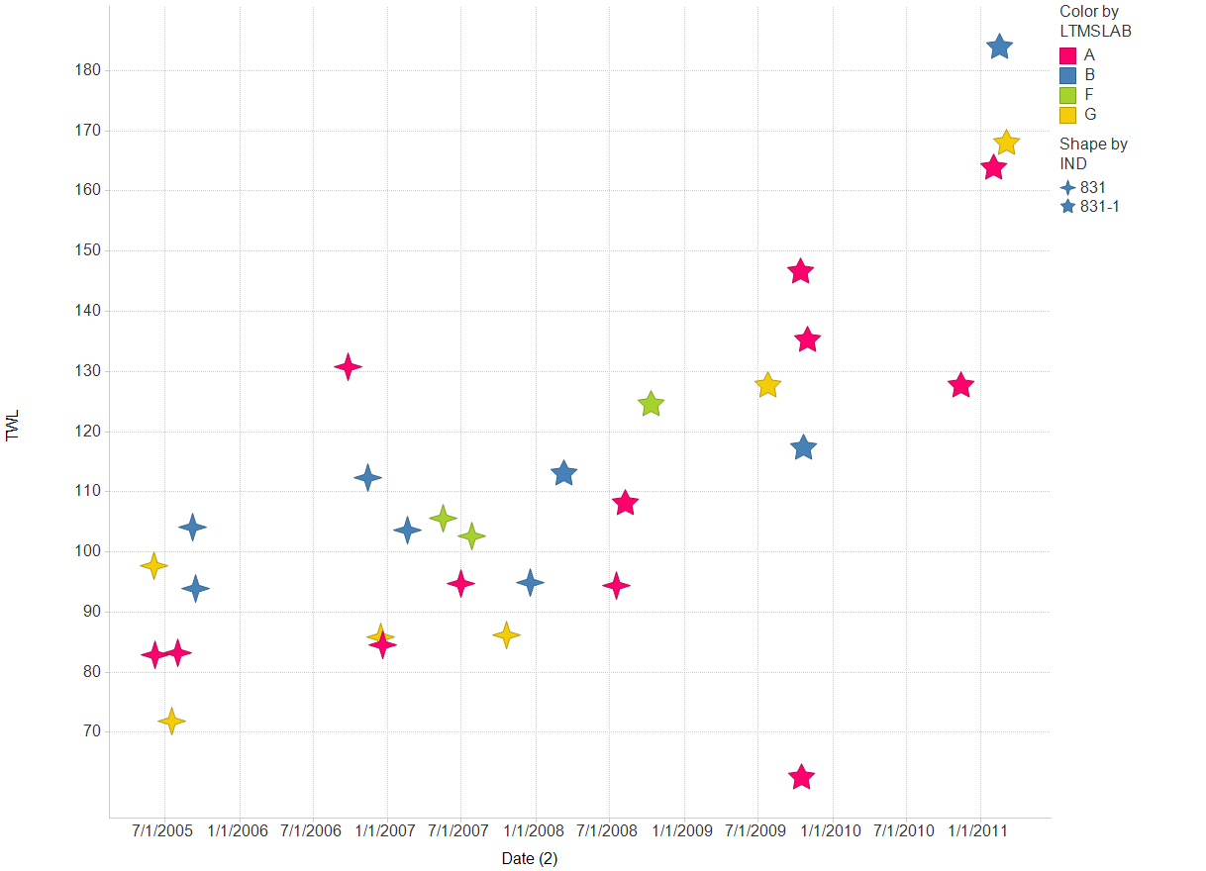

Slide 7
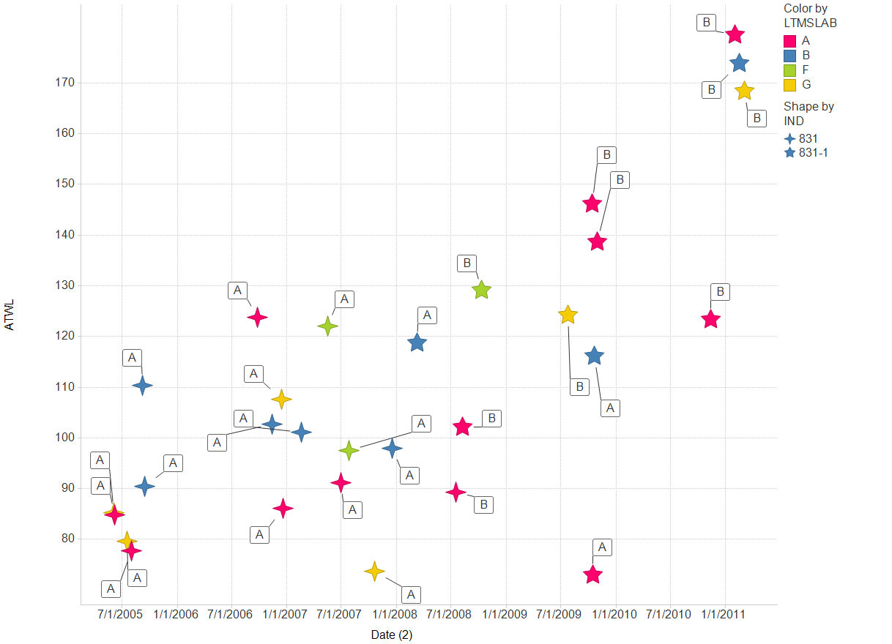
Labels are tappet batches

Slide 8
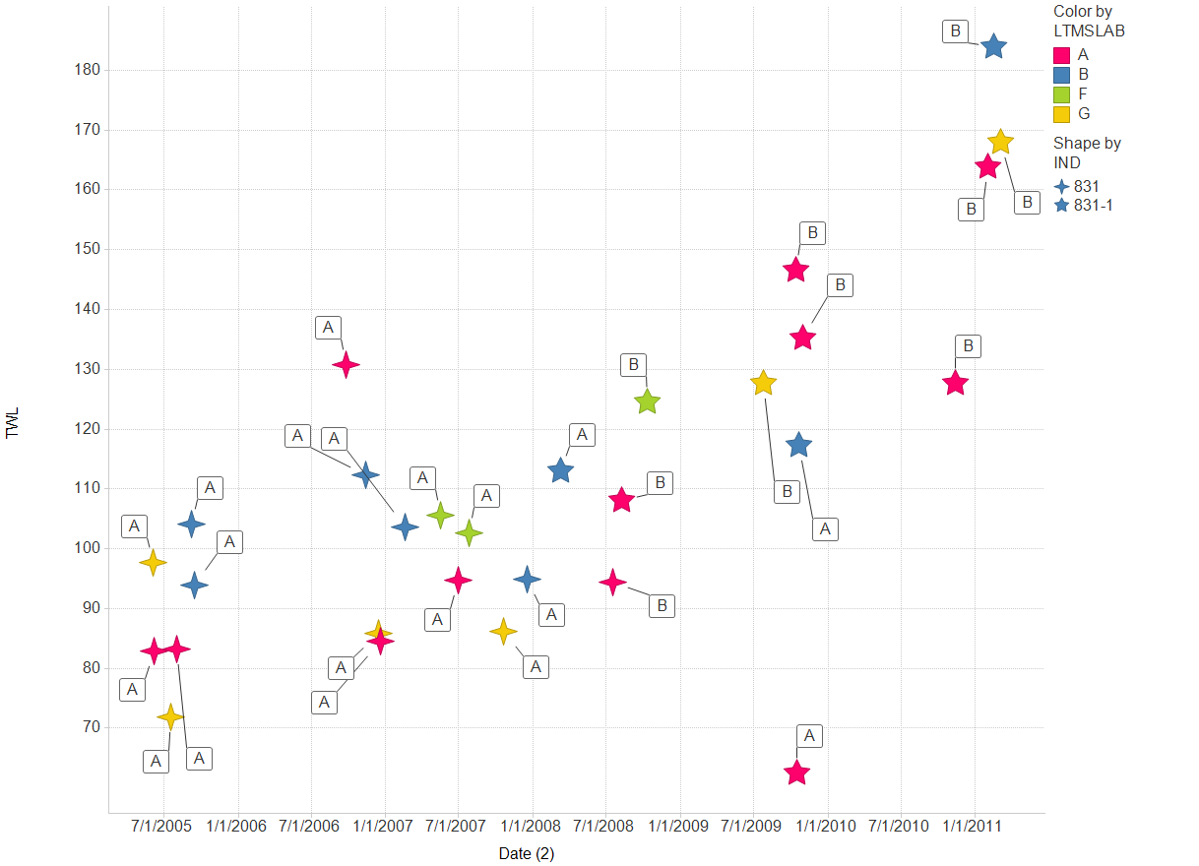
Labels are tappet batches

Slide 9
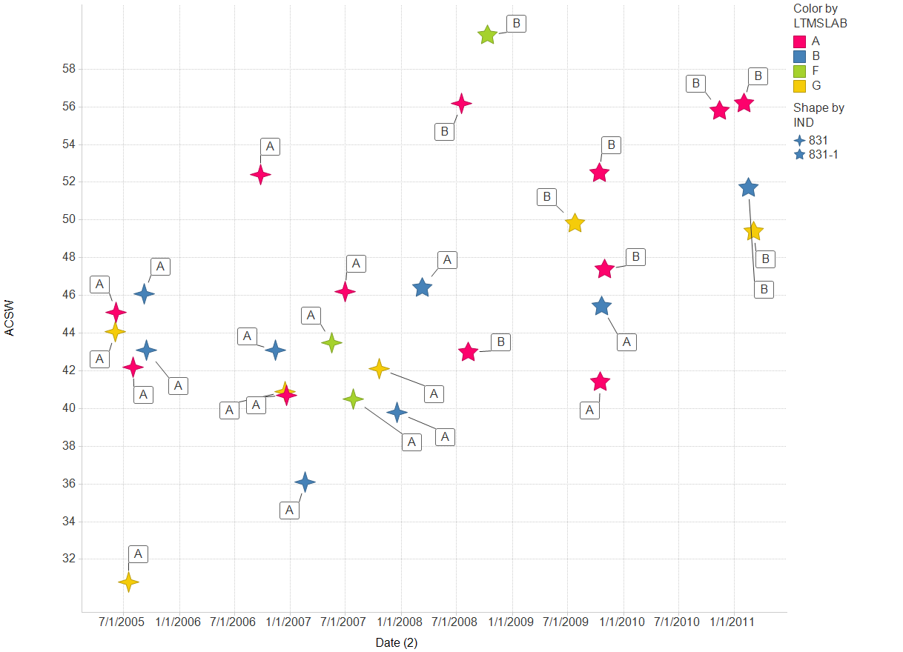
Labels are tappet batches

Slide 10
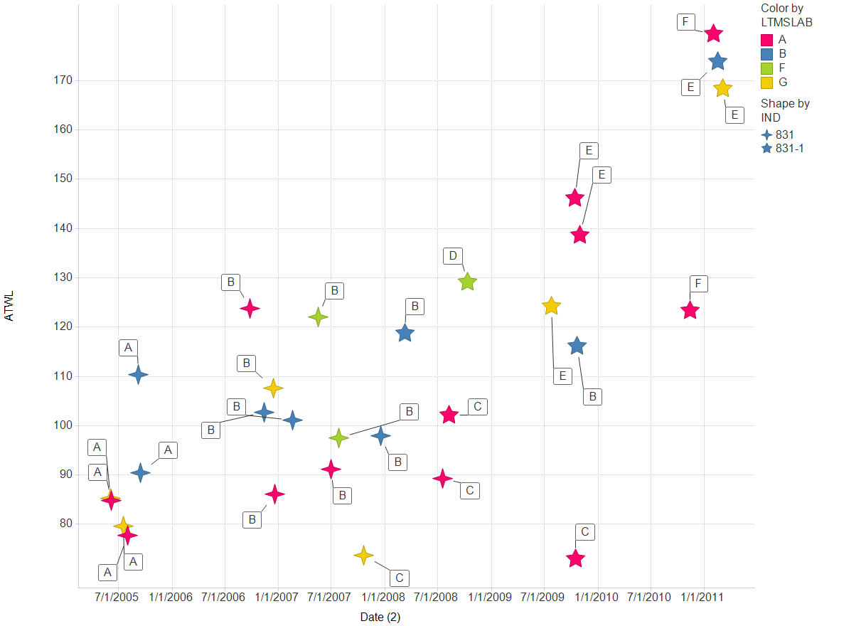
Labels are cam batches

Slide 11

Labels are cam batches

Slide 12

Labels are cam batches

Slide 13
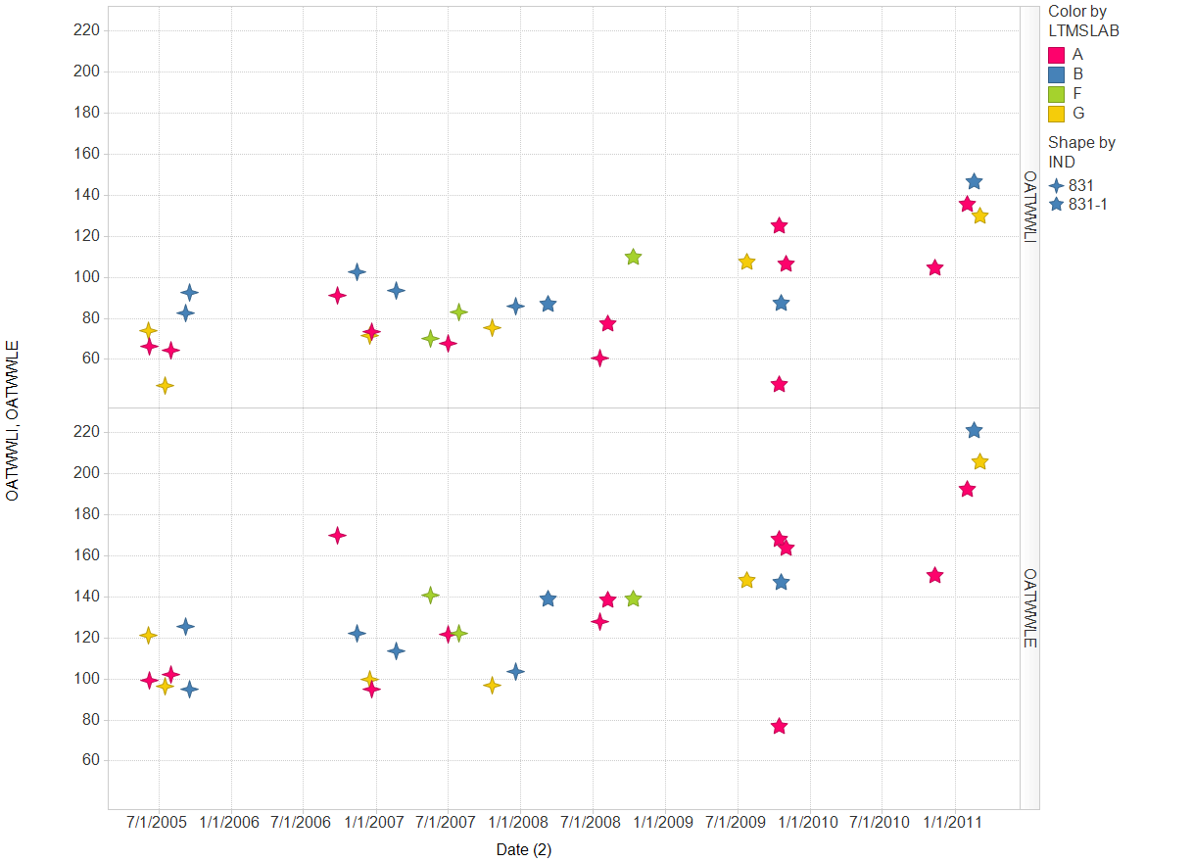

Slide 14
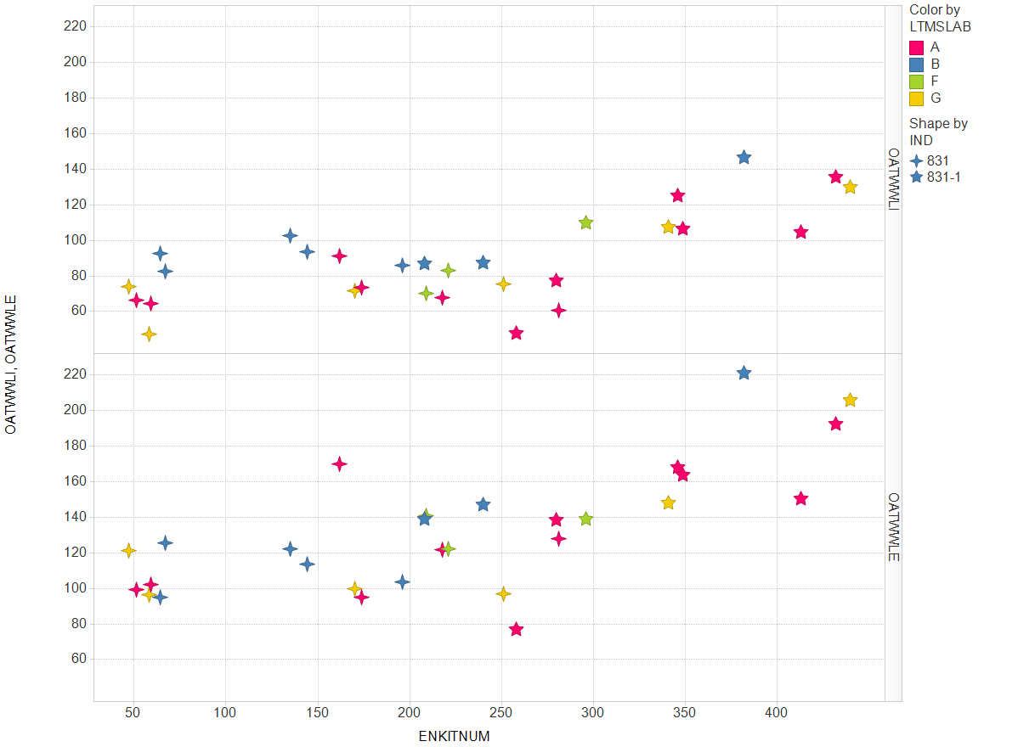

Slide 15
