Slide 1
ISB Data Review
Presented to Cummins
Surveillance Panel
Addendum 3
Cam/Tappet Interactions
Jim Rutherford
March 18, 2011

Slide 2
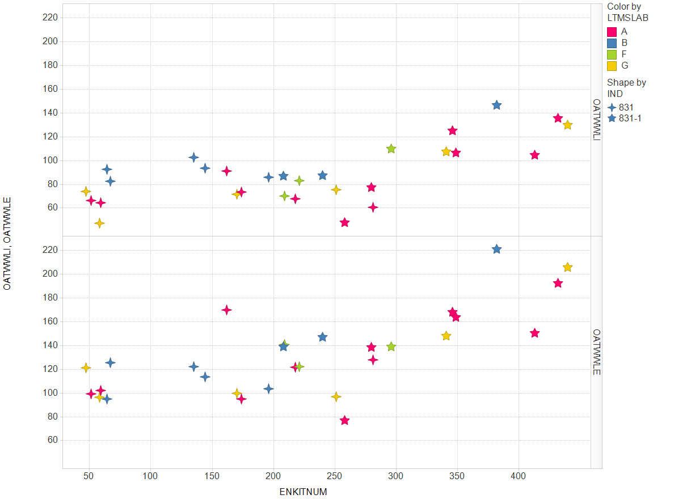
Your have seen something at least similar to this before. We see intake and exhaust tappet wear seeming to increase with kit number or time or something.
It would be hard to conclude an effect of reference oil blends.

Slide 3
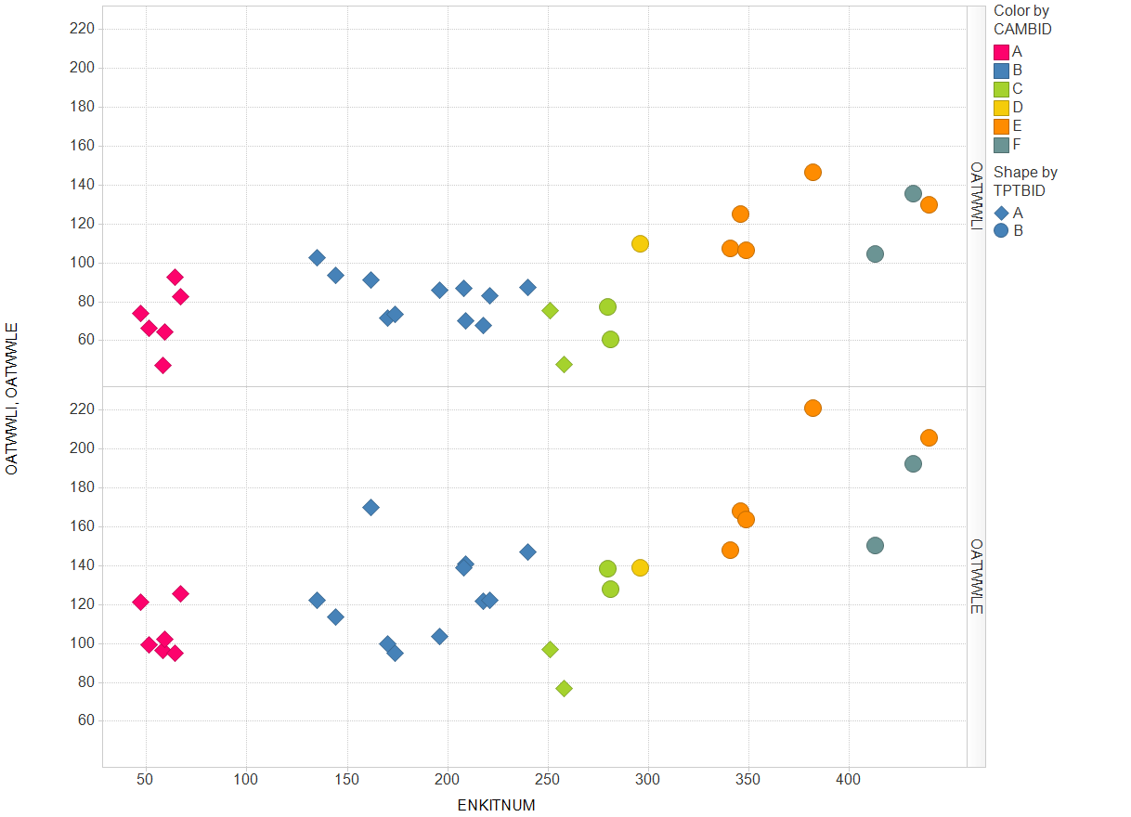
Here is the same picture but with cam and tappet batches identified. There was one batch of cams (C) that ran with both batches of tappets. We can’t really assess an interaction between cam and tappet batches. Most recent cam batches were associated with higher wear. Those four tests with cam batch C could trigger a lot of speculation.

Slide 4
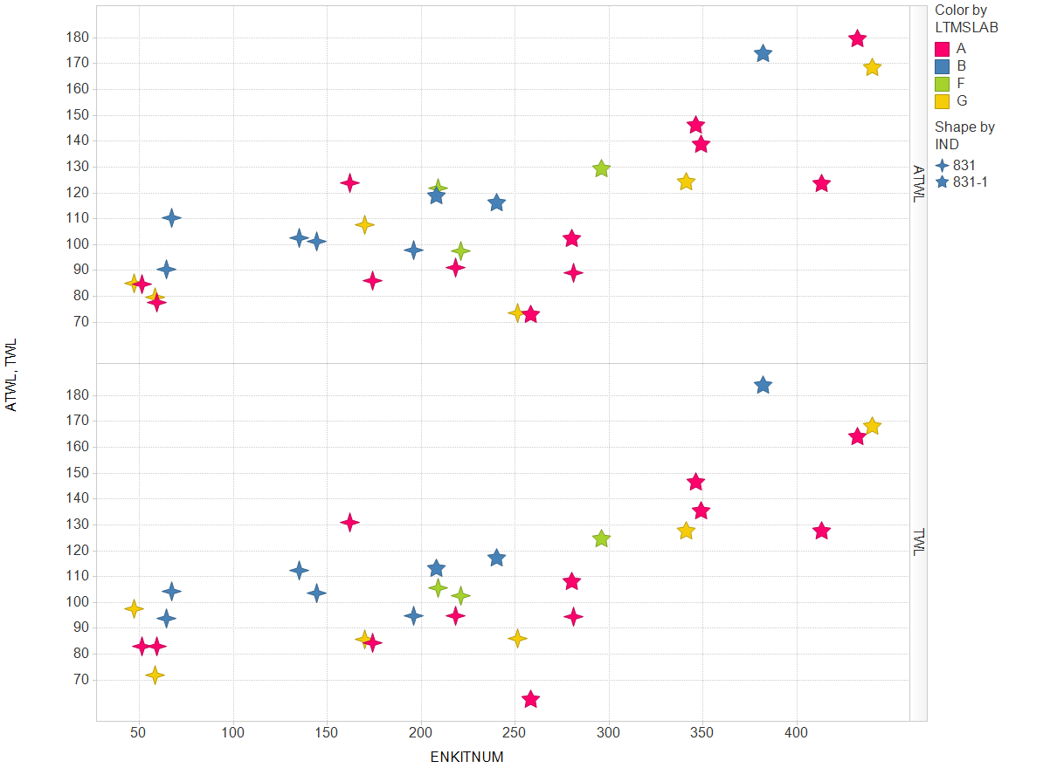
Remember that ATWL is tappet wear after soot adjustment and TWL is without soot adjustment.

Slide 5
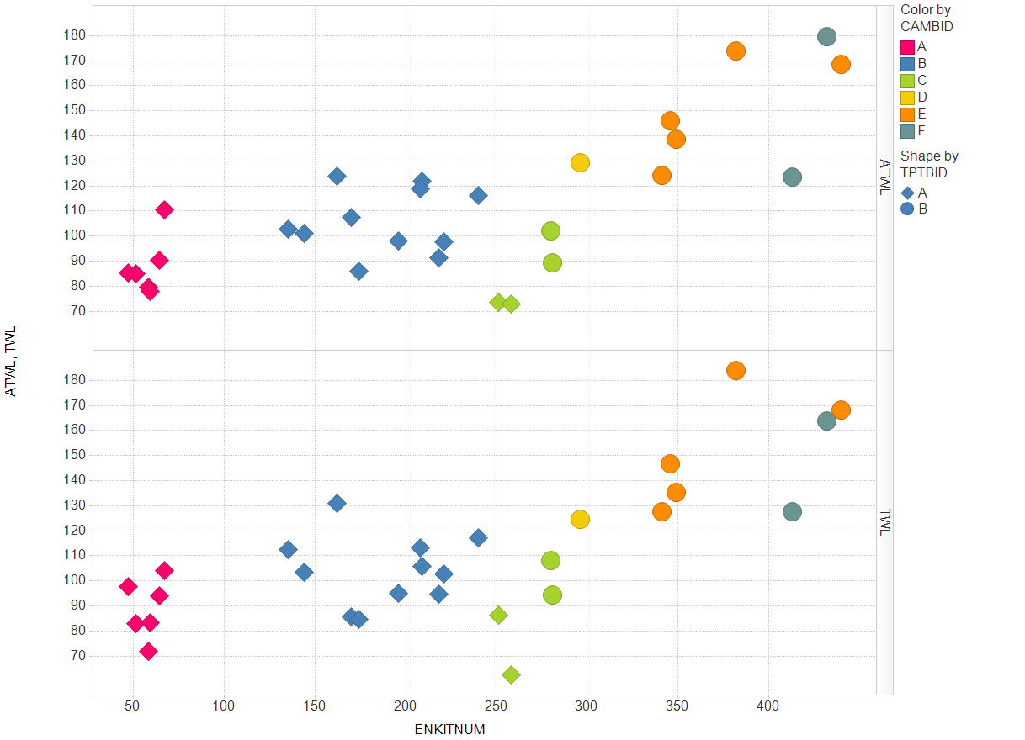

Slide 6
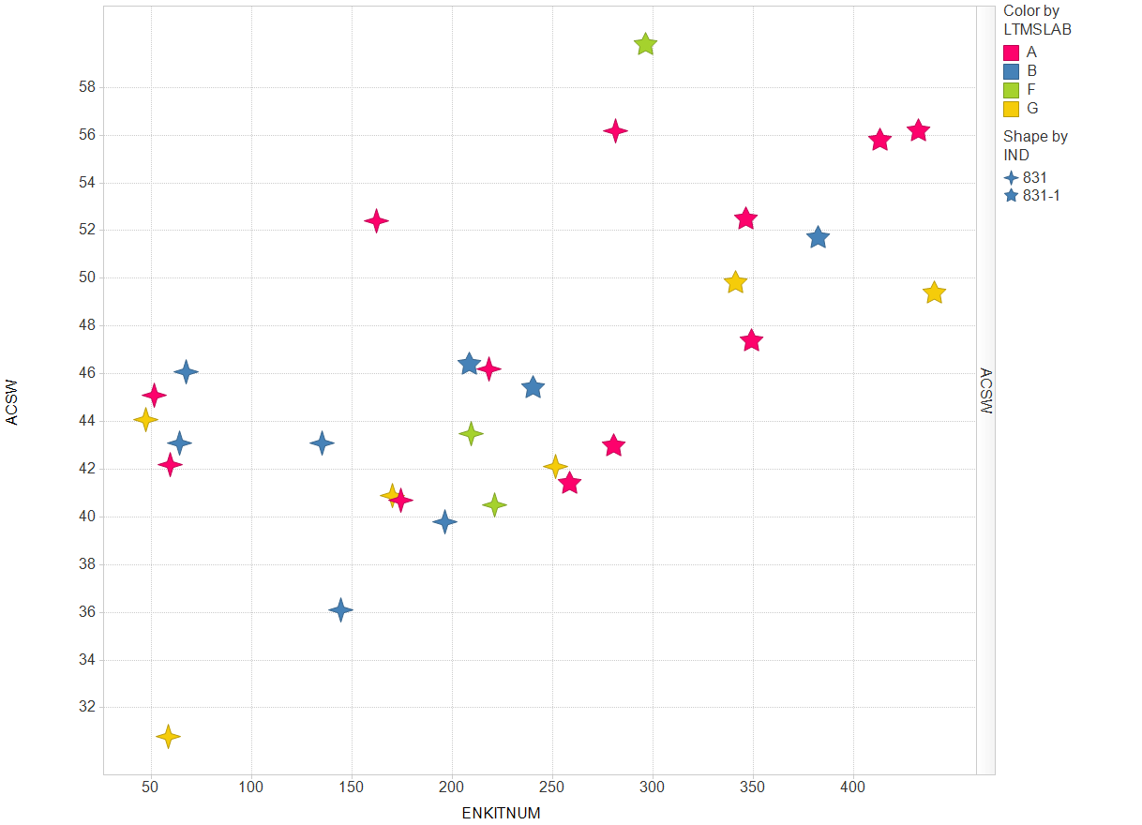
Now with camshaft wear, we again wear seeming to increase with kit number or time or something.
It would be hard to conclude an effect of reference oil blends.

Slide 7
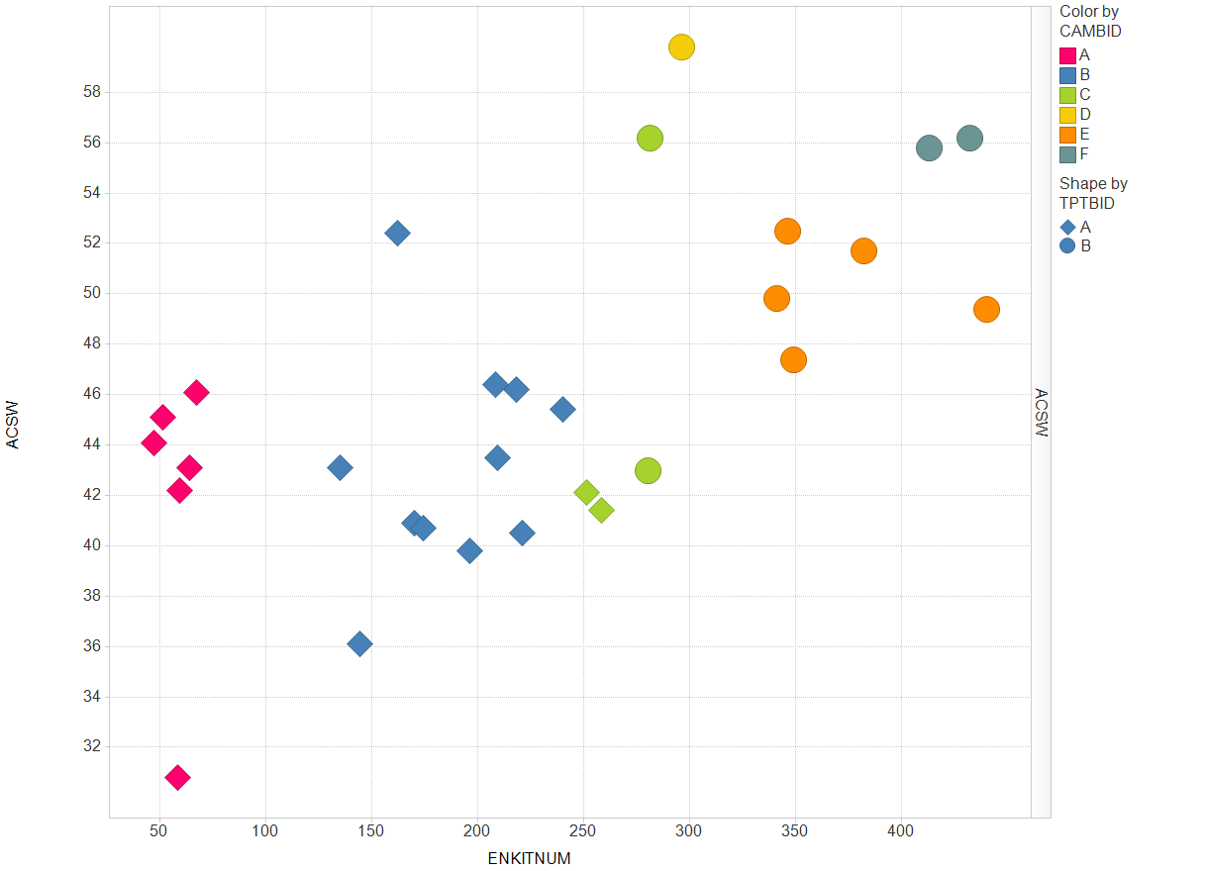
Here is the same camshaft wear picture but with cam and tappet batches identified. Most recent cam batches or tappet batches (?) were associated with higher wear.

Slide 8
For those who would rather look at numbers …

Slide 11
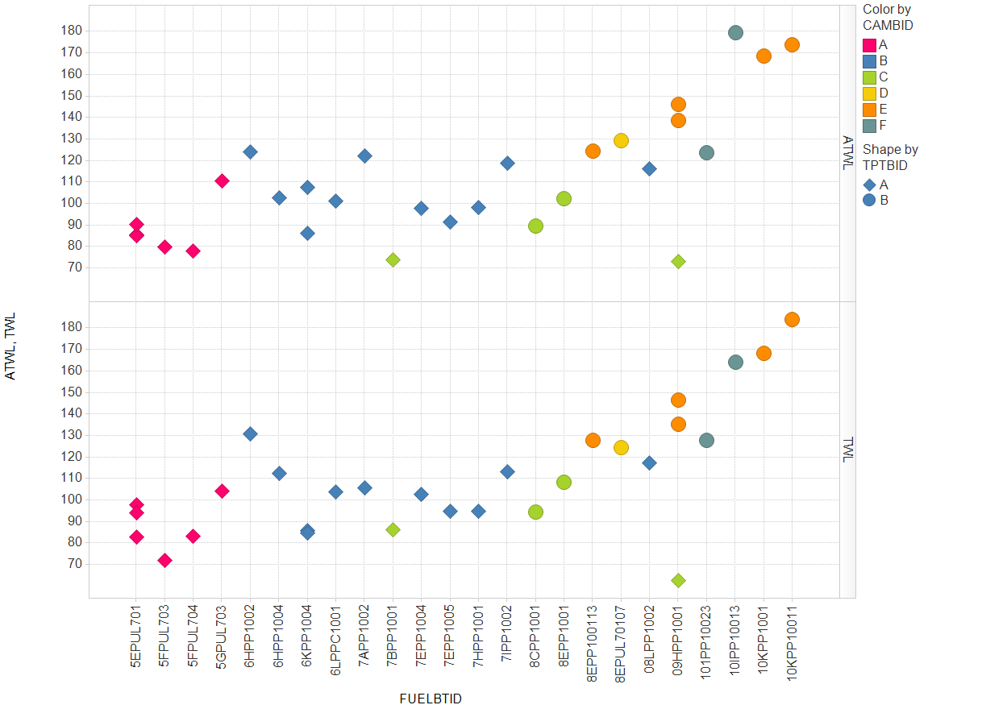
An added extra – another variable correlated with time is fuel batch.

