Slide 1
Cummins ISB
Industry Correction Factor
Cummins Task Force
October 24, 2012
jar
Notes:
Notes go here.

Slide 2
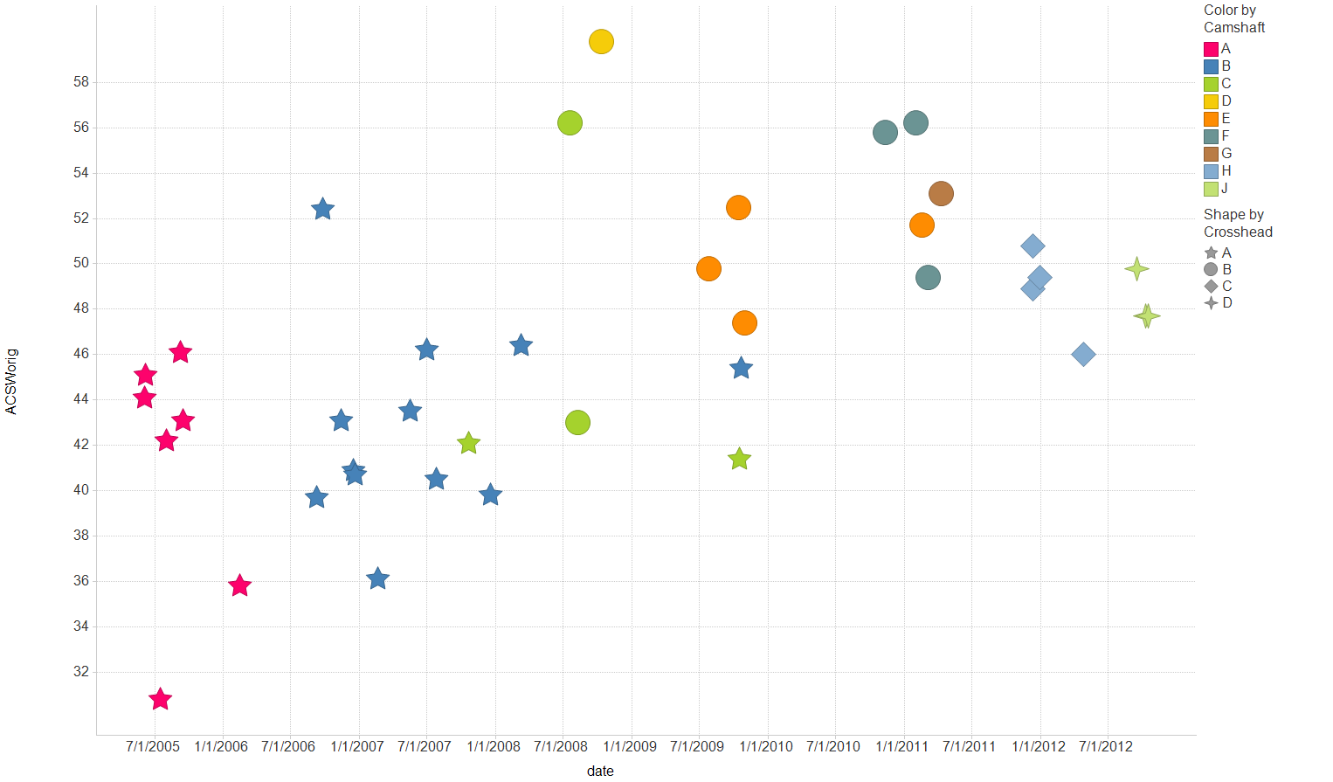
Filter Settings
- IND: ( 831-1 , 831)

Slide 3
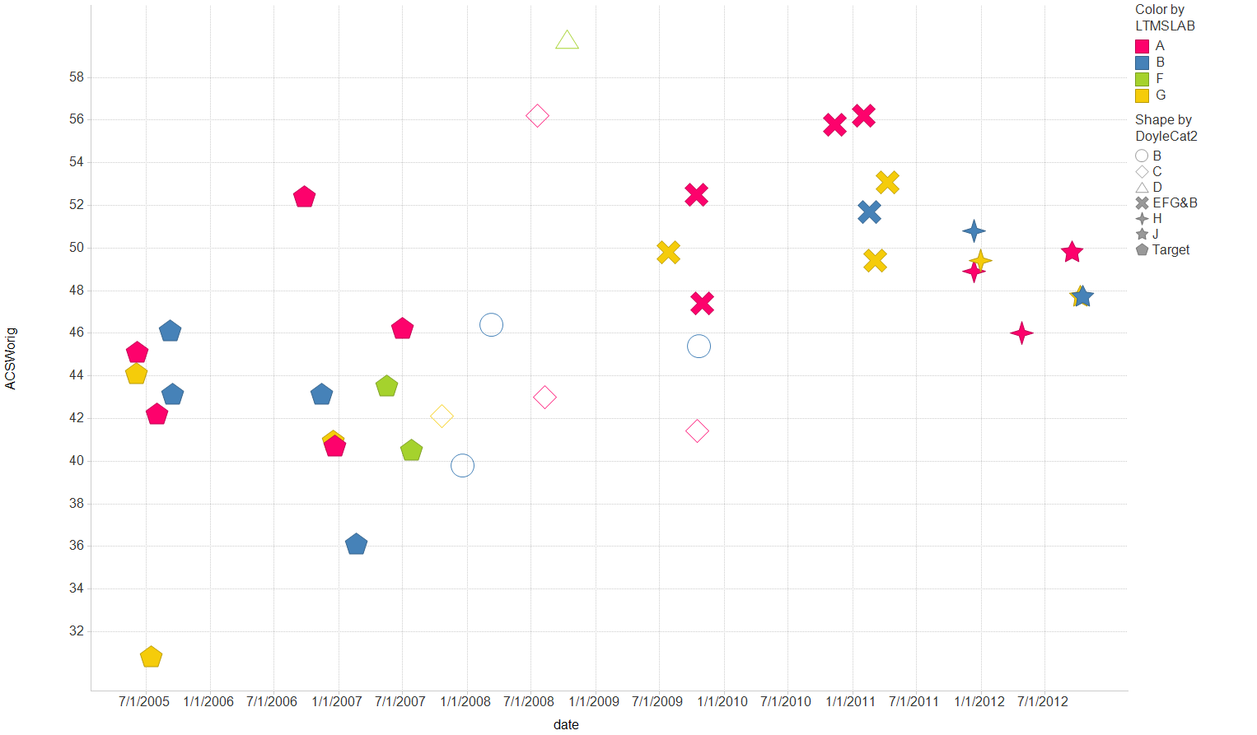
Filter Settings
- IND: ( 831-1 , 831)

Slide 4
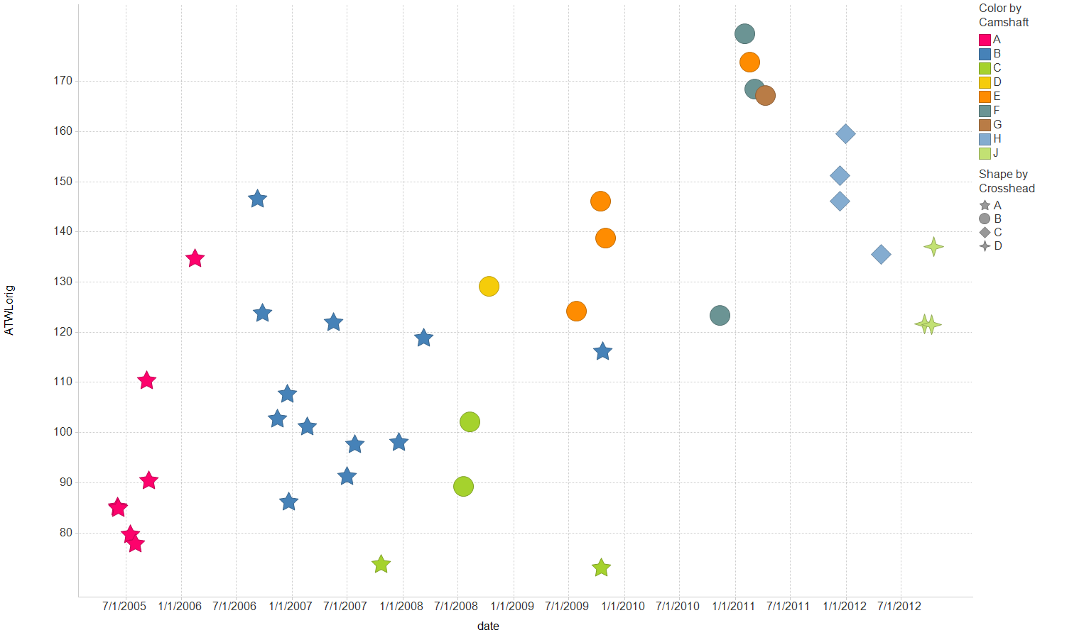
Filter Settings
- IND: ( 831-1 , 831)

Slide 5
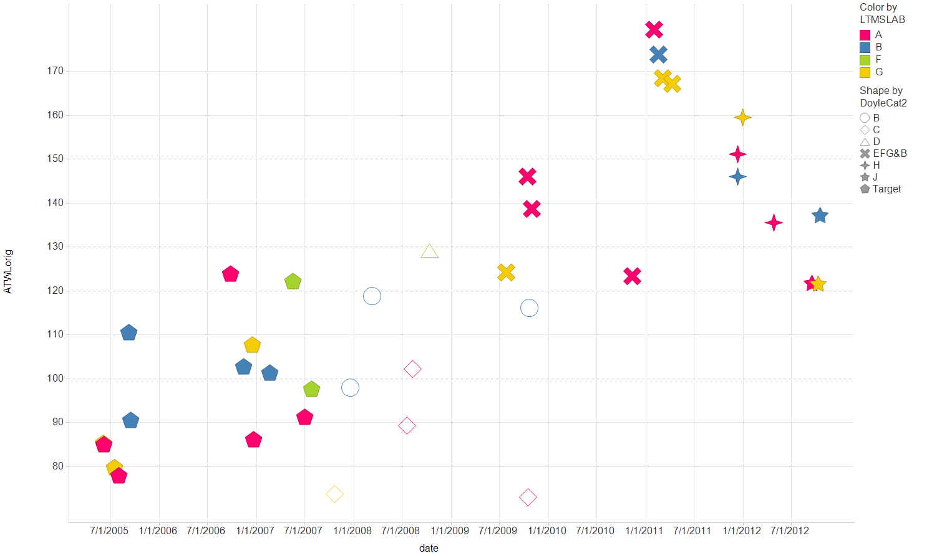
Filter Settings
- IND: ( 831-1 , 831)

Slide 6
Using logic of last ICF, we could argue to leave them unchanged or change from -9.5 to -5.9 and from 0.637 to 0.767.

