Slide 1
Cummins ISB
Industry Correction Factor
Cummins Task Force
November 2, 2012
jar
Notes:
Notes go here.

Slide 2
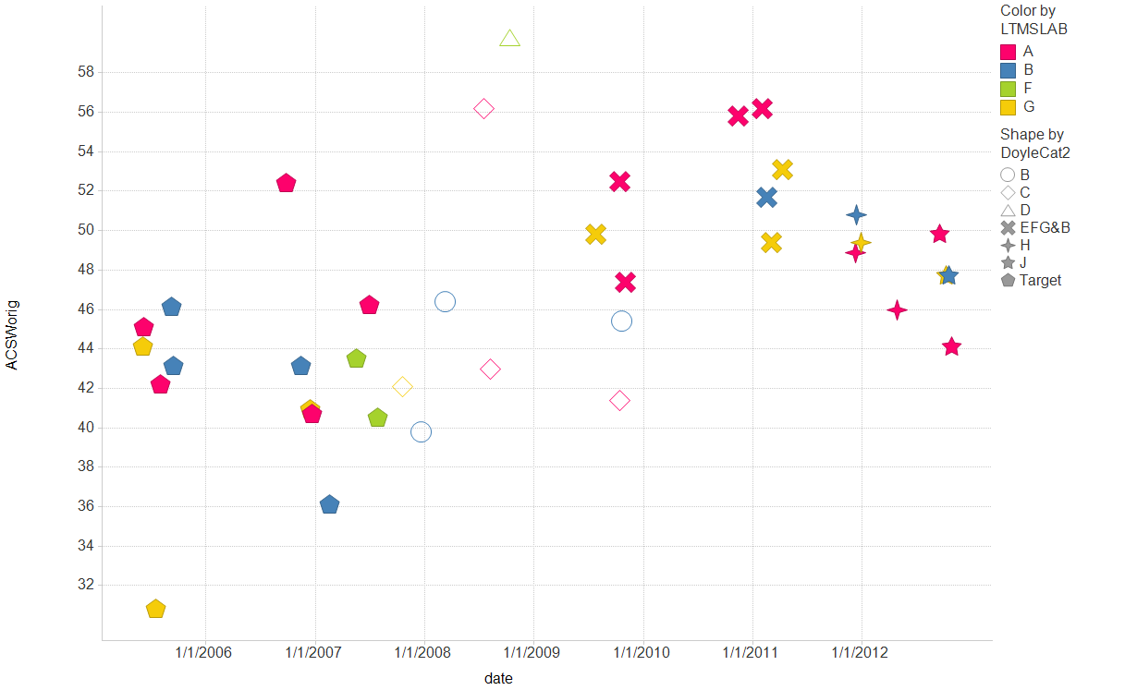
Filter Settings
- IND: ( 831-1 , 831)

Slide 3
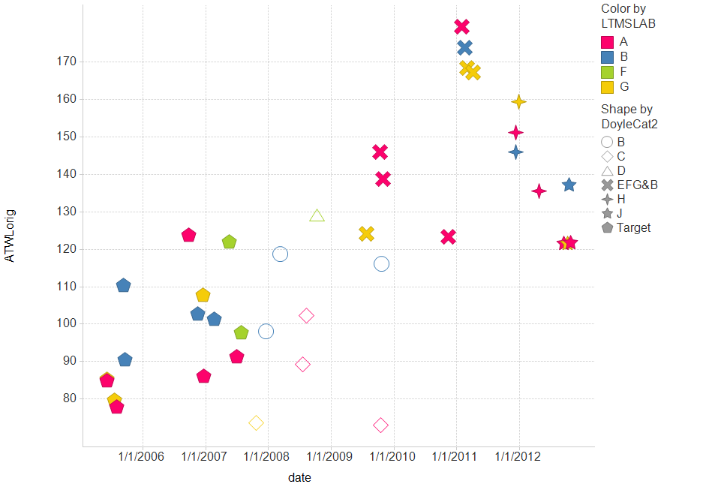
Filter Settings
- IND: ( 831-1 , 831)

