Slide 1
ISB 5.9 Camshaft Key Specifications and Measurements
Phil Shelton
September 16th 2020
Cummins Confidential

Slide 2
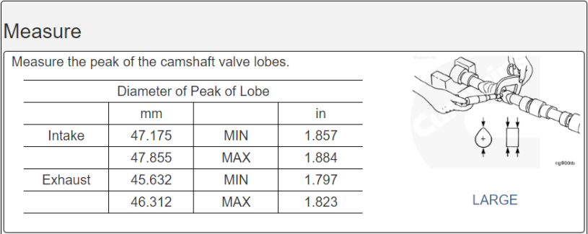
Problem Statement
Cam Lobe Taper – Surveillance Panel spec of 0.010 mm
Cam Lobe total height
  Surveillance Panel spec of 47.175 – 47.855 mm – Intake Lobe
  Surveillance Panel spec of 45.632 – 46.312 mm – Exhaust Lobe
  Total height specs from the B Series Service Manual
Neither specification is called out on the supplier drawing and neither is a controlled parameter
Camshafts are incorrectly being rejected and not being used in Certified Kits
Cummins Confidential

Slide 3
Camshaft Orientation for Counting Journals
We will count from right to left using datum point A as the No. 1 Journal.
Cummins Confidential

Slide 4

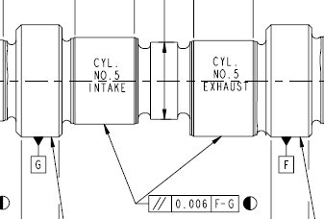
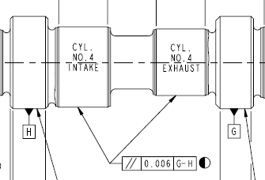
Taper Specs for Intake and Exhaust Lobes
Note: there is no specific specification for taper on the Intake and Exhaust Lobes
  Taper on the Lobes is controlled through a required Parallelism requirement to adjacent Journals
  Journals have a max taper of .01 mm
  Journals also have a Parallelism requirement to each other.
  For example:
    Cylinder No. 5 Intake and Exhaust Valves must be Parallel within 6 microns of adjacent Journals F and G, numbers 2 and 3.
    Cylinder No. 4 Intake and Exhaust Valves must be Parallel within 6 microns of adjacent Journals G and H, numbers 3 and 4.
Cummins Confidential

Slide 5

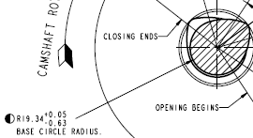
Lift Schedule for Intake and Exhaust Lobes
The Lift Schedule is determined by engineering to meet engine design requirements.
  The amount Taper on the Lobes is controlled through a required Parallelism requirement to adjacent Journals
  The amount of error against the Lift Schedule is tightly controlled to 5 microns per degree.
The total height of the Lobes can vary considerably because the outer base circle
  can vary between 19.34 + 0.05 mm and 19.34 – 0.63 mm.
The Lift Schedules are then calculated based on the outer base circle
  measurement to ensure the Lobes are machined to create the correct Lift
The Lift Schedule indicates 720 data points along the ramp and nose of the Cam
  Lobe to ensure the correct lift is obtained
Cummins Confidential

Slide 6
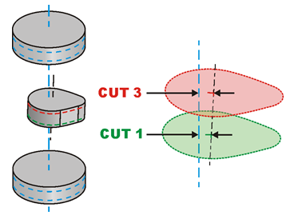
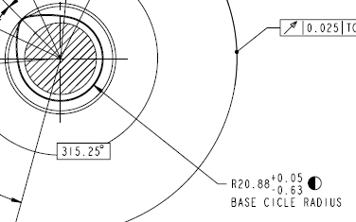
Actions for New Camshaft Batch
Require no pits or dings on the ramp or nose of the cam
Base Circle Radius spec reductions
  Exhaust Lobes – 19.34 mm +- 0.05 mm (was +0.050 mm to -0.63 mm)
  Intake Lobes – 20.88 +- 0.05 mm (was +0.05 mm to -0.63 mm)
Require a 3 cut measurement of the Lobes.
Lift Error reduced to 0.015 mm (was 0.050 mm)
Cummins Confidential

Slide 7
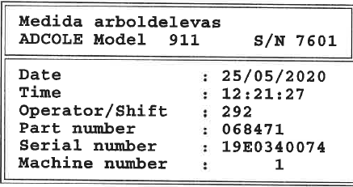

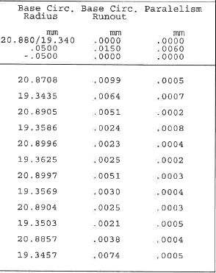
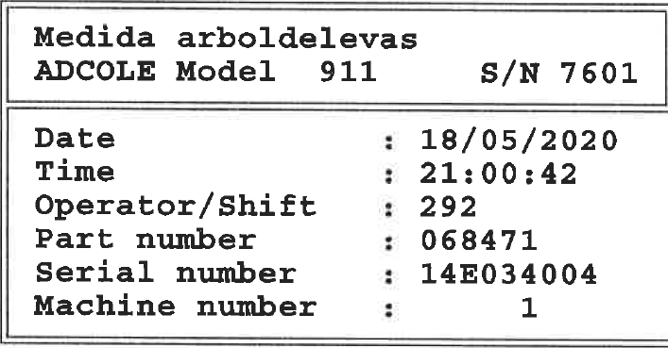
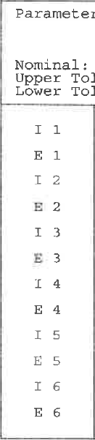
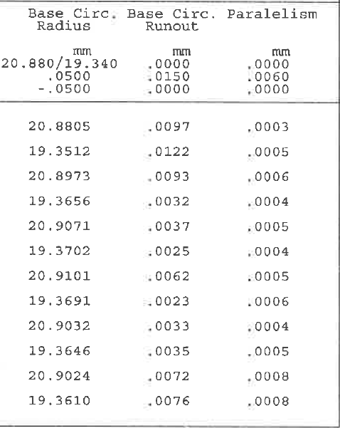
AdCole Example Data
Base Circle Radius spec reductions
  Exhaust Lobes – 19.34 mm +- 0.05 mm (was +0.050 mm to -0.63 mm)
  Intake Lobes – 20.88 +- 0.05 mm (was +0.05 mm to -0.63 mm)
Parallelism spec remains at 0.006 mm
Cummins Confidential

Slide 8
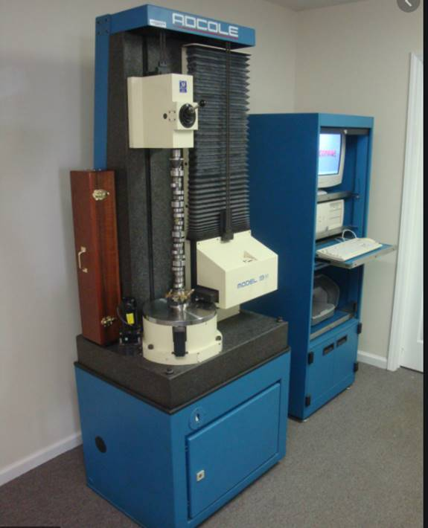
AdCole Instrument Information
911 Model used by Supplier
Instrument cost ~$500K
Instrument uses a contact gauge - roller or flat follower
Cummins Confidential

Slide 9
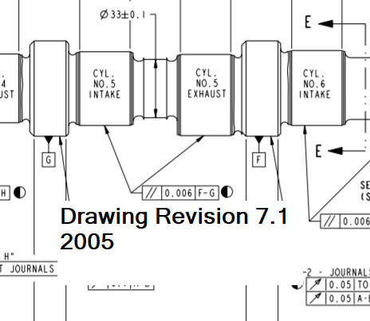
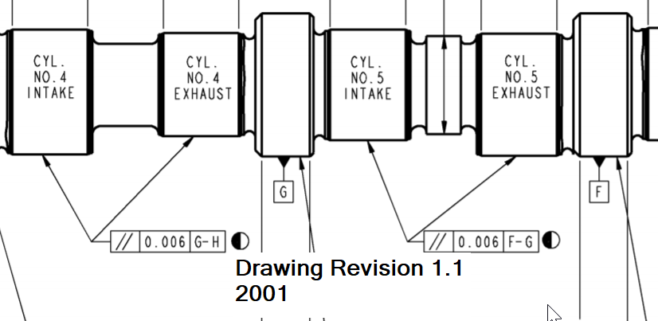
Drawing Revision History
The specifications for these key features have remained the same since the release of the original camshaft
We are currently on Revision 16.1
Cummins Confidential

Slide 10
Proposal for Certified Camshafts
These measurements are taken and stored by AdCole instruments that are the industry standard for anyone making camshafts. “If you can afford it, you use AdCole instruments.”
The ability to measure these key specifications manually cannot match the capability of the AdCole instruments.
Cummins will supply the AdCole data with every camshaft to ensure all key specifications meet the required limits.
The only inspection requirements will be to ensure there are no pits, dings, rust, or scratches on the ramp of the Lobes which might be detrimental to the oil testing results.
The Industry already has test results for camshafts suspected of high taper which show that the suspected taper issue had no affect on the test results
Cummins Confidential

Slide 11
Q+A

Slide 12
Initial Inspection of Batch M Camshafts
Thirty (30) inspected
  Nineteen (19) failed
  Eleven (11) passed
Rejections due to pitting on the cam lobe ramps
Three to Four Months for a new batch
Cummins Confidential

Slide 13



