Slide 1
DD13 Scuffing Test TEI Data Review Ring Batch Comparison
Kevin O’Malley
The Lubrizol Corporation
December 2016

Slide 2
Summary
Kit measurements from 11 reference oil tests using B Batch Top Rings are compared to the measurements observed in prior reference tests (12 matrix tests + 3 post-matrix)
Largest Differences:
Test using B Batch Top Rings generally have
larger ring gap & face peak height location measurements
smaller face width, Rk, Rpk, and back of ring width measurements
Other Observed Differences:
Top Ring:
Test using B Batch Top Rings generally have
higher 180° ring thickness, and 1” after the gap face peak height to 0.2mm diff measurements
smaller Ra and Rz measurements
The tests using B batch Top Rings tend to also have lower 2nd Ring and Oil Ring ring tension as well as lower Oil Ring 180° from gap rail height differential measurements
Percent Scuffing tends to be higher when the top ring face peak height to 2.75mm diff is lower.

Slide 3
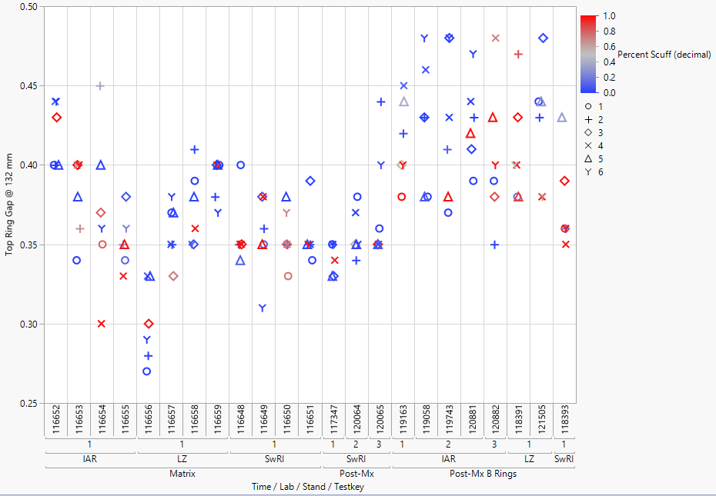
Top Ring Differences Ring Gap
B Rings generally have larger top ring gap measurements than observed on prior rings

Slide 4
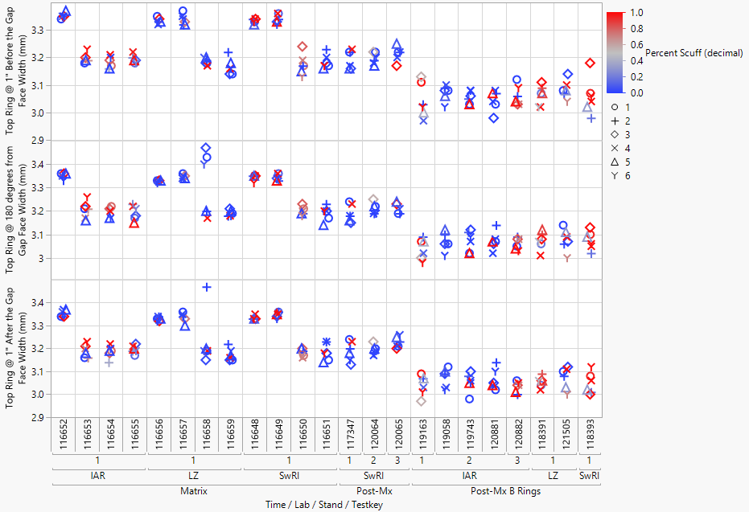
Top Ring Differences Face Width
B Rings have lower face width measurements than observed on prior rings
Note: A 120065 180 degree result close to zero is not plotted

Slide 5
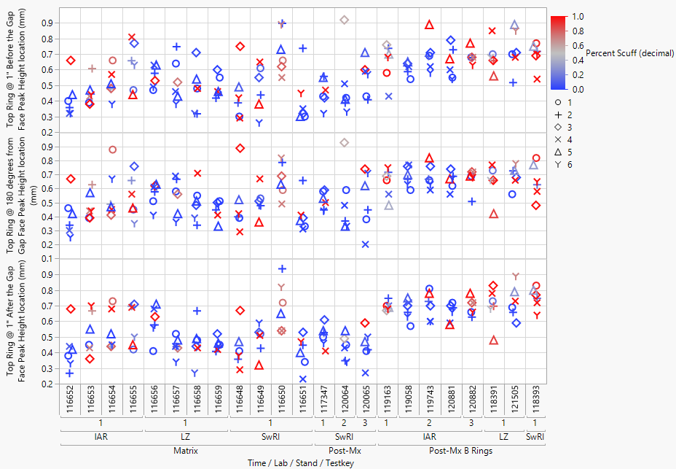
Top Ring Differences Face Peak Height Location
B Rings tend to have face peak height location measurements on the upper end of what was observed on prior rings

Slide 6
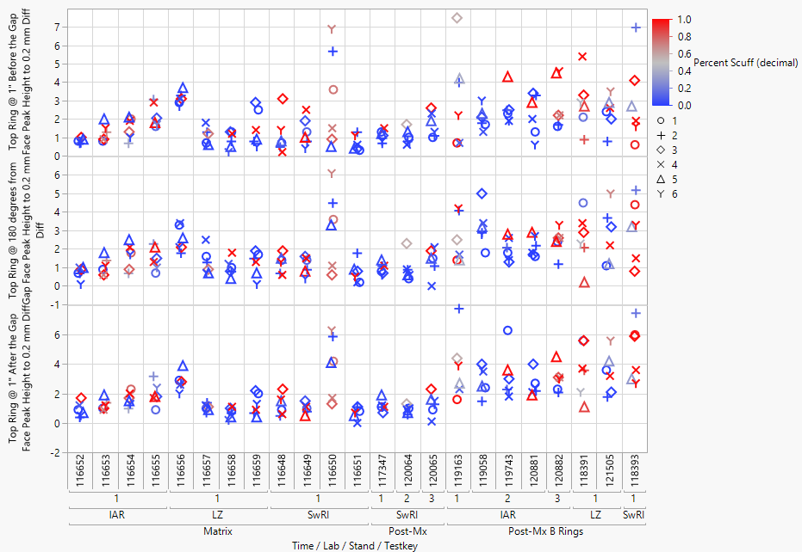
Top Ring Differences Face Peak Height to 0.2mm Diff
B Ring 1” after the gap face peak height to 0.2 mm diff measurements are on upper end of measurements observed on prior rings

Slide 7
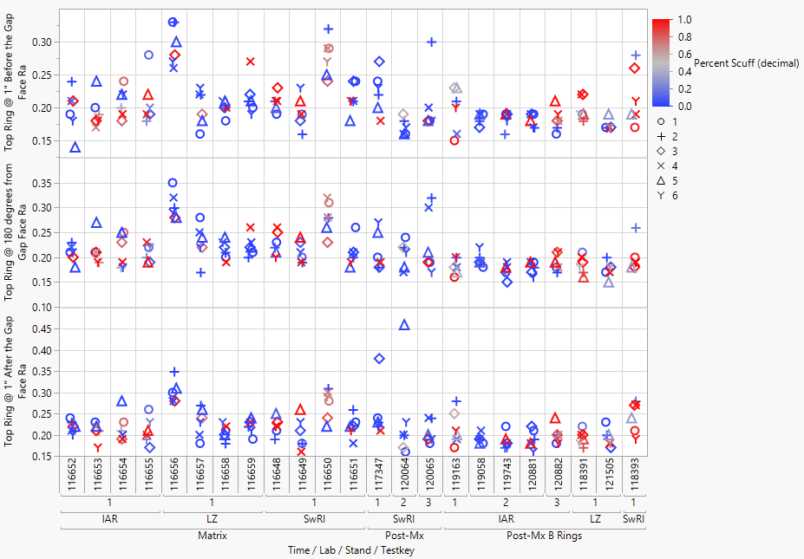
Top Ring Differences Ra
B Ring Ra 180 degrees from gap measurements tend to be on the lower end of measurements observed on prior rings

Slide 8
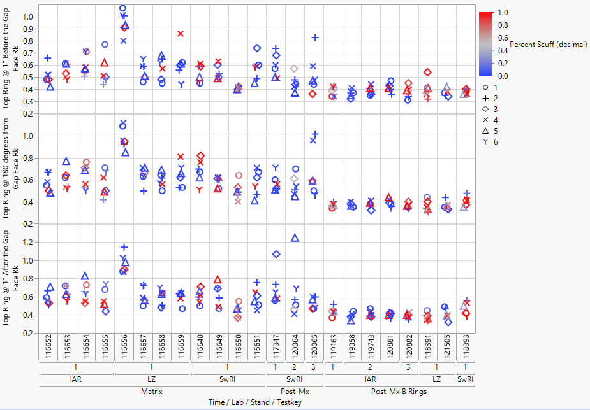
Top Ring Differences Rk
B Ring Rk measurements are generally lower than those observed on prior rings

Slide 9
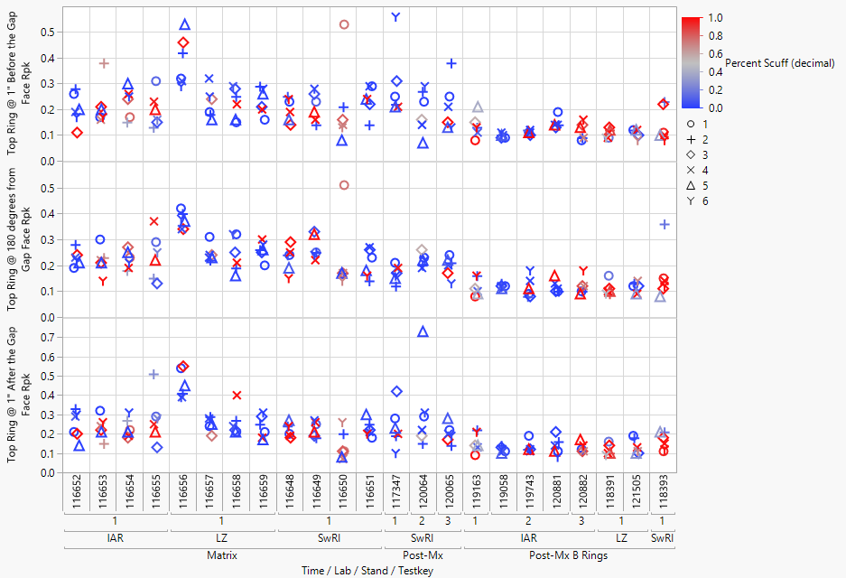
Top Ring Differences Rpk
B Ring Rpk measurements are generally lower than those observed on prior rings

Slide 10
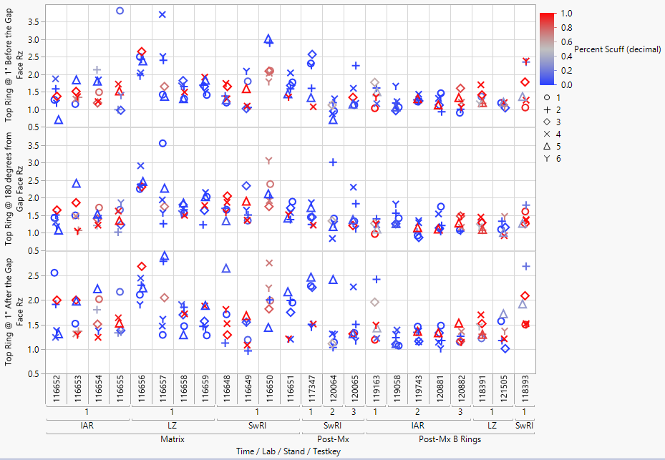
Top Ring Differences Rz
B Ring Rz measurements tend to be on the lower end of what was observed on prior rings

Slide 11
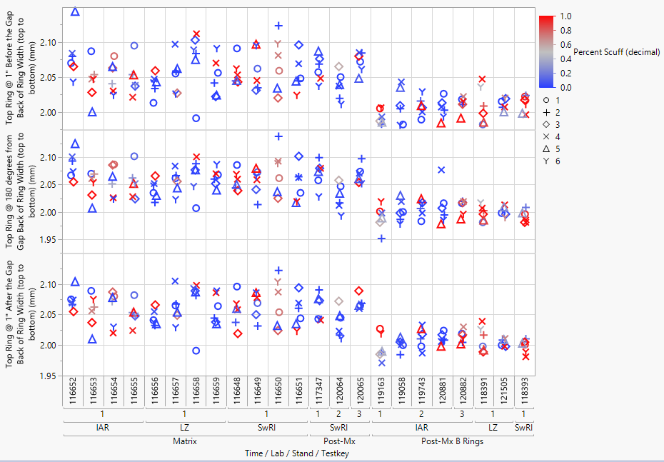
Top Ring Differences Back of Ring Width
B Rings generally have lower back of ring width measurements than the prior rings

Slide 12
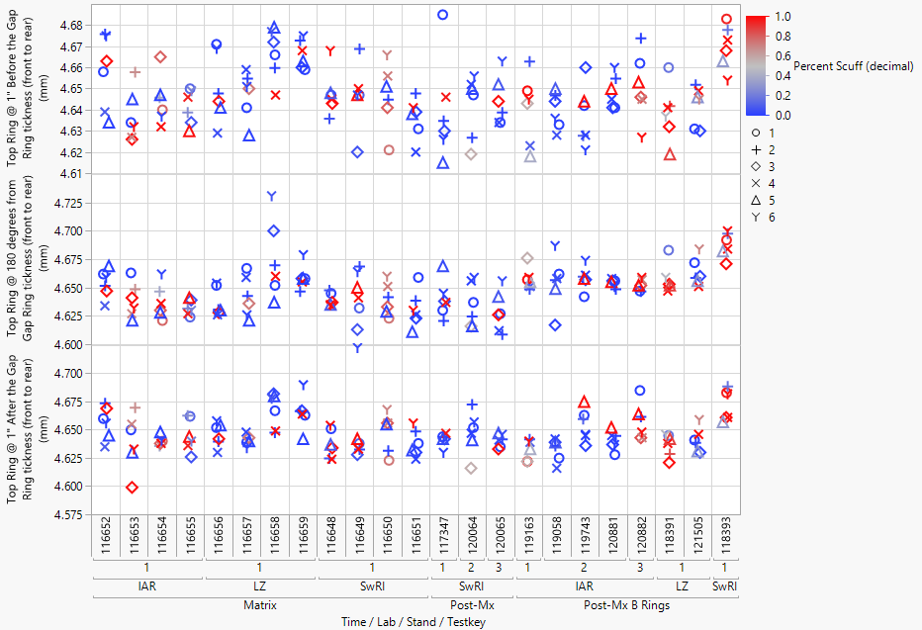
Top Ring Differences Ring Thickness
B Rings generally have higher 180 degree ring thickness measurements than the prior rings

Slide 13
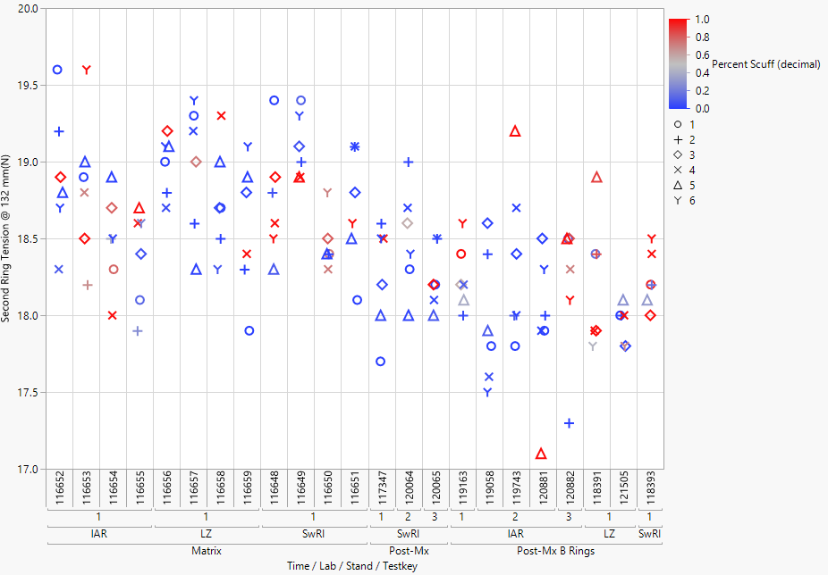
Second Ring Differences Ring Tension @ 132 mm
B Rings tend to have lower ring tension measurements than the prior rings

Slide 14
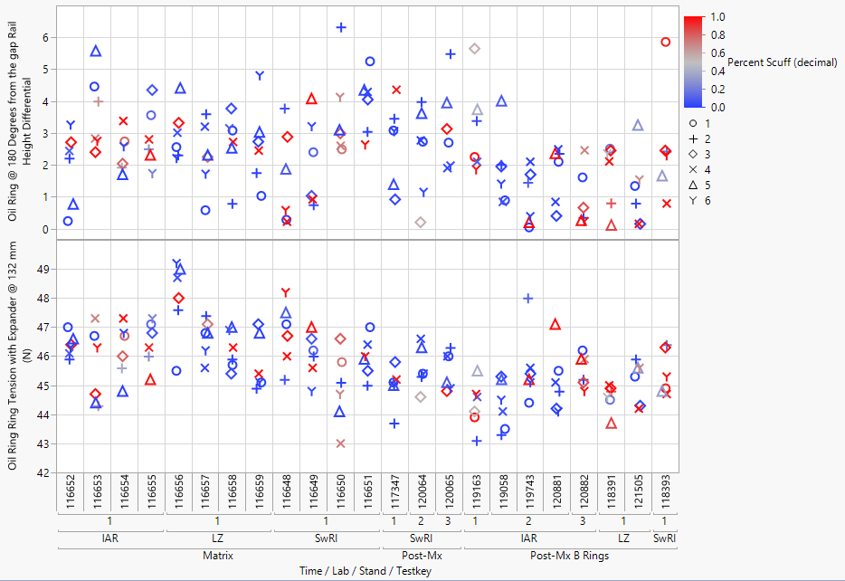
Oil Ring Differences
B Rings tend to have lower ring tension & 180° from gap rail height differential measurements compared to the prior rings

Slide 15
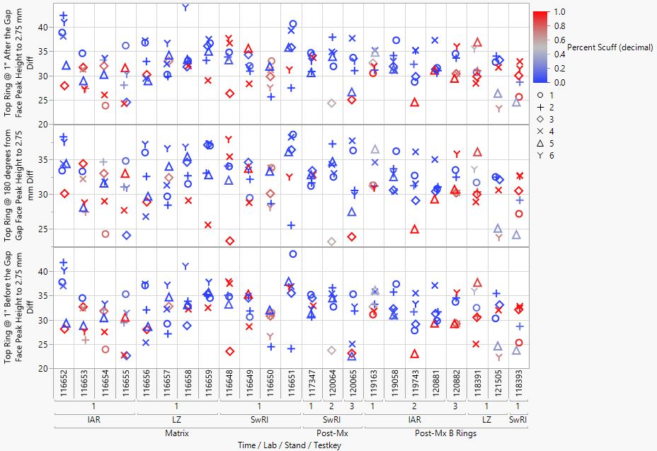
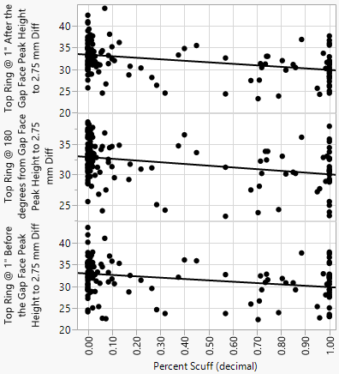
Percent Scuffing by Cylinder
Percent Scuffing tends to be higher when the top ring face peak height to 2.75mm diff is lower

Slide 16
Appendix
TEI Measurements

Slide 17
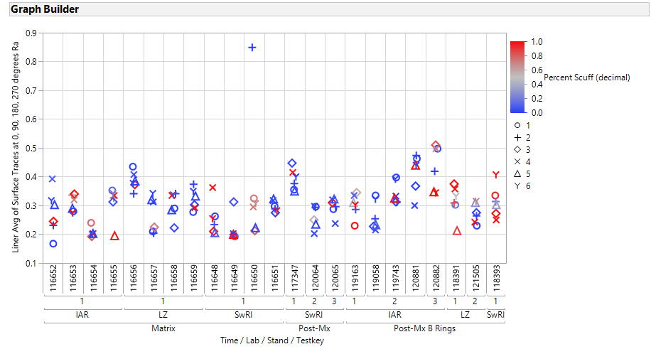

Slide 18
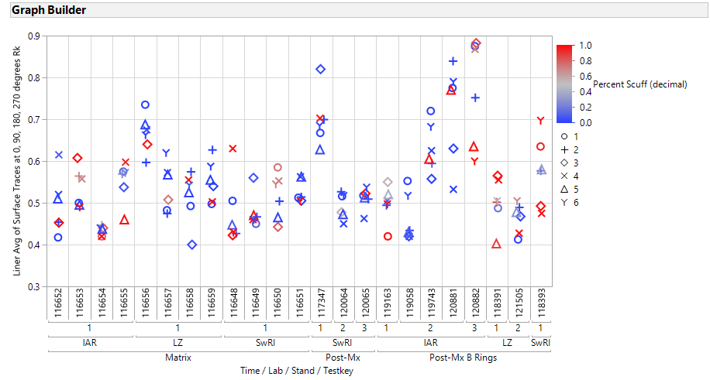

Slide 19
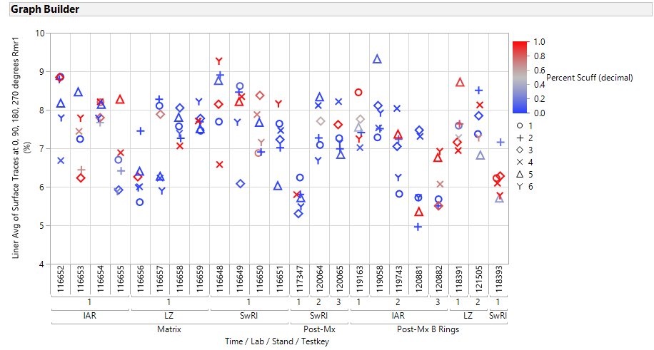

Slide 20
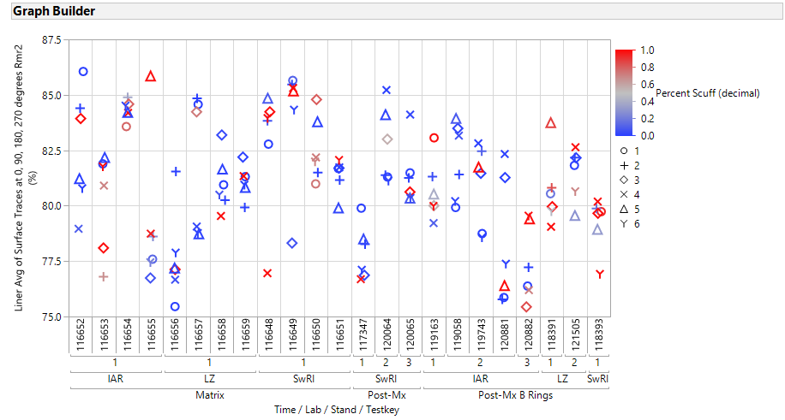

Slide 21
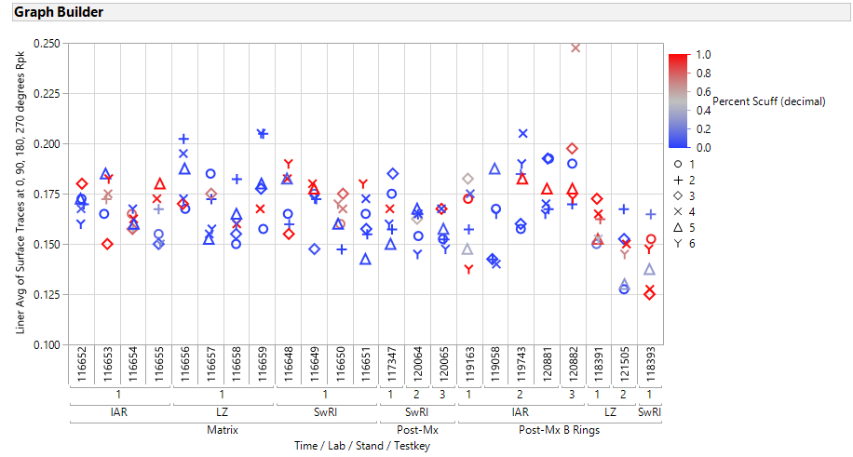

Slide 22
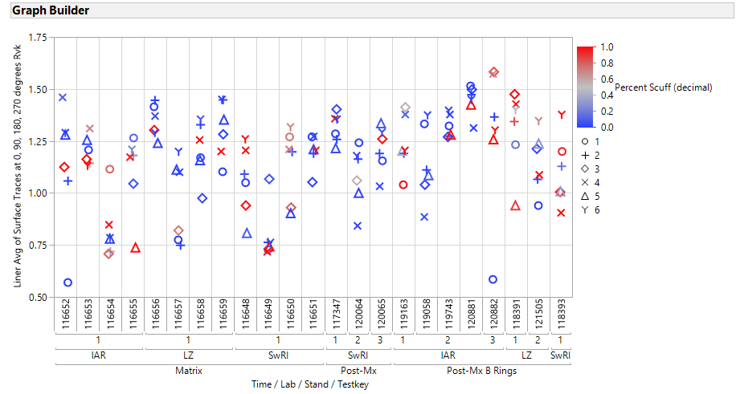

Slide 23
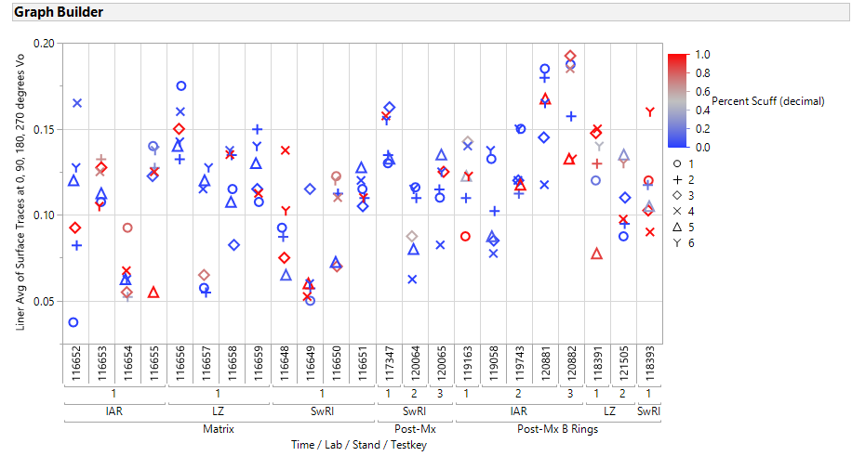

Slide 24
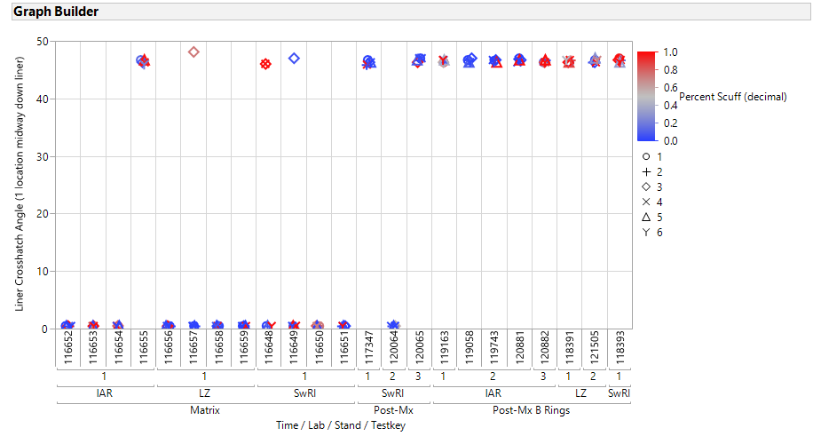

Slide 25
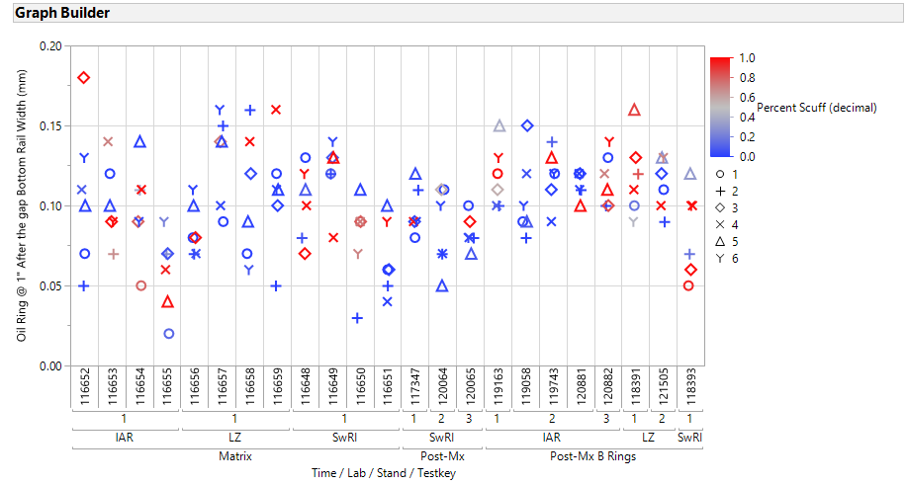

Slide 26
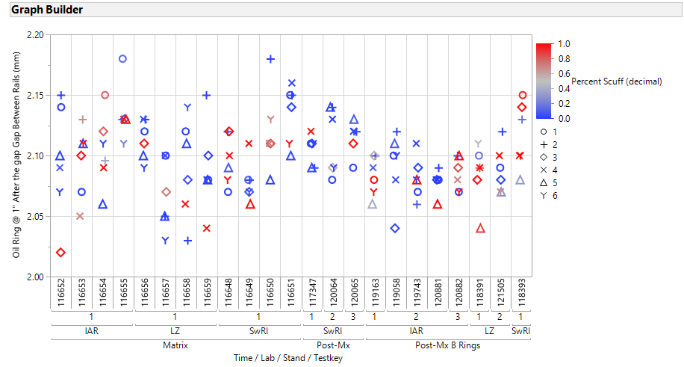

Slide 27
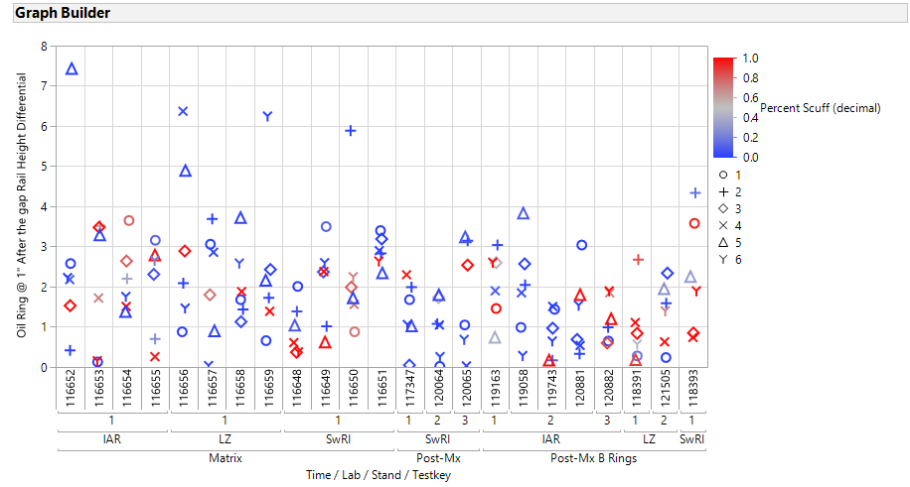

Slide 28
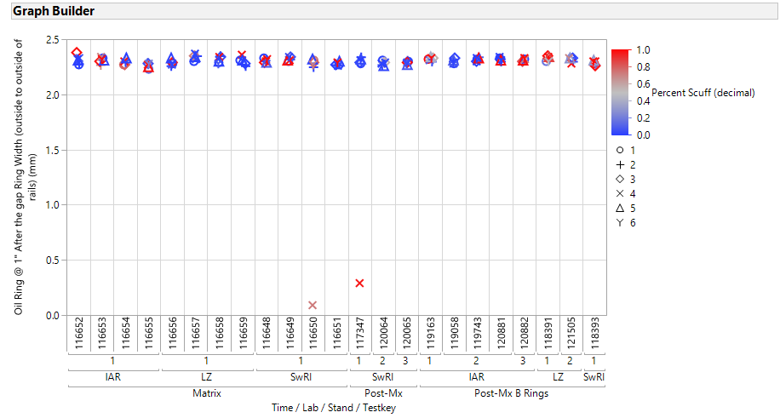

Slide 29
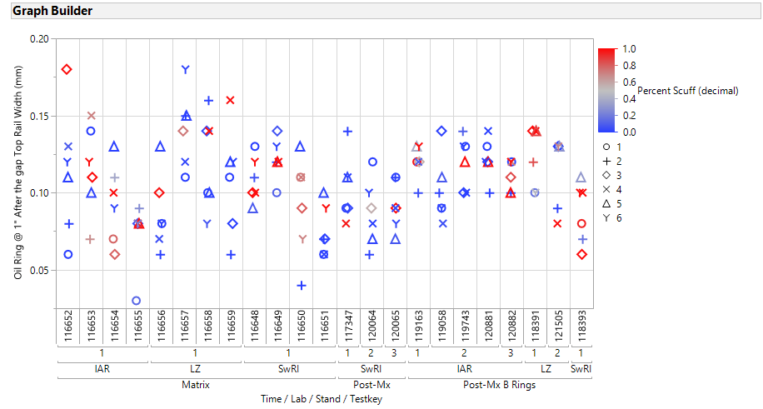

Slide 30
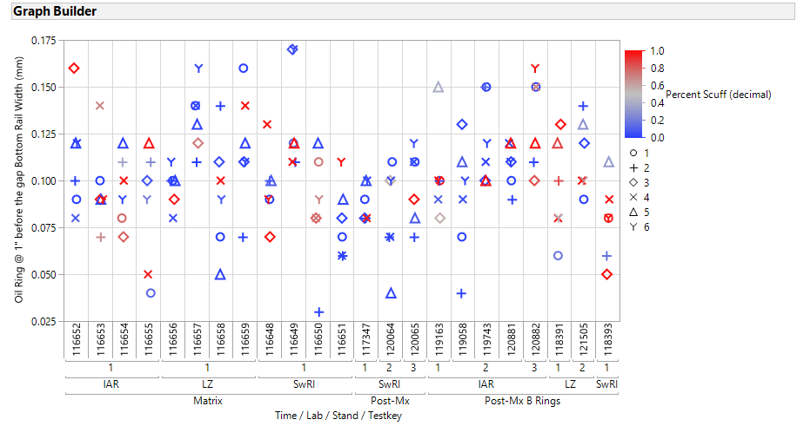

Slide 31
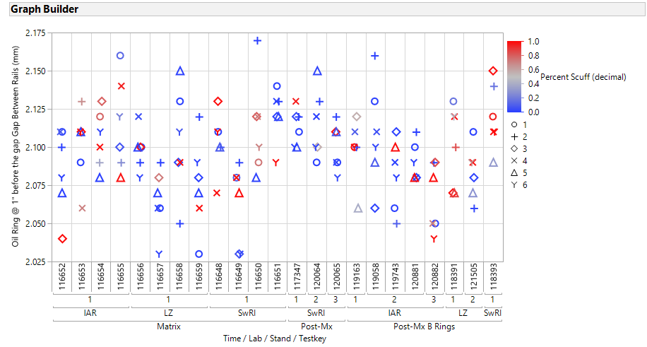

Slide 32
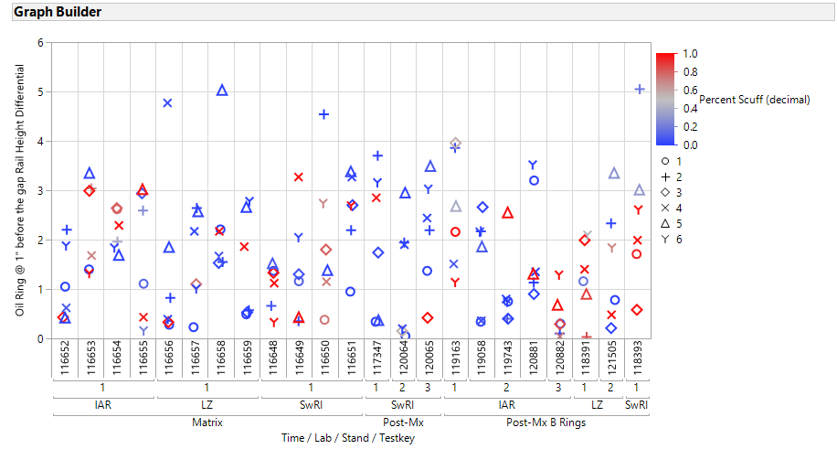

Slide 33
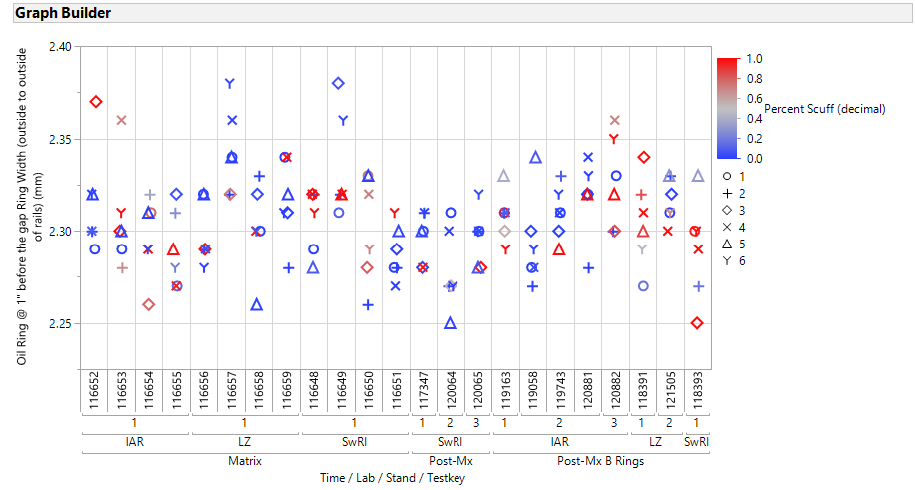

Slide 34
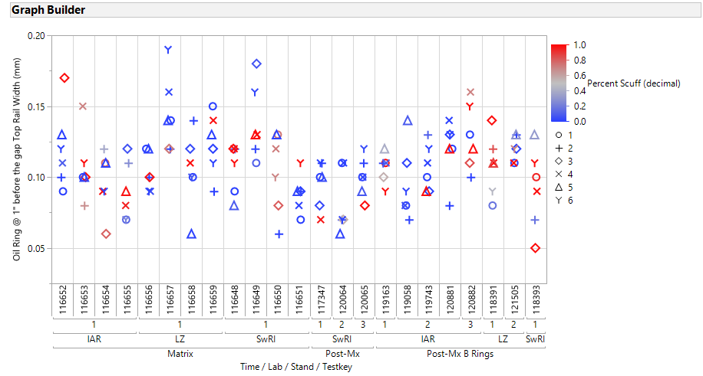

Slide 35
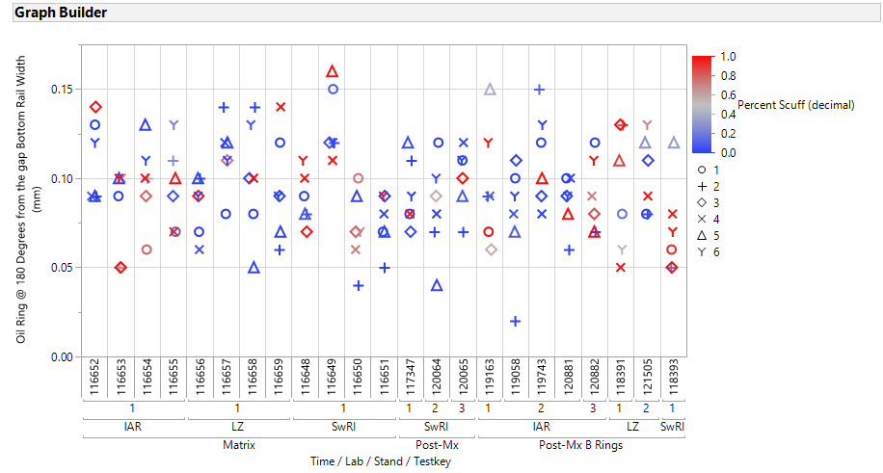

Slide 36
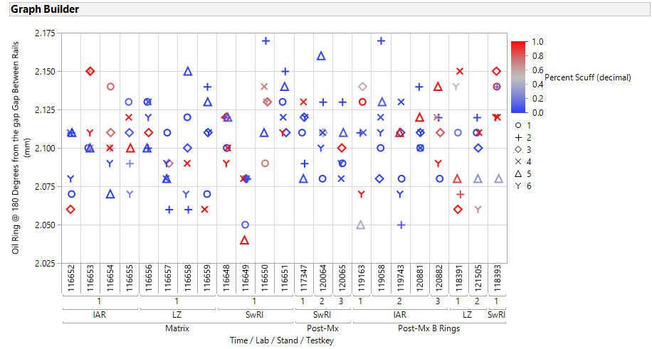

Slide 37
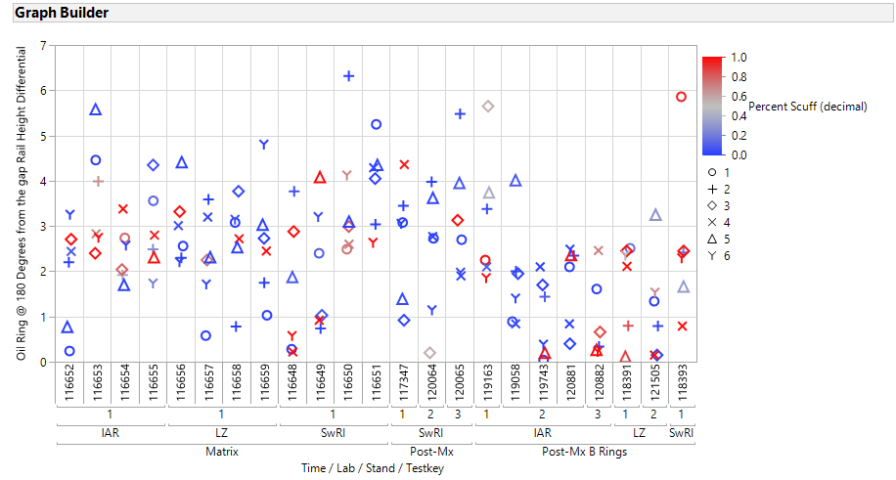

Slide 38
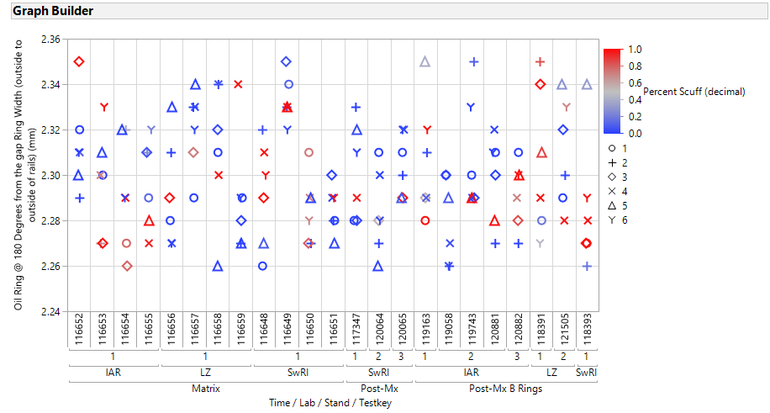

Slide 39
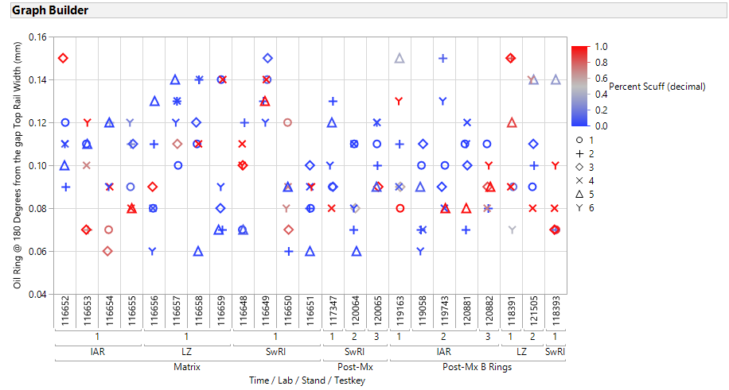

Slide 40
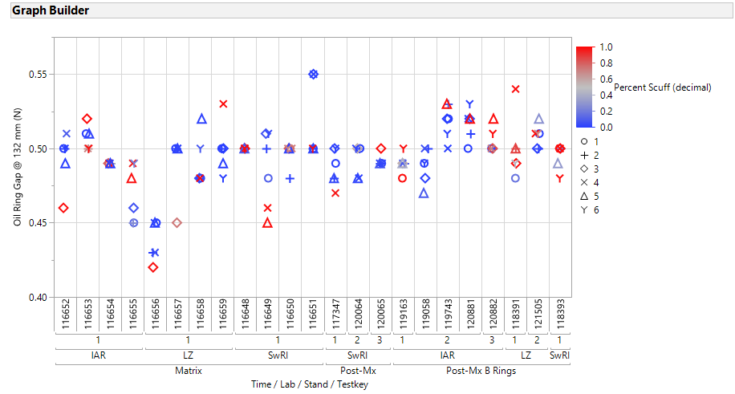

Slide 41
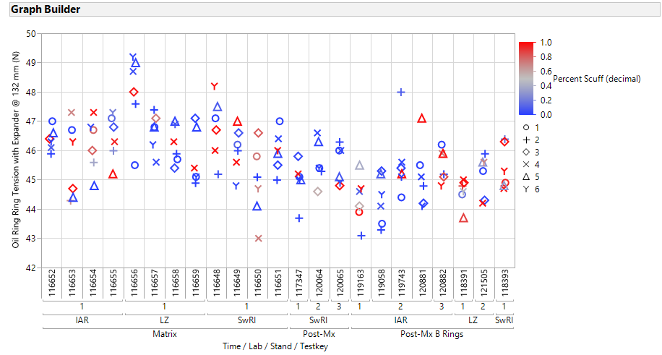

Slide 42
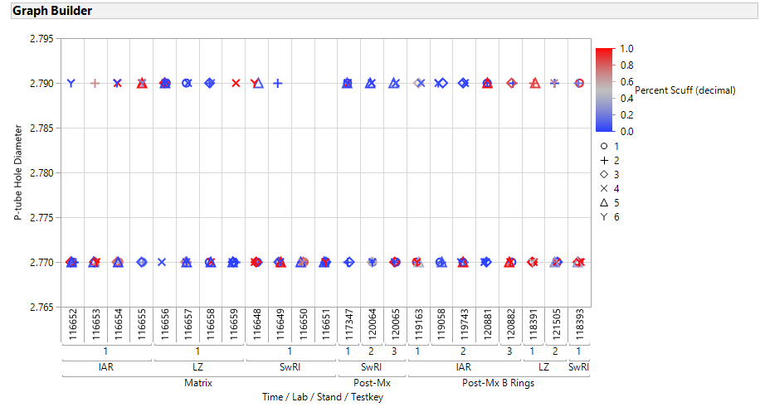

Slide 43
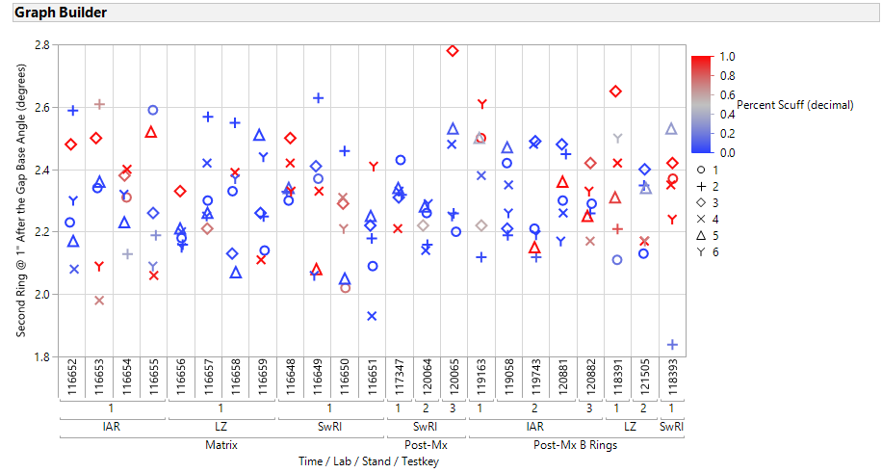

Slide 44
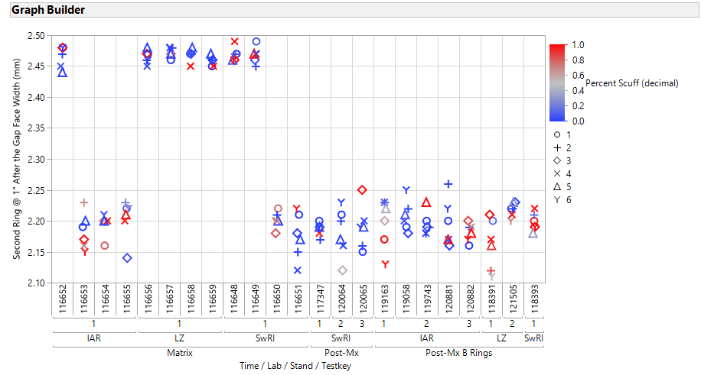

Slide 45
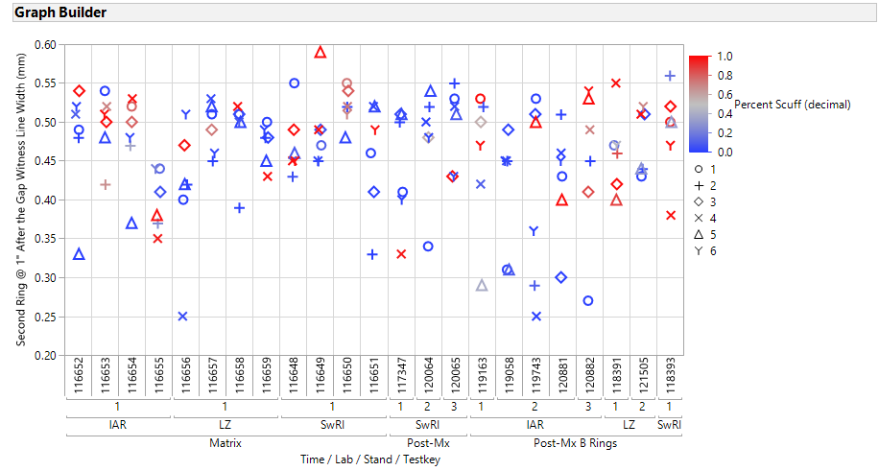

Slide 46
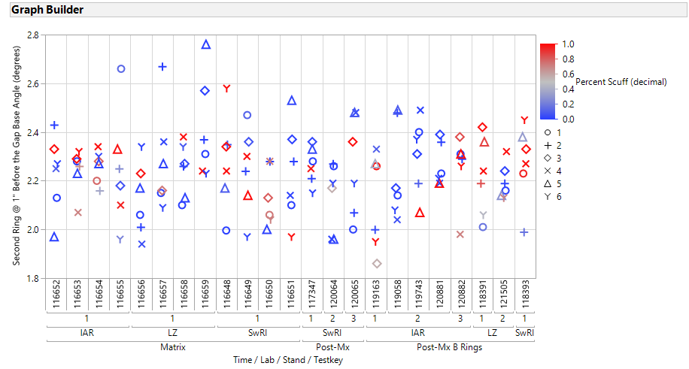

Slide 47
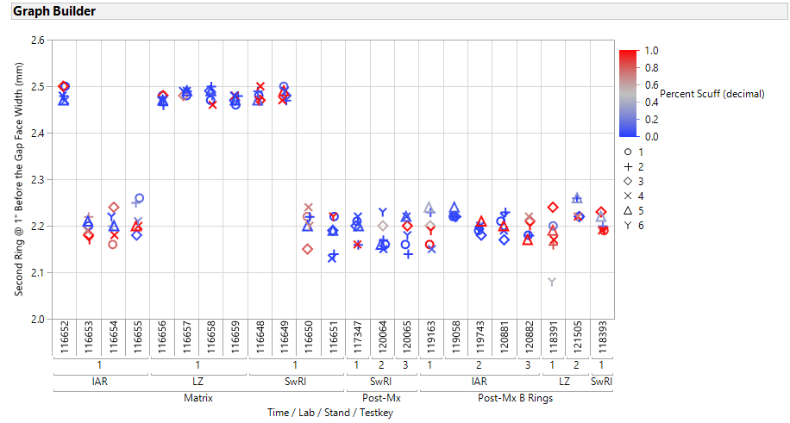

Slide 48
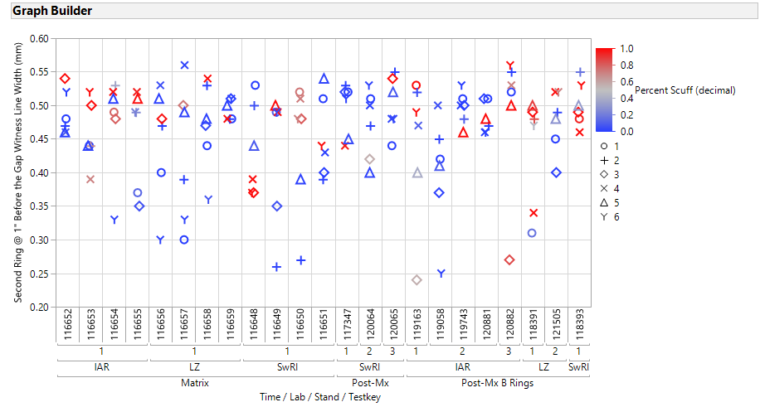

Slide 49
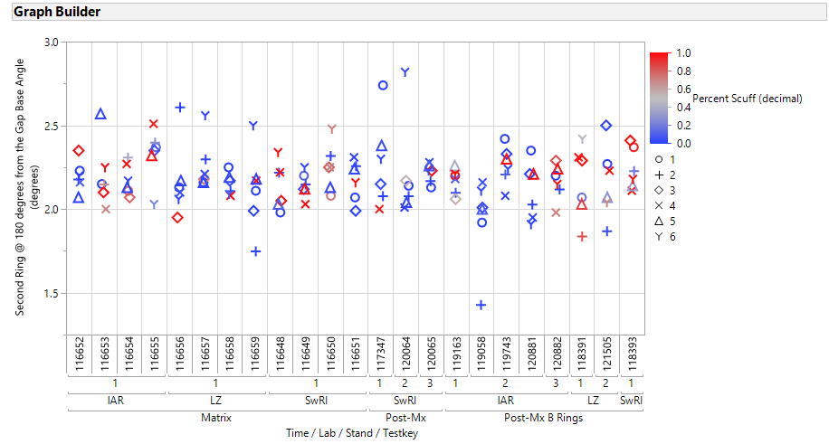

Slide 50
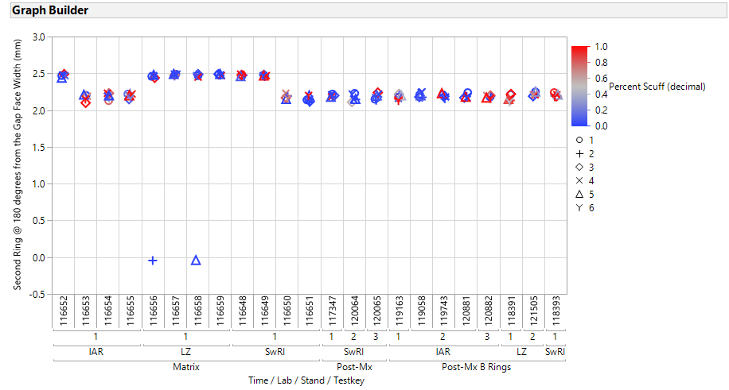

Slide 51
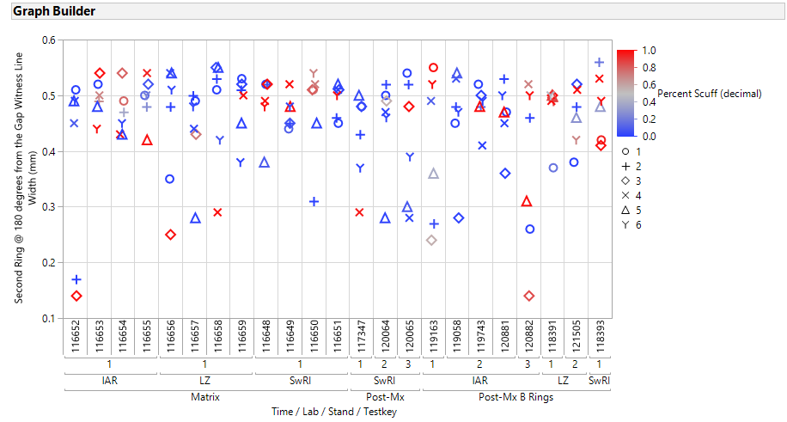

Slide 52
