Slide 1
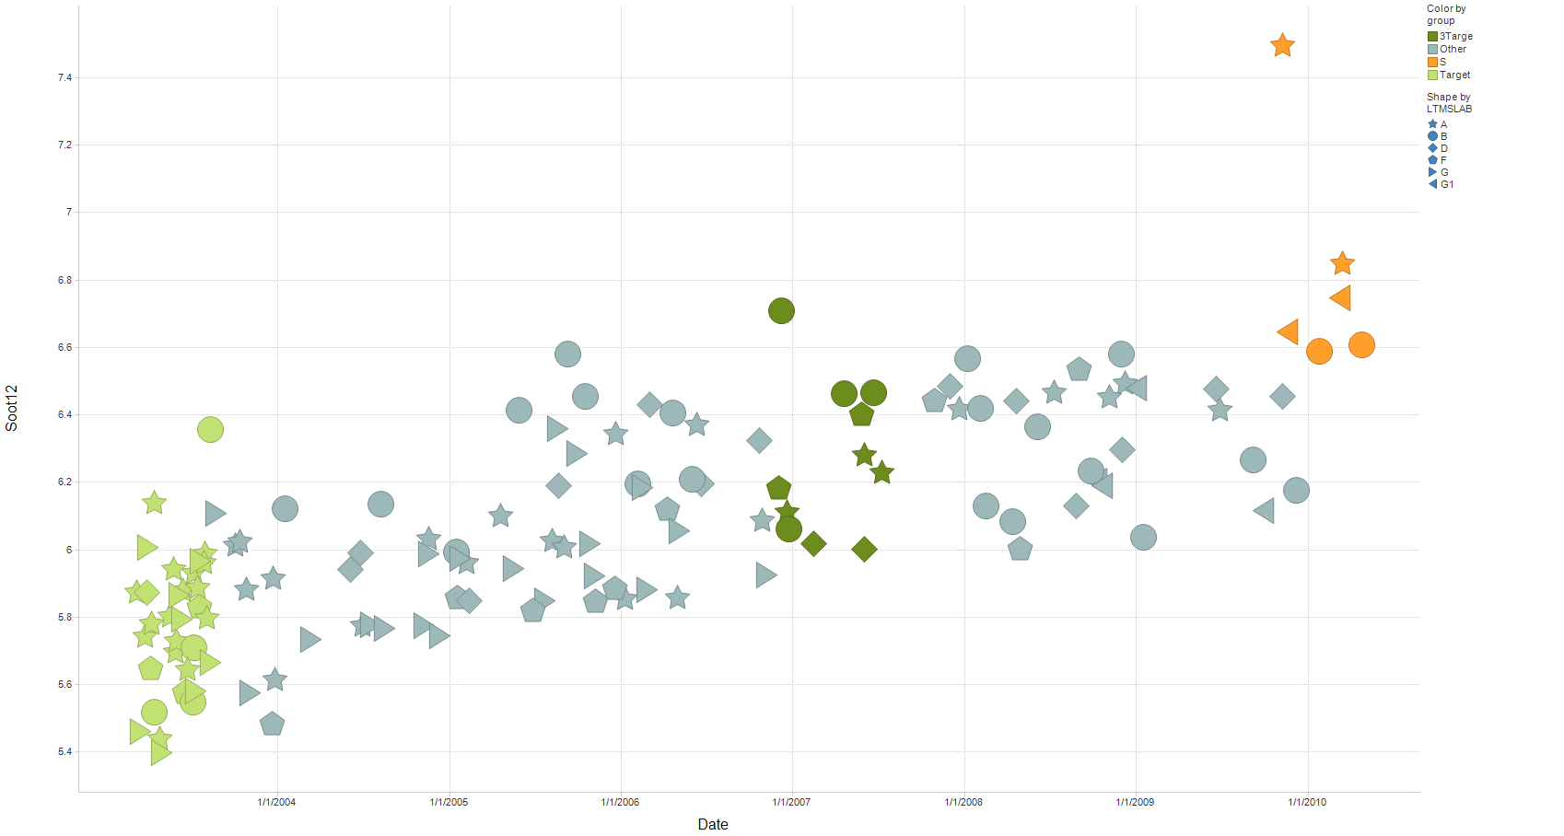
T-11 Soot@12 cSt versus date (all Oil 820 data)
ULSD runs
Mild trend in soot at 12 cSt (Iteration of slide by Jim Rutherford)

Slide 2
Last 2 T-11 reference tests at Intertek and Lubrizol, plus T-11E runs

Slide 3
Last 2 T-11 reference tests at Intertek and Lubrizol, plus T-11E runs

Slide 4
Last 2 T-11 reference tests at Intertek and Lubrizol, plus T-11E runs

Slide 5
EOT TBN may show an bit of an upward trend overall

Slide 6
Oil 820-3 from test count 91 forward

