Slide 1
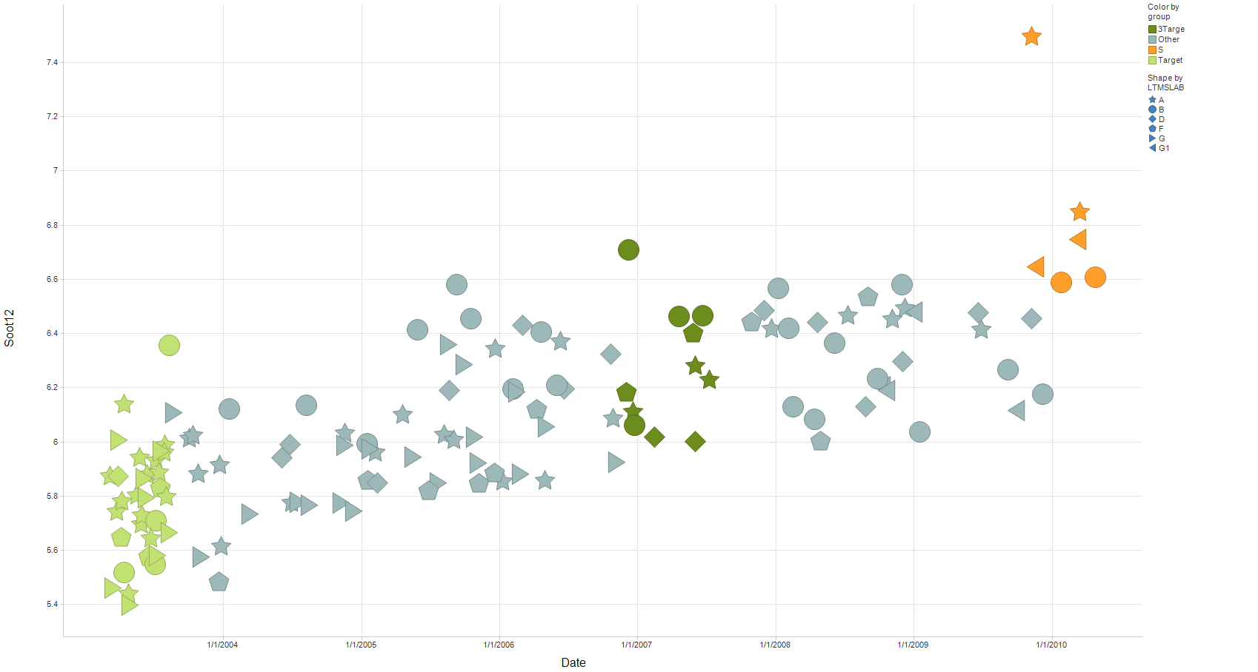
T-11 Soot@12 cSt versus date (all Oil 820 data)
ULSD runs
Afton pair
Mild trend in soot at 12 cSt (Iteration of slide by Jim Rutherford)

