Slide 1
New Liner and Ring Batch
Effects in the Mack T-12
Presented to Mack Surveillance Panel
Conference Call
20101103
Jim Rutherford

Slide 2
Summary
Pb (3 of 4) and Pb2 (2 of 4) higher with T batch rings
CLW dropped, not rings and liners – correction factor needed?
OC higher with T rings
Higher Fe with newer parts?
Different profiles?
No effect on MRV100

Slide 3
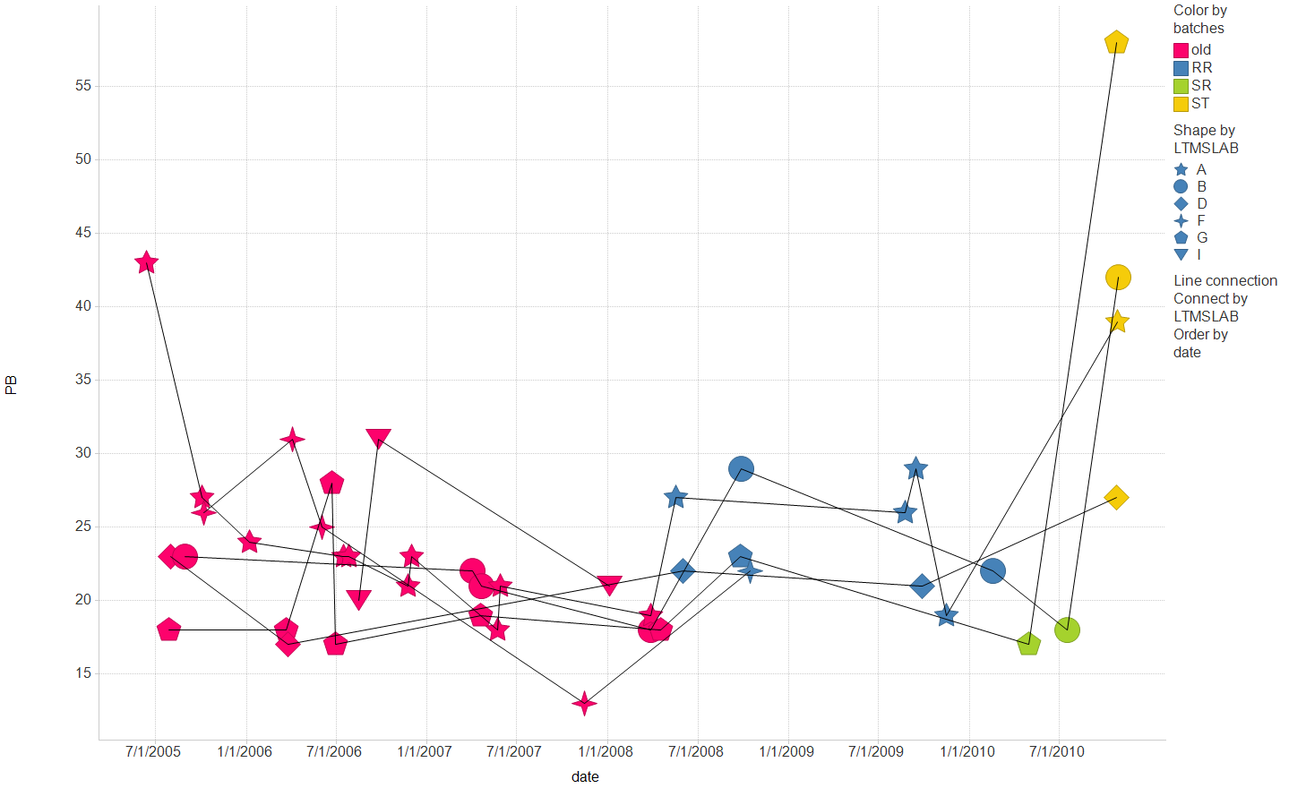
T12: Liner and Ring Batches
Pb higher

Slide 4
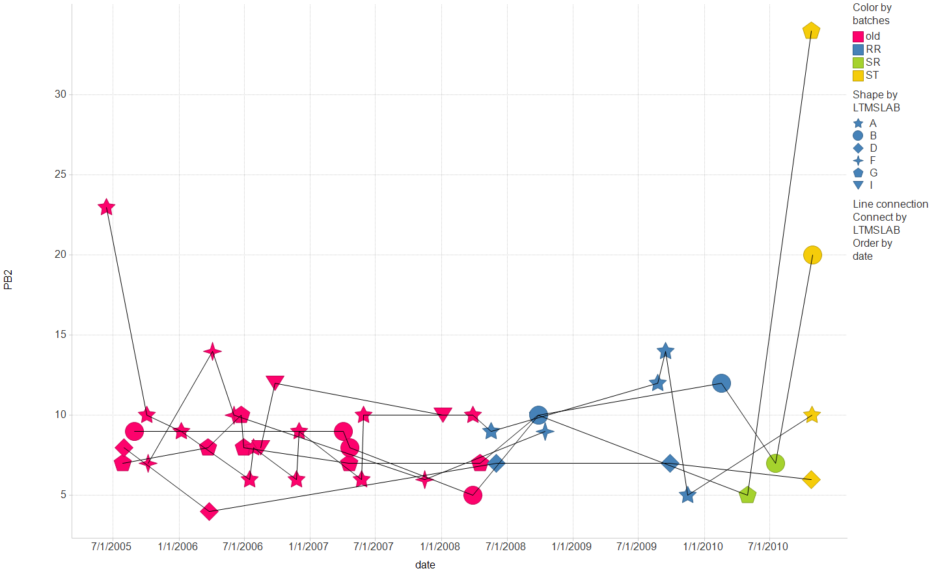
T12: Ring and Liner Batches
Pb2 higher

Slide 5
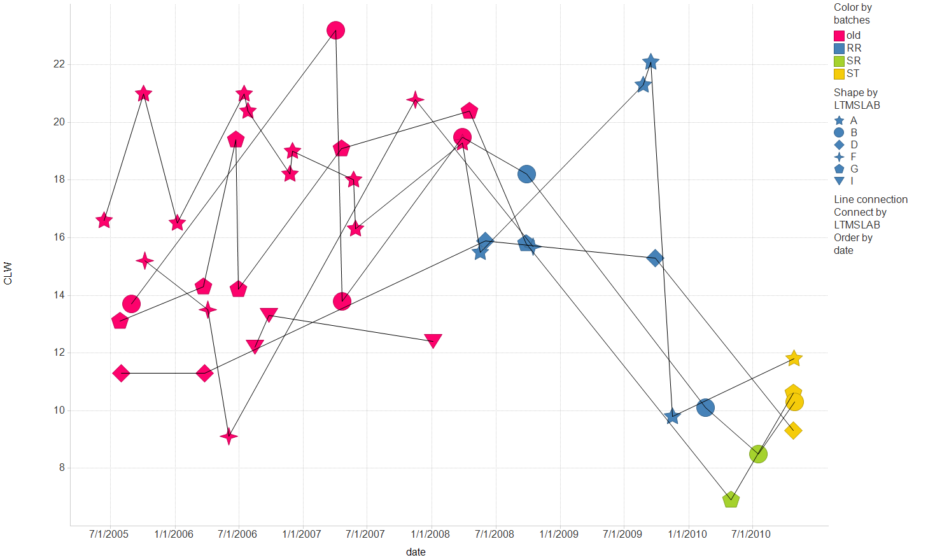
T12: Liner and Ring Batches
CLW dropped, not rings and liners.

Slide 6
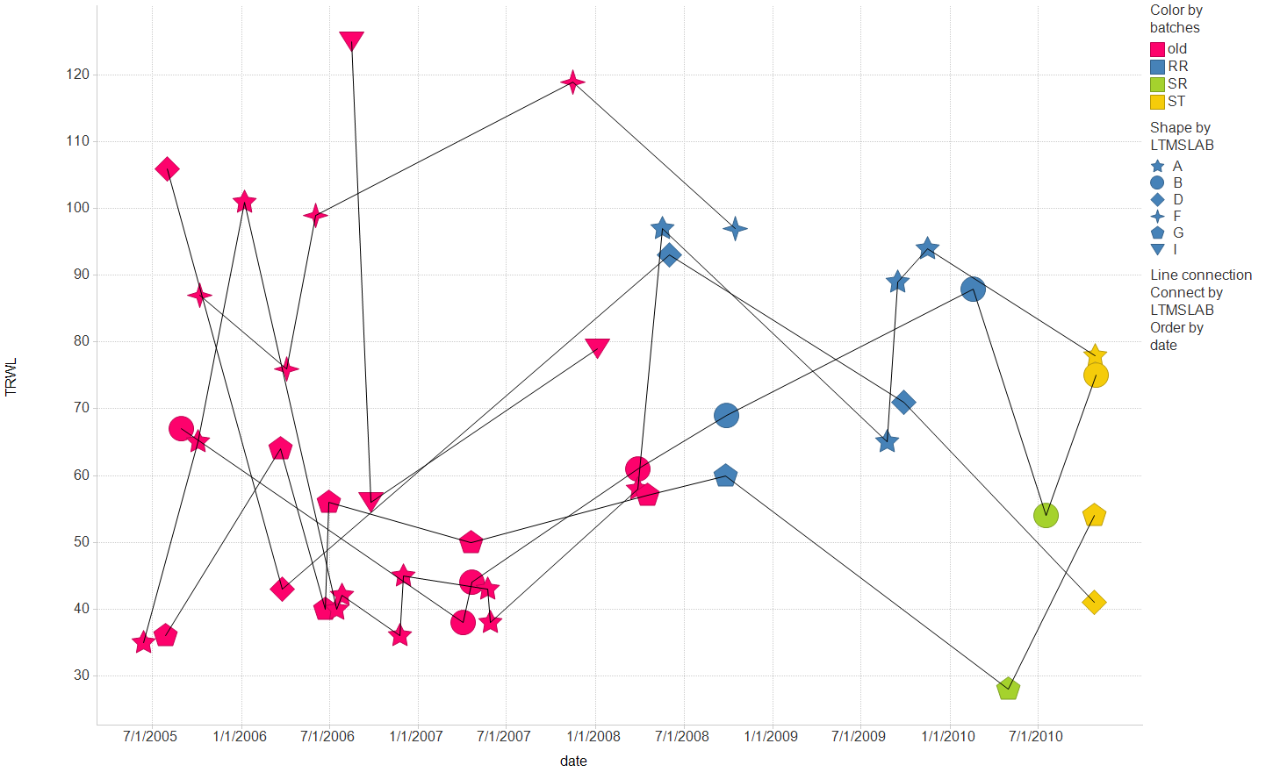
T12: Liner and Ring Batches
TRWL hard to tell

Slide 7
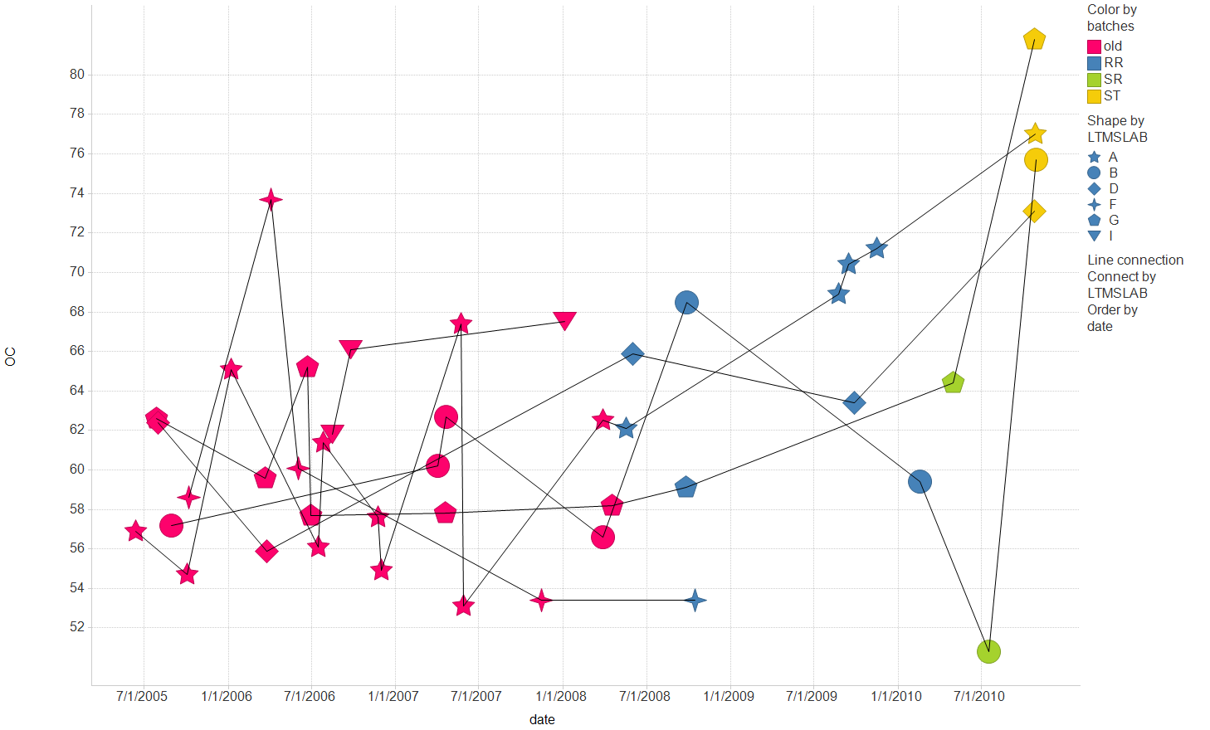
T12: Liner and Ring Batches
OC higher with T rings

Slide 8
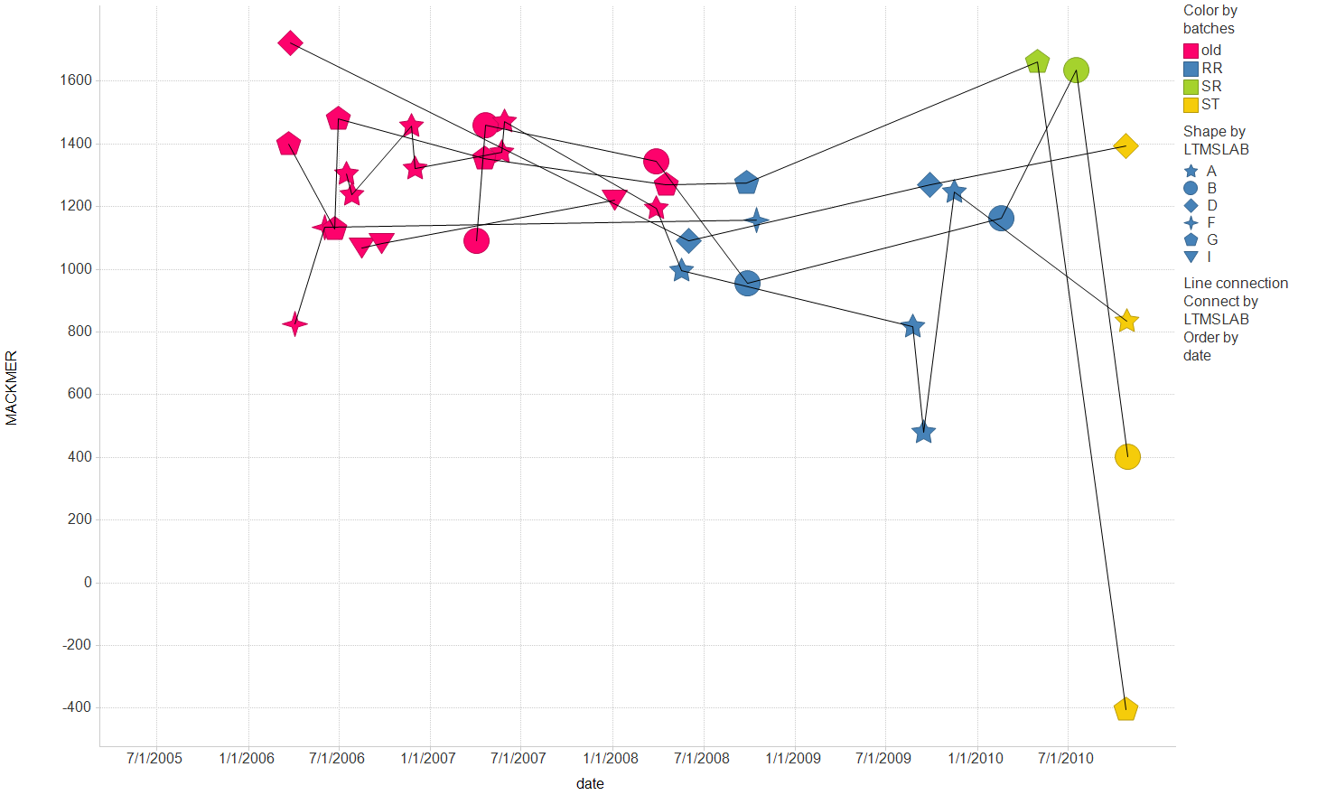
T12: Liner and Ring Batches
Mack merits lower?

Slide 9
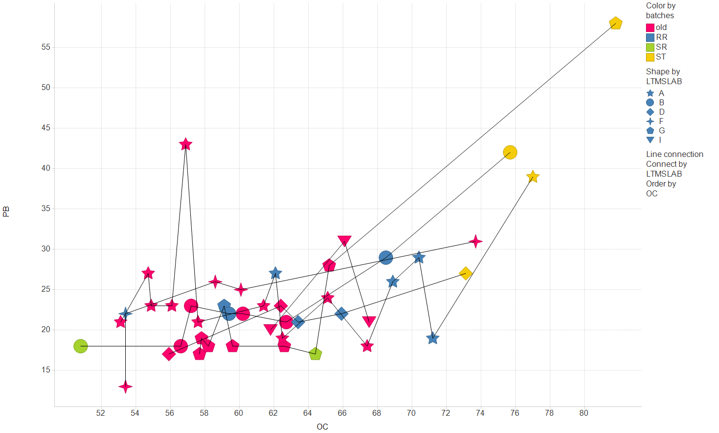
T12: Liner and Ring Batches
Higher Pb function of OC?

Slide 10
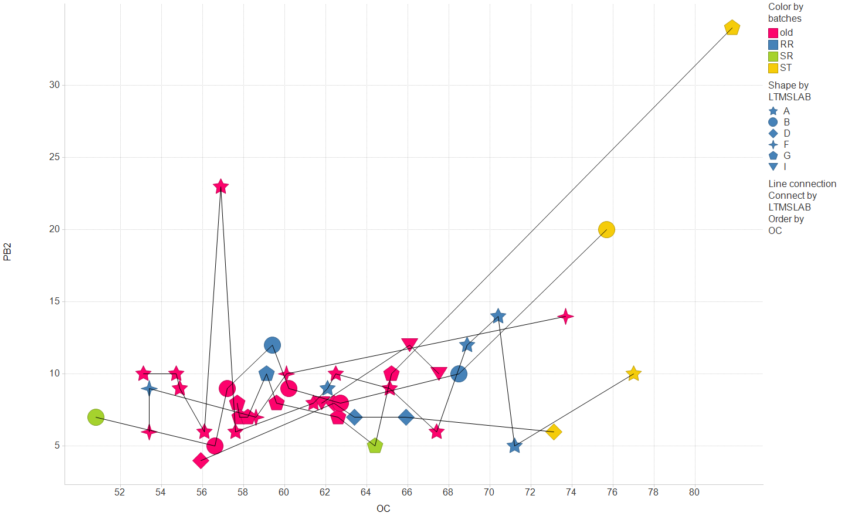
T12: Liner and Ring Batches
Higher Pb2 function of OC?

Slide 11
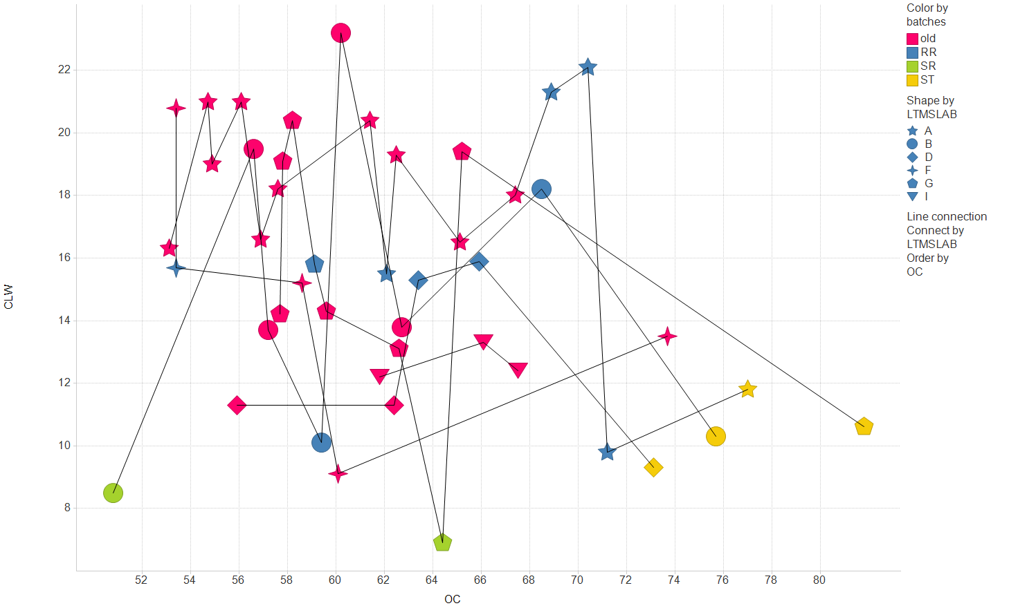
T12: Liner and Ring Batches

Slide 12
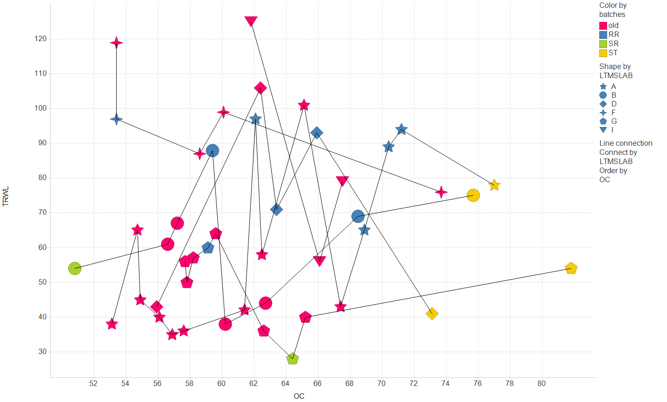
T12: Liner and Ring Batches

Slide 13
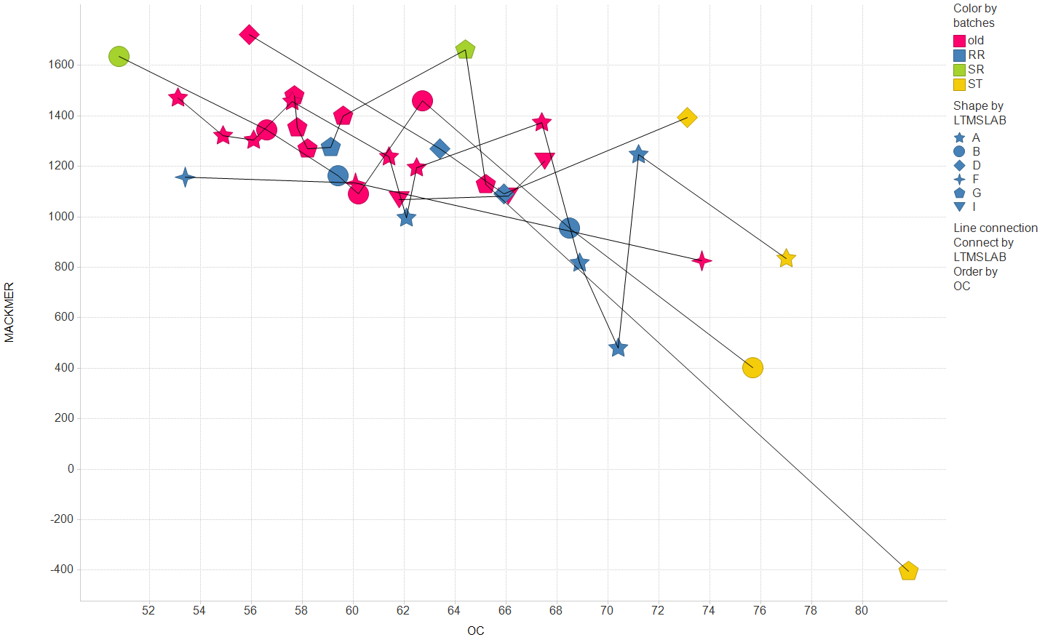
T12: Liner and Ring Batches

Slide 14
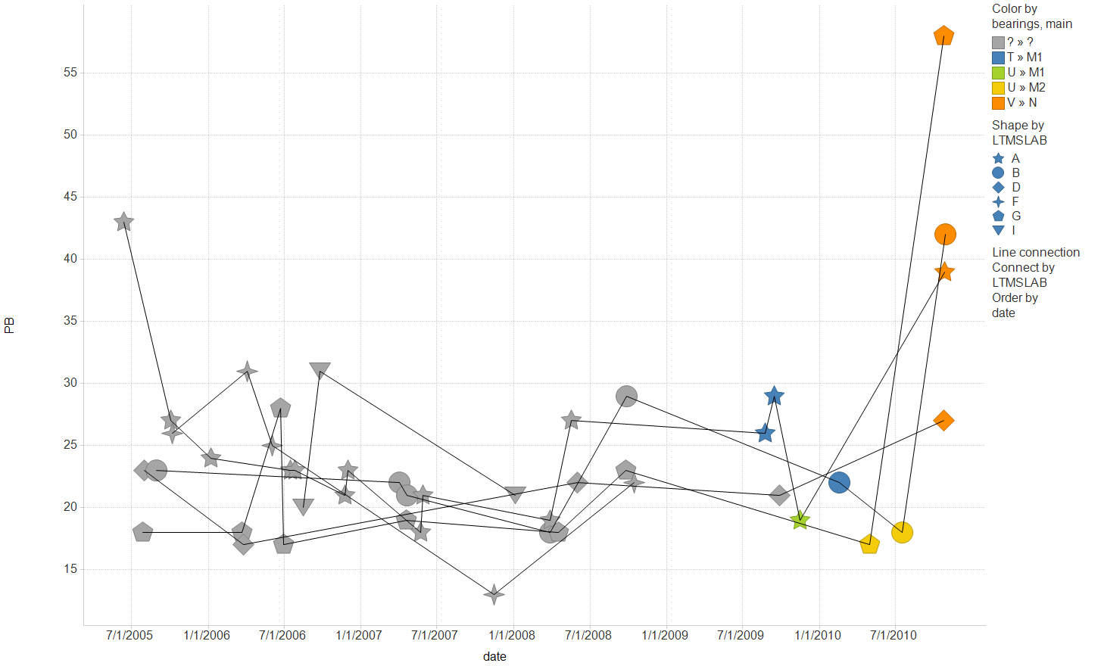
T12: Bearing and Main Batches

Slide 15
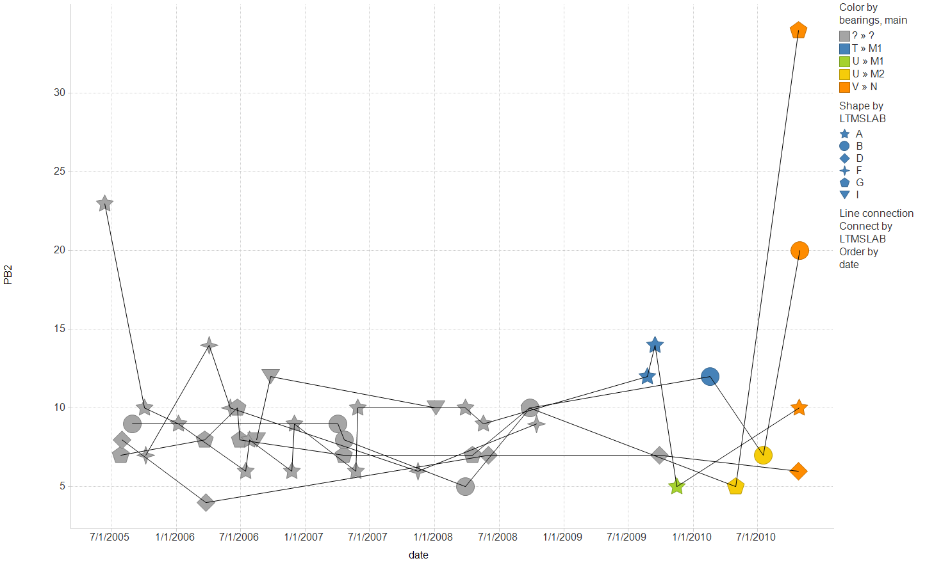
T12: Bearing and Main Batches

Slide 16
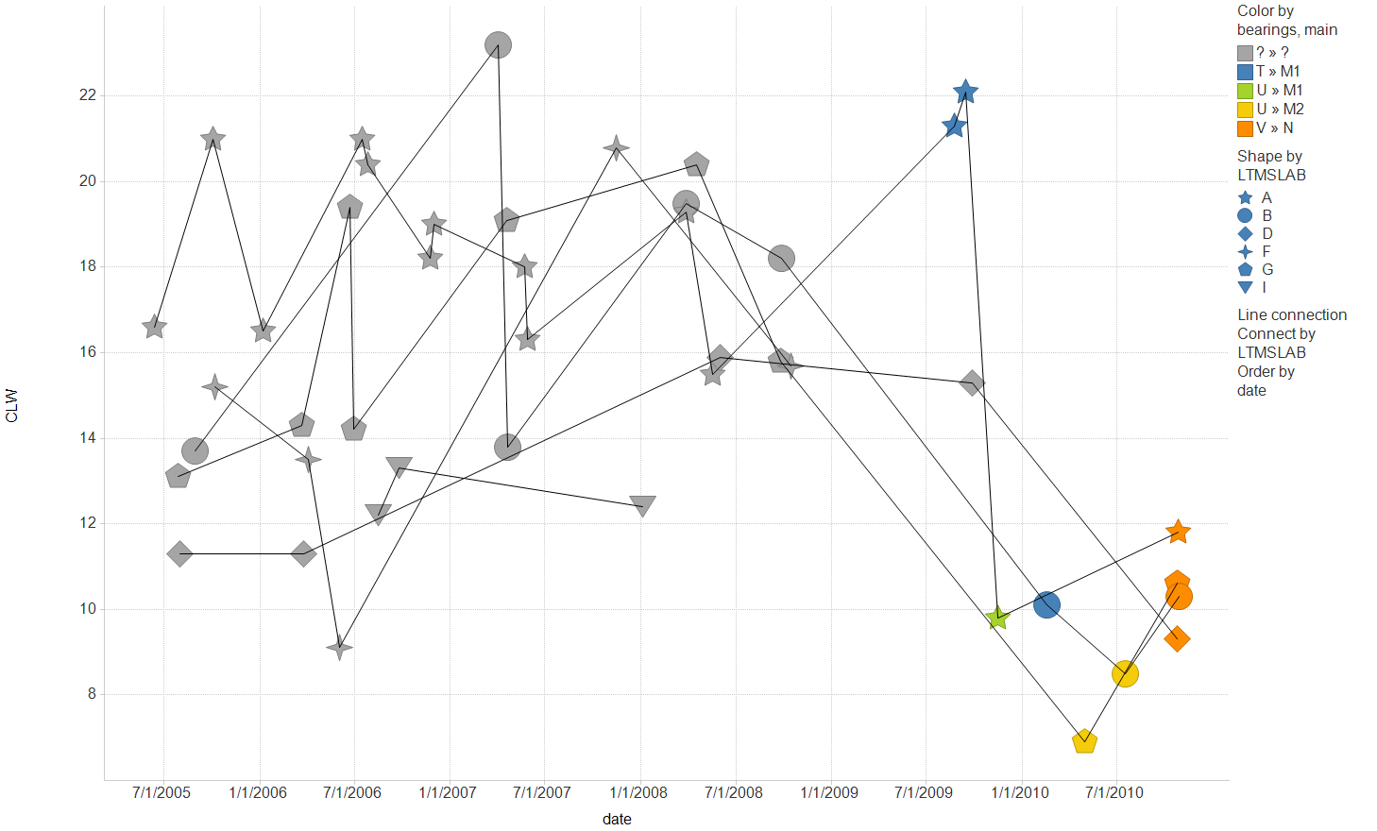
T12: Bearing and Main Batches

Slide 17
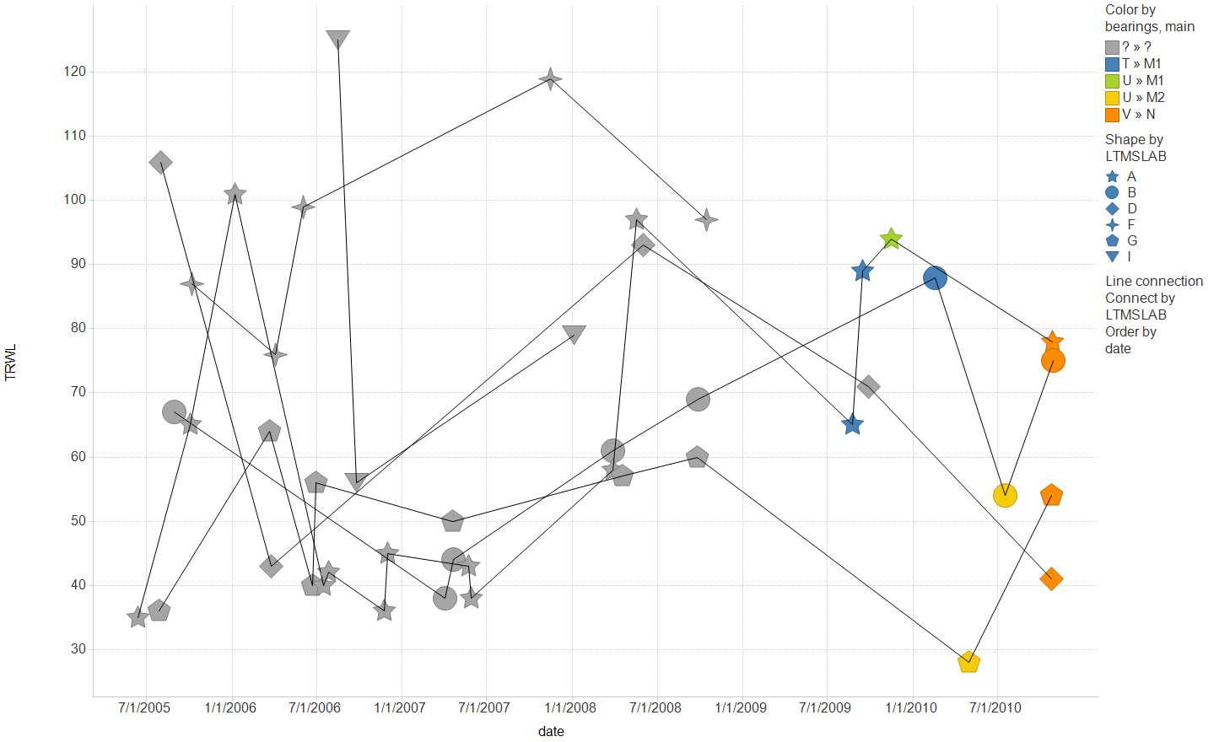
T12: Bearing and Main Batches

Slide 18
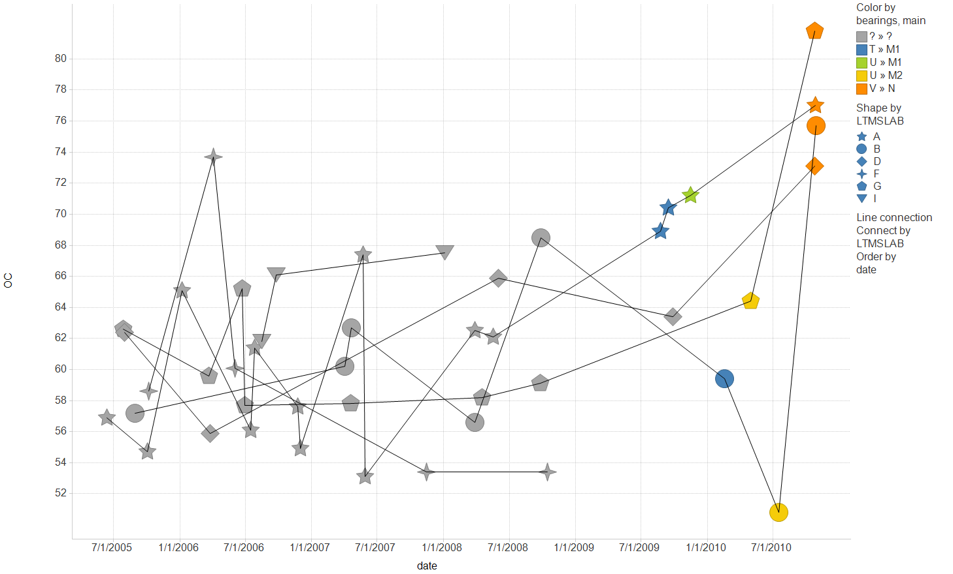
T12: Bearing and Main Batches

Slide 19
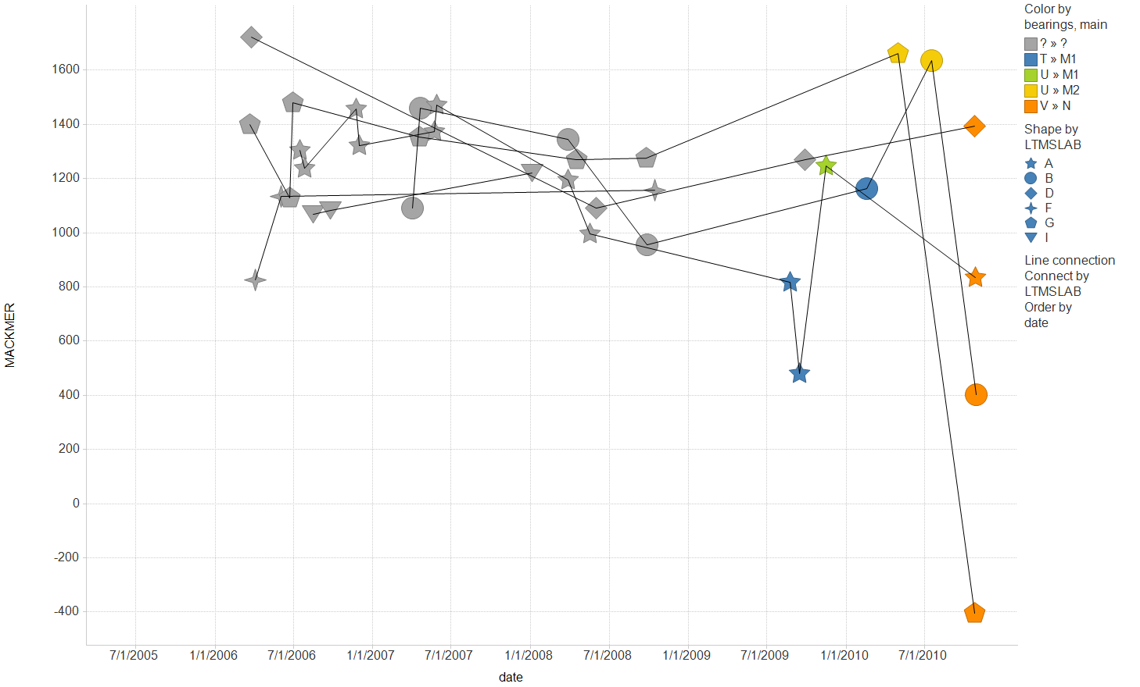
T12: Bearing and Main Batches

Slide 20
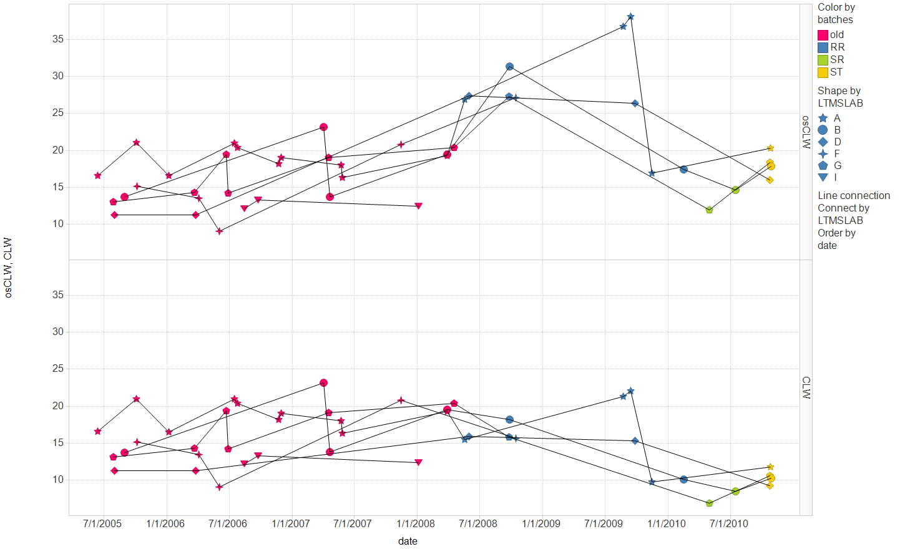
T12: Liner and Ring Batches
The correction factor (osCLW x 0.58) was intended to
bring R batch rings back to target (16.2).

Slide 21
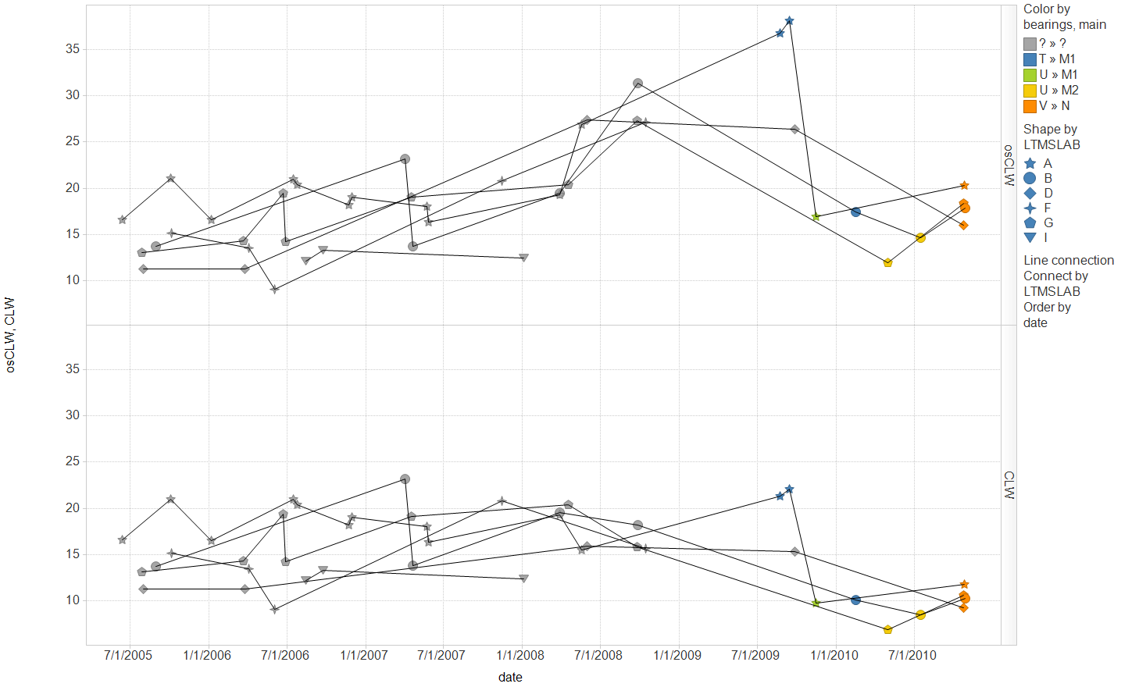
T12: Bearing and Main Batches
The correction factor (osCLW x 0.58) was intended to
bring R batch rings back to target (16.2).

Slide 22
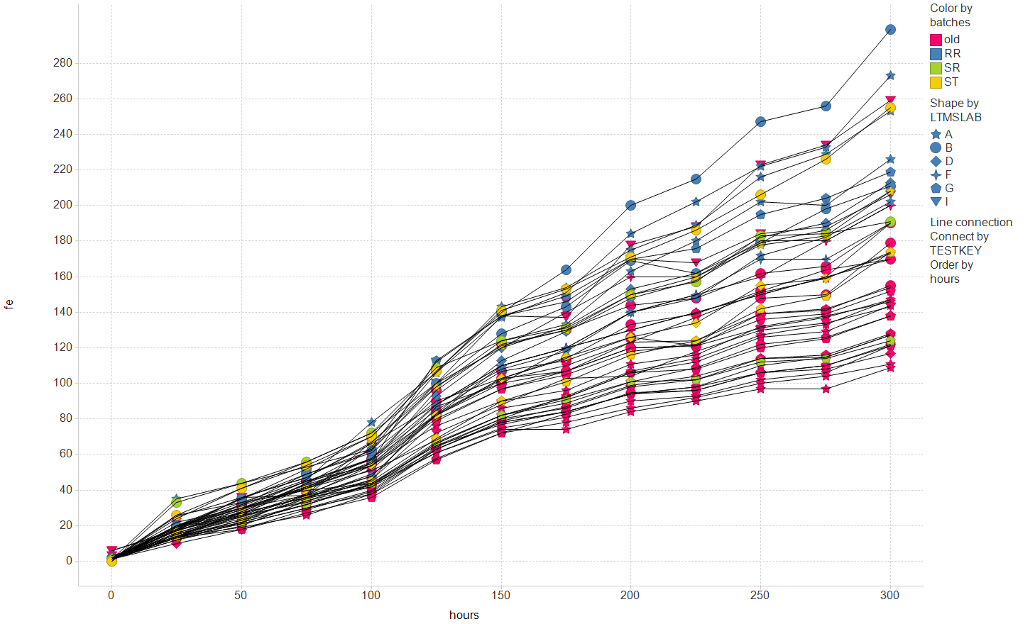
T12: Liner and Ring Batches
Higher Fe with newer parts?

Slide 23
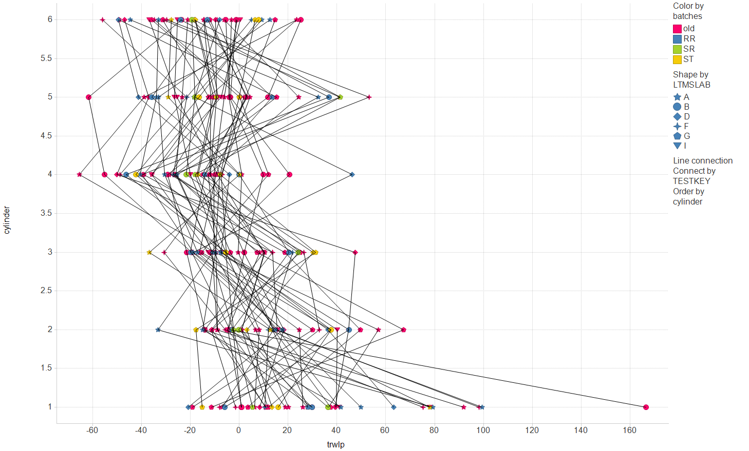
T12: Liner and Ring Batches

Slide 24
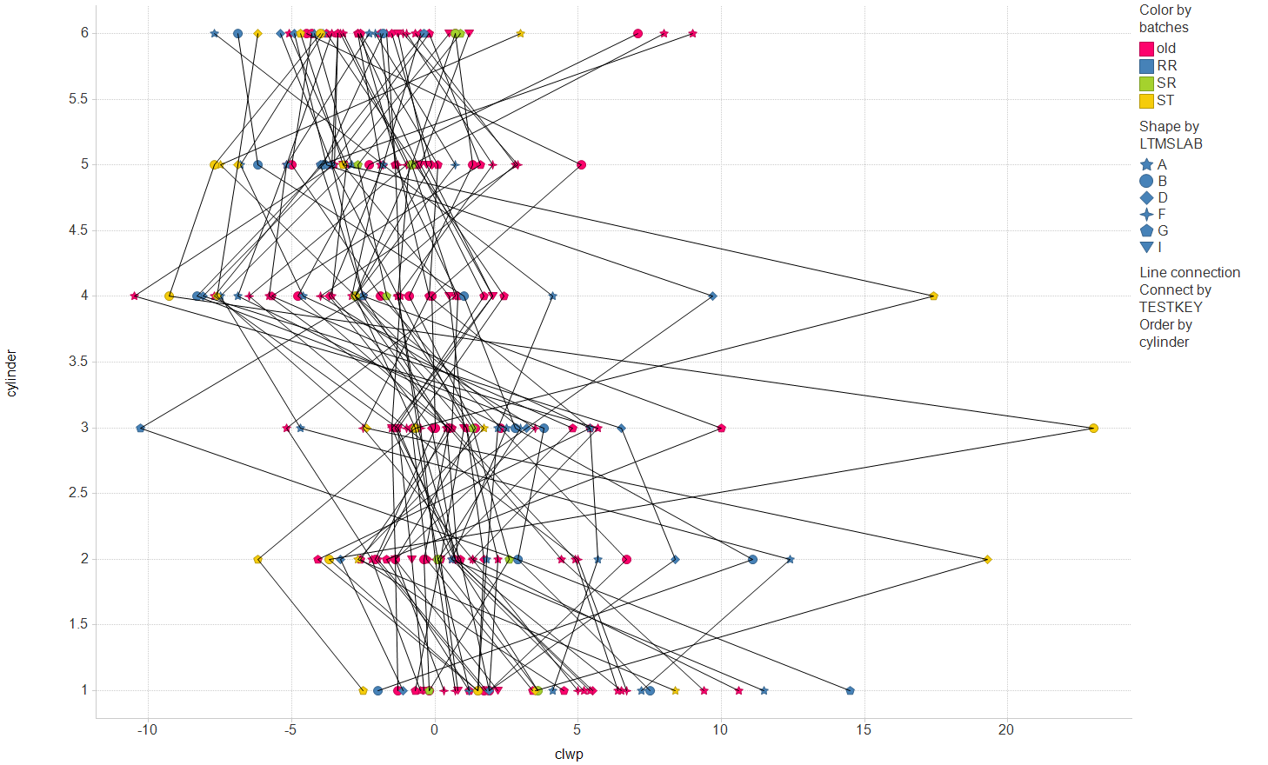
T12: Liner and Ring Batches

Slide 25
T12: Liner and Ring Batches
ST may be more consistent across
cylinders than historical batches

Slide 26
T12: Liner and Ring Batches
ST may be more extreme on cylinders 3 and 5 than historical batches

Slide 27
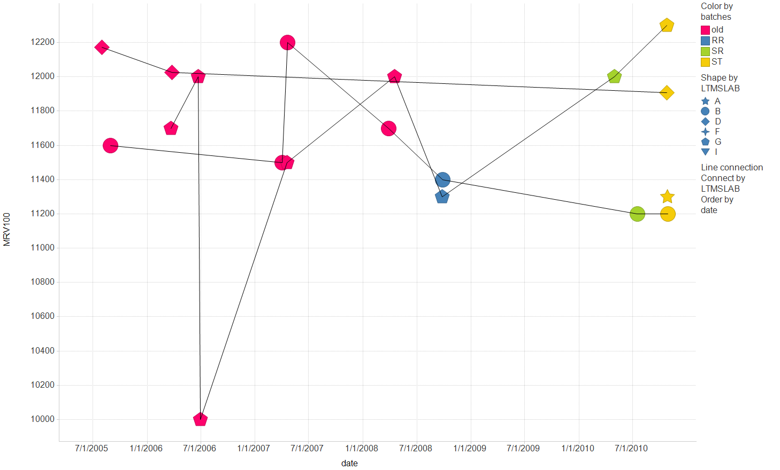
T12: Liner and Ring Batches

Slide 28
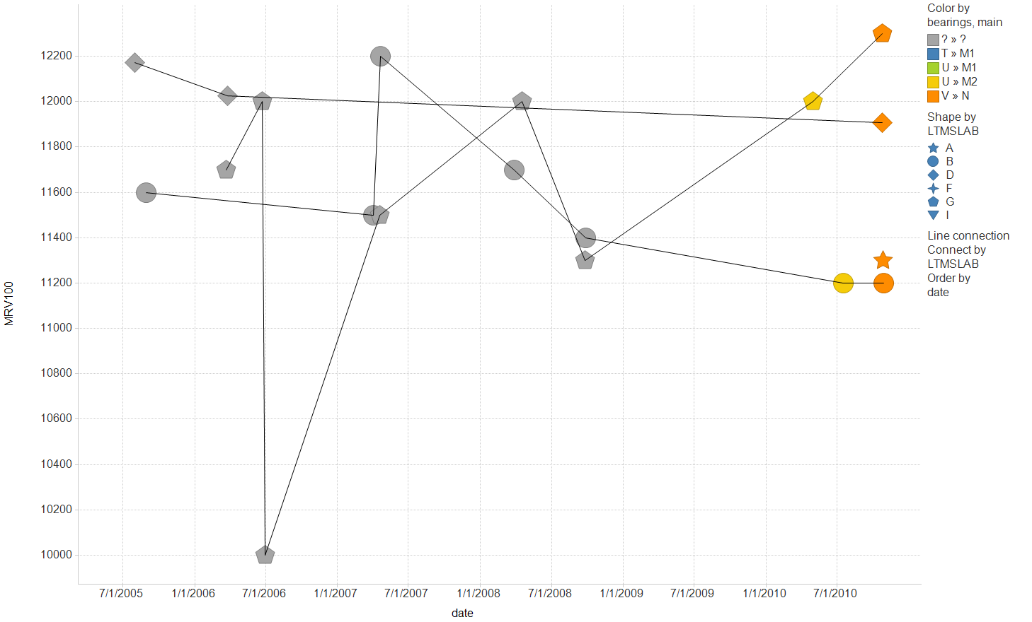
T12: Bearing and Main Batches

