Slide 1
Mack T-11
Ring and Fuel Batches and Correction Factors and Severity Adjustments
Presented to Mack Surveillance Panel
February 28, 2011 –
Revised March 10,2011 pp. 6, 11 ,12
Jim Rutherford

Slide 2
In the next two slides we might interpret that the T-11 had a big shift for the circled tests and now (the most recent 6 or 7 tests) are close to where we used to be. We could conclude that something was fixed and the correction factor is about right and we only need to eliminate the tests from when the test was out of control to make the severity adjustments appropriate.

Slide 3
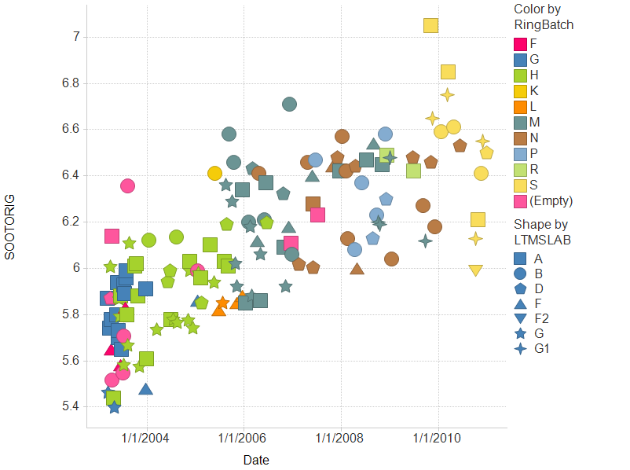

Slide 4
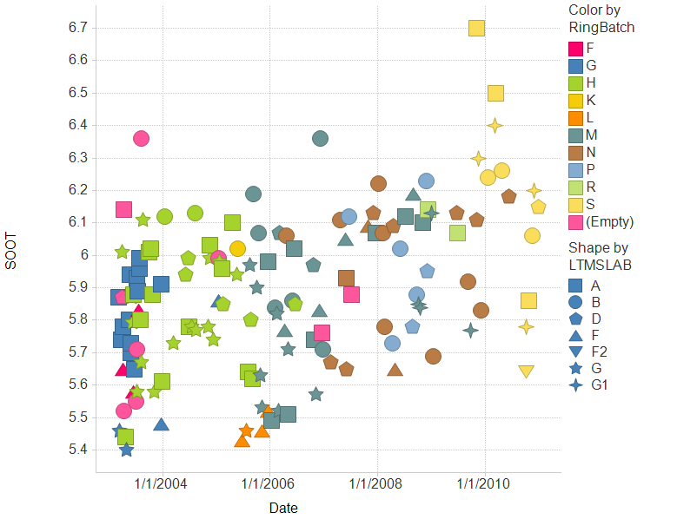

Slide 5
But what was fixed? We think the fuel. So if we could figure out which tests had out of control fuel, we could proceed. But we have had some inconsistencies in “fuel severity”, some ambiguities in fuel batch (and parts batch) designations in the dataset, and our best current understanding of fuel severity might not explain the fix. There is some lab, parts, time, and fuel batch confounding.

Slide 6
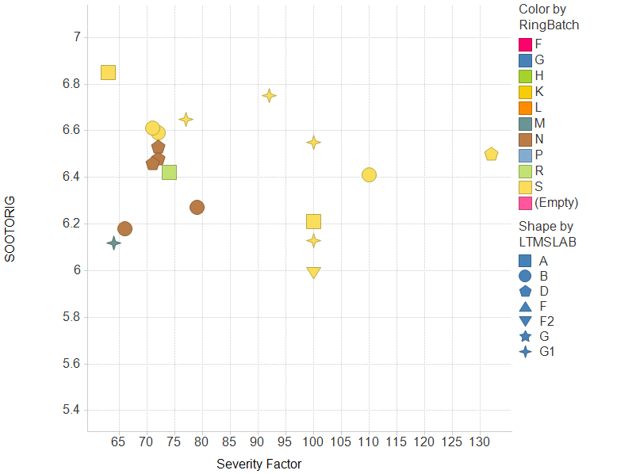

Slide 7
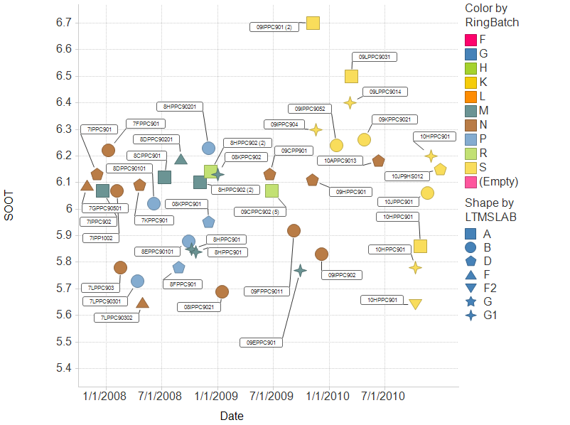

Slide 8
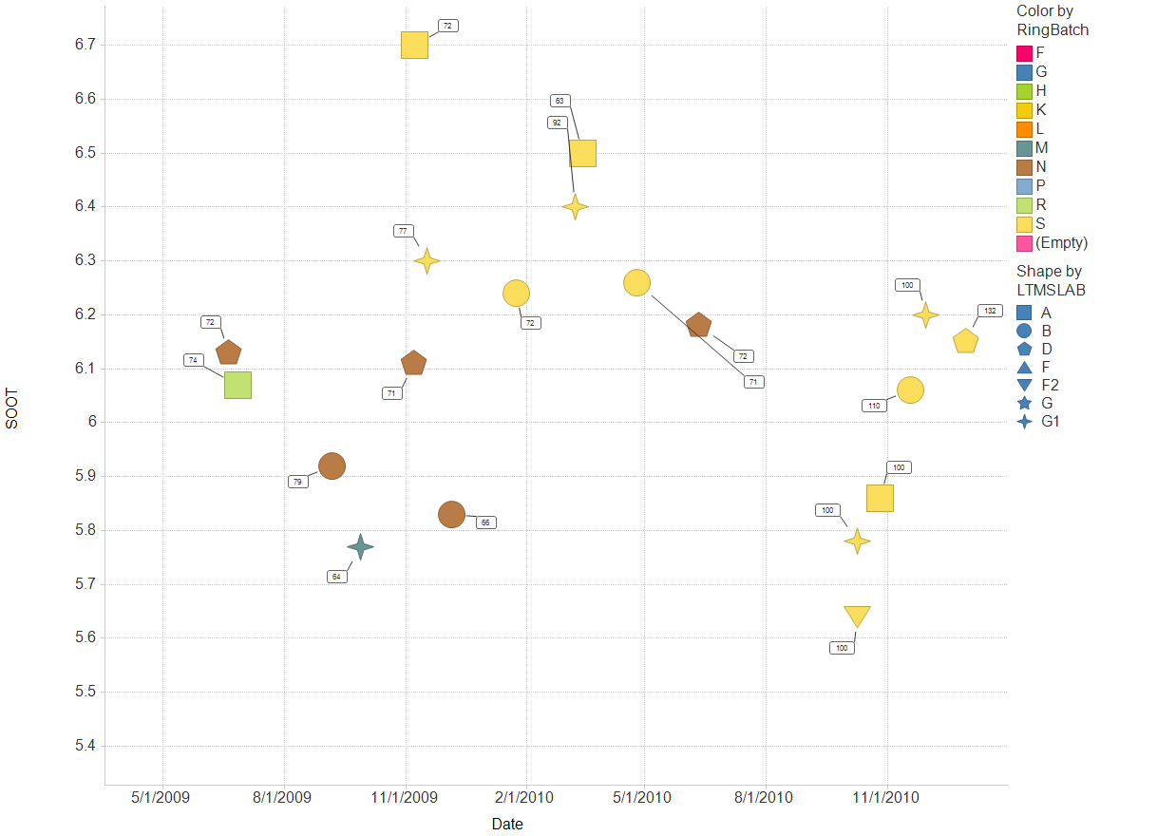
Labels are “fuel severity factors”.

Slide 9
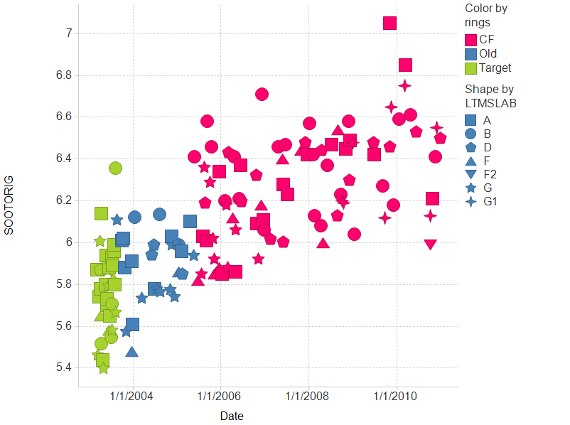

Slide 10
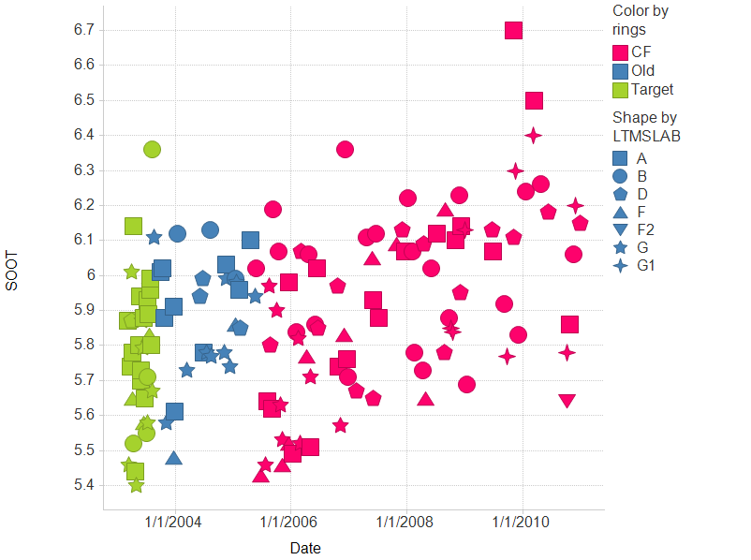

Slide 11
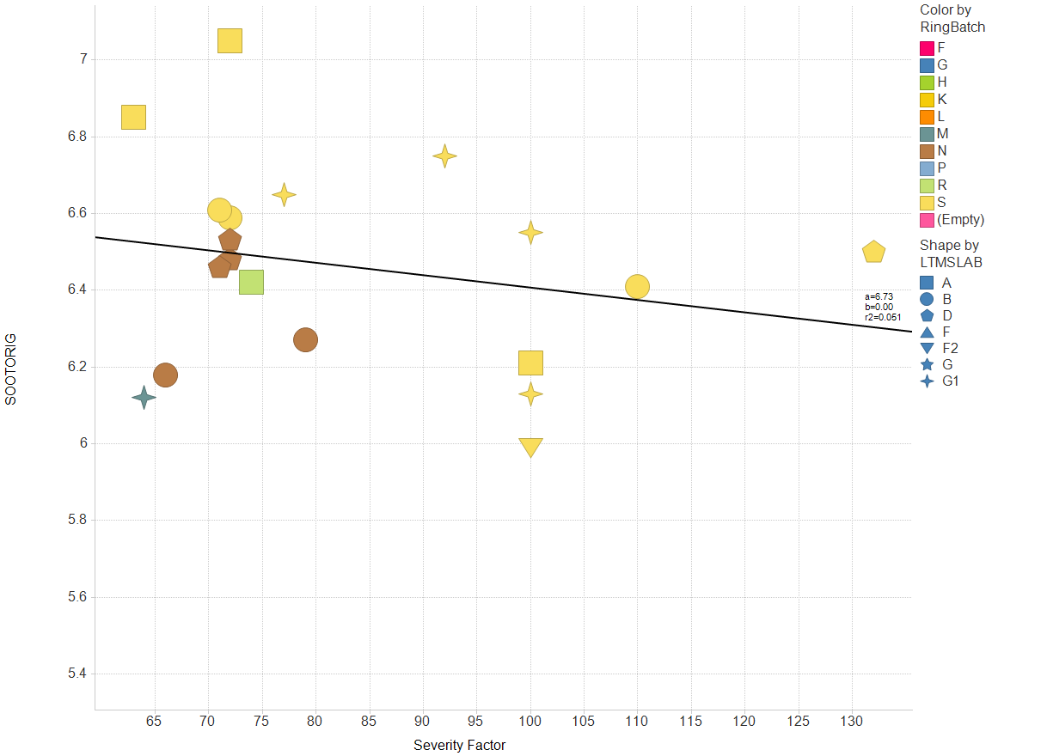

Slide 12
