Slide 1
Mack T-12 Reference Data Review
Jim Rutherford
April 2, 2011

Slide 2
Words
What happened to the test keys in the TMC dataset?
Zack and I did the best we could to identify parts batches associated with tests in the dataset. If labs swapped batches into kits, there could be errors in our designation. I am including the dataset in case you want to provide corrections.
I noticed an error I made in A7 of the procedure. RRPTRML_{cylinder} should be RPTRML_{cylinder} and RRPCLW_{cylinder} should be RPCLW_{cylinder}.
“11.6.3.1 Correction Factor for Average Cylinder Liner Wear—For all test (sic) using Batch R piston ring and cylinder liner hardware, multiply the average cylinder liner wear from 11.6.3 by 0.58 to get the final average cylinder liner wear result.”
I show original targets or ranges for 821. Didn’t have time to go back and find target period.
And now, the first batch of pictures …

Slide 3
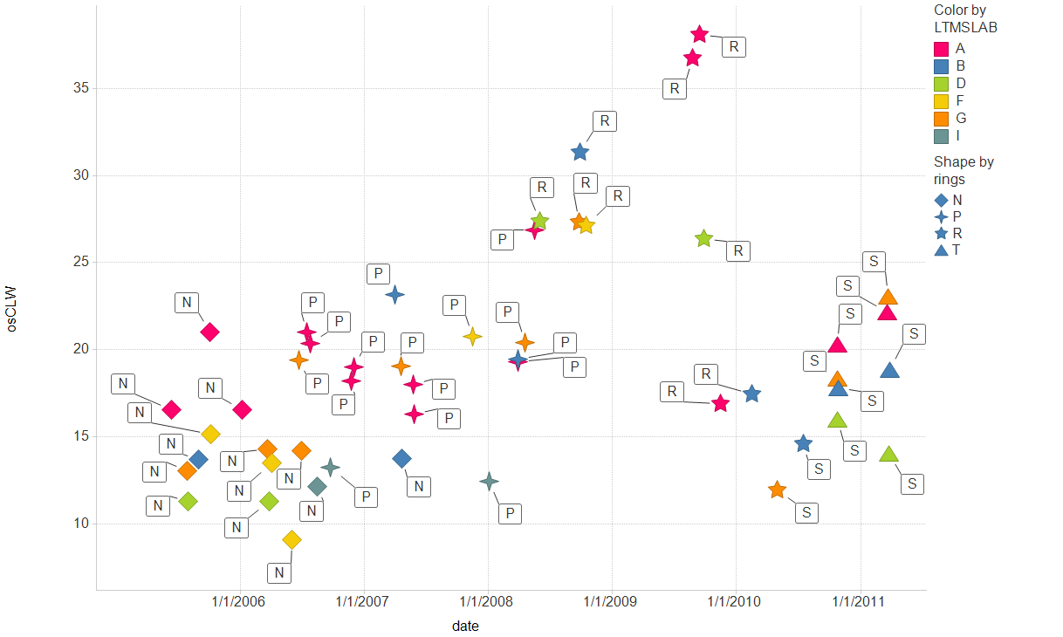
Outlier screened Cylinder Liner Wear
IND: ( 821-1 , 821)
Labels indicate liner batch

Slide 4
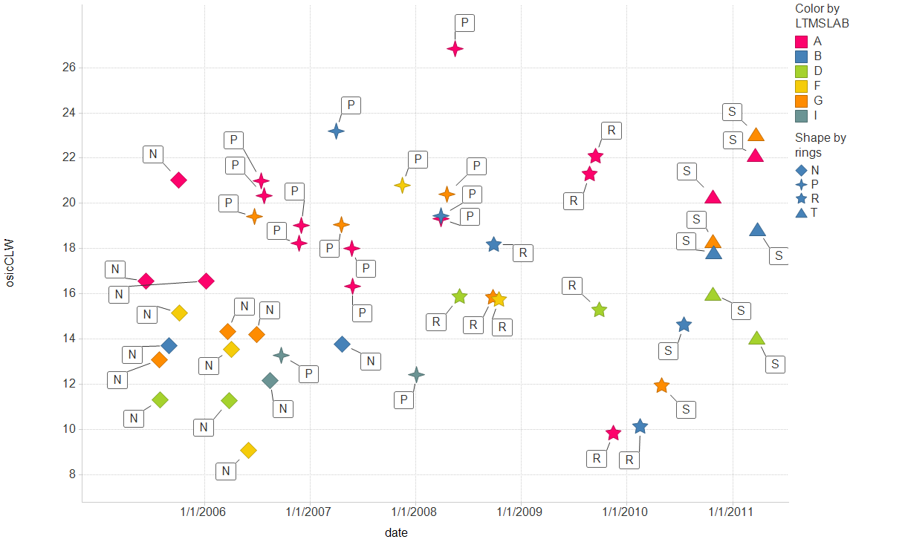
Outlier screened, industry corrected Cylinder Liner Wear
IND: ( 821-1 , 821)
Labels indicate liner batch

Slide 5
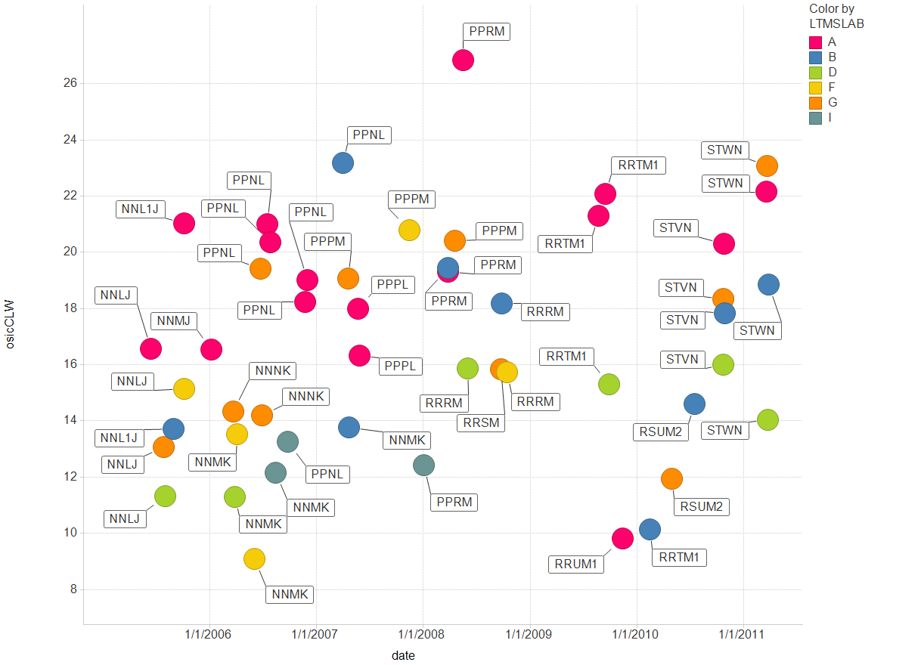
Outlier screened, industry corrected Cylinder Liner Wear
IND: ( 821-1 , 821)
Labels indicate batches for (liners, rings, rod bearings, main bearings)

Slide 6
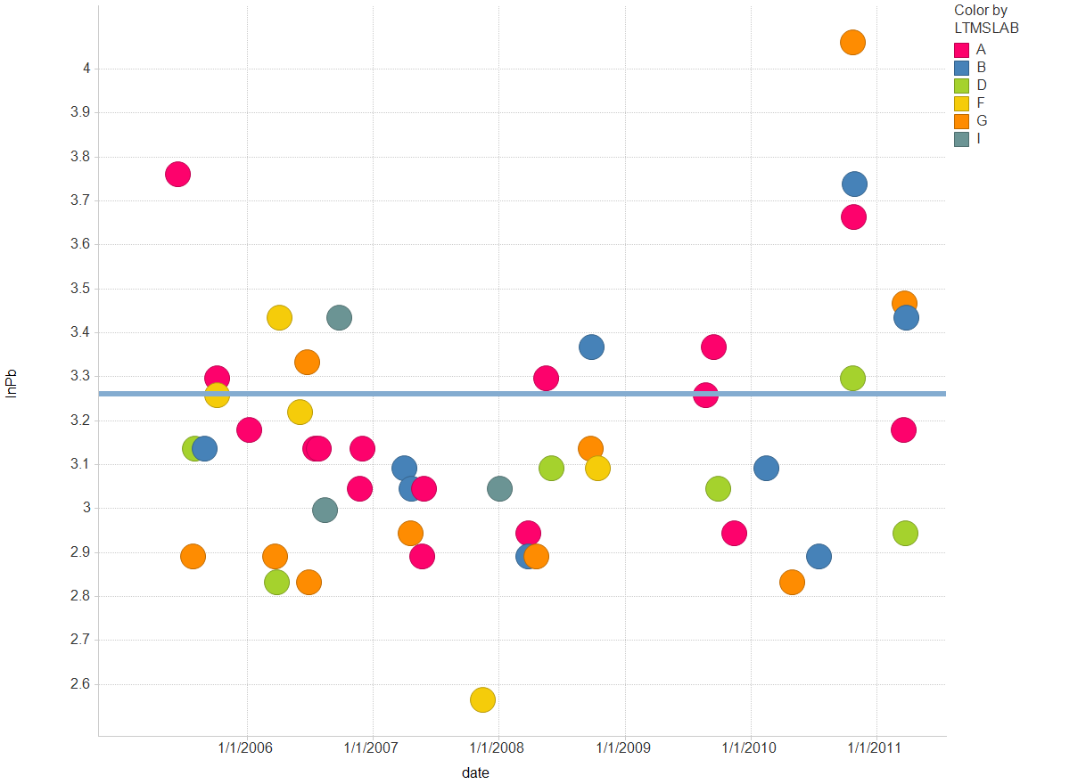
ln(Pb) IND: ( 821-1 , 821)

Slide 7
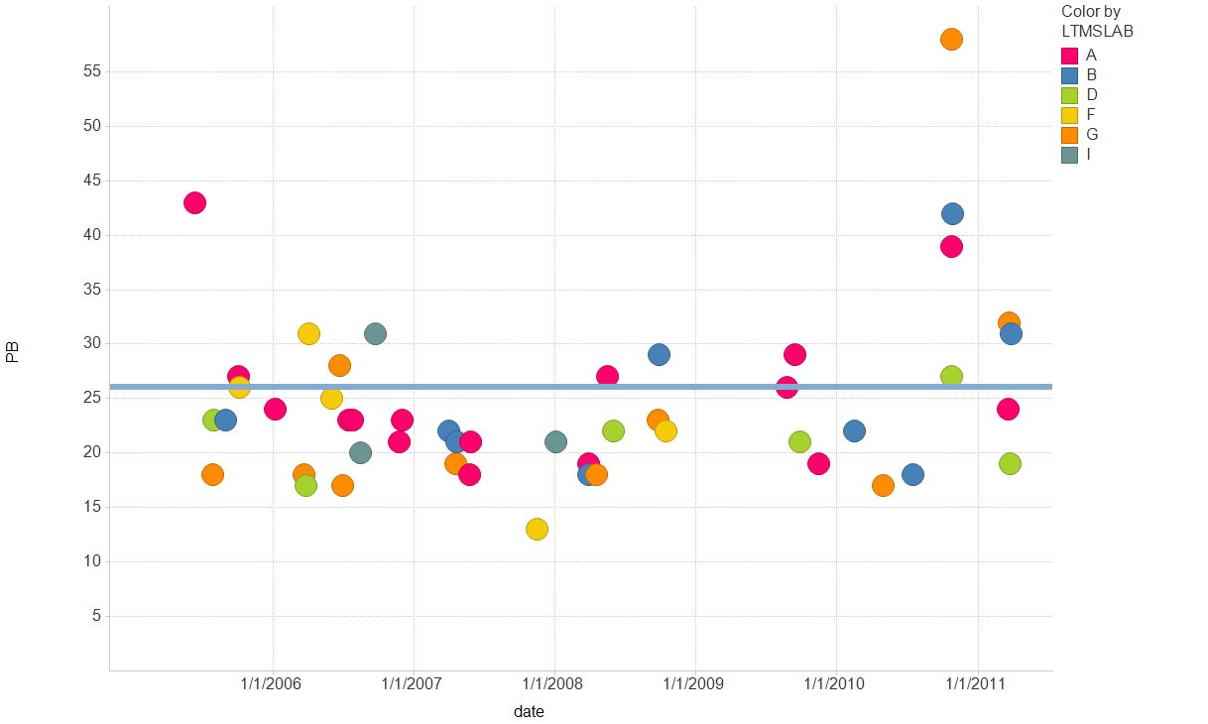
Pb IND: ( 821-1 , 821)

Slide 8
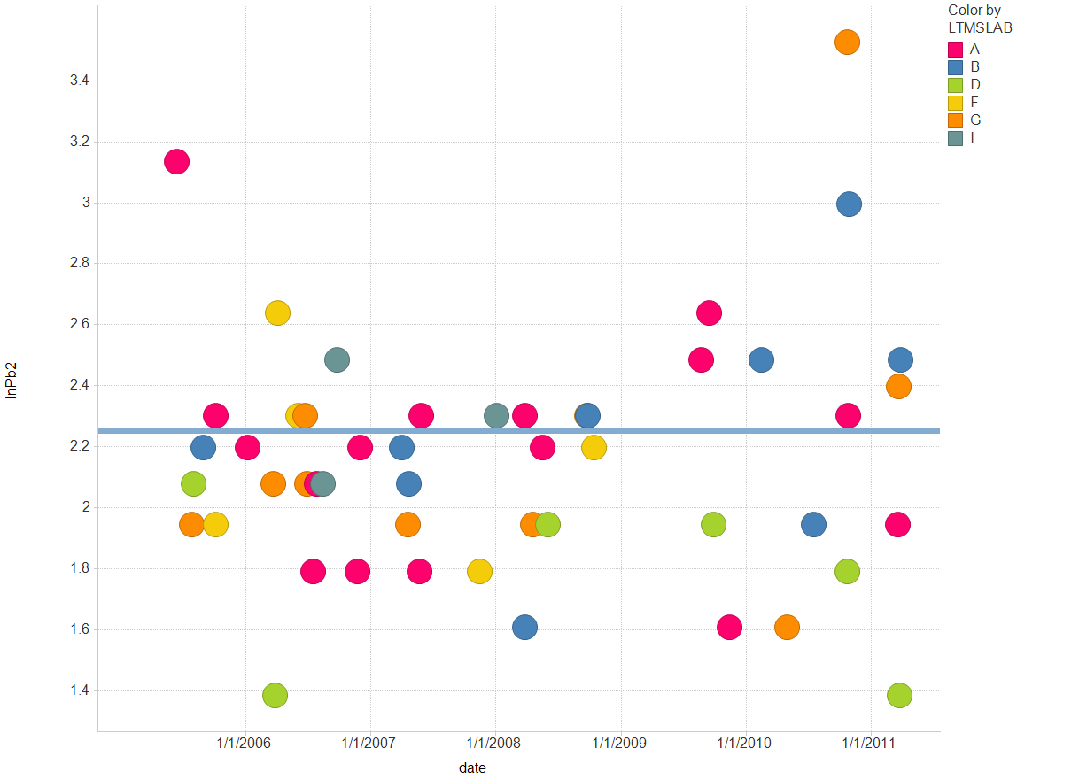
ln(Pb2) IND: ( 821-1 , 821)

Slide 9
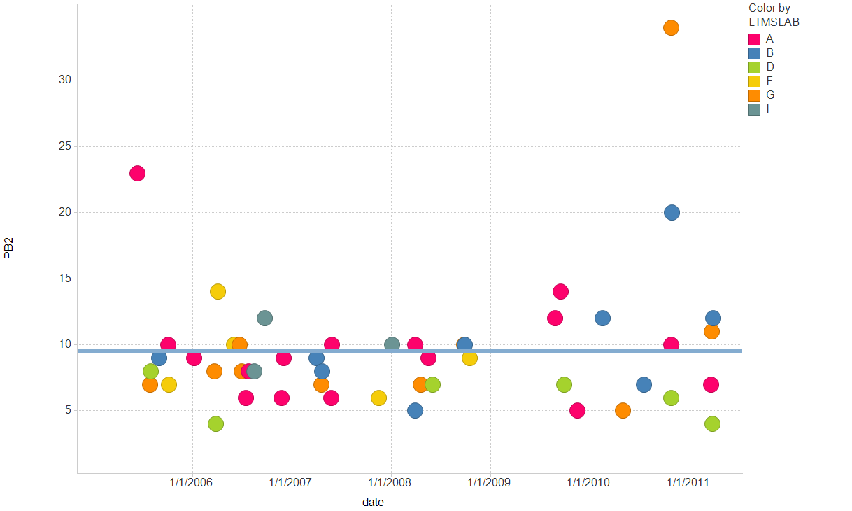
Pb2 IND: ( 821-1 , 821)

Slide 10
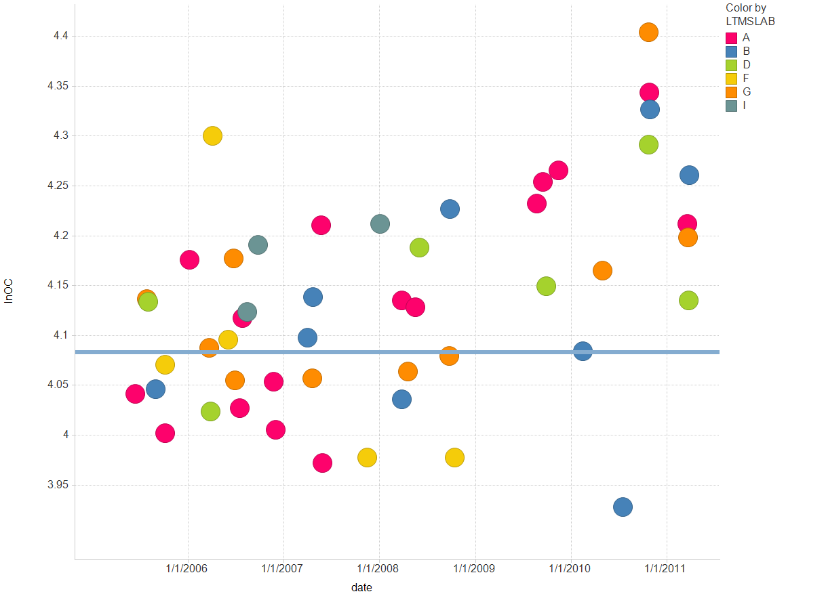
ln(OC) IND: ( 821-1 , 821)

Slide 11
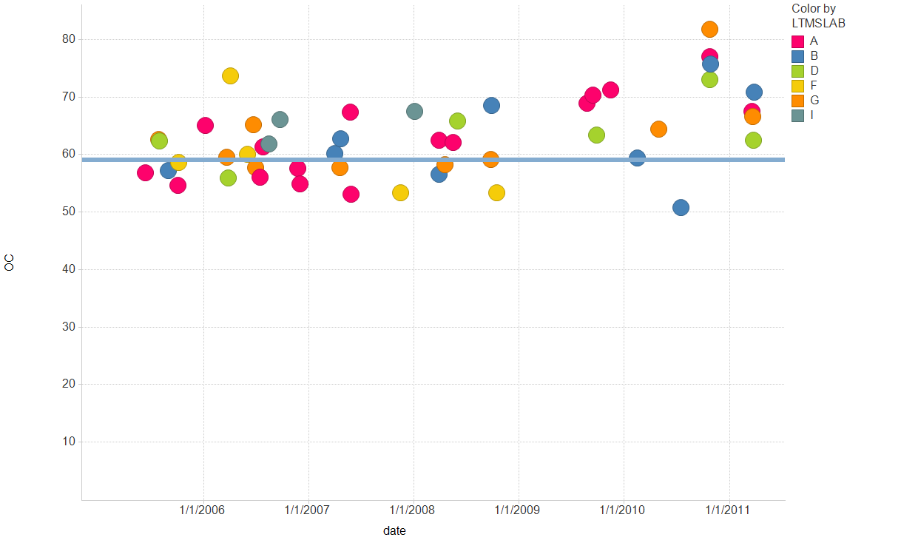
OC IND: ( 821-1 , 821)

Slide 12
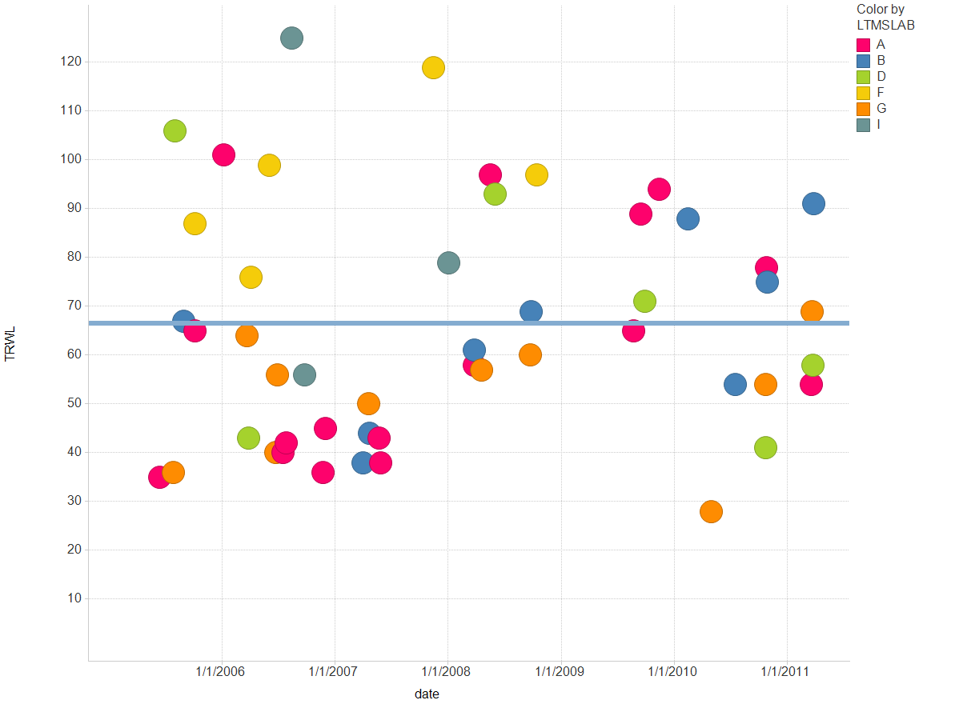
TRWL IND: ( 821-1 , 821)

