Slide 1
Mack T-8 Reference Data draft 6
September 9, 2011
Jim Rutherford

Slide 2
Process
Calculate initial 1004-3 targets and standard deviations arithmetically from all (13) 1998 tests at labs G and J.
Apply LTMS V2 up to start of 1005-2 (June 2007)
Apply severity adjustment from step 2 to 1005 target data set and calculate targets and standard deviations. Using all 1005-2 (10) tests (debatable):
Using 1005-2 targets above, run EWMA through 1005-2 and 1005-3. Calculate targets and standard deviations for 1005-3 as least squared means from severity adjusted results:

Slide 3
Process (continued)
Current Z_{i} = ICF + sa. If sa=0 (debatable):
We could debate what belongs in 1005 target data sets and the relationship between ICF and severity adjustments. It seems with this analysis that rather than ICF, we should use new 1005-3 targets and continuous (no threshold) severity adjustments.

Slide 4
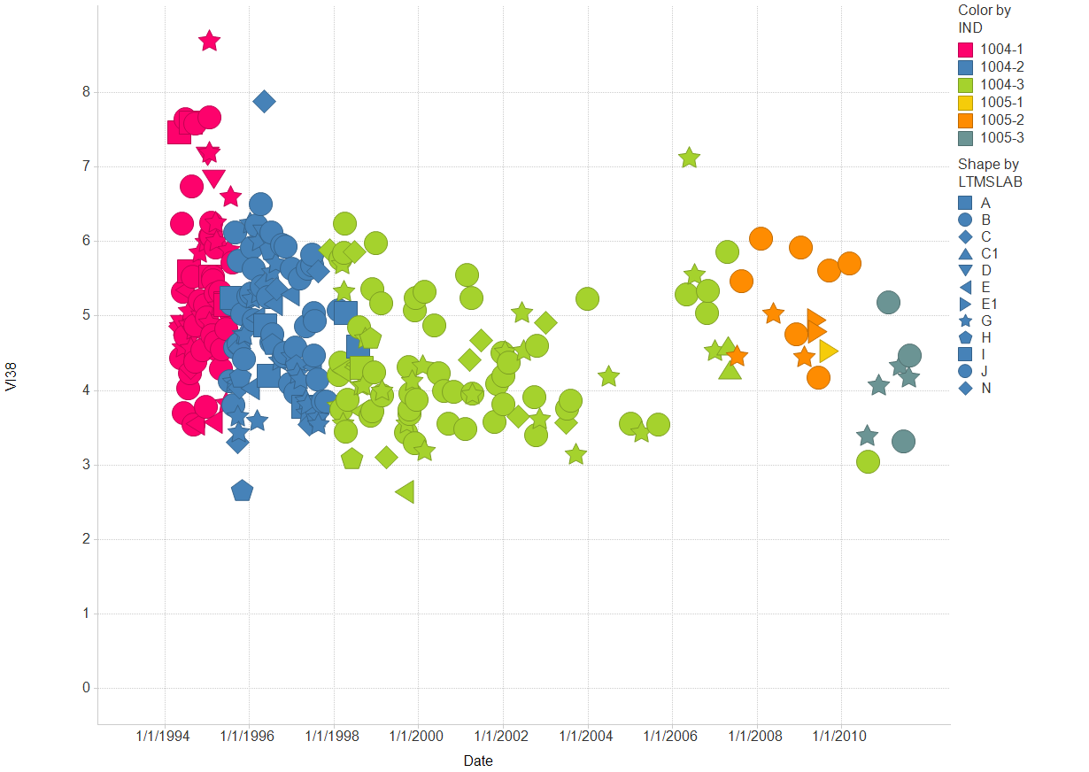
Filter Settings
- CHART: ( Y)

Slide 5
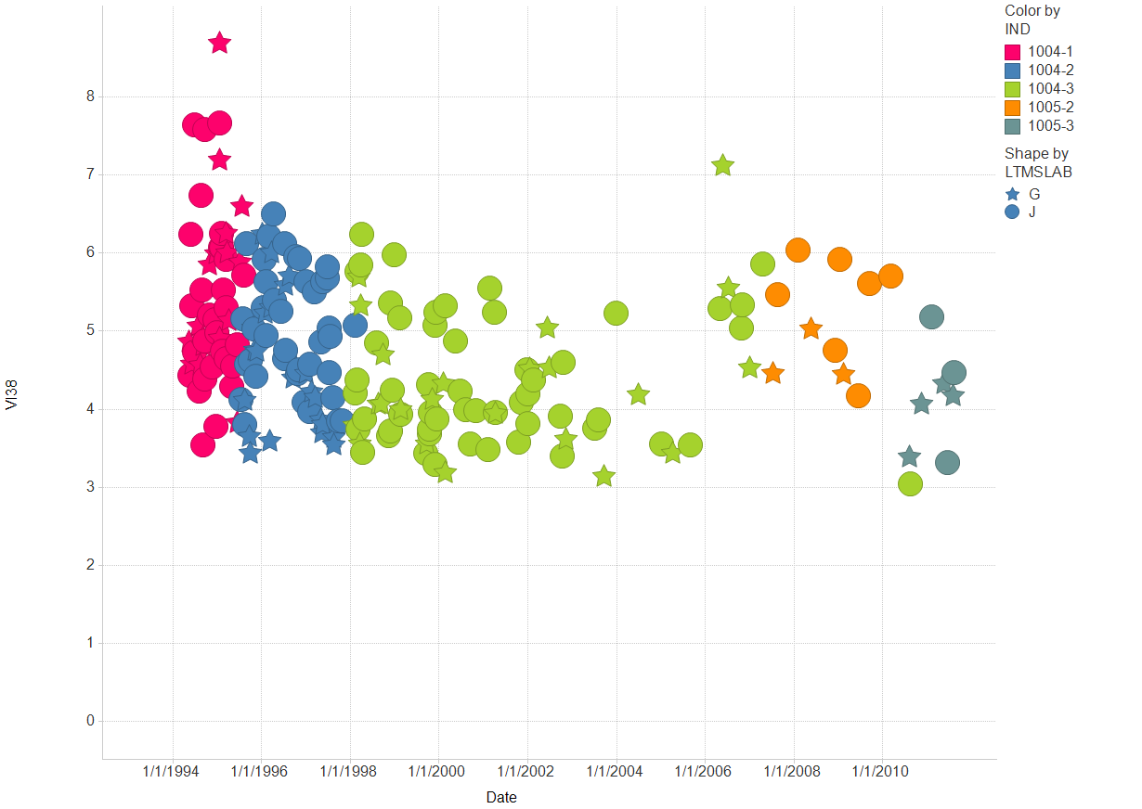
Filter Settings
- LTMSLAB: ( G , J )
- CHART: ( Y)

Slide 6
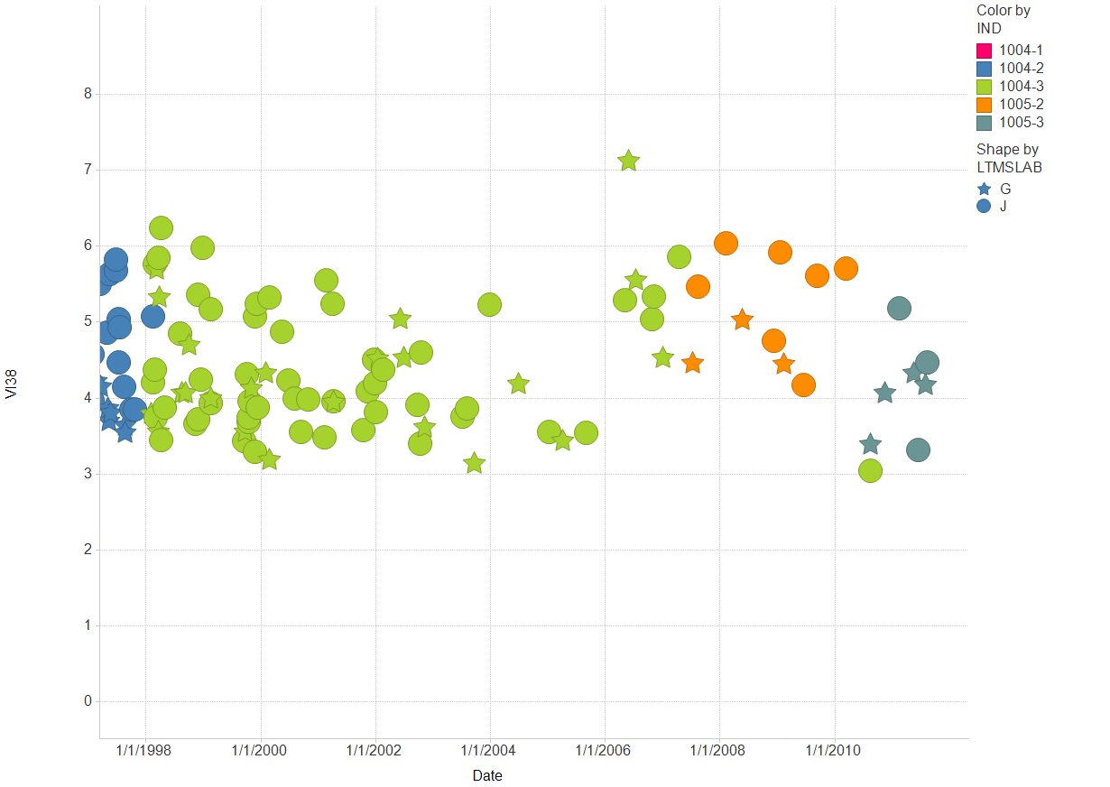
Filter Settings
- LTMSLAB: ( G , J )
- CHART: ( Y)

Slide 7
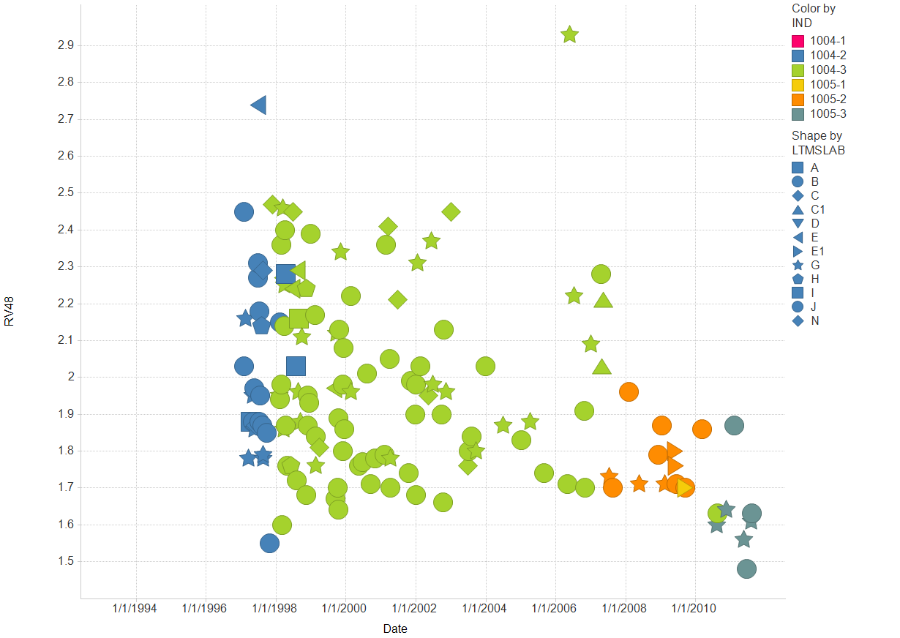
Filter Settings
- CHART: ( Y)

Slide 8
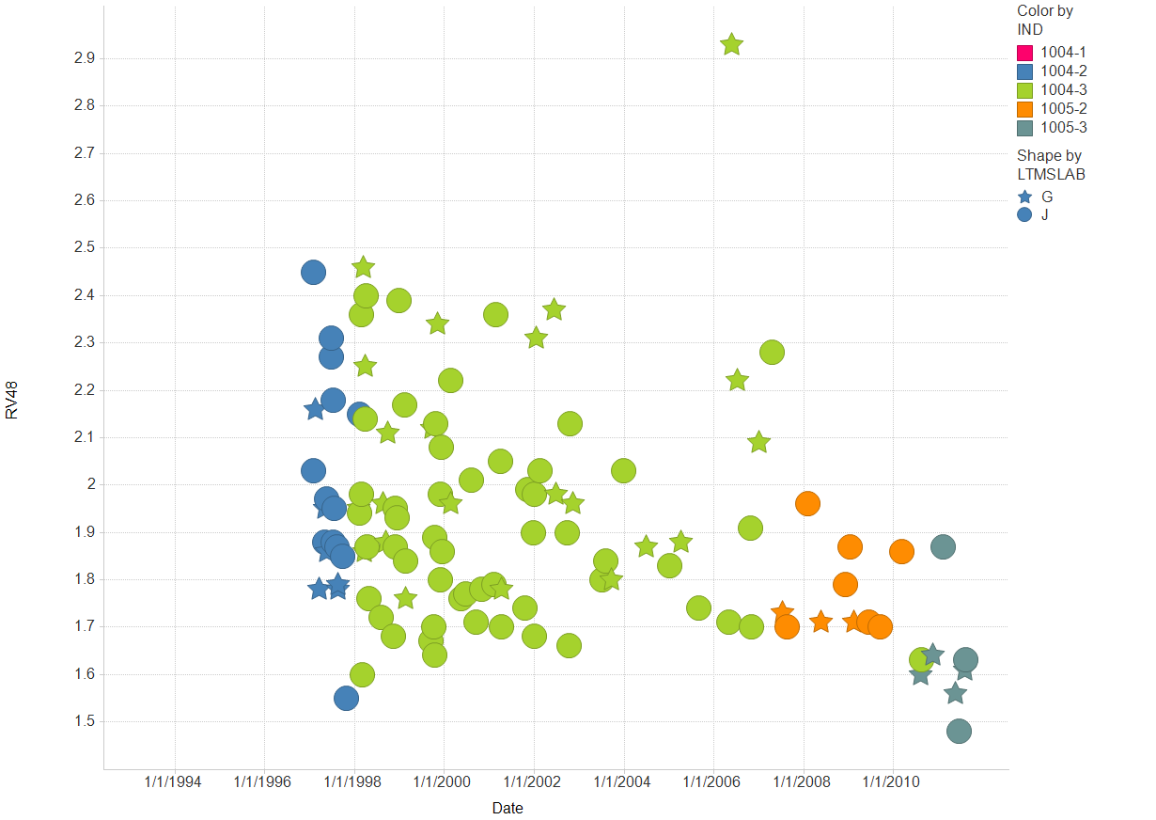
Filter Settings
- LTMSLAB: ( G , J )
- CHART: ( Y)

Slide 9
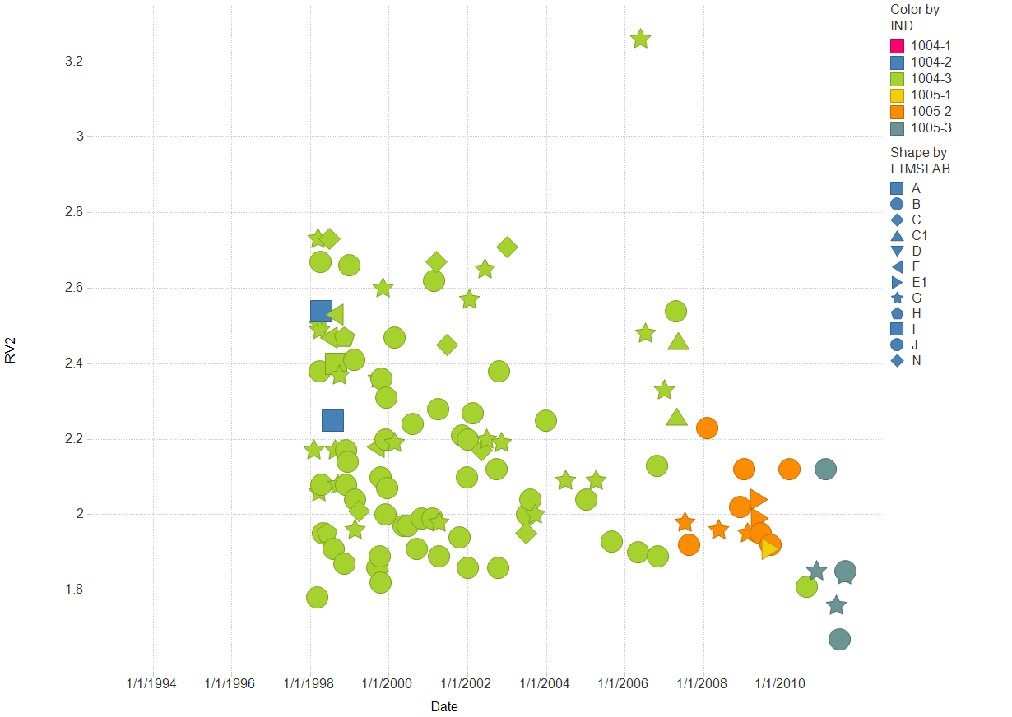
Filter Settings
- CHART: ( Y)

Slide 10
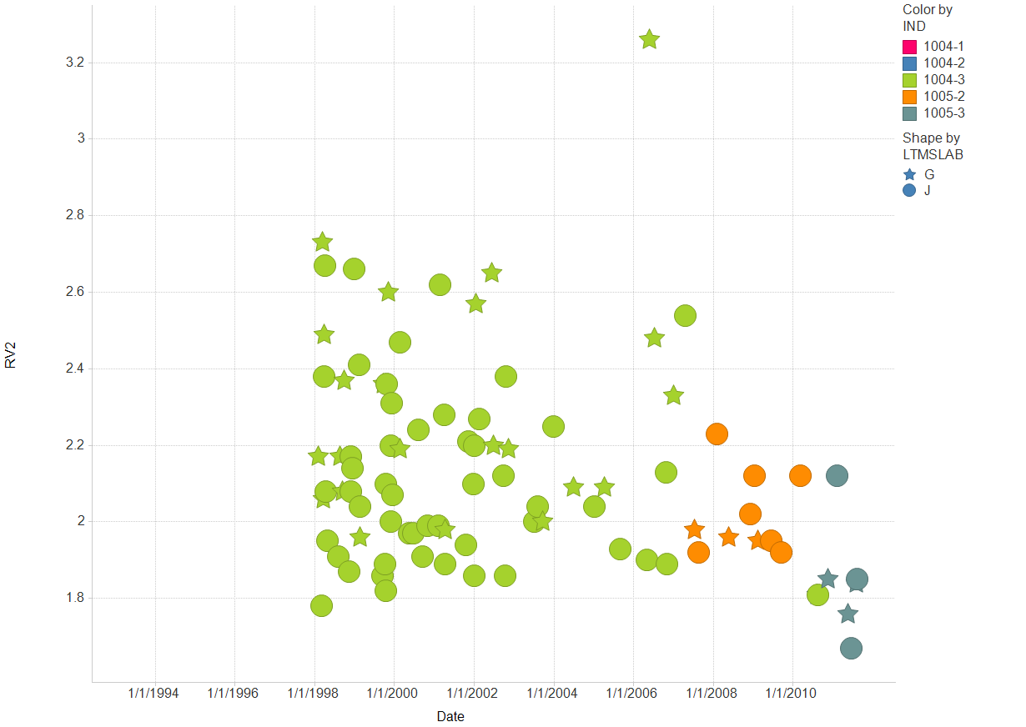
Filter Settings
- LTMSLAB: ( G , J )
- CHART: ( Y)

