Slide 1
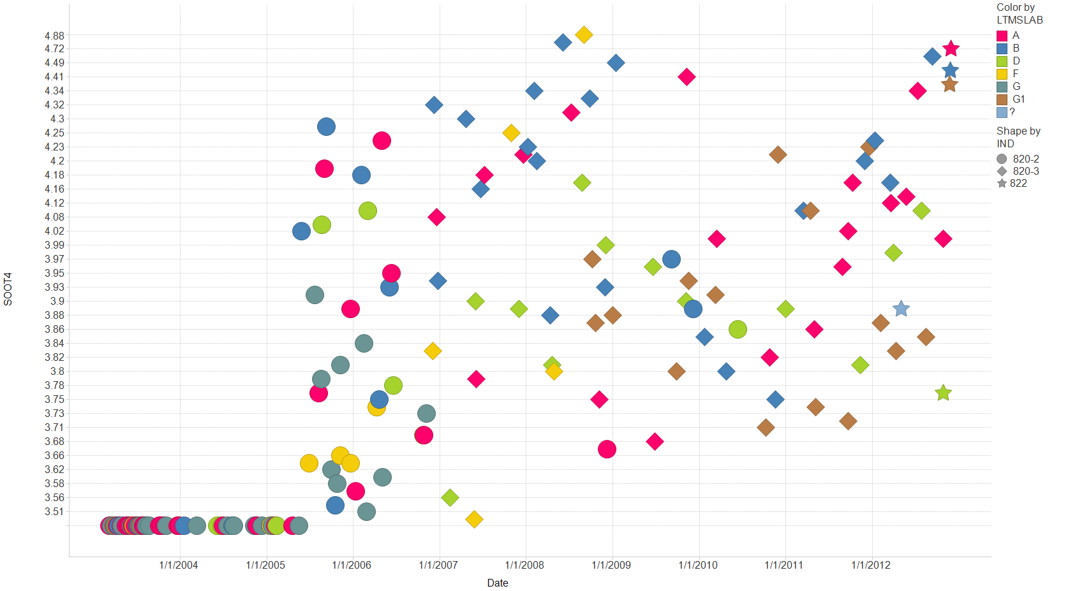
Filter Settings
- CHART: ( Y)

Slide 2
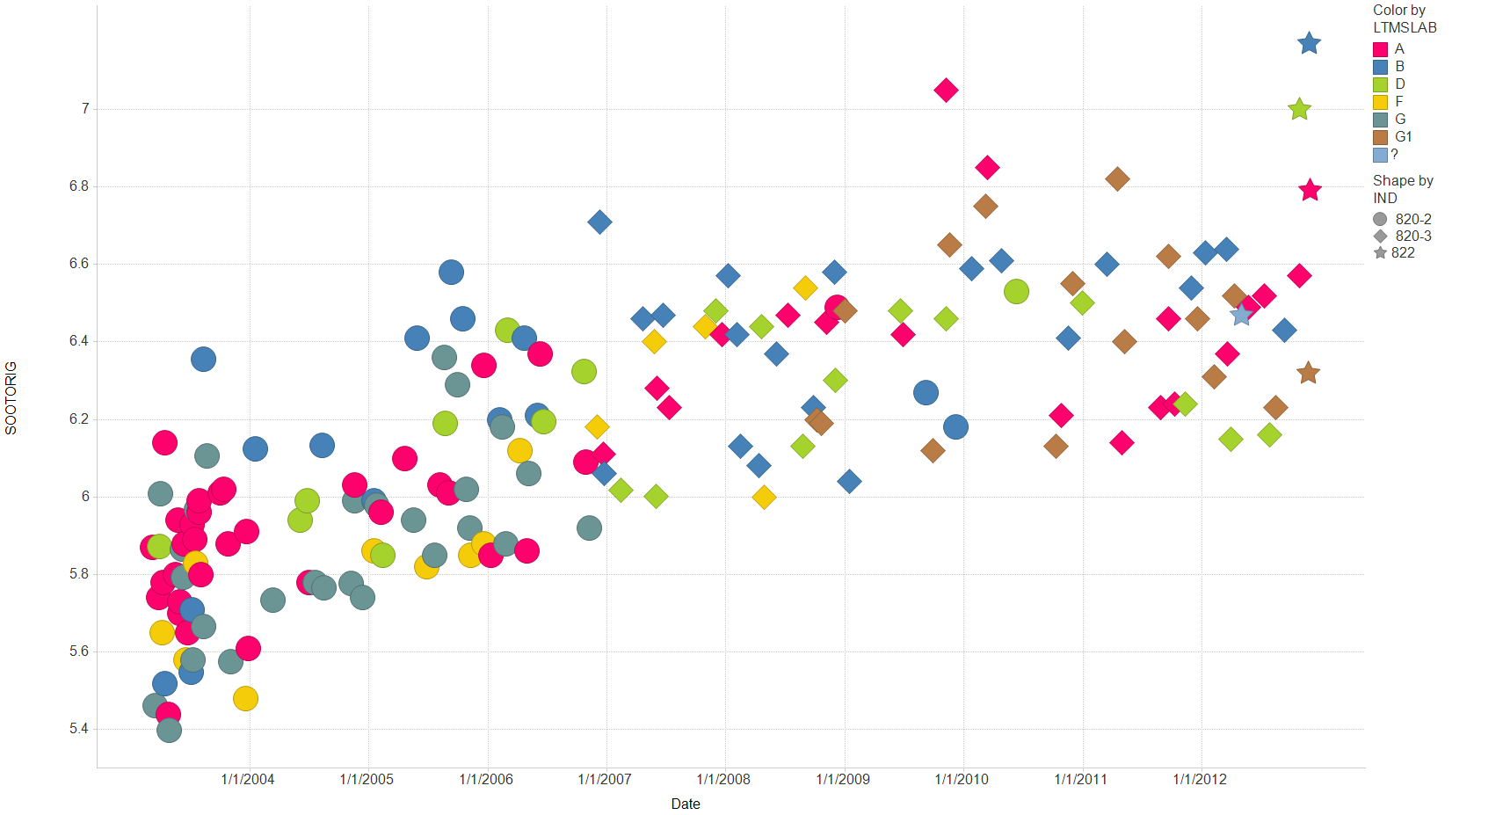
Filter Settings
- CHART: ( Y)

Slide 3
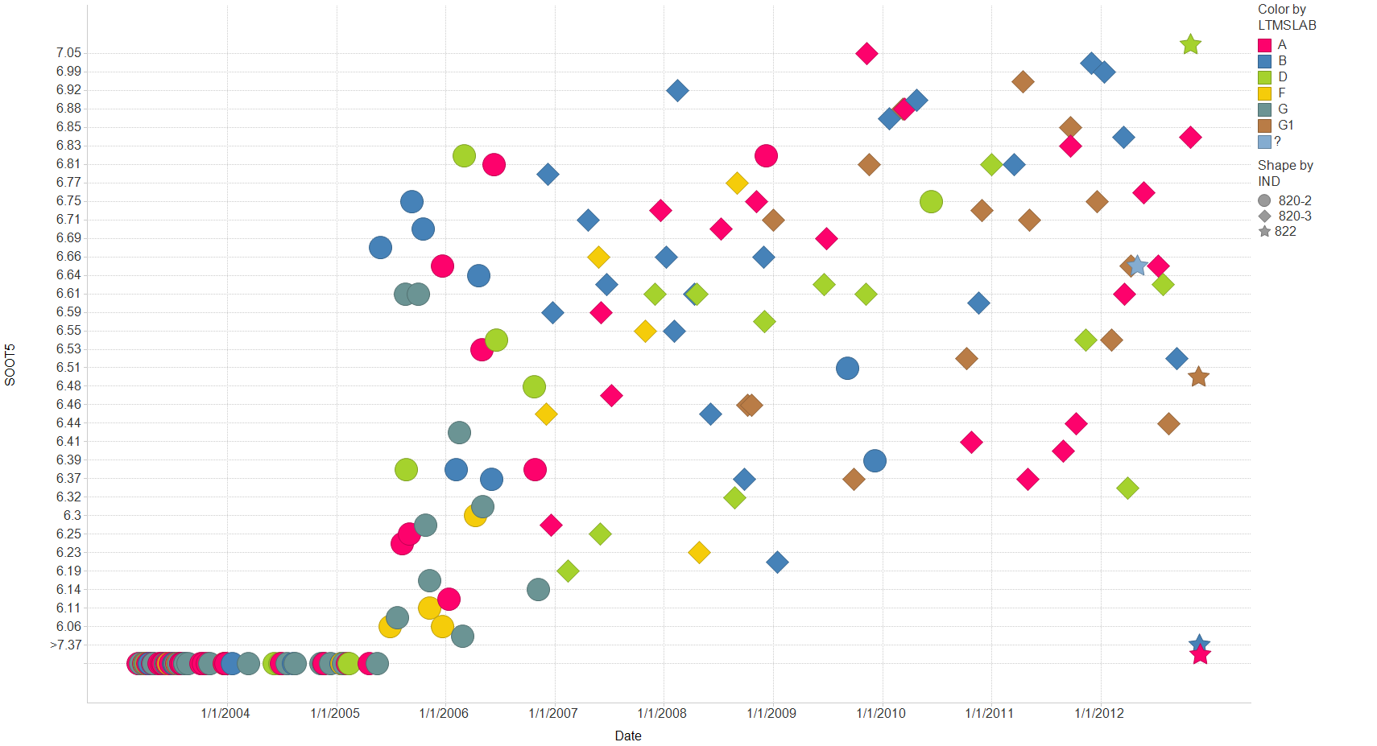
Filter Settings
- CHART: ( Y)

Slide 4
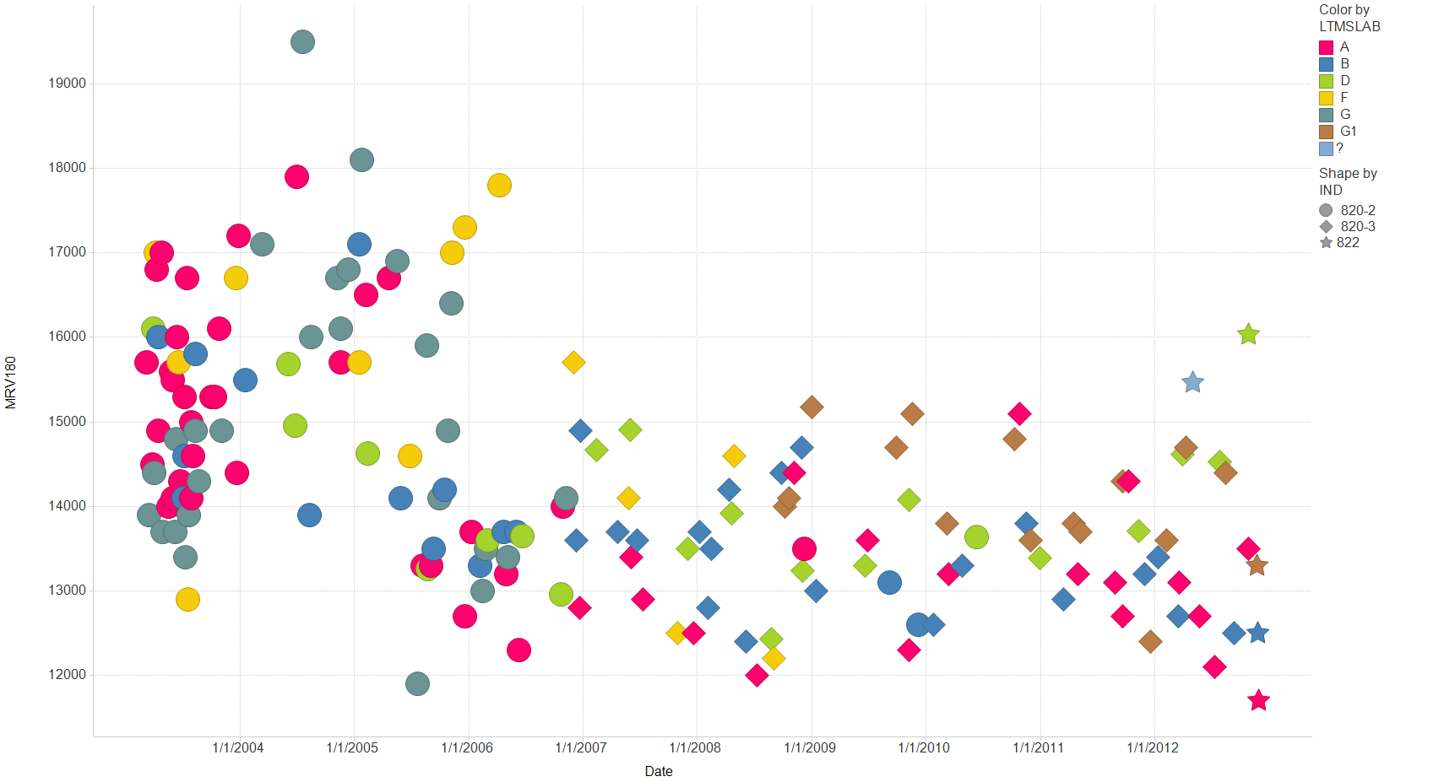
Filter Settings
- CHART: ( Y)

Slide 5
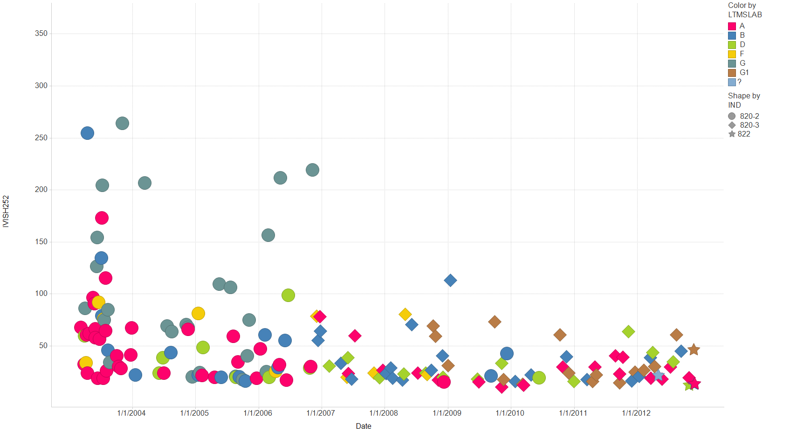
Filter Settings
- CHART: ( Y)

Slide 6
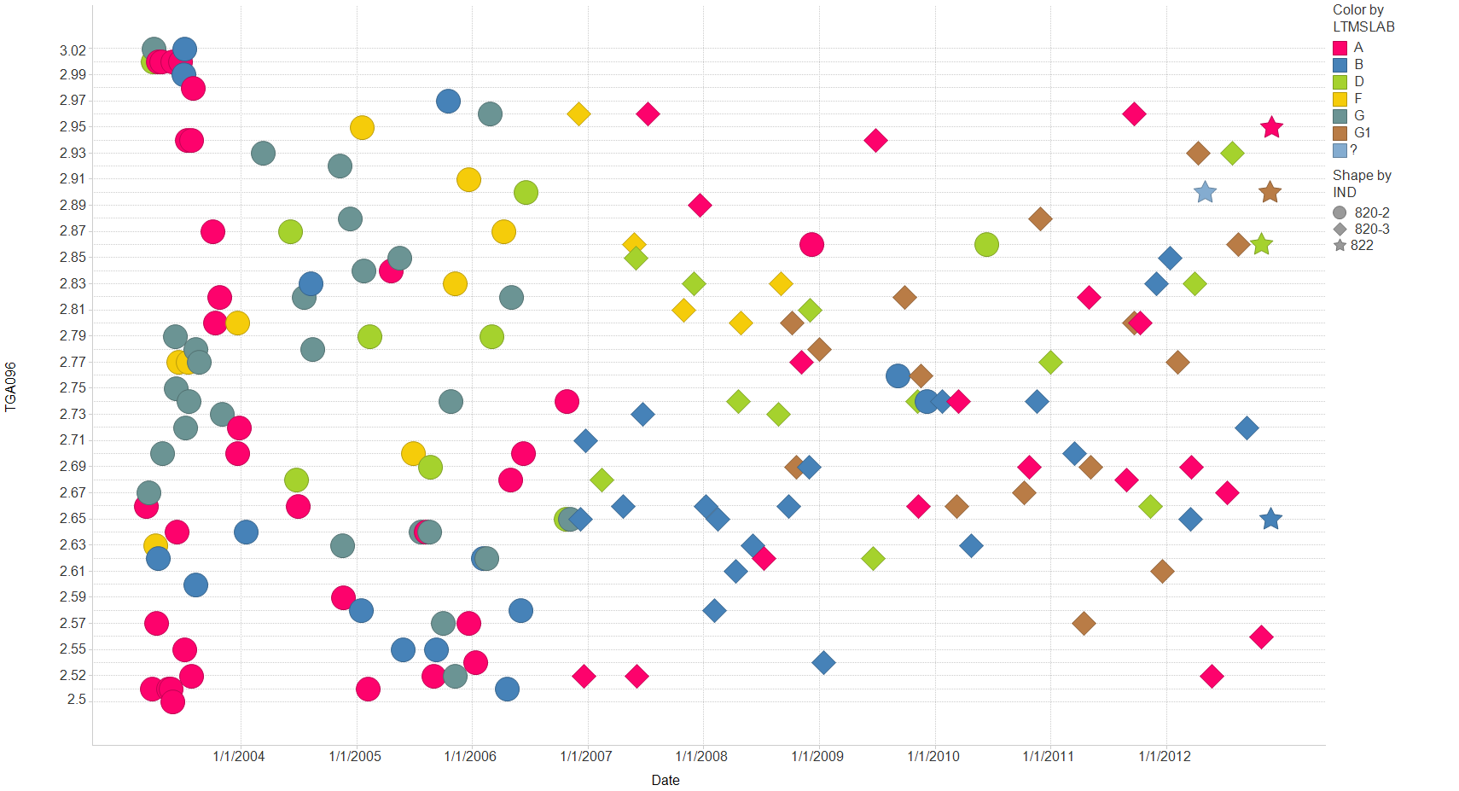
Filter Settings
- CHART: ( Y)

Slide 7
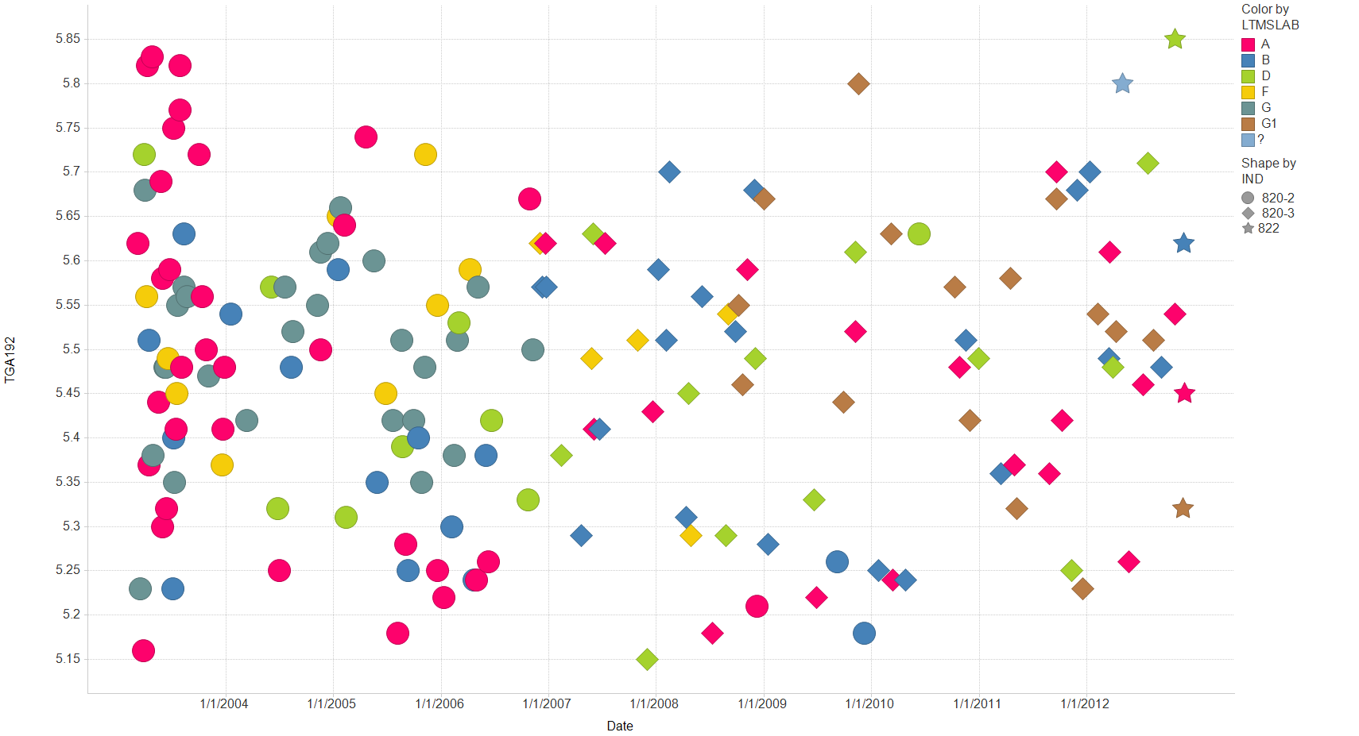
Filter Settings
- CHART: ( Y)

Slide 8
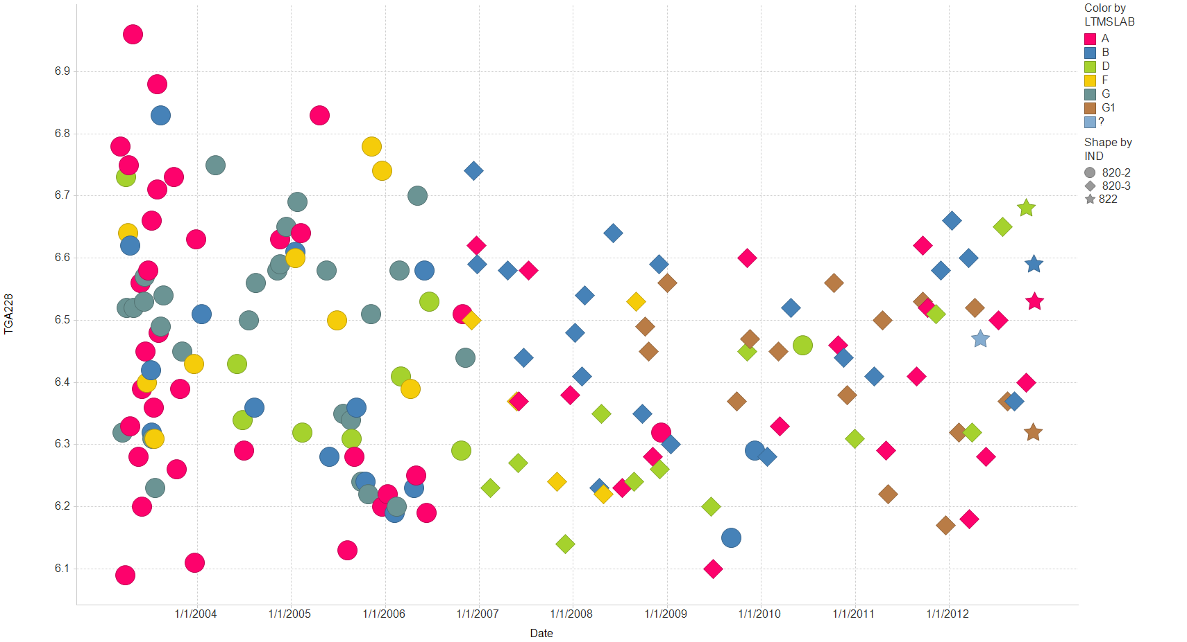
Filter Settings
- CHART: ( Y)

Slide 9
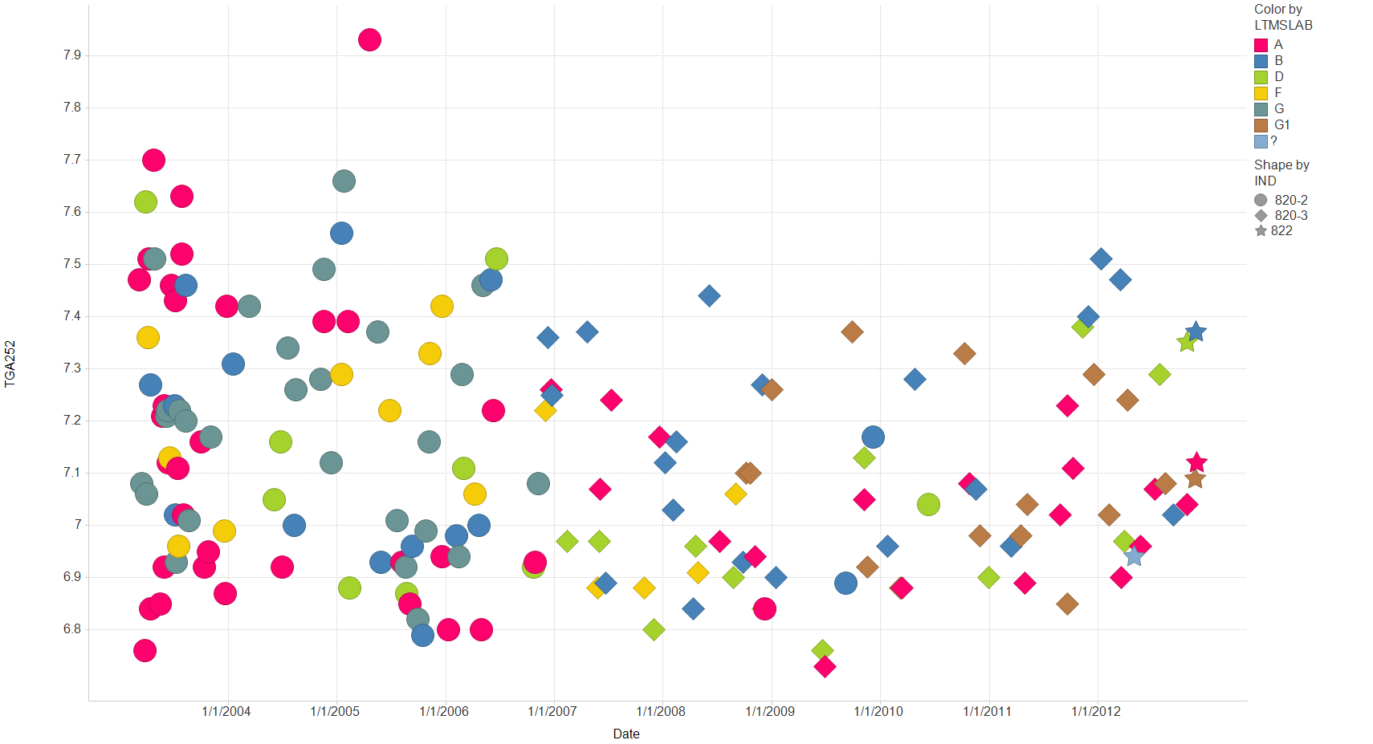
Filter Settings
- CHART: ( Y)

Slide 10
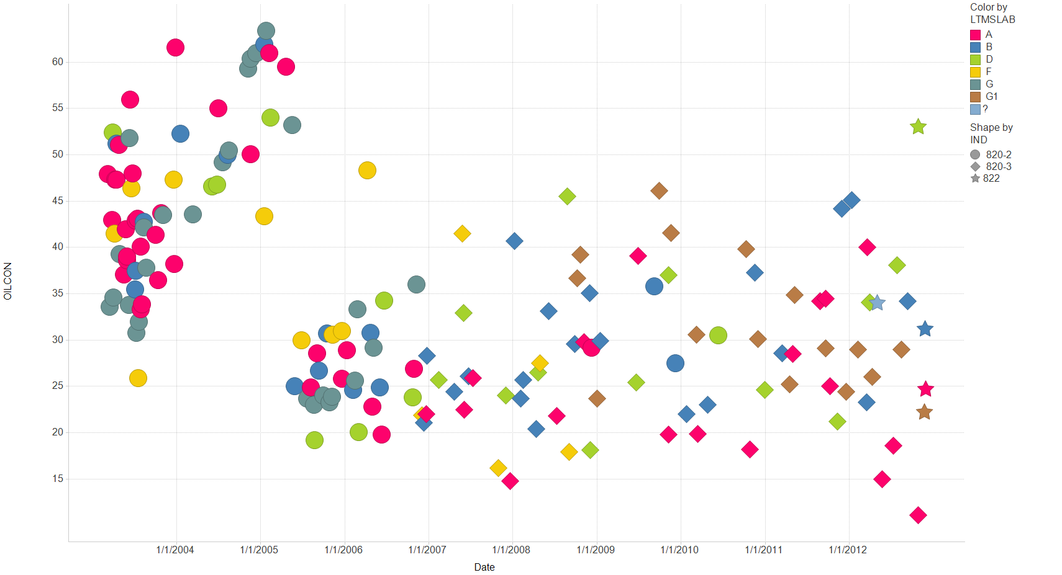
Filter Settings
- CHART: ( Y, Y)

