Slide 1
Mack T12 LTMS20160222
New Parts and ICF Review
Jim Rutherford
03/02/2016

Slide 2
Contents
Just a few additional items based on many conversations
  OC corrected Pb and Pb2 using lower slope below 65
  Various traditional ICFs

Slide 3
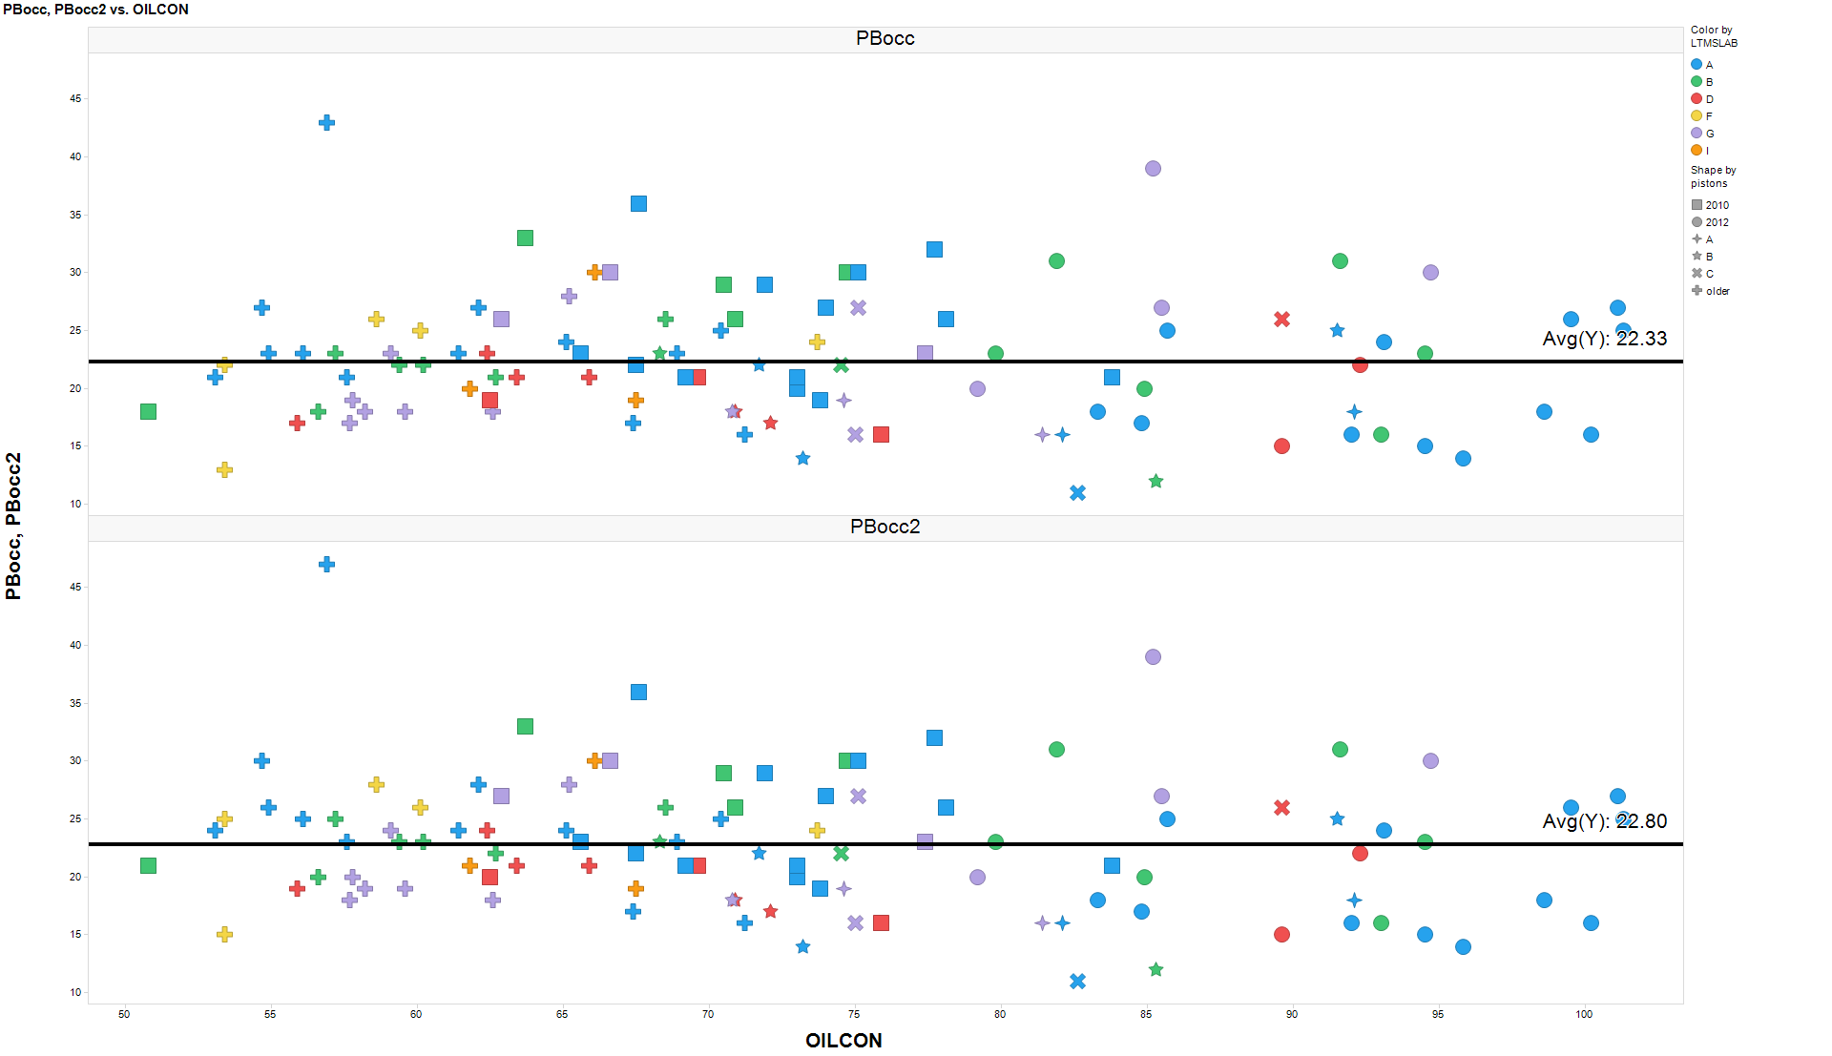

Slide 4
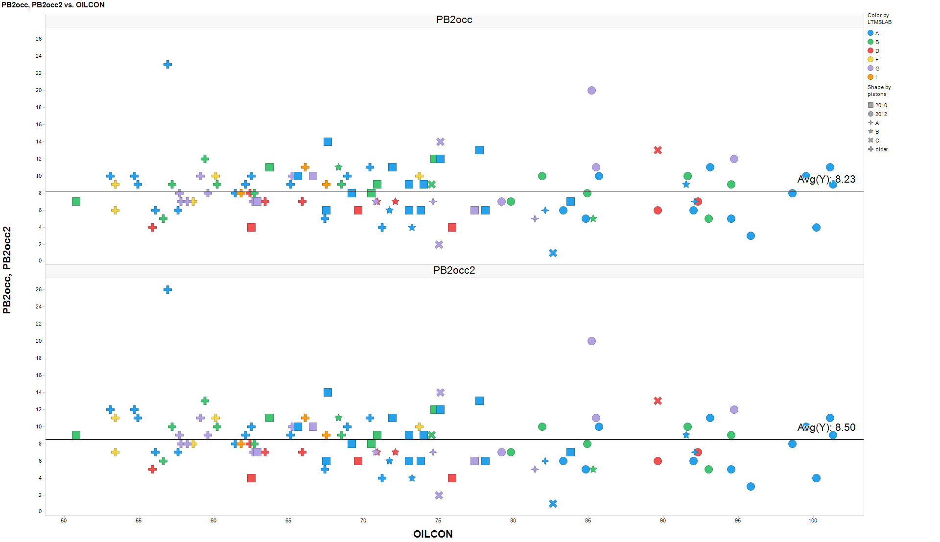

Slide 5
OC, Liner Wear, and TRWL ICFs

Slide 6
Pb and Pb2 Oil Consumption Correction
Correction Factor for ΔLead at EOT—For all tests after April 5, 2011, determine the final ΔLead at EOT result by applying the correction:
    if OC_{100–300} >65.0, then ΔLead_{Final} = e ^{ln(Δlead)+(65-OC}_{100–300}^{) X 0.03088},
    if OC_{100–300} ≤65.0, then ΔLead_{Final} =ΔLead,
  where
    ΔLead_{Final} = final ΔLead at EOT,
    ΔLead = value calculated per Eq 2, and
    OC_{100–300} = average oil consumption from 11.6.6.
Correction Factor for ΔLead(250-300) h—For all tests after April 5, 2011, determine the final ΔLead(250-300)h result by applying the correction:
    if OC_{100–300} >65.0, then ΔLead(250-300)_{Final} = e ^{ln(ΔLead(250-300))+(65-OC}_{100–300}^{) X 0.04021},
    if OC_{100–300} ≤65.0, then ΔLead(250-300)_{Final} =ΔLead(250-300),
  where
    ΔLead(250-300)_{Final} = final ΔLead(250-300) h,
    ΔLead(250-300) = value calculated per 11.6.5, and
    OC_{100–300} = average oil consumption from 11.6.6.

