Slide 1
Mack T-11Severity
Jim Rutherford
Mack Surveillance Panel September 20, 2016

Slide 2
Mack T-11 Severity Summary
Using ltms20160906
261 total tests
206 chartable tests
Processing FUELBTID to match CP Chem Lot Numbers
Truncated FUELBTID to 9 characters
Missing 1 fuel severity factor for 3 tests with 822-2: “16CP9HS01”
If Soot4 has changed, hasn’t it gone severe in roughly the same time frame?
It doesn’t look like an effect of CP Chem fuel severity, or parts batch
Could it be reference oil reblend or something else related to time?
Doesn’t look like Soot at 12 cSt or soot at 15 at cSt have changed

Slide 3
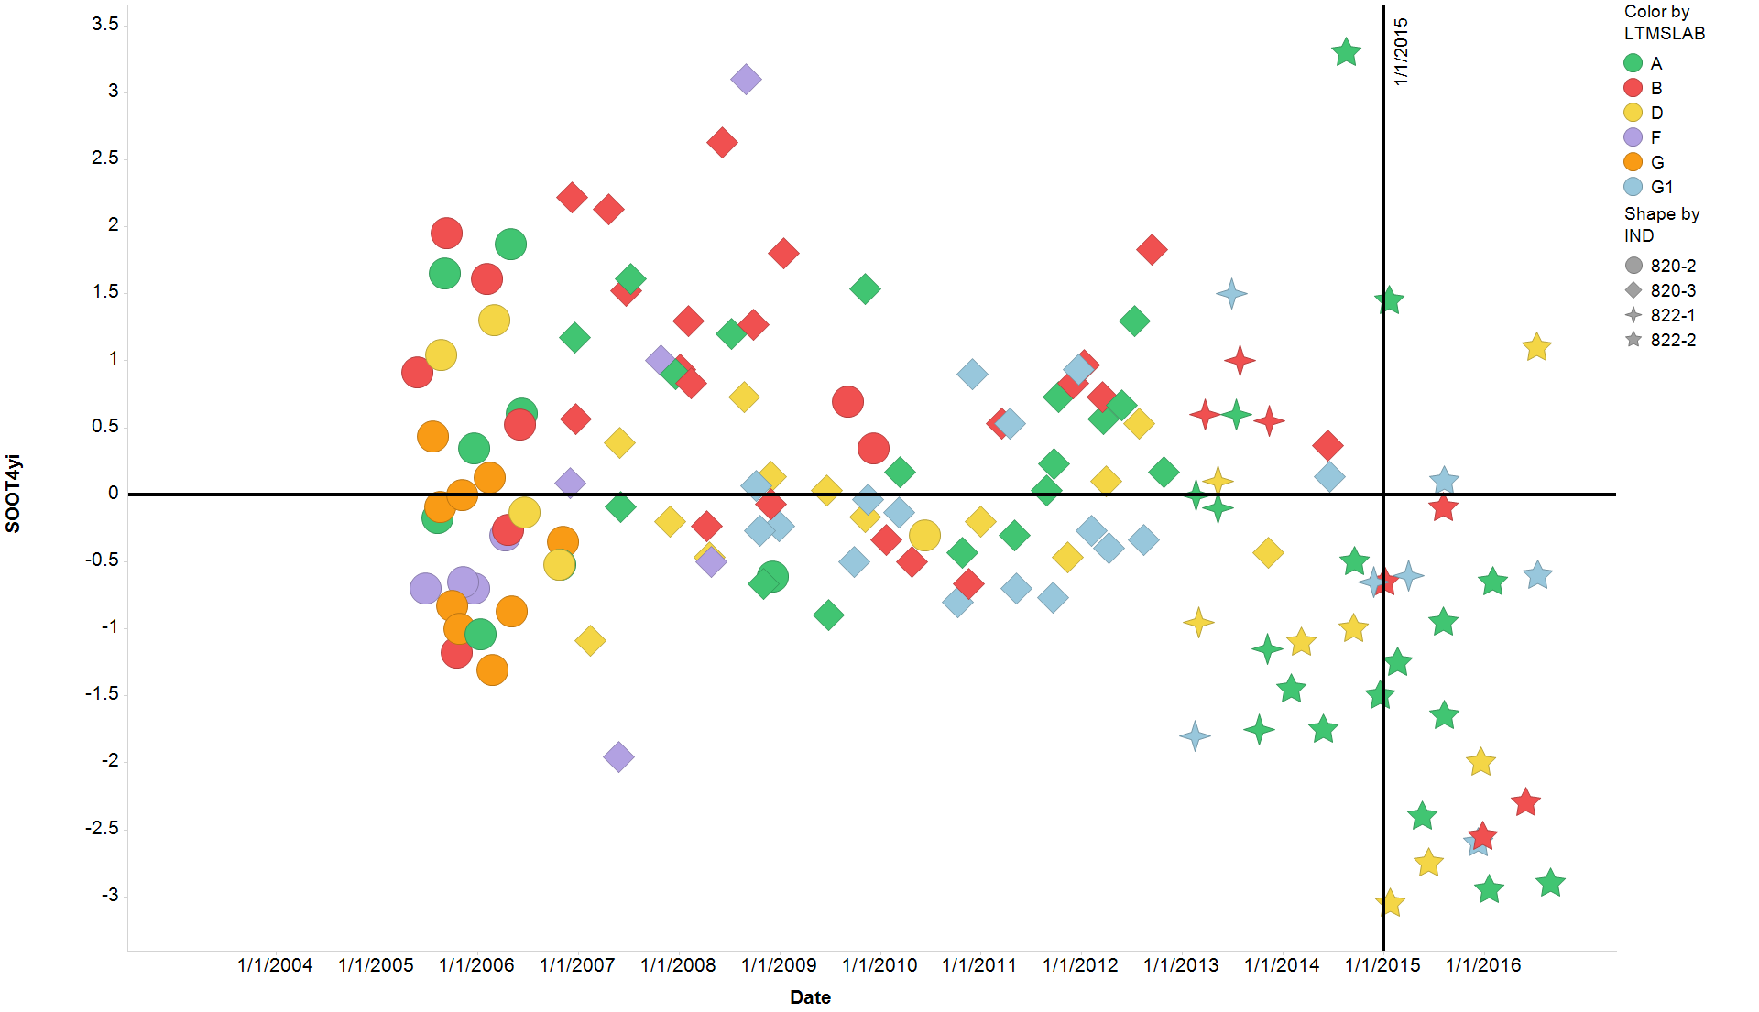
Mack T-11 Severity All chartable tests
Filter Settings
- LTMSLAB: ( A, B, D, F, G, G1)

Slide 4
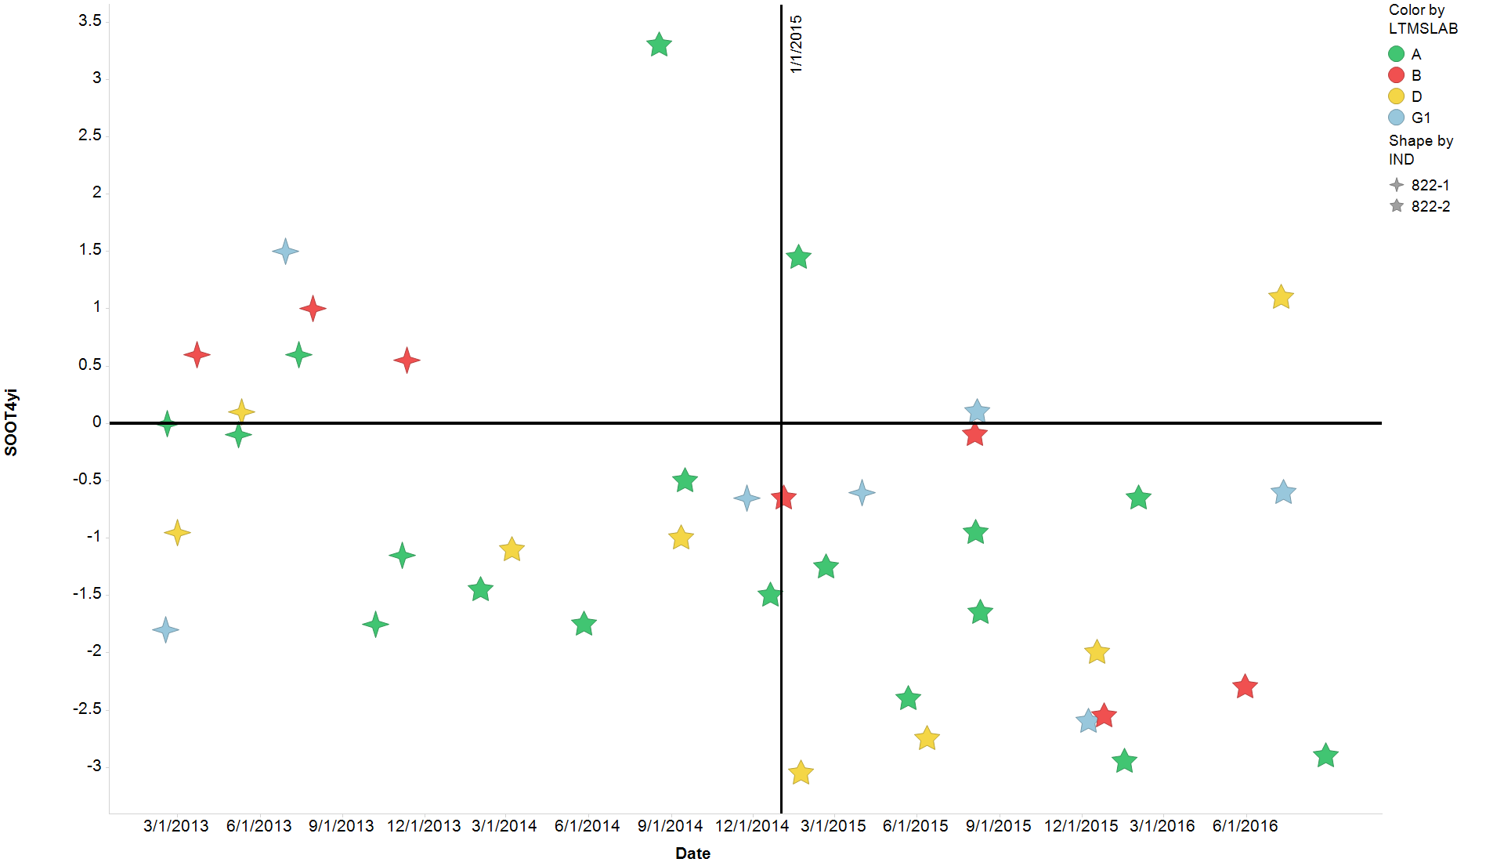
Mack T-11 Severity All chartable tests run with 822 variants

Slide 5
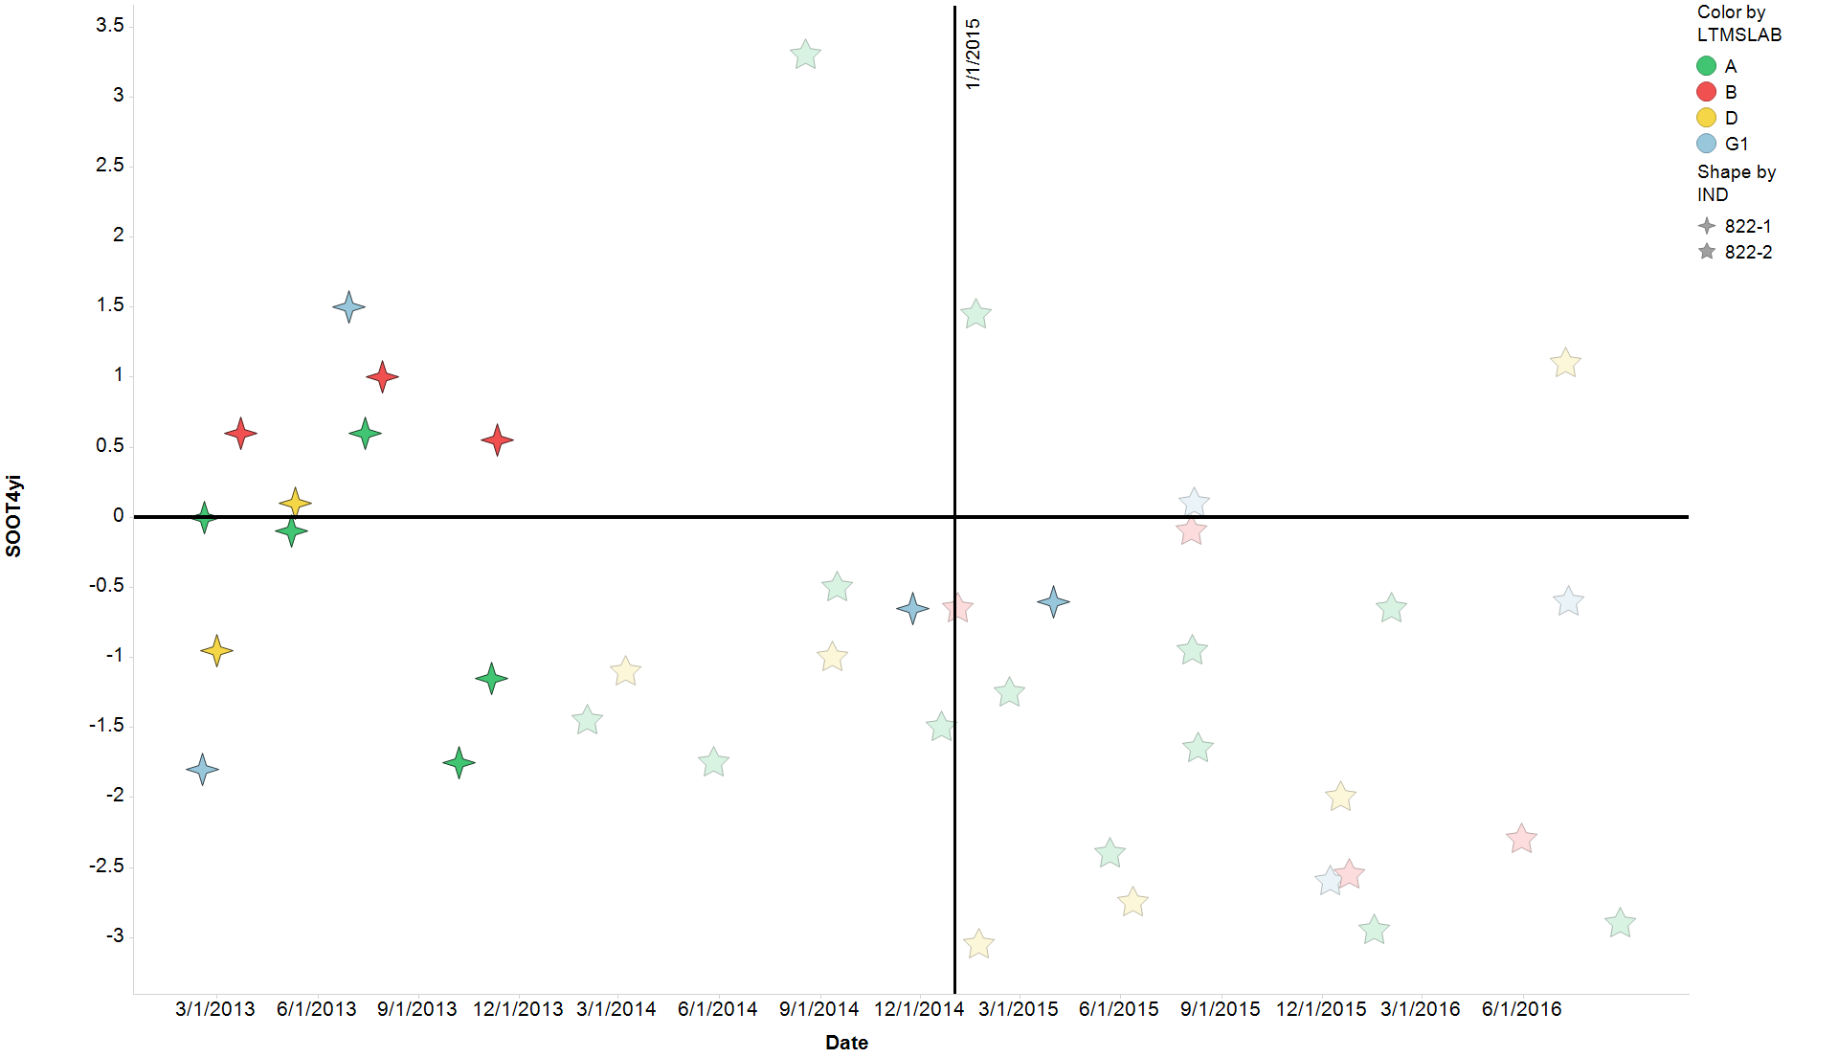
Mack T-11 Severity All chartable tests run with 822 variants
822-1 highlighted

Slide 6
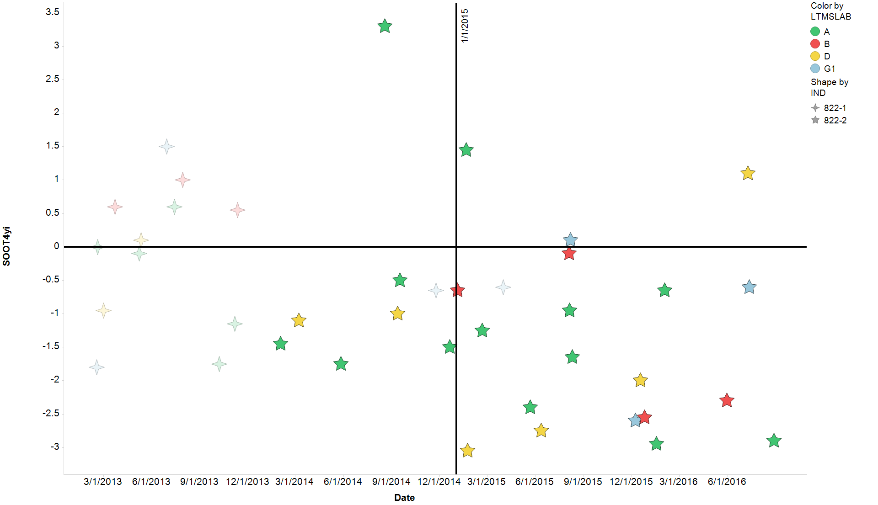
Mack T-11 Severity All chartable tests run with 822 variants
822-2 highlighted

Slide 7
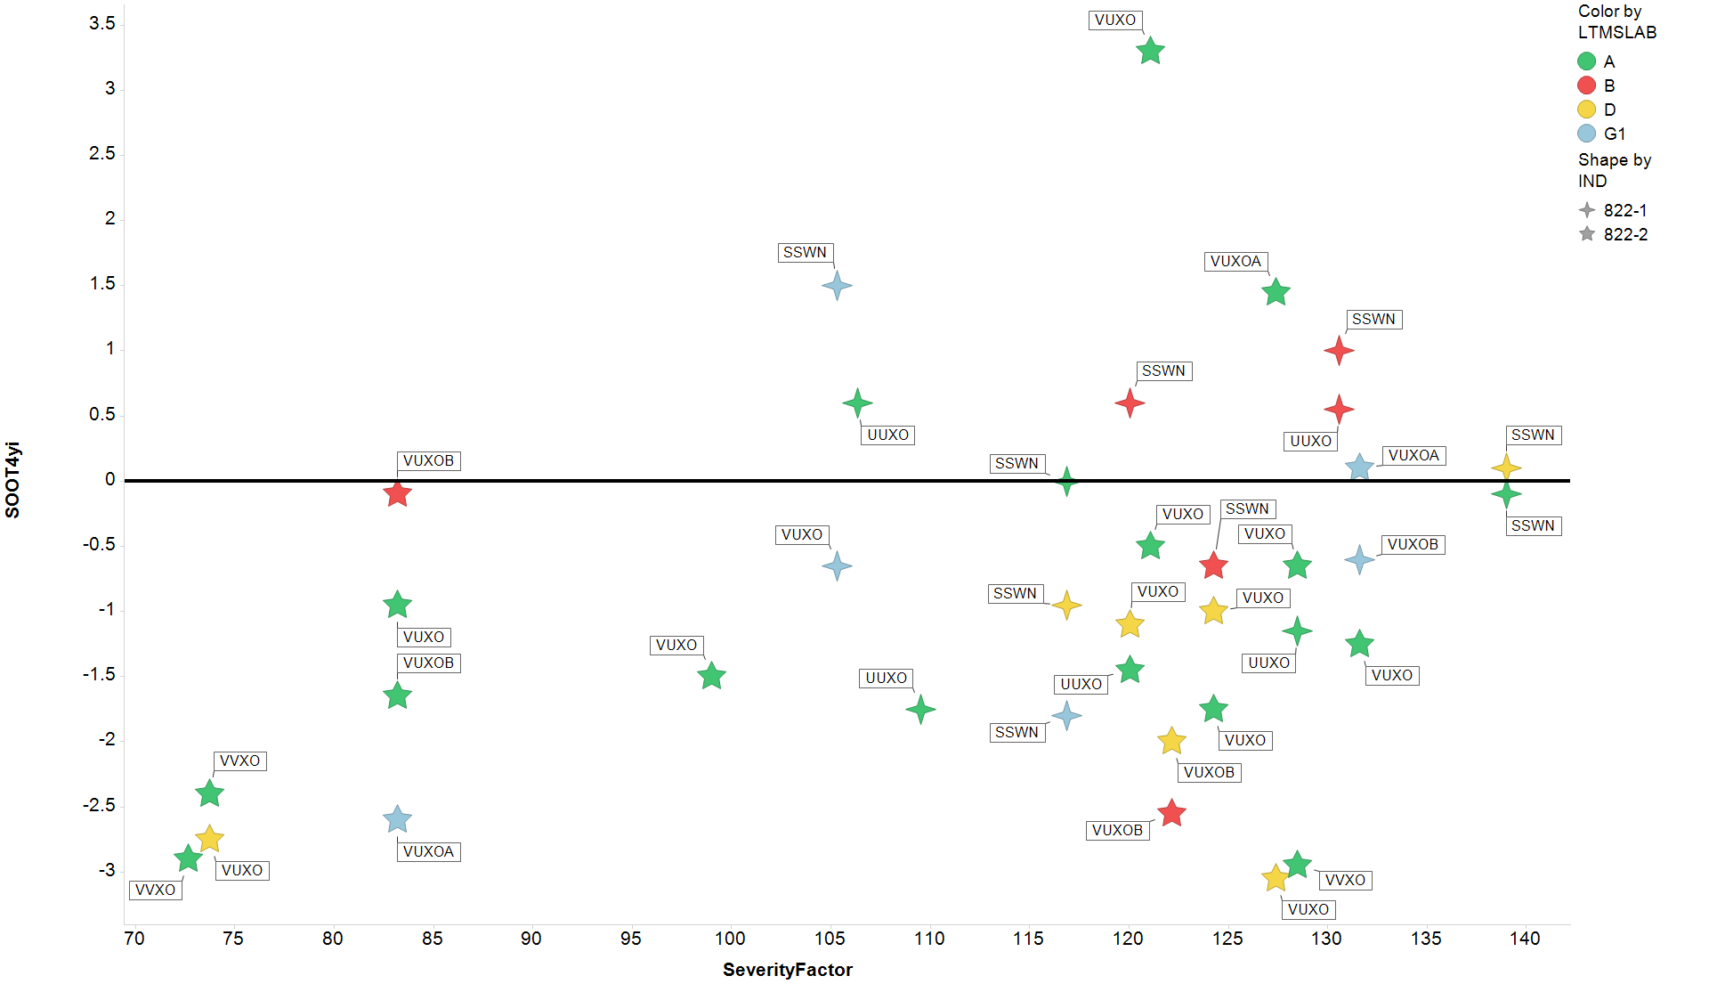
Mack T-11 Severity All chartable tests run with 822 variants

Slide 8
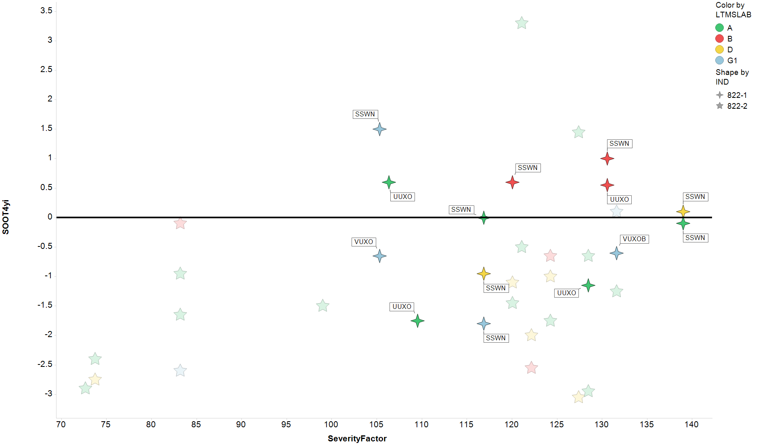
Mack T-11 Severity All chartable tests run with 822 variants
822-1 highlighted

Slide 9
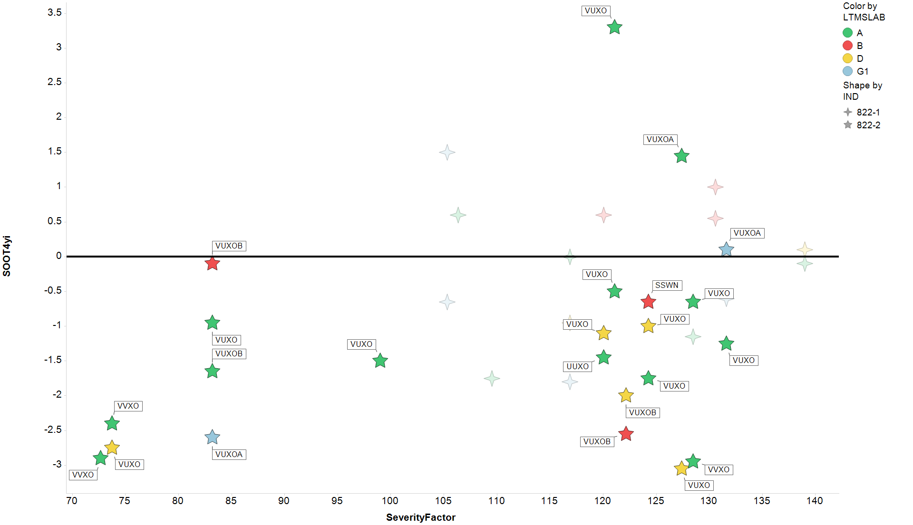
Mack T-11 Severity All chartable tests run with 822 variants
822-2 highlighted

Slide 10
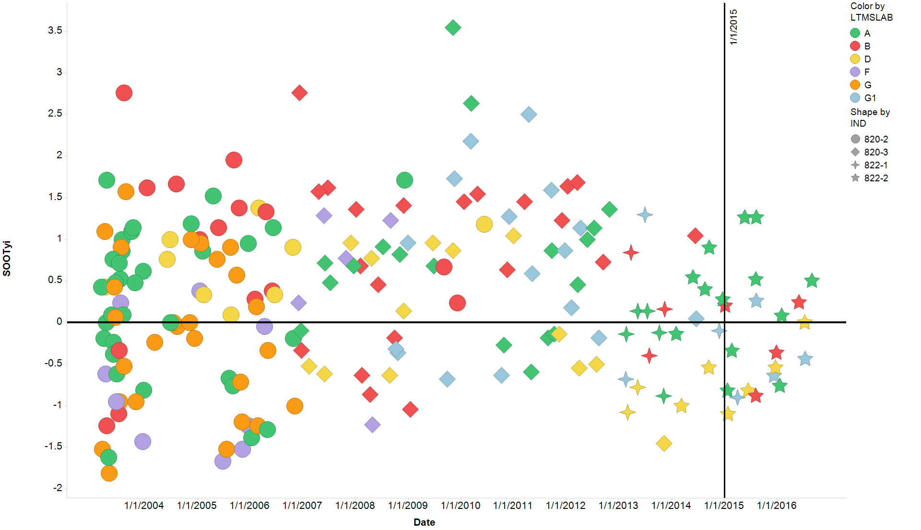
Mack T-11 Severity All chartable tests

Slide 11
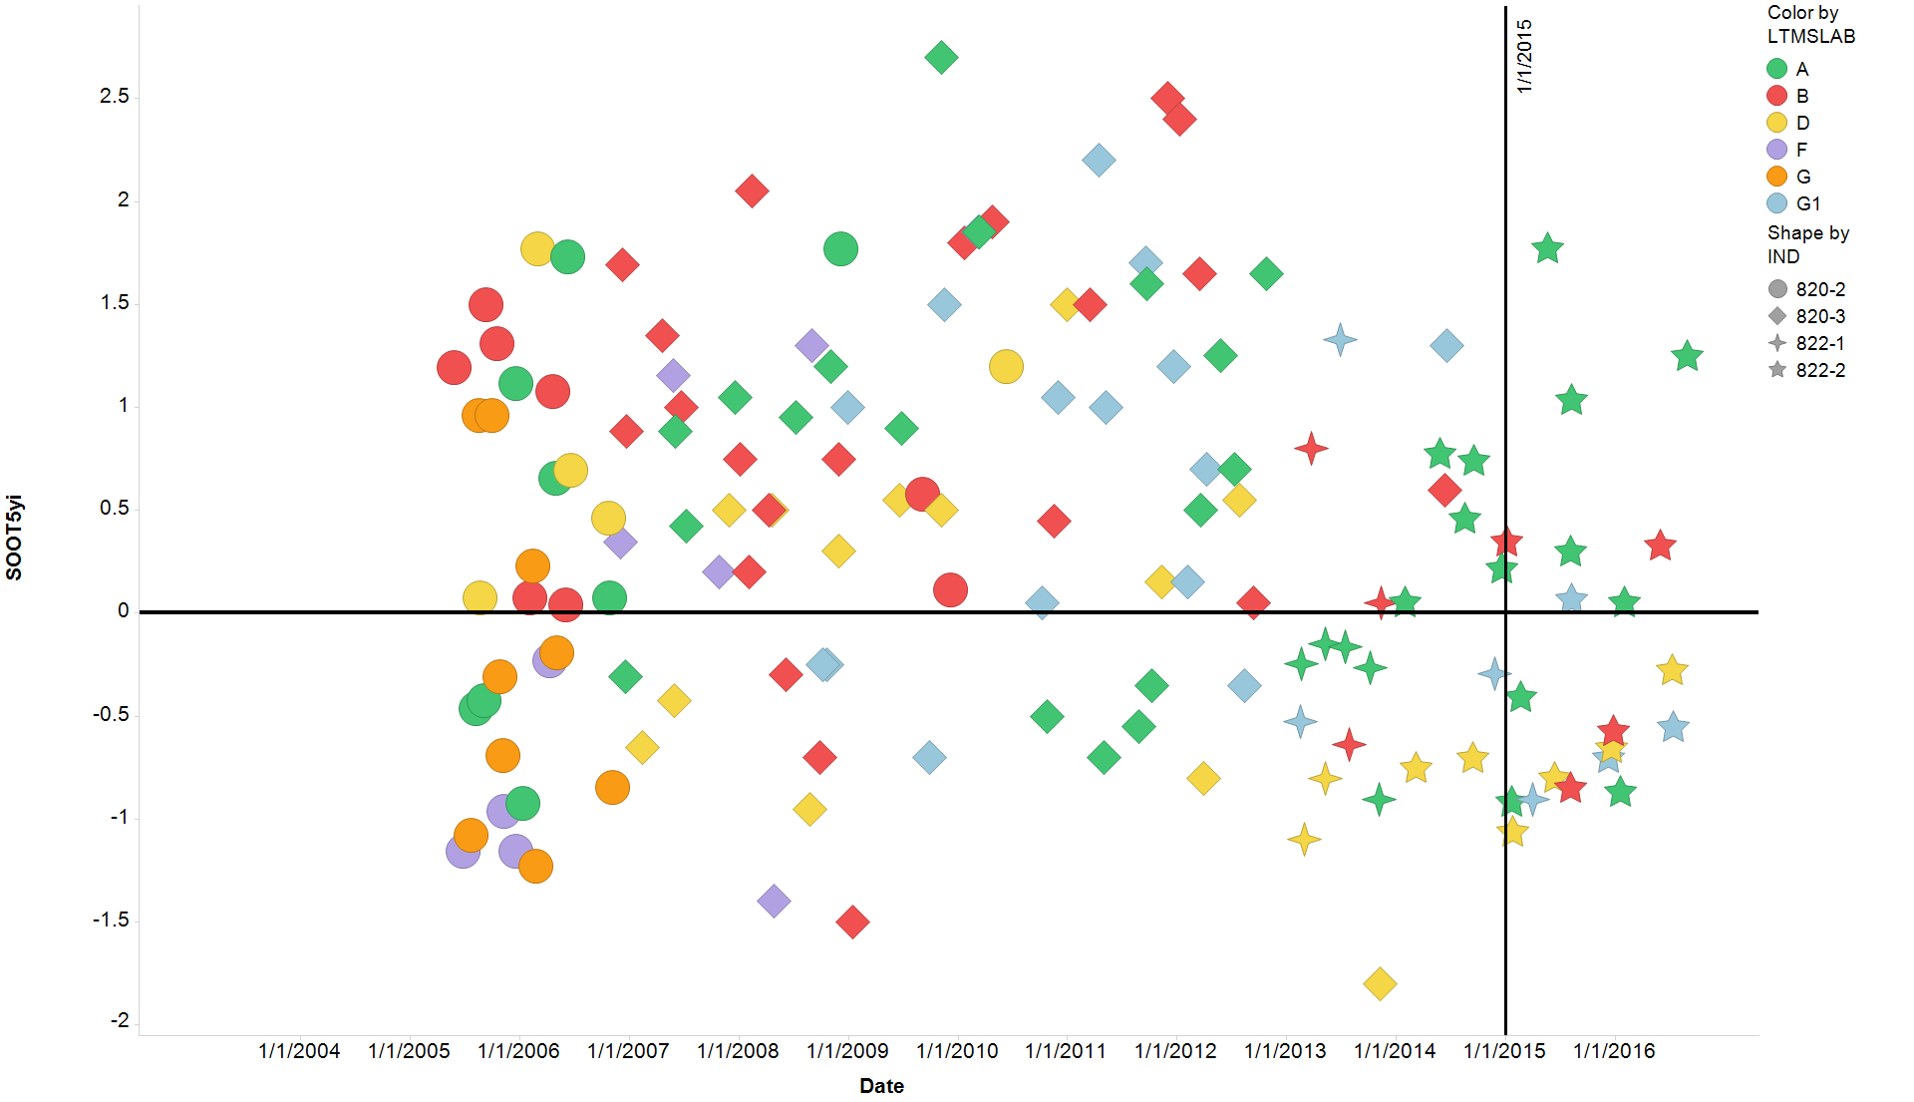
Mack T-11 Severity All chartable tests

