Slide 1
Mack T8-E Severity Update:
VISCOSITY INCREASE 3.8% SOOT Y_{i} vs. Fuel Batch Severity Factor
Jim Rutherford
Mack Surveillance Panel September 12, 2016

Slide 2
Mack T-8E Severity
Summary
Processing FUELBTID to match CP Chem Lot Numbers
Truncated FUELBTID to 9 characters
Assumed “O9APPC901” should be “09APPC901”
Assumed “12BPHS01” should be “12BP9HS01”
Missing 6 fuel batches for 1005-2 pre 2009
Missing 1 fuel batch for 1005-3 “PHILLIPS”
Missing 1 fuel batch for 1005-5 “16CP9HS01”
Fuel Batch Severity Factor might have marginal impact on VI38

Slide 3
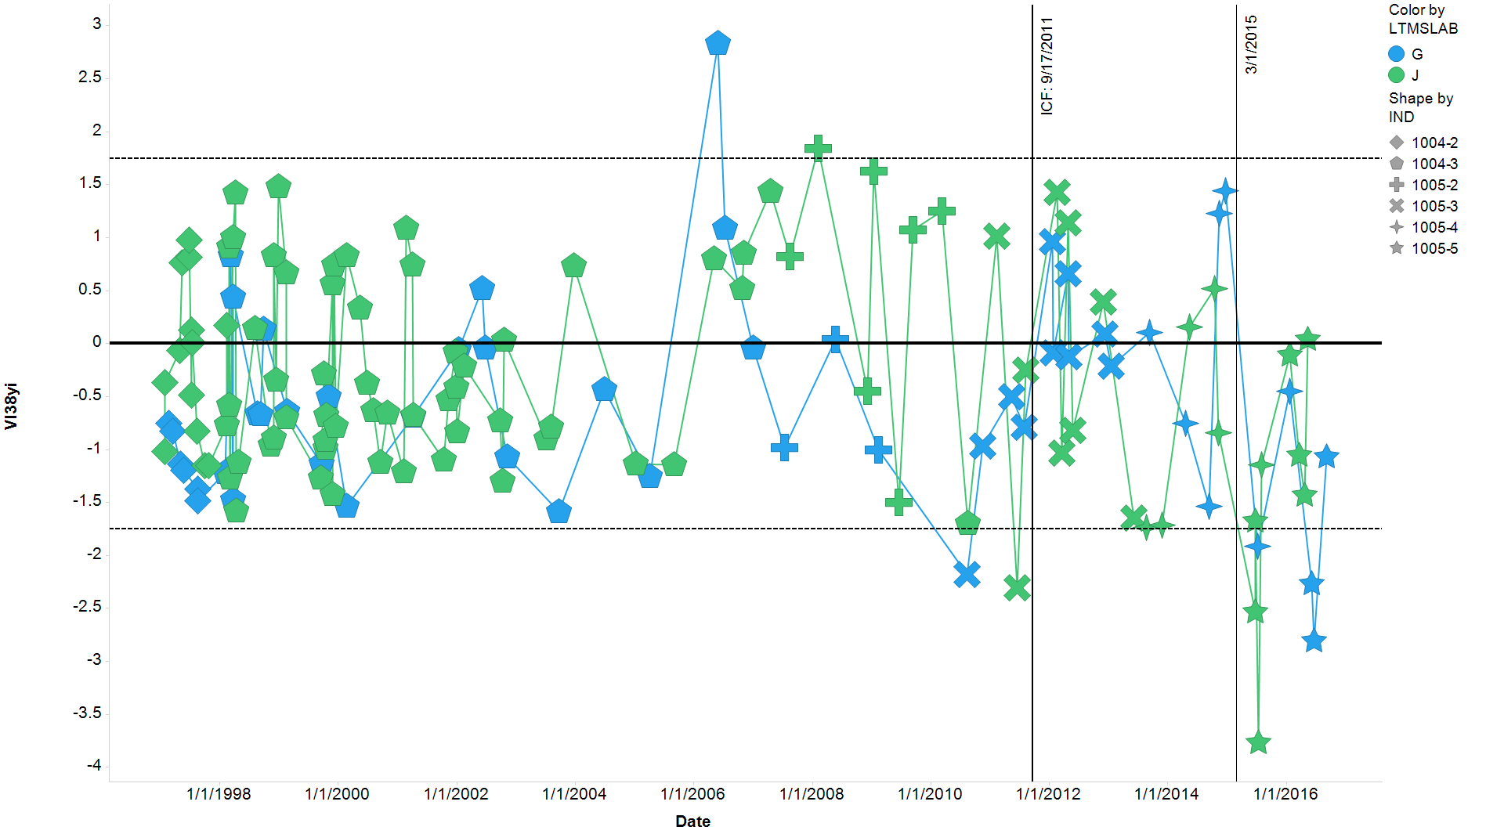
Mack T-8E Severity
VISCOSITY INCREASE 3.8% SOOT - y_{i}
All chartable tests for labs G & J

Slide 4
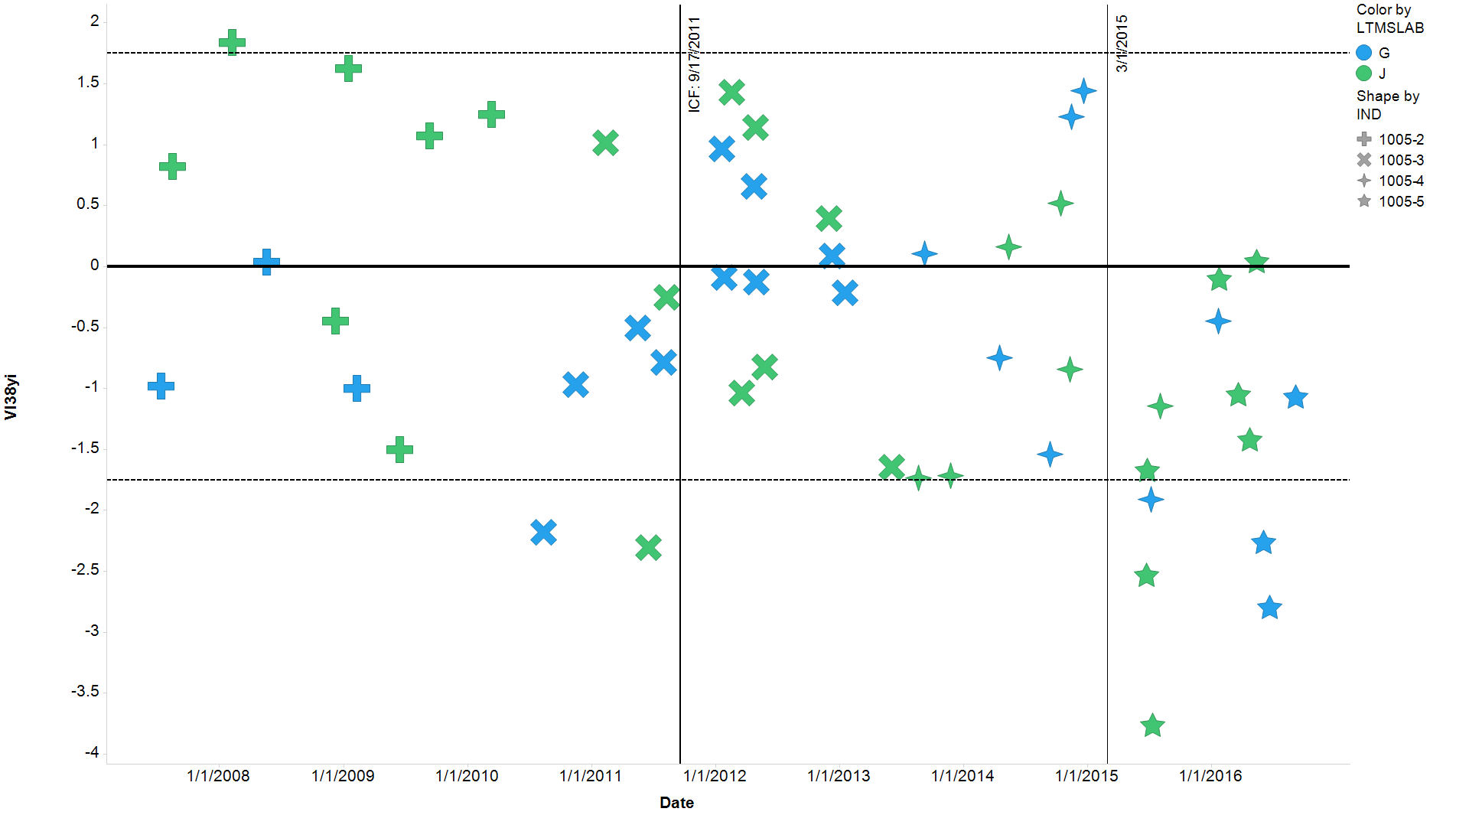
Mack T-8E Severity
VISCOSITY INCREASE 3.8% SOOT - y_{i}
1005 variants

Slide 5
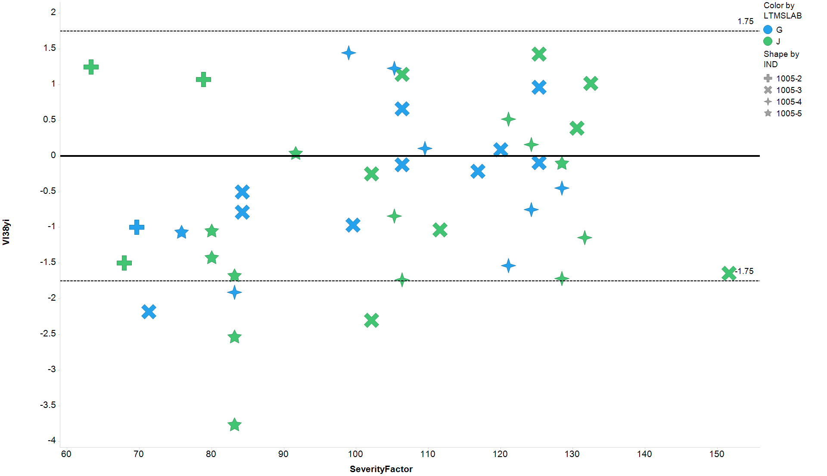
Mack T-8E Severity
VISCOSITY INCREASE 3.8% SOOT – y_{i} vs. fuel severity factor
1005 variants

Slide 6
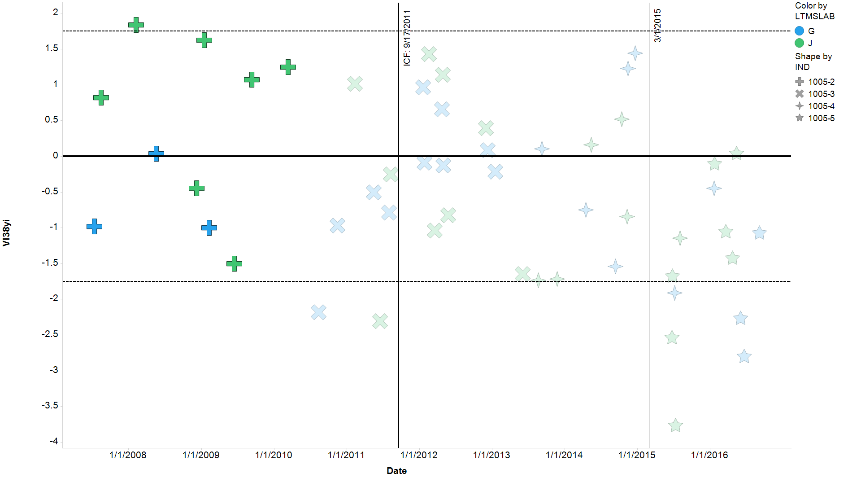
Mack T-8E Severity
VISCOSITY INCREASE 3.8% SOOT - y_{i}
1005-2 highlighted

Slide 7
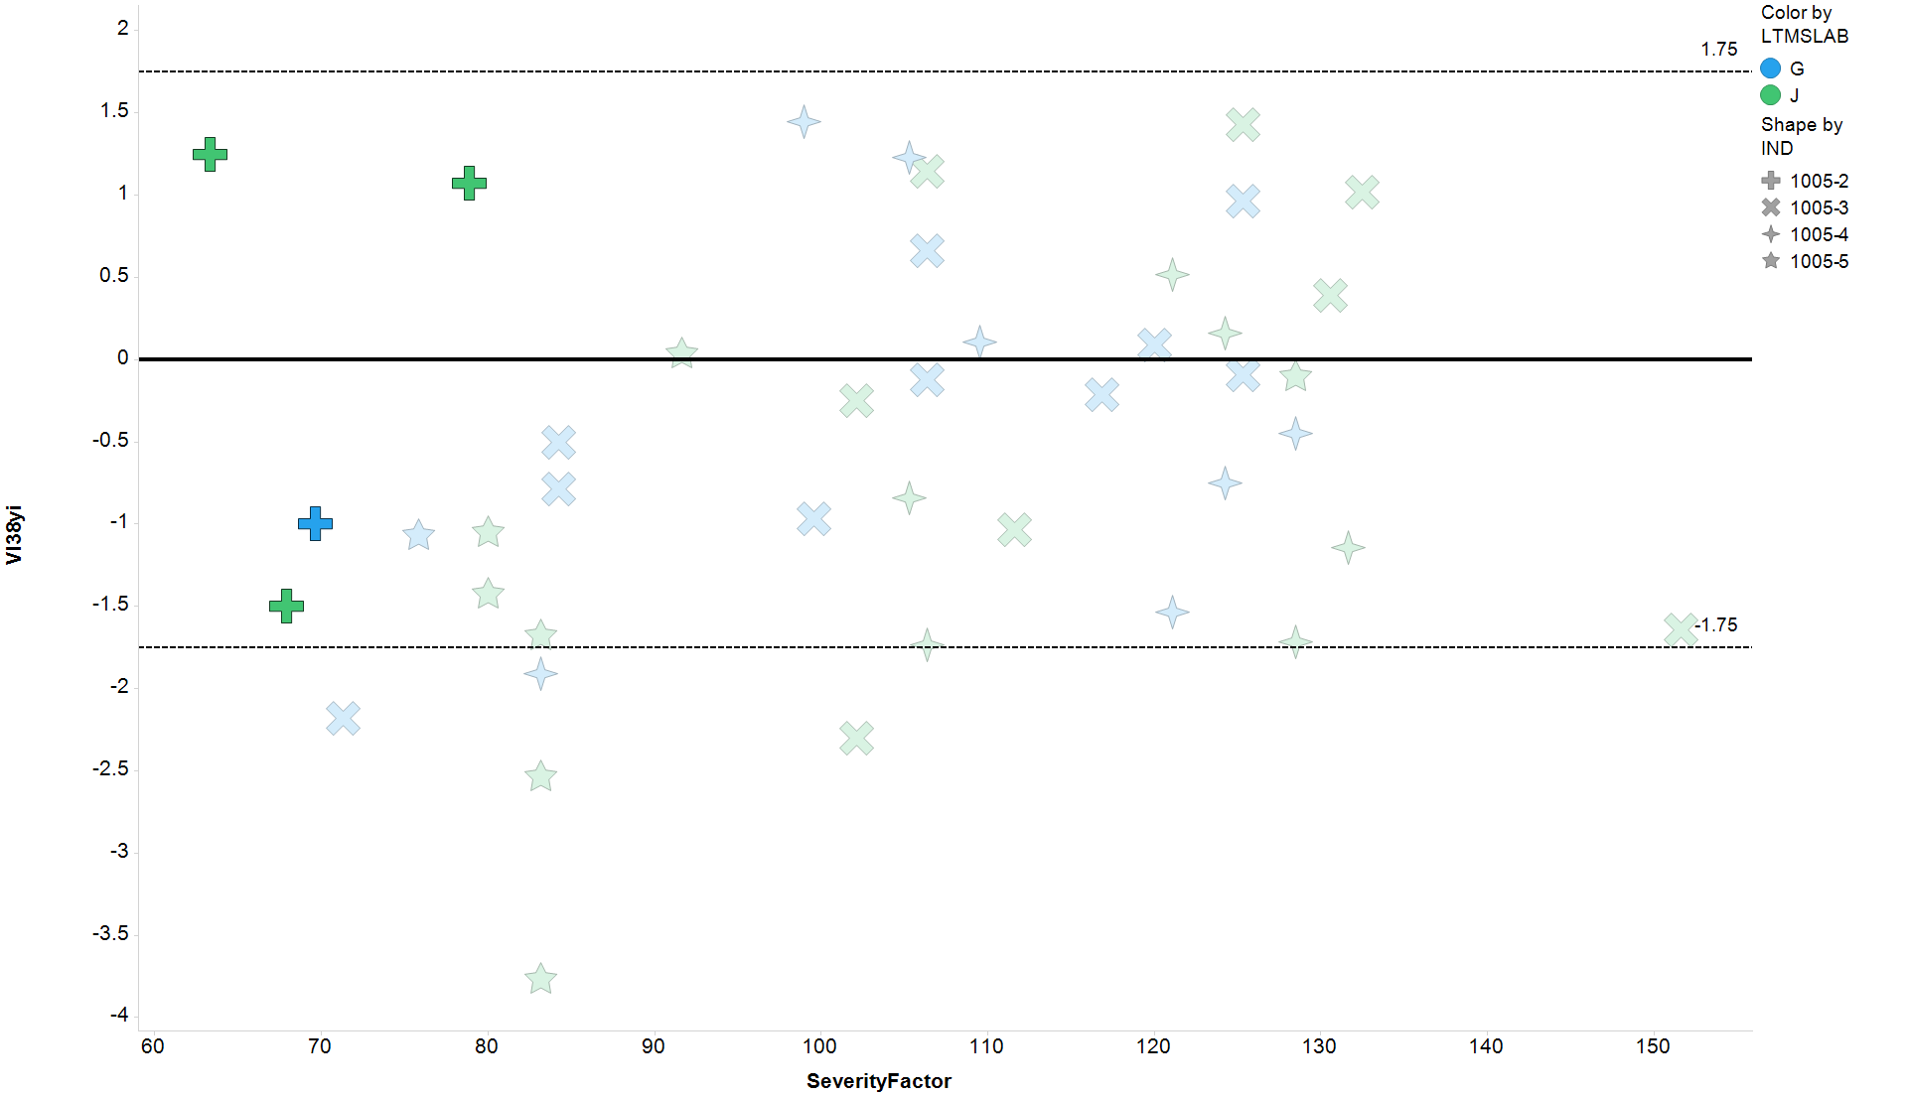
Mack T-8E Severity
VISCOSITY INCREASE 3.8% SOOT – y_{i} vs. fuel severity factor
1005-2 highlighted

Slide 8
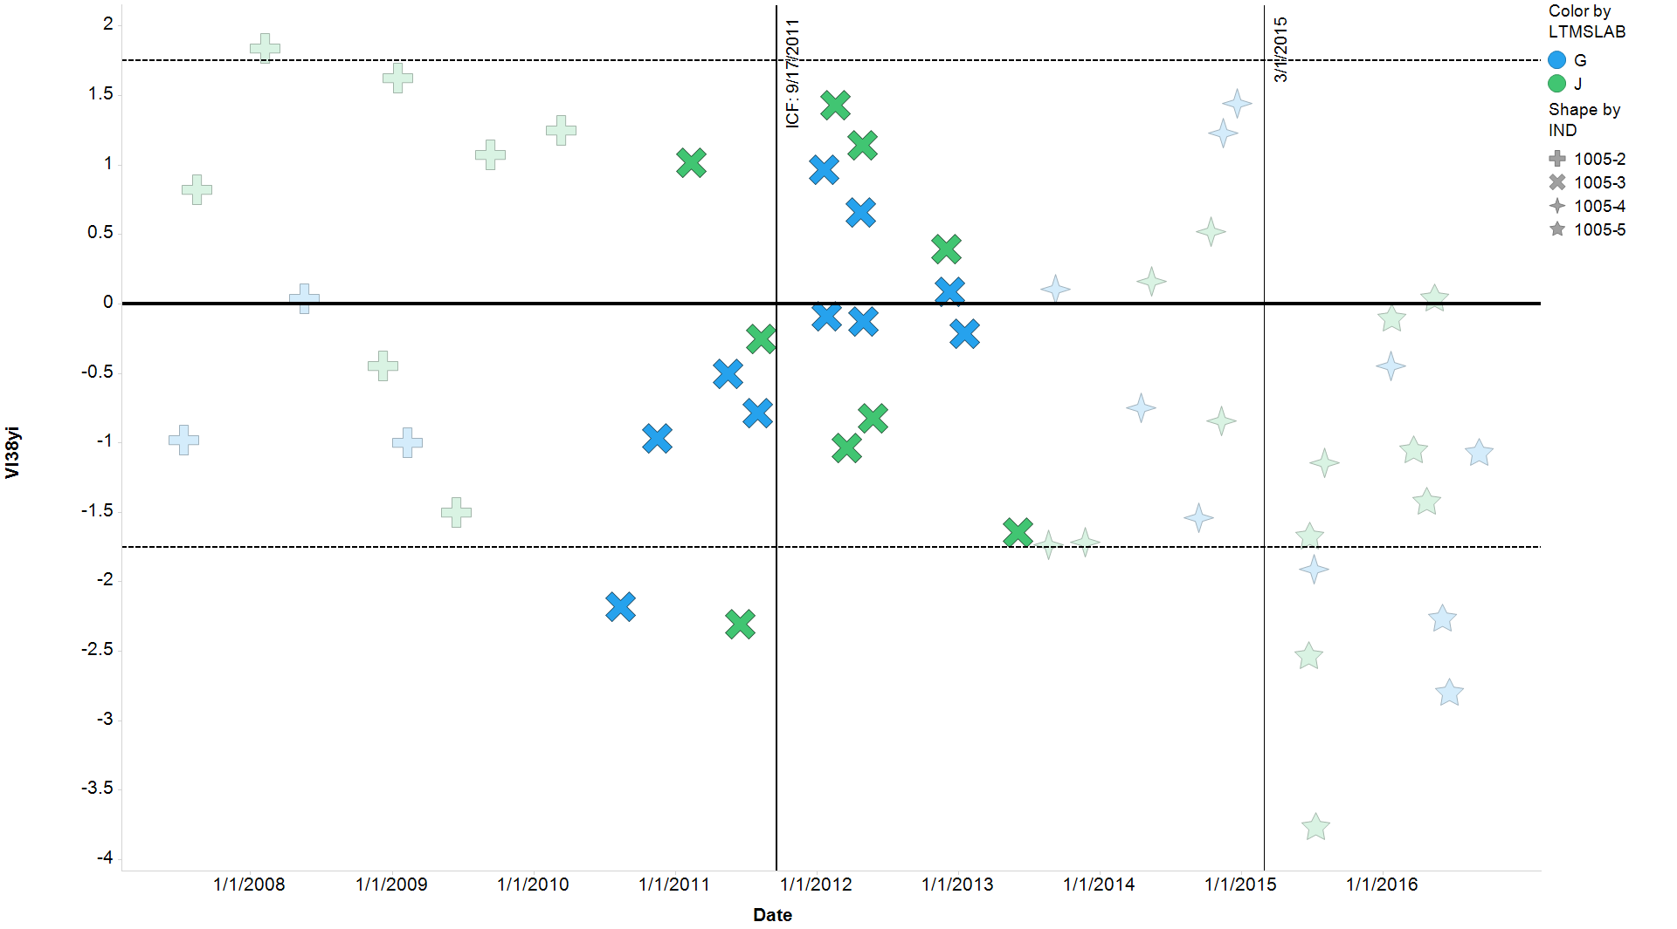
Mack T-8E Severity
VISCOSITY INCREASE 3.8% SOOT - y_{i}
1005-3 highlighted

Slide 9
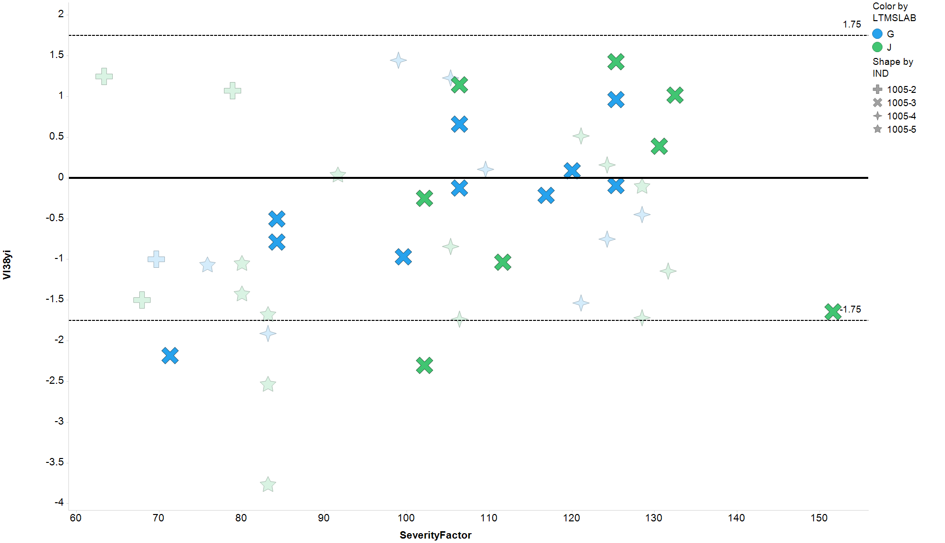
Mack T-8E Severity
VISCOSITY INCREASE 3.8% SOOT – y_{i} vs. fuel severity factor
1005-3 highlighted

Slide 10
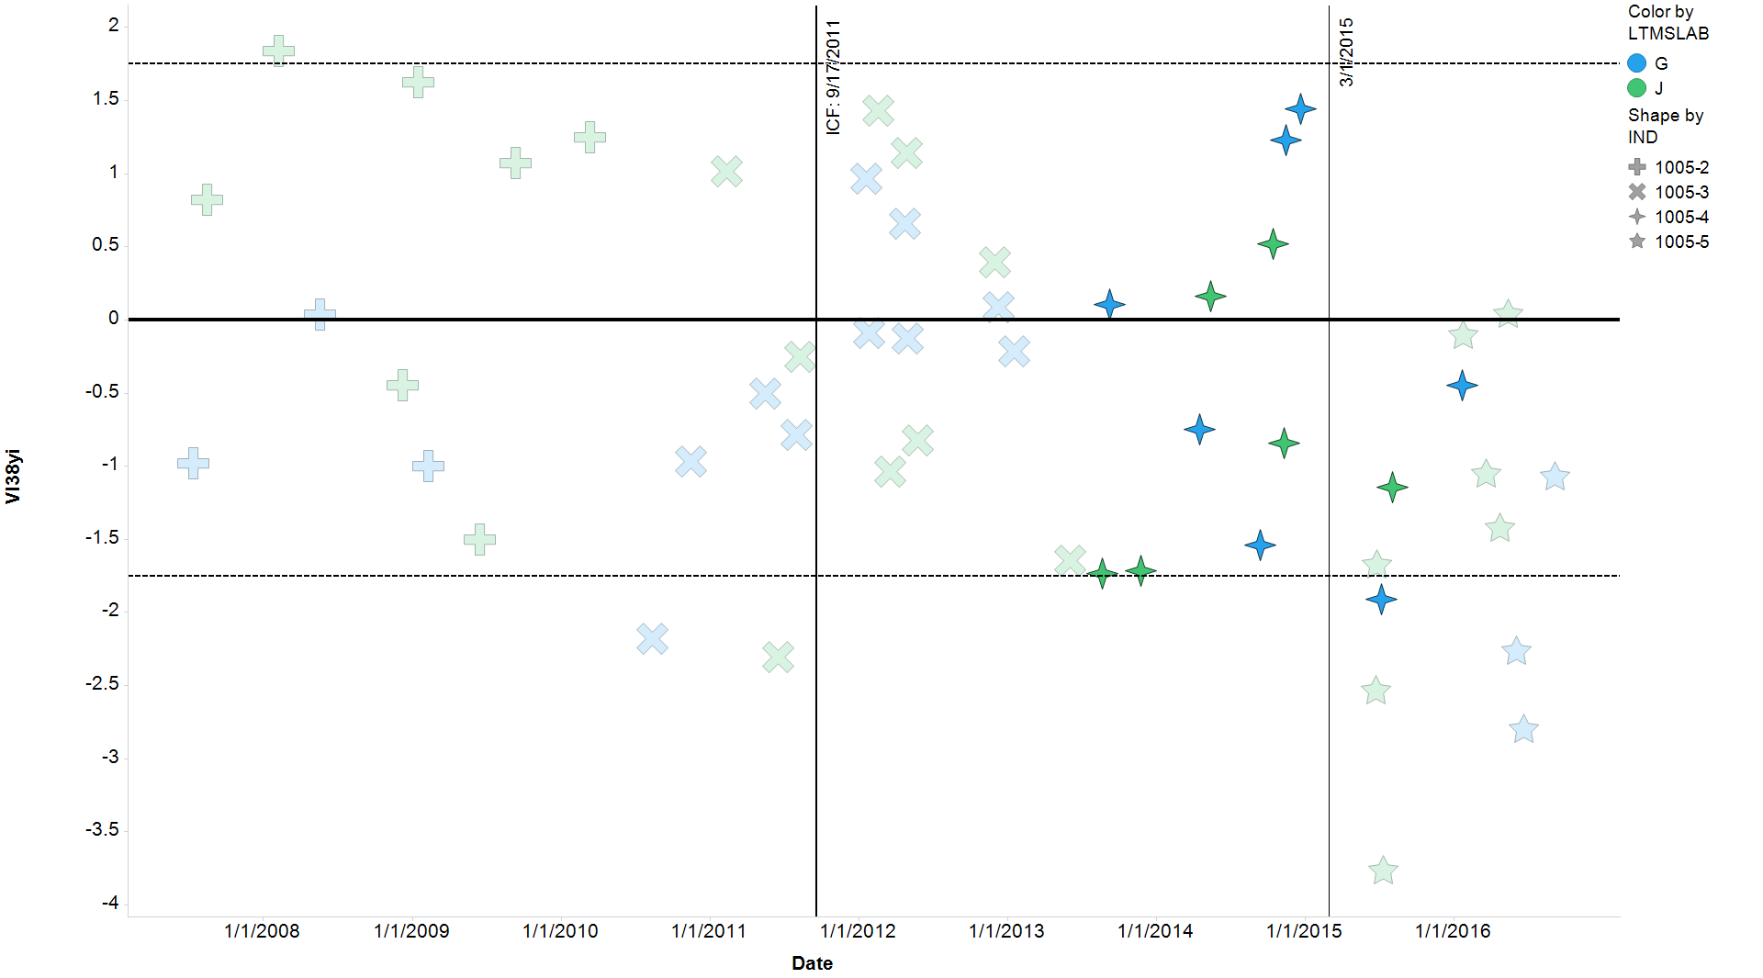
Mack T-8E Severity
VISCOSITY INCREASE 3.8% SOOT - y_{i}
1005-4 highlighted

Slide 11
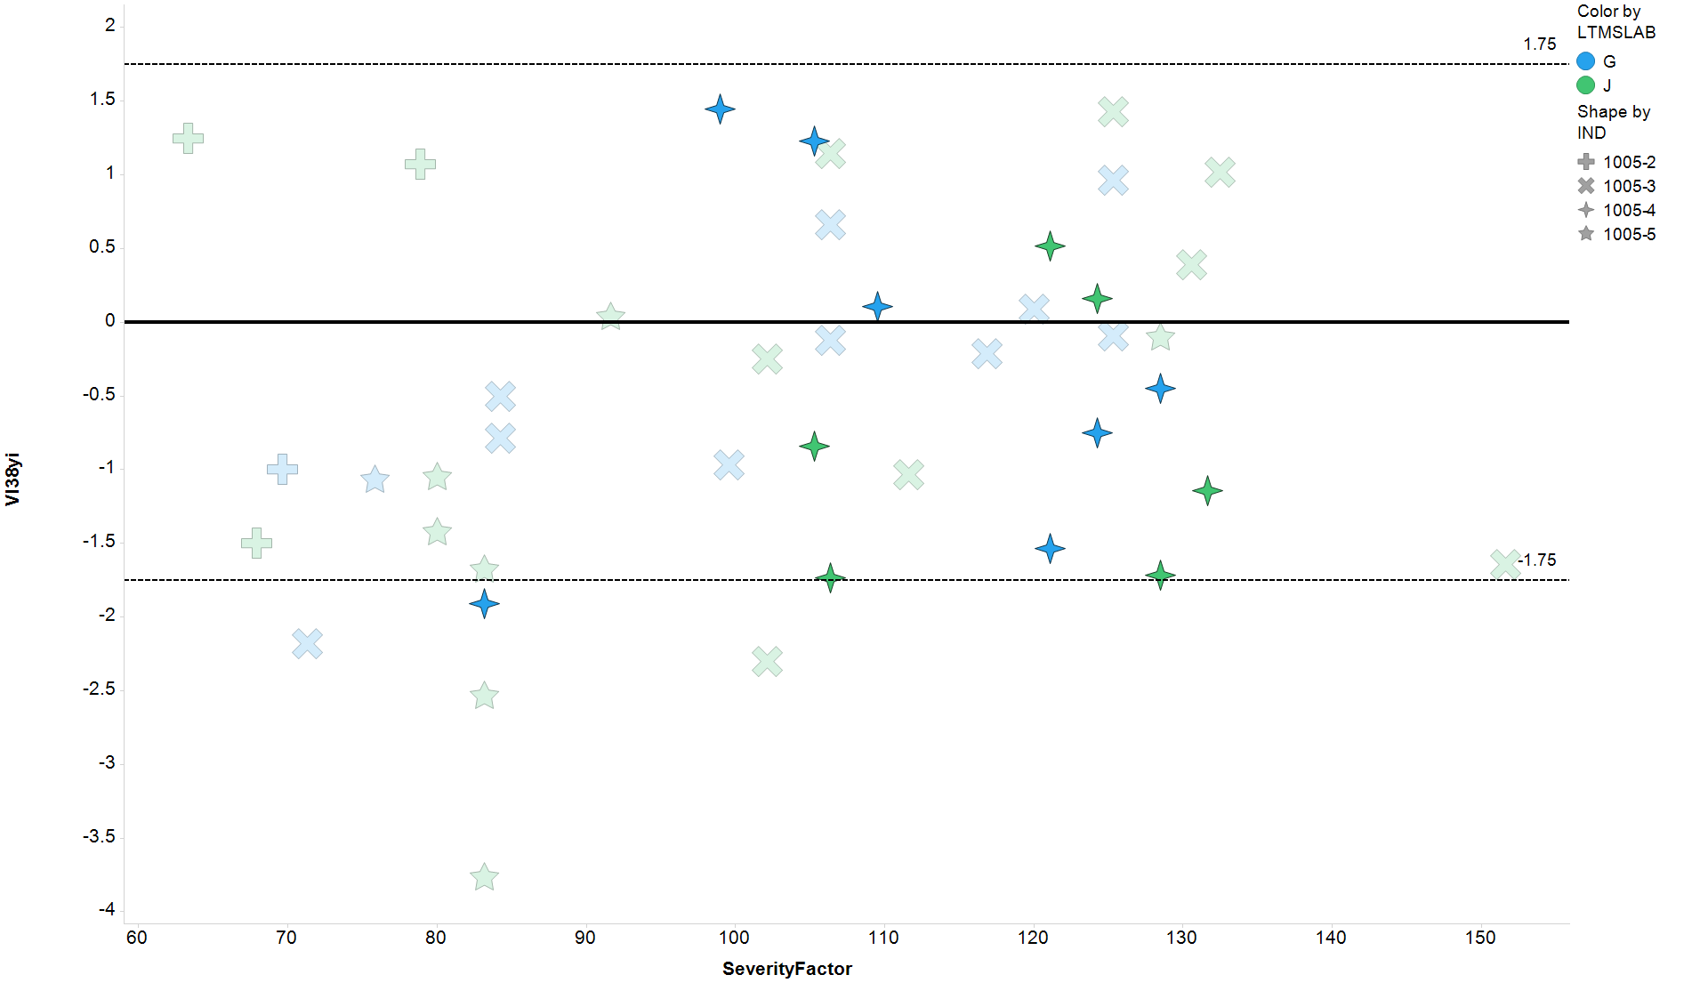
Mack T-8E Severity
VISCOSITY INCREASE 3.8% SOOT – y_{i} vs. fuel severity factor
1005-4 highlighted

Slide 12
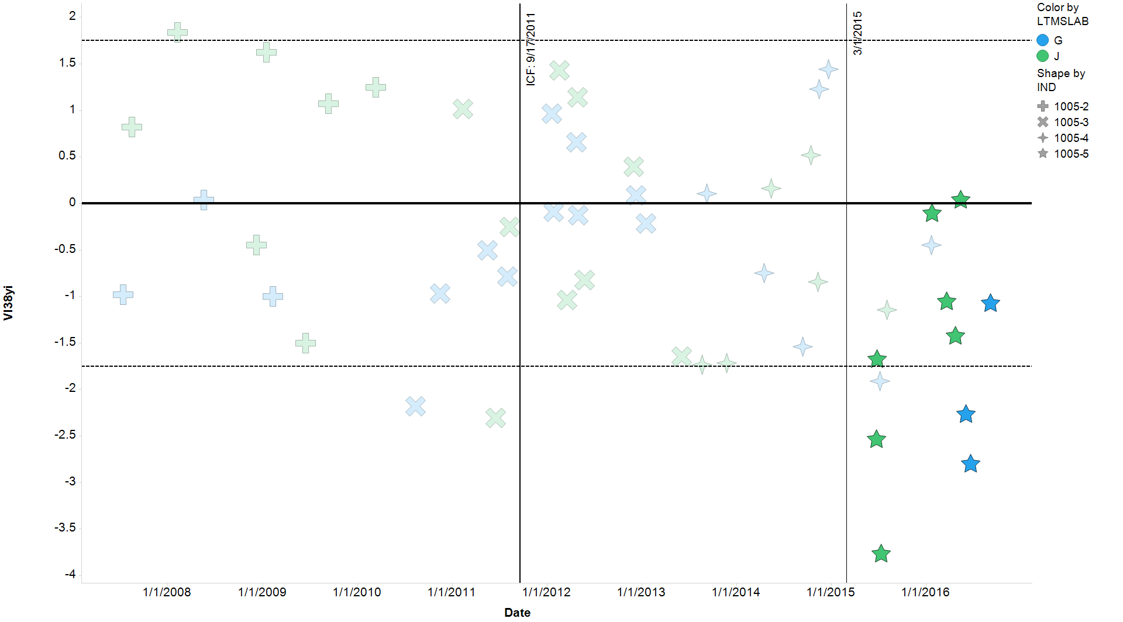
Mack T-8E Severity
VISCOSITY INCREASE 3.8% SOOT - y_{i}
1005-5 highlighted

Slide 13
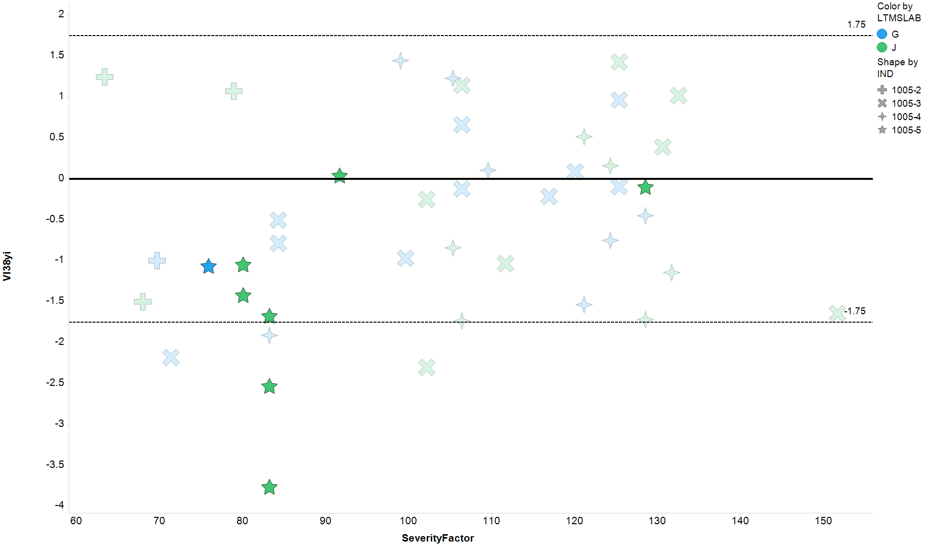
Mack T-8E Severity
VISCOSITY INCREASE 3.8% SOOT – y_{i} vs. fuel severity factor
1005-5 highlighted

Slide 14
Mack T-8E Severity
VISCOSITY INCREASE 3.8% SOOT
For those who ask about statistical significance:

