Slide 1

Volvo/Mack CPD Report
T8/T11/T12/T13

Slide 2
Volvo/Mack CPD Report
Contents
Issues/Updates/Observations
  T8/T11/T12
    Blocks
    New Parts Batches
    T-11/T-12 Skirts
Inventory and Availability
  Critical Parts
  Miscellaneous Parts

Slide 3
Volvo/Mack T11/T12
E7 Blocks
There are currently 51 bare E7 blocks left (according to Mack)
- There were 53 bare blocks at the end of 2015.

Slide 4
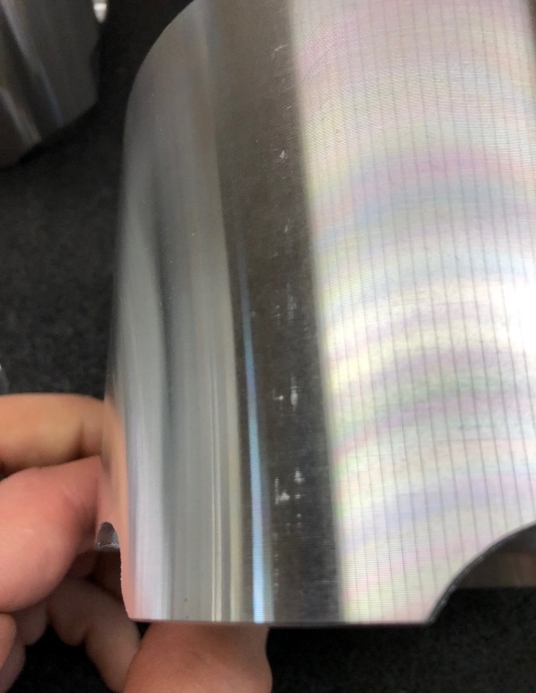
Volvo/Mack
T-11/T-12 Skirts
Most T-11/T-12 skirts have some sort of blemish.
We are currently sending out the best of what is in stock.

Slide 5
Volvo/Mack T13
New Parts Batches
A quote has been submitted to Volvo by Federal Mogul for liners, piston crowns, and skirts.
Quote is for 2,000 of each (333 kits worth)

Slide 6
T-11/T-12 Batches
How do we want to order?
Option 1: Use all of the remaining parts and order new batches as we run out.
Option 2: Start fresh with all new batches and dump the remaining inventory.
Price difference between the two options is ~$2,000,000
For liners, piston crowns, skirts, main bearings, rod bearings, and rings.

Slide 7
Volvo/Mack Kit Parts Inventory
Critical Parts Inventory
Part Description | Test Type | Part Number | Batch/Date | In Stock | ~Reject %
Cylinder Liner | T8, T11, T12 | 509GC471 | V | 522 | 10%
Piston Crown | T11, T12 | 240GC5125M | D | 154 | 5%
Piston Skirt | T8,T11, T12 | 240GC5119M | A | 160 | 20%
Piston Assembly | T8 | 215SB232A | n/a | 0 | 0%
Top Ring | T8, T11, T12 | 349GC3107 | X | 1198 | 5%
 |  |  | V | 40 | n/a
2nd Ring | T8, T11, T12 | 349GC3108 | W | 640 | 5%
Oil Ring | T8, T11, T12 | 350GC343 | W | 640 | 5%
Connecting Rod Bearing (sets) | T8, T11, T12 | *20705743 | Y | 1488 | 25%
Main Bearing (sets) | T8, T11, T12 | *25503508 | P | 225 | 15%
Cylinder Liner | T13 | 21334768 | A | 442 | 1%
Piston | T13 | **21330684 | n/a | 196 | 50%
Top Ring | T13 | **21330684 | n/a | 324 | 10%
2nd Ring | T13 | **21330684 | n/a | 324 | 10%
Oil Ring | T13 | **21330684 | n/a | 324 | 10%
Connecting Rod Bearing (sets) | T13 | **20580558 | B | 216 | 10%
Main Bearing (sets) | T13 | **20530916 | n/a | 196 | 10%

Slide 8
Volvo/Mack Miscellaneous Parts Inventory
 | Miscellaneous Parts Inventory
Test Type | Part Description | Part Number | In Stock
T8 | Injection Pump "calibrated" | 313GC5212P16X | 0
 | Injector Nozzle | 736GB343P2X | 7
T11 | EGR Cooler | 19GBX52 | 11
 | Injection Nozzle | 736GB411M2 | 28
 | Modine Intercooler | 5424-03928031 | 2
 | Turbo Small | 631GC5145M3 316686-S400 | 16
T12 | EGR Cooler | 28GB519 | 0
 | Injection Nozzle | 736GB419M3 | 34
 | Modine Intercooler | 5424-1A166566D | 2
 | Turbo Small | 631GC5176CM7 | 0
T11 and T12 | Camshaft Kit | 57GC2209A | 0
 | Cylinder Head - Low Swirl | 732GB3499M | 2
 | Electronic Actuator | 9MS42 | 1
 | Engine - Bare Block | 239GB5551M | 0
 | Engine - Basic Engine | 86SB3536N | 1
 | Exhaust Manifold Assembly (front and rear) | M10104GC5164M | 19
 | Fuel Injector Line | HL69-151 | 20
 | Fuel Injector Line | HL69-152 | 6
 | Full Flow Oil Filter | 485GB3236 | 0
 | High Temperature Hose | 3101632M | 397
 | Intake Manifold Assembly | M10105GCX4332/5212 | 1
 | Lifter Assembly | 72GC373A | 0
 | Machine Elbow | 454GC5236 | 20
 | Oil Cooler End Caps | TEI-T12OCEC | 1
 | Oil Filter Housing | 27GB528M2 | 0
 | Oil Pump Assembly - Low Flow - 9-tooth internal gears | 315GC465BM | 9
 | Connecting Rod | 367GC4243M2 | 0
 | Covert Connecting Rods | 20706148N | 42
 | Short EGR Exhaust Probe | TEGR0005 | 12
 | Turbo Gasket | TEIEX201064AM | 130
 | Turbo Large | 3801847R | 0
 | Venturi | 762GBX433SS | 2

Slide 9
Questions ?

