Slide 1
Ford LSPI Prove Out Analysis
12-17-15
Kevin O’Malley
The Lubrizol Corporation

Slide 2
Overview
40 tests included
  16 IAR (2 stands; 8 tests per stand; 2 engine builds per stand)
  16 SwRI (2 stands; 8 tests per stand; 2 engine builds per stand)
  8 LZ (1 stand; 2 engine builds)
2 oils tested (low event oil and high event oil)
  Each oil tested in duplicate within each stand-engine build combination

Slide 3
Data Table

Slide 4
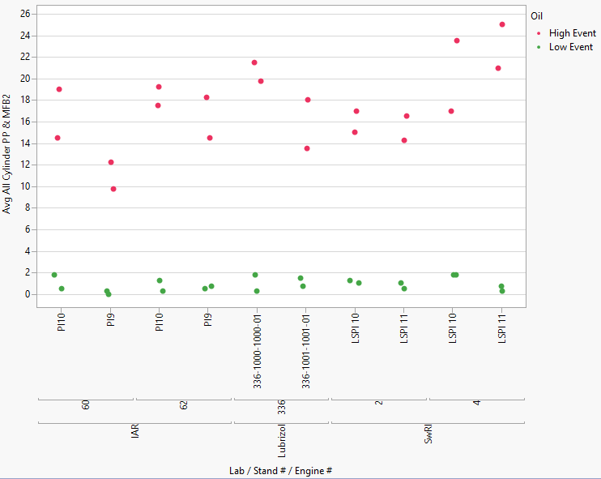
Plot of Prove out Results

Slide 5
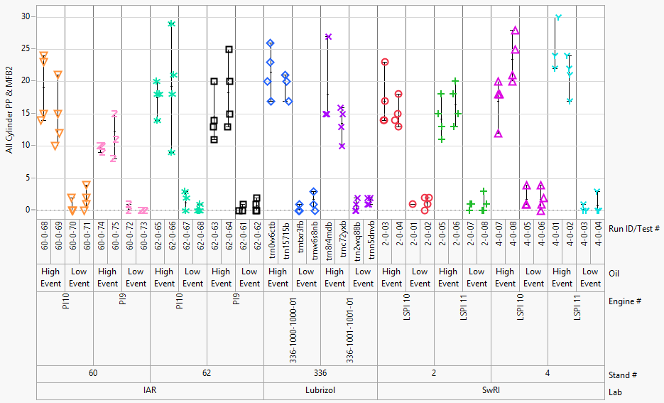
Plot of Prove out Results
The number of LSPI events is shown for each of the 4 valid iterations per test

Slide 6
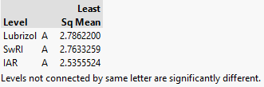

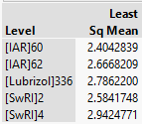
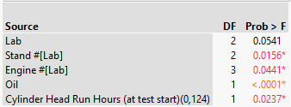

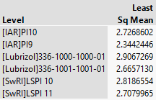
Regression Analysis – HEO & LEO
IAR tends to be more mild compared to LZ and SwRI
Overall Effects Table
IAR Stand 60 tends to be more mild than Stand 62
SwRI Stand 2 is more mild than Stand 4
Carry Over Effect not included; No strong evidence of its effect
IAR PI10 is more severe than PI9
No strong indication that engines significantly differ within other labs

Slide 7
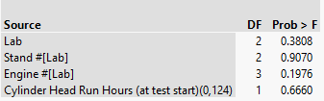
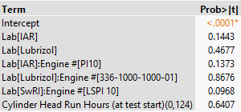
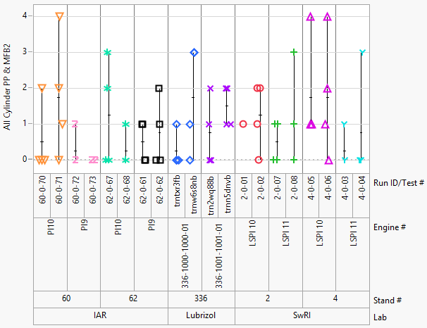
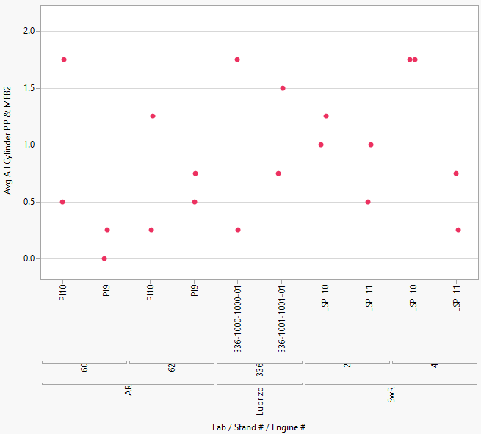
Regression Analysis – LEO Only
Overall Effects Table
On average, there is no strong evidence to conclude lab, stand, engine, and cylinder head hours affect the number of LSPI events
However, there is some evidence suggesting
  IAR is more mild than LZ and SwRI
  IAR PI10 is more severe than PI9
  SwRI LSPI 10 is more severe than LSPI 11
Parameter Estimates Table

Slide 8

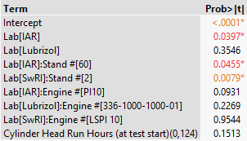

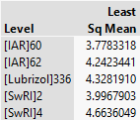
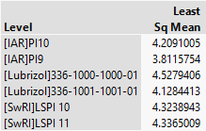
Regression Analysis – HEO Only
IAR tends to be more mild compared to LZ and SwRI
Overall Effects Table
IAR Stand 60 is more mild than Stand 62
SwRI Stand 2 is more mild than Stand 4
There is more evidence that cylinder head run hours affects LSPI events in HEO results
IAR PI10 is more severe than PI9
No strong indication that engines significantly differ within other labs

Slide 9
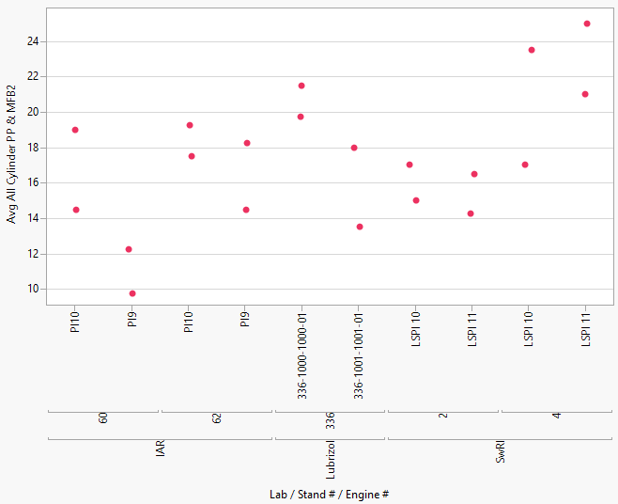
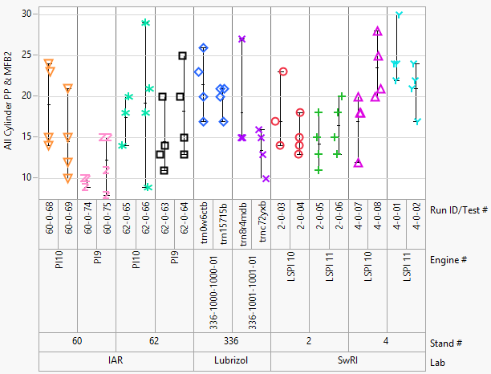
Regression Analysis – HEO Only

Slide 10
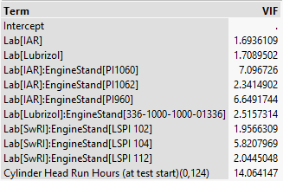
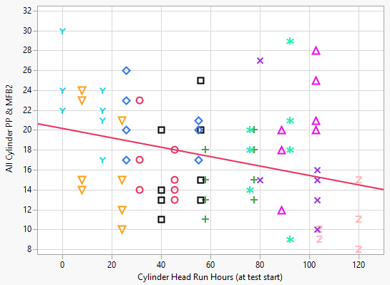
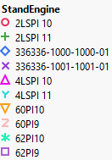
Regression Analysis – HEO Only
VIF values give us an indication of the collinearity among the factors in the model
The higher the VIF the more difficult it is to separate the factor’s effect from other terms in the model
This suggests that there could be engine-stand differences as opposed to an cylinder head hours effect
EngineStand(lab) included in the model
4LSPI 11 is on the high end of # of events
60PI9 is on the low end of # of events

Slide 11

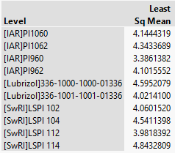

Regression Analysis – HEO Only
IAR tends to be the most mild lab
Overall Effects Table
A deeper inspection of these differences reveals:
At IAR, Stand 60 PI9 is more severe than the other stand-engine combinations
At LZ, engine 1000 tends to be more severe than 1001
At SwRI, LSPI 11 in stand 4 is more severe than both engines in stand 2

Slide 12
What are these prove-out data trying to tell us?
Option 1: There are only oil differences
(analysis suggests this is not the case, but it’s still possible)
Perhaps 62-0-66 suggests a wide range of variability and the other differences observed in the data are happening by chance

Slide 13
What are these prove-out data trying to tell us?
Option 2: There are oil differences and the effect of cylinder head run hours is real
IAR is the most mild lab on average
IAR Stand 60 is more mild than Stand 62
SwRI Stand 2 is more mild than Stand 4
IAR PI10 is more severe than PI9

Slide 14
What are these prove-out data trying to tell us?
Option 3: There are oil and stand-engine differences
IAR tends to be the most mild lab
At IAR, Stand 60 PI9 is more severe than the other stand-engine combinations
At LZ, engine 1000 tends to be more severe than 1001
At SwRI, LSPI 11 in stand 4 is more severe than both engines in stand 2

Slide 15
General Comments
It is not very clear what explains variability in the number of LSPI events
  It’s possible that cylinder head hours affects the variability
  Or it could be attributed to something related to setting up engine-stand combinations
  Or it could be that the only difference in LSPI events is the oil
  Or it could be build or operational data differences
  Or it could be something we have not yet identified or recorded
The complexity in these data should be kept in mind when setting up LTMS post precision matrix
  We may find that the most conservative approach is an engine-stand based system

Slide 16
Quest to Understand Sources of variability
Assume each of the 3 options is plausible
Mine operational data and build data to identify correlations for further review
  Mean, median, and standard deviation of each operational parameter
    Summarized by iteration
  Build data is unique to the engine
Trend lines have been added to plots, but should be used with caution
Comments
  When option 1 is assumed, build and a few operational differences could be affecting the number of LSPI events
    These differences generally line up with stand-engine differences
  When options 2 and 3 are assumed, build and operational differences do not appear to explain the residual variability

Slide 17
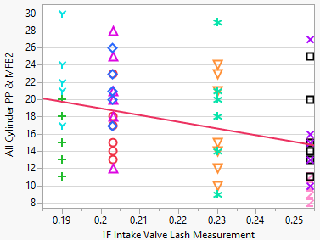
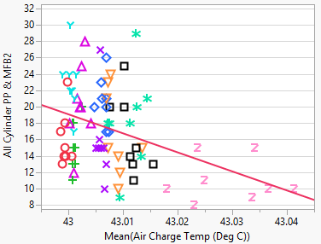
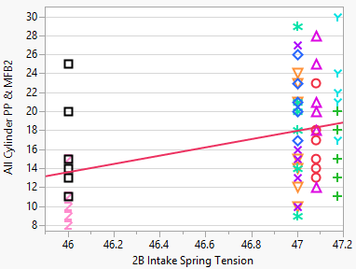
Quest to Understand Sources of variability - Option1

Slide 18
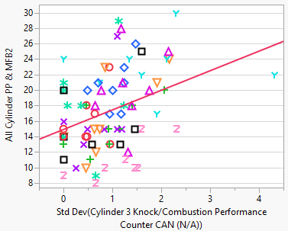
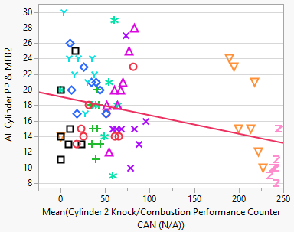
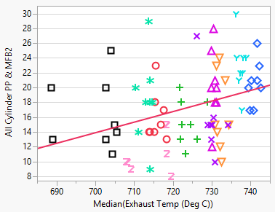
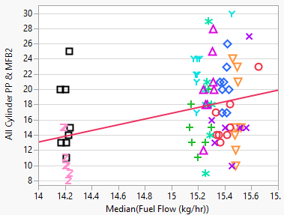
Quest to Understand Sources of variability - Option1

Slide 19
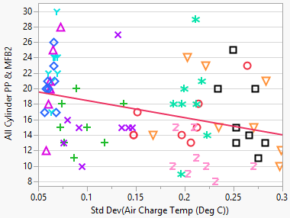
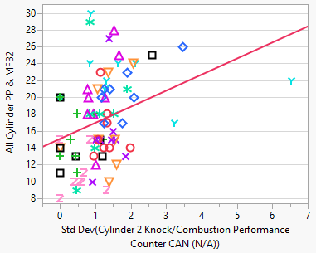
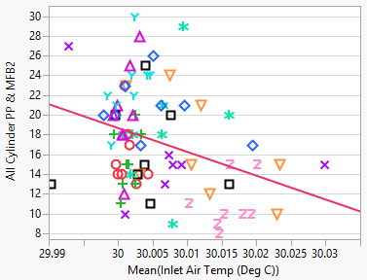
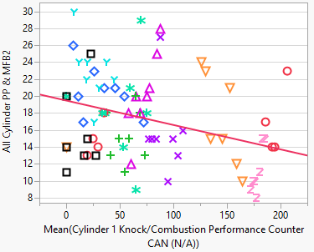
Quest to Understand Sources of variability - Option1

Slide 20
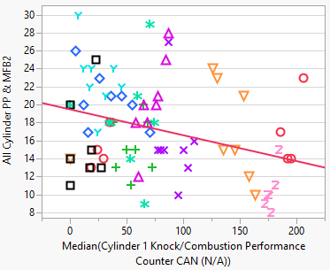
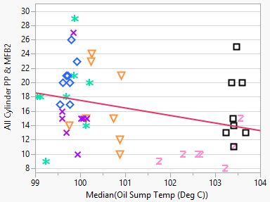
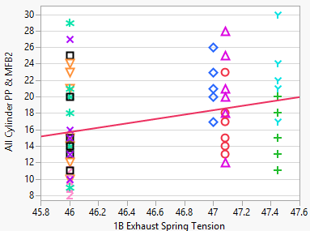
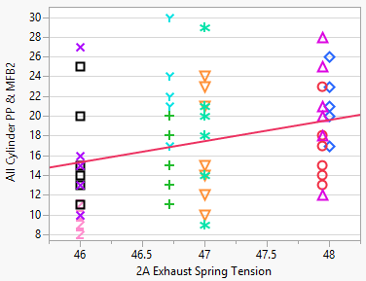
Quest to Understand Sources of variability - Option1

Slide 21
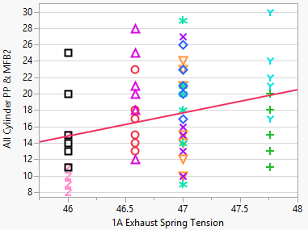
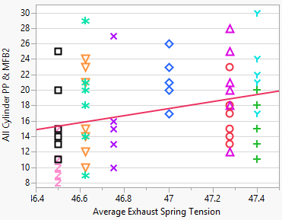
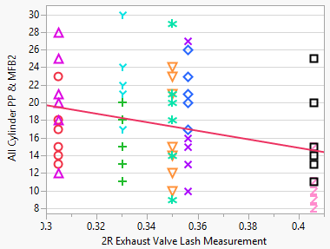
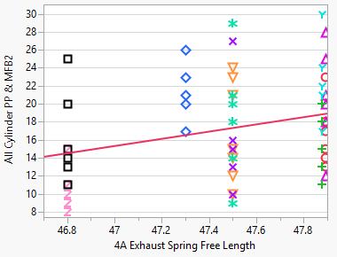
Quest to Understand Sources of variability - Option1

Slide 22
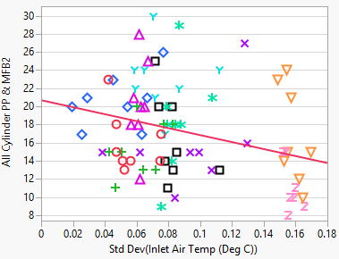
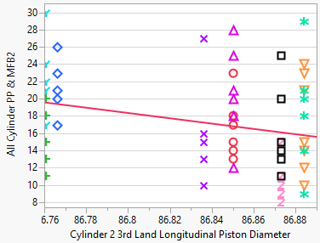
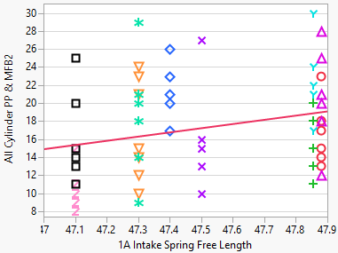
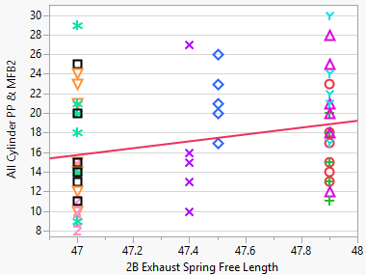
Quest to Understand Sources of variability - Option1

Slide 23
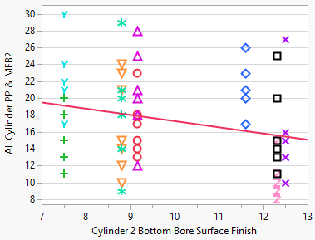
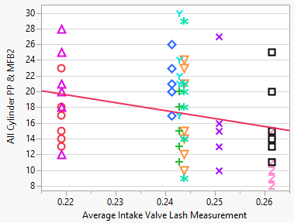
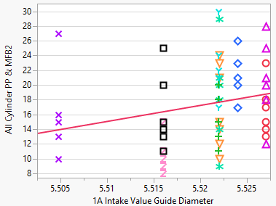
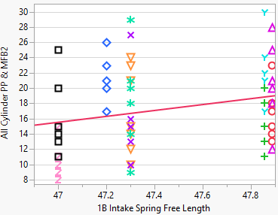
Quest to Understand Sources of variability - Option1

Slide 24
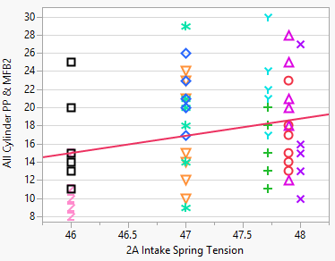
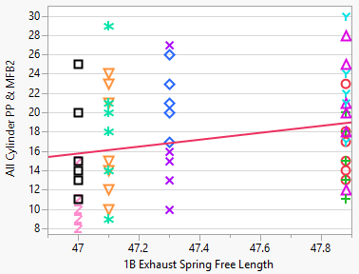
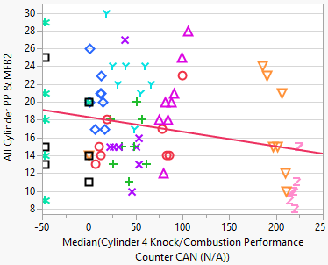
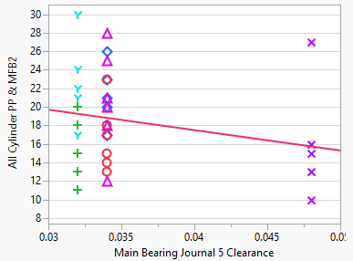
Quest to Understand Sources of variability - Option1

Slide 25



Quest to Understand Sources of variability - Option1

Slide 26
Quest to Understand Sources of variability – Option2
Build and operational differences do not appear to explain the residual variability

Slide 27
Quest to Understand Sources of variability – Option2
Build and operational differences do not appear to explain the residual variability

Slide 28
Operational Data Plots

Slide 29
Overview
Operational parameters are plotted versus cumulative time
  Cumulative time is a combination of time from valid iterations A, B, C, and D; time at start of iteration A = 0hrs
Each RunID/Test # is plotted in a separate pane
Each parameter has plots with a legend for both lab and number of LSPI events (a.k.a. All Cylinder PP & MFB2)
CAN data are plotted with and without stand 62

Slide 30
Engine Speed

Slide 31


Slide 32

Low Event Oil
ZOOMED IN

Slide 33

High Event Oil

Slide 34
Engine Load

Slide 35


Slide 36

Low Event Oil
ZOOMED IN

Slide 37

High Event Oil

Slide 38
Coolant Out Temperature

Slide 39


Slide 40

Low Event Oil
ZOOMED IN

Slide 41

High Event Oil

Slide 42
Oil Gallery Temperature

Slide 43


Slide 44

Low Event Oil
ZOOMED IN

Slide 45

High Event Oil

Slide 46
Air Charge Temperature

Slide 47


Slide 48

Low Event Oil
ZOOMED IN

Slide 49

High Event Oil

Slide 50
Inlet Air Temperature

Slide 51


Slide 52

ZOOMED IN

Slide 53

Low Event Oil
ZOOMED IN

Slide 54

High Event Oil

Slide 55
Inlet Air Pressure

Slide 56


Slide 57

Low Event Oil
ZOOMED IN

Slide 58

High Event Oil

Slide 59
Exhaust Back Pressure

Slide 60


Slide 61

Low Event Oil
ZOOMED IN

Slide 62

High Event Oil

Slide 63
Fuel Temperature

Slide 64


Slide 65

ZOOMED IN

Slide 66

Low Event Oil
ZOOMED IN

Slide 67

High Event Oil

Slide 68
Fuel Flow

Slide 69


Slide 70

Low Event Oil
ZOOMED IN

Slide 71

High Event Oil

Slide 72
Air Charge Pressure

Slide 73


Slide 74

Low Event Oil
ZOOMED IN

Slide 75

High Event Oil

Slide 76
Barometric Pressure

Slide 77


Slide 78

Low Event Oil
ZOOMED IN

Slide 79

High Event Oil

Slide 80
Atmospheric Temp

Slide 81


Slide 82

Low Event Oil
ZOOMED IN

Slide 83

High Event Oil

Slide 84
Crankcase Pressure

Slide 85


Slide 86

ZOOMED IN

Slide 87

Low Event Oil
ZOOMED IN

Slide 88

Low Event Oil
ZOOMED IN

Slide 89

High Event Oil

Slide 90

High Event Oil
ZOOMED IN

Slide 91
Blowby Flow

Slide 92


Slide 93

Low Event Oil
ZOOMED IN

Slide 94

High Event Oil

Slide 95
Oil Sump Temp

Slide 96


Slide 97

Low Event Oil
ZOOMED IN

Slide 98

High Event Oil

Slide 99
Oil Fiter In Temp

Slide 100


Slide 101

Low Event Oil
ZOOMED IN

Slide 102

High Event Oil

Slide 103
Exhaust Temp

Slide 104


Slide 105

Low Event Oil
ZOOMED IN

Slide 106

High Event Oil

Slide 107
Ignition Timing Advance for #1 Cylinder CAN

Slide 108


Slide 109

ZOOMED IN

Slide 110

Low Event Oil
ZOOMED IN

Slide 111

High Event Oil

Slide 112
Absolute Throttle Position CAN

Slide 113


Slide 114

ZOOMED IN

Slide 115

Low Event Oil
ZOOMED IN

Slide 116

High Event Oil
ZOOMED IN

Slide 117
Engine Coolant Temperature CAN

Slide 118


Slide 119

ZOOMED IN

Slide 120

Low Event Oil
ZOOMED IN

Slide 121

High Event Oil
ZOOMED IN

Slide 122
Intake Air Temperature CAN

Slide 123


Slide 124

ZOOMED IN

Slide 125

Low Event Oil
ZOOMED IN

Slide 126

High Event Oil
ZOOMED IN

Slide 127
Equivalence Ratio (Lambda) CAN

Slide 128


Slide 129

ZOOMED IN

Slide 130

ZOOMED IN

Slide 131

Low Event Oil
ZOOMED IN

Slide 132

High Event Oil
ZOOMED IN

Slide 133
Absolute Load Value CAN

Slide 134


Slide 135

ZOOMED IN

Slide 136

Low Event Oil
ZOOMED IN

Slide 137

High Event Oil
ZOOMED IN

Slide 138
Intake Manifold Absolute Pressure CAN

Slide 139


Slide 140

ZOOMED IN

Slide 141

Low Event Oil
ZOOMED IN

Slide 142

High Event Oil
ZOOMED IN

Slide 143
Fuel Rail Pressure CAN

Slide 144


Slide 145

ZOOMED IN

Slide 146

Low Event Oil
ZOOMED IN

Slide 147

High Event Oil
ZOOMED IN

Slide 148
Boost Absolute Pressure - Raw Value CAN

Slide 149


Slide 150

ZOOMED IN

Slide 151

Low Event Oil
ZOOMED IN

Slide 152

High Event Oil
ZOOMED IN

Slide 153
Turbocharger/Supercharger Wastegate Solenoid A Duty Cycle CAN

Slide 154


Slide 155

ZOOMED IN

Slide 156

Low Event Oil
ZOOMED IN

Slide 157

High Event Oil
ZOOMED IN

Slide 158
Actual Intake (A) Camshaft Position Bank 1 CAN

Slide 159


Slide 160

ZOOMED IN

Slide 161

ZOOMED IN

Slide 162

Low Event Oil
ZOOMED IN

Slide 163

Low Event Oil
ZOOMED IN

Slide 164

High Event Oil
ZOOMED IN

Slide 165

High Event Oil
ZOOMED IN

Slide 166
Actual Exhaust (B) Camshaft Position Bank 1 CAN

Slide 167


Slide 168

ZOOMED IN

Slide 169

Low Event Oil
ZOOMED IN

Slide 170

High Event Oil
ZOOMED IN

Slide 171
Intake (A) Camshaft Position Actuator Duty Cycle Bank 1 CAN

Slide 172


Slide 173

ZOOMED IN

Slide 174

Low Event Oil
ZOOMED IN

Slide 175

High Event Oil
ZOOMED IN

Slide 176
Exhaust (B) Camshaft Position Actuator Duty Cycle Bank 1 CAN

Slide 177


Slide 178

ZOOMED IN

Slide 179

Low Event Oil
ZOOMED IN

Slide 180

High Event Oil
ZOOMED IN

Slide 181
Charge Air Cooler Temperature Bank 1 Sensor 1 - Raw CAN

Slide 182


Slide 183

ZOOMED IN

Slide 184

Low Event Oil
ZOOMED IN

Slide 185

High Event Oil
ZOOMED IN

Slide 186
Cylinder 1 Knock/Combustion Performance Counter CAN

Slide 187


Slide 188

Low Event Oil
ZOOMED IN

Slide 189

High Event Oil

Slide 190
Cylinder 2 Knock/Combustion Performance Counter CAN

Slide 191


Slide 192

Low Event Oil
ZOOMED IN

Slide 193

High Event Oil

Slide 194
Cylinder 3 Knock/Combustion Performance Counter CAN

Slide 195


Slide 196

Low Event Oil
ZOOMED IN

Slide 197

High Event Oil

Slide 198
Cylinder 4 Knock/Combustion Performance Counter CAN

Slide 199


Slide 200

Low Event Oil
ZOOMED IN

Slide 201

High Event Oil

Slide 202
Accelerator Pedal Position D CAN

Slide 203


Slide 204

ZOOMED IN

Slide 205

ZOOMED IN

Slide 206

Low Event Oil
ZOOMED IN

Slide 207

Low Event Oil
ZOOMED IN

Slide 208

High Event Oil
ZOOMED IN

Slide 209

High Event Oil
ZOOMED IN

Slide 210
Build Data

Slide 211
Average LSPI events per test are plotted versus lab-stand-engine combinations
The color on the plot is associated with the various build measurements collected

Slide 212


Slide 213


Slide 214


Slide 215


Slide 216


Slide 217


Slide 218


Slide 219


Slide 220


Slide 221


Slide 222


Slide 223


Slide 224


Slide 225


Slide 226


Slide 227


Slide 228


Slide 229


Slide 230


Slide 231


Slide 232


Slide 233


Slide 234


Slide 235


Slide 236


Slide 237


Slide 238


Slide 239


Slide 240


Slide 241


Slide 242


Slide 243


Slide 244


Slide 245


Slide 246


Slide 247


Slide 248


Slide 249


Slide 250


Slide 251


Slide 252


Slide 253


Slide 254


Slide 255


Slide 256


Slide 257


Slide 258


Slide 259


Slide 260


Slide 261


Slide 262


Slide 263


Slide 264


Slide 265


Slide 266


Slide 267


Slide 268


Slide 269


Slide 270


Slide 271


Slide 272


Slide 273


Slide 274


Slide 275


Slide 276


Slide 277


Slide 278


Slide 279


Slide 280


Slide 281


Slide 282


Slide 283


Slide 284


Slide 285


Slide 286


Slide 287


Slide 288


Slide 289


Slide 290


Slide 291


Slide 292


Slide 293


Slide 294


Slide 295


Slide 296


Slide 297


Slide 298


Slide 299


Slide 300


Slide 301


Slide 302


Slide 303


Slide 304


Slide 305


Slide 306


Slide 307


Slide 308


Slide 309


Slide 310


Slide 311


Slide 312


Slide 313


Slide 314


Slide 315


Slide 316


Slide 317


Slide 318


Slide 319


Slide 320


Slide 321


Slide 322


Slide 323


Slide 324


Slide 325


Slide 326


Slide 327


Slide 328


Slide 329


Slide 330


Slide 331


Slide 332


Slide 333


Slide 334


Slide 335


Slide 336


Slide 337


Slide 338


Slide 339


Slide 340


Slide 341


Slide 342


Slide 343


Slide 344


Slide 345


Slide 346


Slide 347


Slide 348


Slide 349


Slide 350


Slide 351


Slide 352


Slide 353


Slide 354


Slide 355


Slide 356


Slide 357


Slide 358


Slide 359


Slide 360


Slide 361


Slide 362


Slide 363


Slide 364


Slide 365


Slide 366


Slide 367


Slide 368


Slide 369


Slide 370


Slide 371


Slide 372


Slide 373


Slide 374


Slide 375


Slide 376


Slide 377


Slide 378


Slide 379


Slide 380


Slide 381


Slide 382


Slide 383


Slide 384


Slide 385


Slide 386


Slide 387


Slide 388


Slide 389


Slide 390


Slide 391


Slide 392


Slide 393


Slide 394


Slide 395


Slide 396


Slide 397


Slide 398


Slide 399


Slide 400


Slide 401


Slide 402


Slide 403


Slide 404


Slide 405


Slide 406


Slide 407


Slide 408


Slide 409


Slide 410


Slide 411


Slide 412


Slide 413


Slide 414


Slide 415


Slide 416


Slide 417


Slide 418


Slide 419


Slide 420


Slide 421


Slide 422


Slide 423


Slide 424


Slide 425


Slide 426


Slide 427


Slide 428


Slide 429


Slide 430


Slide 431


Slide 432


Slide 433


Slide 434


Slide 435


Slide 436


Slide 437


Slide 438


Slide 439


Slide 440


Slide 441


Slide 442


Slide 443


Slide 444


Slide 445


Slide 446


Slide 447


Slide 448


Slide 449


Slide 450


Slide 451


Slide 452


Slide 453


Slide 454


Slide 455


Slide 456


Slide 457


Slide 458


Slide 459


Slide 460


Slide 461


Slide 462


Slide 463


Slide 464


Slide 465


Slide 466


Slide 467


Slide 468


Slide 469


Slide 470


Slide 471


Slide 472


Slide 473


Slide 474


Slide 475


Slide 476


Slide 477


Slide 478


Slide 479


Slide 480


Slide 481


Slide 482


Slide 483


Slide 484


Slide 485


Slide 486


Slide 487


Slide 488


Slide 489


Slide 490


Slide 491


Slide 492


Slide 493


Slide 494


Slide 495


Slide 496


Slide 497


Slide 498


Slide 499


Slide 500


Slide 501


Slide 502


Slide 503


Slide 504


Slide 505


Slide 506


Slide 507


Slide 508


Slide 509


Slide 510


Slide 511


Slide 512


Slide 513


Slide 514


Slide 515


