Slide 1

LSPI Precision Matrix + Non-PM Data Analysis
Statistics Group
Mar 24, 2017

Slide 2
Statistics Group
Arthur Andrews, ExxonMobil
Doyle Boese, Infineum
Jo Martinez, Chevron Oronite
Kevin O’Malley, Lubrizol
Martin Chadwick, Intertek
Richard Grundza, TMC
Lisa Dingwell, Afton
Todd Dvorak, Afton
Travis Kostan, SwRI

Slide 3
Thoughts from Stats Group
The test discriminate oils and shows adequate repeatability.
Issues that the Stats Group could not reach a consensus:
With or without engine hour adjustment
Oil to use in the model to estimate precision and LTMS targets (with or without 220)
  220 is not a reference oil used for Severity Adjustment
  Fail to estimate precision in the range of results if we don’t include 220

Slide 4
With Engine Hour Effect

Slide 5
Summary
Data utilized is 221 and 222 Precision Matrix and non-Matrix data (n = 24).
LSPI transformed as Ln[AVPIE + 1] and Sqrt[AVPIE + 0.5] was regressed on Lab, Stand[Lab], Engine[Stand, Lab], Oil, and EngHrs.
  p-Values for EngHrs were 0.13 and 0.15.
Engine hour term is borderline statistically significant
  Regardless of practical data subset, EngHr coefficient is negative.
  Plots on following slides indicate consistent negative correlation between AVPIE and EngHrs.

Slide 6
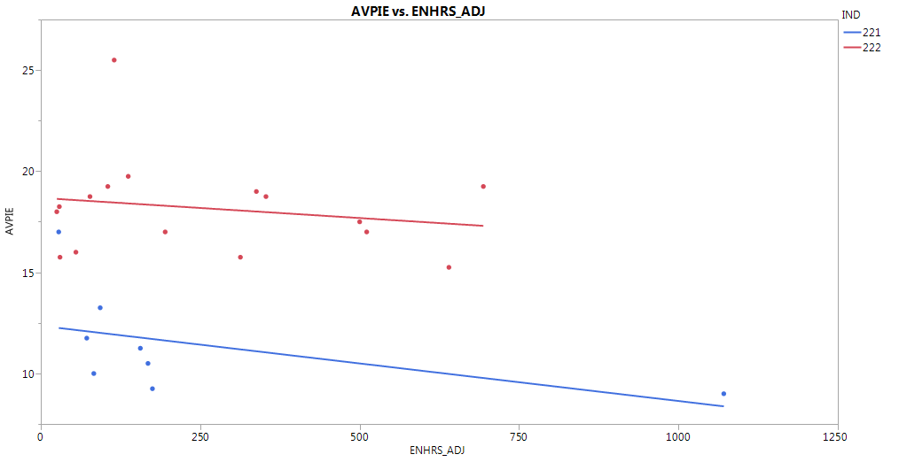
Average LSPI Versus Engine Hours
The slopes for both 221 and 222 have slight negative slopes.

Slide 7
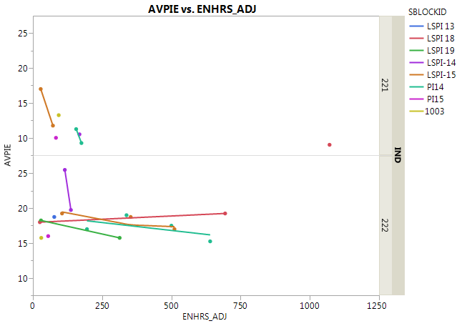
Average LPSI Versus Engine Hours by Engine
Of the 4 engines with substantial engine hours, 3 showed a negative slope.

Slide 8
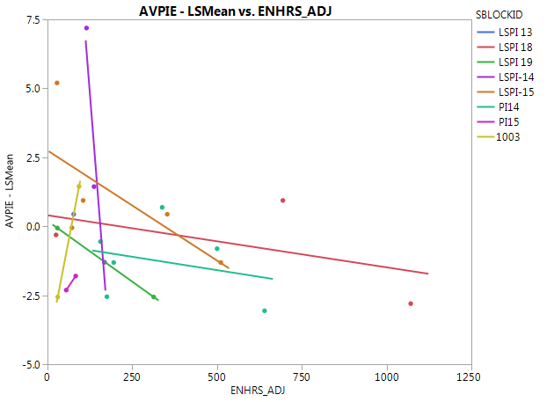
Average LSPI – LS Mean Versus Engine Hours
Only 221 and 222 results are plotted.
Each of the 4 engines with substantial run time have negative slopes.

Slide 9
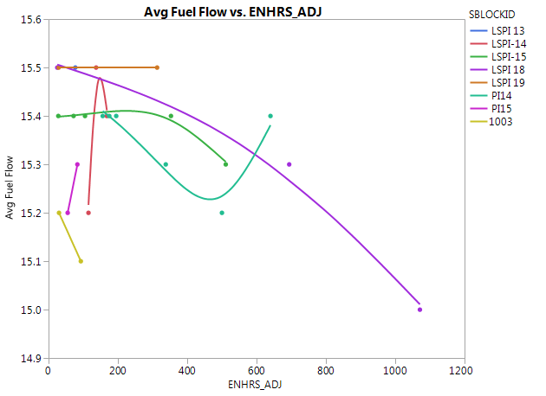
Average Fuel Flow Versus Engine Hours
Average Fuel Flow was used a factor as a replacement for Engine Hours in a regression model but did not explain nearly as much variation.
Fuel Flow was added as a factor to the model with Engine Hours (and the other terms) with both being statistically significant but had VIFs between 3 and 4.

Slide 10
Regression Details
Ln[AVPIE + 1]
Sqrt[AVPIE + 0.5]
n = 24
RMSE = 0.1387
Engine Hour Coefficient = -0.0002287
n = 24
RMSE = 0.2869
Engine Hour Coefficient = -0.000445

Slide 11
Without Engine Hour Effect

Slide 12
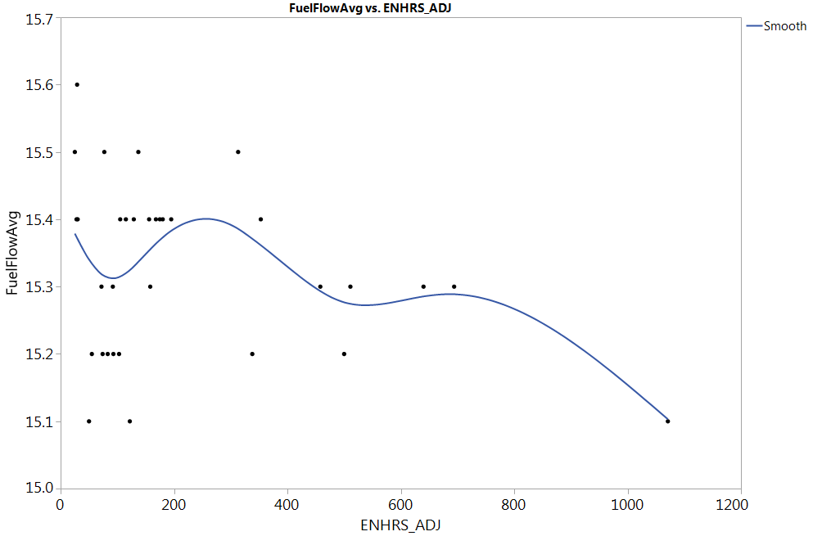
ENHRS and FUEL FLOW Correlation

Slide 13
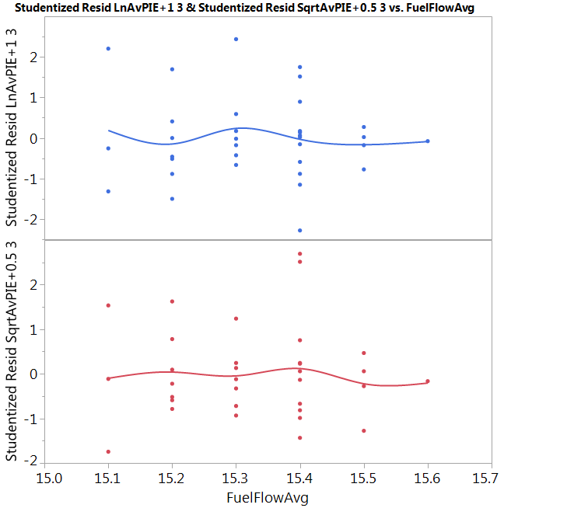
No indication of FUEL FLOW effect
Note: Residuals from Oil, Lab model (n=34)

Slide 14
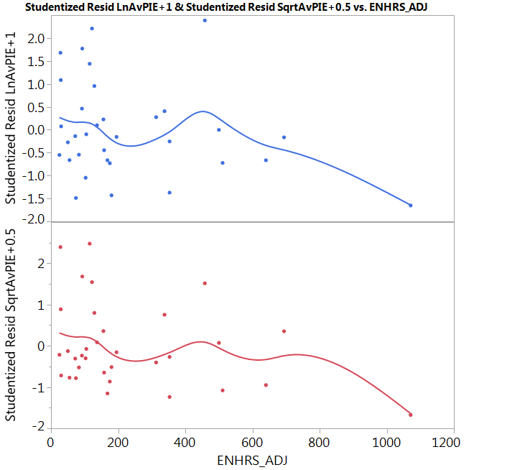
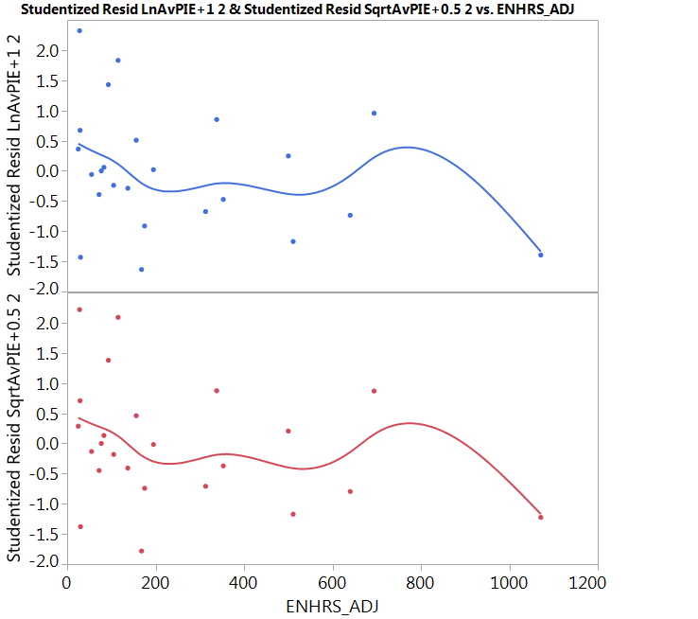
Model: Oil Lab Engine(Lab)
220, 221, 222
221, 222

Slide 15
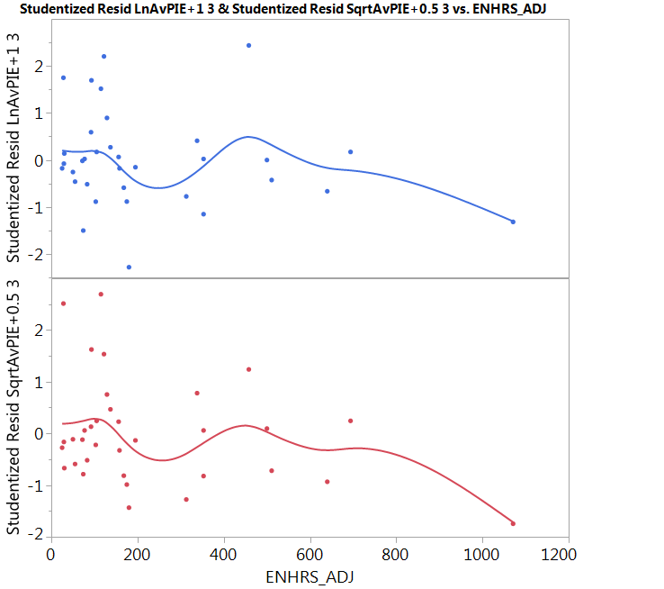
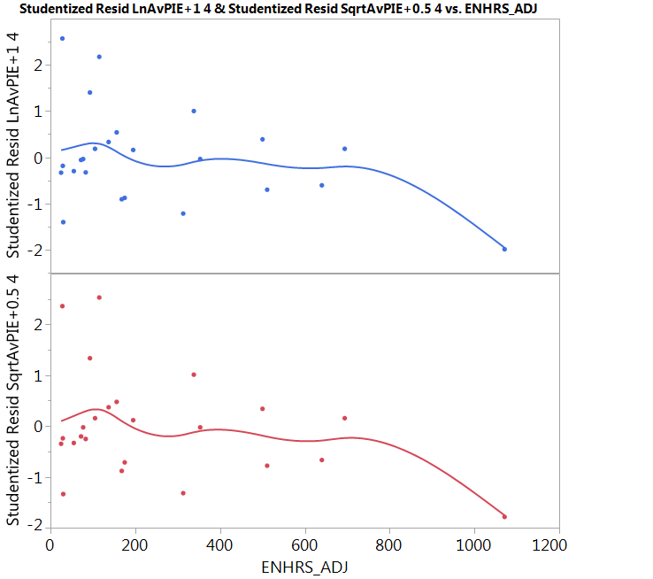
Model: Oil Lab
220, 221, 222
221, 222

Slide 16
ENHRS Effect
ENHRS effect is influenced by a single Non-PM test with the highest engine hours (1071). Without this data, ENHRS is not statistically significant.
There’s a gap in the data between 700-1000 hours.
More appropriate data is needed to ensure correct estimation of ENHRS effect.

Slide 17
LSPI Precision Matrix Statistical Analysis

Slide 18
Executive Summary
Precision Matrix (PM) Analysis Highlights:
  This analysis includes the results of 20 valid precision matrix tests plus an additional 14 non-matrix tests run on identical hardware to the same procedure which were deemed operationally valid by the LSPI development team.
  Data supports the use of Ln(AvPIE+1) transformation or Sqrt(AvPIE+0.5)
  Significant oil differences: 222 > 221 > 220
  Marginal Lab differences; Engine within Lab differences are not statistically significant
  Estimated within an engine test precision
    Ln(AvPIE+1) = 0.2085
    Sqrt(AvPIE+0.5) = 0.2813
  Estimated test precision across labs and engines
    Ln(AvPIE+1) = 0.2101
    Sqrt(AvPIE+0.5) = 0.2856

Slide 19
LSPI Precision Matrix Original Data Set
  Original Precision Matrix Data Summary:
    3 Labs {A, B, and G}
    3 Reference Oils {220, 221, and 222}
    5 Engines (named here by “LAB-SBLOCKID”)
      {A-LSPI14, A-LSPI15, B-1003, G-PI14, and G-PI15}
    From the original 20-test matrix:
      4 were discovered to have run on different hardware, 6 were deemed operationally invalid. All 10 tests were rerun to arrive at 20 total matrix tests all deemed operationally valid by the LSPI development group.
Notes:
Updated

Slide 20
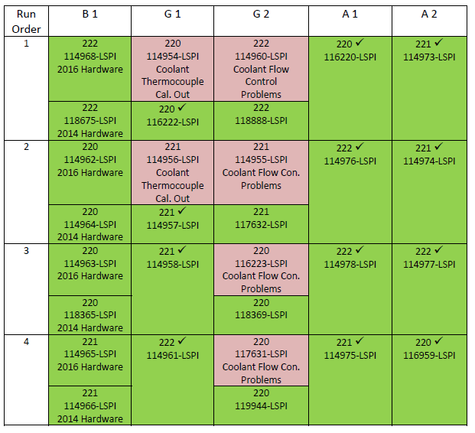
LSPI Precision Matrix Original Data Set
  Precision Matrix Data Table from Frank Farber’s 20160919 LSPI Matrix Test Status update.
Notes:
Updated

Slide 21
LSPI Precision Matrix – Additional Tests
  On March 9, 2017, the LSPI development group deemed 14 additional tests as operationally valid and viable for inclusion in precision matrix analysis.
    2 Labs {A and G}
    3 Reference Oils {220 (n=3), 221 (n=1), and 222 (n=10)}
    6 Engines (named here by “LAB-SBLOCKID”)
      {A-LSPI13, A-LSPI14*, A-LSPI15*, A-LSPI18, A-LSPI19, and G-PI14*}
        * - precision matrix engine
Notes:
Updated

Slide 22
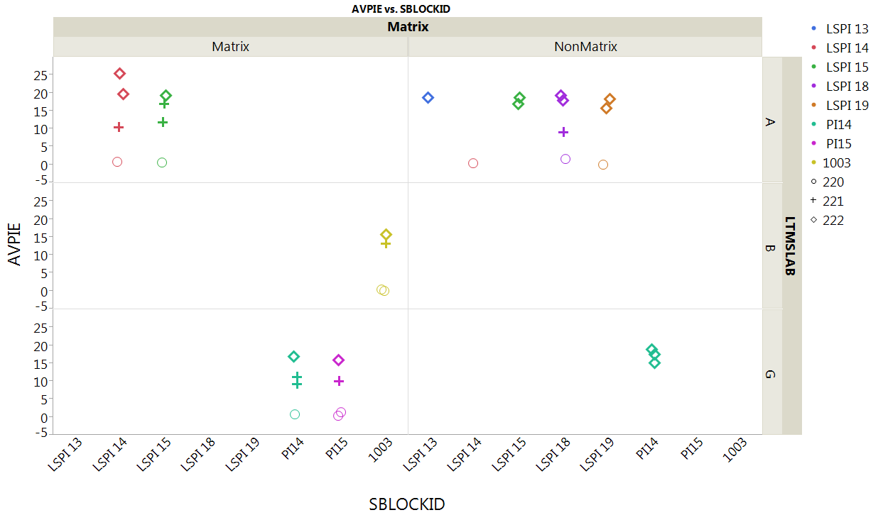
LSPI Precision Matrix - Additional Tests
  Below is a plot of the matrix and non-matrix data
Notes:
Updated

Slide 23
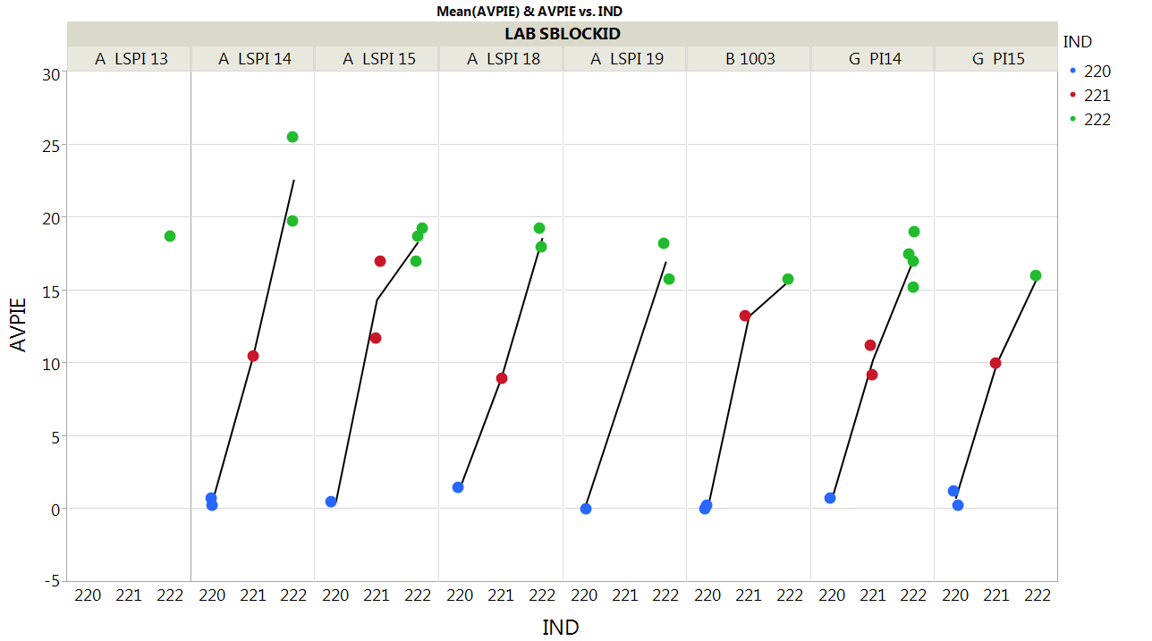
Raw AvPIE by Engine
Oil ranking is consistent across engines.
Notes:
Updated

Slide 24
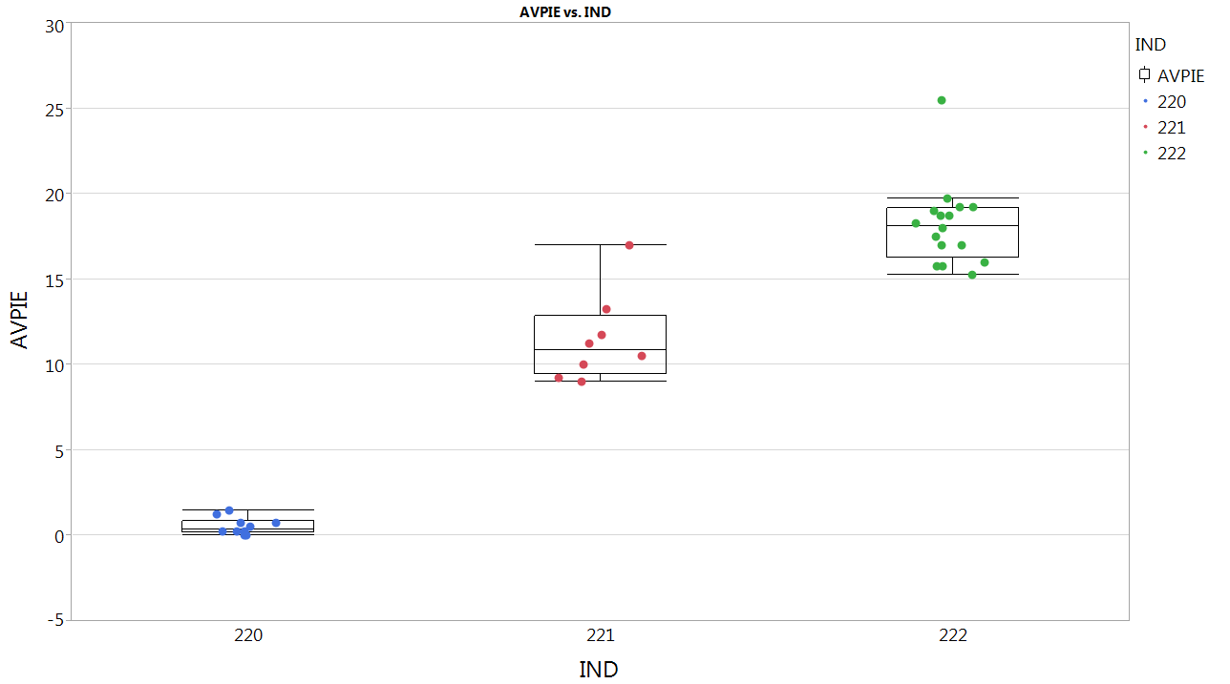
Raw AvPIE by Oil
The oils show good separation, with only a small overlap between 221 and 222.
Notes:
Updated

Slide 25
Evaluating the Transformation of AvPIE

Slide 26
Transformation of AvPIE
Since precision statements and other conclusions made from the ANOVA model are based on the assumption that the model residuals have a Normal distribution with mean zero and constant variance which is independent of response level, often times a transformation is needed to ensure that these assumptions are reasonable.
Example:
$$Test_Repeatability=RMSE_{Model}∗1.96∗\sqrt{2}$$
Estimated standard deviation of results within an engine.
95% coverage based on a Normal distribution of residuals
Multiplier due to inference on 2 results
Notes:
Updated

Slide 27
Summary of Transformation Evaluation
In the Box-Cox Analysis, the square root transformation is preferred when using all oils and all data. Using only 221 and 222 would make the natural log transformation slightly more favorable.
The square root transformation does a better job of stabilizing the variance across all 3 oils tested, which will be critical to ensure that our test precision statement is representative of all oils to be tested in the future.
The repeatability limits seem much more appropriate with the square root transformation. For the natural log transformation, the windows appear to be too small for low event oils, and too large for high event oils.
Notes:
Updated

Slide 28
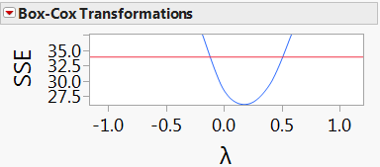
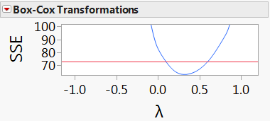
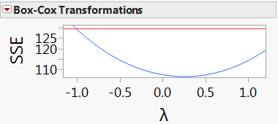
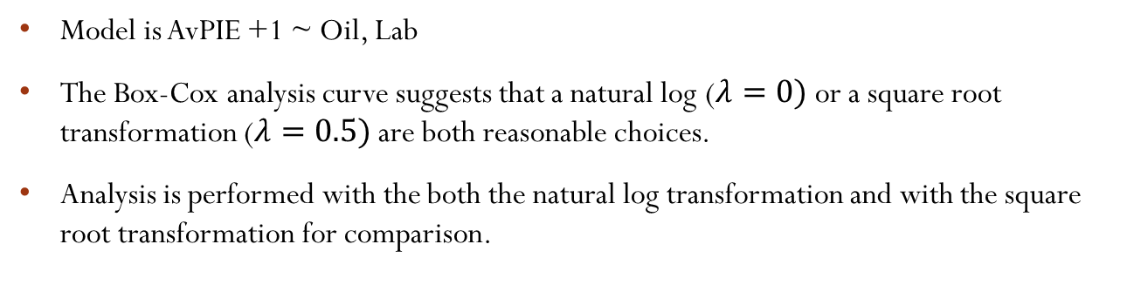
Transformation of AvPIE
Model is AvPIE +1 ~ Oil, Lab
The Box-Cox analysis curve suggests that a natural log ($λ=0)$ or a square root transformation ($λ=0.5)$ are both reasonable choices.
Analysis is performed with the both the natural log transformation and with the square root transformation for comparison.
Matrix Tests (n=20)
Matrix and Non-matrix (n=34)
Matrix and Non-matrix, 221,222 only (n=24)
Notes:
Updated

Slide 29
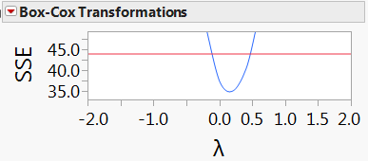
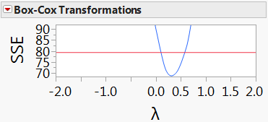
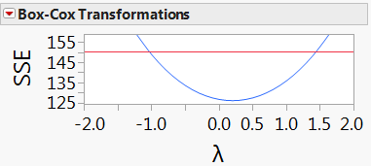
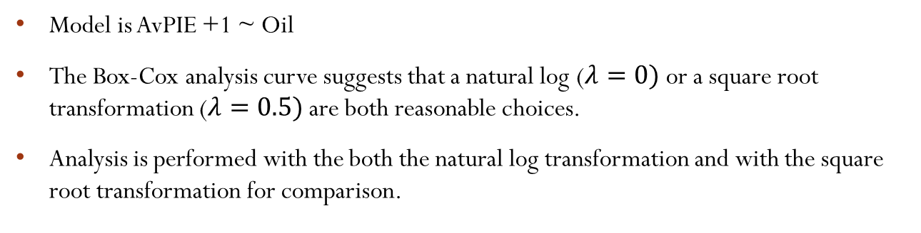
Transformation of AvPIE
Model is AvPIE +1 ~ Oil
The Box-Cox analysis curve suggests that a natural log ($λ=0)$ or a square root transformation ($λ=0.5)$ are both reasonable choices.
Analysis is performed with the both the natural log transformation and with the square root transformation for comparison.
Matrix Tests (n=20)
Matrix and Non-matrix (n=34)
Matrix and Non-matrix, 221,222 only (n=24)
Notes:
Updated

Slide 30
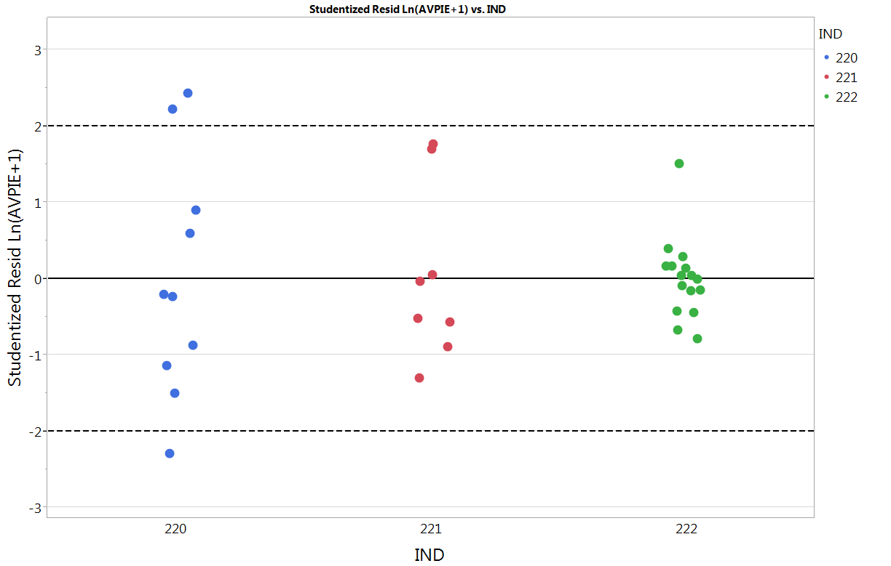
Ln(AvPIE +1) ~ Oil, Lab
Residual Plot by Oil
There variance does not appear similar across all oils.
Notes:
Updated

Slide 31
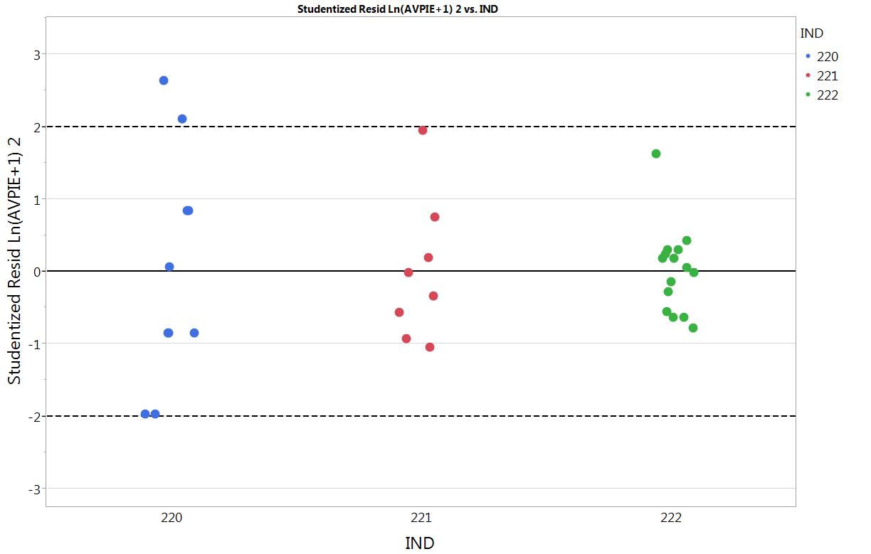
Ln(AvPIE +1) ~ Oil
Residual Plot by Oil
There variance does not appear similar across all oils.
Notes:
Updated

Slide 32
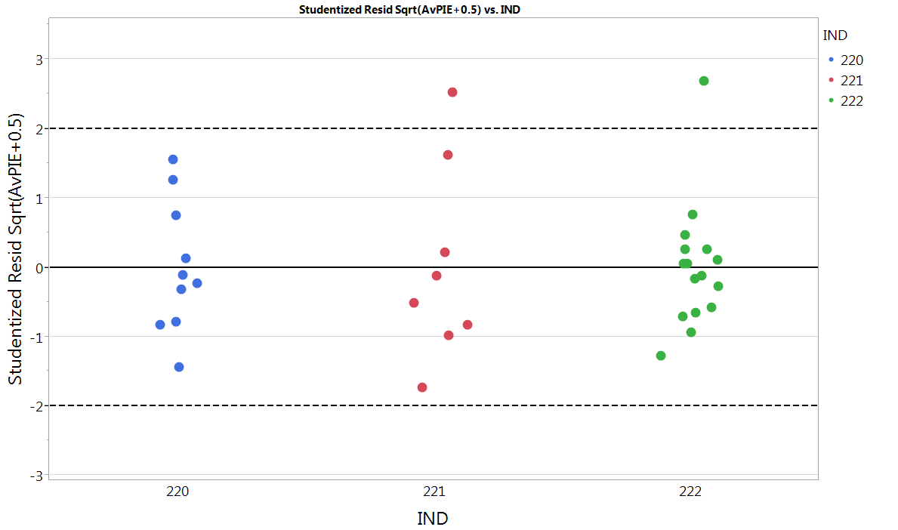
Sqrt(AvPIE+0.5) ~ Oil, Lab
Residual Plot by Oil
There variance appears reasonably similar across oils.
Notes:
Updated

Slide 33
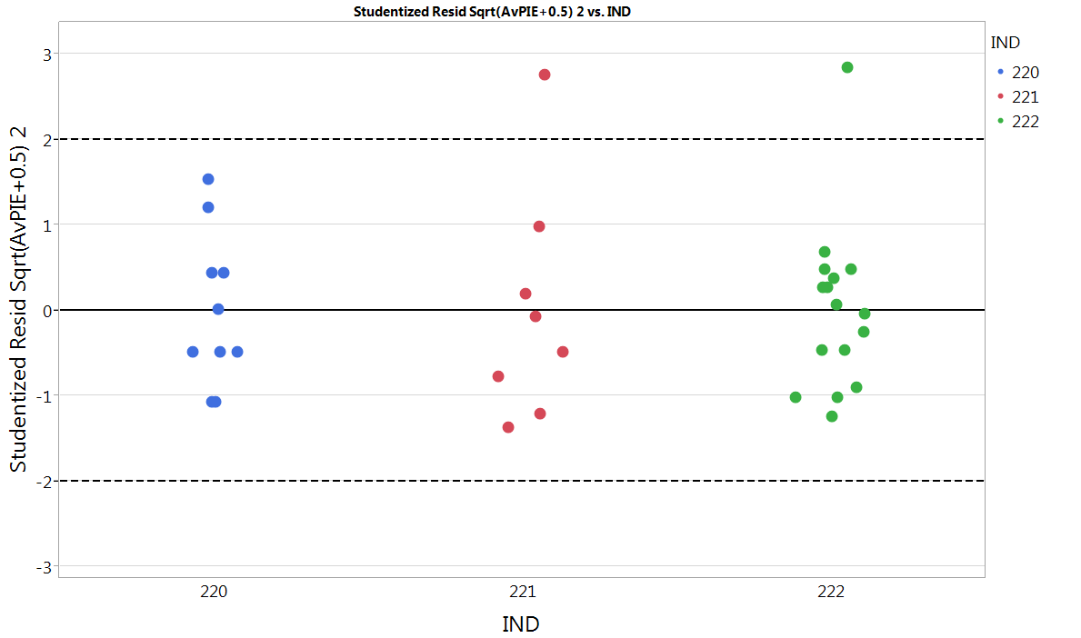
Sqrt(AvPIE+0.5) ~ Oil
Residual Plot by Oil
There variance appears reasonably similar across oils.
Notes:
Updated

Slide 34
Repeatability Limits
The following tables show examples of repeatability limits at various response levels. This shows the maximum difference of two repeated results before being considered statistically different at the 5% level of significance.
Ln(AvPIE+1)~Oil, Lab
Sqrt(AvPIE+0.5)~Oil, Lab
Low | High
0.00 | 0.79
5.00 | 9.74
15.00 | 27.64
Low | High
0.00 | 1.71
5.00 | 9.26
15.00 | 21.74
Realized values will end in a multiple of 0.25, but unrounded values are shown here for better comparison.
Notes:
Updated

Slide 35


Comparing raw standard deviations
The following tables show the raw standard deviations by oil. Clearly, the Sqrt transformation does a better job of stabilizing the variance across all oil levels.
Ln(AvPIE+1)~Oil
Sqrt(AvPIE+0.5)~Oil
Oil | Std. Dev.
220 | 0.3162
221 | 0.1931
222 | 0.1176
Oil | Std. Dev.
220 | 0.2425
221 | 0.3609
222 | 0.2694
$$\frac{{s^{2}}_{Max}}{{s^{2}}_{Min}}=\frac{.1000}{.0138}=7.25$$
$$\frac{{s^{2}}_{Max}}{{s^{2}}_{Min}}=\frac{.1302}{.0588}=2.21$$
Notes:
Updated

Slide 36
Analysis of Results
Using Ln(AvPIE+1) Transformation

Slide 37
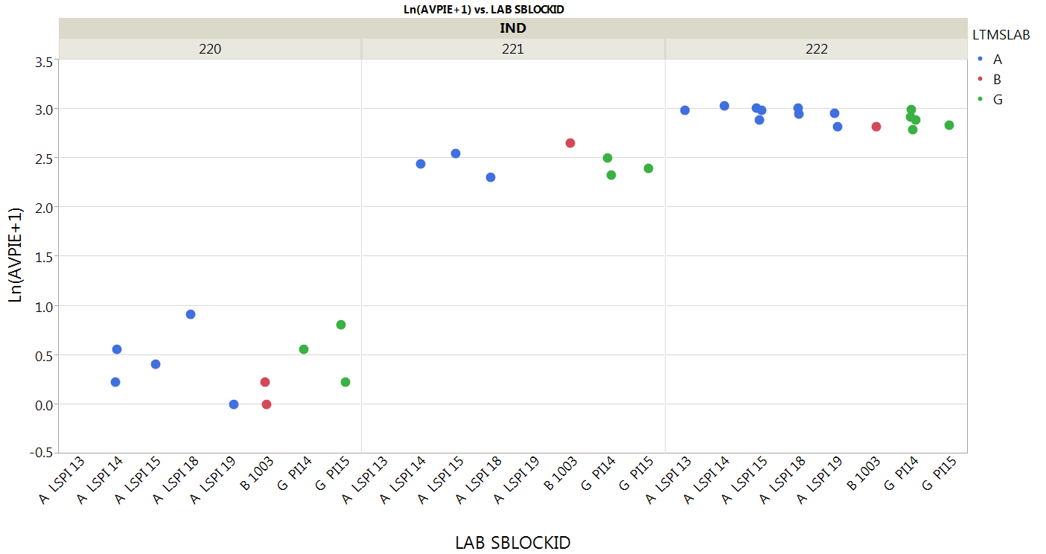
Ln(AvPIE +1) Plot by Oil/Engine
Plot of Ln(AvPIE + 1) by Oil and Engine, colored by lab
Variance appears to decrease as the response level increases, which may mean the transformation is not appropriate.
Notes:
Updated

Slide 38
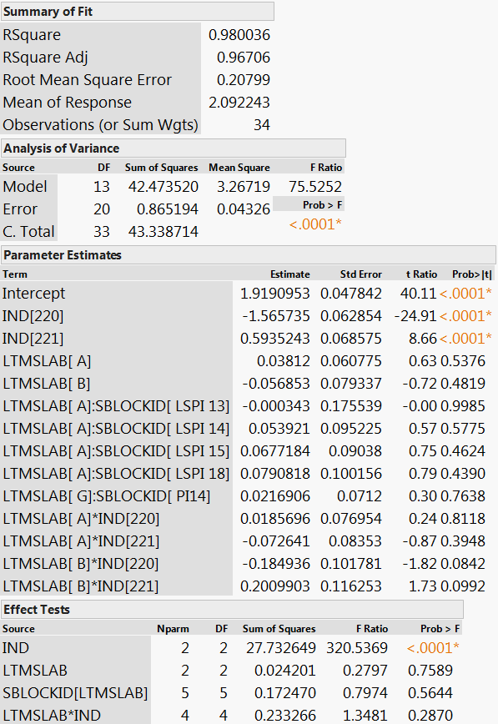
Ln(AvPIE +1) ANOVA Full Model
Statistically significant differences:
Oil
Not significantly different:
Labs
Engines within Labs
Lab-Oil Interaction
Notes:
Updated

Slide 39
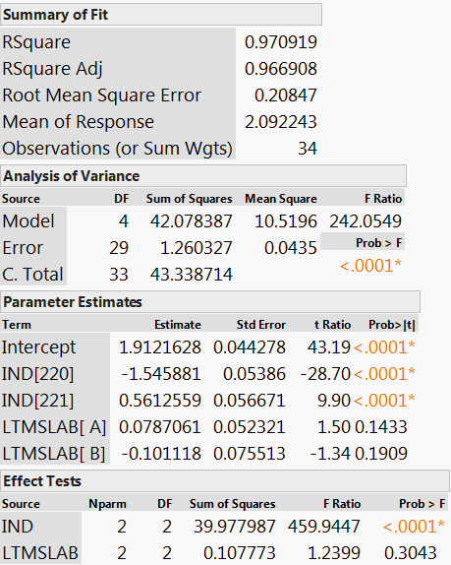
Ln(AvPIE +1) ANOVA Reduced Model
In this reduced model, the lab differences are still not statistically significant.
Notes:
Updated

Slide 40
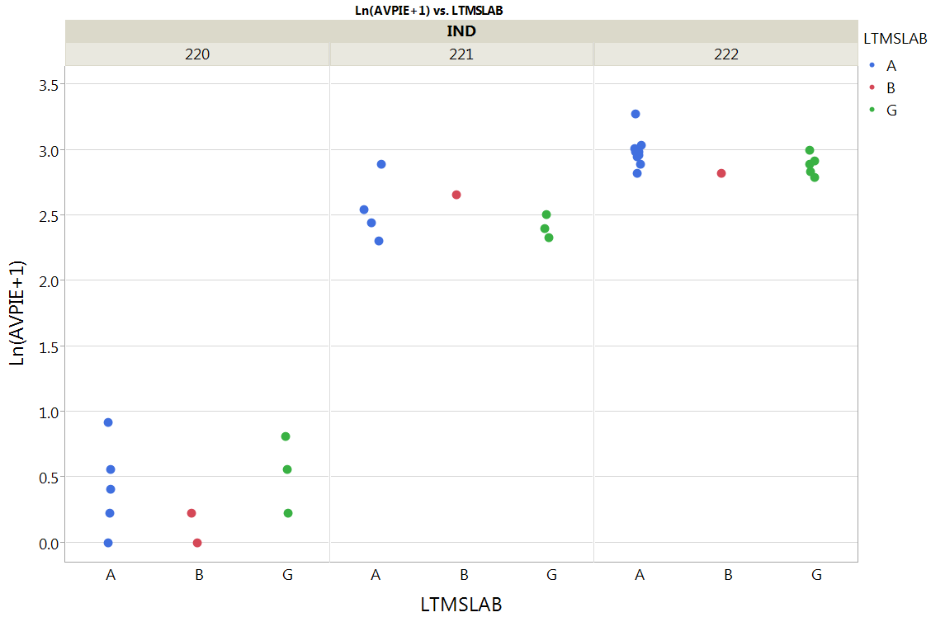
Ln(AvPIE +1) Plot by Oil
Plot below is Ln(AvPIE + 1) by Oil and Lab, colored by lab
Notes:
Updated

Slide 41
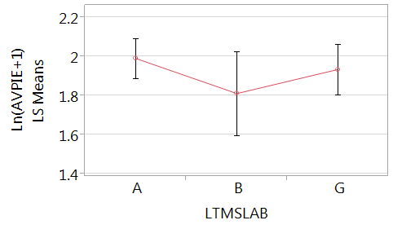
Ln(AvPIE +1) Lab Differences
Model is Ln(AvPIE +1) ~ Oil, Lab
Plot below of Ln(AvPIE + 1) LSMeans by Lab, with 95% confidence intervals
LSMeans by Lab
LSMeans Differences Between Labs
Lab | Ln(AvPIE+1) LSMean | AvPIE LSMean
A | 1.9909 | 6.32
B | 1.8110 | 5.12
G | 1.9346 | 5.92
Lab1 | Lab2 | Ln(AvPIE+1) LSMean Difference | p-Value
A | B | 0.1798 | 0.29
G | B | 0.1235 | 0.58
A | G | 0.0563 | 0.76
Notes:
Updated

Slide 42
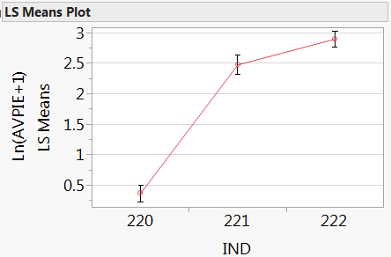
Ln(AvPIE +1) Oil Differences
Model is Ln(AvPIE +1) ~ Oil, Lab
Oil significantly differ
  All pairwise comparisons
    are statistically significant
  222 > 221 > 220
Plot shows Ln(AvPIE + 1) LSMeans by Lab,
with 95% confidence intervals
LSMeans by Oil
LSMeans Differences Between Oils
Oil | Ln(AvPIE+1) LSMean | AvPIE LSMean
220 | 0.3663 | 0.44
221 | 2.4734 | 10.86
222 | 2.8968 | 17.12
Oil1 | Oil2 | Ln(AvPIE+1) LSMean Difference | p-Value
222 | 220 | 2.5305 | <.0001
221 | 220 | 2.1071 | <.0001
222 | 221 | 0.4234 | 0.0002
Notes:
Updated

Slide 43
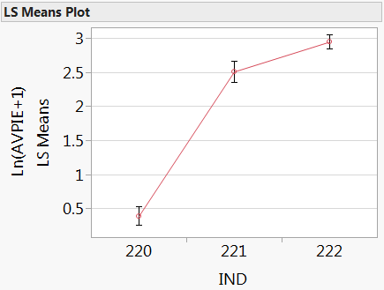
Ln(AvPIE +1) Oil Differences
Model is Ln(AvPIE +1) ~ Oil
Oil significantly differ
  All pairwise comparisons
    are statistically significant
  222 > 221 > 220
Plot shows Ln(AvPIE + 1) LSMeans by Lab,
with 95% confidence intervals
LSMeans by Oil
LSMeans Differences Between Oils
Oil | Ln(AvPIE+1) LSMean | AvPIE LSMean
220 | 0.3921 | 0.48
221 | 2.5085 | 11.29
222 | 2.9467 | 18.04
Oil1 | Oil2 | Ln(AvPIE+1) LSMean Difference | p-Value
222 | 220 | 2.5545 | <.0001
221 | 220 | 2.1164 | <.0001
222 | 221 | 0.4381 | 0.0001
Notes:
Updated

Slide 44
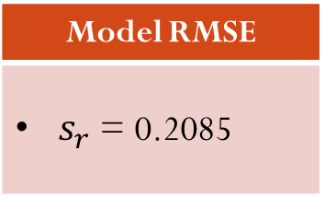
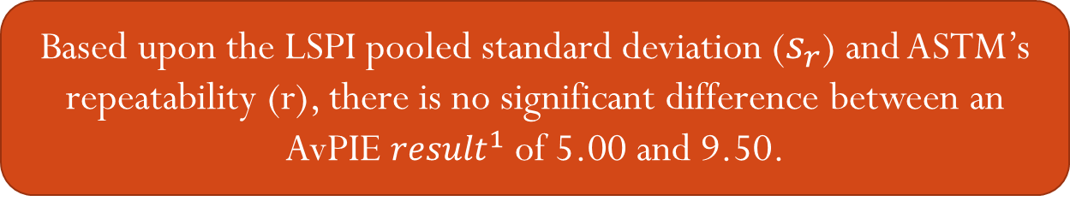
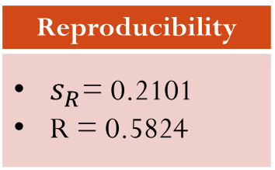
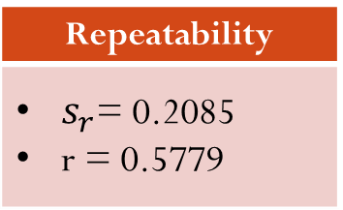
Ln(AvPIE +1) Precision
Model: Ln(AvPIE+1) ~ Oil, Lab
Model: Ln(AvPIE+1) ~ Oil
Model RMSE
$s_{r}$ = 0.2085
Repeatability
$s_{r}$= 0.2085 r = 0.5779
Reproducibility
$s_{R}$= 0.2101 R = 0.5824
Based upon the LSPI pooled standard deviation ($s_{r}$) and ASTM’s repeatability (r), there is no significant difference between an AvPIE ${result}^{1}$ of 5.00 and 9.50.
Note 1: An AvPIE result of 5.0 was arbitrarily selected as the pass/fail limit
Notes:
Updated

Slide 45
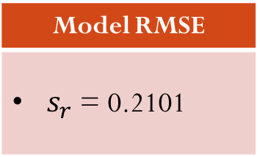
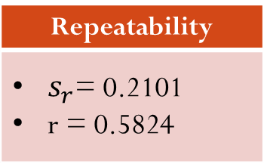
Ln(AvPIE +1) Precision
Model: Ln(AvPIE+1) ~ Oil
Model RMSE
$s_{r}$ = 0.2101
Repeatability
$s_{r}$= 0.2101 r = 0.5824
Reproducibility
$s_{R}$= 0.2101 R = 0.5824
Based upon the LSPI pooled standard deviation ($s_{r}$) and ASTM’s repeatability (r), there is no significant difference between an AvPIE ${result}^{1}$ of 5.00 and 9.50.
Note 1: An AvPIE result of 5.0 was arbitrarily selected as the pass/fail limit
Notes:
Updated

Slide 46
Reference Oil Targets
Model: Ln(AvPIE+1) ~ Oil, Lab
  Average Number of Preignition Events (AvPIE)
  Unit of Measure: Ln(AvPIE +1)
Ref. Oil | Target | St. Dev | RMSE
220 | 0.3663 | 0.2965 | 0.2085
221 | 2.4734 | 0.2097 | 0.2085
222 | 2.8968 | 0.1038 | 0.2085

Slide 47
Reference Oil Targets
Model: Ln(AvPIE+1) ~ Oil
  Average Number of Preignition Events (AvPIE)
  Unit of Measure: Ln(AvPIE +1)
Ref. Oil | Target | St. Dev | RMSE
220 | 0.3921 | 0.3162 | 0.2101
221 | 2.5085 | 0.1931 | 0.2101
222 | 2.9467 | 0.1176 | 0.2101

Slide 48
Analysis of Results
Using Sqrt(AvPIE+0.5) Transformation

Slide 49
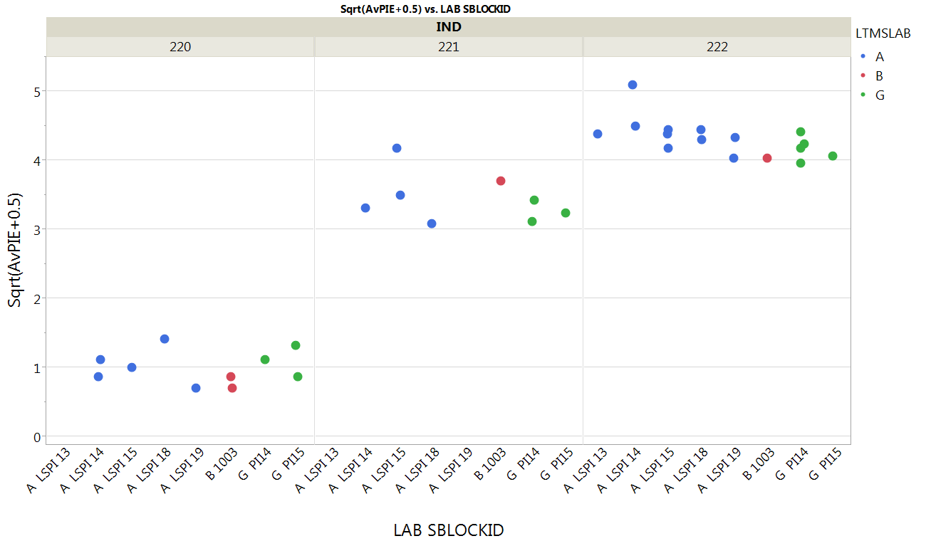
Sqrt(AvPIE+0.5) Plot by Oil/Engine
Plot of Sqrt(AvPIE+0.5) by Oil and Engine, colored by lab
Notes:
Updated

Slide 50
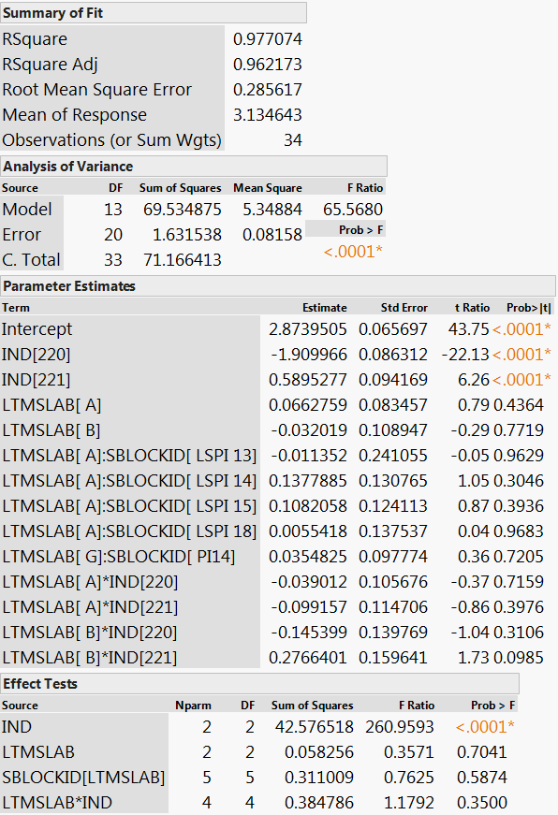
Sqrt(AvPIE+0.5) ANOVA Full Model
Statistically significant differences:
Oil
Not significantly different:
Labs
Engines within Labs
Lab-Oil Interaction
Notes:
Updated

Slide 51
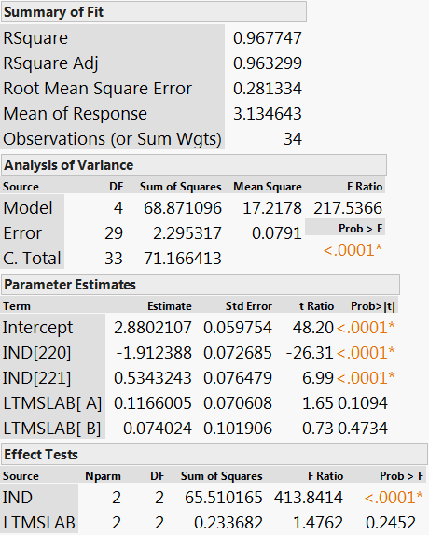
Sqrt(AvPIE+0.5) ANOVA Reduced Model
In this reduced model, the lab differences are still not statistically significant.
Notes:
Updated

Slide 52
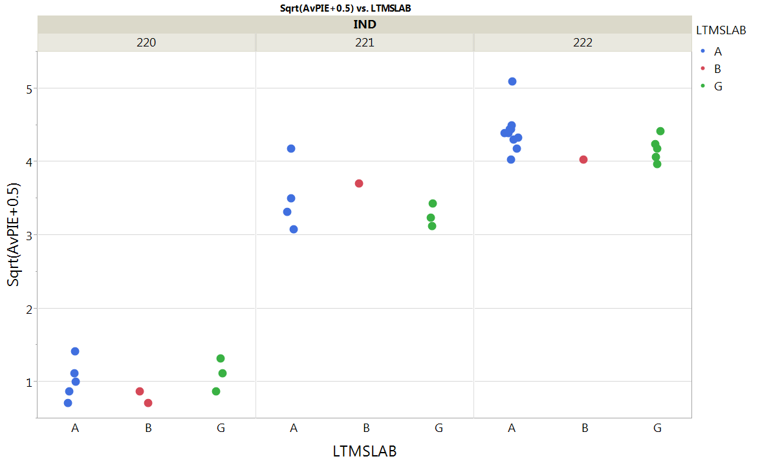
Sqrt(AvPIE+0.5) Plot by Oil, Lab
Plot below is Sqrt(AvPIE+0.5) by Oil and Lab, colored by lab
Notes:
Updated

Slide 53
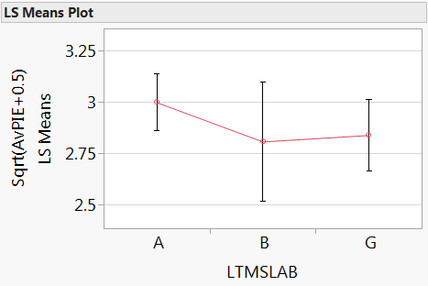
Sqrt(AvPIE+0.5) Lab Differences
Model is Sqrt(AvPIE+0.5) ~ Oil, Lab
Plot below of Sqrt(AvPIE+0.5) LSMeans by Lab, with 95% confidence intervals
LSMeans by Lab
LSMeans Differences Between Labs
Lab | Ln(AvPIE+1) LSMean | AvPIE LSMean
A | 2.9968 | 8.48
B | 2.8062 | 7.37
G | 2.8376 | 7.55
Lab1 | Lab2 | Ln(AvPIE+1) LSMean Difference | p-Value
A | B | 0.1906 | 0.46
A | G | 0.1592 | 0.31
G | B | 0.0314 | 0.98
Notes:
Updated

Slide 54
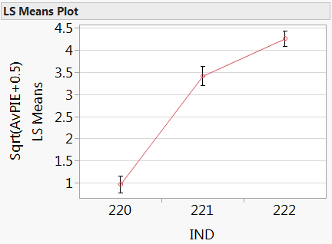
Sqrt(AvPIE+0.5) Oil Differences
Model is Sqrt(AvPIE+0.5) ~ Oil, Lab
Oil significantly differ
  All pairwise comparisons
    are statistically significant
  222 > 221 > 220
Plot shows Sqrt(AvPIE+0.5) LSMeans by Lab,
with 95% confidence intervals
LSMeans by Oil
LSMeans Differences Between Oils
Oil | Ln(AvPIE+1) LSMean | AvPIE LSMean
220 | 0.9678 | 0.44
221 | 3.4145 | 11.16
222 | 4.2583 | 17.63
Oil1 | Oil2 | Ln(AvPIE+1) LSMean Difference | p-Value
222 | 220 | 3.2905 | <.0001
221 | 220 | 2.4467 | <.0001
222 | 221 | 0.8437 | <.0001
Notes:
Updated

Slide 55
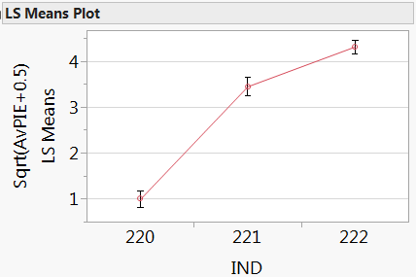
Sqrt(AvPIE+0.5) Oil Differences
Model is Sqrt(AvPIE+0.5) ~ Oil
Oil significantly differ
  All pairwise comparisons
    are statistically significant
  222 > 221 > 220
Plot shows Sqrt(AvPIE+0.5) LSMeans by Lab,
with 95% confidence intervals
LSMeans by Oil
LSMeans Differences Between Oils
Oil | Ln(AvPIE+1) LSMean | AvPIE LSMean
220 | 0.9985 | 0.50
221 | 3.4476 | 11.39
222 | 4.3132 | 18.10
Oil1 | Oil2 | Ln(AvPIE+1) LSMean Difference | p-Value
222 | 220 | 3.3147 | <.0001
221 | 220 | 2.4491 | <.0001
222 | 221 | 0.8656 | <.0001
Notes:
Updated

Slide 56
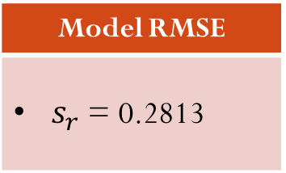
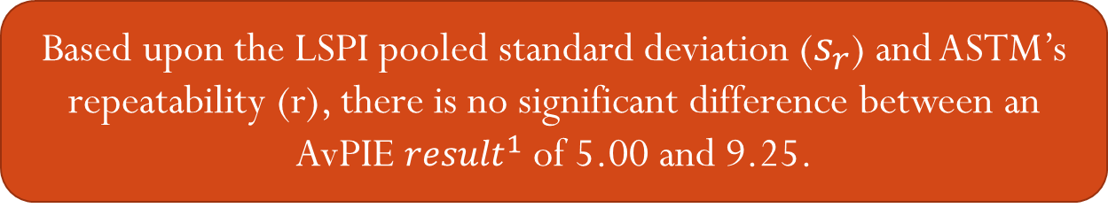
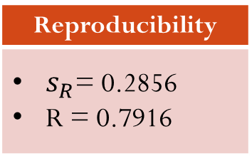
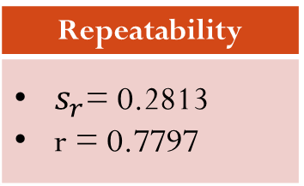
Sqrt(AvPIE+0.5) Precision
Model: Sqrt(AvPIE+0.5) ~ Oil, Lab
Model: Sqrt(AvPIE+0.5) ~ Oil
Model RMSE
$s_{r}$ = 0.2813
Repeatability
$s_{r}$= 0.2813 r = 0.7797
Reproducibility
$s_{R}$= 0.2856 R = 0.7916
Based upon the LSPI pooled standard deviation ($s_{r}$) and ASTM’s repeatability (r), there is no significant difference between an AvPIE ${result}^{1}$ of 5.00 and 9.25.
Note 1: An AvPIE result of 5.0 was arbitrarily selected as the pass/fail limit
Notes:
Updated

Slide 57


Sqrt(AvPIE+0.5) Precision
Model: Sqrt(AvPIE+0.5) ~ Oil
Model RMSE
$s_{r}$ = 0.2856
Repeatability
$s_{r}$= 0.2856 r = 0.7916
Reproducibility
$s_{R}$= 0.2856 R = 0.7916
Based upon the LSPI pooled standard deviation ($s_{r}$) and ASTM’s repeatability (r), there is no significant difference between an AvPIE ${result}^{1}$ of 5.00 and 9.25.
Note 1: An AvPIE result of 5.0 was arbitrarily selected as the pass/fail limit
Notes:
Updated

Slide 58
Reference Oil Targets
Model: Sqrt(AvPIE+0.5) ~ Oil, Lab
  Average Number of Preignition Events (AvPIE)
  Unit of Measure: Sqrt(AvPIE+0.5)
Ref. Oil | Target | St. Dev | RMSE
220 | 0.9678 | 0.2453 | 0.2813
221 | 3.4145 | 0.3569 | 0.2813
222 | 4.2583 | 0.2397 | 0.2813

Slide 59
Reference Oil Targets
Model: Sqrt(AvPIE+0.5) ~ Oil
  Average Number of Preignition Events (AvPIE)
  Unit of Measure: Sqrt(AvPIE+0.5)
Ref. Oil | Target | St. Dev | RMSE
220 | 0.9985 | 0.2425 | 0.2856
221 | 3.4476 | 0.3609 | 0.2856
222 | 4.3132 | 0.2694 | 0.2856

Slide 60
Appendix 1: Evaluating the Engine Hours Effect

Slide 61



Ln(AvPIE +1) Engine Hours Effect
The significance of the engine hours term is dependent on the model used.
Ln(AvPIE +1) ~ Oil, EngineHours
Ln(AvPIE +1) ~ Oil, Lab, EngineHours
Ln(AvPIE +1) ~ Oil, Lab, Engine[Lab], EngineHours
Notes:
Updated

Slide 62

Ln(AvPIE +1) Residuals by Engine Hours
Model is Ln(AvPIE +1) ~ Oil, Lab, Engine[Lab], EngineHours
There is no observable trend in the residuals in the first 500 hours, with potential concern arising above 600 hours, where all 4 residuals are negative.
Notes:
Updated

Slide 63



Sqrt(AvPIE + 0.5) Engine Hours Effect
Sqrt(AvPIE+0.5) ~ Oil, EngineHours
The significance of the engine hours term is dependent on the model used.
Sqrt(AvPIE+0.5) ~ Oil, Lab, EngineHours
Sqrt(AvPIE+0.5) ~ Oil, Lab, Engine[Lab], EngineHours
Notes:
Updated

Slide 64

Sqrt(AvPIE + 0.5) Residuals by Engine Hours
Model is Ln(AvPIE +1) ~ Oil, Lab, Engine[Lab], EngineHours
Though there is no clear trend, the two high residuals early in the engine life, along with the two low residuals late in the engine life, are potential areas of concern.
Notes:
Updated

Slide 65
Appendix 2: Additional Plots

Slide 66

Ln(AvPIE +1) ~ Oil
Residual Plot by Stand
There are two results that falls just outside the range of +/- 2, both on oil 220. The variability of 220 appears to be greater than the other oils, further supporting an alternative transformation.
Notes:
Updated

Slide 67

Sqrt(AvPIE + 0.5) ~ Oil
Residual Plot by Stand
There is one result that falls just outside the range of +/- 2
Notes:
Updated

