Slide 1
Sequence X Severity Task Force
Meeting Minutes
11/03/21

Slide 2
Attendance
Michael Deegan
Rich Grundza
Christian Porter
Christine Eickstead
Amol Savant
George Szappanos (absent)
Jason Soto
Alfonso Lopez
Travis Kostan
Pat Lang

Slide 3
Agenda 09/15/21
Review Travis plots of Valvoline 271 test operational data
Review Valvoline Chemistry Data from 271 tests
  Oil Analysis
  Oil Consumption
  Reference History
Procedure corrections – George Szappanos
Superseded Part numbers

Slide 4
Meeting Minutes
Attached below are the operational plots from the Valvoline tests in comparison to other industry tests. The plots focus on severe and mild 271 tests run at Valvoline with and without the blowby restrictor.
  Crankcase was higher with the restrictor as expected
  Blowby gas temperature was lower for both 271 tests compared to the industry
  No other Parameters were remarkable
  In discussion the team realized that injection timing was not being observed, Deegan to forward pid address for CAN data logging of this parameter
Attached are the oil consumption data for the Valvoline tests
  Oil consumption was similar between mild and severe tests on 271 oil
  Intertek has reported no oil consumption in recent tests

Slide 5
Meeting Minutes Cont’d
Valvoline oil analysis was studied – data tables below
  Pentanes were higher in the severe 271 test
  Water, acids, and base were similar
  Oxidation was higher in the mild test
  Travis to plot oil data from the LTMS file – compare Valvoline mild/severe tests to industry data
Blowby flow discussion
  PCV valves need to be compared. Labs to look for old valves and flow them
  Amol – data shows more oil consumption without restrictor
Oil 271 suspension expired October 7th. TMC not assigning oil
Meeting adjourned – next meeting on the 16th to finish agenda items and plan for Panel and PassCar meetings

Slide 6
Valvoline Seq X Reference Oil Tests
 |  |  | CWT- Reference Oil Run History - Valvoline Stand
 |  |  |  |  |  |  |  | Ref. oil Targets
Stand Status / Change description | CW stand Test no. | Oil Code | EOT Date | no. of CW tests | IND | % CHST (Xi) | Ln(CHST, %) (Ti) | Mean | std. dev. (s) | Target (Mean) | Shewhart Severity |  | % increase in results using BB constrictor over previous runs
 |  |  |  |  |  | norm. units | trans. units | trans. units | trans. units | norm. unit | Yi |  | in terms of | in terms of
 |  |  |  |  |  |  |  |  |  |  |  |  | Δ CHST | Δ Yi
Stand was reset to Seq. X, CW config., incl. full instru. calib. | 10 | FRO | 20200902 | 5 | 270 -preblend (from Proveout) | 0.0513 | -2.97006 | -2.15699 | 0.17435 |  | -4.663
fine tuned spd, trq (dyno) tuned temp. ramps & t-BB Engine mounts replaced, engine angles adjusted | 10A | TK157100 | 20201022 | 6 | TMC-270 | 0.0552 | -2.89625 | -2.15699 | 0.17435 |  | -4.240
changed to new Chain batch | 11 | LWO | 20201207 | 7 | 271 -preblend (from Proveout) | 0.0379 | -3.27280 | -2.60987 | 0.17537 |  | -3.780
 |  | vv Experimental Reference Runs with Orifice Constriction in Blowby Ckt. vv
Orifice constriction added in the blowby ckt. past oil separator everything else same as before (no other change) | 12 | TK131725 | 20210413 | 8 | TMC-1011 | 0.1282 | -2.05416 | -2.08191 | 0.18882 | 0.12469 | +0.147 |  | no prev. data on the stand for this oil to compare
 | 13 | TK157101 | 20210524 | 9 | TMC-270 | 0.1165 | -2.14986 | -2.15699 | 0.17435 | 0.11567 | +0.041 |  | 110.9% | 101.0%
No change from 13 | 14 | TK157103 | 20210625 | 10 | TMC-271 | 0.0721 | -2.62970 | -2.60987 | 0.17537 | 0.07354 | -0.113 |  | 90.2% | 97.0%

Slide 7
Valvoline Sequence X Oil Consumption

Slide 8
Valvoline 271 Seq X Oil Analysis

Slide 9
Valvoline 271 Seq X Oil Analysis

Slide 10
Valvoline Data Comparison to
Other Industry Data

Slide 11
The Data Set
Previous Analysis
Based on the EWMA, labs asked to submit tests both before and after the mild severity shift, going back to 09/01/2018
32 tests were collected for the analysis
This data is color coded by severity (more green = milder)
Valvoline Data
2 tests on oil 271
  Test without blowby restrictor had CHST = 0.0379 ( Yi = -3.78)
  Test with blowby restrictor had CHST = 0.0721 (Yi = -0.11)
In addition to being colored by severity, these tests are identified in the plots as dashed lines (“-----”)

Slide 12
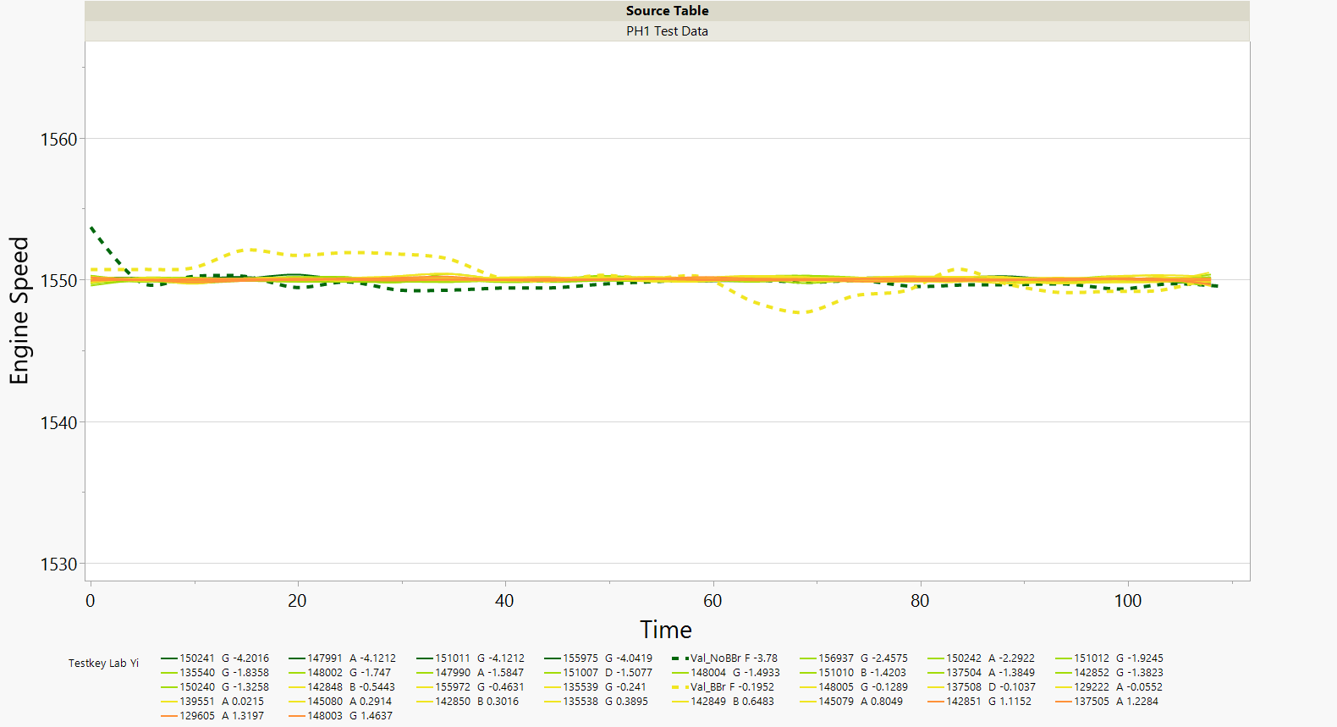
Engine Speed – Phase I

Slide 13
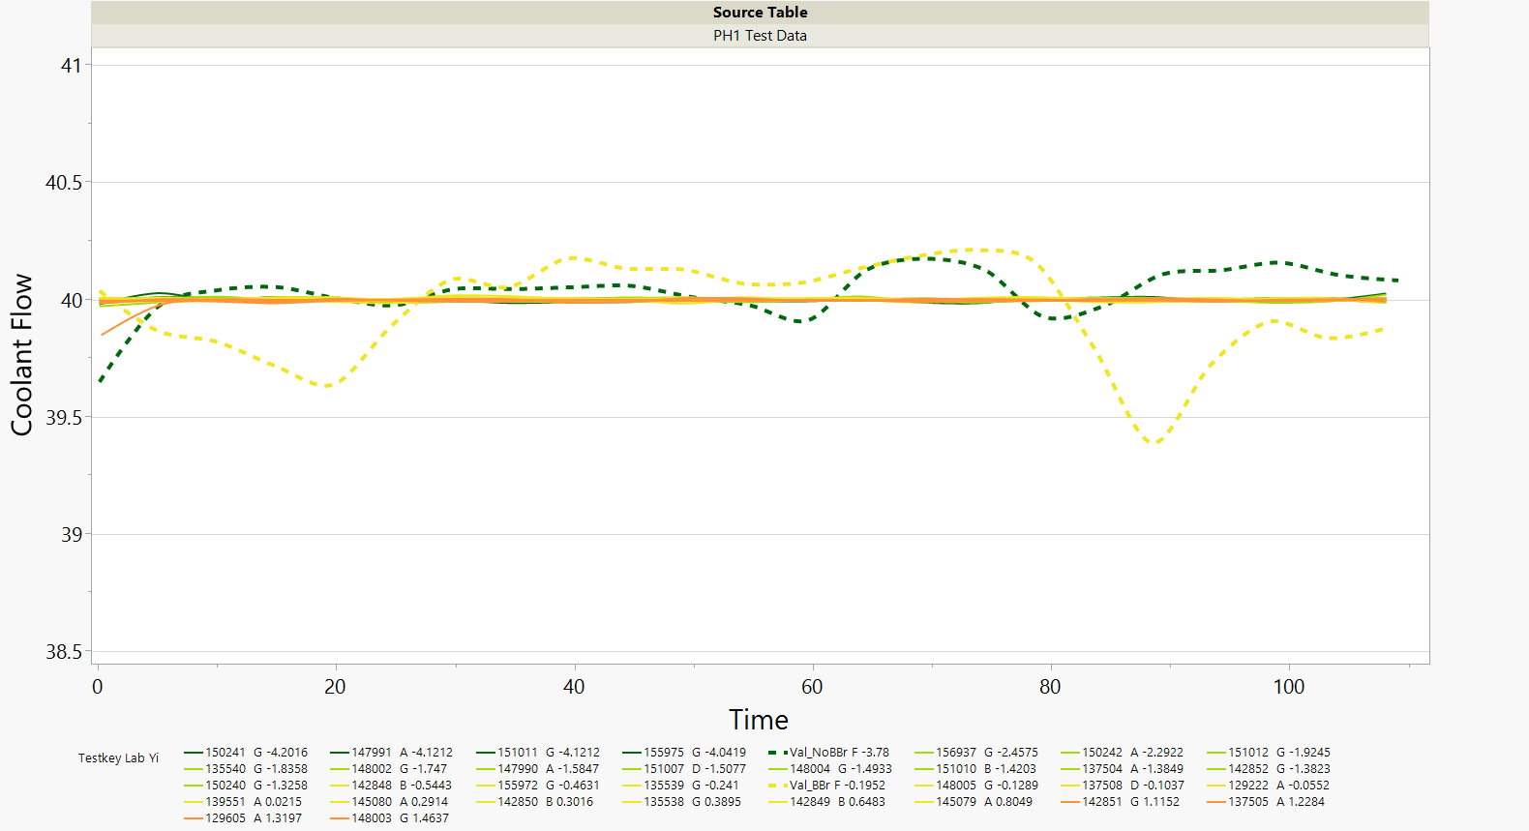
Coolant Flow – Phase I

Slide 14
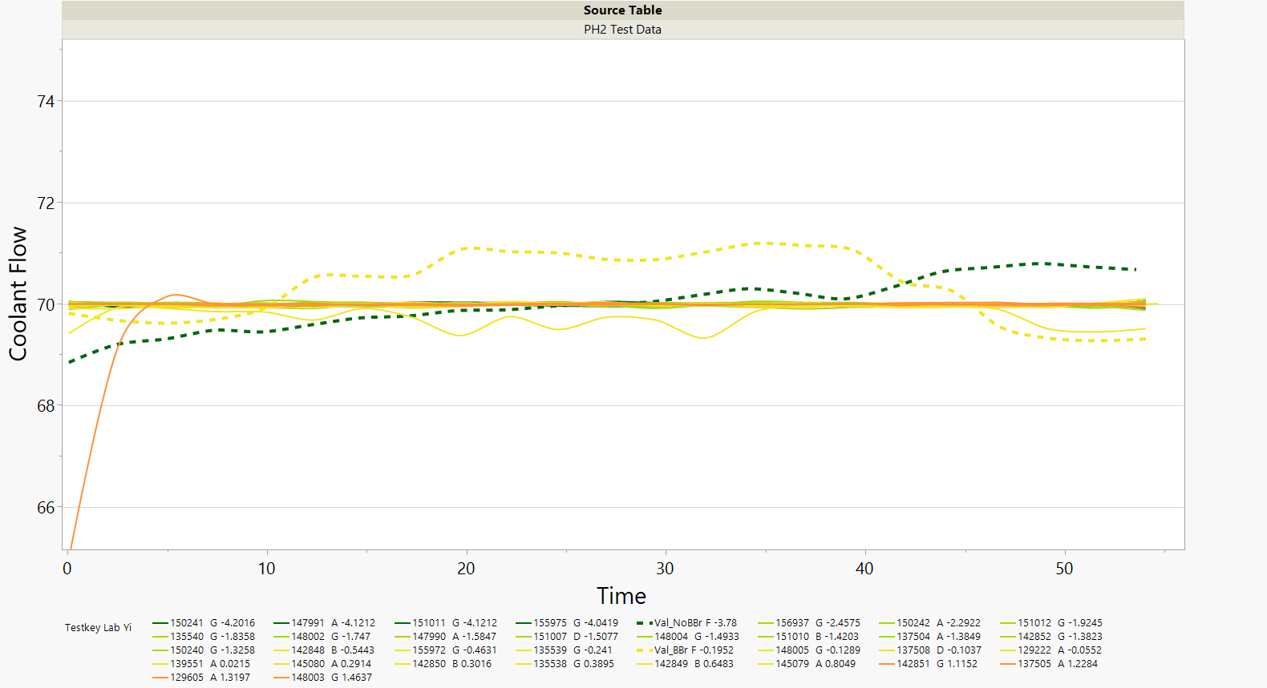
Coolant Flow – Phase 2

Slide 15
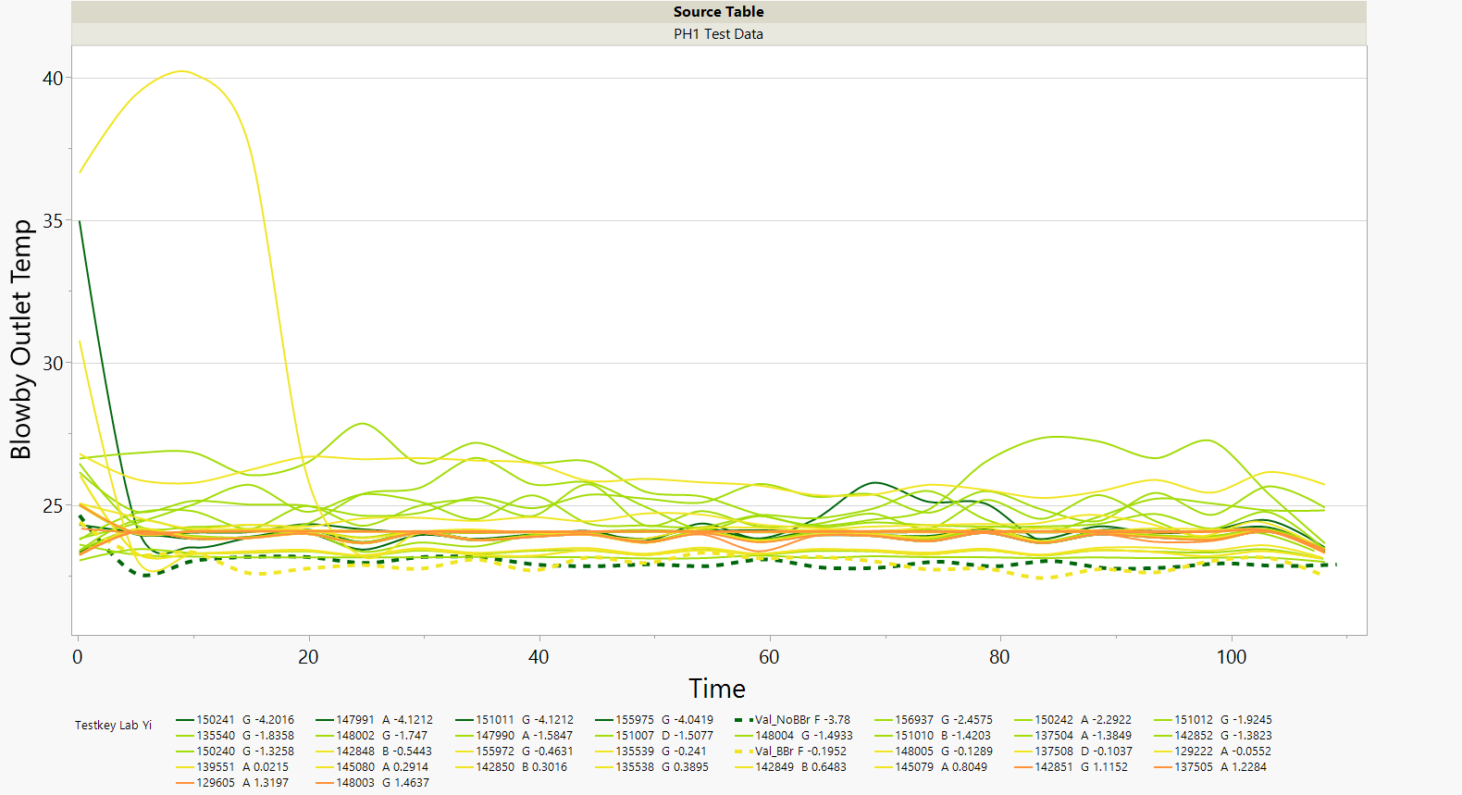
Blowby Outlet Temperature – Phase I

Slide 16
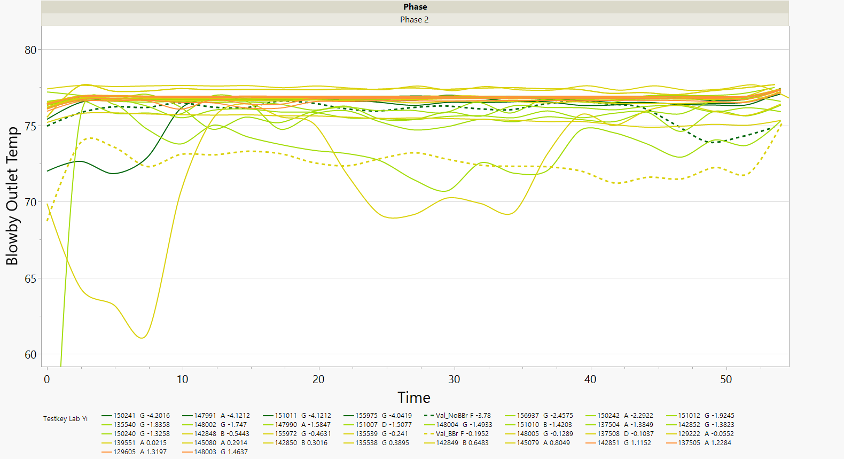
Blowby Outlet Temperature – Phase 2

Slide 17
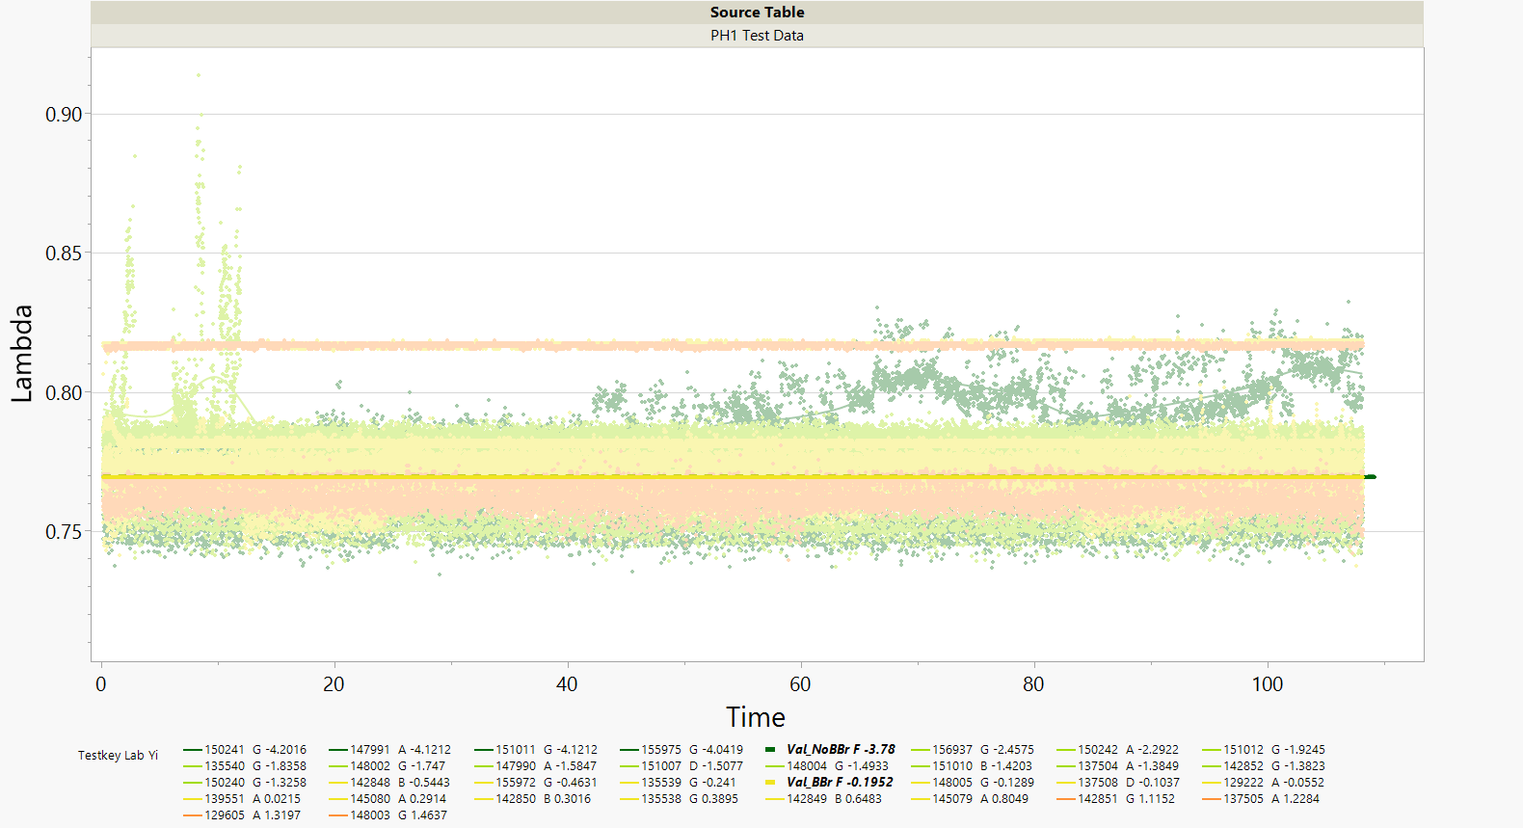
Lambda – Phase I

Slide 18
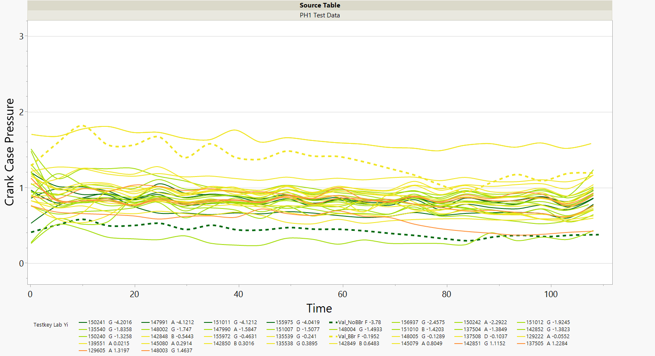
Crankcase Pressure – Phase 1

Slide 19
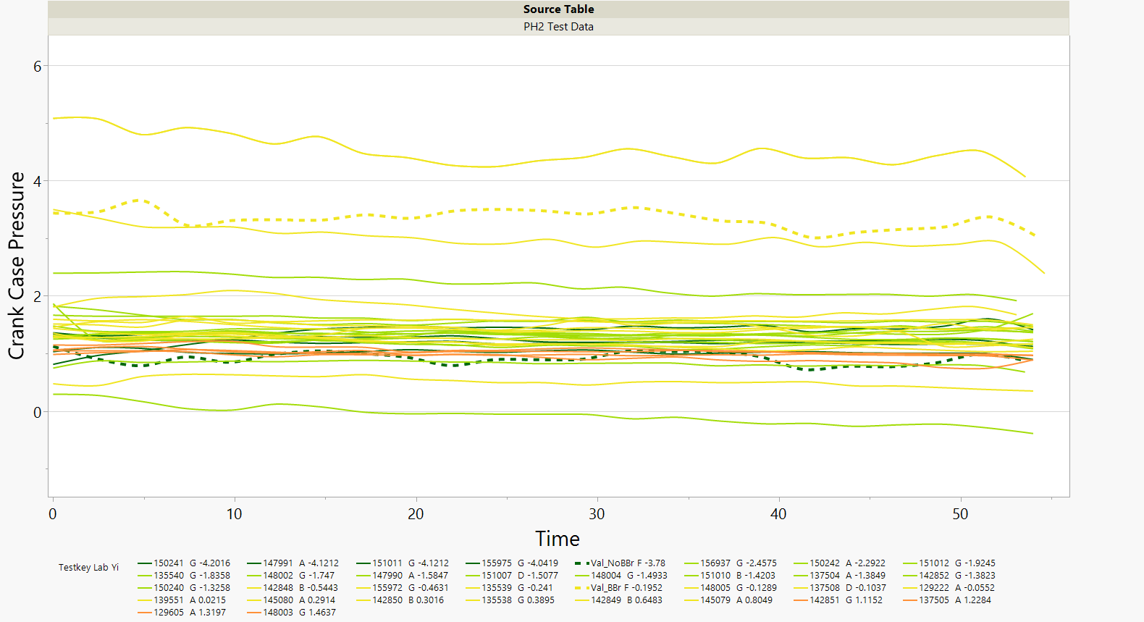
Crankcase Pressure – Phase 2

Slide 20
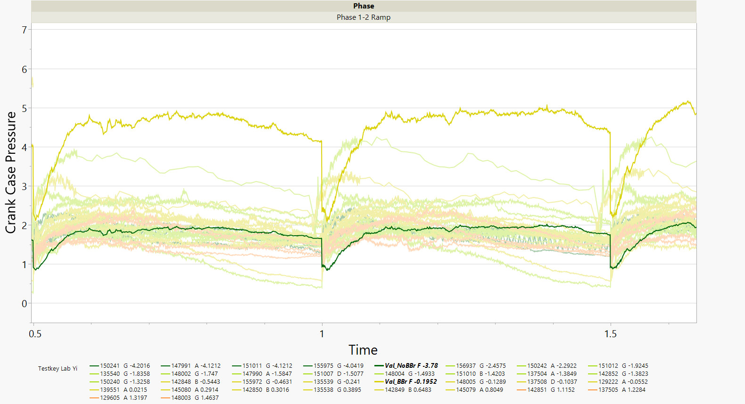
Crankcase Pressure – Phase 1-2 Ramp

Slide 21
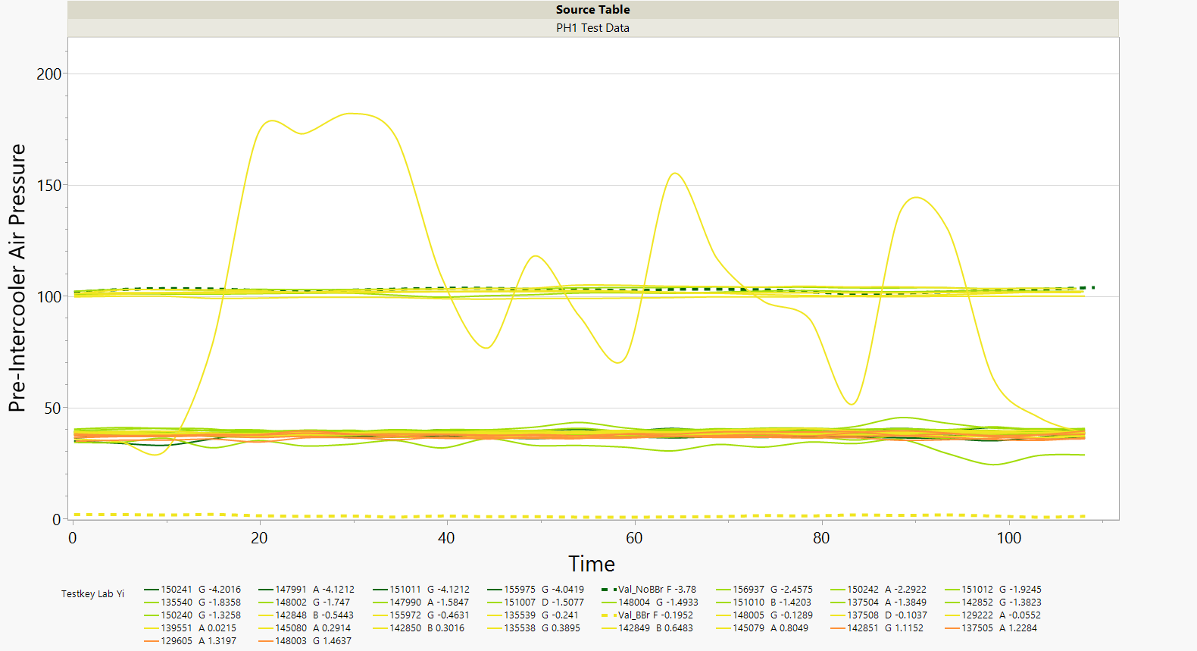
Pre-Intercooler Air Pressure – Phase 1
Some A, B, and D tests

Slide 22
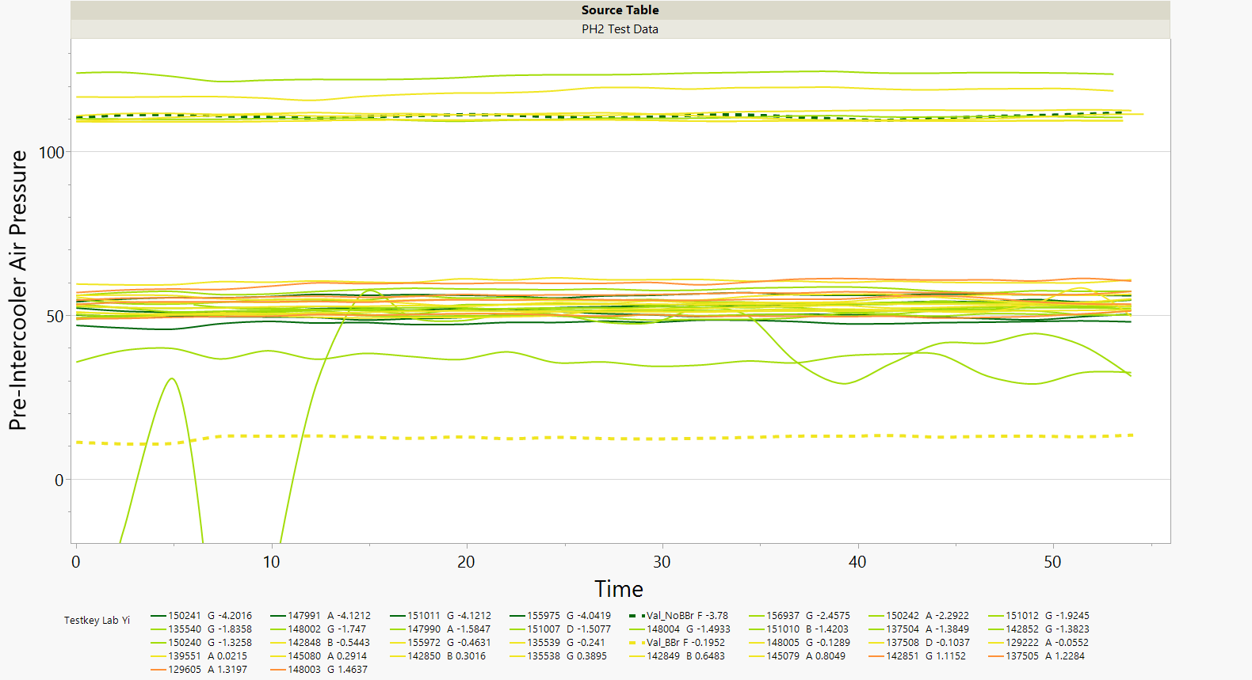
Pre-Intercooler Air Pressure – Phase 2

Slide 23
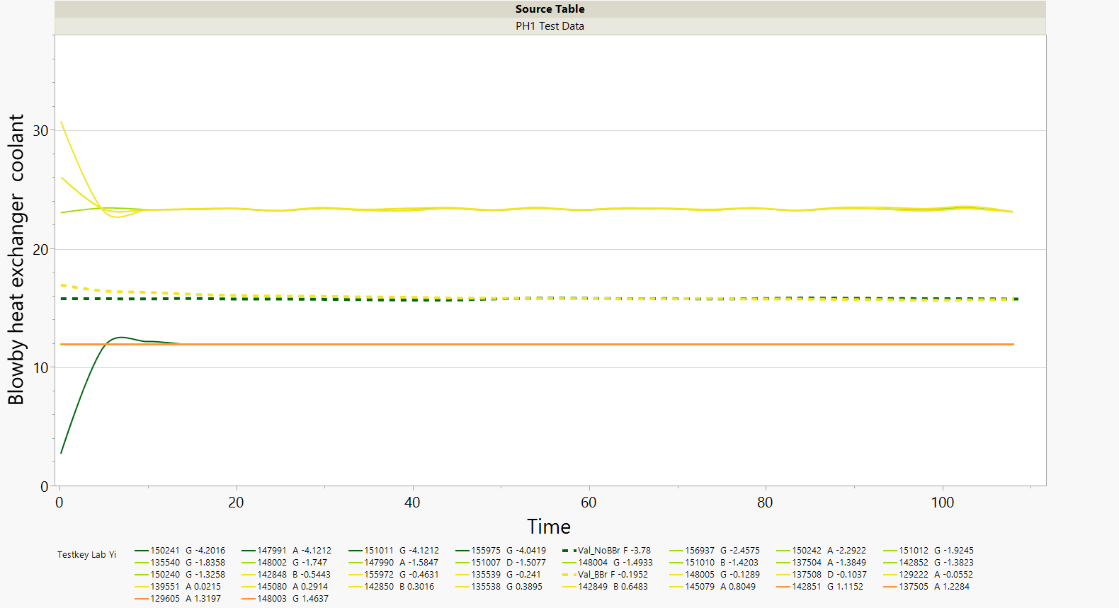
Blowby Heat Exchanger Coolant – Phase 1
Lab B

Slide 24
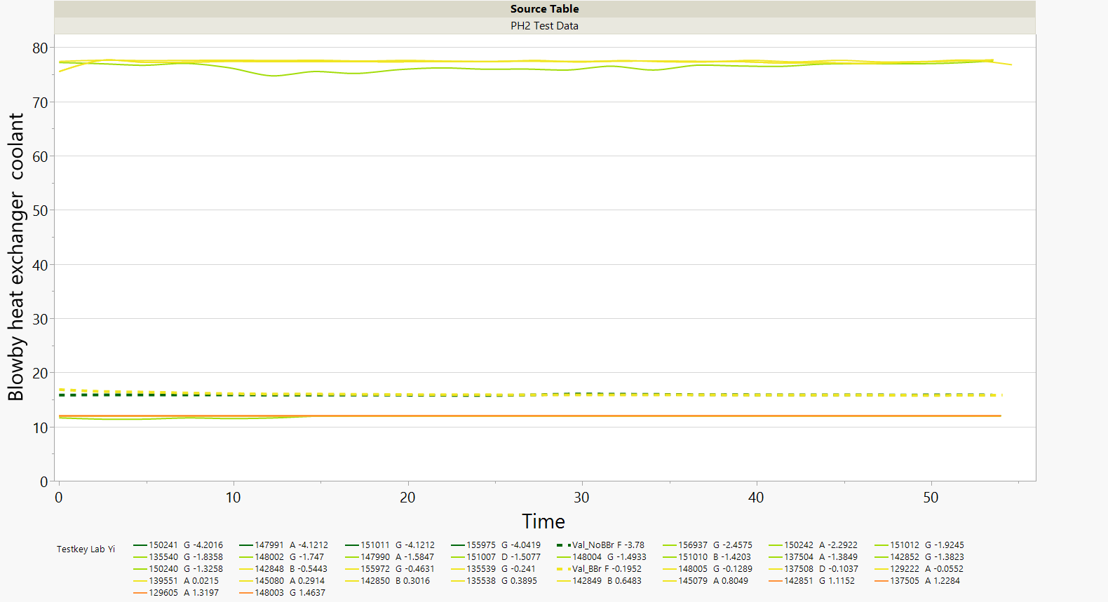
Blowby Heat Exchanger Coolant – Phase 2
Lab B

Slide 25
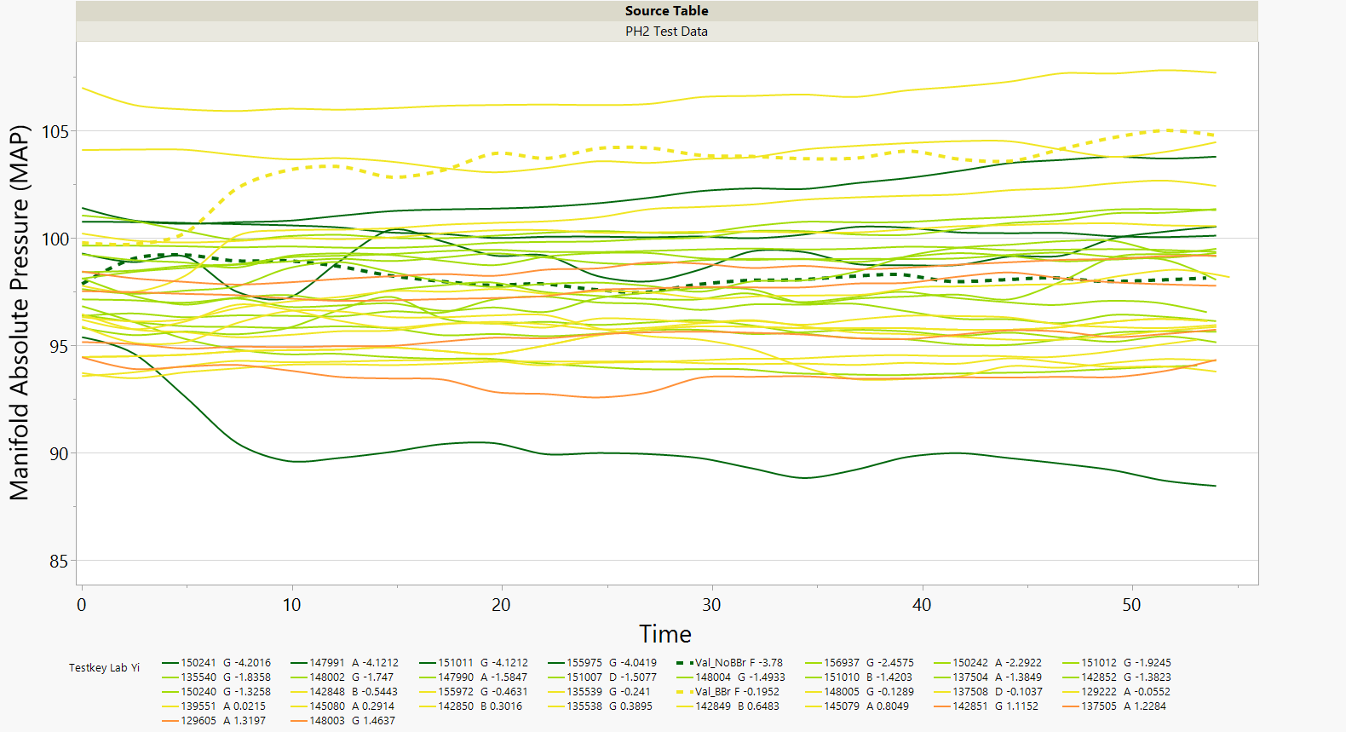
MAP – Phase 2

Slide 26
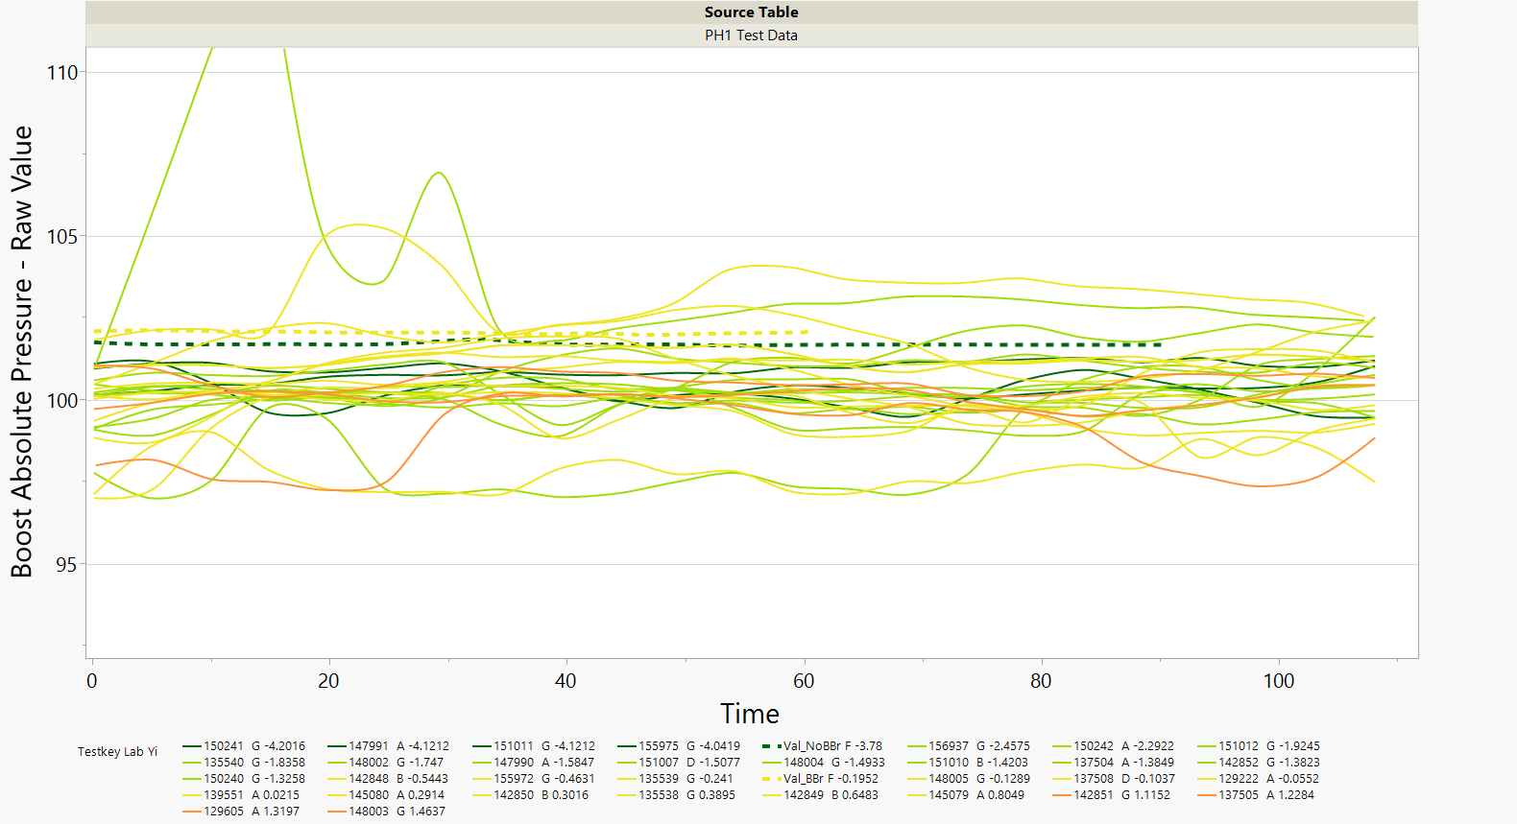
Boost Absolute Pressure – Raw Value – Phase I

Slide 27
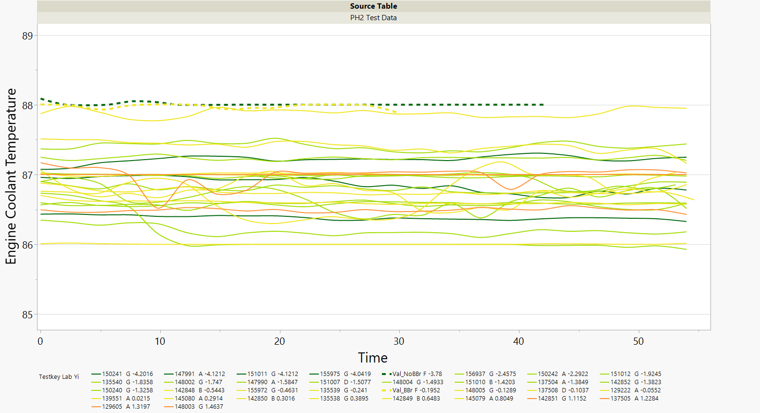
Engine Coolant Temperature – Phase 2
Valvoline test with blowby restriction had bad data for this parameter (near zero).

Slide 28
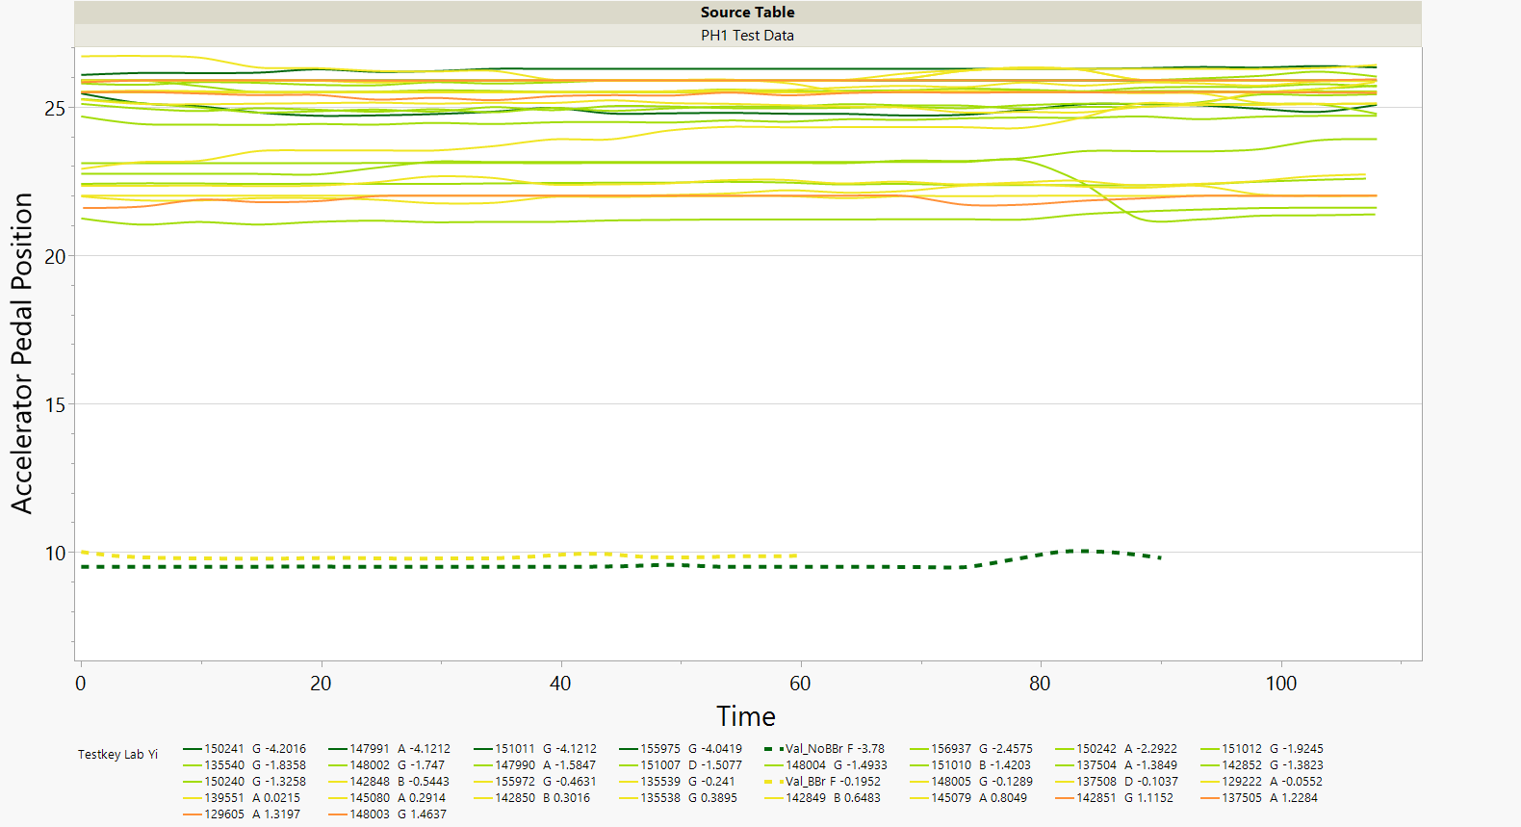
Accelerator Pedal Position – Phase I

Slide 29
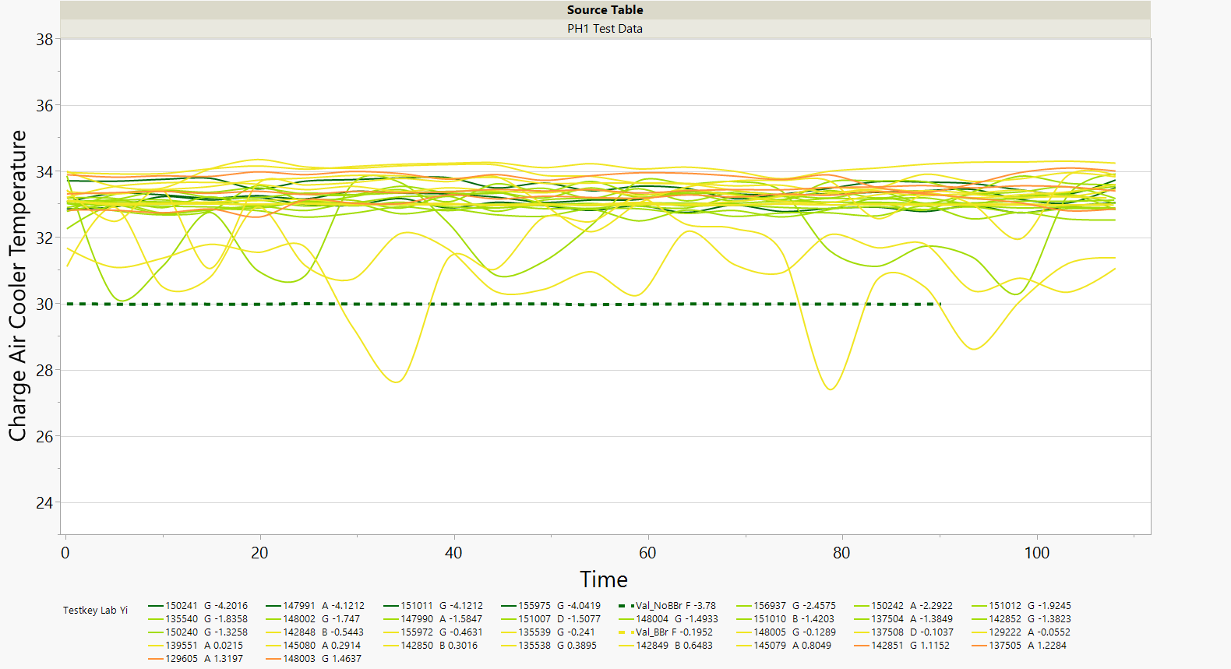
Charge Air Cooler Temperature – Phase 1
Only 1 Valvoline test with data for this parameter

Slide 30
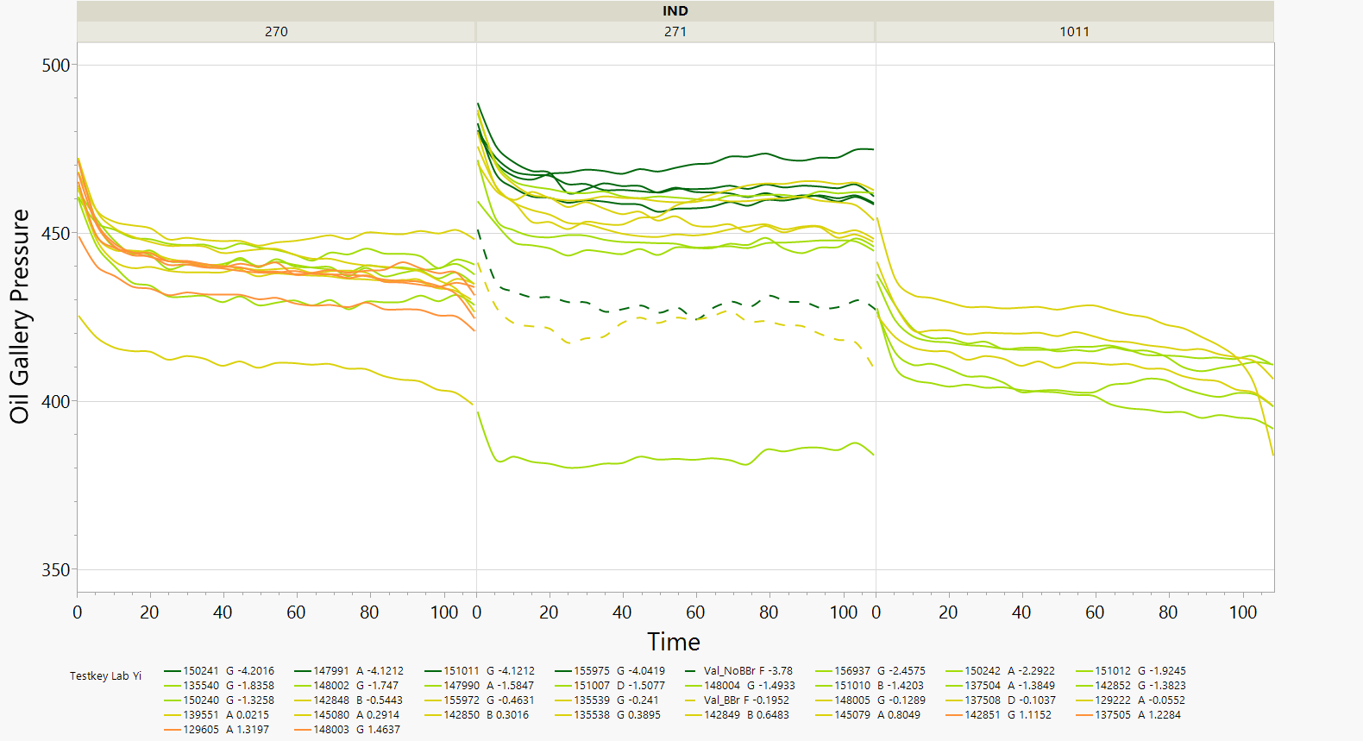
Oil Gallery Pressure – Phase I
Note: Color scheme changed.

