Slide 1
Sequence X ASTM D8729 Ford Chain Wear Test Surveillance Panel Meeting November 18, 2021
Prepared By: Alfonso Lopez, S.P. Chairman

Slide 2
Sequence X Surveillance Panel Meeting Agenda 11/18/21
Roll call
Approval of the meeting minutes 06/16/21
TMC Update – Reference Oil Status
Fuel Report
Alternative Supplier
Mild shift Task Force update
Oil 271 Suspension
Candidate Activity
Hardware Update
Report to Sub B

Slide 3
Meeting Minutes
Attendance roster attached below
Meeting minutes from 04/21/21 were approved
TMC Report Attached
Test in alarm – mild
Oil 271 remains suspended
Oil 1011 depleted
Oil 1011-1 will not be assigned due to severity alarm
All labs calibrated – two test stands on target-to-severe on oil 270 in labs A and B

Slide 4
Meeting Minutes
Fuel Report
Prasad from Haltermann reported 320K gallons of EEE remaining
Next Fuel batch will be blended in January
Shortage of drivers with proper tanker license still a problem
The panel was approached by an alternative fuel supplier with a request for guidance and testing requirements to supply fuel to the industry for Sequence X testing. The panel agreed to form an alternative fuels task force. The objective of the task force will be to establish testing guidelines that will be included in the test procedure for any alternative supplier.

Slide 5
Meeting Minutes
Mild severity shift task force update. Summary slide attached.
Amol presented a slide of experimental test results using an orifice restrictor.
Valvoline data showed on target results using the restrictor
Not all labs have conducted experiments with the restriction, some stands on target with no restrictor.
Intertek was still mild using a restrictor
Discussion of Task Force activities
No root cause for mild shift has been identified after more than 1 year of review and experimentation
Options that were presented by stats group and panel for a go forward path (See presentation attached)
Remove oil 271 from service completely or use as discrimination oil only
Mathematical solution of increasing the standard deviation to prevent overinfluence of oil 271
Continue Task Force activity for engineering solution.

Slide 6
Meeting Minutes
Severity Shift discussion Cont’d
The group agreed to continue with Task Force Efforts. A motion was made to maintain suspension of oil 271 through April 8, 2022 with the condition that the task force maintains full effort in solving the problem.
The motion passed with 10 approves and 3 waives.
Mike Deegan expressed concern that poor oils may be entering the market. Grundza replied that the severity adjustment system was doing its job in generating accurate candidate test results.
Hardware update
A survey was sent to all labs for hardware availability. No specific needs were expressed by any lab.
A summary slide is attached below for industry inventory
Candidate Activity – slide attached
The industry pace is about 4-5 tests a month this year.

Slide 7
Motion/Action Item List 11/18/21
Motion 1: Approval of the SP Meeting minutes from 06//21
Motion: Rich Grundza
Second: Robert Stockwell
Passed: unanimous
Motion 2: Continue the Mild Severity Task force activity and maintain oil 271 suspended through April 08, 2022
Motion: Andy Ritchie
Second: Rich Grundza
Passed: 10 Approve, 0 Negative, 3 Waive
Action – Form Alternative Fuel Task Force

Slide 8
Mild Severity Shift Task Force Update
4 Task Force meetings since last panel call
Experiments with blowby stack orifice plate
Higher CC pressure
More severity in Lab F
Oil 271 comparison mild vs severe tests see attached slide from Valvoline
Task force analyzing Lab F data
Operational review
Oil Analysis
See Task Force minutes for presentations
Valvoline slide below shows summary
Hardware investigation ongoing

Slide 9
Valvoline BB Restrictor Comparison Data
 |  |  | CWT- Reference Oil Run History - Valvoline Stand
 |  |  |  |  |  |  |  | Ref. oil Targets
Stand Status / Change description | CW stand Test no. | Oil Code | EOT Date | no. of CW tests | IND | % CHST (Xi) | Ln(CHST, %) (Ti) | Mean | std. dev. (s) | Target (Mean) | Shewhart Severity |  | % increase in results using BB constrictor over previous runs
 |  |  |  |  |  | norm. units | trans. units | trans. units | trans. units | norm. unit | Yi |  | in terms of | in terms of
 |  |  |  |  |  |  |  |  |  |  |  |  | Δ CHST | Δ Yi
Stand was reset to Seq. X, CW config., incl. full instru. calib. | 10 | FRO | 20200902 | 5 | 270 -preblend (from Proveout) | 0.0513 | -2.97006 | -2.15699 | 0.17435 |  | -4.663
fine tuned spd, trq (dyno) tuned temp. ramps & t-BB Engine mounts replaced, engine angles adjusted | 10A | TK157100 | 20201022 | 6 | TMC-270 | 0.0552 | -2.89625 | -2.15699 | 0.17435 |  | -4.240
changed to new Chain batch | 11 | LWO | 20201207 | 7 | 271 -preblend (from Proveout) | 0.0379 | -3.27280 | -2.60987 | 0.17537 |  | -3.780
 |  | vv Experimental Reference Runs with Orifice Constriction in Blowby Ckt. vv
Orifice constriction added in the blowby ckt. past oil separator everything else same as before (no other change) | 12 | TK131725 | 20210413 | 8 | TMC-1011 | 0.1282 | -2.05416 | -2.08191 | 0.18882 | 0.12469 | +0.147 |  | no prev. data on the stand for this oil to compare
 | 13 | TK157101 | 20210524 | 9 | TMC-270 | 0.1165 | -2.14986 | -2.15699 | 0.17435 | 0.11567 | +0.041 |  | 110.9% | 101.0%
No change from 13 | 14 | TK157103 | 20210625 | 10 | TMC-271 | 0.0721 | -2.62970 | -2.60987 | 0.17537 | 0.07354 | -0.113 |  | 90.2% | 97.0%

Slide 10
Panel Roster
Sequence X Surveillance Panel Meeting
November 18, 2021
 | Attendance | Voting Member | Motion 1
Porter, Christian <Christian.Porter@AftonChemical.com> | x | Afton | Y
Todd Dvorak <Todd.Dvorak@AftonChemical.com> | x
Martin Chadwick Intertek <martin.chadwick@intertek.com>
Dan Lanctot <DLanctot@tei-net.com> | x | TEI | Y
Jason Bowden <jhbowden@OHTech.com> | x | OHT | Y
'Rich Grundza' (reg@astmtmc.cmu.edu) | x | TMC | Y
Jason Soto Intertek <jason.soto@intertek.com> |  | IAR | Y
doyle.boese@infineum.com | x
Martinez, Jo G. (jogm) <JoMartinez@chevron.com> |  | Chevron
J.Hsu@shell.com | x | Shell | W
Gleason, Joseph <Joseph.Gleason@lubrizol.com>
Kostan, Travis G. <travis.kostan@swri.org>
ptumati@jhaltermann.com | x | Haltermann | Y
Khaled , Zreik Khaled.zreik@gm.com | x | GM
Chiappelli, Maria <Maria.Chiappelli@Infineum.com> |  | Infineum
Montufar, Ashley <ashley.montufar@exxonmobil.com> | x | ExxonMobil | Y
Charlie Leverett <charlie.leverett@yahoo.com> | x
Amol C Savant <ACSavant@valvoline.com> | x | Valvoline | W
Eickstead, Christine M. <christine.eickstead@swri.org> | x | SWRI | Y
Brys, Jerome <Jerome.Brys@lubrizol.com> |  | Lubrizol
'Bob.Campbell@aftonchemical.com'
Patrick M. Lang <patrick.lang@swri.org> |  | SWRI
Stockwell, Robert T (Robert.Stockwell@chevron.com) | x | Chevron | W
Bill Buscher Intertek <william.buscher@intertek.com>
Ritchie, Andrew <Andrew.Ritchie@Infineum.com> | x |  | Y
Rais, Khaled <khaled.rais@swri.org> | x
Stevens, Andrew <Andrew.Stevens@Lubrizol.com>
Matthews, Tim <Tim.Matthews@uk.bp.com> |  | BP
Lopez, Alfonso <al.lopez@intertek.com> |  | Intertek
Deegan, Michael (M.D.) <mdeegan@ford.com> |  | Ford | Y
Lochte, Michael D. <michael.lochte@swri.org>
joshua cooley valvoline
George Szappanos | x | LZ
Timothy Cushing <timothy.cushing@gm.com> |  | GM
Wingert, Dean (D.) <dwingert@ford.com>
Michael Luhard |  | Afton
Ben Maddock | x | Afton
Angela Willis
Haing Tang |  | Chrysler
Gabrel, Izabela <IGabrel@h-c-s-group.com> | x | Haltermann Carless

Slide 11
Sequence X History
Sequence X Milestones
1/1/2012 | Start of Chain Wear Test Development
12/7/2017 | AOAP Approval for GF6
4/2/2018 | Live Registration (03/19/16 Retro - Registration)
2/20/2019 | Surveillance Panel Procedure Acceptance Vote
4/4/2019 | Subcommittee B Ballot
6/16/2019 | Main Committee D02 Ballot - ASTM Procedure D8279
11/7/2019 | Memorandum 19-043 Use of Calibrated Sequence X Stands to Generate Used Oil Samples for Seq IX (LSPI)
11/20/2020 | Information Letter 20-1 Procedure Edits / Drive Shaft Spec
1/27/2020 | Information Letter 20-2 Criteria for Multiple Test Type Calibration
6/1/2020 | Mild Severity Shift Task Force Formed
9/11/2020 | Information Letter 20-3 Correction to Table 12
10/14/2020 | Information Letter 20-4 (1) Correcting PCV Flow Meters (2) Correction to Section 12.1.1
4/8/2021 | Oil 271 Suspended from use due to mild results
9/17/2021 | Information Letter 22-1 Engine run limits, honing procedure, connecting rod orientation, blowby gas thermocouple orientation

Slide 12
Sequence X
October 2021

Slide 13
Calibrated Labs and Stands*
Test | Labs | Stands
IIIH/A/B | 4 | 12
IVA | 2 | 2
IVB | 4 | 6
VH | 5 | 14
VIE | 3 | 9
VIF | 3 | 5
VIII | 2 | 4
IX | 3 | 5
X | 4 | 5
Return to Table of Contents
*As of 9/30/2021

Slide 14
Sequence X Activity
Test Status | Validity Code | #
Acceptable Calibration Test | AC | 6
Operationally Invalid Calibration Test, Lab Judgement | LC | 1
Terminated Calibration Test | XC | 1
Not for Industry Statistics Test (shakedown tests to evaluate installation of blowby orifce) | NN | 4
Total Number of Tests |  | 12

Slide 15
Sequence X - Lost Tests*
Test Status | Cause | #
Terminated | Missed Blowby reading | 1
Invalid | Test ran 48 hours with blowby orifice installed | 1
Totals |  | 2
*Invalid and aborted tests

Slide 16
Sequence X Test Severity
Average Chain Stretch % in Severity Action Alarm (mild)

Slide 17
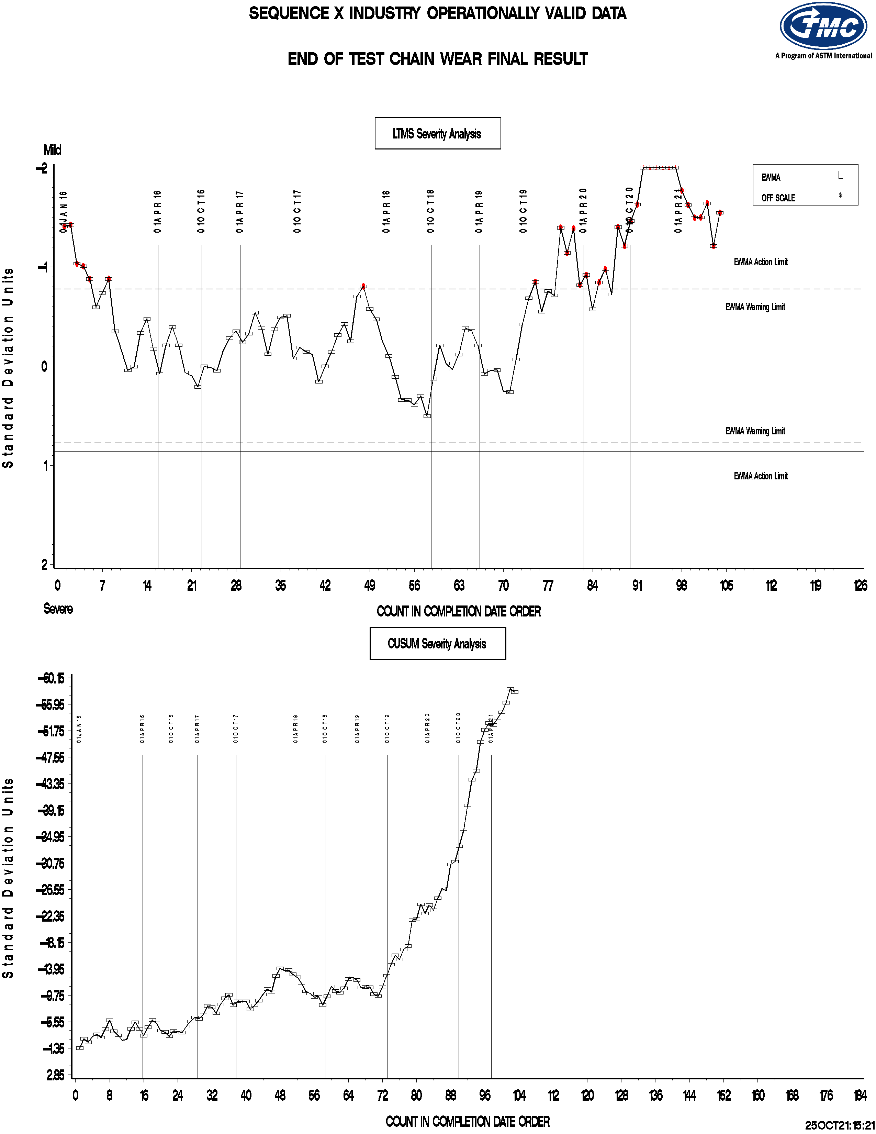

Slide 18
Sequence X Precision Estimates
Return to Table of Contents

Slide 19
Sequence X S.P. Report Reference Oils Status
271 SAE 5W-30 passing reference oil (5yr)
Use suspended until mild trend is addressed
1011 SAE 0W-16 (<1yr) Limited to lab inventories Reblend (1011-1) available
270 SAE 5W-30 failing reference oil (5yr)

Slide 20
Sequence X Hardware Status
7-8 Year inventory of test engines with BC pistons
Non-critical parts are being purchased from the dealerships
Industry order planned for non-critical parts
2017 Ring Batch – EJ7Z6148A
6 tests per engine
1100 tests at independent labs (as of 11/01/19)
Survey sent to labs for hardware needs

Slide 22
Sequence X Severity Mathematical Corrective Options
Statistics Group
June 2021

Slide 23
Statistics Group
Doyle Boese, Infineum
Jo Martinez, Chevron Oronite
Martin Chadwick, Intertek
Phil Scinto, Lubrizol
Richard Grundza, TMC
Todd Dvorak, Afton
Travis Kostan, SwRI

Slide 24
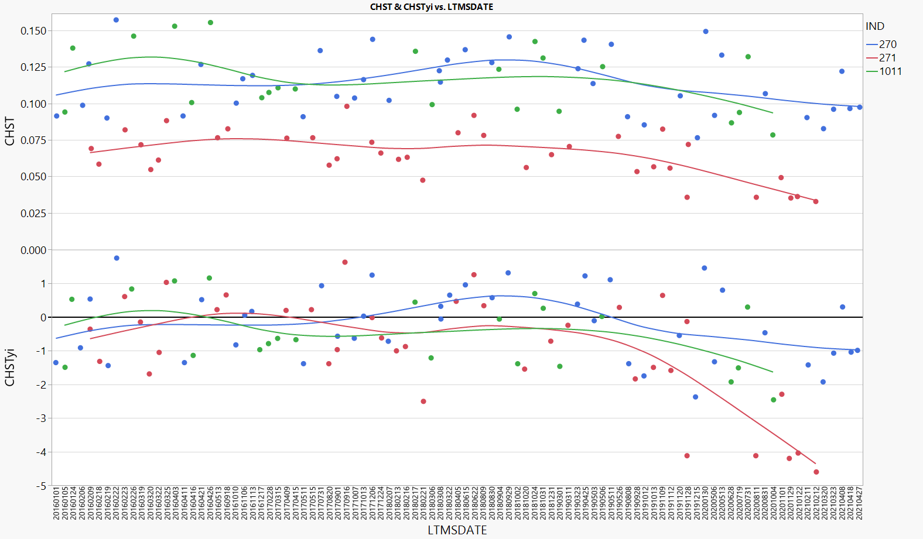
Background
All 3 reference oils appear to have shifted by similar CHST amount. Therefore Ln(CHST) more greatly impacted Oil 271. Oil 271 has been temporarily suspended.
Notes:
Updated

Slide 25
Executive Summary
The statistics group has ordered potential test severity remedies below in order from most to least preferred.
Return the test to traditional severity levels through an engineering solution.
Continue the suspension of reference oil 271.
The remaining 2 oils can still track test severity in both the mild and severe direction, and are not causing problems with lab calibration.
Some options exist for running 271 on a less frequent basis and not for calibration. This can be explored/discussed further if the panel desires.
If a mathematical solution is desired, the majority preference of the statistics group is to update the reference oil standard deviations as shown in the table below. To prevent an overly large influence of oil 271 on the severity adjustment standard deviation, the stats group recommends using the oil 270 standard deviation as the standard deviation for severity adjustments. This is appropriate if one believes candidate results near the performance of oil 271 have not seen as large a shift in transformed units.
Oil | Current S.D. | New S.D.
270 | 0.17435 | 0.24011
271 | 0.17537 | 0.56272
1011 | 0.18882 | 0.27434
Severity Adj. S.D. | 0.17856 | 0.24011*
* - Standard deviation on Oil 270

Slide 26
Mathematical Corrective Options Considered
The following are a list of options for mathematical corrective options evaluated (in no particular order). Fixing a problem mathematically for the reference oils does not mean that the underlying problem will be fixed for candidate oils.
Re-evaluate the transformation based on the current data set. If different from Ln, calculate new means and standard deviations. Also consider removing the transformation from Oil 271 only. Would require new mean and standard deviation for this oil.
Result – A square root transformation was slightly preferred over the natural log but provided only small relief. This fix would likely be needed in addition to a standard deviation adjustment, and fewer changes are preferred to many.
Correction factors. This would be applied equally to all oils, candidates and references. Evaluate constant and proportional correction factors to transformed and untransformed results.
Result – Constant correction factors in untransformed units were reasonable, but slightly over- and under-corrected some reference oils. Proportional correction factors bring all oils back to target, but results in large positive corrections for mild oils, requiring strong belief that candidates near oil 271 performance are behaving similarly. For any correction factor options, the lack of root cause also makes starting/stopping point of correction factor implementation unclear.
Calculate new standard deviations. This will make the standard deviation of 271 larger and thus bring the standardized result closer to target.
Result – This option was chosen, as it provides relief to the test while requiring the least amount of changes to the way the test has been run historically.
Notes:
Updated

