Slide 1
Sequence X
ASTM D8729
Ford Chain Wear Test
Surveillance Panel Meeting
June 21, 2022
Prepared By: Alfonso Lopez, S.P. Chairman

Slide 2
Sequence X Surveillance Panel Meeting Agenda
06/21/22
Roll call
Approval of the meeting minutes 11/18/21
TMC Update – Reference Oil Status
  Oil 271 Suspension
Fuel Report
  Alternative Supplier
Hardware Update (2028)
Mild shift Task Force update
  Stats Group Presentation
Candidate Activity
Report to Sub B

Slide 3
Motion/Action Item List 06/21/22
Motion1 : Approval of the minutes from 11/18/21
  Motion: Ritch Grundza
  Second: Robert Stockwell
  Passed: Approved Unanimous
Motion 2: The Sequence X Surveillance Panel agrees to have calibrated labs donate one reference oil test per lab on oil 271. The panel agrees to direct the TMC to grant a one test, two week extension to those stands which generated the 271 results.
  Motion: Al Lopez
  Second: Mike Deegan
  Motioned withdrawn after discussion

Slide 4
Sequence X S.P. Report
LTMS Laboratory/Stand Distribution
 | Reporting Data | Calibrated as of 3/31/22
Number of Laboratories | 2 | 2
Number of Stands | 4 | 4

Slide 5
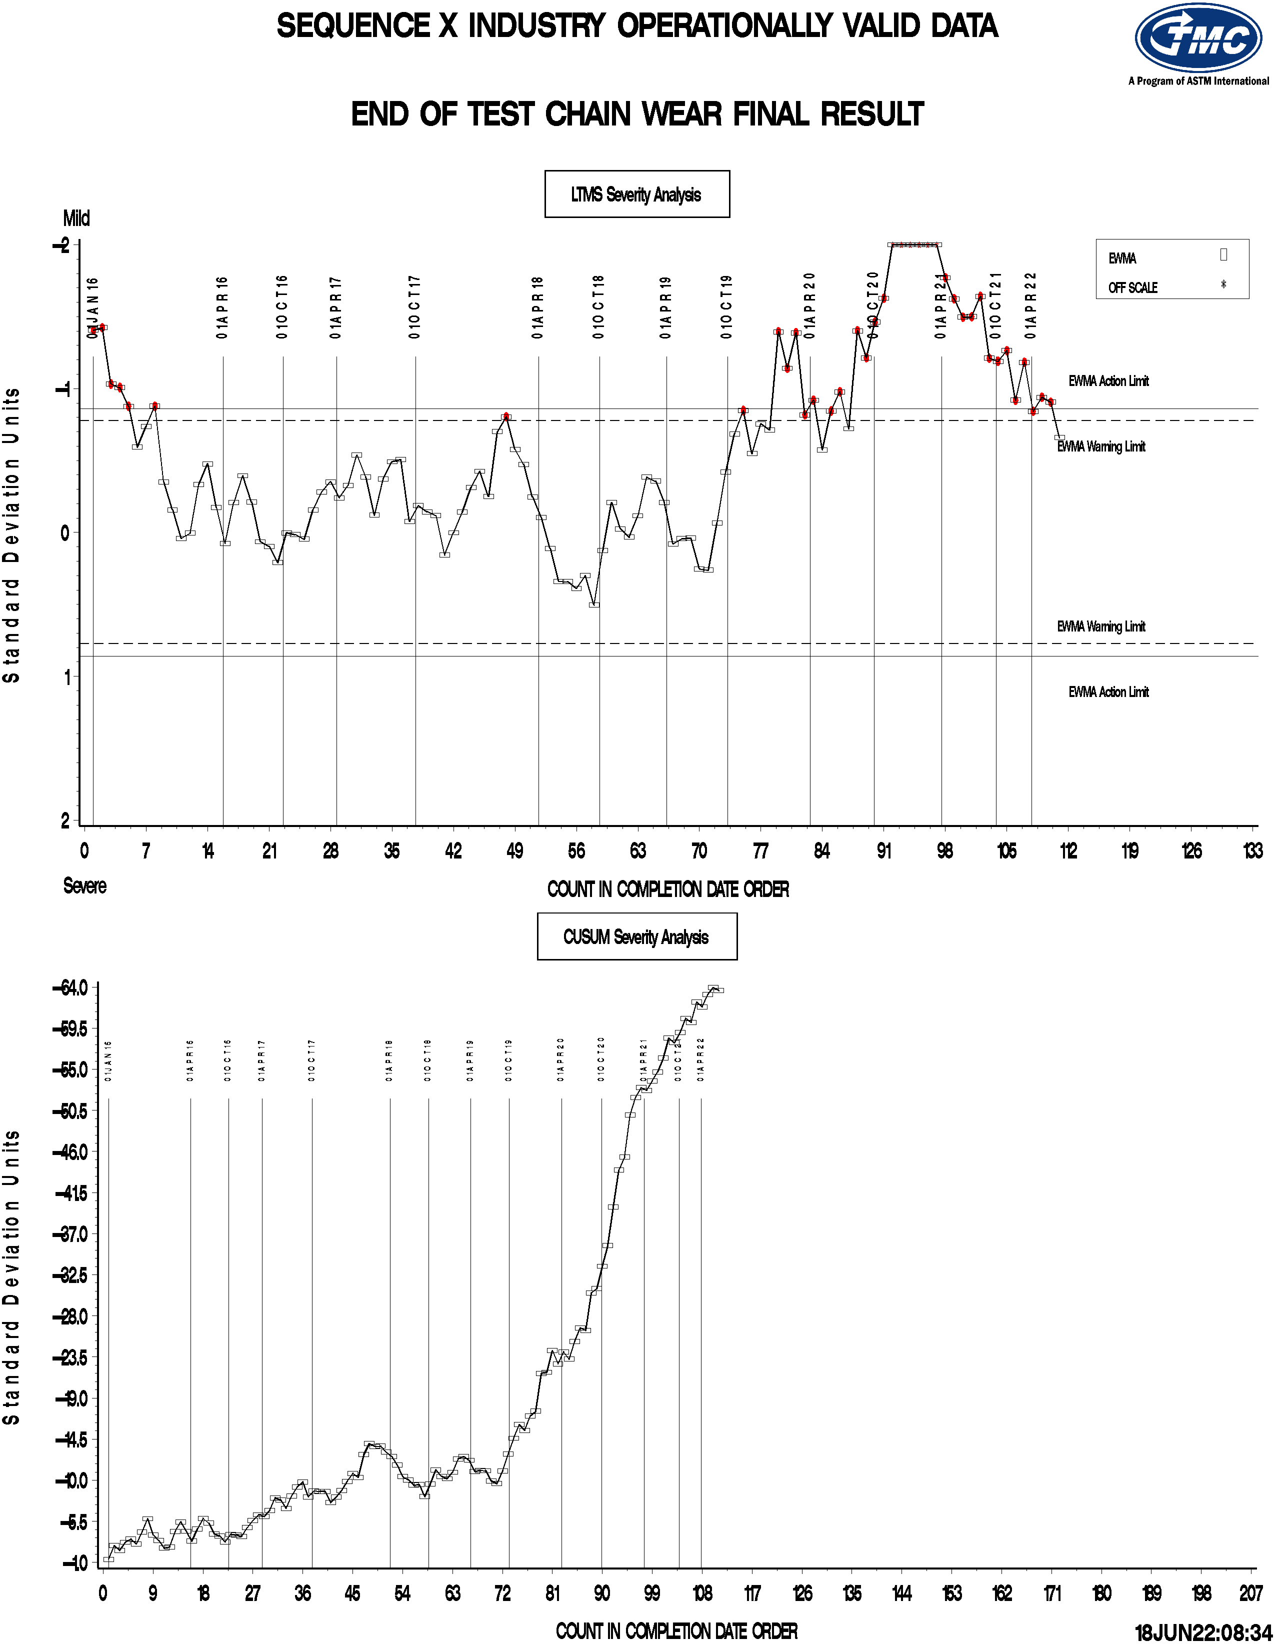

Slide 6
Reference Oil Update
Oil 271 Suspension 04/08/21 – Present
Oil 1011 Depleted
  1011-1 Assignment on hold pending severity shift resolution
Oil 270 – all stand calibrated on oil 270 for past year

Slide 7
Fuel / Hardware Update
Fuel
  EEE (137K gal) Next Batch in August
  Alternative fuel testing on hold pending severity shift resolution
Hardware
  Labs received quote from Ford Component Sales (FCS) for non-critical hardware
  Critical hardware group purchase planned
  Test life planned through 2028

Slide 8
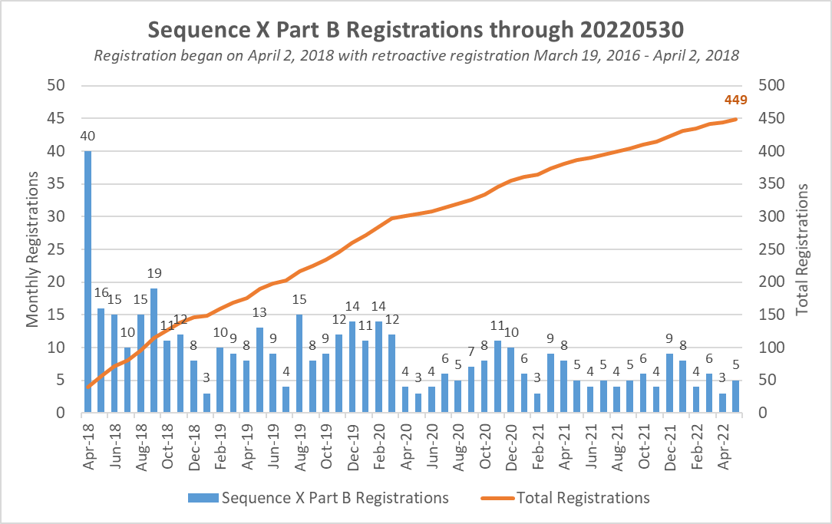

Slide 9
Statistician Report
Travis presented the report below (Slide 10) - Corrective options for Seq X mild severity shift.
Motion for labs to donate tests on oil 271 to gather current performance data. New standard deviation proposed to negate the overinfluence of the transform near zero chain stretch. Reference frequency to increase.
Discussion
  Some stands seem on target but others still mild. Which stands do we use?
  What are the short and long term consequences on severity adjustments during this increase of standard deviation. Mild stand will get closer to Yi target. Any severe result will also be adjusted towards targte and the resulting severity adjustment may allow unworthy oils pass.
Another option was introduced – Remove reference oil from rotation and use only as a discrimination oil.
Surveillance Panel to continue discussion mid July
Motion to donate tests and recalculate standard deviation was withdrawn

Slide 10

Sequence X Severity
Mathematical Corrective Options
Statistics Group
June 2021

Slide 11
Statistics Group
Doyle Boese, Infineum
Jo Martinez, Chevron Oronite
Martin Chadwick, Intertek
Phil Scinto, Lubrizol
Richard Grundza, TMC
Todd Dvorak, Afton
Travis Kostan, SwRI

Slide 12
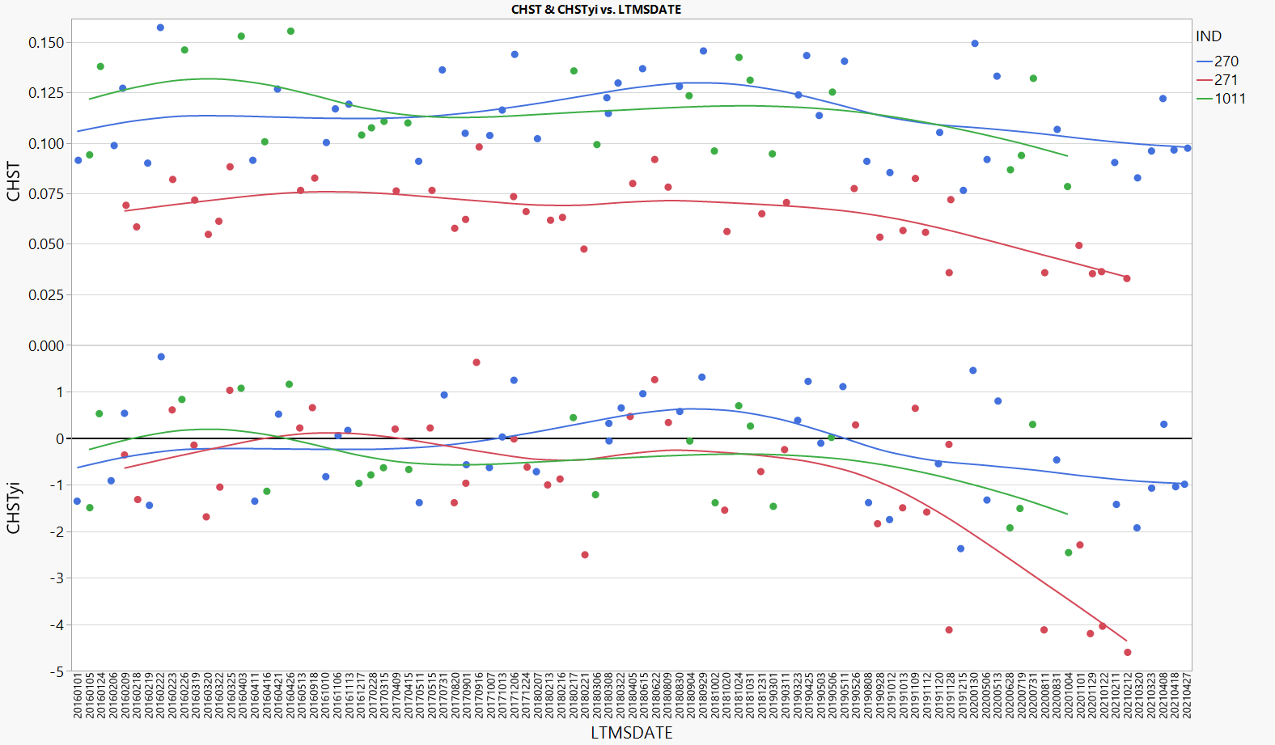
Background
All 3 reference oils appear to have shifted by similar CHST amount. Therefore Ln(CHST) more greatly impacted Oil 271. Oil 271 has been temporarily suspended.
Notes:
Updated

Slide 13
Executive Summary
The statistics group has ordered potential test severity remedies below in order from most to least preferred.
Return the test to traditional severity levels through an engineering solution.
Continue the suspension of reference oil 271.
  The remaining 2 oils can still track test severity in both the mild and severe direction, and are not causing problems with lab calibration.
  Some options exist for running 271 on a less frequent basis and not for calibration. This can be explored/discussed further if the panel desires.
If a mathematical solution is desired, the majority preference of the statistics group is to update the reference oil standard deviations as shown in the table below. To prevent an overly large influence of oil 271 on the severity adjustment standard deviation, the stats group recommends using the oil 270 standard deviation as the standard deviation for severity adjustments. This is appropriate if one believes candidate results near the performance of oil 271 have not seen as large a shift in transformed units.
Oil | Current S.D. | New S.D.
270 | 0.17435 | 0.24011
271 | 0.17537 | 0.56272
1011 | 0.18882 | 0.27434
Severity Adj. S.D. | 0.17856 | 0.24011*
* - Standard deviation on Oil 270

Slide 14
Recommendations if Increased s Adopted
Conduct additional tests on RO271 prior to implementing any changes. At least one test per lab is recommended.
  The last 271 runs with the current procedure were in Feb-2021 and at least one lab may have shifted performance on 270 since then.
Increase reference frequency as long as standard deviations that incorporate bias are used and perform regular reviews of the data.
  The LTMS will not work as intended if standard deviations that incorporate bias are used for ei and Zi calculations. Any future shift in severity will be less likely to be detected while this correction is in use. It is critical that we collect more data than when the process is performing as expected to increase the chance of developing a correction that is more effective long term and to reduce the risk that a new shift in severity occurs that is not appropriately addressed by the severity adjustments resulting from the new calculations.

Slide 15
Mathematical Corrective Options Considered
The following are a list of options for mathematical corrective options evaluated (in no particular order). Fixing a problem mathematically for the reference oils does not mean that the underlying problem will be fixed for candidate oils.
Re-evaluate the transformation based on the current data set. If different from Ln, calculate new means and standard deviations. Also consider removing the transformation from Oil 271 only. Would require new mean and standard deviation for this oil.
  Result – A square root transformation was slightly preferred over the natural log but provided only small relief. This fix would likely be needed in addition to a standard deviation adjustment, and fewer changes are preferred to many.
Correction factors. This would be applied equally to all oils, candidates and references. Evaluate constant and proportional correction factors to transformed and untransformed results.
  Result – Constant correction factors in untransformed units were reasonable, but slightly over- and under-corrected some reference oils. Proportional correction factors bring all oils back to target, but results in large positive corrections for mild oils, requiring strong belief that candidates near oil 271 performance are behaving similarly. For any correction factor options, the lack of root cause also makes starting/stopping point of correction factor implementation unclear.
Calculate new standard deviations. This will make the standard deviation of 271 larger and thus bring the standardized result closer to target.
  Result – This option was chosen, as it provides relief to the test while requiring the least amount of changes to the way the test has been run historically.
Notes:
Updated

Slide 16
When Did the Shift Occur?

Slide 17
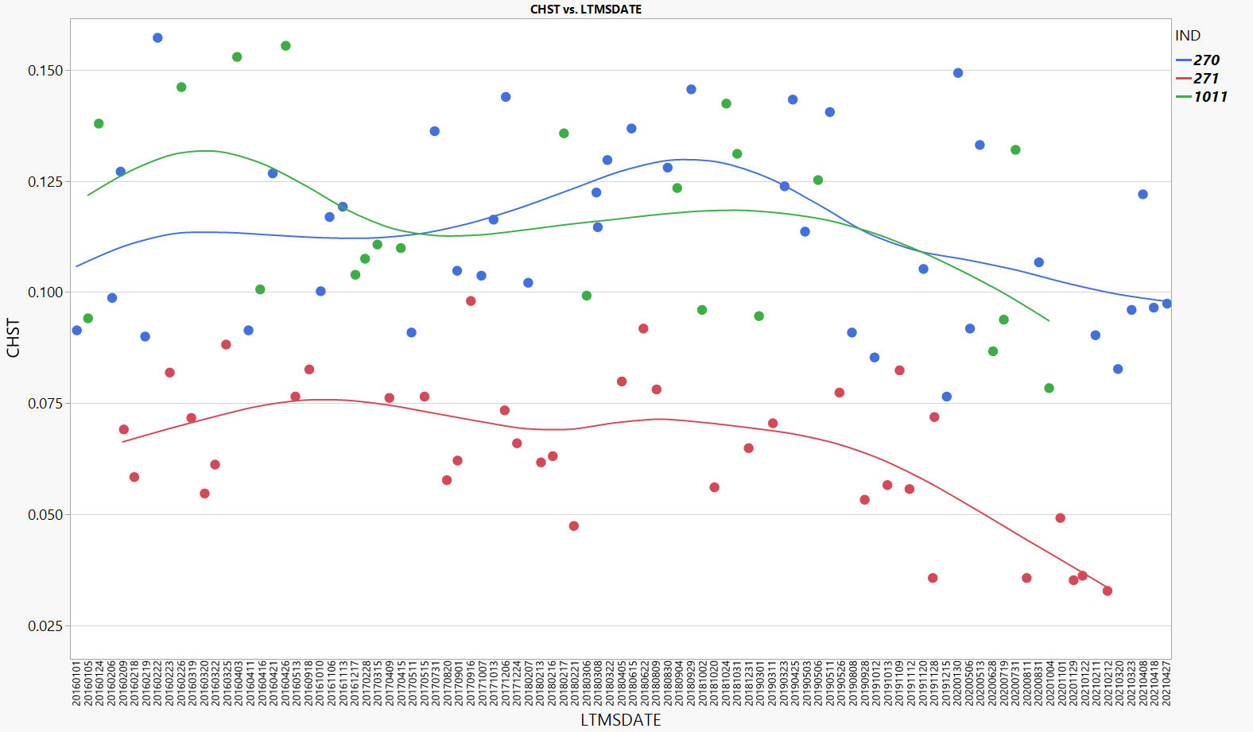
When did the shift occur?
Because we have been unable to tie the shift in severity to any particular change in the test, we do not have clear guidance as to how we draw the line in the sand. The following slides will discuss each of the 3 options below.
#1
#2
#3

Slide 18
When did the shift occur?
Line #1 is suggested as the best split according to a partition analysis (08/08/19). After this date we began to see some of the lowest results even seen on oil 270.
#1

Slide 19
When did the shift occur?
Split #2 is based on the date of the first data of an extreme mild 271. The other 271 from the same day would go in the pre-shift group.
#2

Slide 20
When did the shift occur?
Split #3 appears to be the split which best captures the point in time when all 3 oils were producing almost exclusively mild results.
#3

Slide 21
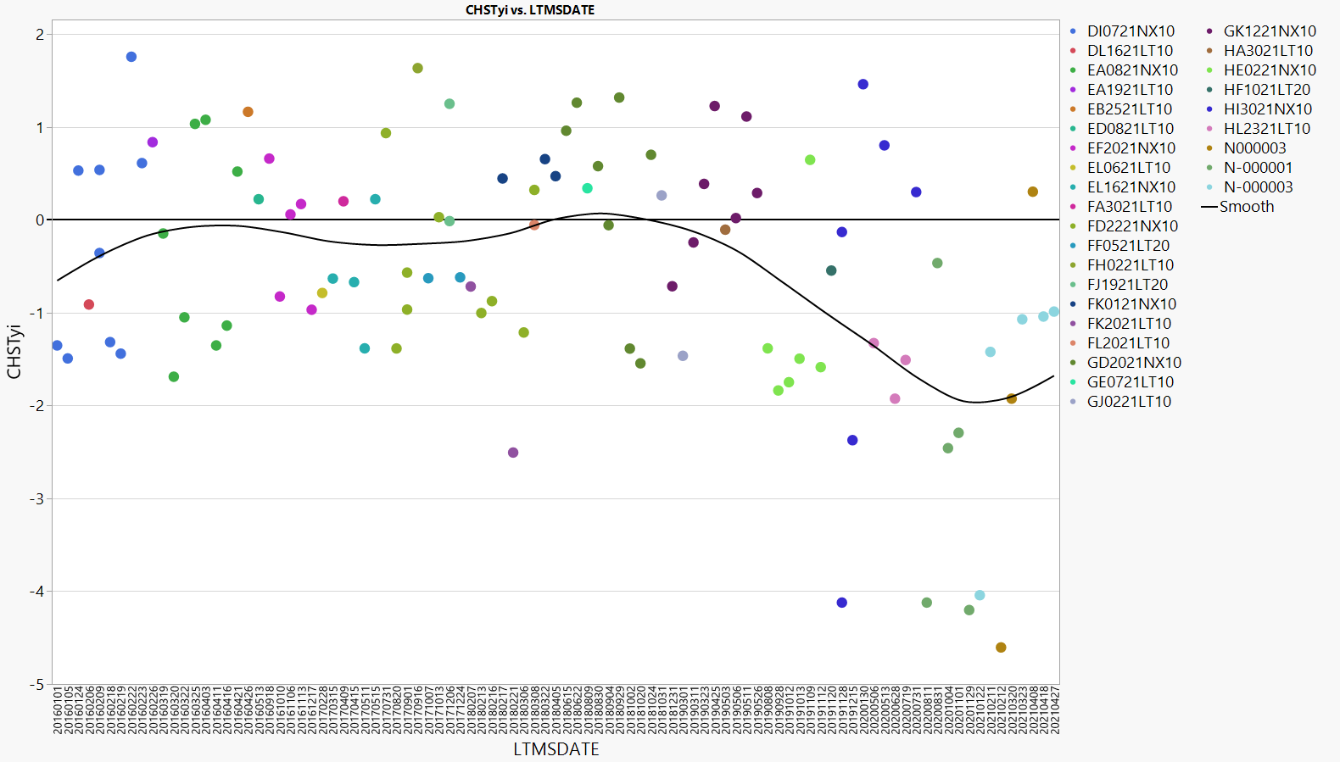
When did the shift occur?
-Fuel Batches
The data was colored by fuel batch ID to investigate how the timeline aligns with fuel batch changes. Split #1 lines up fairly well with change to “H” batch, while split #3 lines up with change to “N” batch.
#1
#2
#3

Slide 22
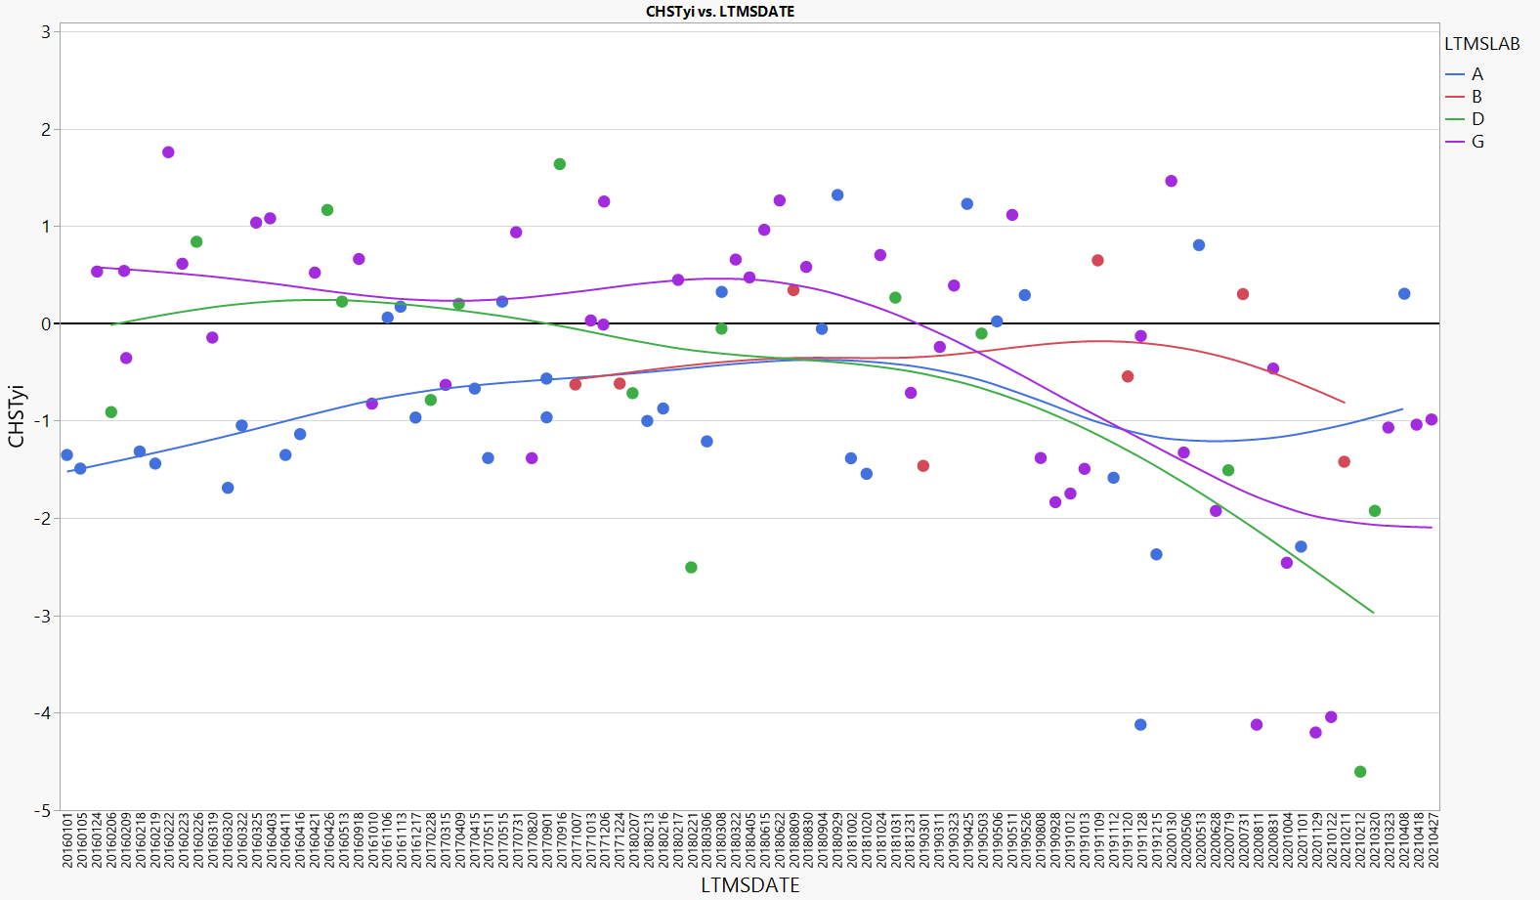
When did the shift occur?
-Lab Differences
The plot below shows Lab G showed the first evidence of the shift among labs after split #1.
#1
#2
#3

Slide 23
Standard Deviation Update

Slide 24
New Standard Deviations
Below are some comparisons of options for new standard deviations. The standard deviation update using “Post #1” was preferred.
Oil | Current S.D. | S.D. Post #1 | S.D. Post #3 | S.D. All Data
270 | 0.17435 | 0.24011 | 0.21619 | 0.19023
271 | 0.17537 | 0.56272 | 0.77157 | 0.33291
1011 | 0.18882 | 0.27434* | 0.24701* | 0.21735
Pooled | 0.17856 | 0.39913 | 0.46779 | 0.25746
Recommended |  | 0.24011**
* - Actual was 0.37932. However, with only 4 data points in Post #1 and Post #3, it seemed more appropriate to estimate using the ratio observed with the “All Data” standard deviation for 270/1011 (0.21735/0.19023).
** - Standard deviation of oil 270

Slide 25
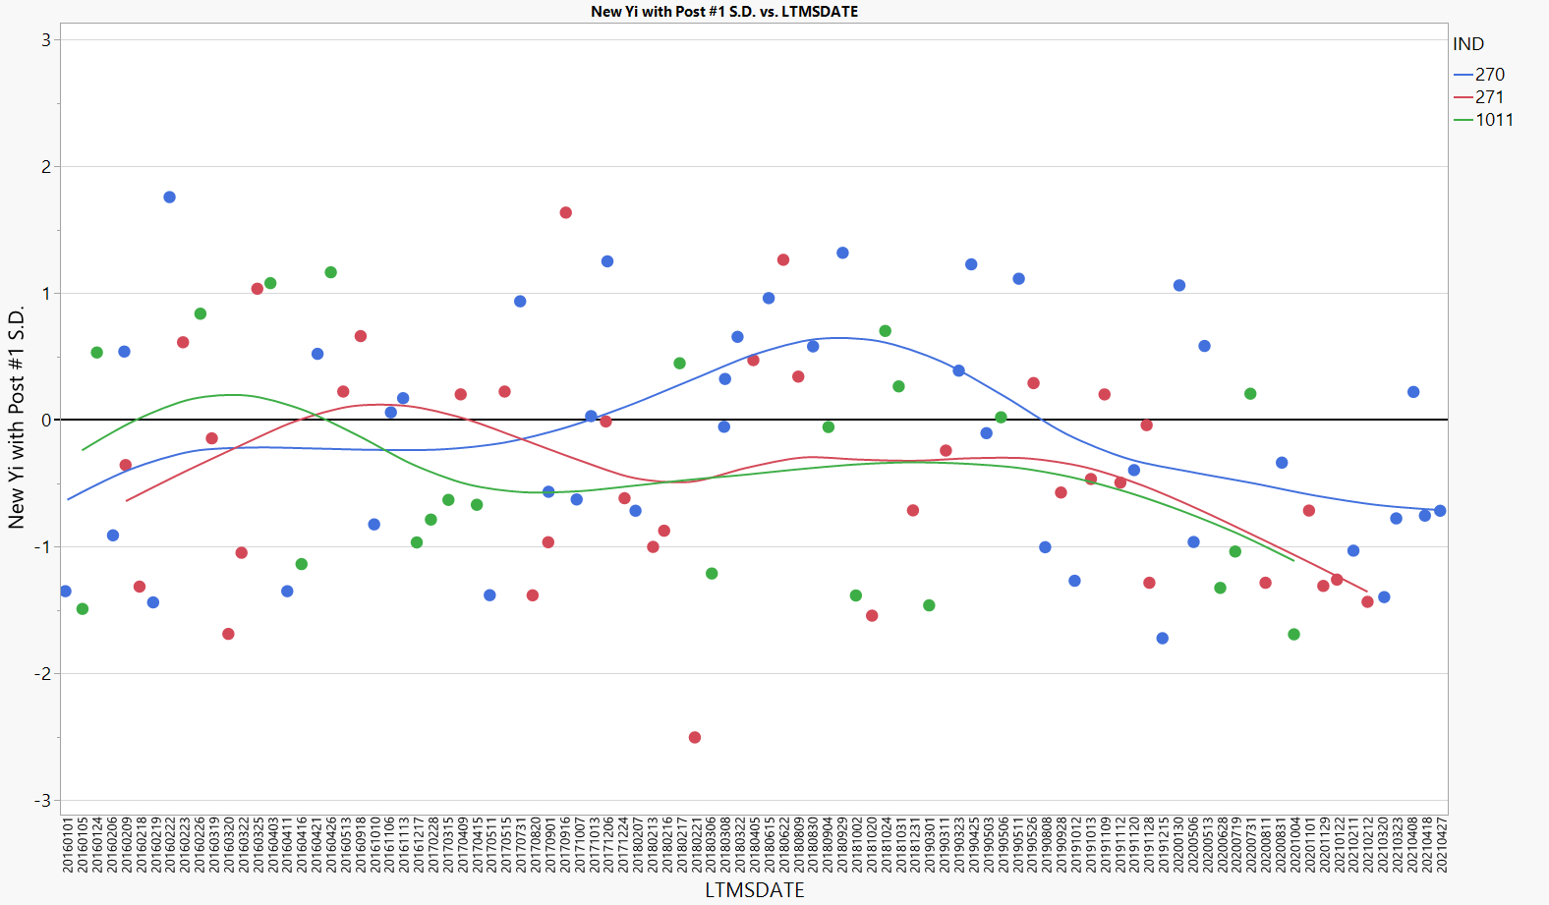
Updating Yi Using Post #1 S.D.
Yi’s after 08/08/2019 here shown with updated standard deviations for Post #1 period.
Tests after here corrected

Slide 26
Impact of Updated Severity Adjustment S.D.
The table to the right indicates how candidate results will be adjusted on a stand with a Zi value of -1 with the updated pooled SA of 0.24011.
CHST | Ln(CHST) | Ln(CHST)+0.24011 | CHST FNL
0.010 | -4.6052 | -4.3651 | 0.013
0.020 | -3.9120 | -3.6719 | 0.025
0.030 | -3.5066 | -3.2664 | 0.038
0.040 | -3.2189 | -2.9788 | 0.051
0.050 | -2.9957 | -2.7556 | 0.064
0.060 | -2.8134 | -2.5733 | 0.076
0.070 | -2.6593 | -2.4192 | 0.089
0.080 | -2.5257 | -2.2856 | 0.102
0.090 | -2.4079 | -2.1678 | 0.114
0.100 | -2.3026 | -2.0625 | 0.127
0.110 | -2.2073 | -1.9672 | 0.140
0.120 | -2.1203 | -1.8802 | 0.153
0.130 | -2.0402 | -1.8001 | 0.165
0.140 | -1.9661 | -1.7260 | 0.178
0.150 | -1.8971 | -1.6570 | 0.191

Slide 27
Appendix
Notes:
Updated

Slide 28
Re-evaluation of the Transformation
Notes:
Updated

Slide 29
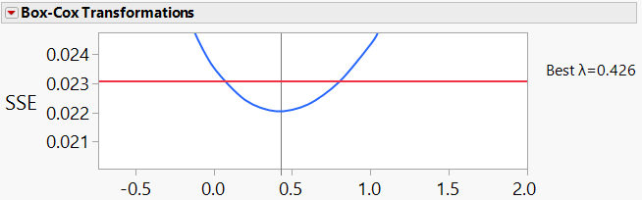
Re-evaluating the transformation
-Using All Data with “Pre” or “Post” added to Model
Partition analysis suggests best split at 08/08/19. All data in in right box labeled as “Post.” All other data labeled “Pre”. Then modeled CHST ~ Oil, Lab, Stand[Lab], Pre/Post. Square root transformation more appropriate here.
Pre #1
Post #1

Slide 30
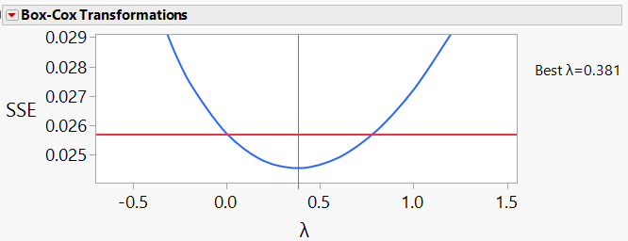
Re-evaluating the transformation
-Using All Data with “Pre” or “Post” added to Model
All data in in right box labeled as “Post” (except for first near target 271). All other data labeled “Pre”. Then modeled CHST ~ Oil, Lab, Stand[Lab], Pre/Post. Square root transformation more appropriate here.
Pre #2
Post #2

Slide 31
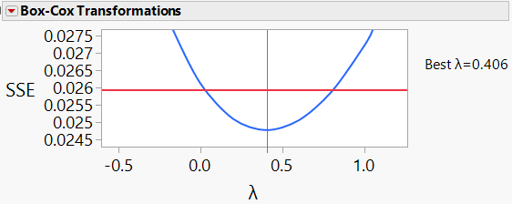
Re-evaluating the transformation
-Using All Data with “Pre” or “Post” added to Model
All data in in right box labeled as “Post” All other data labeled “Pre”. Then modeled CHST ~ Oil, Lab, Stand[Lab], Pre/Post. Square root transformation more appropriate here.
Pre #3
Post #3

Slide 32
Sqrt. Transformed Targets
-Averages
In order to keep the pivot point the same for positive and negative severity adjustments, the original targets were back-transformed into original units, and then the square root transformation is applied to obtain the target Sqrt(CHST) for each oil.
Reference Oil | Target Ln(CHST) | Target CHST | Target Sqrt(CHST)
270 | -2.15699 | 0.1157 | 0.34011
271 | -2.60987 | 0.0735 | 0.27119
1011 | -2.08191 | 0.1247 | 0.35312

Slide 33
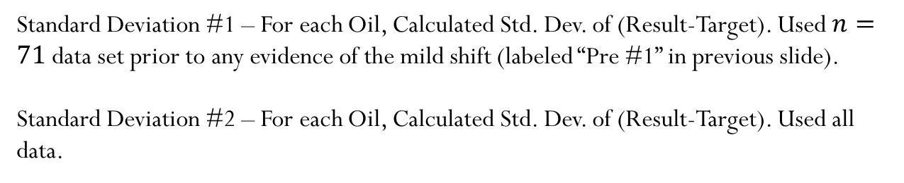
Sqrt. Transformed Targets
-Standard Deviations
Standard Deviation #1 – For each Oil, Calculated Std. Dev. of (Result-Target). Used $n=71$ data set prior to any evidence of the mild shift (labeled “Pre #1” in previous slide).
Standard Deviation #2 – For each Oil, Calculated Std. Dev. of (Result-Target). Used all data.
Reference Oil | Target Sqrt(CHST) | Std. Dev. 1 | Std. Dev. 2
270 | 0.34011 | 0.02784 | 0.03116
271 | 0.27119 | 0.02298 | 0.03421
1011 | 0.35312 | 0.03023 | 0.03343
Pooled |  | 0.02681 | 0.03281
Average |  | 0.02702 | 0.03293

Slide 34
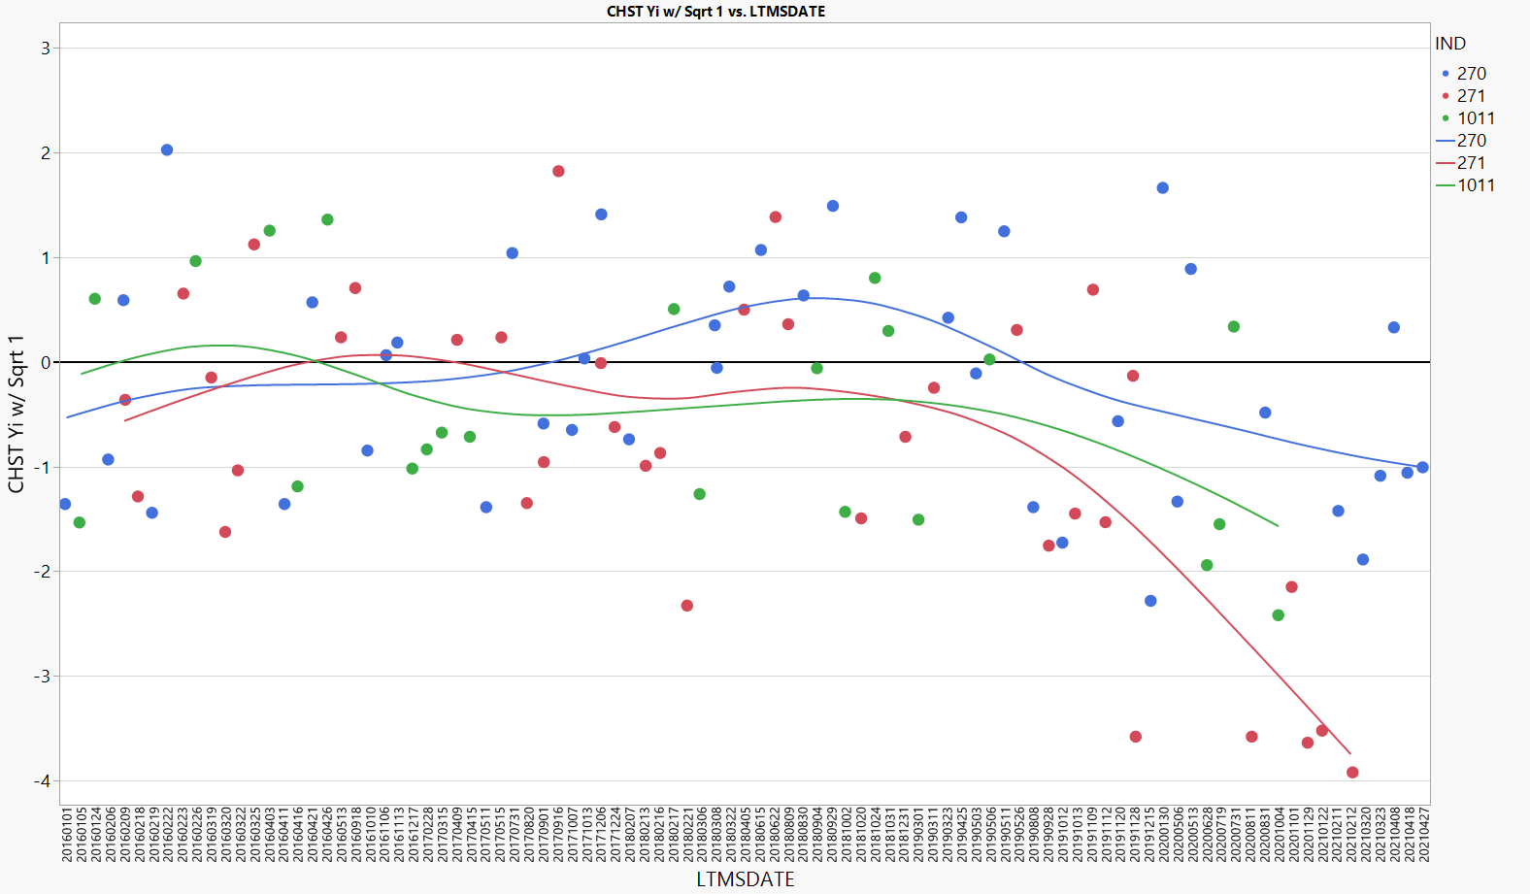
Plot of CHST Yi Using Sqrt. With SD#1
Below is a plot of the CHST Yi when calculated using the standard deviation of the data “PRE #1” data only with the square root transformation.

Slide 35
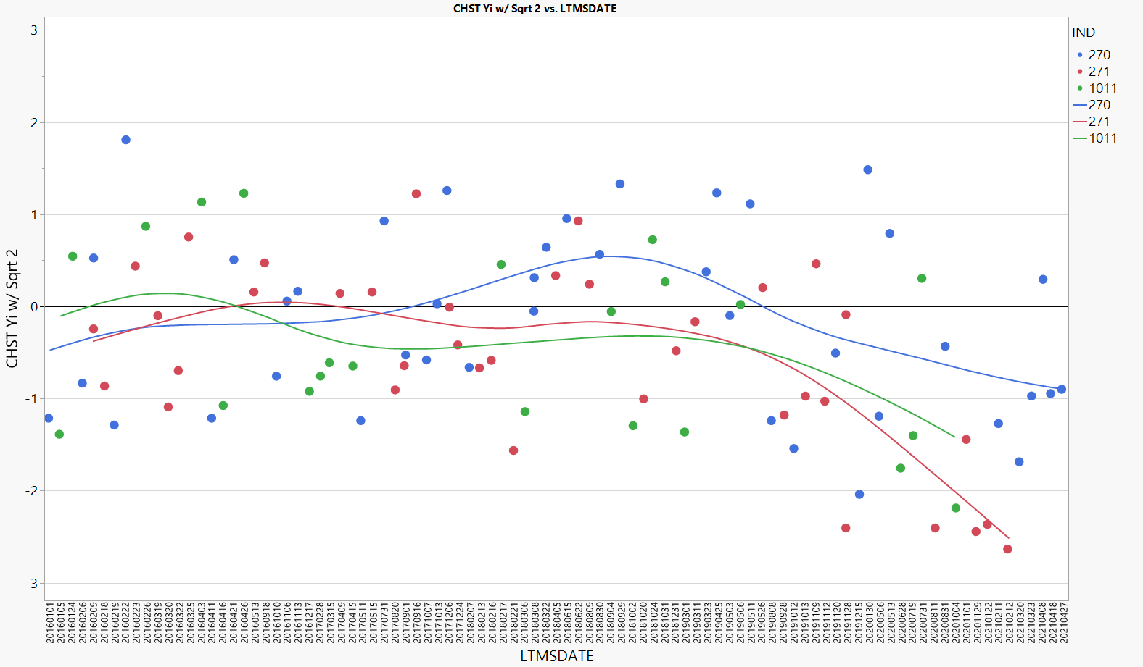
Plot of CHST Yi Using Sqrt. With SD#2
Below is a plot of the CHST Yi when calculated using the standard deviation calculated using all of the data and the square root transformation.

Slide 36
No Transformation for Oil 271
For Oil 271, the mean of untransformed result is the back-transformed current mean for Ln(CSHT).
Standard deviation of (result-mean) is calculated using the 271 untransformed data from data set “Pre 1” only.
No changes to oil 270 or oil 1011.
Oil | CHST Mean | Standard deviation
271 | 0.0735 | 0.0125
Same as current LTMS for these oils
Oil | Ln(CHST) Mean | Standard deviation
270 | -2.15699 | 0.17435
1011 | -2.08191 | 0.18882

Slide 37
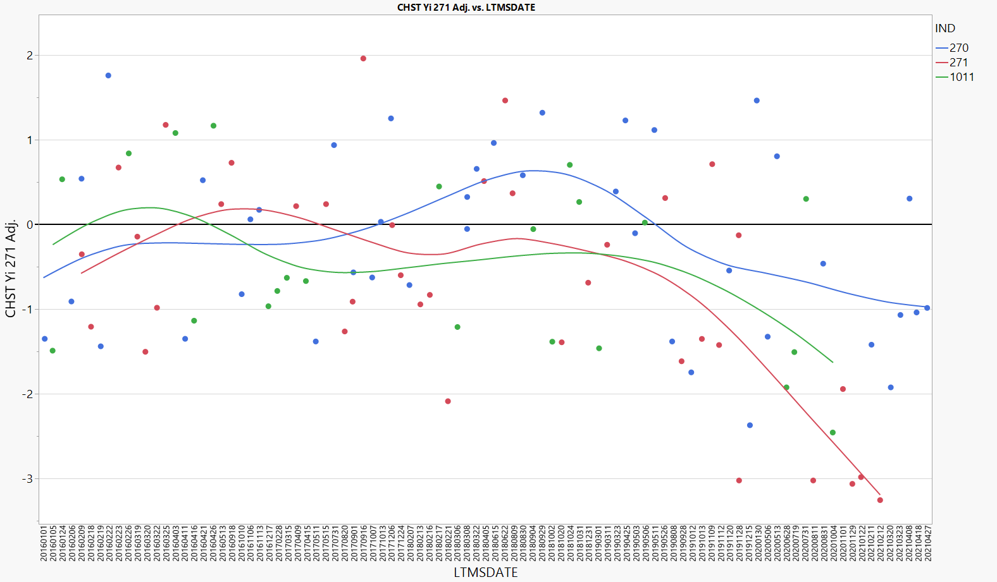
271 New Yi’s
The graph below shows how the 271 Yi values would change without the transformation.

Slide 38
Correction Factors
Pre- and Post-Transformation Options

Slide 39
Some Constant Correction Options
Below are some options for corrections to be applied to all tests depending on when you choose to identify the start of the shift and the type of correction factor you wish to apply (before of after transformation).
C.F. Number | Model | Pre LS Mean | Post LS Mean | Post Correction Factor (To “Pre”) | Post Correction Factor (To Target)*
1. | CHST ~ Oil, Lab, Stand[Lab], Pre/Post #1 | 0.1047 | 0.0785 | +0.0262 | +0.0253
2. | CHST ~ Oil, Lab, Stand[Lab], Pre/Post #2 | 0.1021 | 0.0785 | +0.0236 | +0.0249
3. | CHST ~ Oil, Lab, Stand[Lab], Pre/Post #3 | 0.1024 | 0.0740 | +0.0284 | +0.0296
4. | Ln(CHST) ~ Oil, Lab, Stand[Lab], Pre/Post #1 | -2.28375 | -2.62183 | +0.33808 | +0.33073
5. | Ln(CHST)~ Oil, Lab, Stand[Lab], Pre/Post #2 | -2.31325 | -2.63989 | +0.32664 | +0.34451
6. | Ln(CHST) ~ Oil, Lab, Stand[Lab], Pre/Post #3 | -2.31344 | -2.68375 | +0.37031 | +0.39137
*Calculated by using the prediction equation to predict average performance across all lab-stands in the “post” period (did not use nested stand term here, but lab-stand).

Slide 40
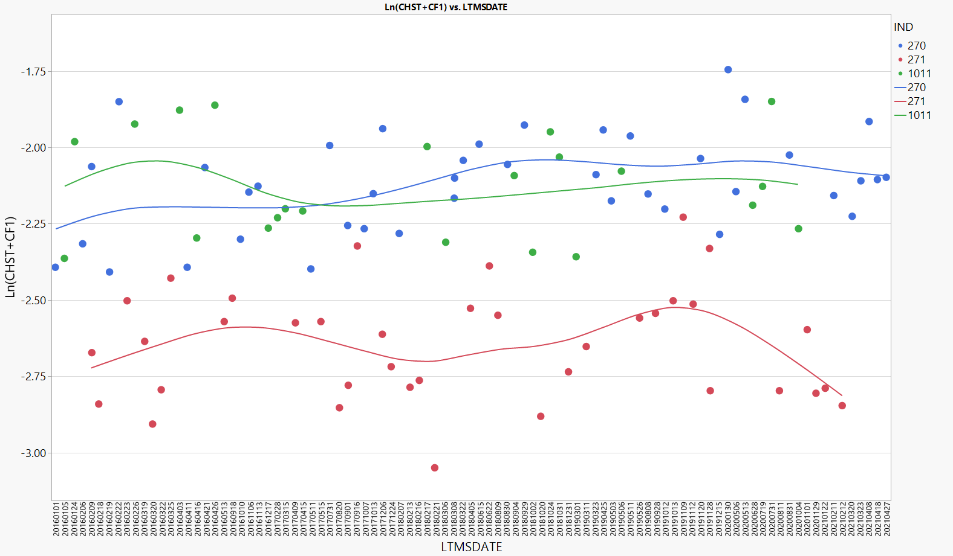
Ln(CHST+CF) with Measurement Correction Factor #1
-Corrected To Target
Reference tests shown below on of after 08/08/2019 have the measurement correction factor of +0.0253 applied.
Tests after here corrected

Slide 41
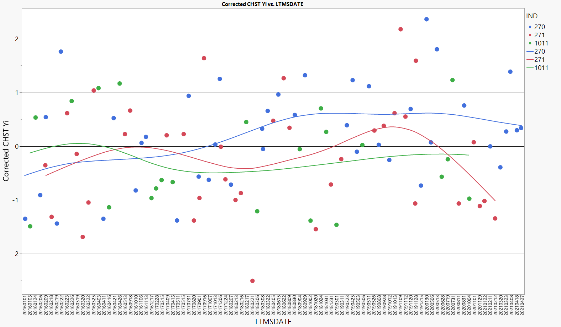
LN(CHST+CF) with Measurement C.F. #1
Reference tests shown below on of after 08/08/2019 have the measurement correction factor of +0.0253 applied.
Tests after here corrected

Slide 42
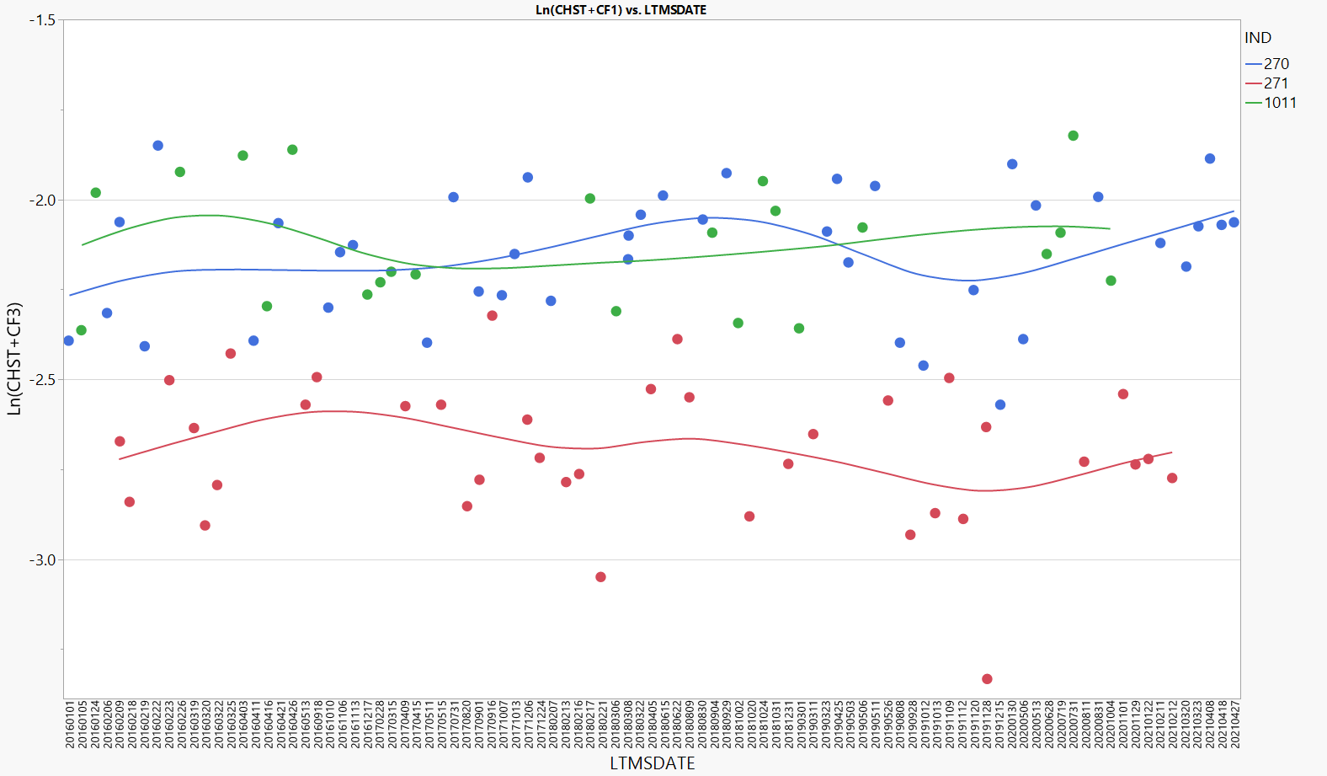
Ln(CHST+CF) with Measurement Correction Factor #3
-Corrected To Target
Reference tests shown below on of after 06/28/2020 have the measurement correction factor of +0.0296 applied.
Tests after here corrected

Slide 43
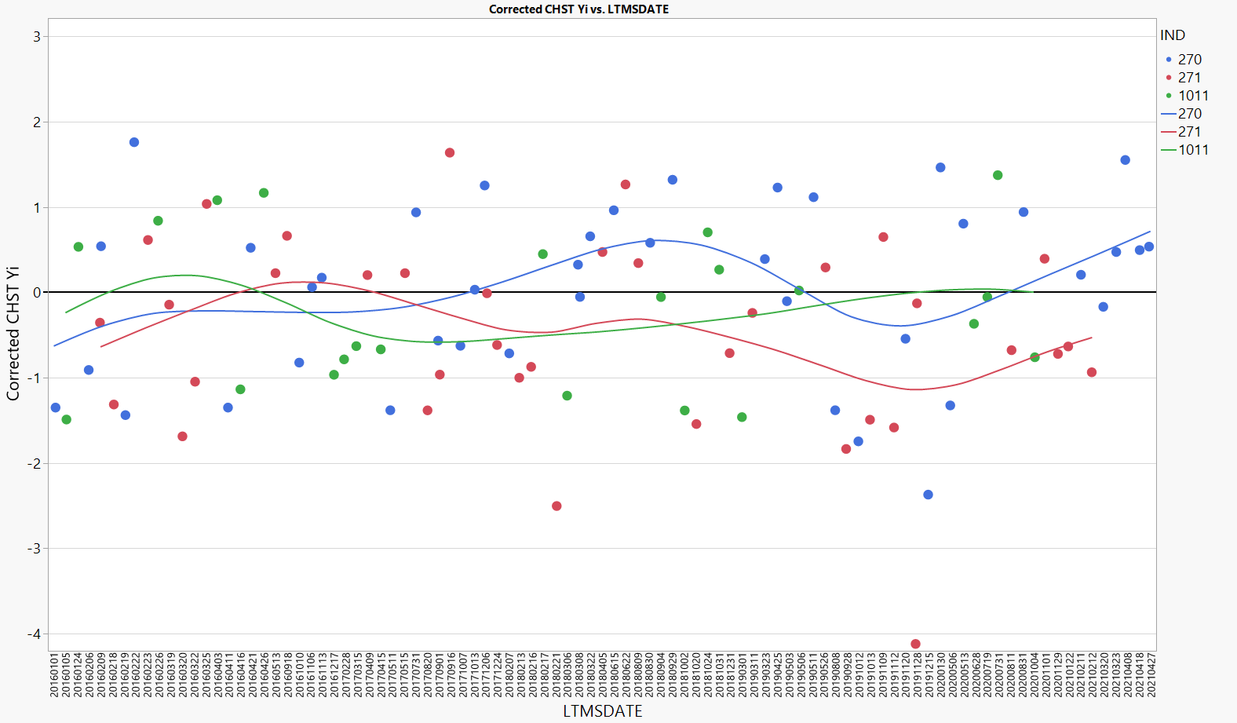
LN(CHST+CF) with Measurement C.F. #3
Reference tests shown below on of after 06/28/2020 have the measurement correction factor of +0.0296 applied.
Tests after here corrected

Slide 44
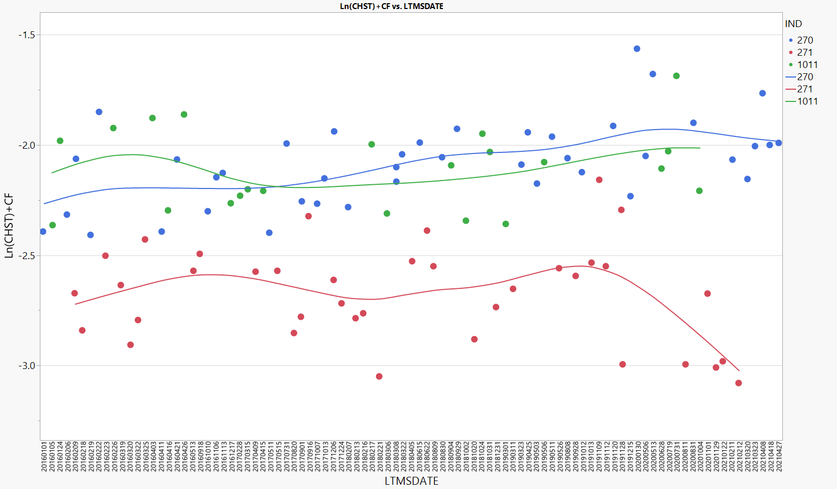
Ln(CHST)+CF with Correction Factor #4
Reference tests shown below on of after 08/08/2019 have the post-transformation (typical application) correction factor of +0.33073 applied.
Tests after here corrected

Slide 45
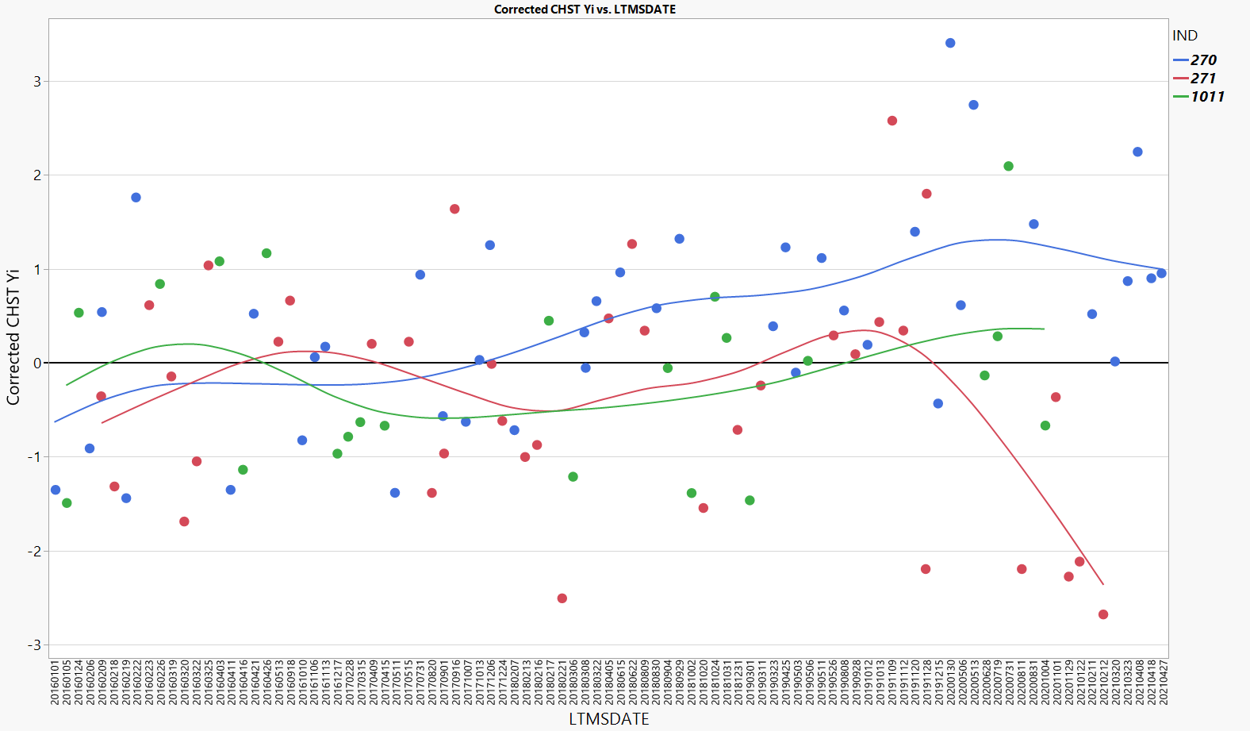
Ln(CHST)+CF with Correction Factor #4
Reference tests shown below on of after 08/08/2019 have the post-transformation (typical application) correction factor of +0.33073 applied.
Tests after here corrected

Slide 46
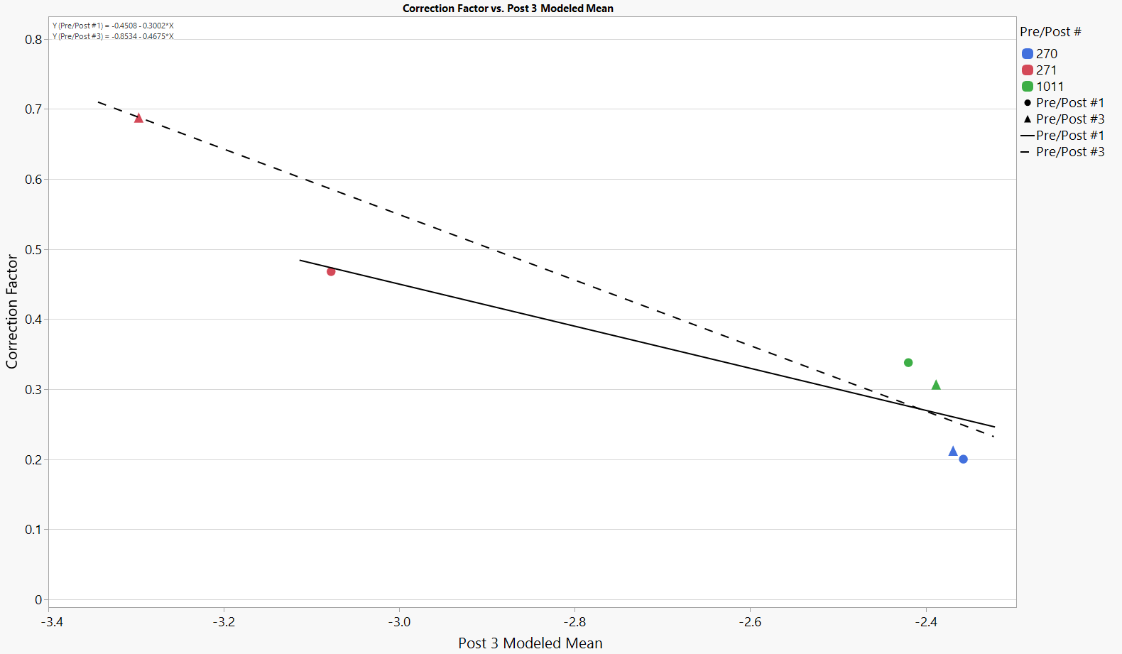
What about a non-constant C.F.?
-Using Post #1 & #3 Modeled Means
The below shows how the correction factor would increase with improved oil performance. This assumes candidates are showing the same trend as the reference oils by level.
Correction Factor = -0.8534-0.4675X,
Where “X” is the Ln(CHST) result.
Correction Factor = -0.4508-0.3002X,
Where “X” is the Ln(CHST) result.

Slide 47
Correction factors by CHST Level
The table below shows how the CHST values would adjust when using a level dependent correction factor.
CHST | Ln(CHST) | C.F. w/ Post #1 | Adj. CHST w/ Post #1 | C.F. w/ Post #3 | Adj CHST w/ Post #3
0.010 | -4.6052 | 0.9317 | 0.025 | 1.2995 | 0.037
0.020 | -3.9120 | 0.7236 | 0.041 | 0.9755 | 0.053
0.030 | -3.5066 | 0.6019 | 0.055 | 0.7859 | 0.066
0.040 | -3.2189 | 0.5155 | 0.067 | 0.6514 | 0.077
0.050 | -2.9957 | 0.4485 | 0.078 | 0.5471 | 0.086
0.060 | -2.8134 | 0.3938 | 0.089 | 0.4619 | 0.095
0.070 | -2.6593 | 0.3475 | 0.099 | 0.3898 | 0.103
0.080 | -2.5257 | 0.3074 | 0.109 | 0.3274 | 0.111
0.090 | -2.4079 | 0.2721 | 0.118 | 0.2723 | 0.118
0.100 | -2.3026 | 0.2404 | 0.127 | 0.2231 | 0.125
0.110 | -2.2073 | 0.2118 | 0.136 | 0.1785 | 0.131
0.120 | -2.1203 | 0.1857 | 0.144 | 0.1378 | 0.138
0.130 | -2.0402 | 0.1617 | 0.153 | 0.1004 | 0.144
0.140 | -1.9661 | 0.1394 | 0.161 | 0.0658 | 0.150
0.150 | -1.8971 | 0.1187 | 0.169 | 0.0335 | 0.155

Slide 48
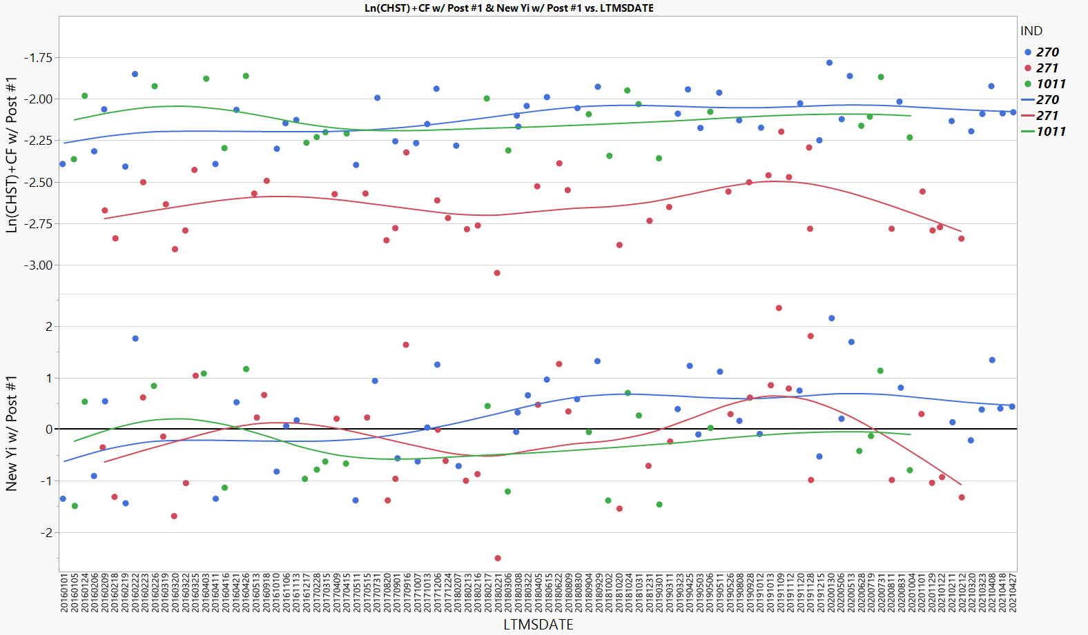
New Ln(CHST) and Yi w/ Post #1
The table below shows how data after 08/08/2019 would change with the level-dependent correction factor.
Tests after here corrected

Slide 49
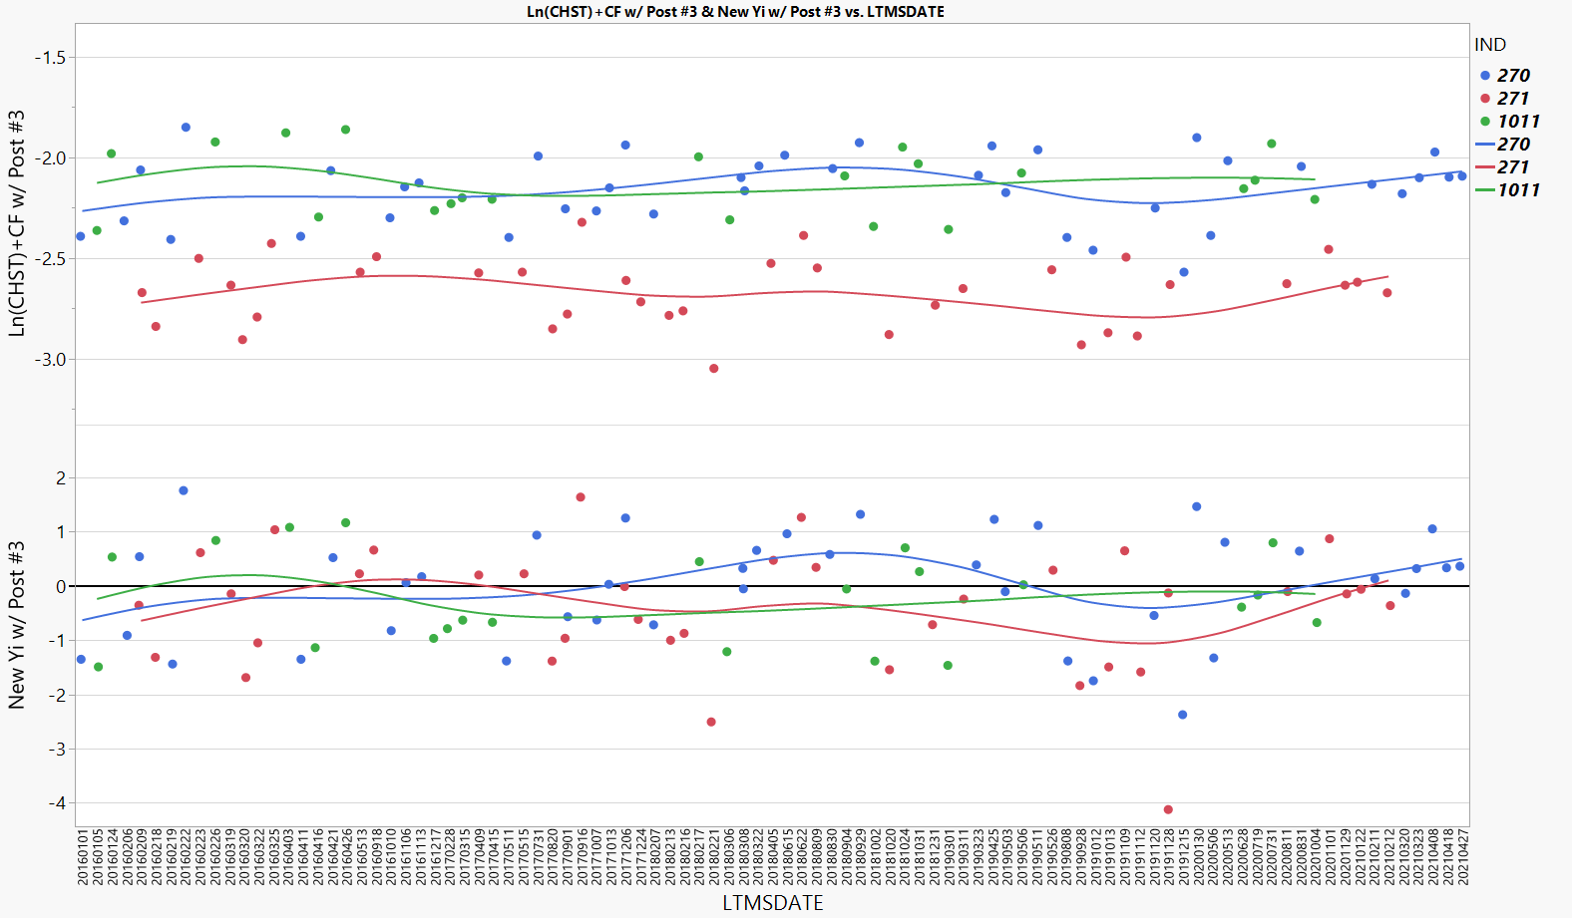
New Ln(CHST) and Yi w/ Post #3
The table below shows how data after 06/28/2020 would change with the level-dependent correction factor.
Tests after here corrected

Slide 50
More Standard Deviation Options

Slide 51
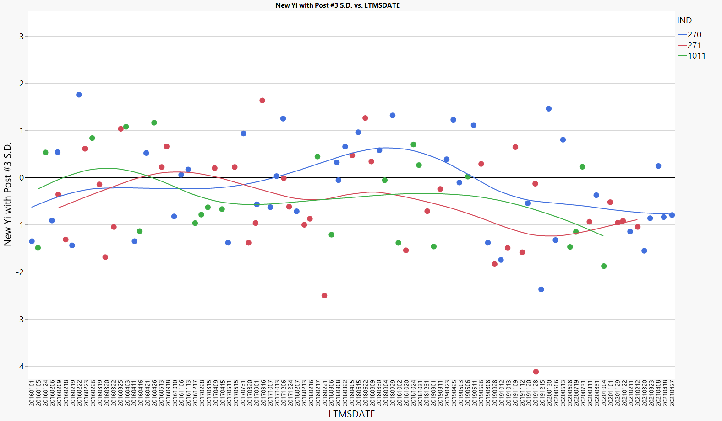
Updating Yi Using Post #3 S.D.
Yi’s after 06/28/2020 here shown with updated standard deviations for Post #3 period.
Tests after here corrected

Slide 52
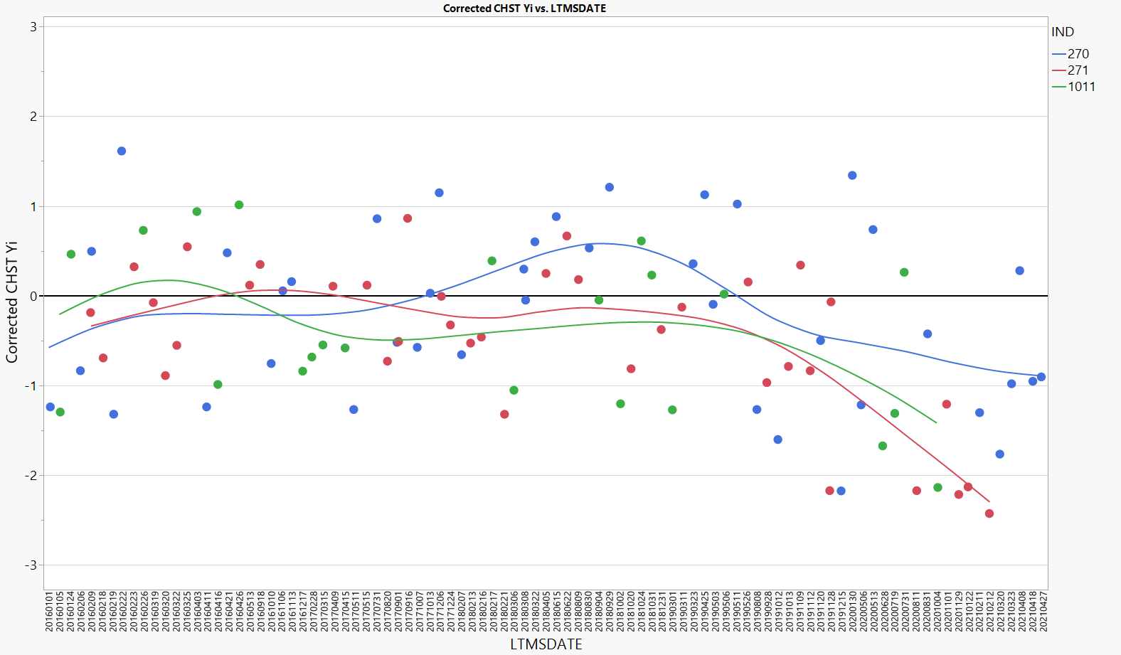
Updating Yi All Data Standard Deviations
All tests below have been corrected using the updated standard deviations calculated with all data.
All tests corrected

Slide 53
Sequence X History
Sequence X Milestones
1/1/2012 | Start of Chain Wear Test Development
12/7/2017 | AOAP Approval for GF6
4/2/2018 | Live Registration (03/19/16 Retro - Registration)
2/20/2019 | Surveillance Panel Procedure Acceptance Vote
4/4/2019 | Subcommittee B Ballot
6/16/2019 | Main Committee D02 Ballot - ASTM Procedure D8279
11/7/2019 | Memorandum 19-043 Use of Calibrated Sequence X Stands to Generate Used Oil Samples for Seq IX (LSPI)
11/20/2020 | Information Letter 20-1 Procedure Edits / Drive Shaft Spec
1/27/2020 | Information Letter 20-2 Criteria for Multiple Test Type Calibration
6/1/2020 | Mild Severity Shift Task Force Formed
9/11/2020 | Information Letter 20-3 Correction to Table 12
10/14/2020 | Information Letter 20-4 (1) Correcting PCV Flow Meters (2) Correction to Section 12.1.1
4/8/2021 | Oil 271 Suspended from use due to mild results
9/17/2021 | Information Letter 22-1 Engine run limits, honing procedure, connecting rod orientation, blowby gas thermocouple orientation

