Slide 1
Mack T-11 LTMS Version 2 Exploration
Mack Surveillance Panel
May 25, 2010

Slide 2
Reference oil data summary
Includes 161 reference tests in TMC dataset
Includes 134 chartable reference tests
Six test laboratories
  A – 42 chartable tests
  B – 29 chartable tests
  D – 16 chartable tests
  F – 14 chartable tests
  G – 27 chartable tests
  G1 – 6 chartable tests
Latest reference oil result is April 25, 2010

Slide 3
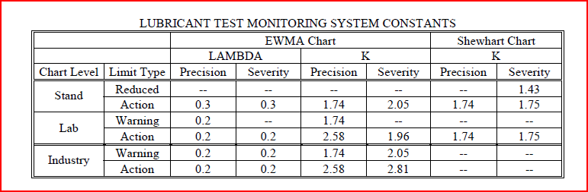
Current LTMS
Critical Parameter: Soot at 12 cSt viscosity increase – Conduct additional reference test if stand severity EWMA is exceeded and “if the direction of the test stand severity is deemed different from that of the test laboratory”. Conduct additional reference test if stand severity Shewhart limit is exceeded. Apply severity adjustment as for noncritical parameters.
Noncritical Parameters: Soot at 4 cSt viscosity increase, soot at 15 cSt viscosity increase, MRV at 180 hours – Apply severity adjustment if lab severity EWMA limit is exceeded.

Slide 4
LTMS Version 2
e_{i} and Z_{i} Parameter: Soot at 12 cSt viscosity increase
Z_{i} only Parameters: Soot at 4 cSt viscosity increase, soot at 15 cSt viscosity increase, MRV at 180 hours
Prediction Error: e_{i} = Y_{i} - Z_{i-1}
Limit Type | Limit
Level 3 | 2.066
Level 2 | 1.734
Level 1 | 1.351
Lab EWMA : Z_{i}=λ(Y_{i}) + (1 – λ)Z_{i-1}
Limit Type | Lambda | Limit
Level 2 Lower | 0.2 | TBD by SP
Level 2 Upper | 0.2 | TBD by SP
Level 1 | 0.2 | 0
Industry EWMA : Z_{i} = λ(Y_{i}) + (1 – λ)Z_{i-1}
Limit Type | λ | Limit
Level 2 Lower | 0.2 | TBD by SP Input
Level 2 Upper | 0.2 | TBD by SP Input
Level 1 | 0.2 | 0.65

Slide 5
Review of alarms and actions
Fate of T-11 Calibration Attempts in Current System

Slide 6
Review of alarms and actions
Fate of T-11 Calibration Attempts in Current System

Slide 7
Review of alarms and actions
Fate of T-11 Calibration Attempts
Current System versus New System

Slide 8
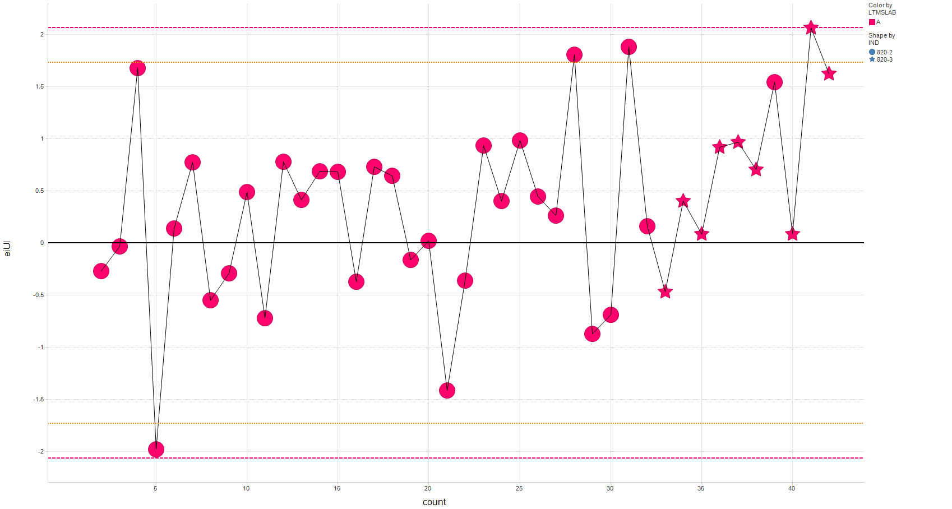
Prediction error by lab for Soot at 12 cSt e_{i} for Laboratory A

Slide 9
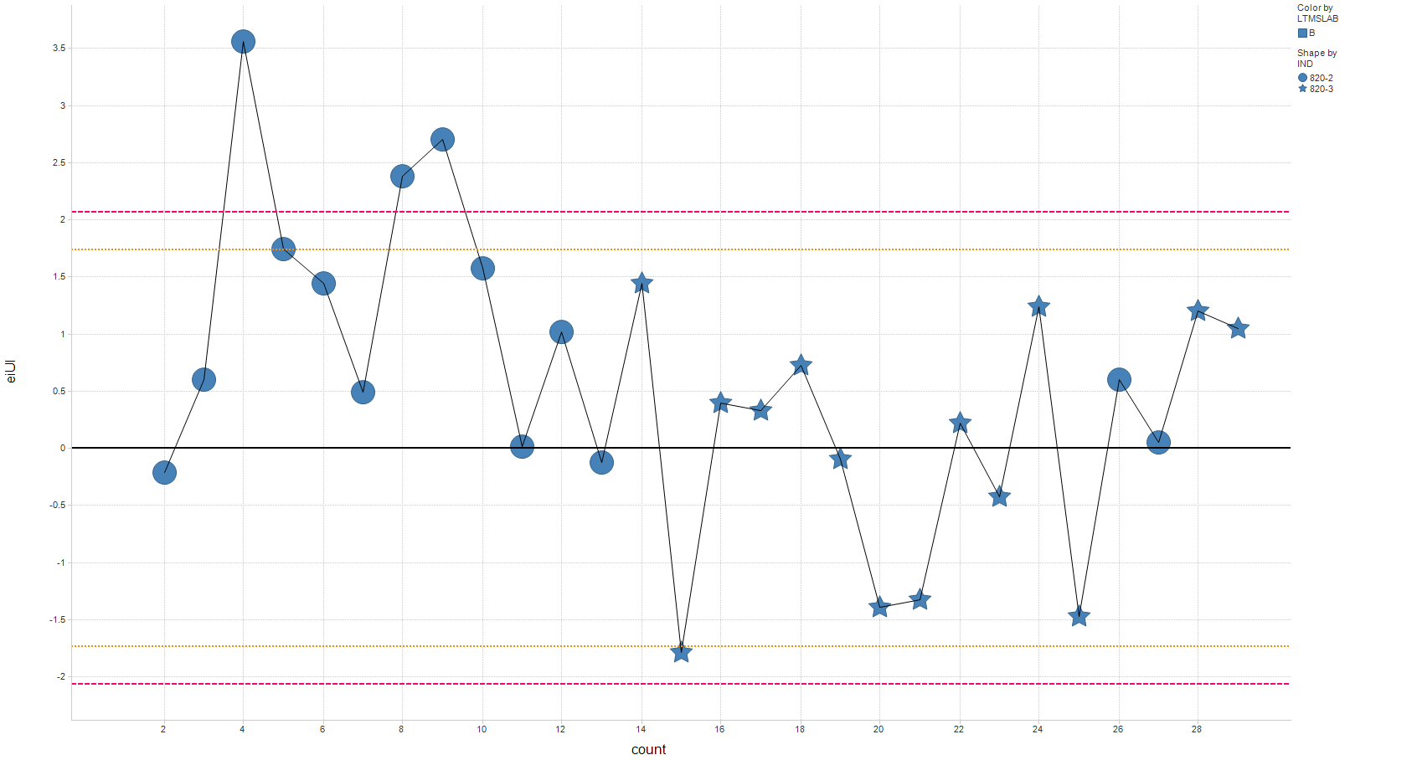
Prediction error by lab for Soot at 12 cSt e_{i} for Laboratory B

Slide 10
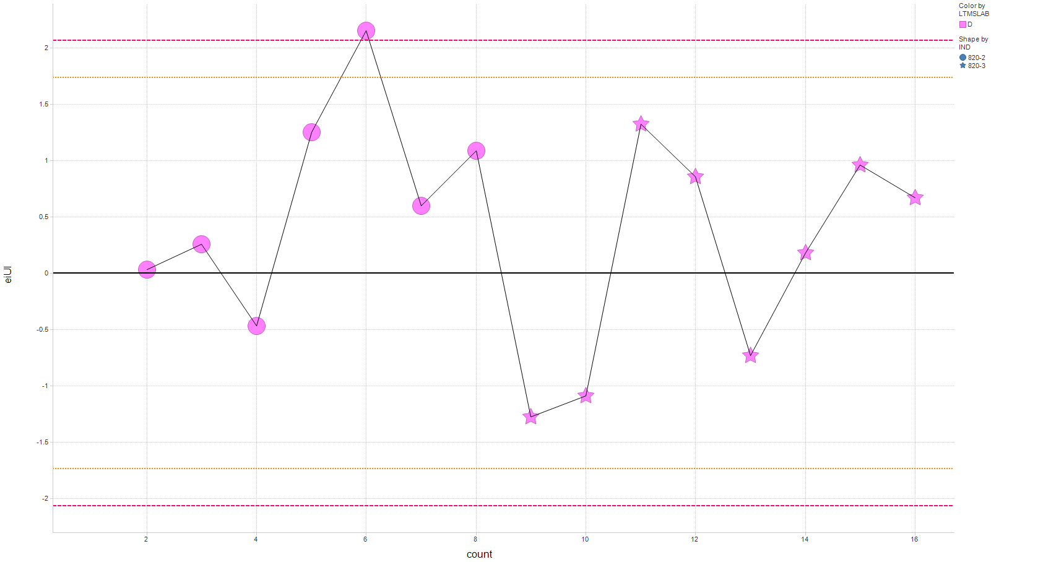
Prediction error by lab for Soot at 12 cSt e_{i} for Laboratory D

Slide 11
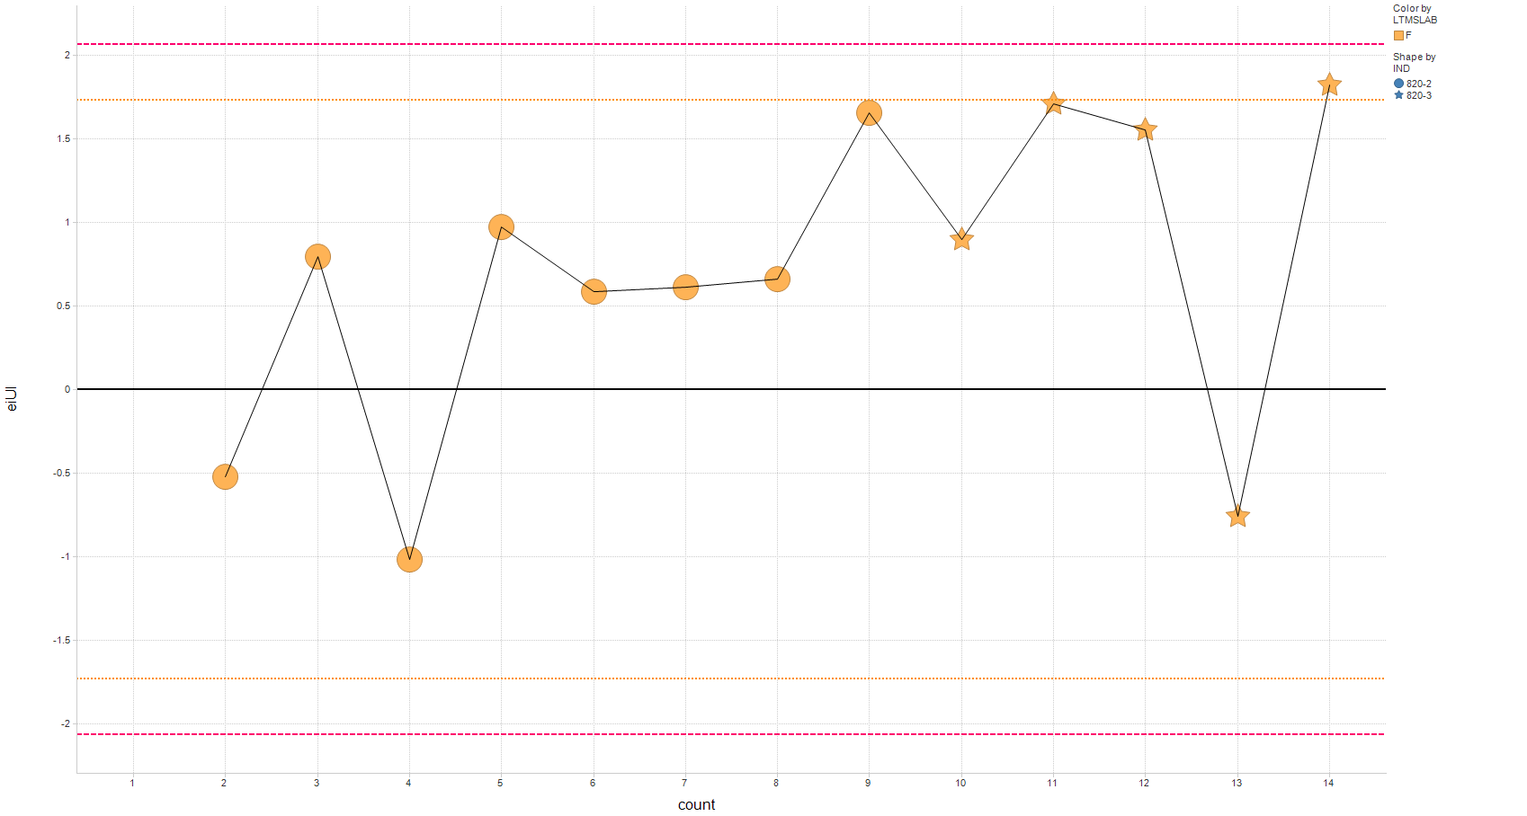
Prediction error by lab for Soot at 12 cSt e_{i} for Laboratory F

Slide 12
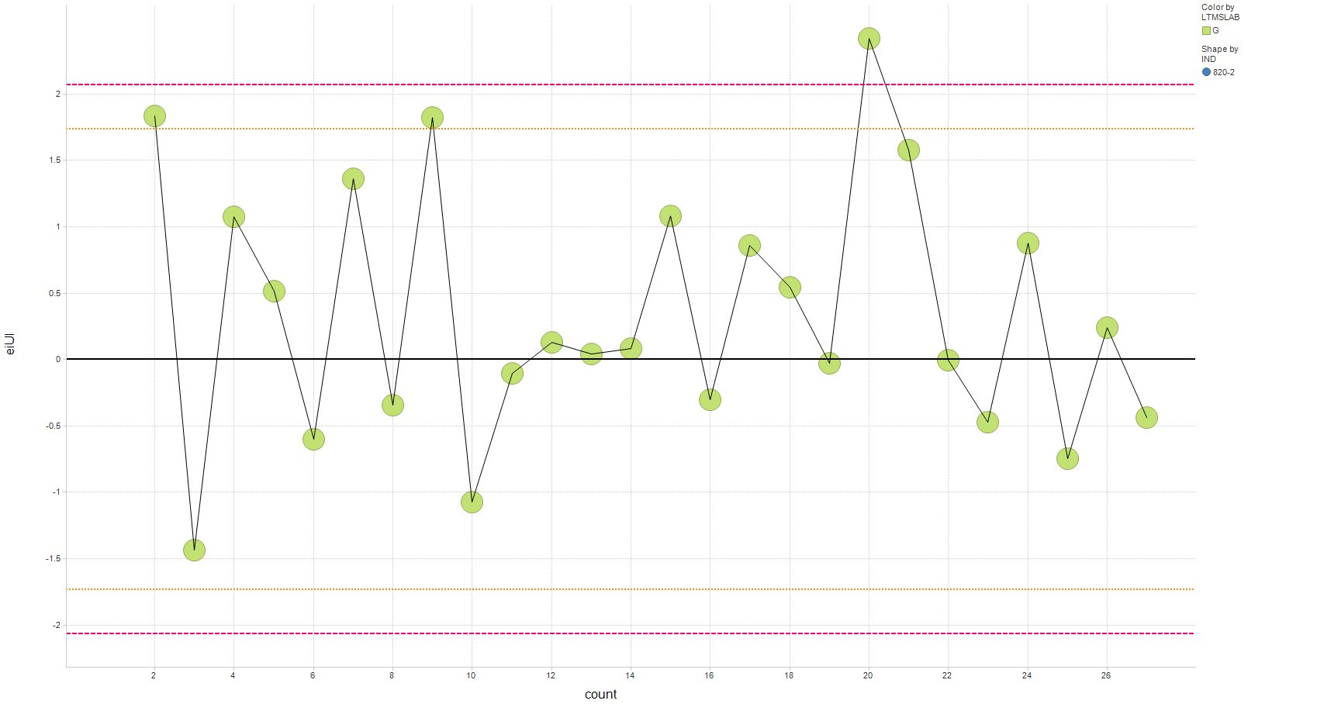
Prediction error by lab for Soot at 12 cSt e_{i} for Laboratory G

Slide 13
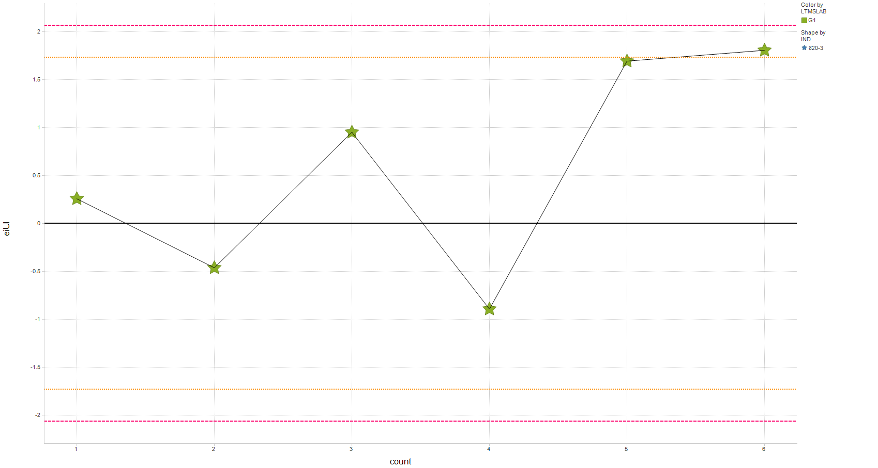
Prediction error by lab for Soot at 12 cSt e_{i} for Laboratory G1

Slide 14
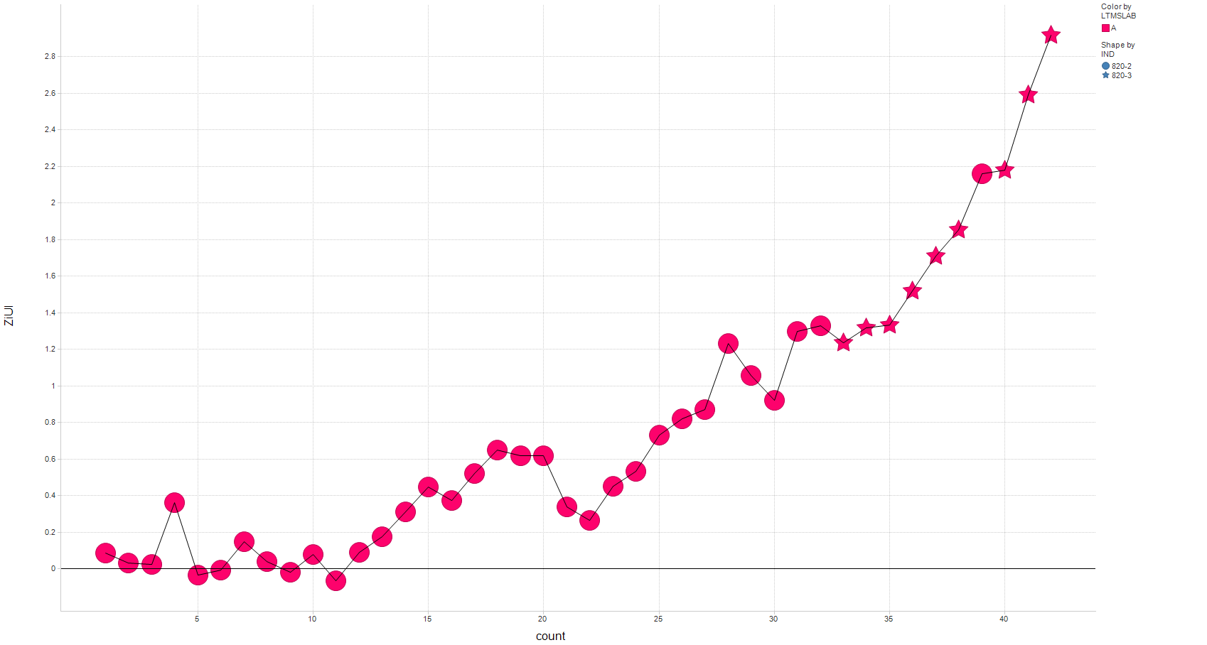
EWMA by lab for Soot at 12 cSt
Z_{i} for Laboratory A

Slide 15
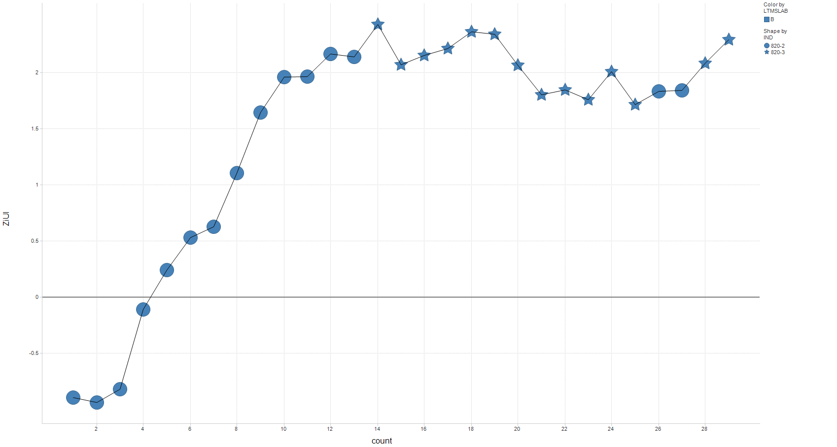
EWMA by lab for Soot at 12 cSt
Z_{i} for Laboratory B

Slide 16
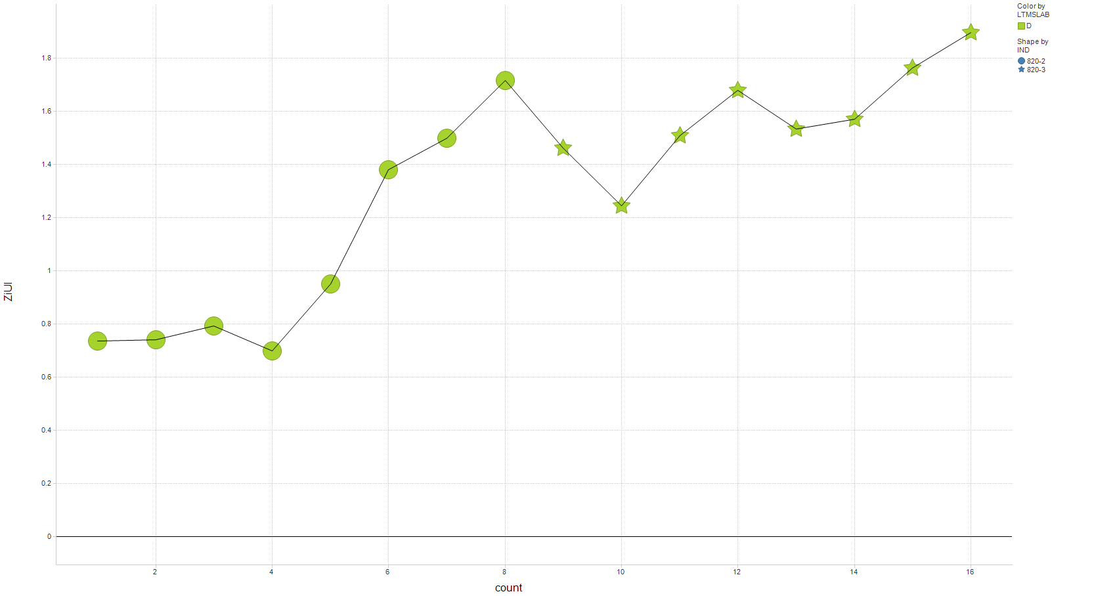
EWMA by lab for Soot at 12 cSt
Z_{i} for Laboratory D

Slide 17
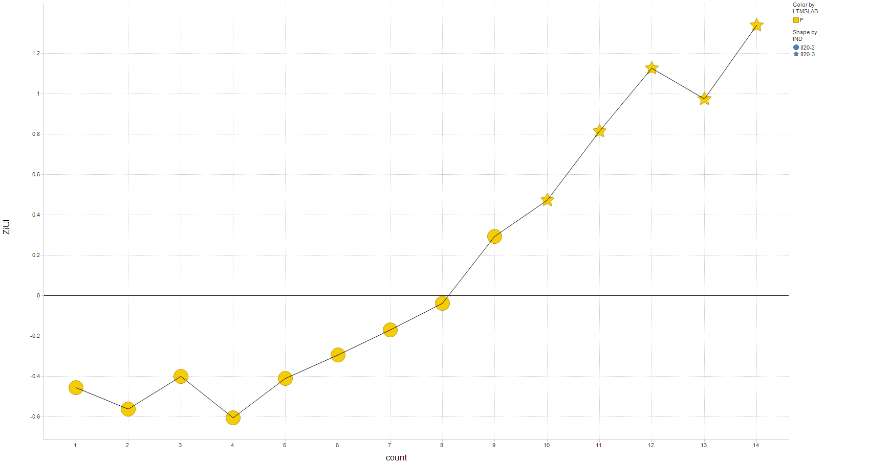
EWMA by lab for Soot at 12 cSt
Z_{i} for Laboratory F

Slide 18
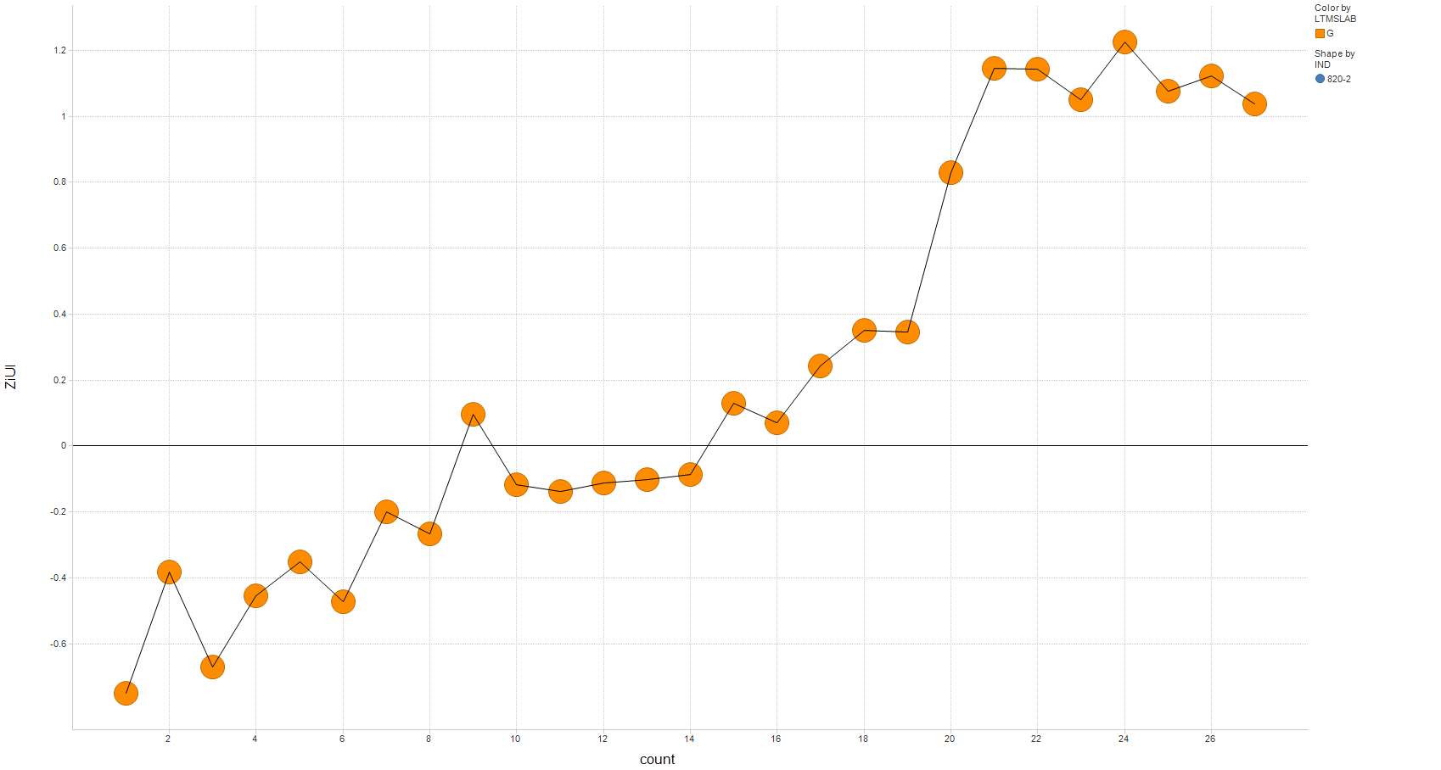
EWMA by lab for Soot at 12 cSt
Z_{i} for Laboratory G

Slide 19
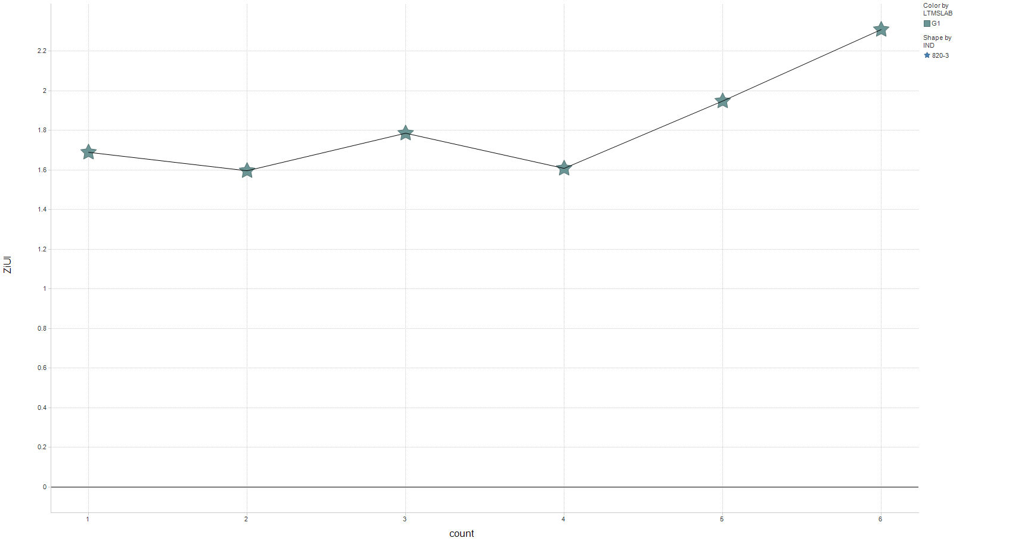
EWMA by lab for Soot at 12 cSt
Z_{i} for Laboratory G1

Slide 20
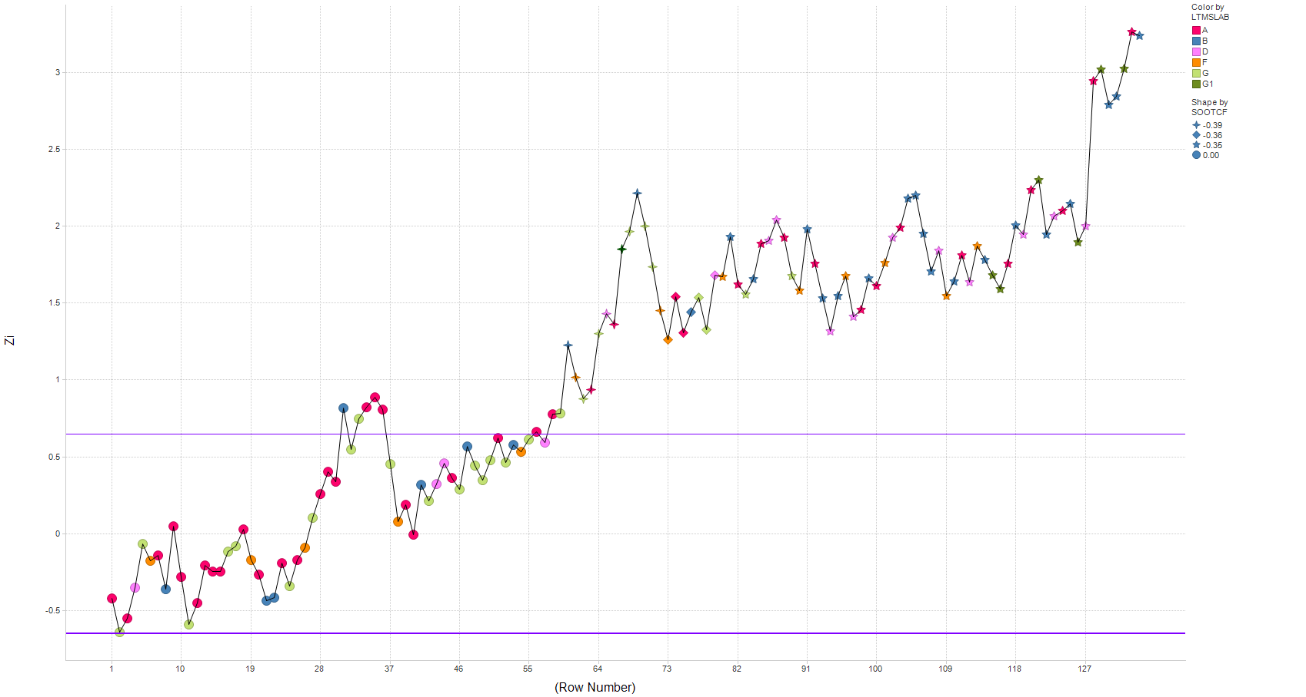
Industry EWMA for Soot at 12 cSt
September 14, 2005:
First ICF

Slide 21
Prediction error – Soot @ 12 cSt

Slide 22
Prediction error – MRV

Slide 23
Prediction error – Soot @ 4 cSt

Slide 24
Prediction error – Soot @ 15 cSt

Slide 25
Effective pass limit Soot at 12 cSt
New System versus Current – Laboratory A

Slide 26
Effective pass limit Soot at 12 cSt
New System versus Current – Laboratory B

Slide 27
Effective pass limit Soot at 12 cSt
New System versus Current – Laboratory D

Slide 28
Effective pass limit Soot at 12 cSt
New System versus Current – Laboratory F

Slide 29
Effective pass limit Soot at 12 cSt
New System versus Current – Laboratory G

Slide 30
Effective pass limit Soot at 12 cSt
New System versus Current – Laboratory G1

Slide 31
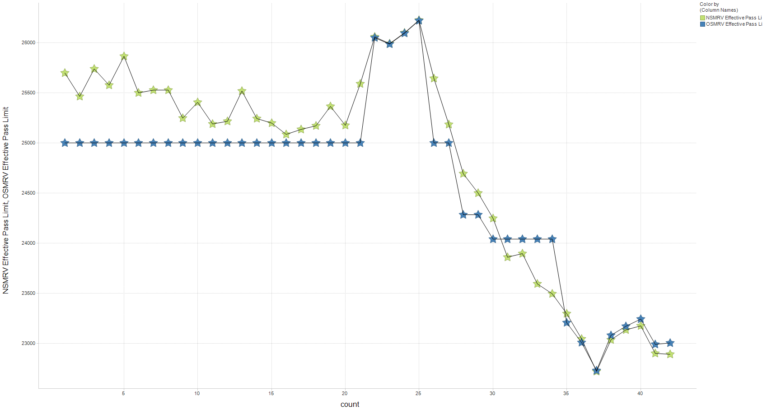
Effective pass limit MRV
New System versus Current – Laboratory A

Slide 32
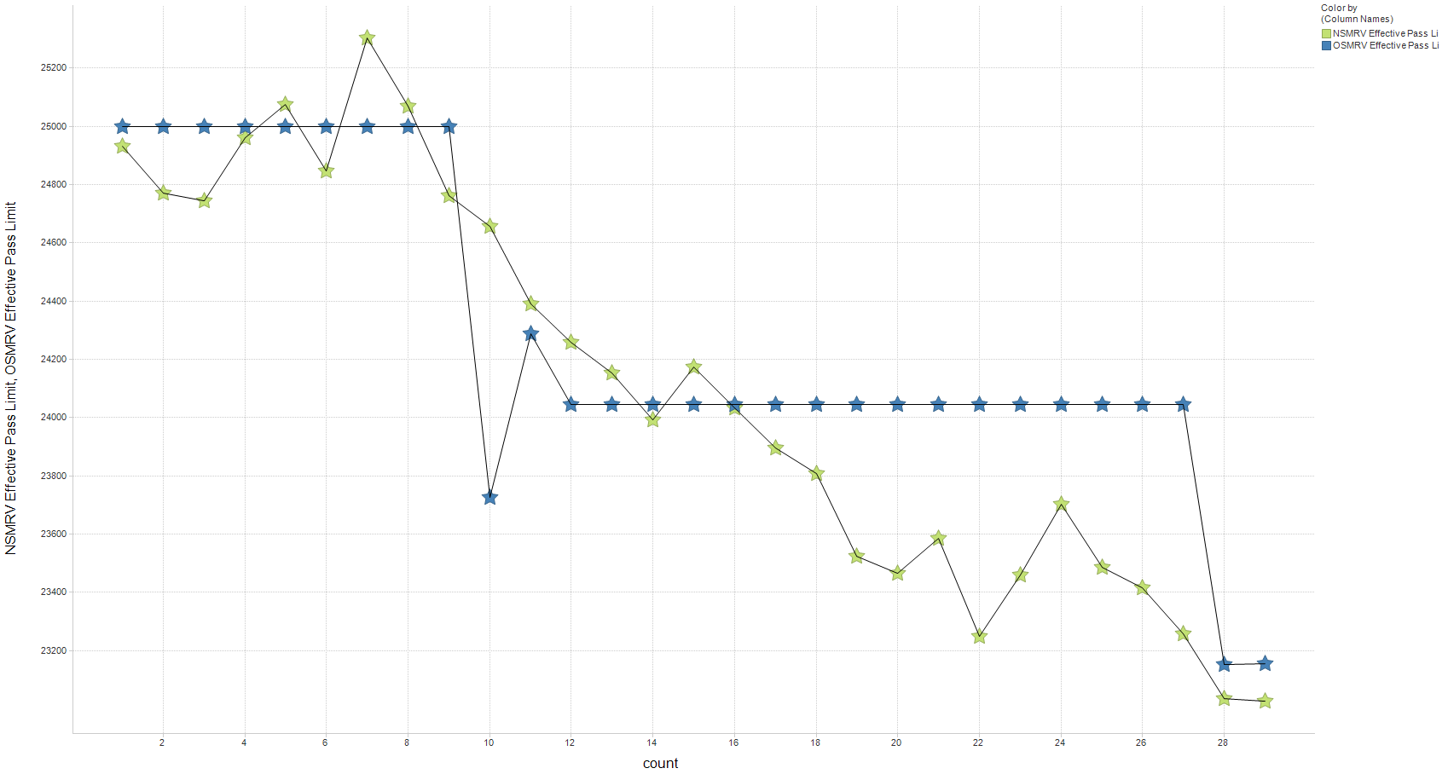
Effective pass limit MRV
New System versus Current – Laboratory B

Slide 33
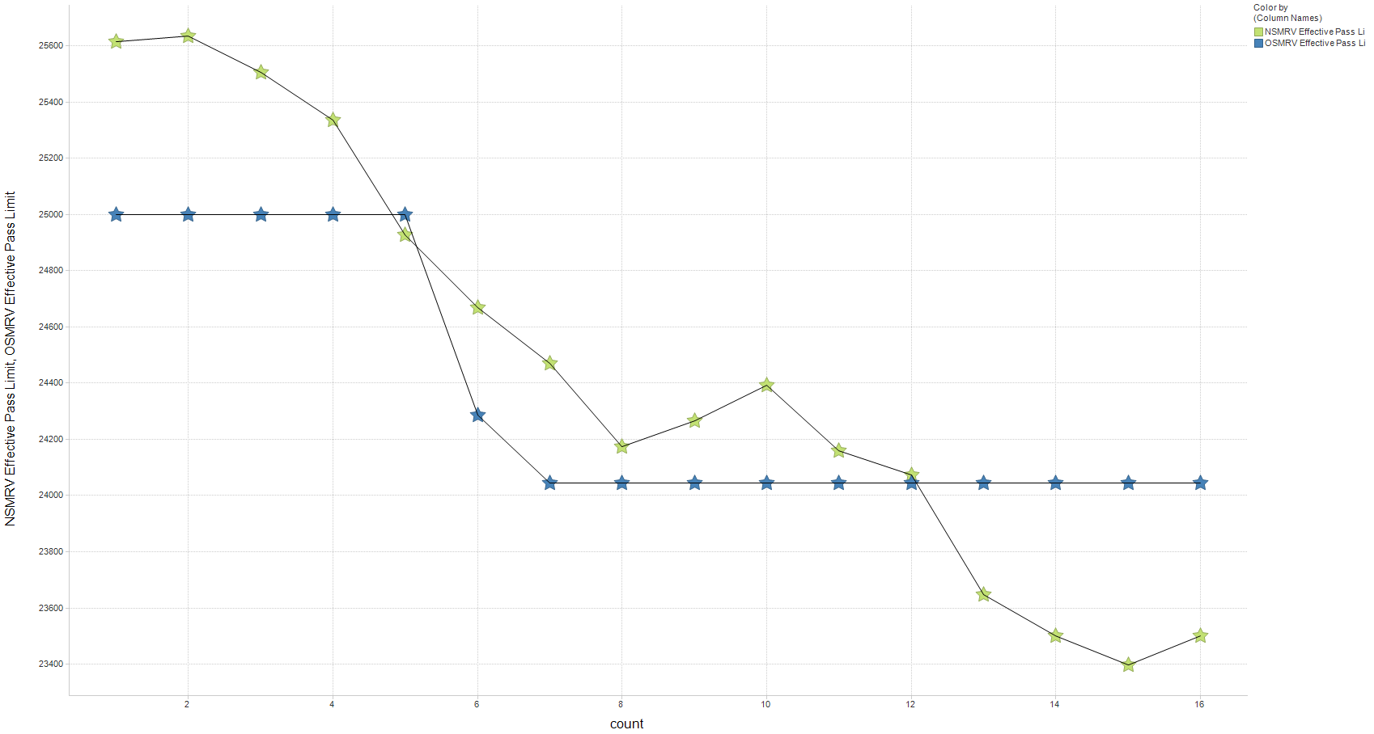
Effective pass limit MRV
New System versus Current – Laboratory D

Slide 34
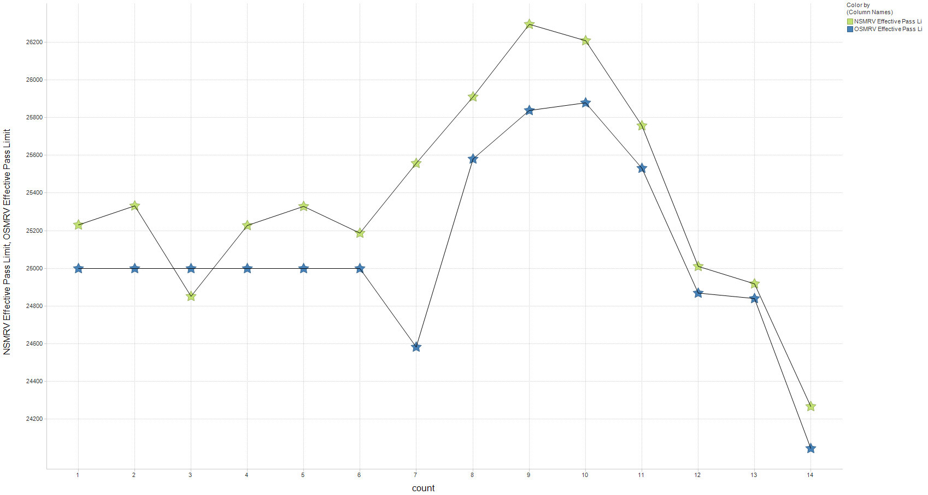
Effective pass limit MRV
New System versus Current – Laboratory F

Slide 35
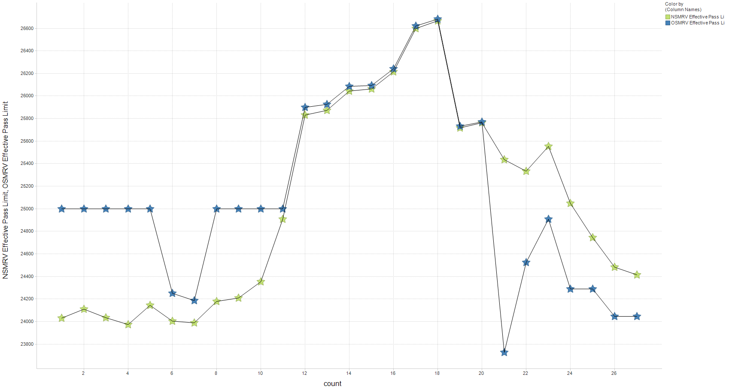
Effective pass limit MRV
New System versus Current – Laboratory G

Slide 36
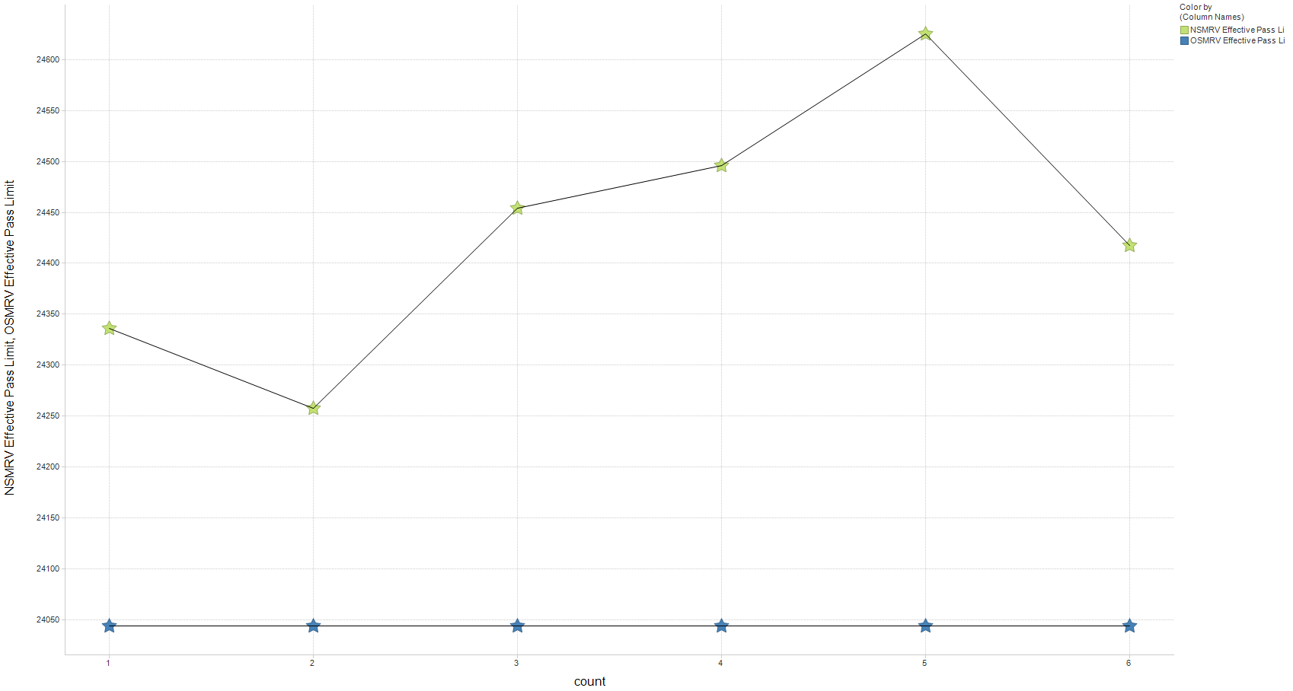
Effective pass limit MRV
New System versus Current – Laboratory G1

Slide 37
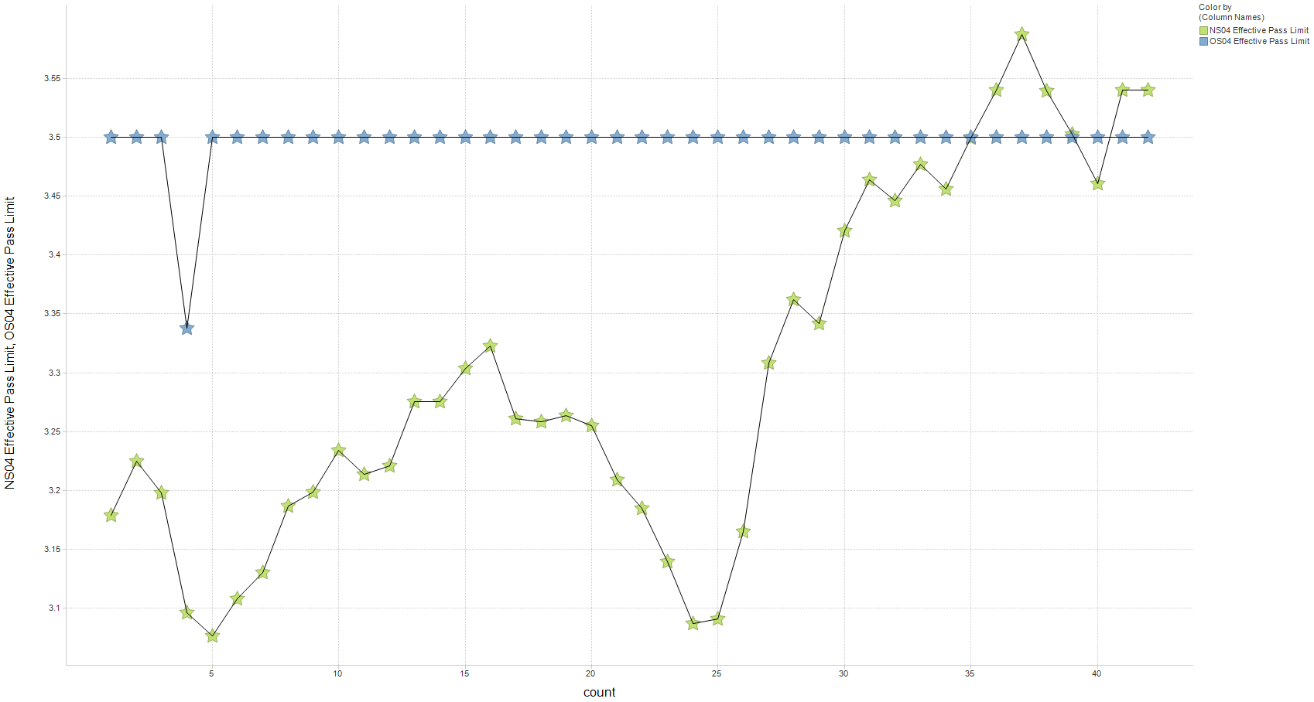
Effective pass limit Soot @ 4 cSt
New System versus Current – Laboratory A

Slide 38
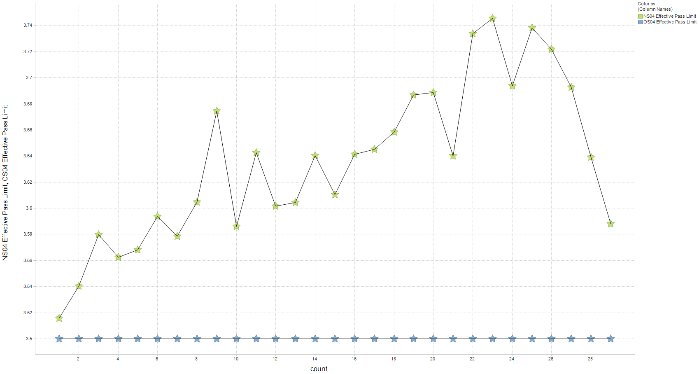
Effective pass limit Soot @ 4 cSt
New System versus Current – Laboratory B

Slide 39
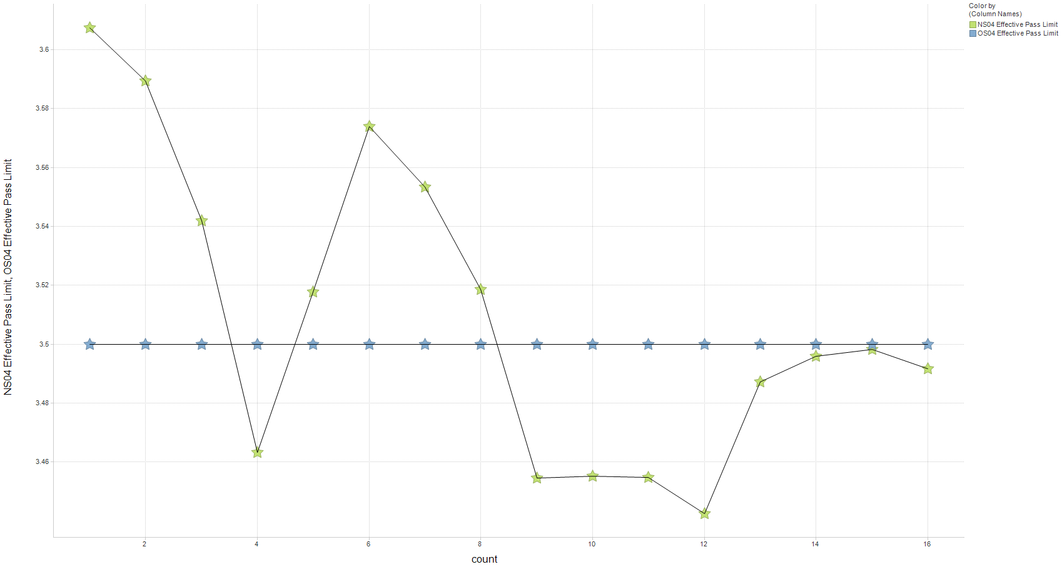
Effective pass limit Soot @ 4 cSt
New System versus Current – Laboratory D

Slide 40
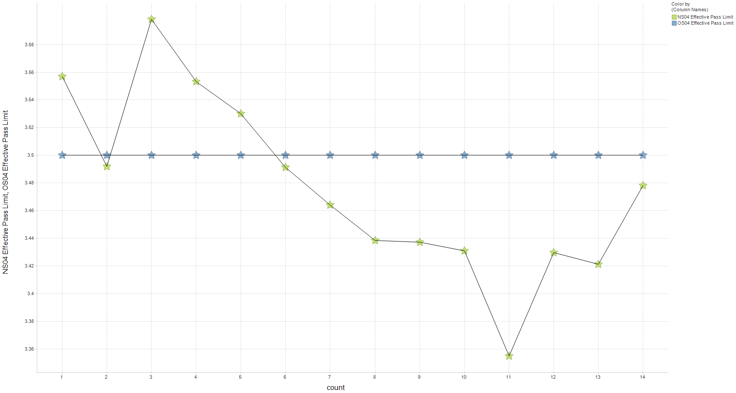
Effective pass limit Soot @ 4 cSt
New System versus Current – Laboratory F

Slide 41
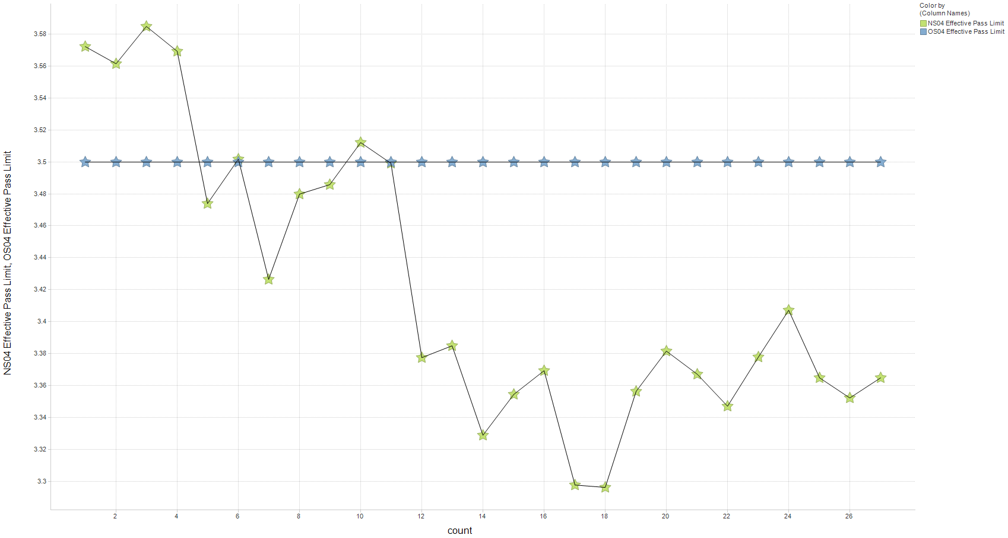
Effective pass limit Soot @ 4 cSt
New System versus Current – Laboratory G

Slide 42
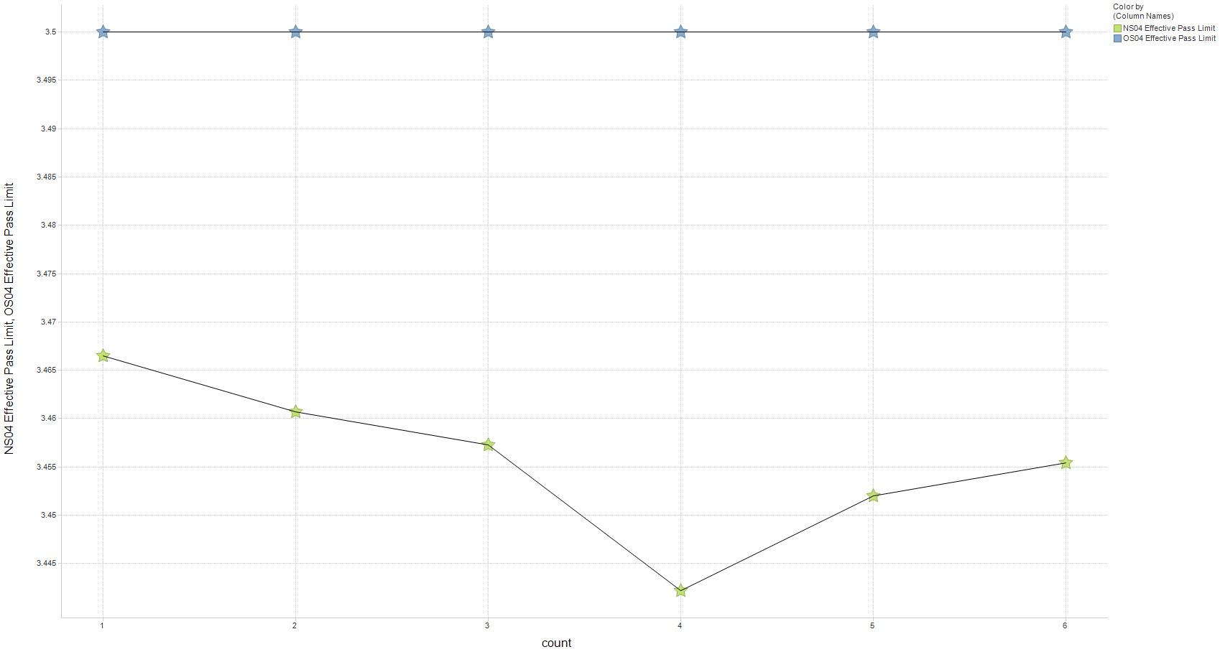
Effective pass limit Soot @ 4 cSt
New System versus Current – Laboratory G1

Slide 43
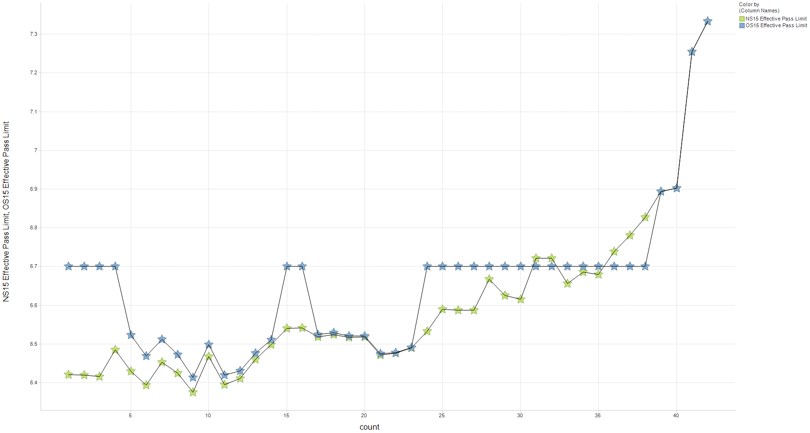
Effective pass limit Soot @ 15 cSt
New System versus Current – Laboratory A

Slide 44
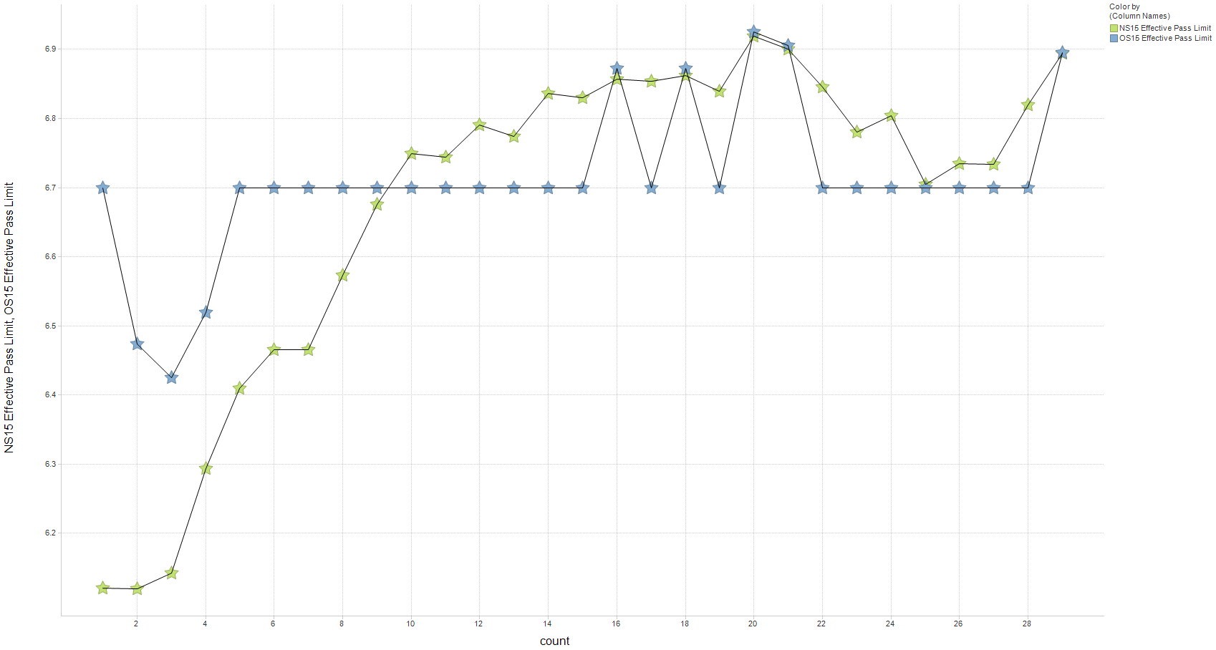
Effective pass limit Soot @ 15 cSt
New System versus Current – Laboratory B

Slide 45
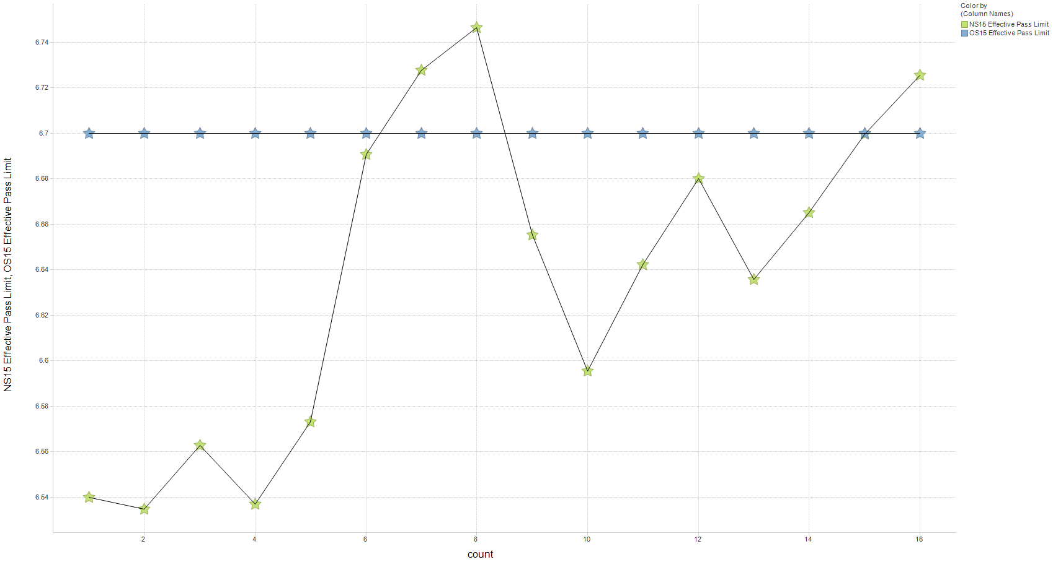
Effective pass limit Soot @ 15 cSt
New System versus Current – Laboratory D

Slide 46
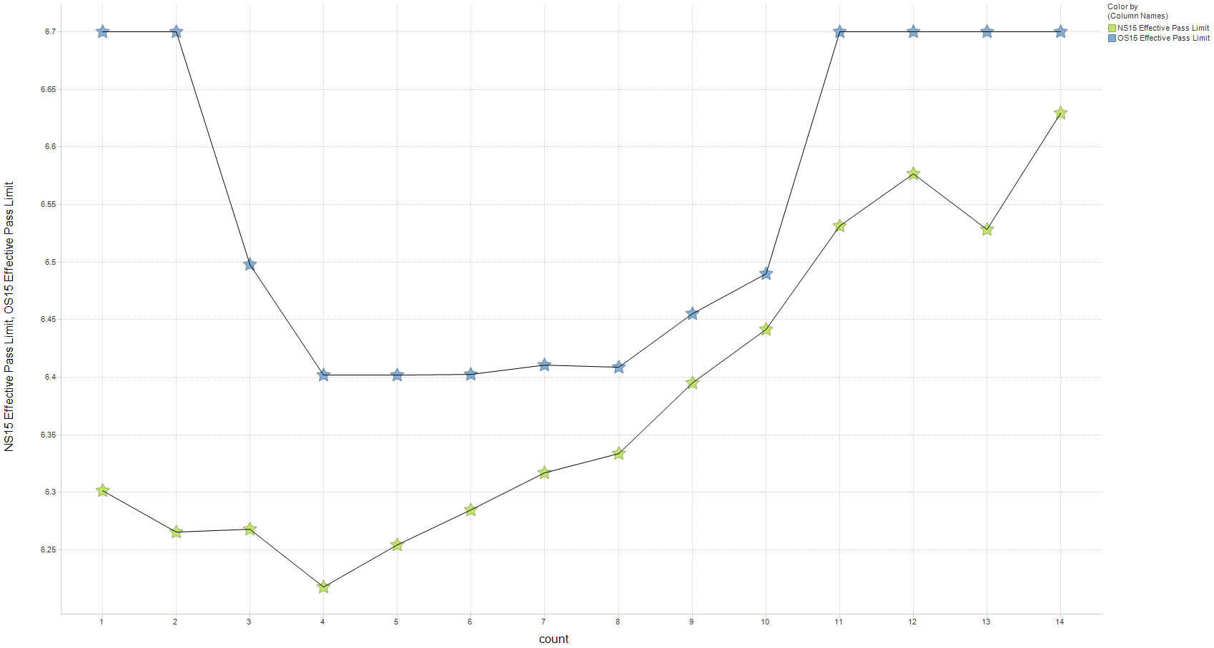
Effective pass limit Soot @ 15 cSt
New System versus Current – Laboratory F

Slide 47
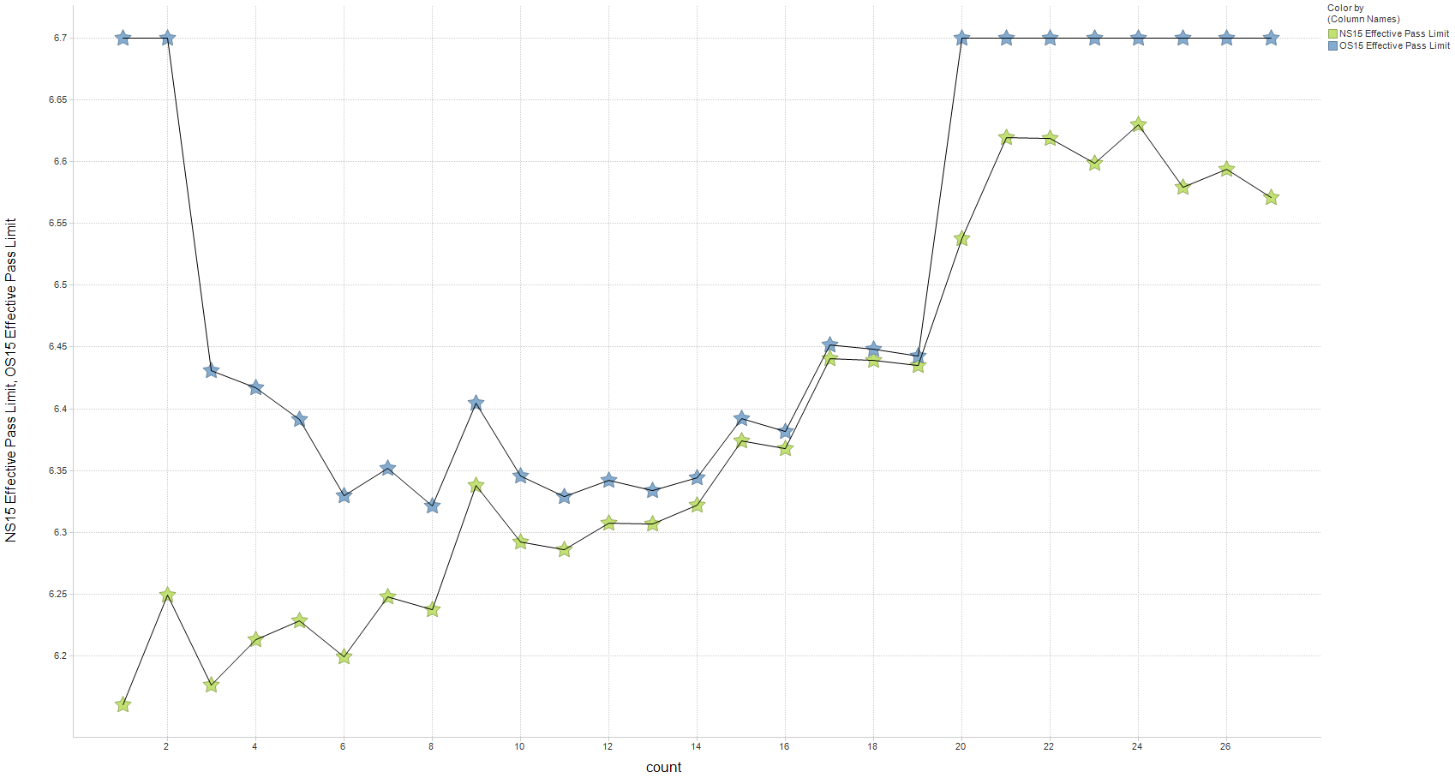
Effective pass limit Soot @ 15 cSt
New System versus Current – Laboratory G

Slide 48
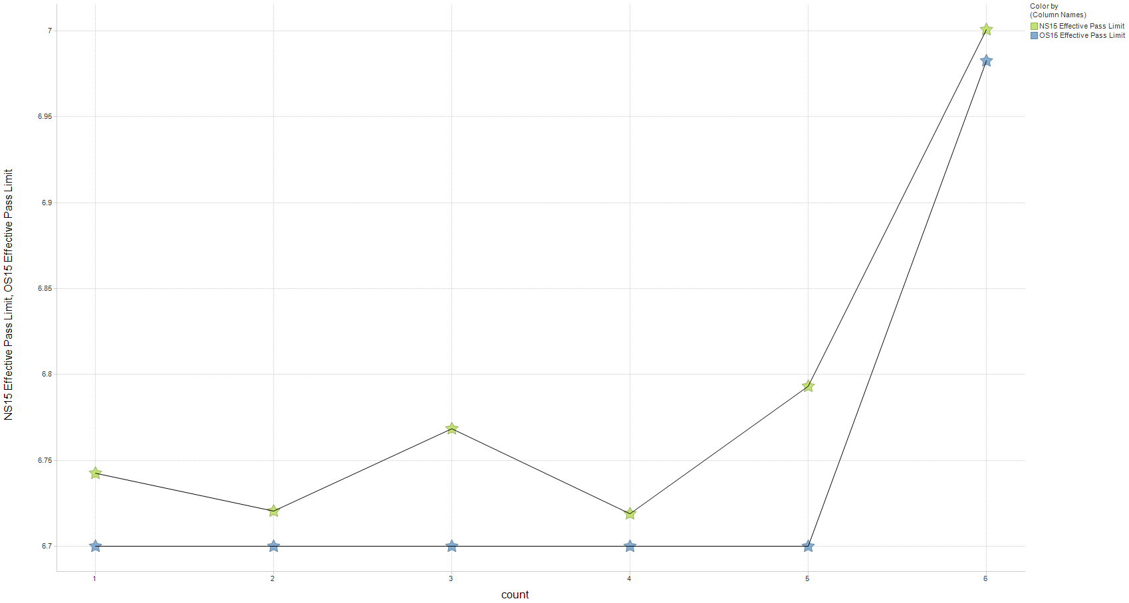
Effective pass limit Soot @ 15 cSt
New System versus Current – Laboratory G1

