Slide 1
Stage 1- 2 transitions
VH Prove out tests with data available

Slide 2
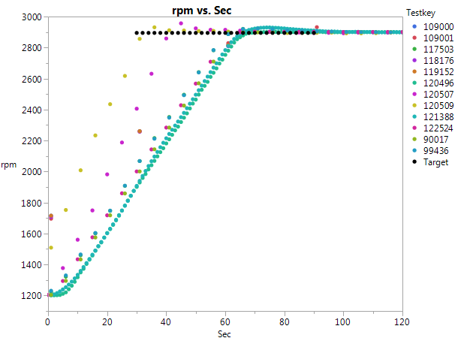

Slide 3
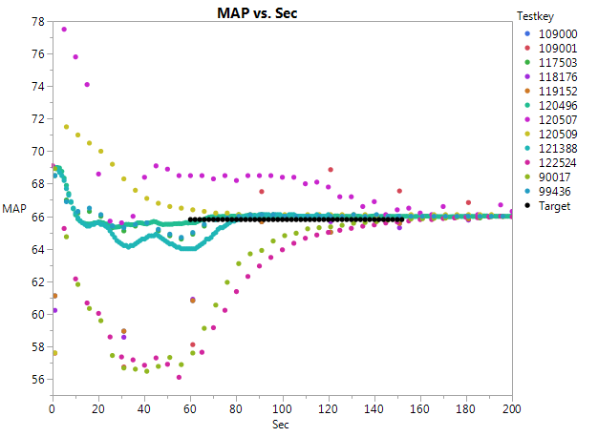

Slide 4
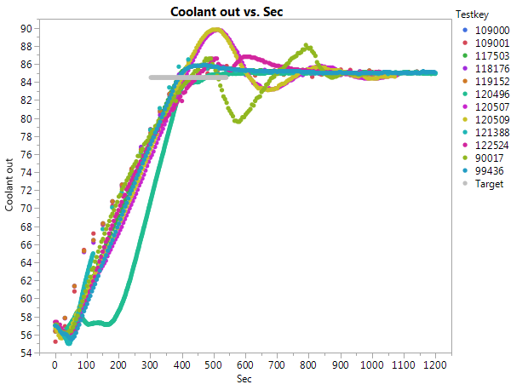

Slide 5
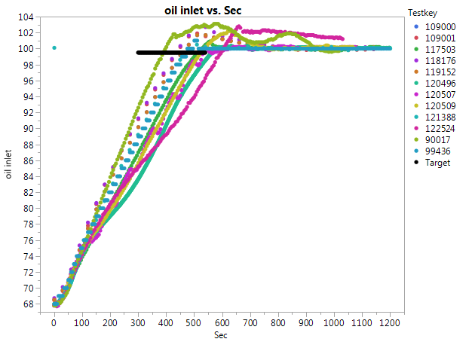

Slide 6
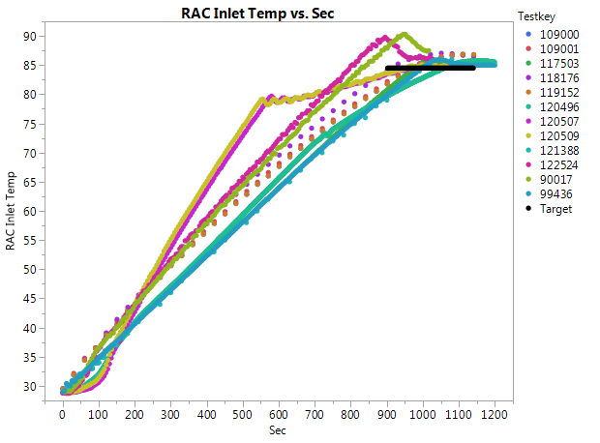

Slide 7
Stage 2-3 transitions
VH Prove out tests with data available

Slide 8
Stage 2-3 transitions
Only plotted parameters with specified windows.

Slide 9
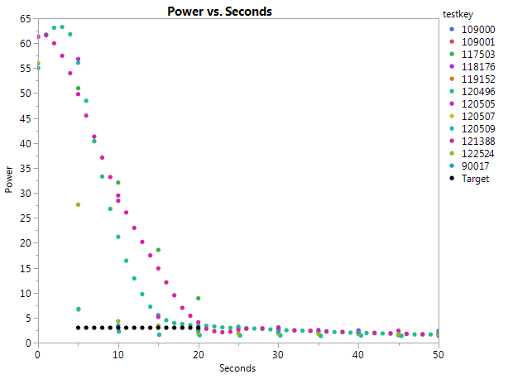

Slide 10
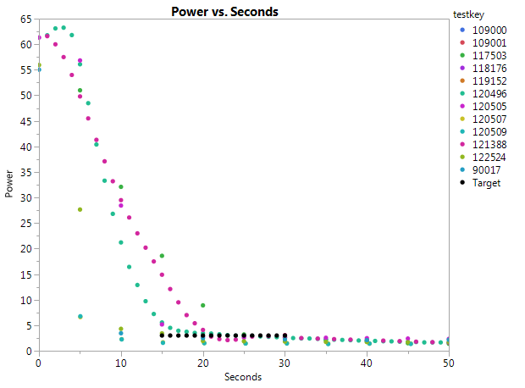
Target window adjusted to 15-30 seconds

Slide 11
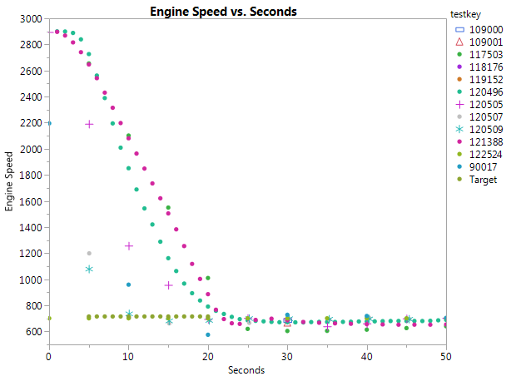

Slide 12
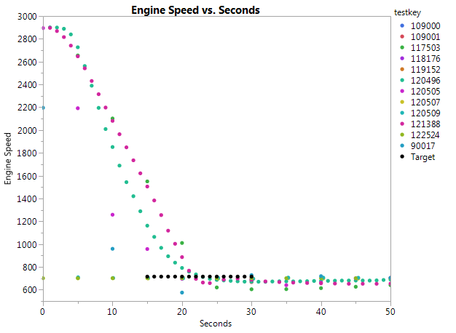
Speed window adjusted to 15 – 30 sec

Slide 13
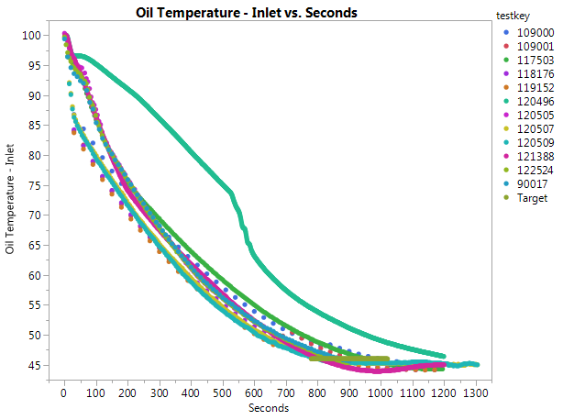

Slide 14
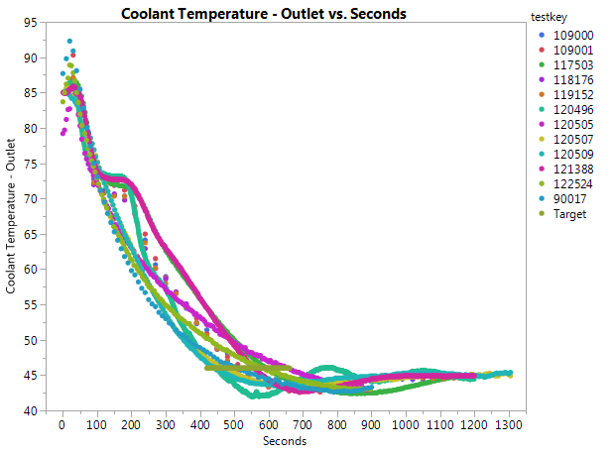

Slide 15
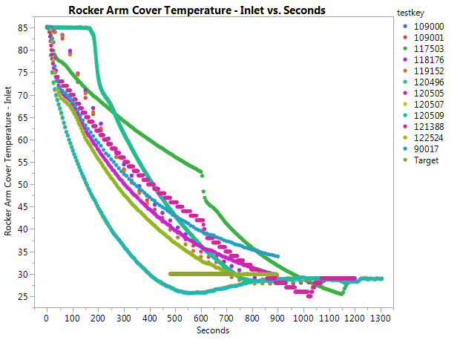

Slide 16
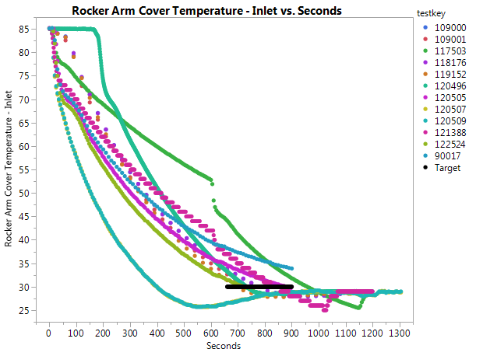
Transition window adjusted to 13±2 min two tests still need adjustment and one test gets there too soon

Slide 17
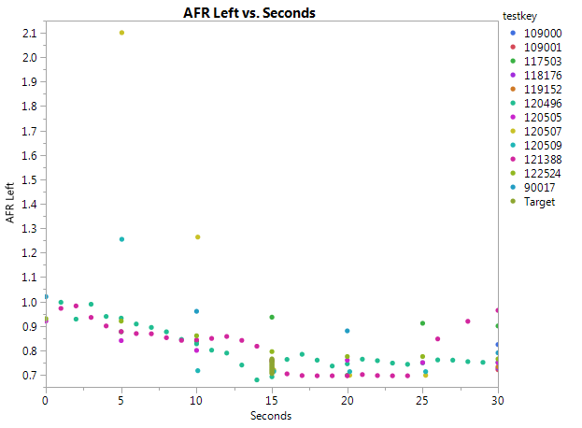

Slide 18
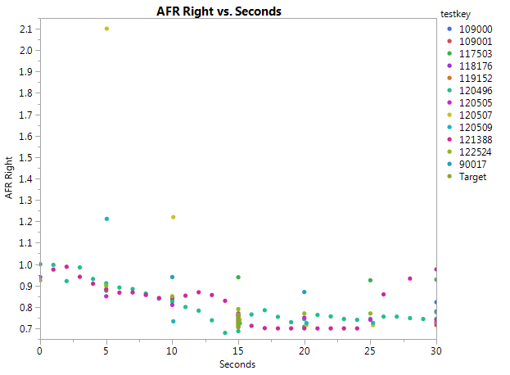

Slide 19
Stage 3-1 transitions
VH Prove out tests with data available

Slide 20
Stage 3-1 transitions
Only plotted parameters with specified windows.

Slide 21
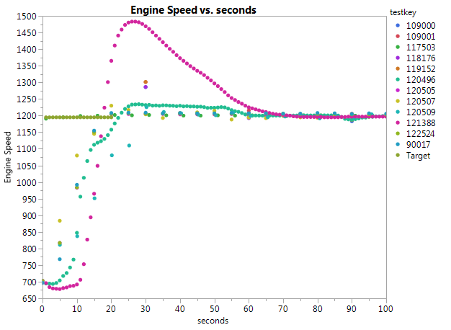

Slide 22
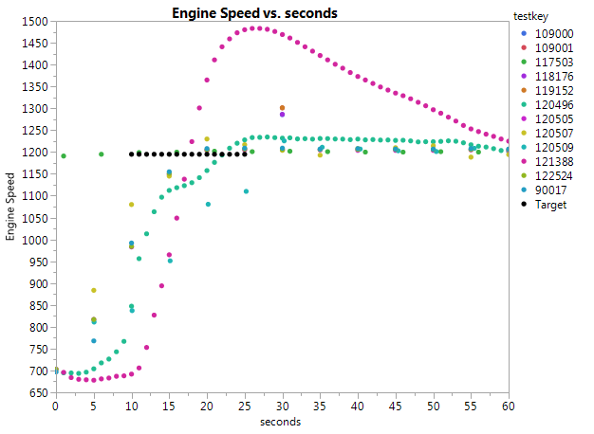
Adjusted Speed window

Slide 23
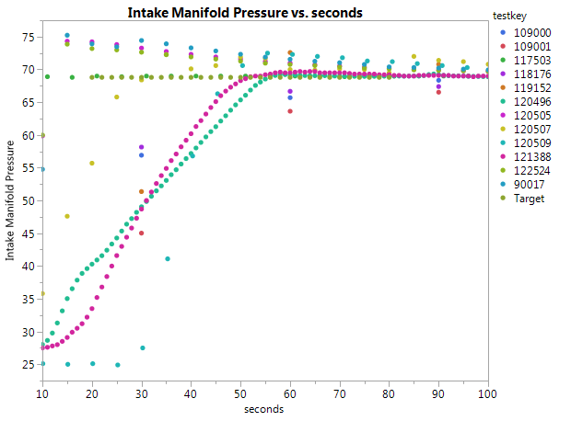

Slide 24
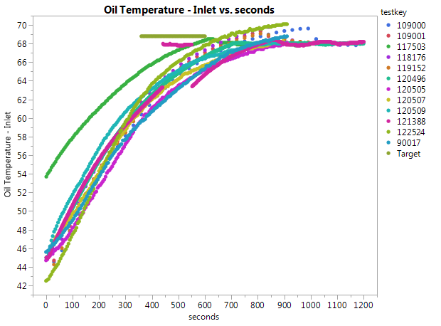

Slide 25
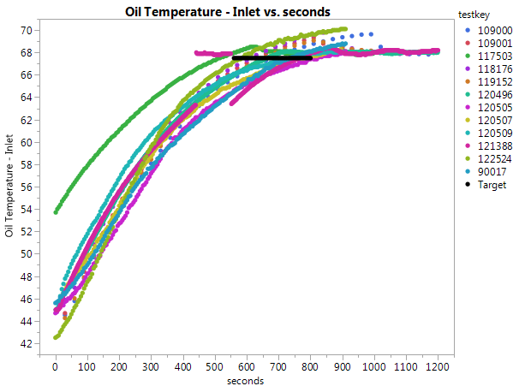
Ramp window adjusted one test just a little slow

Slide 26
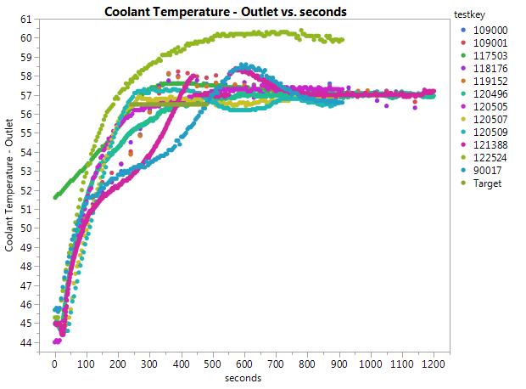

Slide 27
