Slide 1
VH Precision Matrix Operational Data Analysis
Statistics Group
June 2017

Slide 2
Statistics Group
Doyle Boese, Infineum
Jo Martinez, Chevron Oronite
Kevin O’Malley, Lubrizol
Martin Chadwick, Intertek
Richard Grundza, TMC
Lisa Dingwell, Afton
Todd Dvorak, Afton
Travis Kostan, SwRI
Art Andrews, ExxonMobil

Slide 3
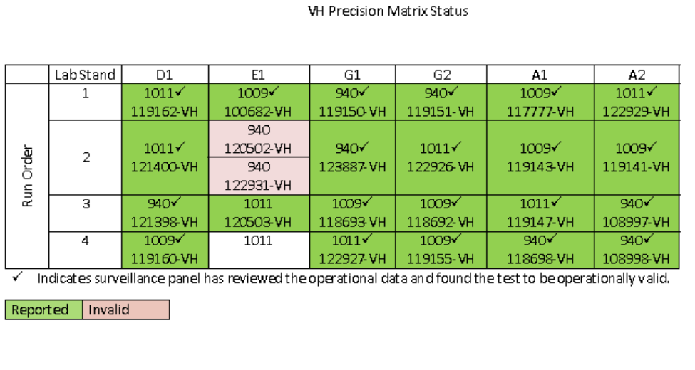
Precision Matrix Data Set
Precision Matrix Data Table from Frank Farber’s 20170526 VH Matrix Test Status update.
The operational data from 22 precision matrix tests were included in analyses
Notes:
Updated

Slide 4
Highlights
Varnish (AEV, AEV50, APV, & APV50)
Labs A and D have the lowest ratings for 1009 and 940.
The change in cylinder head (left and right) and pump pressures later in the test correlate with varnish severity; the larger the increase in pressure the more severe the varnish.
Since this correlation coincides with lab differences, it is difficult to say whether there is an influence of test operation, differences among the labs, or some other effect which manifests itself in these ways.
Sludge (AES & RAC)
A correlation exists between sludge and the volatility/variability in phase 3 exhaust pressure (which is related to the barometric pressure).
This is only observed in 1009 and 940.
The data suggest higher amounts of sludge are correlated with higher phase 3 exhaust pressure volatility (higher volatility in barometric pressure).
This relationship is influenced by the results of 3 or 4 tests.
Additional Observations:
Pending any measurement differences across labs, it appears that:
Lab E has more silicon in the oil drains compared to the other labs.
Lab D may have less wear occurring in the engine (Al and Fe).

Slide 5
AEV, AEV50, APV, and APV50

Slide 6
Varnish Summary
AEV and AEVB 100% and 50% ratings are correlated – no surprise
In oil 1009 and 940 varnish results, Labs A and D have the lowest ratings.
It could be that labs rate parts differently. However, extensive work has been done to mitigate this.
Or it could be possible that differences exist which manifest as operational and/or lab differences.
The change in cylinder head (left and right) and pump pressures later in the test correlate with varnish severity; the larger the increase in pressure the more severe the varnish. This implies that Labs A and D generally have a higher increase in pressure.
Perhaps we would have expected the increase in pressure to correspond to an increase in oil viscosity due to sludge buildup, but this may not be the case.
There isn’t a strong correlation between the pressure increase and sludge parameters.
KV40 doesn’t correlate well with the test results or the pressure increase.

Slide 7
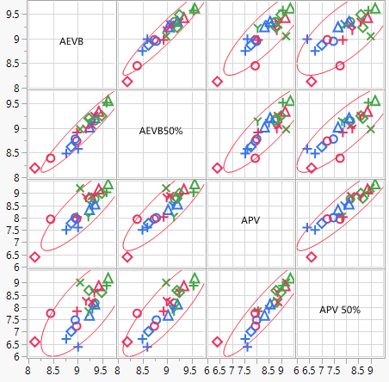
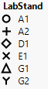
Varnish
Correlation among Varnish Parameters
As expected, engine and piston varnish are correlated

Slide 8
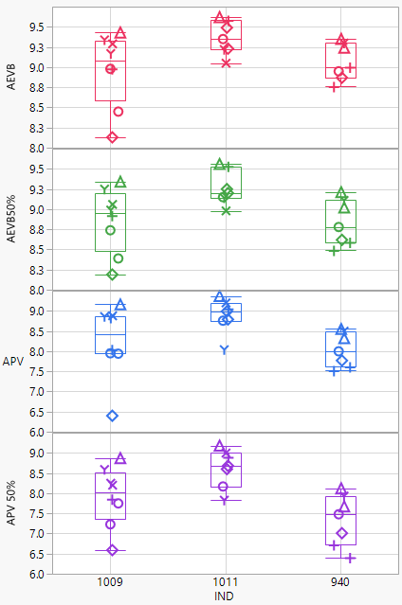
Varnish
Lab Differences
Labs A and D yield the most severe varnish results for 1009 and 940.
Improved precision in varnish may be achieved by understanding the cause(s) which manifests as lab/stand differences.

Slide 9
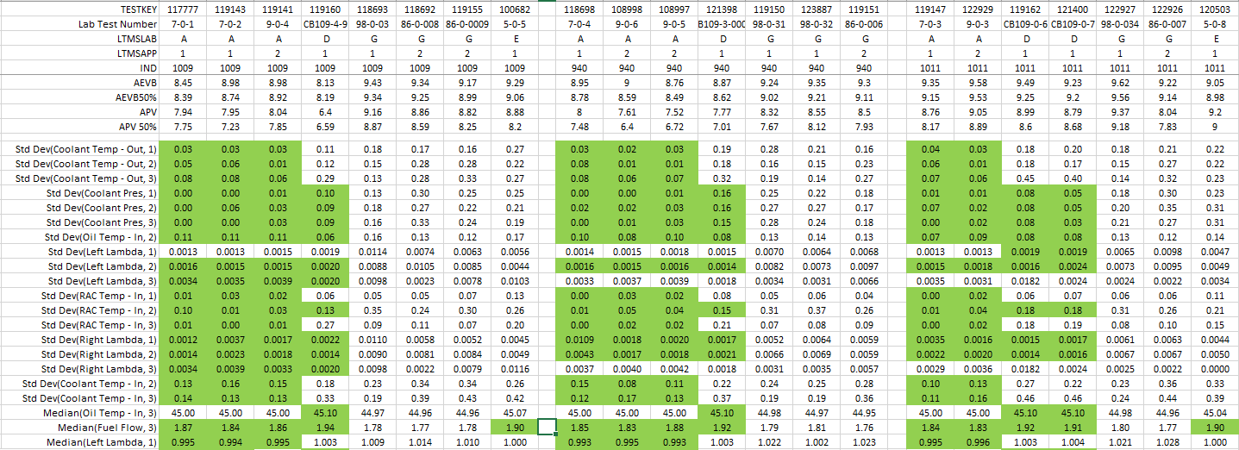
Varnish
Operational Differences Corresponding to Lab Differences
Differences suggest better control (or less variability) correlates to more severe results. This may not be consistent with what we would expect.
Differences in operation are small and not consistent across phases.
Number indicates the test phase summarized

Slide 10
Varnish
Operational Differences Corresponding to Lab Differences
Tests with a greater change in pump and cylinder head pressures later in the test correlate to more severe varnish. This correlation is observed in oils 1009 and 940.
Labs A and D generally have a greater change in pressure later in the test.
After the initial drop in pressure, a slope was calculated across the remaining test (shown in table below).
Hours refers to Total Phase Hours listed in the operational data files

Slide 11
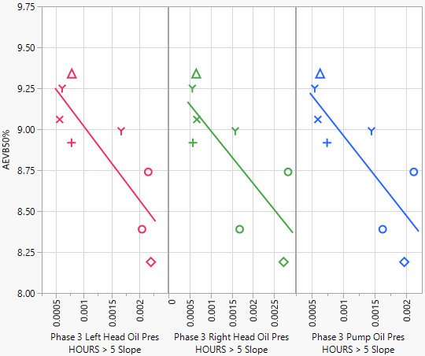
Varnish
Example: Oil 1009; Phase 3; AEVB50%
The increase in cylinder head and pump pressures later in the test correlate to varnish ratings. A higher increase in pressure is generally observed at Labs A and D
Slope calculate using Total Phase Hours > 5
Additional AEV50 and APV50 plots by oil and phase can be found in Appendices A & B

Slide 12
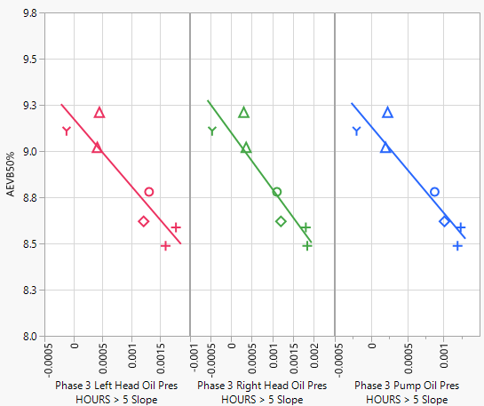
Varnish
Example: Oil 940; Phase 3; AEVB50%
The increase in cylinder head and pump pressures later in the test correlate to varnish ratings. A higher increase in pressure is generally observed at Labs A and D
Slope calculate using Total Phase Hours > 5
Additional AEV50 and APV50 plots by oil and phase can be found in Appendices A & B

Slide 13
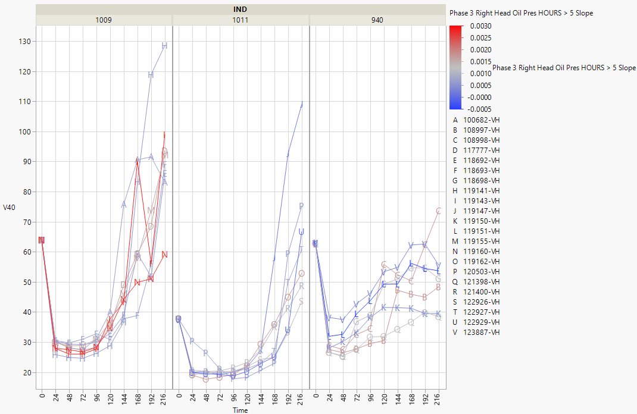
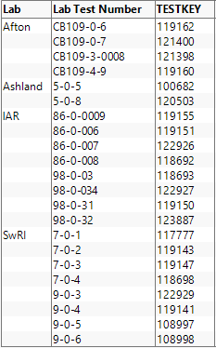
Varnish
KV40 vs. Pressure Increase Later in Test
The slope in pressure later in the test does not correlate well with the viscosity increase.
Note: There isn’t a strong correlation between KV40 and test parameters.

Slide 14
AES, RAC, and OSCR

Slide 15
Sludge Summary
A correlation exists between AES, RAC, and OSCR.
A correlation exists between sludge and the volatility/variability in phase 3 exhaust pressure (which is related to the barometric pressure).
This is only observed in 1009 and 940.
The data suggest higher amounts of sludge are correlated with higher phase 3 exhaust pressure volatility (higher volatility in barometric pressure).
This relationship is influenced by the results of 3 or 4 tests.

Slide 16
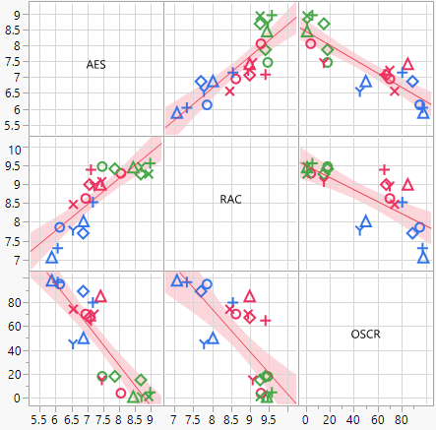
Sludge
AES, RAC, & OSCR Correlation
A correlation exists between AES, RAC, and OSCR

Slide 17
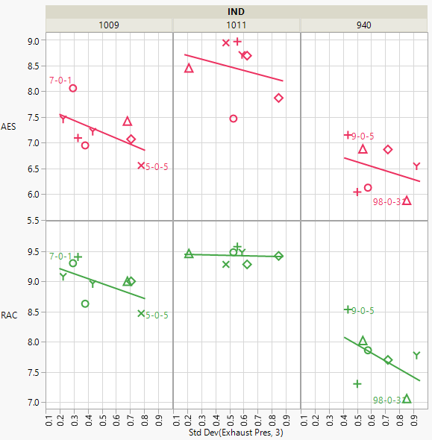
Sludge: AES & RAC
1009 and 940 data suggest higher phase 3 exhaust pressure volatility is correlated with the production of more sludge. However, a few tests contribute heavily to the correlation.
AES
1009
940
RAC
1009
940
Exhaust pressure is correlated to barometric pressure in phase 3. This suggests that fluctuations in barometric pressure may influence the production of sludge.

Slide 18
Highlights of Analytical Results

Slide 19
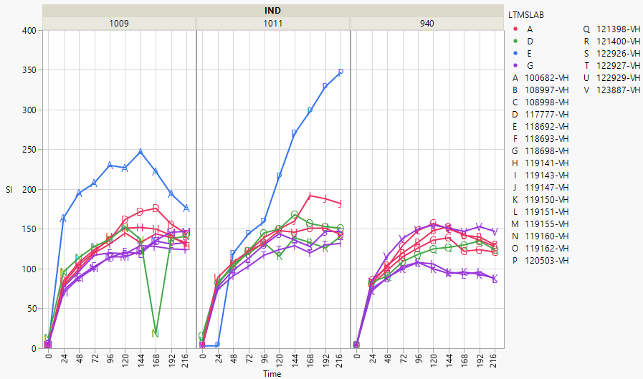
Analyticals
Silicon
Lab E appears to be getting more silicon in the oil drains than the other labs.

Slide 20
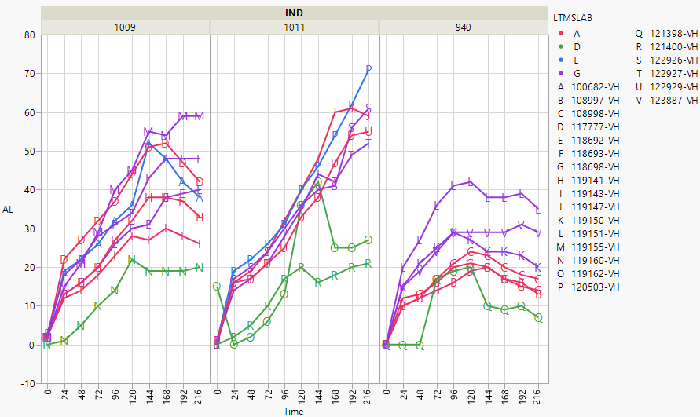
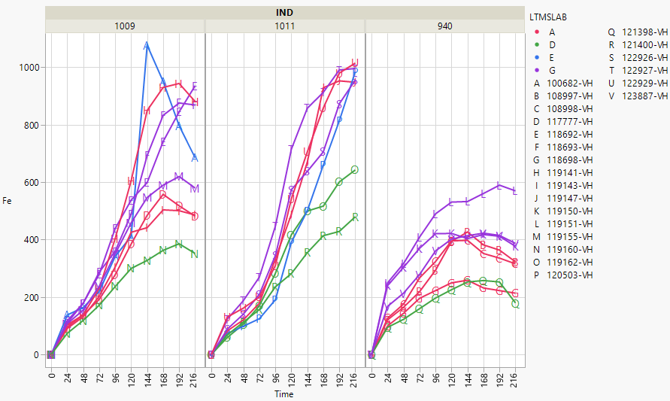
Analyticals
Iron and Aluminum
Lab D may have less wear occurring in the engine.

Slide 21
Questions?
Appendix A: AEVB50 vs. Cylinder Head and Pump Oil Pressures
Appendix B: APV50 vs. Cylinder Head and Pump Oil Pressures
Appendix C: Oil Drain Analyticals
Appendix D: Phase Operational Data
Appendix E: Ramp Operational Data

Slide 22
Appendix A
AEVB50%
vs.
Cylinder Head and Pump Oil Pressures by Phase and Oil

Slide 23
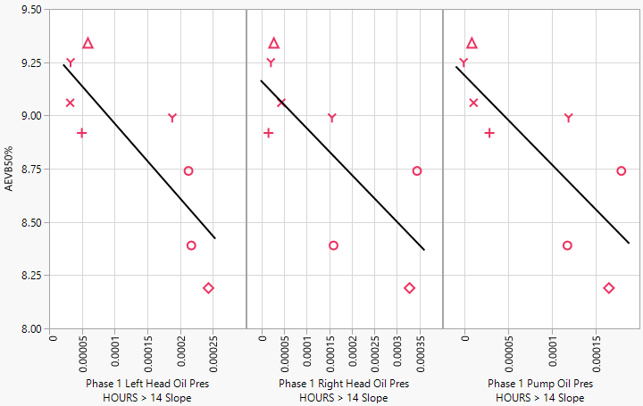
Oil 1009 Phase 1
AEVB50%

Slide 24
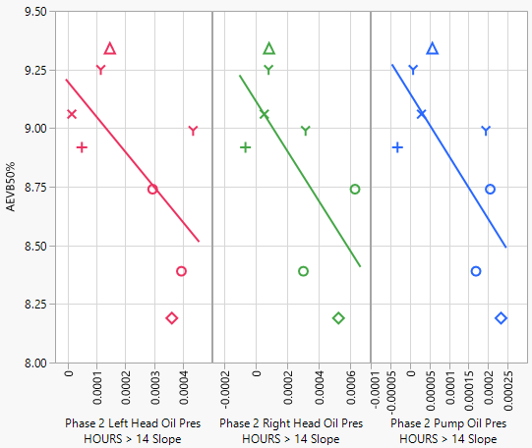
Oil 1009 Phase 2
AEVB50%

Slide 25
Oil 1009 Phase 3
AEVB50%

Slide 26
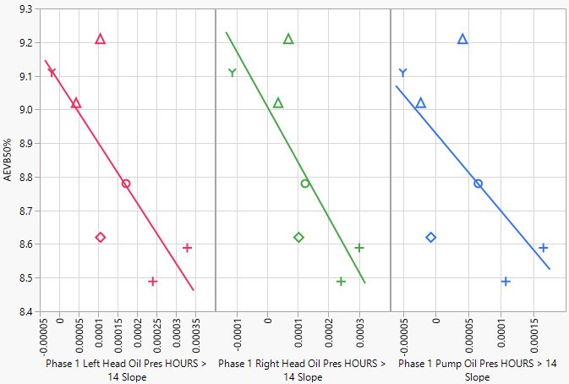
Oil 940 Phase 1
AEVB50%

Slide 27
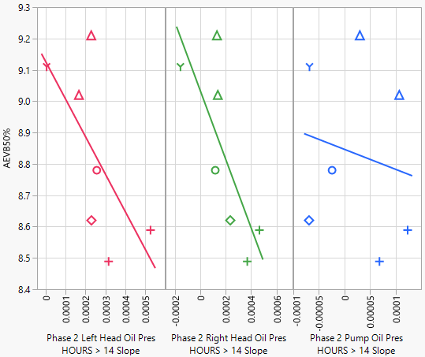
Oil 940 Phase 2
AEVB50%

Slide 28
Oil 940 Phase 3
AEVB50%

Slide 29
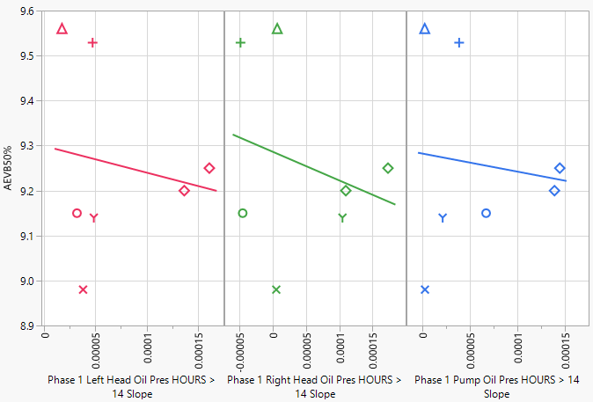
Oil 1011 Phase 1
AEVB50%

Slide 30
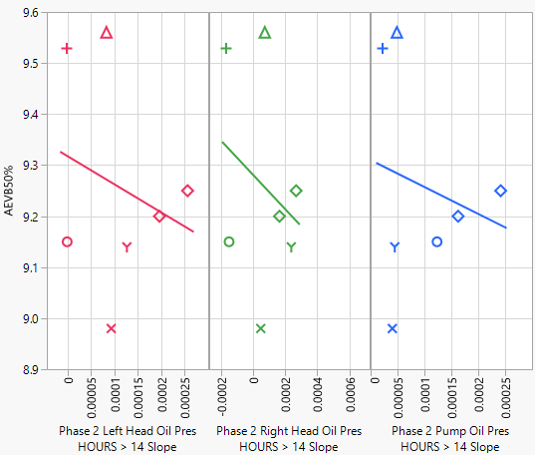
Oil 1011 Phase 2
AEVB50%

Slide 31
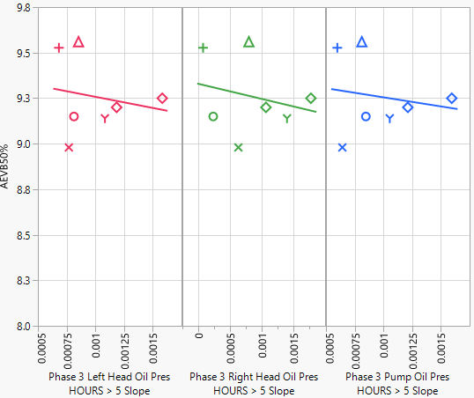
Oil 1011 Phase 3
AEVB50%

Slide 32
Appendix B
APV50%
vs.
Cylinder Head and Pump Oil Pressures by Phase and Oil

Slide 33
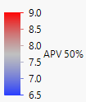
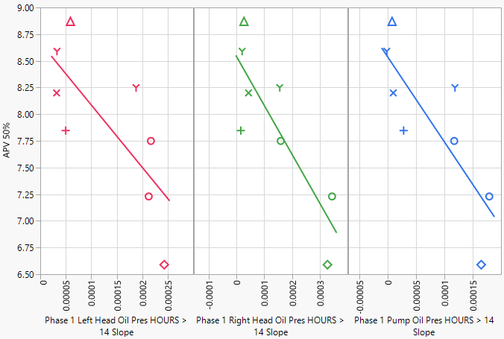
Oil 1009 Phase 1
APV50%

Slide 34
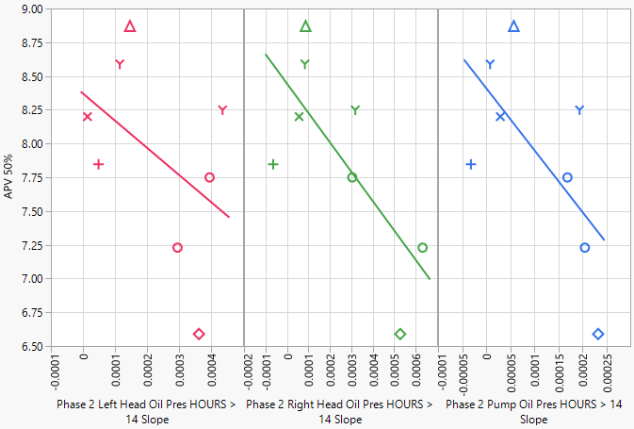
Oil 1009 Phase 2
APV50%

Slide 35
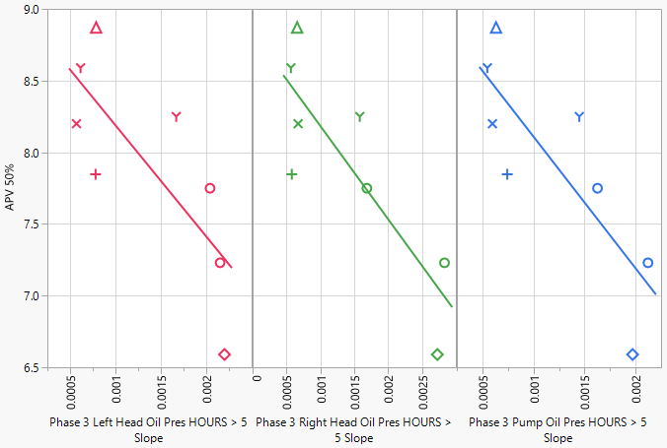
Oil 1009 Phase 3
APV50%

Slide 36
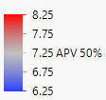
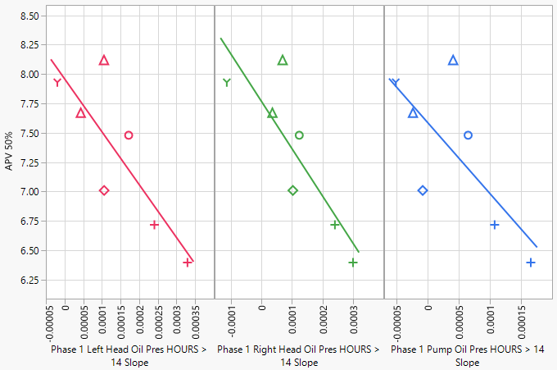
Oil 940 Phase 1
APV50%

Slide 37
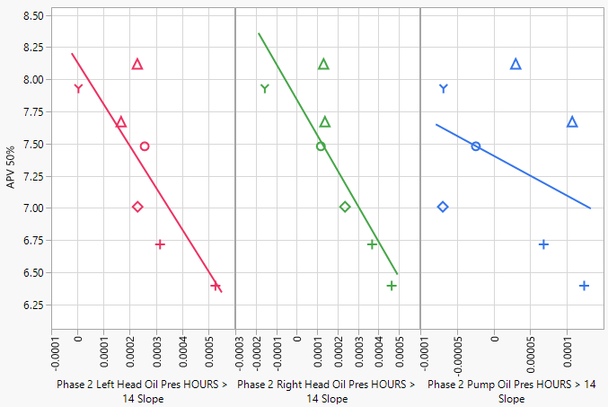
Oil 940 Phase 2
APV50%

Slide 38
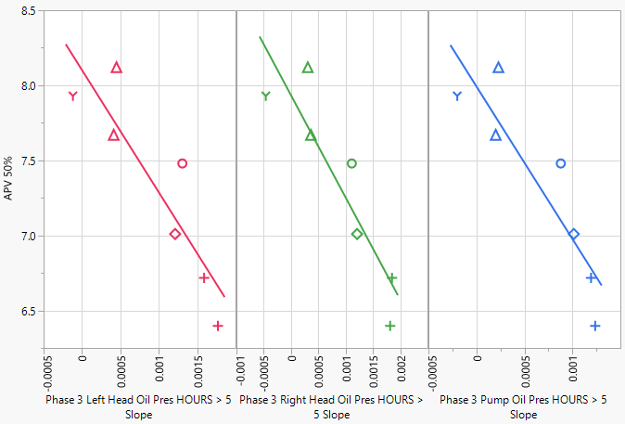
Oil 940 Phase 3
APV50%

Slide 39
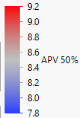
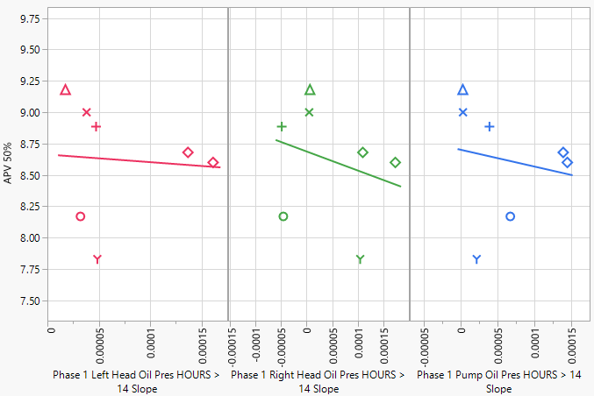
Oil 1011 Phase 1
APV50%

Slide 40
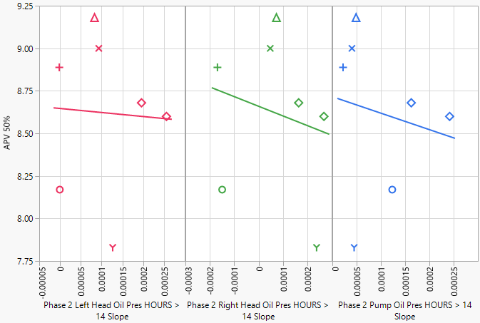
Oil 1011 Phase 2
APV50%

Slide 41
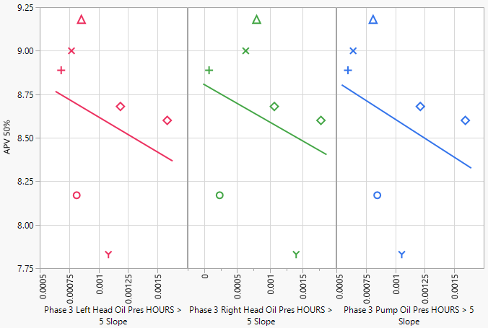
Oil 1011 Phase 3
APV50%

Slide 42
Appendix C
Analytical Data

Slide 44
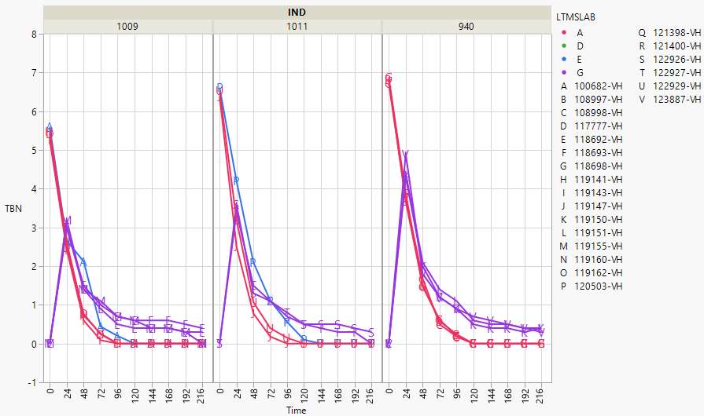

Slide 45
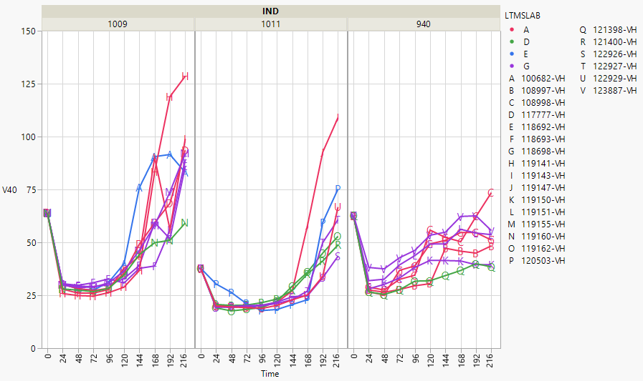

Slide 47
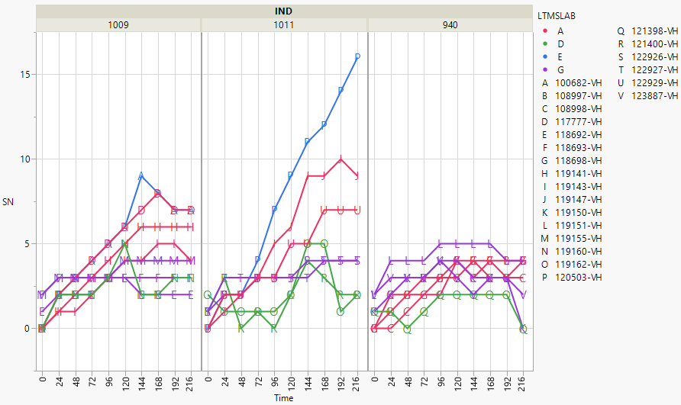

Slide 49
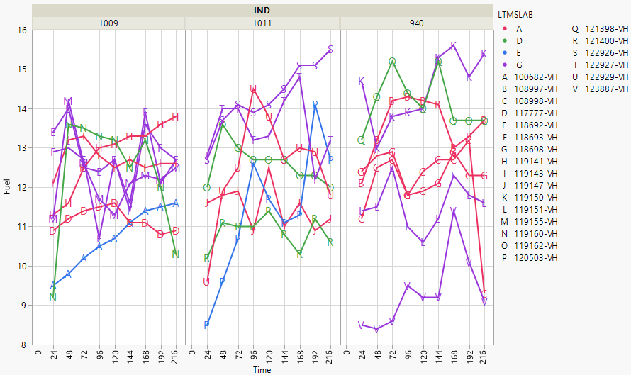

Slide 50
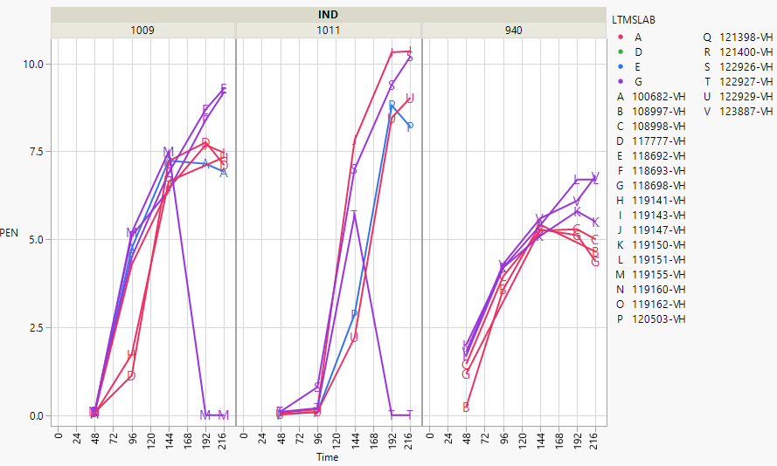

Slide 51
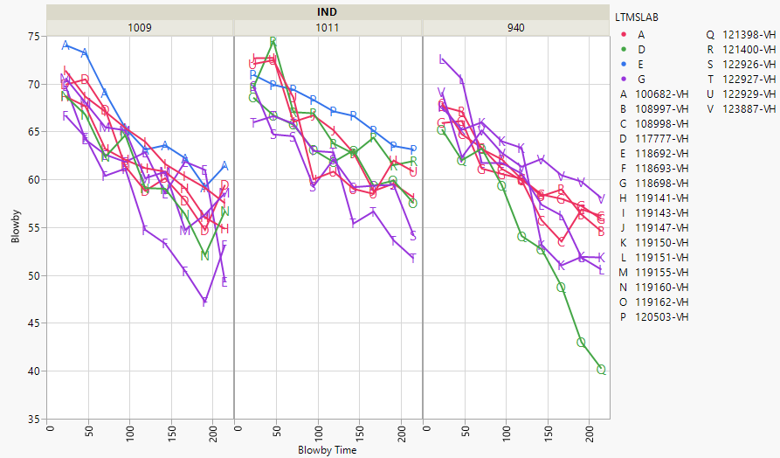

Slide 52
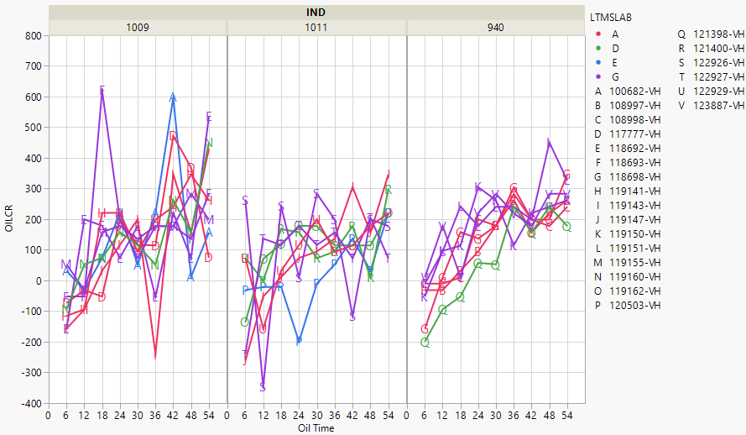

Slide 53
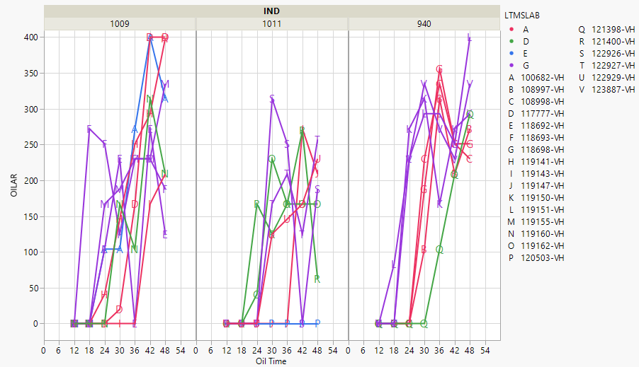

Slide 54
Appendix D
Phases 1, 2, and 3 Data
Plots show cycles in succession as well as overlaid
Phases are plotted separately
Parameters are shown in alphabetical order
Additional plots of zoomed in axes are included where appropriate

Slide 55
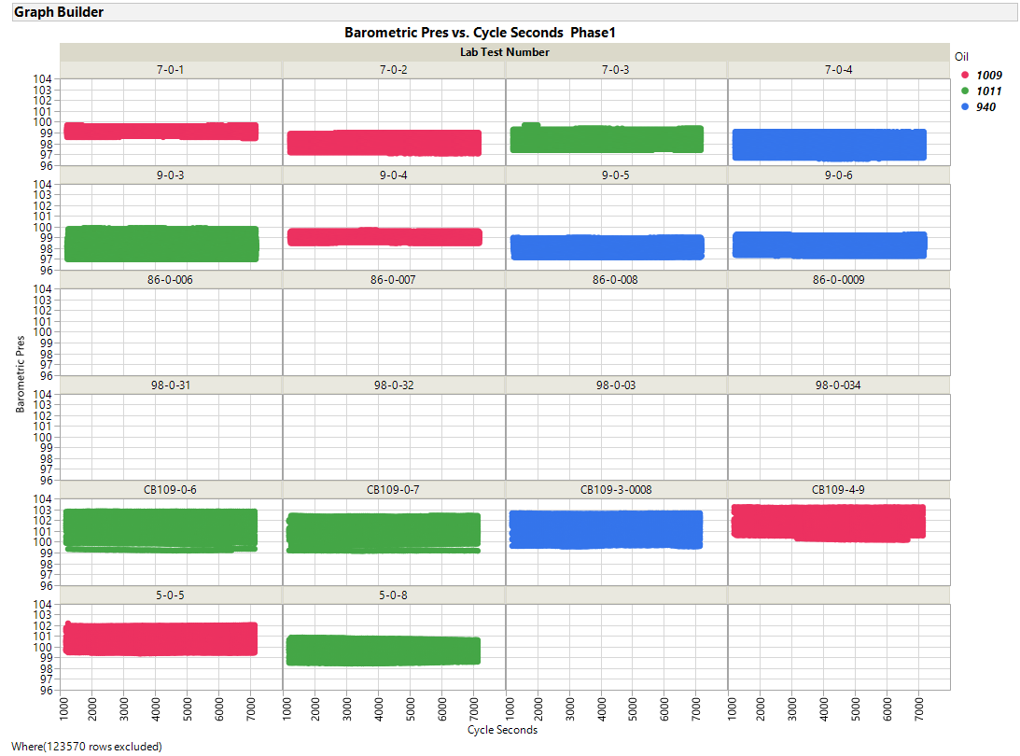

Slide 56
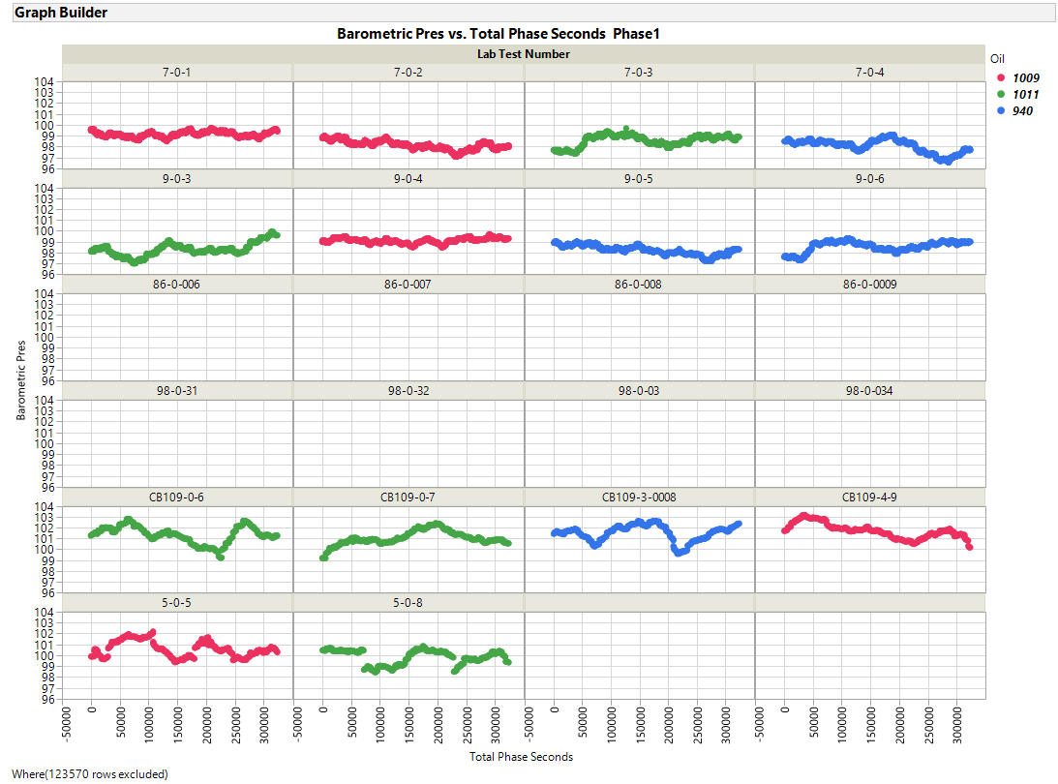

Slide 57
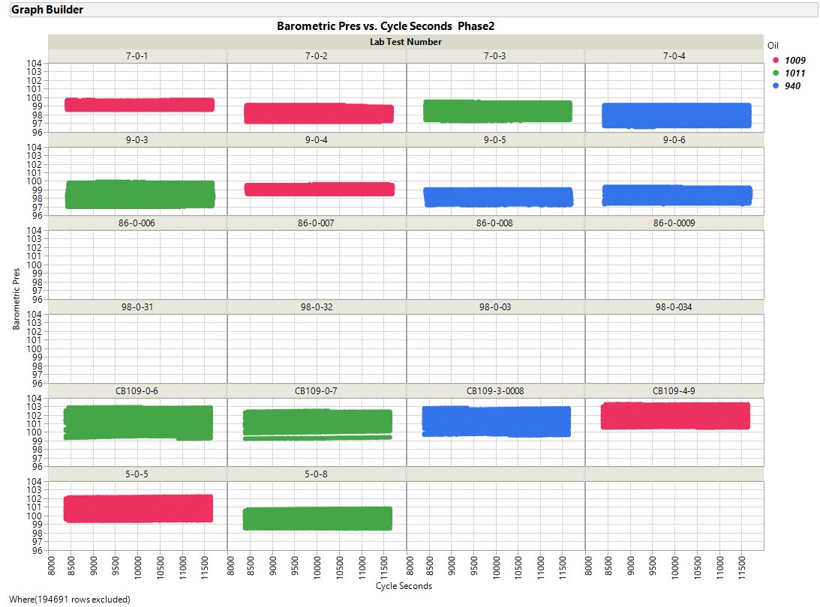

Slide 58
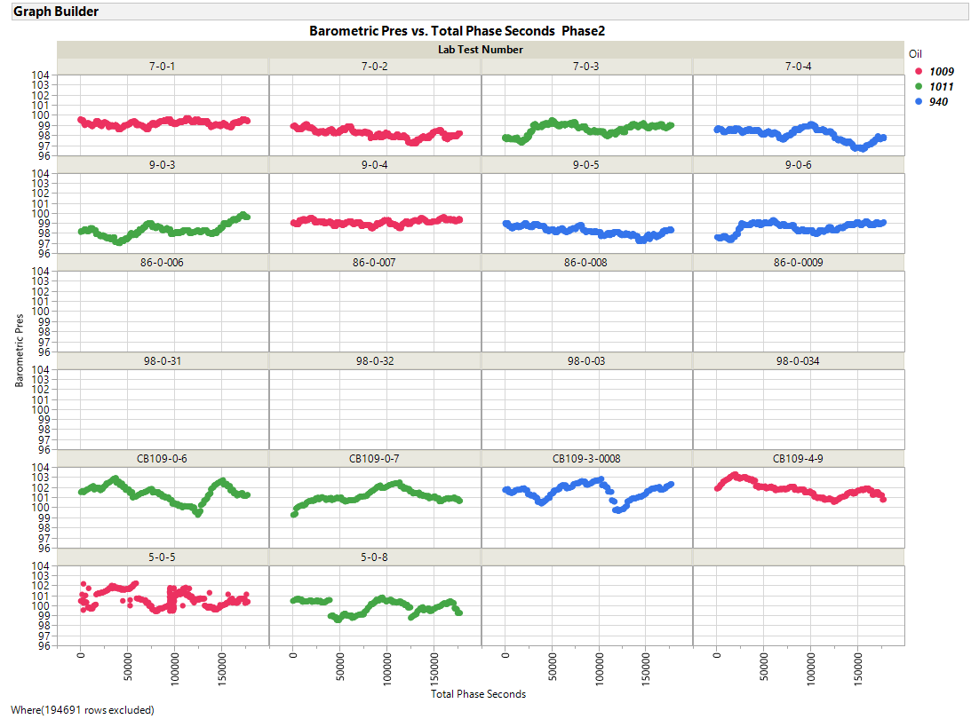

Slide 59
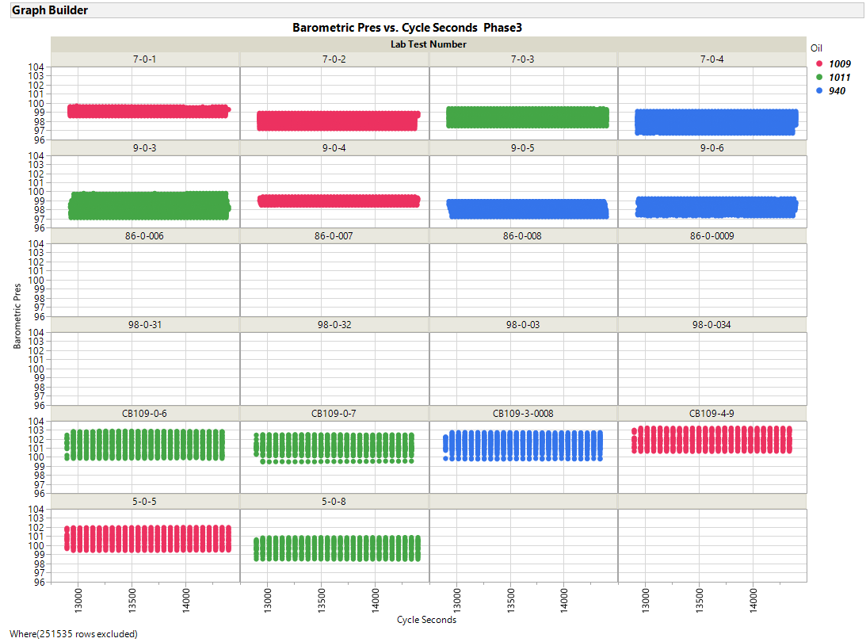

Slide 60
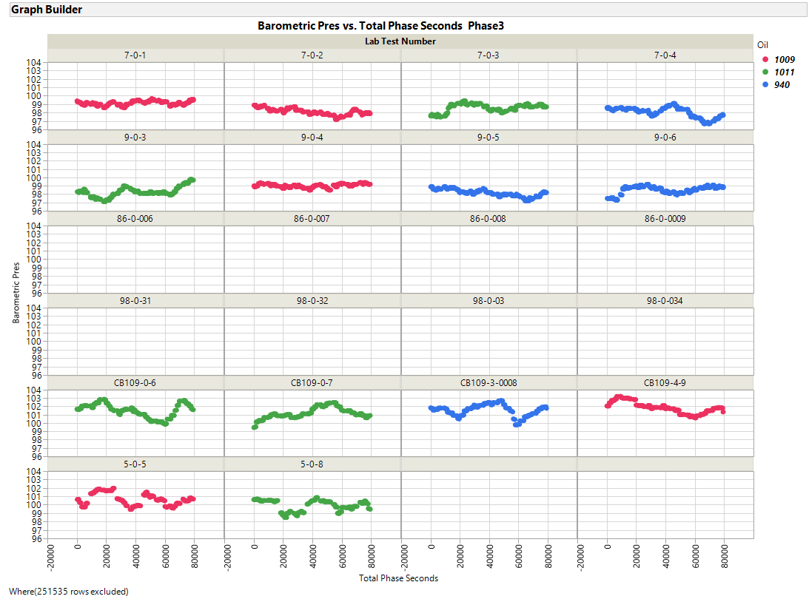

Slide 61
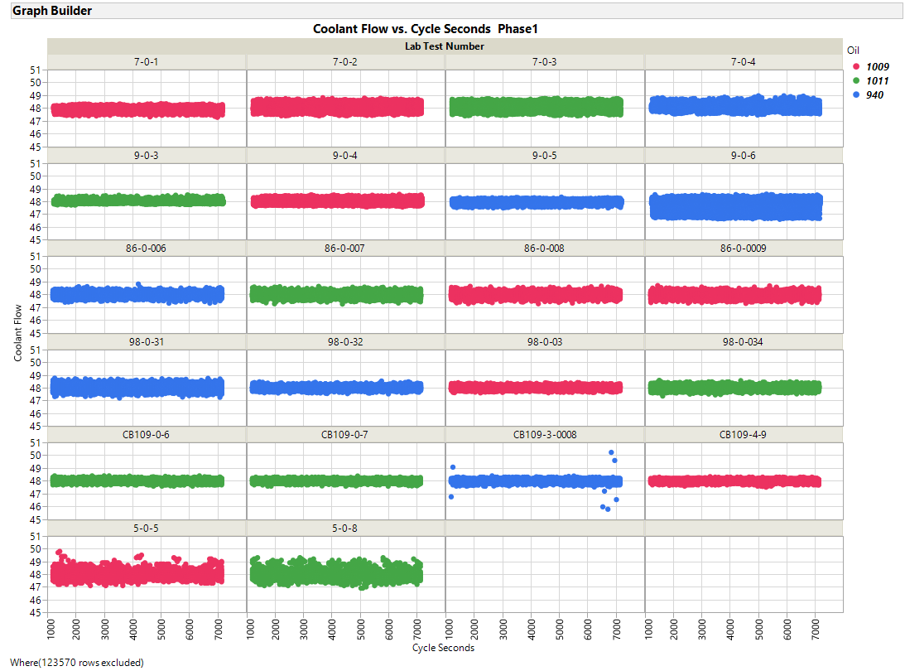

Slide 62
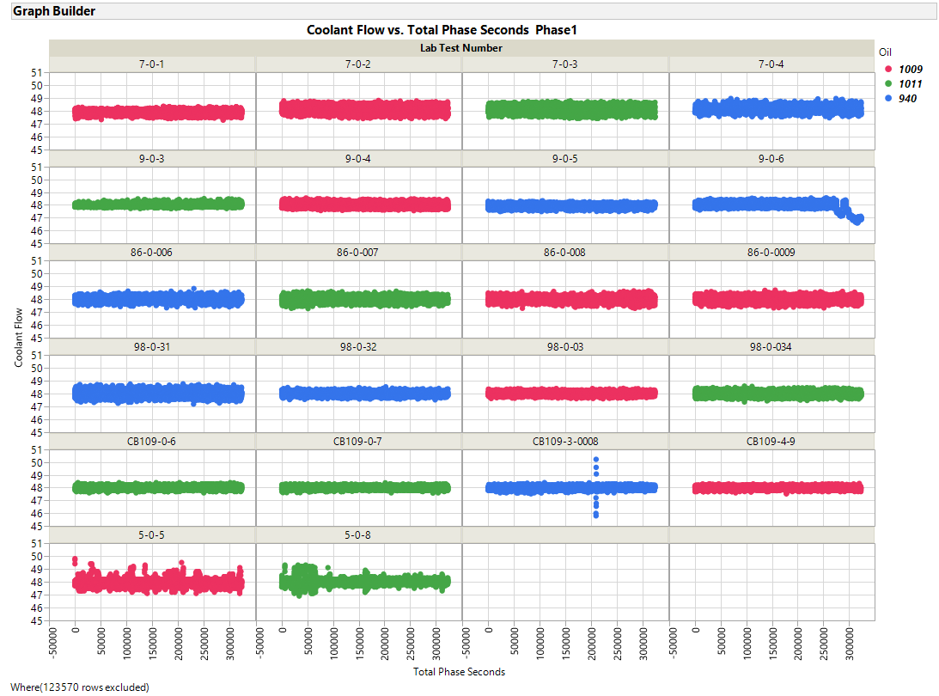

Slide 63
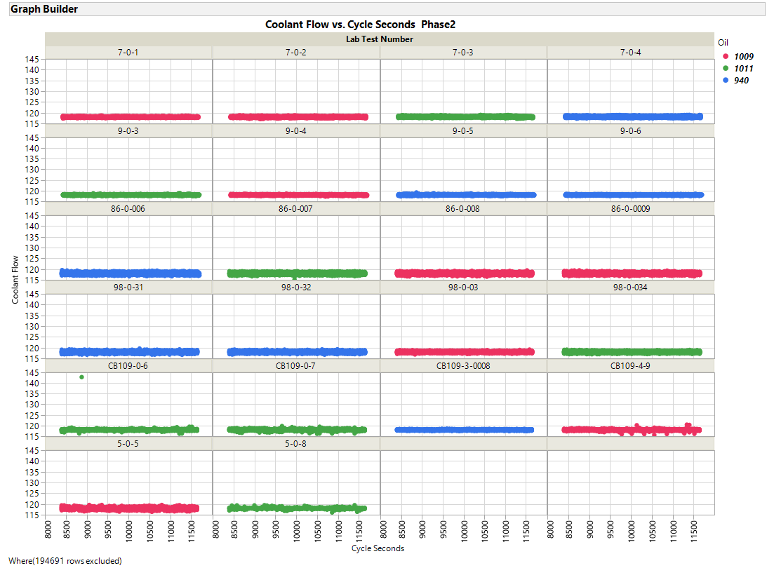

Slide 64
ZOOMED IN

Slide 66
ZOOMED IN

Slide 88
ZOOMED IN

Slide 90
ZOOMED IN

Slide 92
ZOOMED IN

Slide 94
ZOOMED IN

Slide 98
ZOOMED IN

Slide 100
ZOOMED IN

Slide 126
ZOOMED IN

Slide 128
ZOOMED IN

Slide 130
ZOOMED IN

Slide 132
ZOOMED IN

Slide 140
ZOOMED IN

Slide 142
ZOOMED IN

Slide 162
ZOOMED IN

Slide 164
ZOOMED IN

Slide 166
ZOOMED IN

Slide 168
ZOOMED IN

Slide 218
ZOOMED IN

Slide 220
ZOOMED IN

Slide 222
ZOOMED IN

Slide 224
ZOOMED IN

Slide 226
ZOOMED IN

Slide 228
ZOOMED IN

Slide 235
Appendix E
Ramp Data
Cycles Overlaid on Plots by Test
Ramps between cycle phases are shown separately
Parameters are shown in alphabetical order

