Slide 1
Normal Oil Consumption Engine, # 29
Seq. VIE PM Engine Teardown Observations
Valvoline Test Lab

Slide 2
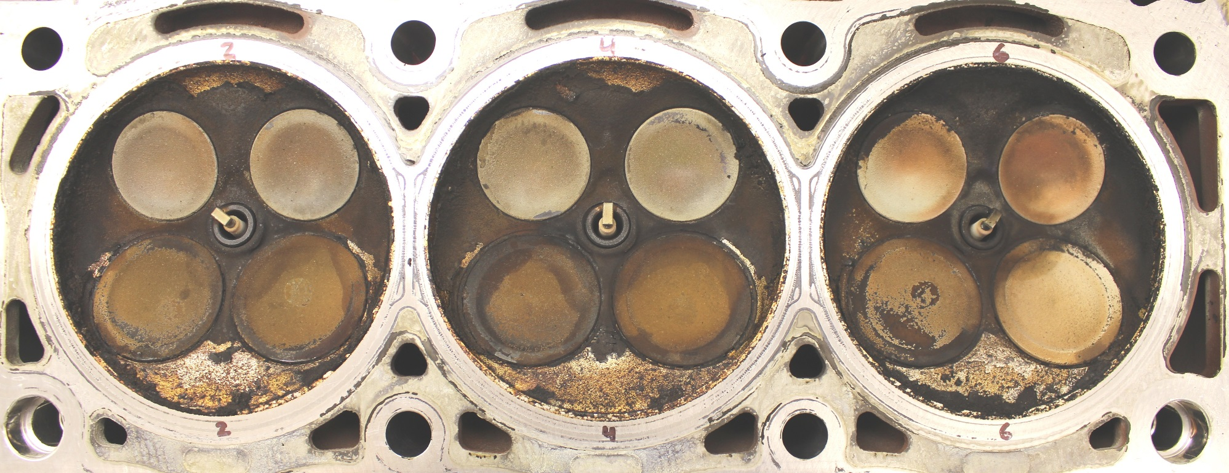
Engine 29, Normal Oil Cons. Engine
Combustion Chamber Heads - Left

Slide 3
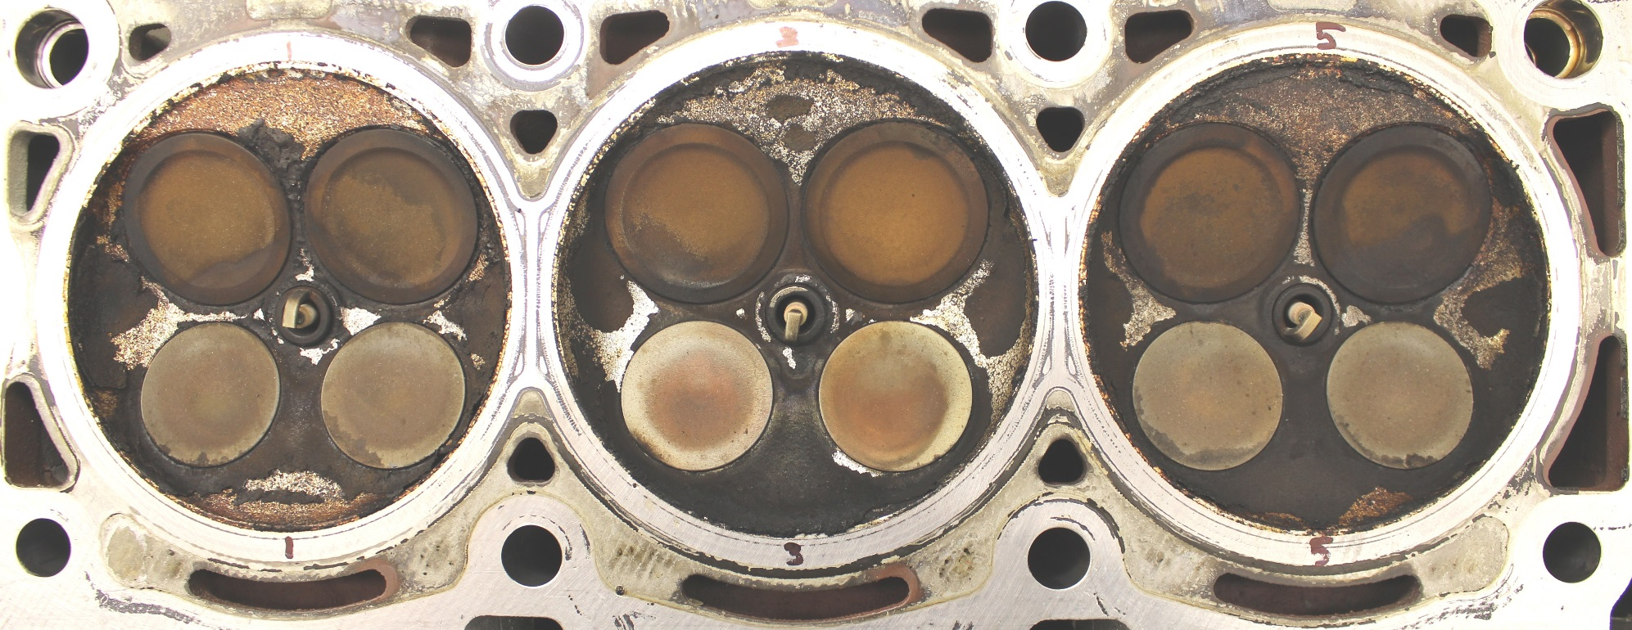
Engine 29, Normal Oil Cons. Engine
Combustion Chamber Heads - Right

Slide 4
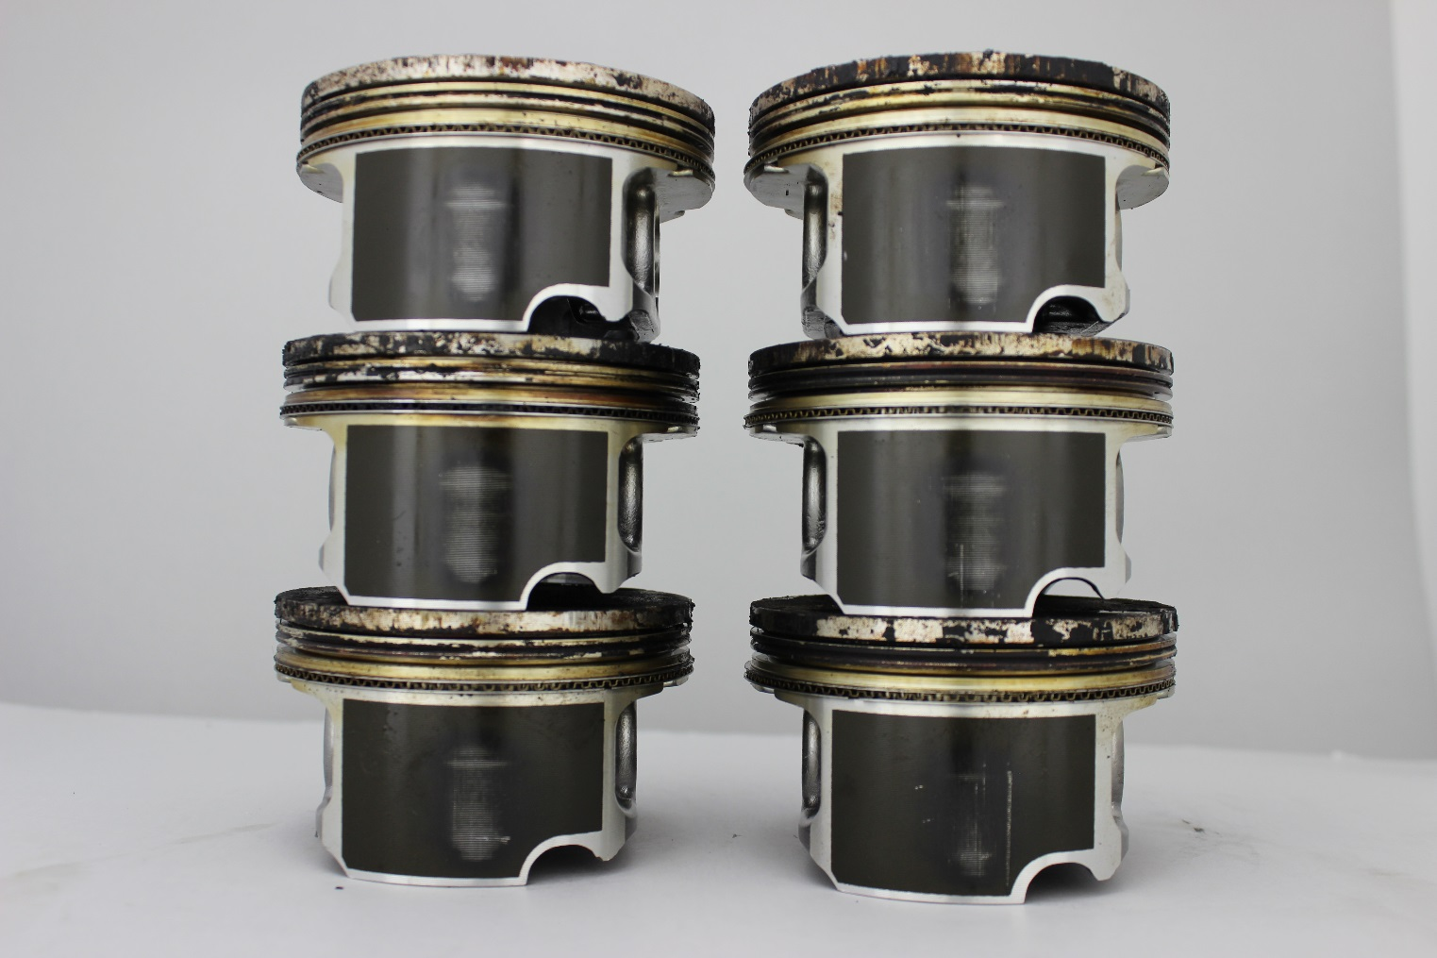
Engine 29, Normal Oil Cons. Engine
Pistons - Thrust Side

Slide 5
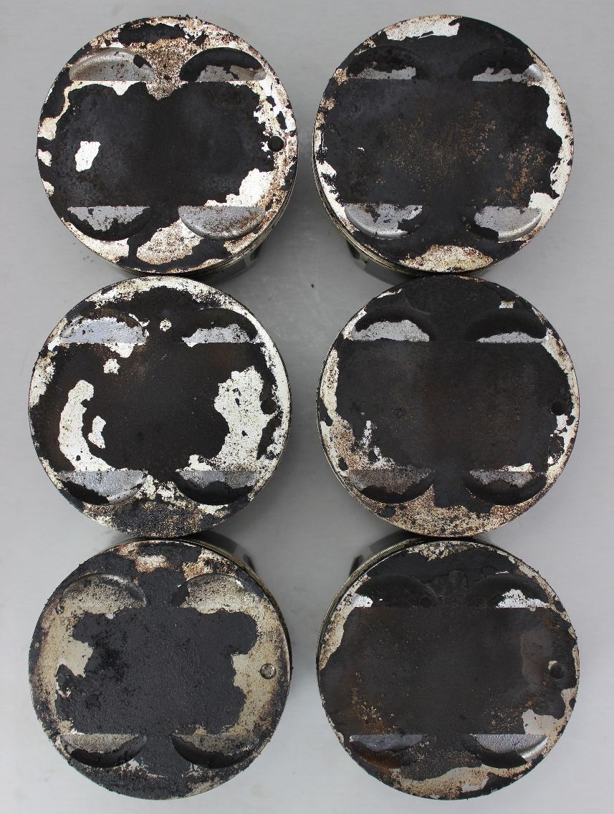
Engine 29, Normal Oil Cons. Engine
Pistons - Top

Slide 6
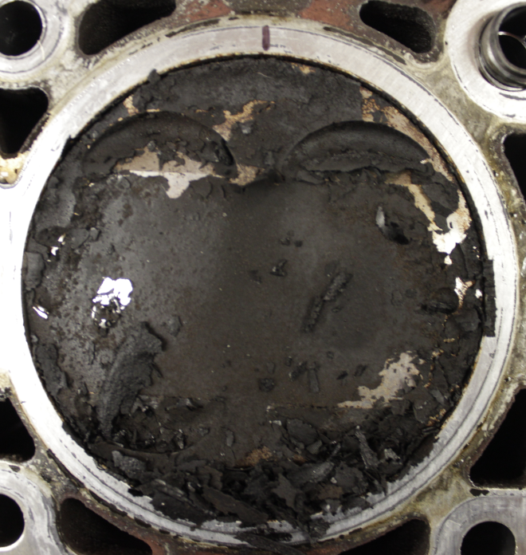
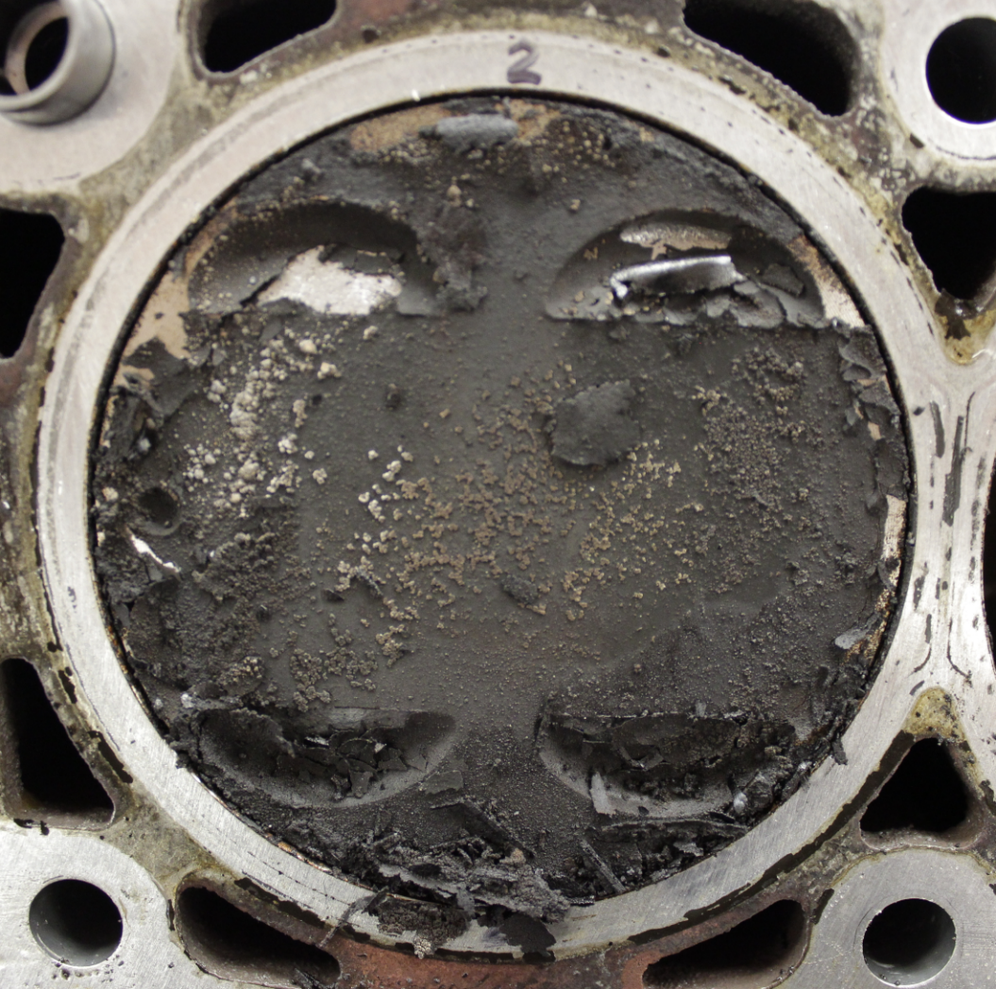
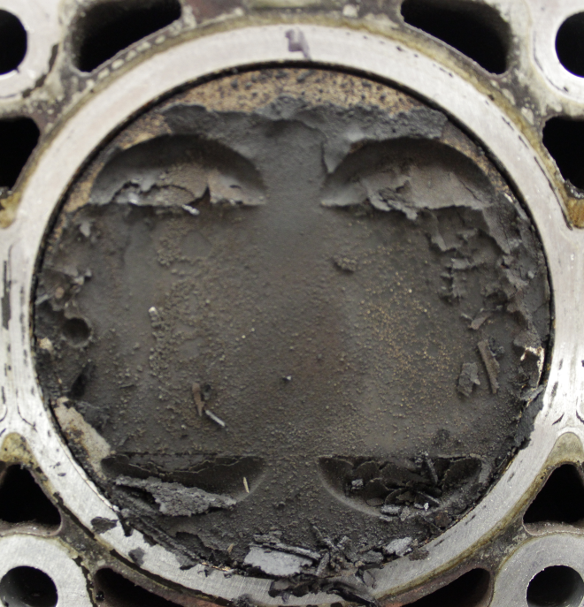
Engine 29, Normal Oil Cons. Engine
Pistons – Top (in cylinder)

Slide 7
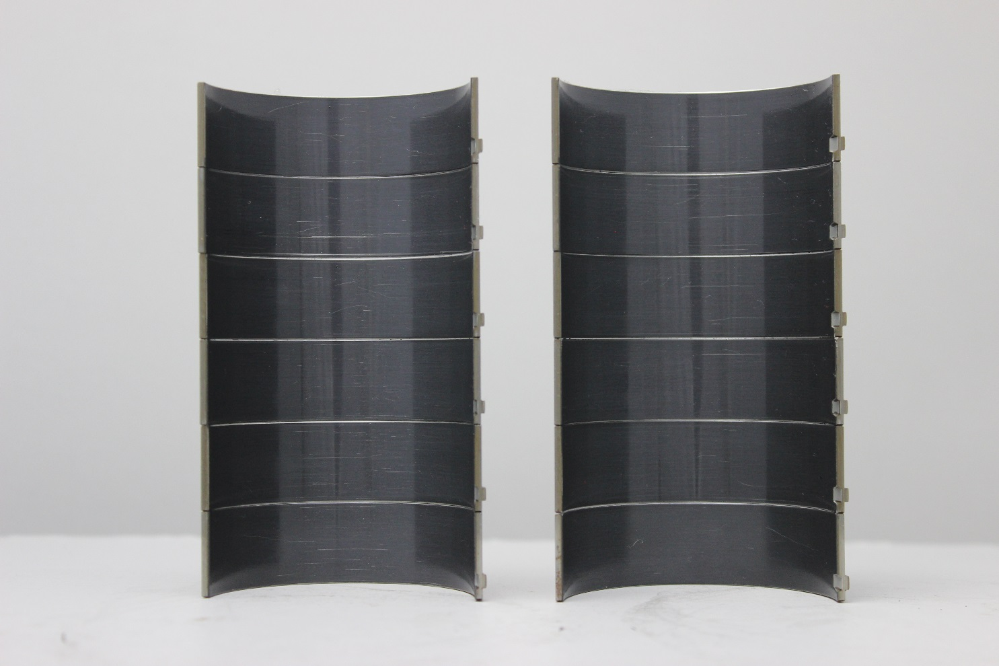
Engine 29, Normal Oil Cons. Engine
Connecting Rod Bearings

Slide 8
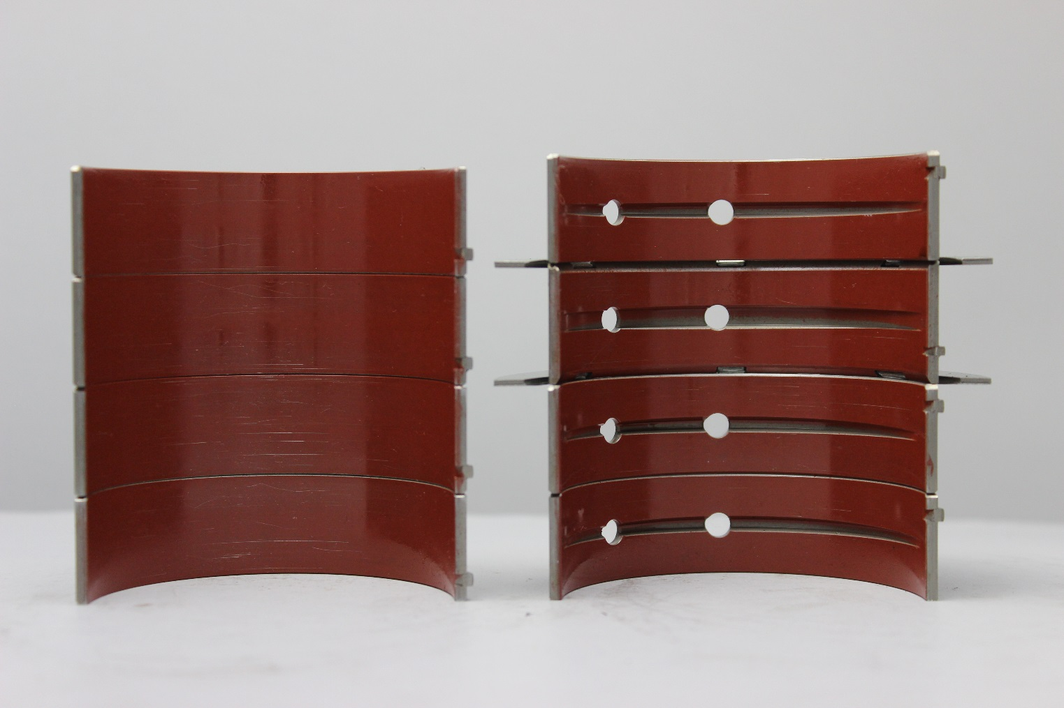
Engine 29, Normal Oil Cons. Engine
Crankshaft Bearings

Slide 9
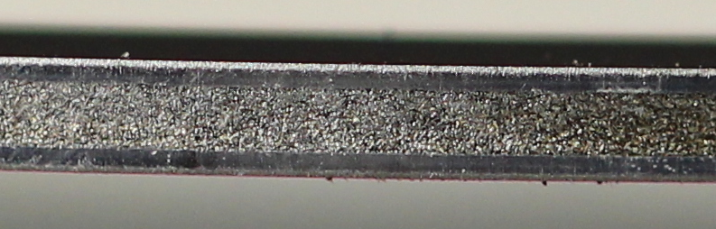
Engine 29, Normal Oil Cons. Engine
Piston Rings

Slide 10
Engine 29, Normal Oil Cons. Engine
Piston Rings Gaps

Slide 11
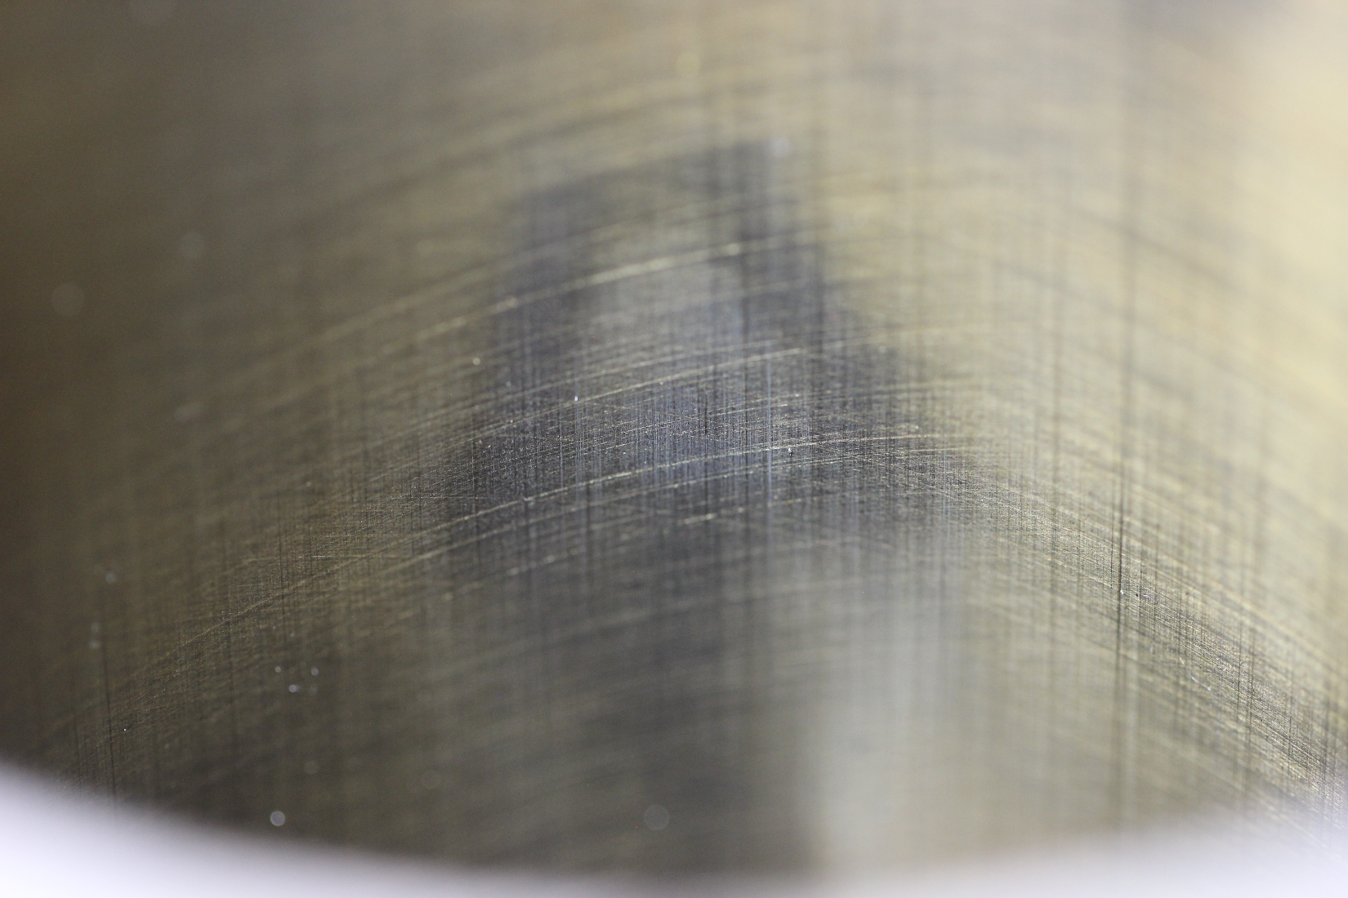
Engine 29, Normal Oil Cons. Engine
Bore polish

Slide 12
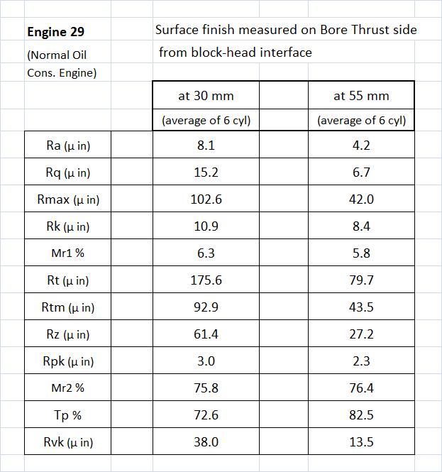
Engine 29, Normal Oil Cons. Engine
Bore Surface finish

