Slide 1
Sequence X Severity Review

Slide 2
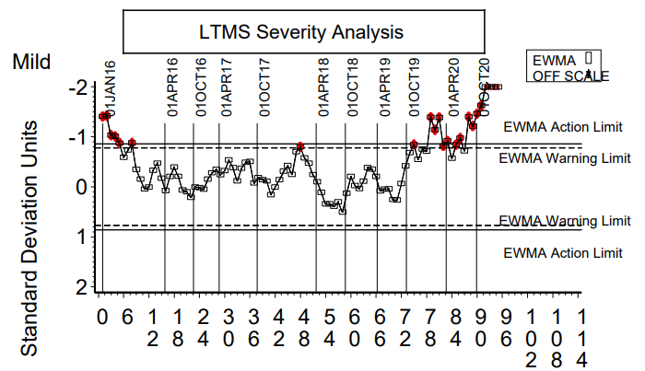
Background
The industry is currently mild for chain stretch and beyond the EWMA action limit. It appears the trend began somewhere around October of 2019.

Slide 3
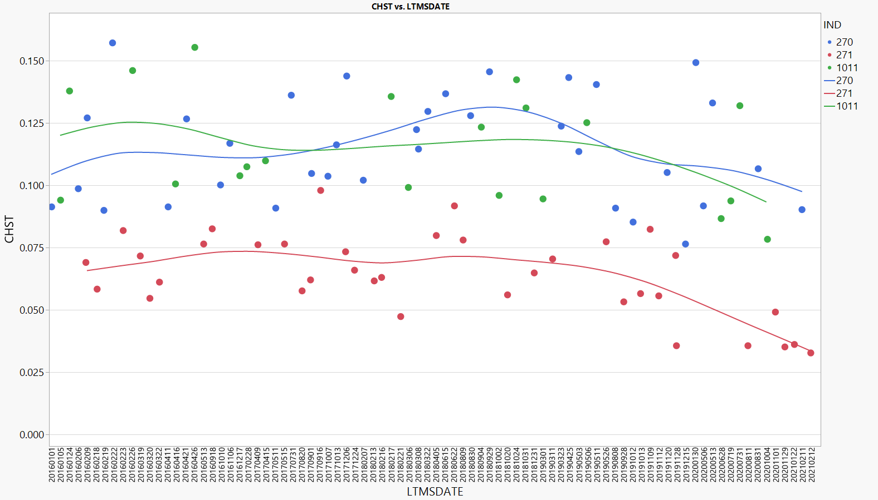
Oil Severity Differences – Untransformed
In untransformed units, the three oils appear to have all shifted by a similar magnitude.

Slide 4
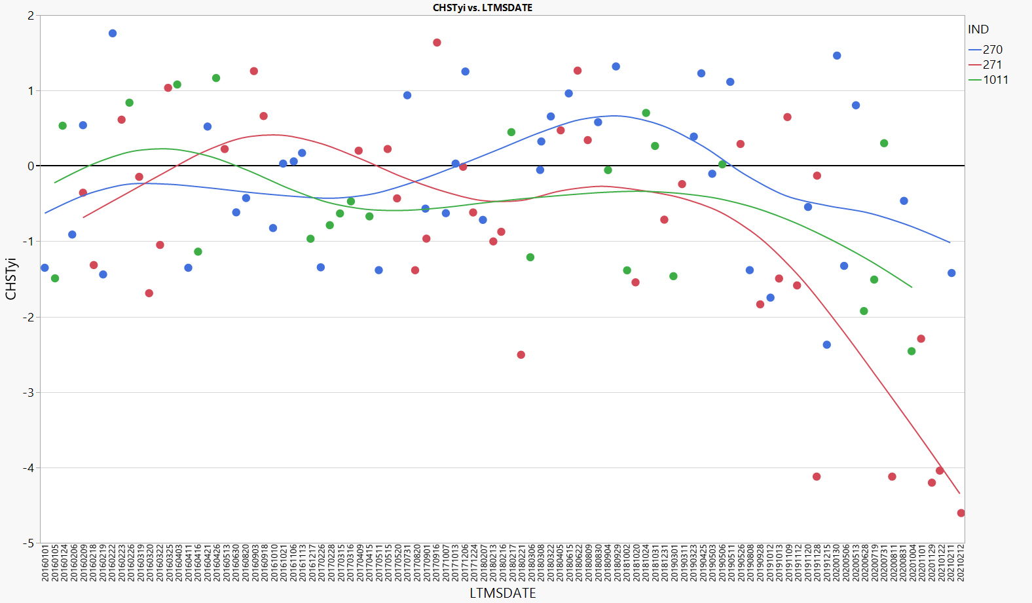
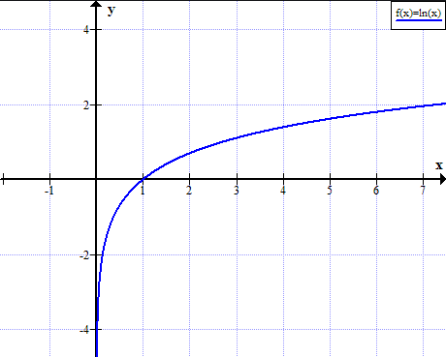
Oil Severity Differences – Ln(Chst.) Yi
In transformed units, the shift is having a major impact on the mild reference oil due to the shape of the natural log curve.
Ln(X) goes very quickly to negative infinite the closer you get to zero.

Slide 5
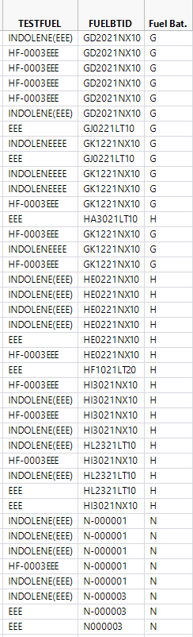
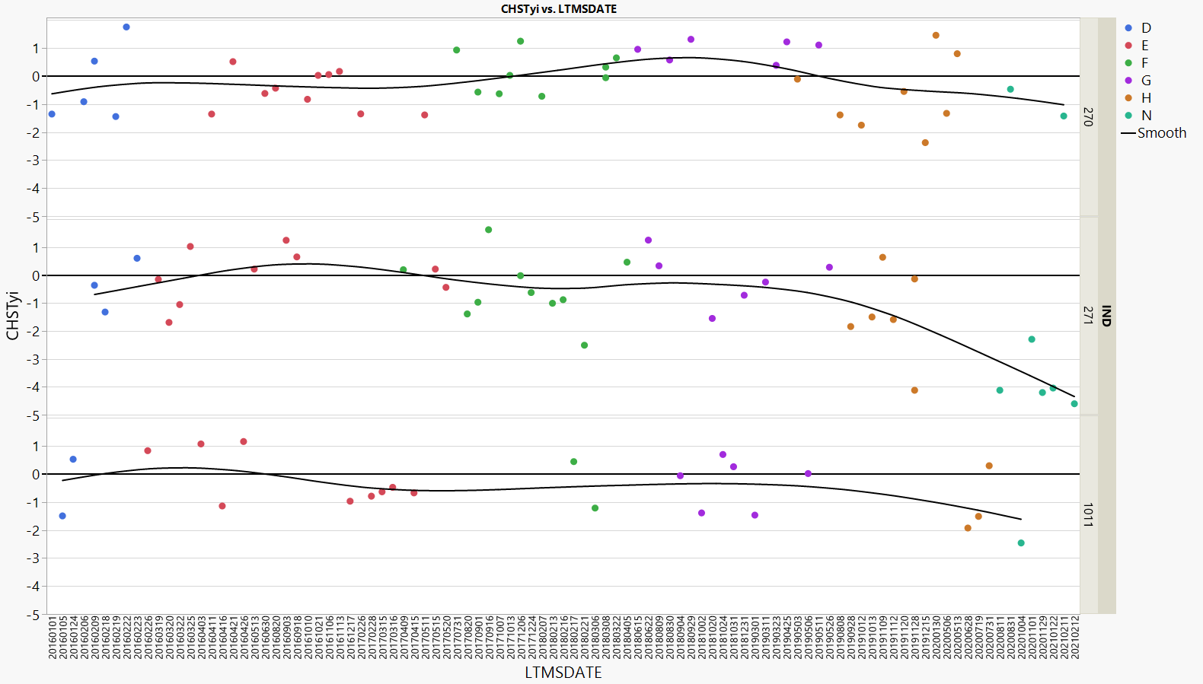
Fuel Batch
Some mild results have occurred with H batch of fuel, but most extreme mild results are with “N” batch (not sure about “N” designation).

Slide 6
Operational Data Review

Slide 7
The Data Set
Based on the EWMA, labs asked to submit tests both before and after the severity shift, going back to 09/01/2018
32 tests were collected for the analysis
  Lab A, 10 tests (4 test missing CAN data)
  Lab B, 4 tests (only reported a single ramp for Phase 1-2 Ramp and Phase 2-1 Ramp)
  Lab D, 2 tests
  Lab G, 16 tests (Reported every 6th ramp for the Phase 2-1 Ramp)

Slide 8
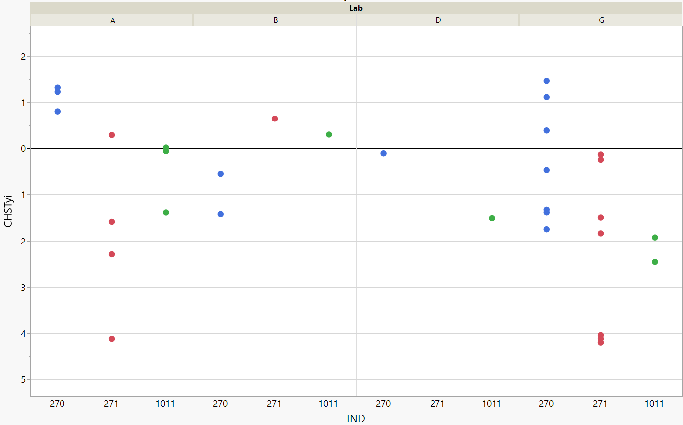
Chainstretch Yi
A plot of Chainstretch Yi is shown below for the tests in the analysis.

Slide 9
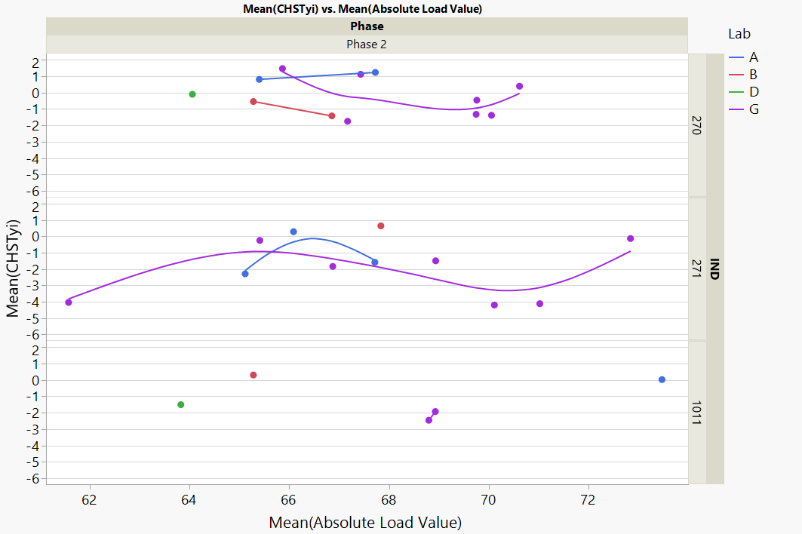
Plots Layout
Phase
Colored by Lab
EOT Chainstretch Yi
(Not actually an average. EOT CHST Yi was replicated on every row of each file.)
Ref. Oil
(Not all plots have this breakout)
Parameter of Interest

Slide 10
Phase 1- All Data

Slide 11
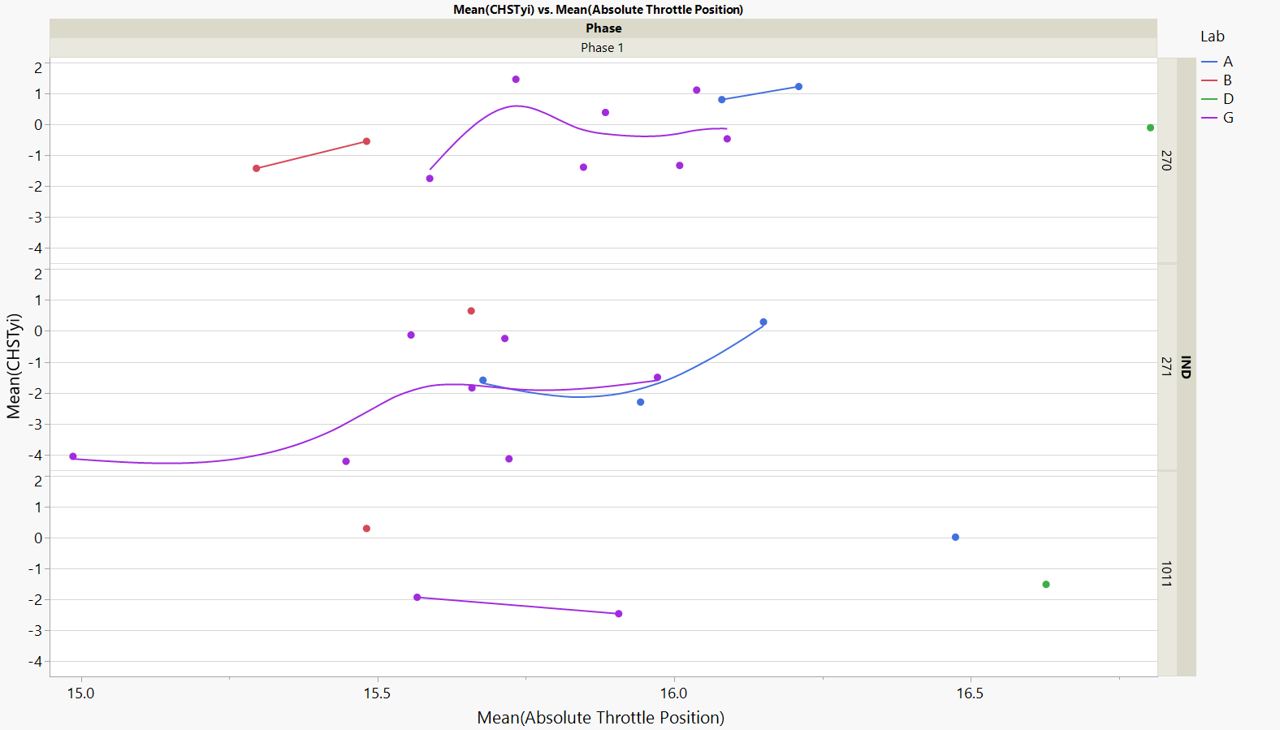
Chst. Vs. Absolute Throttle Position

Slide 12
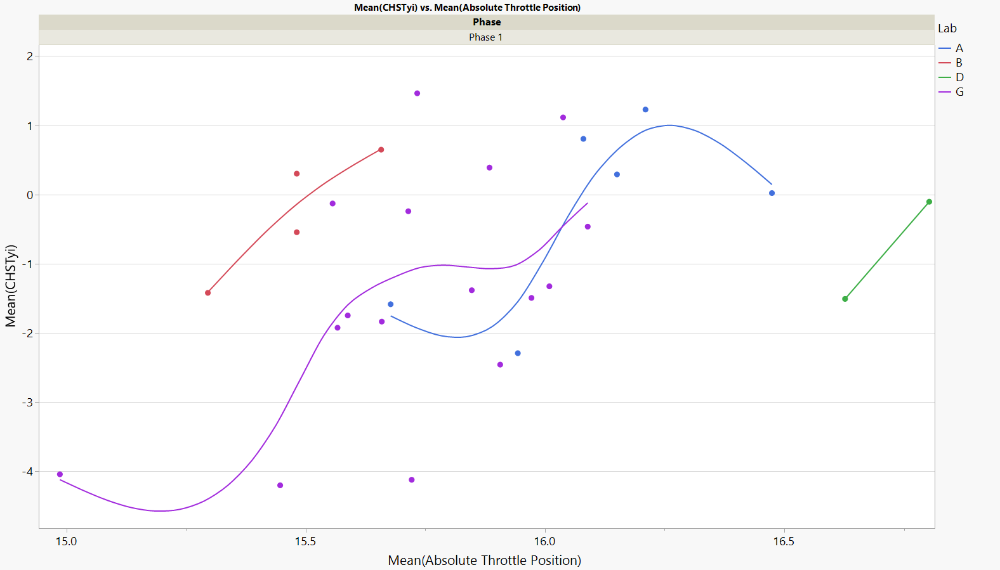
Chst. Vs. Absolute Throttle Position
Potential relationship with Absolute Throttle Position and Chainstretch.

Slide 13
Phase 2 - All Data

Slide 14
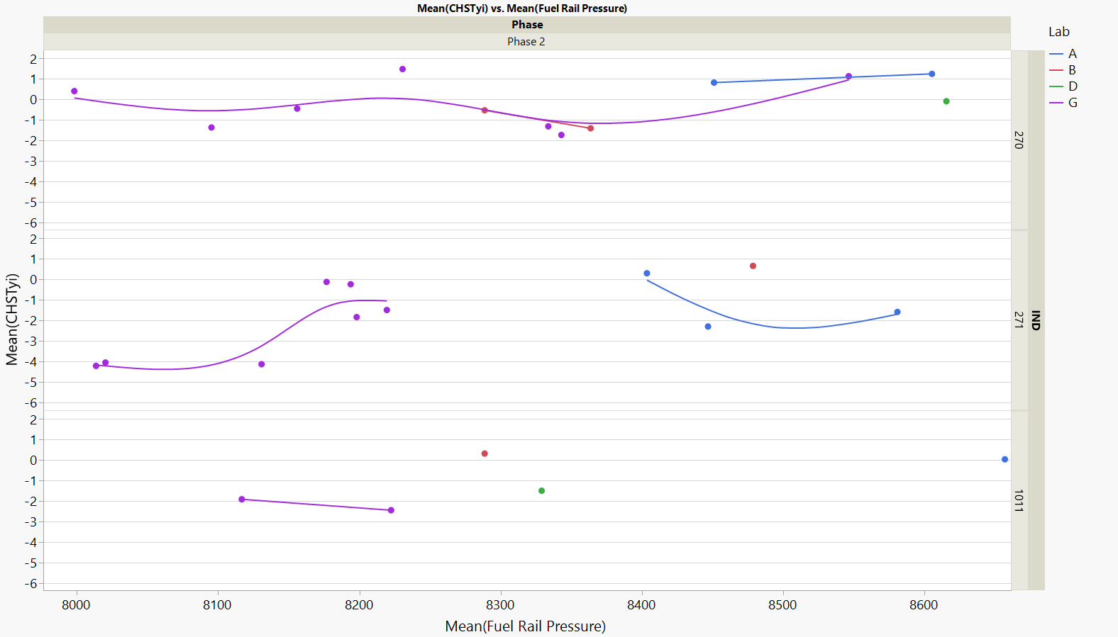
Chst. Vs. Fuel Rail Pressure
Potential relationship with Fuel Rail Pressure and Chainstretch.

Slide 15
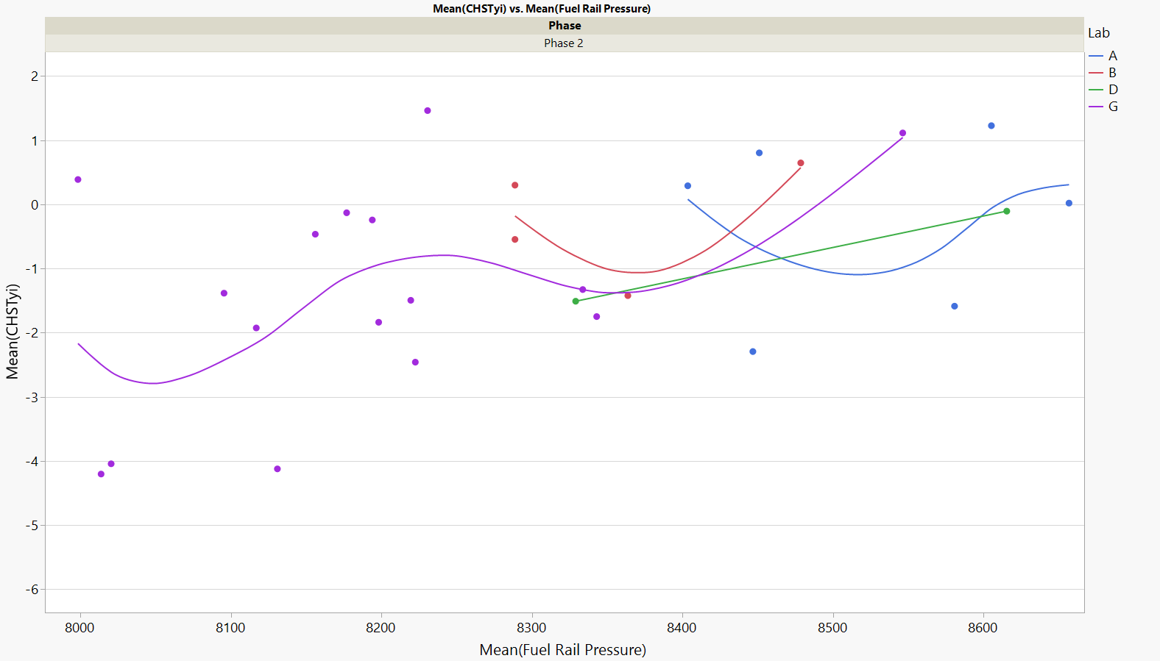
Chst. Vs. Fuel Rail Pressure
Potential relationship with Fuel Rail Pressure and Chainstretch.

Slide 16
Appendix 1
Phase 1 Average Plots

Slide 17
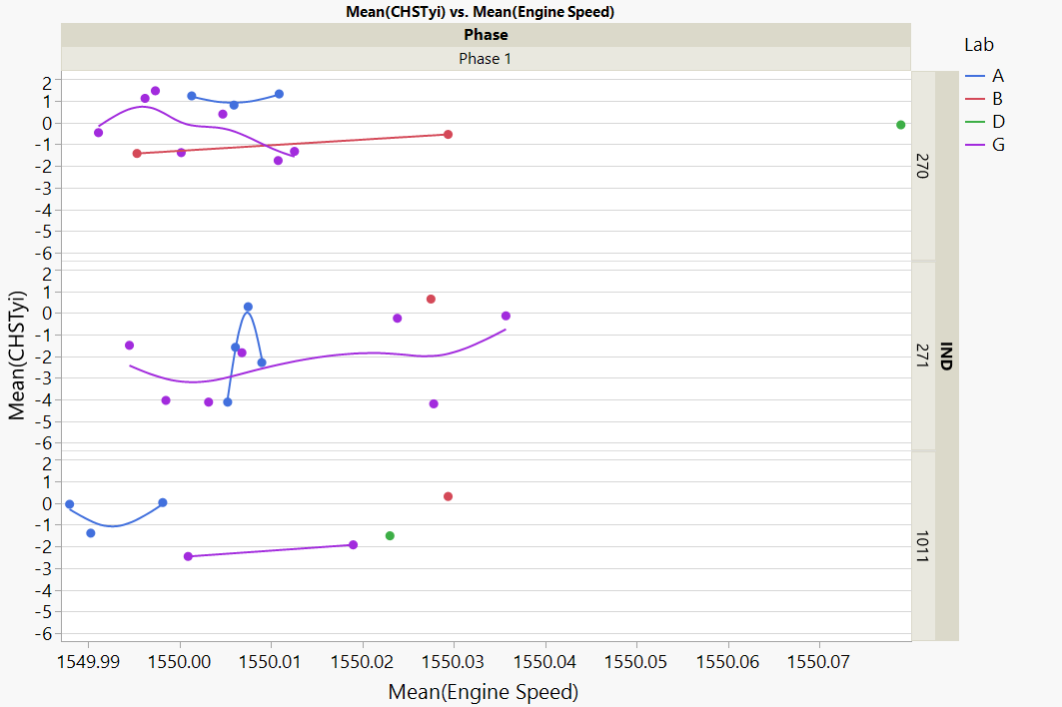
Chst. Vs. Engine Speed

Slide 18
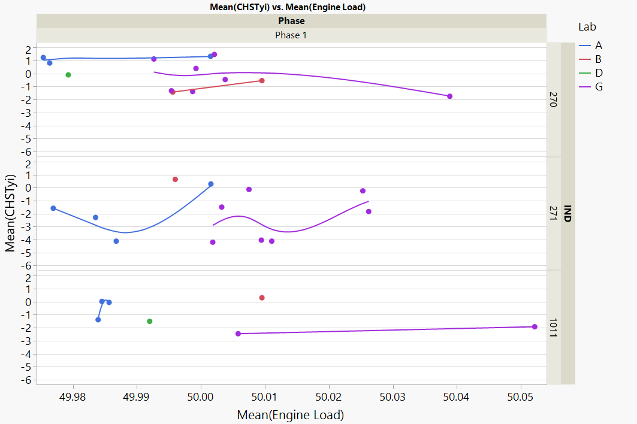
Chst. Vs. Engine Load

Slide 19
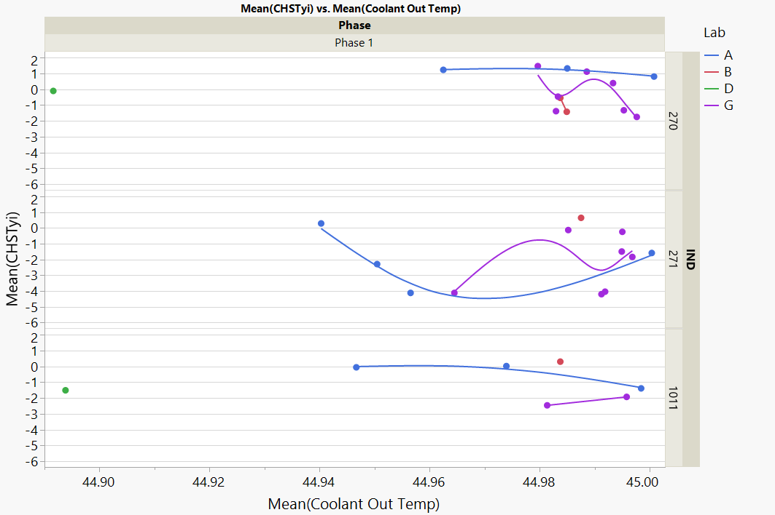
Chst. Vs. Coolant Out Temp

Slide 20
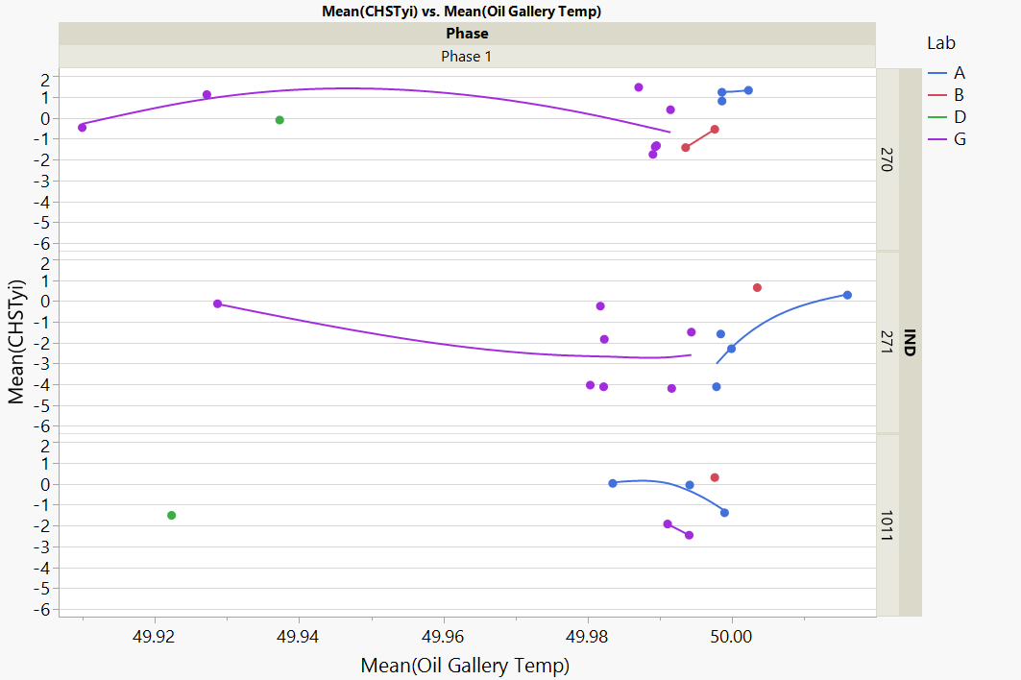
Chst. Vs. Oil Gallery Temp

Slide 21
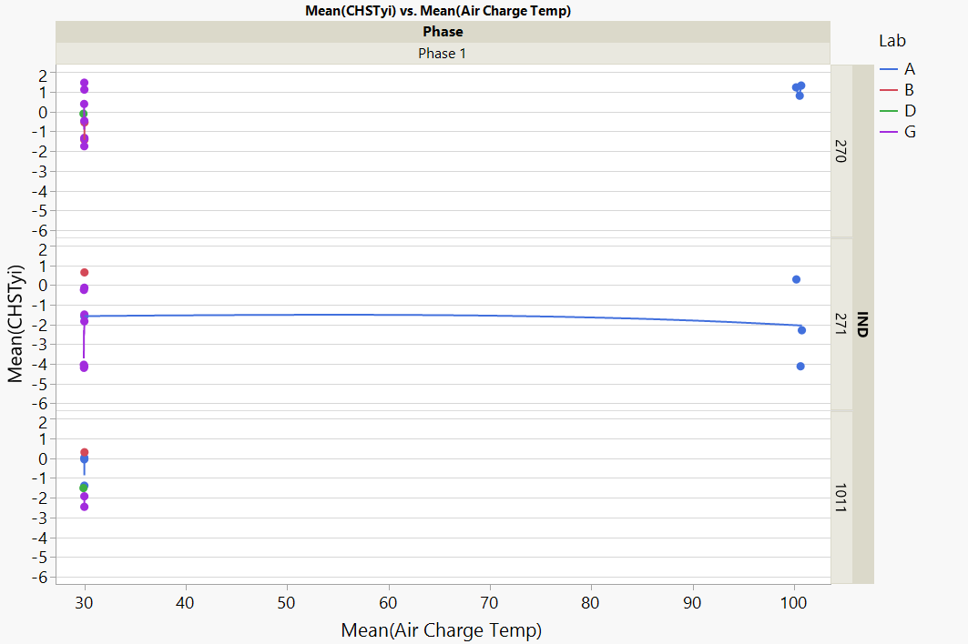
Chst. Vs. Air Charge Temp

Slide 22
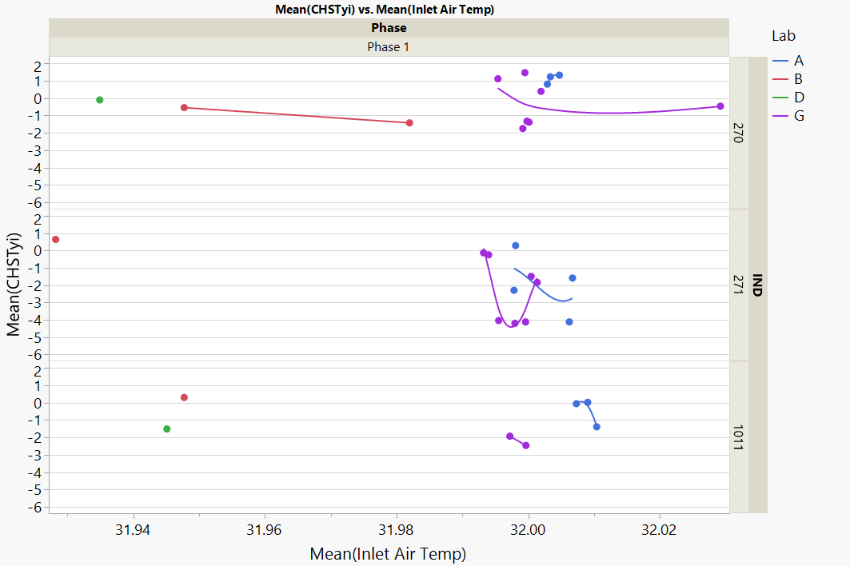
Chst. Vs. Inlet Air Temp

Slide 23
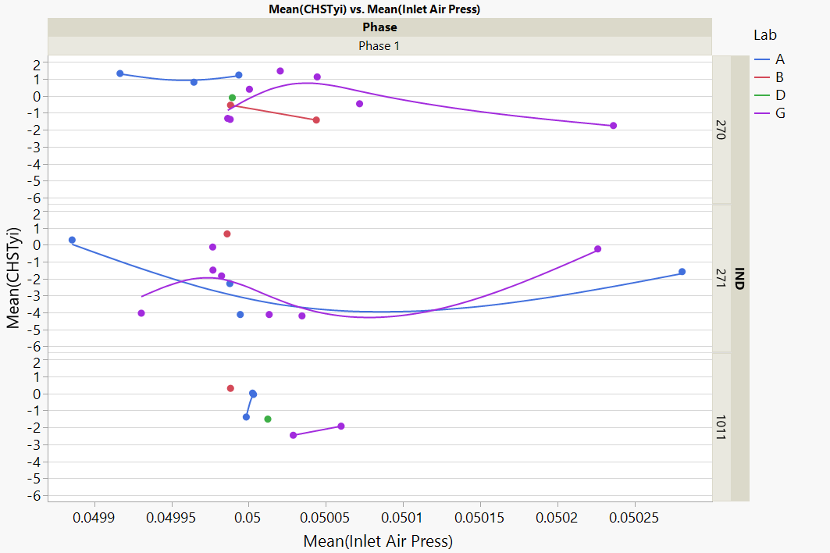
Chst. Vs. Inlet Air Pressure

Slide 24
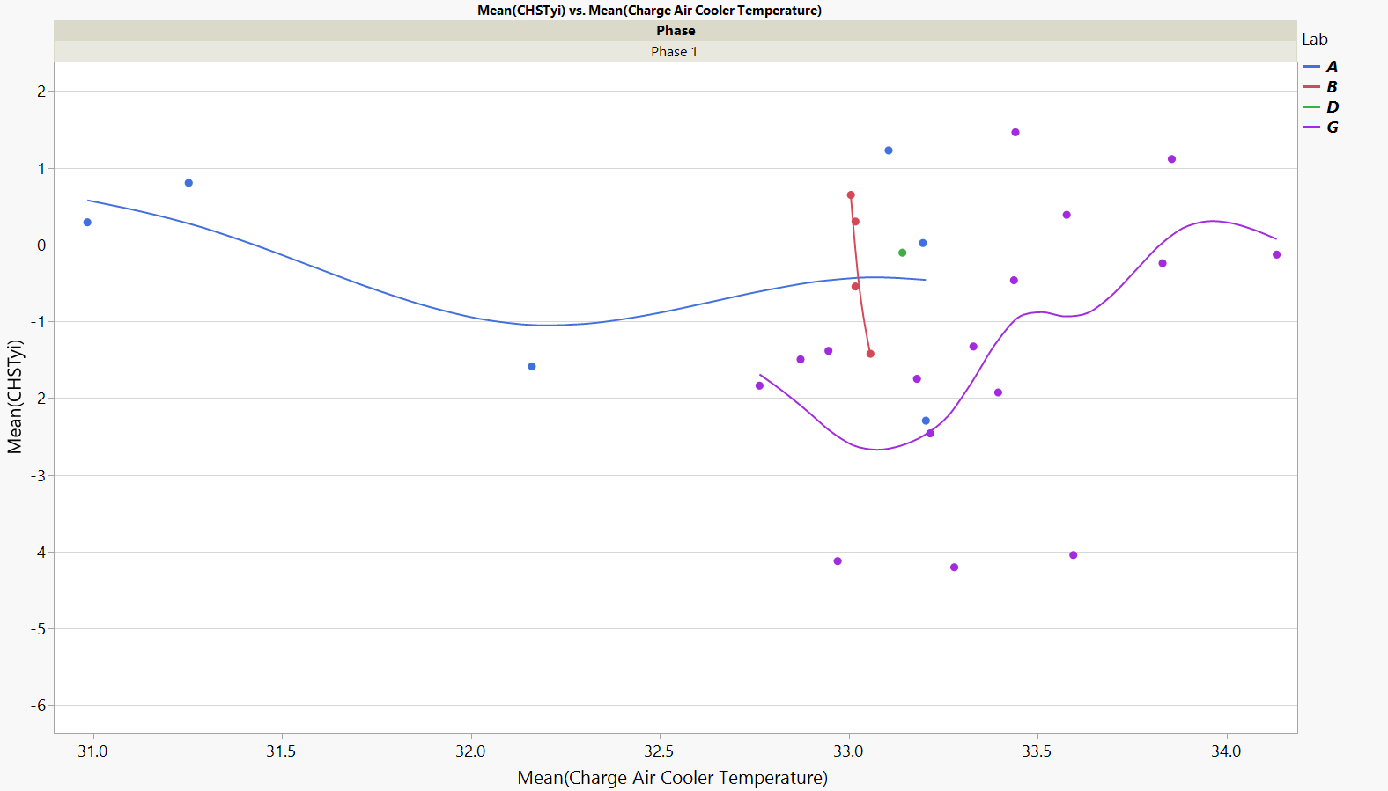
Chst. Vs. Charge Air Cooler Temp

Slide 25
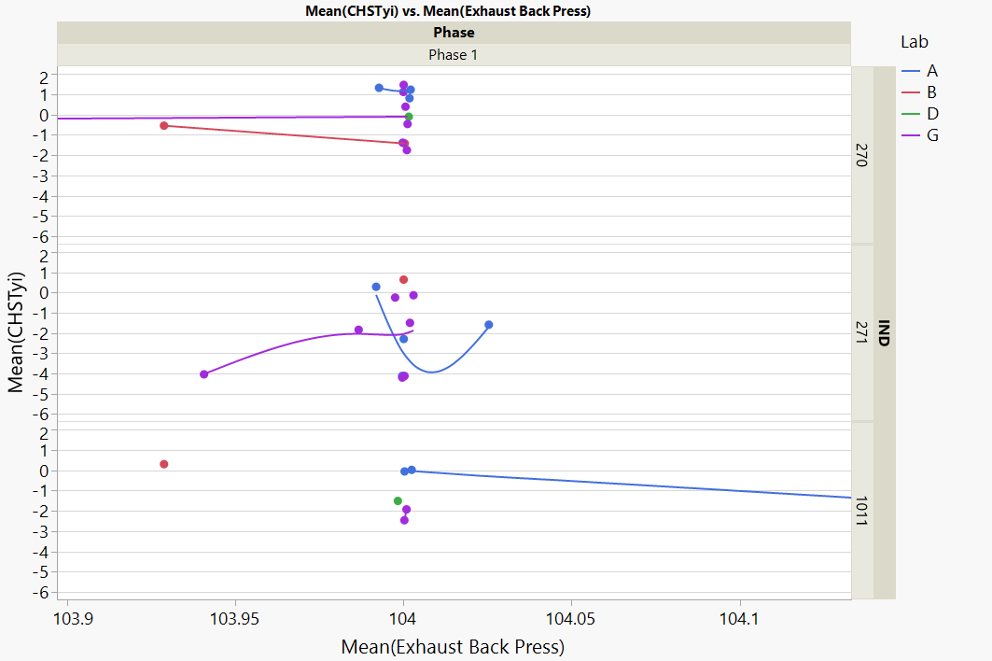
Chst. Vs. Exhaust Backpressure

Slide 26
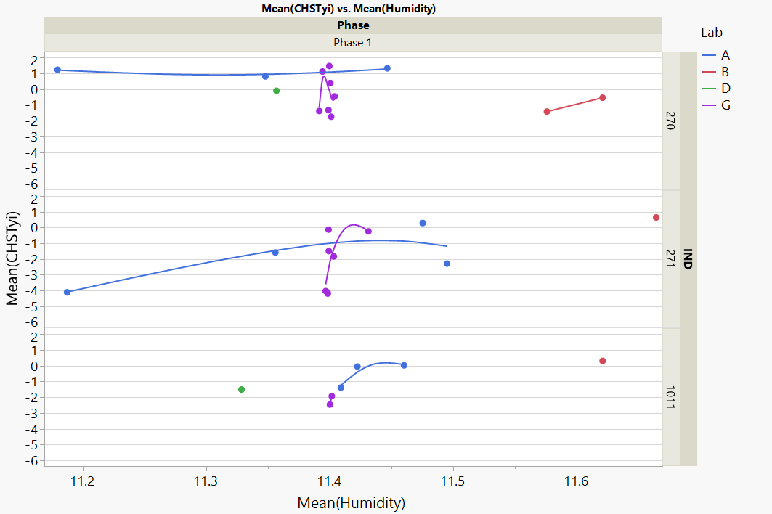
Chst. Vs. Humidity

Slide 27
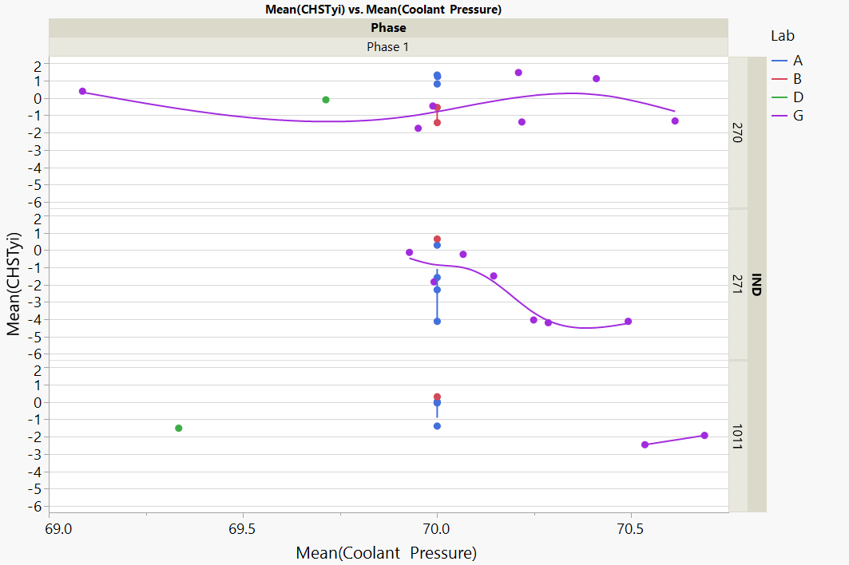
Chst. Vs. Coolant Pressure

Slide 28
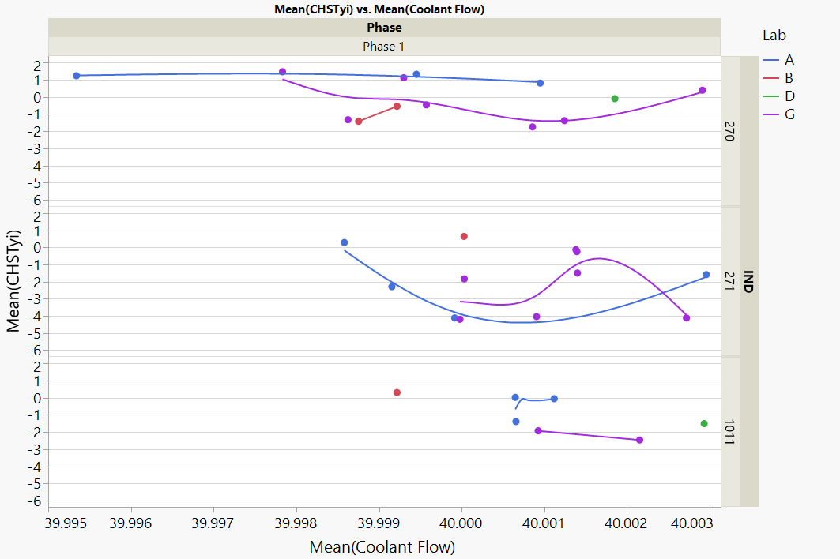
Chst. Vs. Coolant Flow

Slide 29
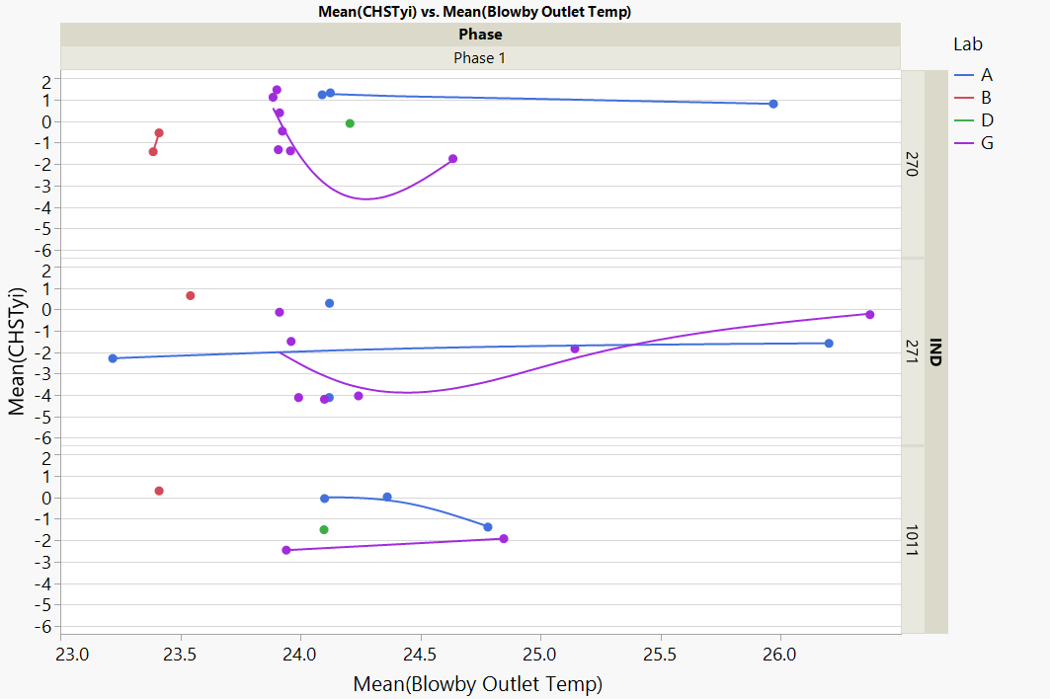
Chst. Vs. Blowby Outlet Temp

Slide 30
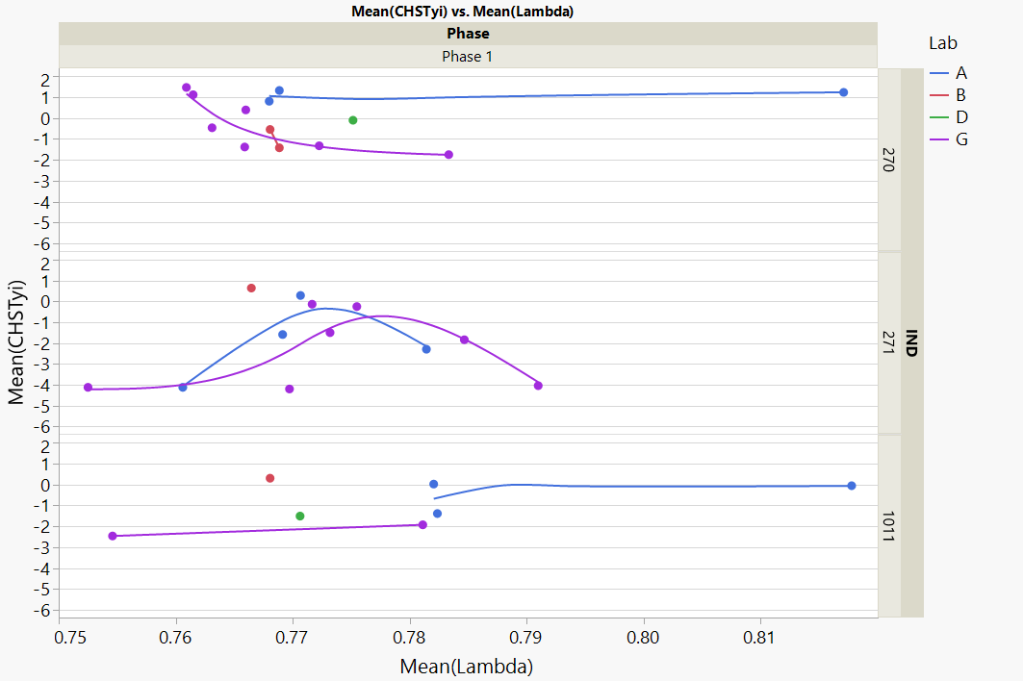
Chst. Vs. Lambda

Slide 31
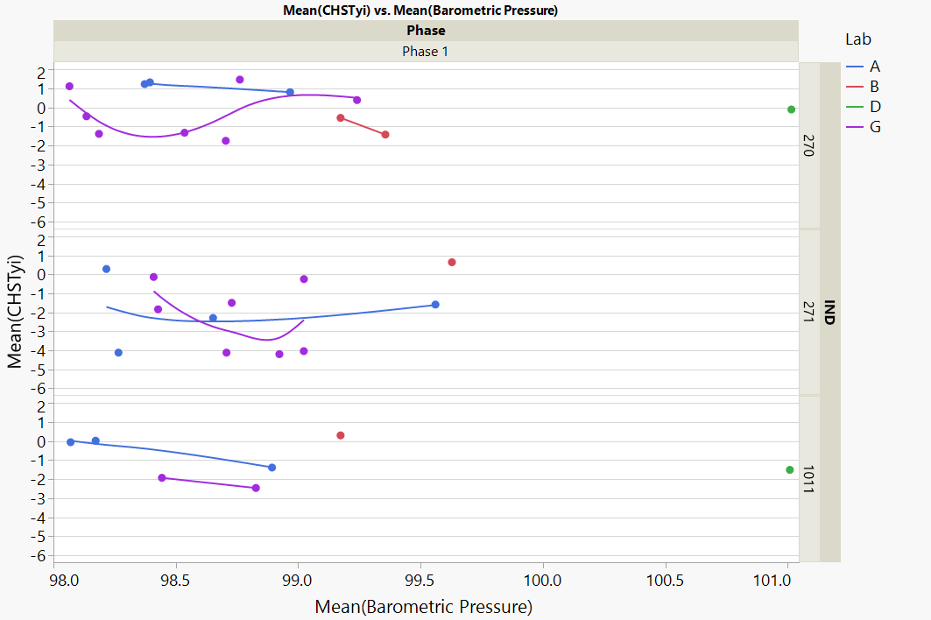
Chst. Vs. Barometric Pressure

Slide 32
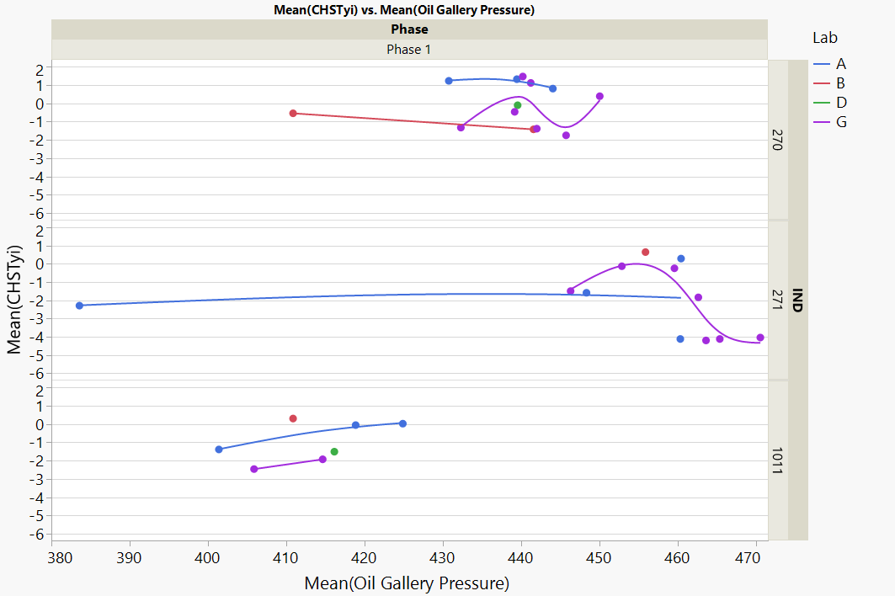
Chst. Vs. Oil Gallery Pressure

Slide 33
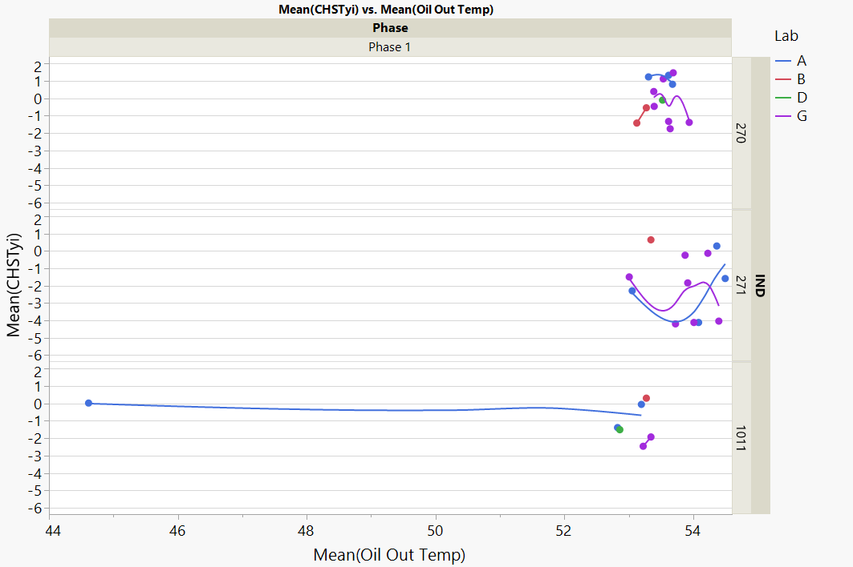
Chst. Vs. Oil Out Temp

Slide 34
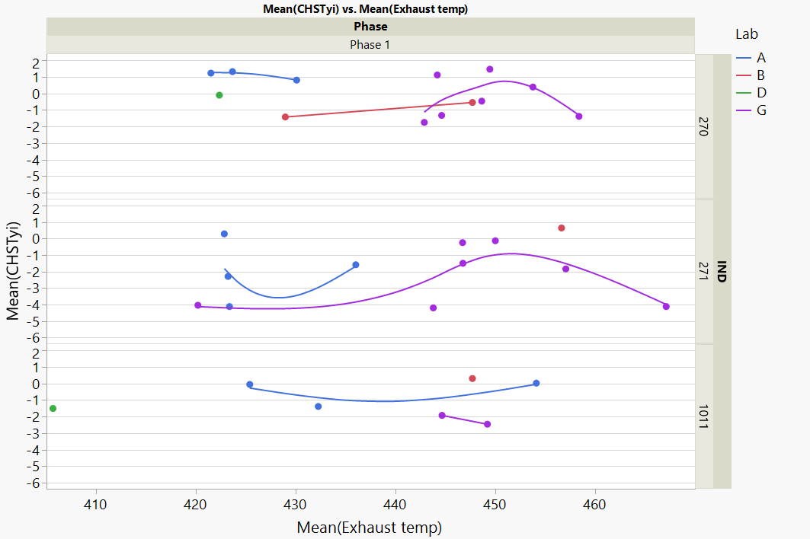
Chst. Vs. Exhaust Temp

Slide 35
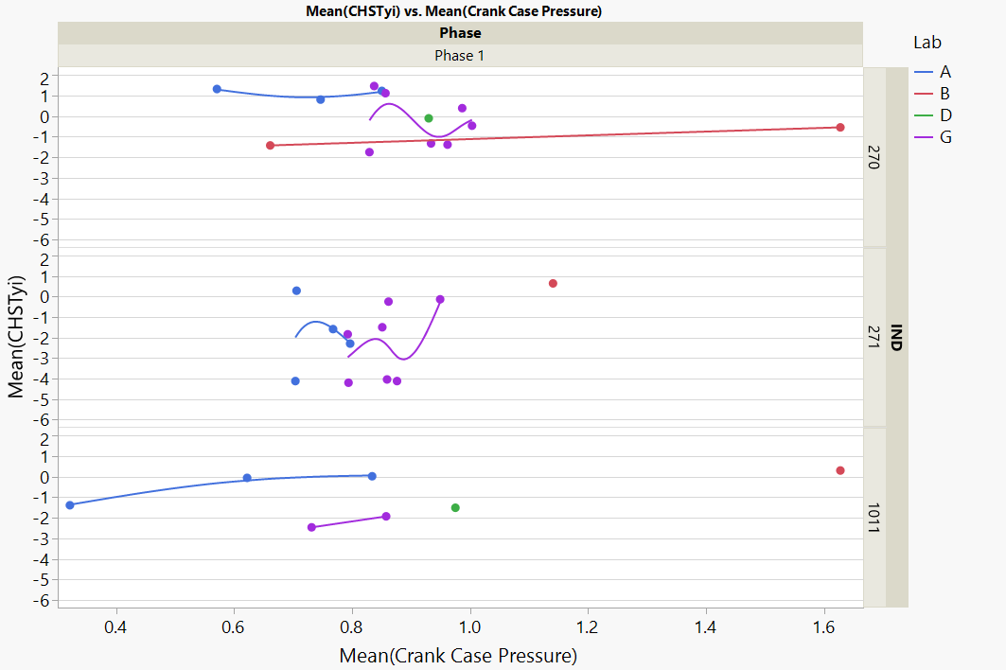
Chst. Vs. Crankcase Pressure

Slide 36
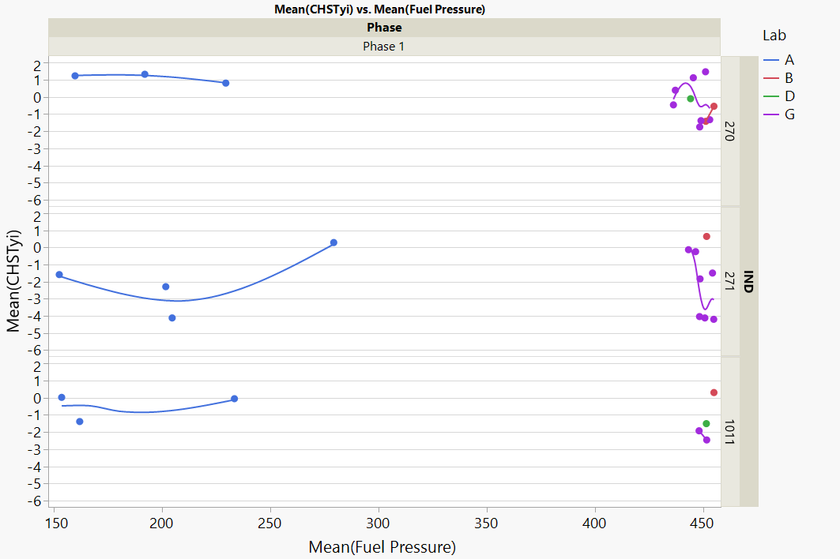
Chst. Vs. Fuel Pressure

Slide 37
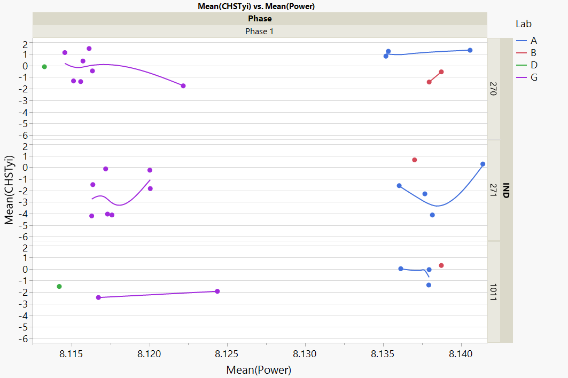
Chst. Vs. Power

Slide 38
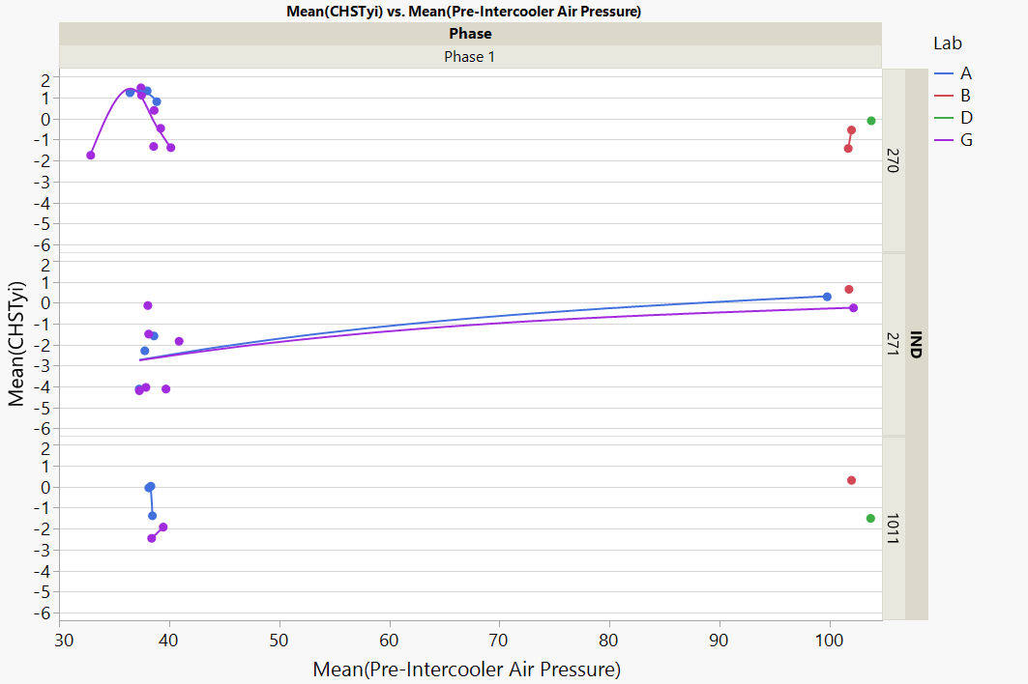
Chst. Vs. Pre-Intercooler Air Pressure

Slide 39
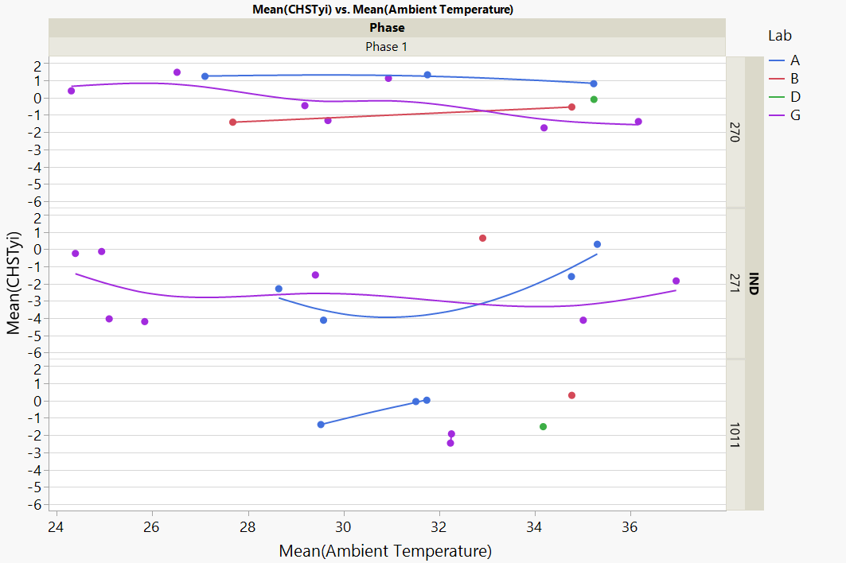
Chst. Vs. Ambient Temp

Slide 40
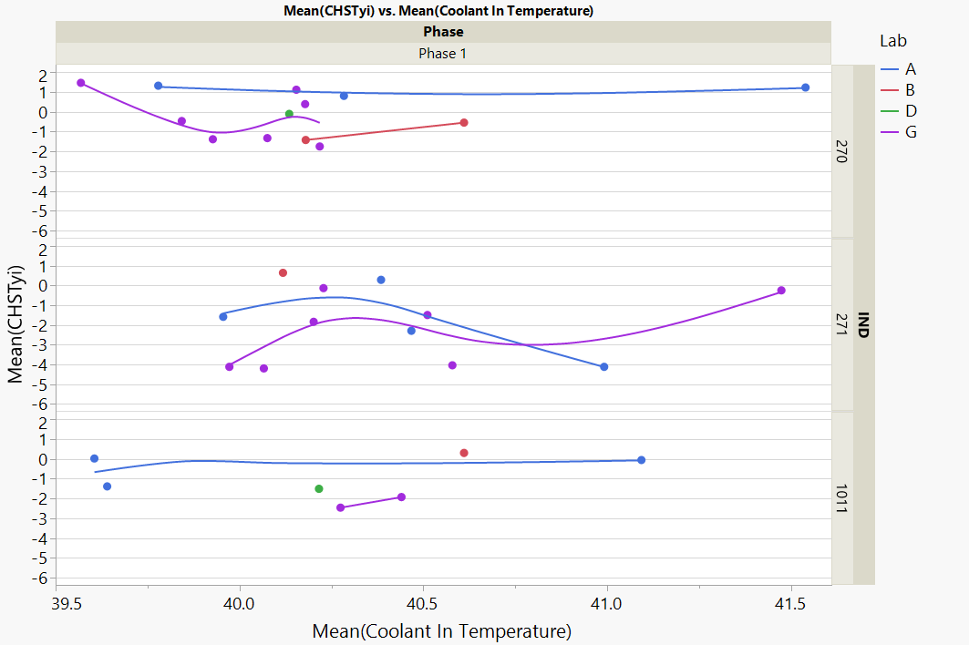
Chst. Vs. Coolant In Temp

Slide 41
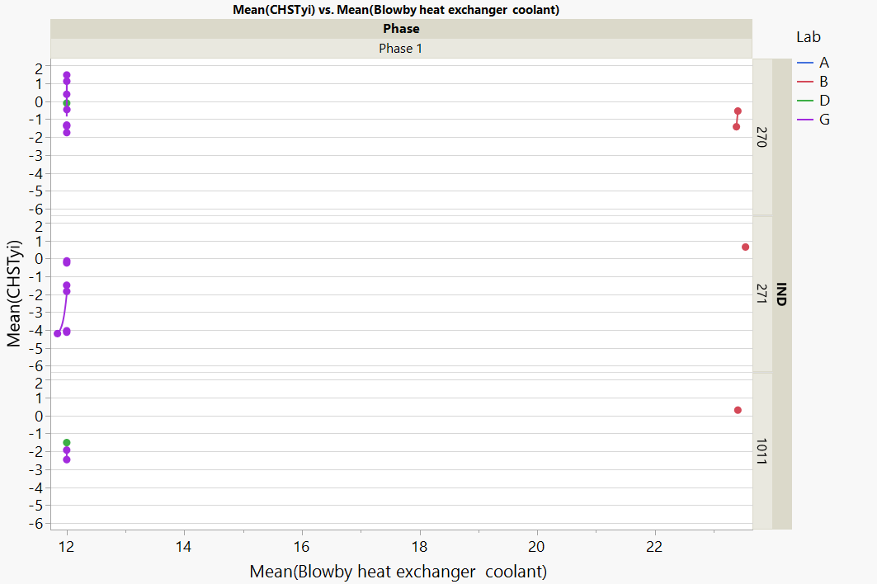
Chst. Vs. Blowby Heat Exchanger Coolant

Slide 42
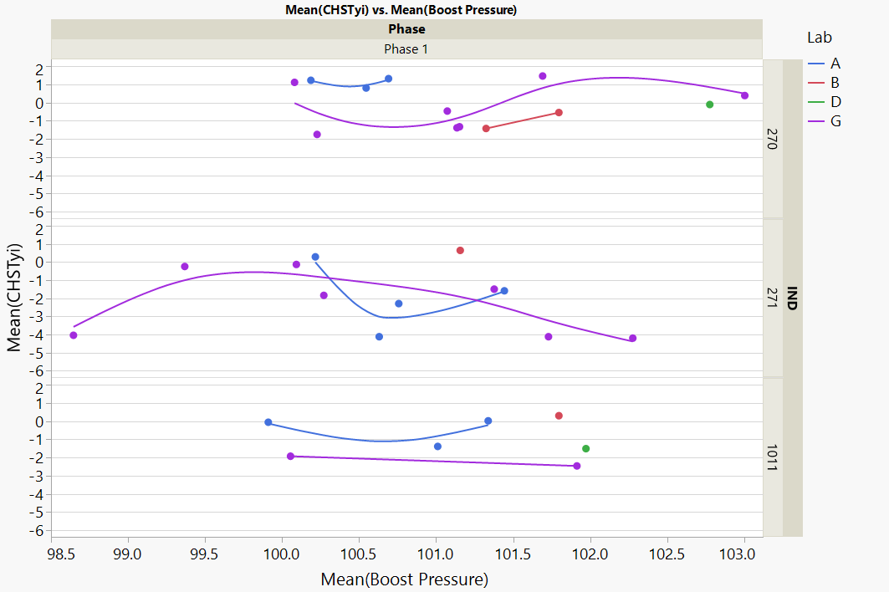
Chst. Vs. Boost Pressure

Slide 43
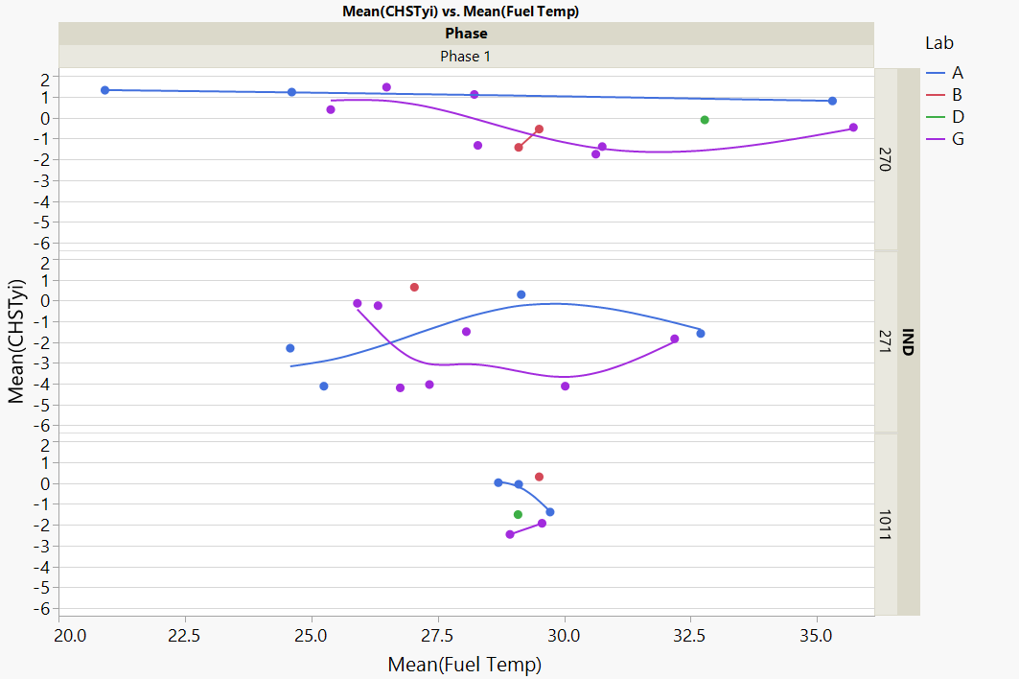
Chst. Vs. Fuel Temp

Slide 44
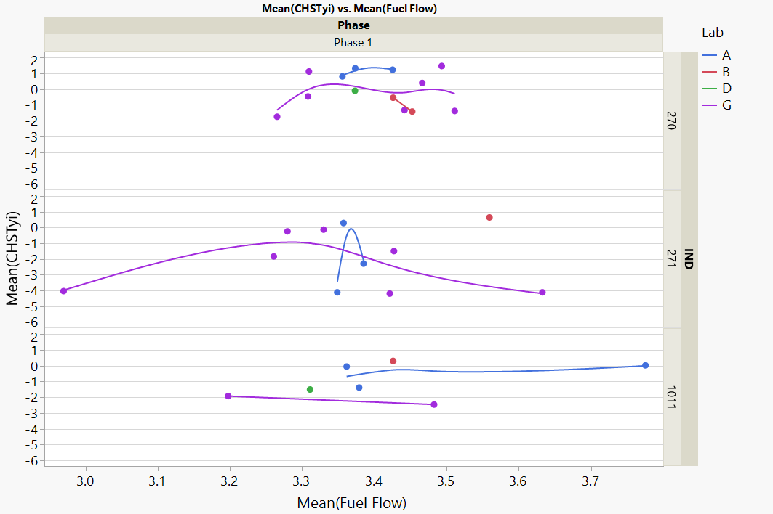
Chst. Vs. Fuel Flow

Slide 45
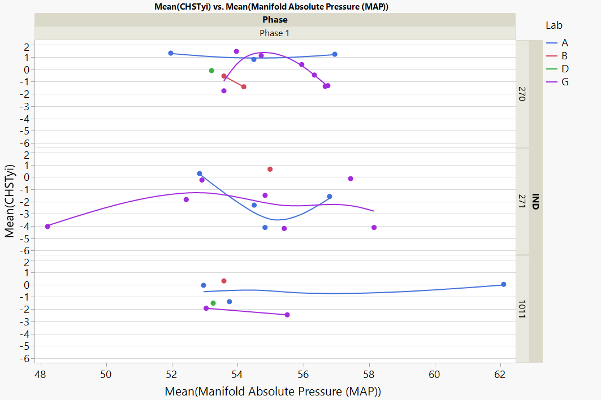
Chst. Vs. Manifold Absolute Pressure

Slide 46
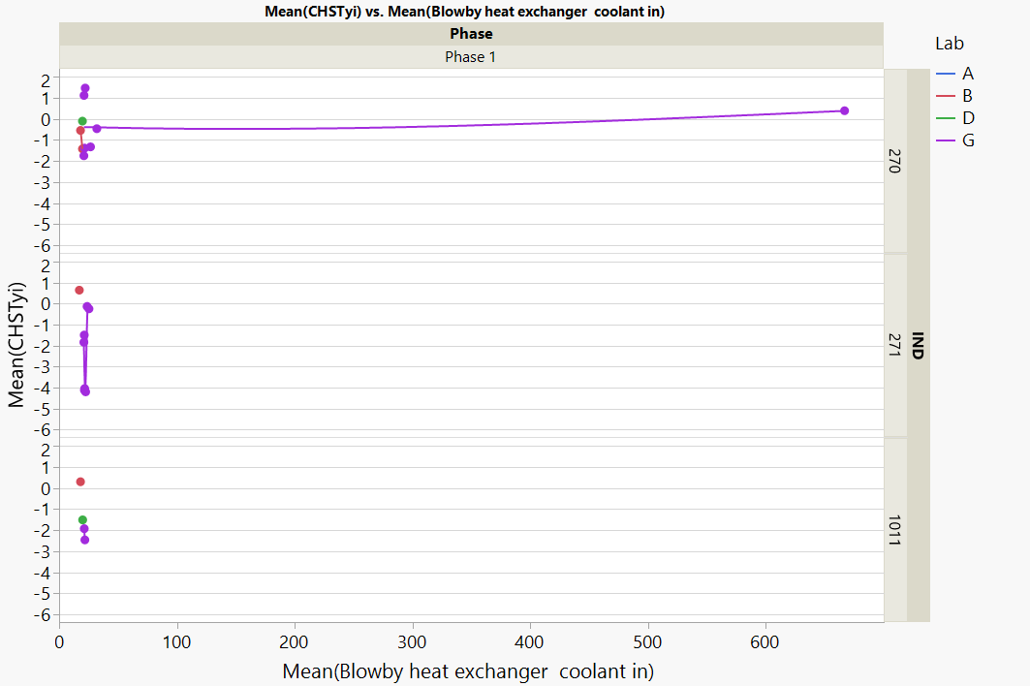
Chst. Vs. Blowby Heat Exchanger Coolant In

Slide 47
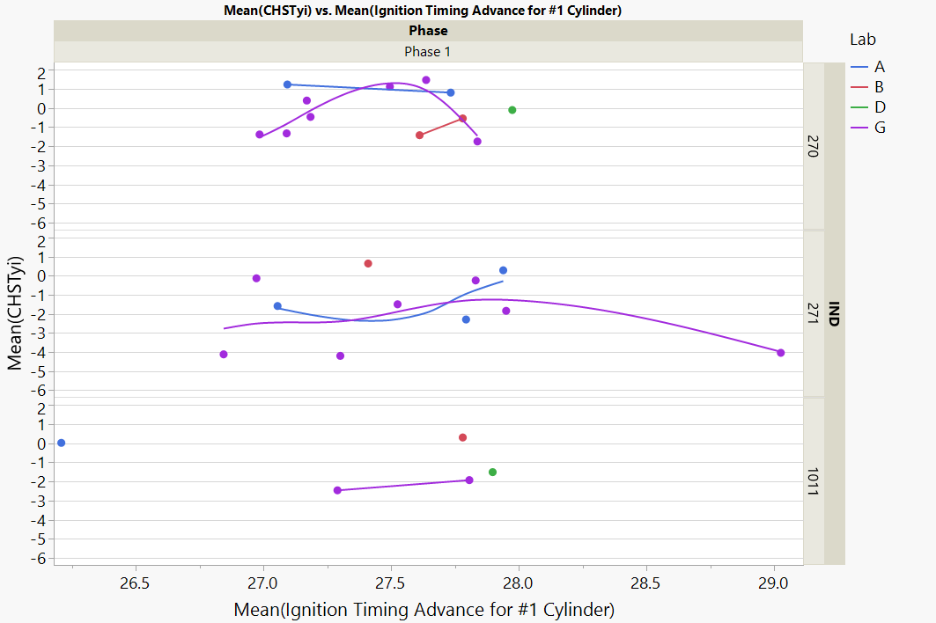
Chst. Vs. Ignition Timing Advance Cyl. #1

Slide 48
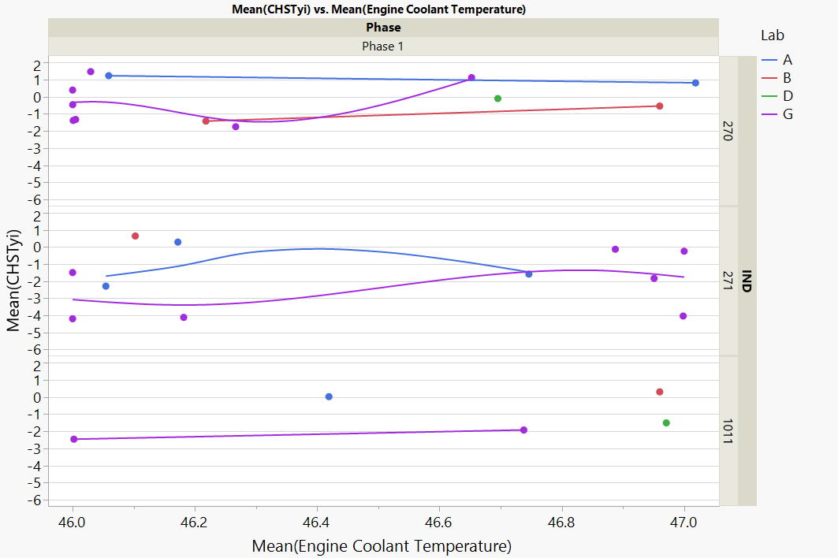
Chst. Vs. Engine Coolant Temp

Slide 49
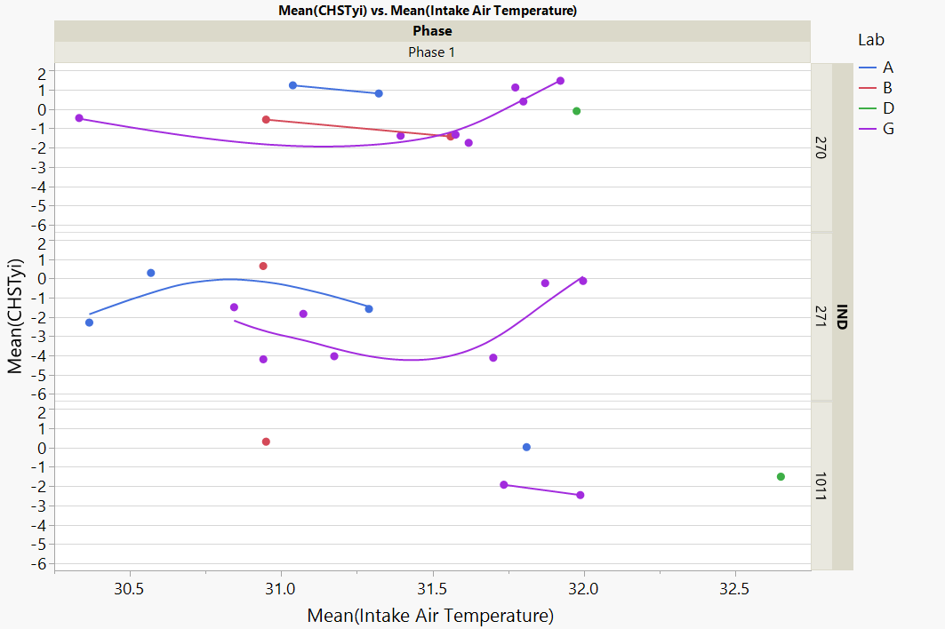
Chst. Vs. Intake Air Temp

Slide 50
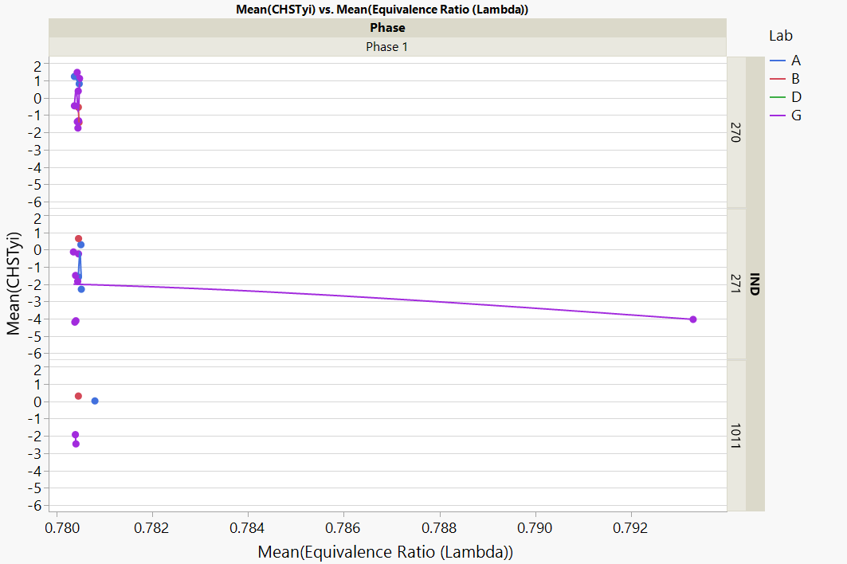
Chst. Vs. Equivalence Ratio (Lambda)

Slide 51
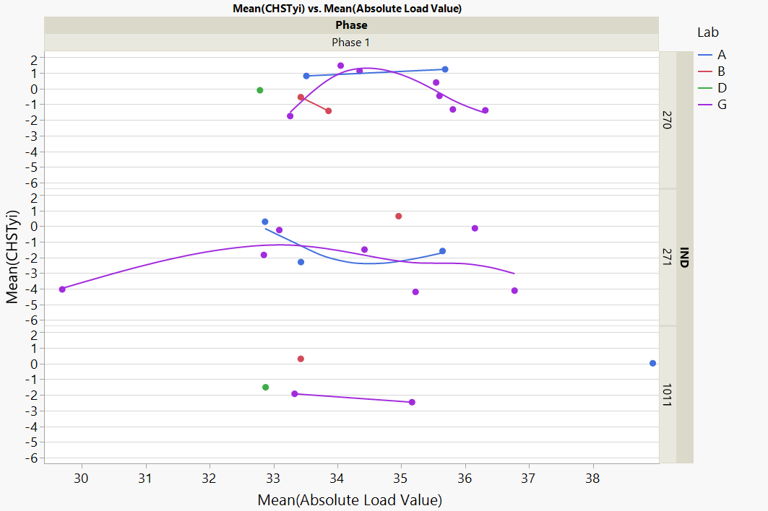
Chst. Vs. Absolute Load Value

Slide 52
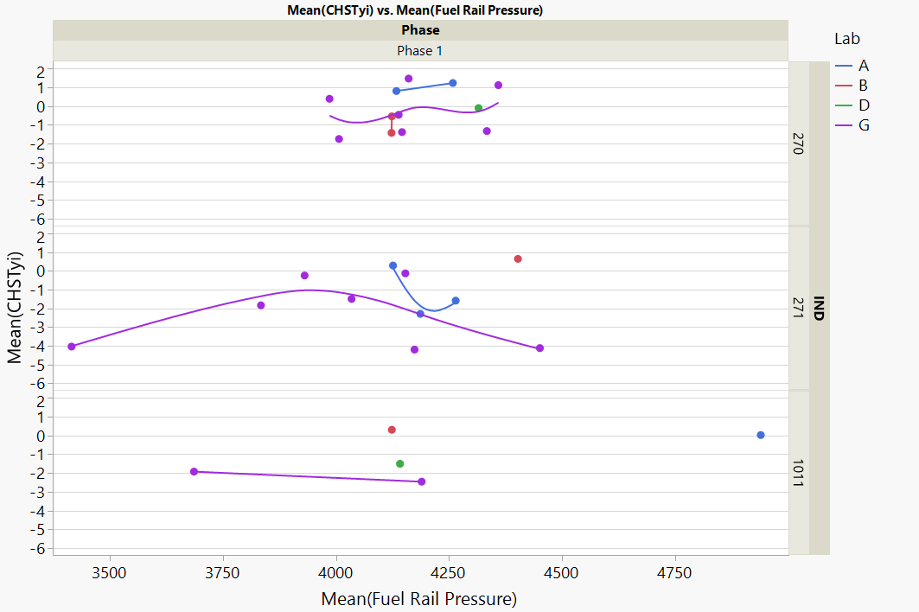
Chst. Vs. Fuel Rail Pressure

Slide 53
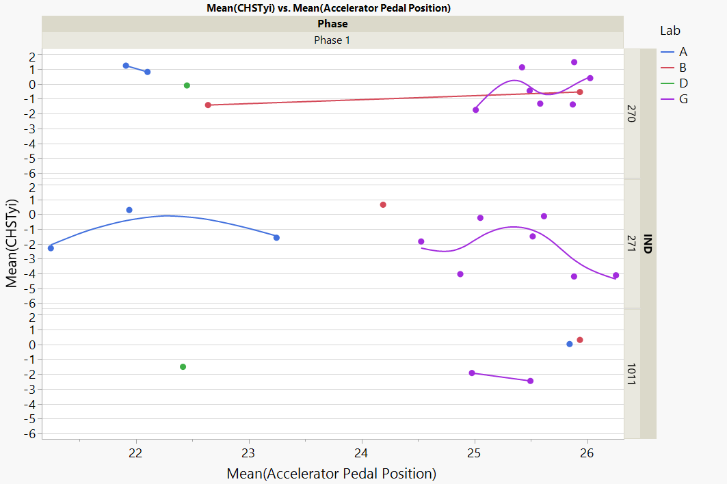
Chst. Vs. APP

Slide 54
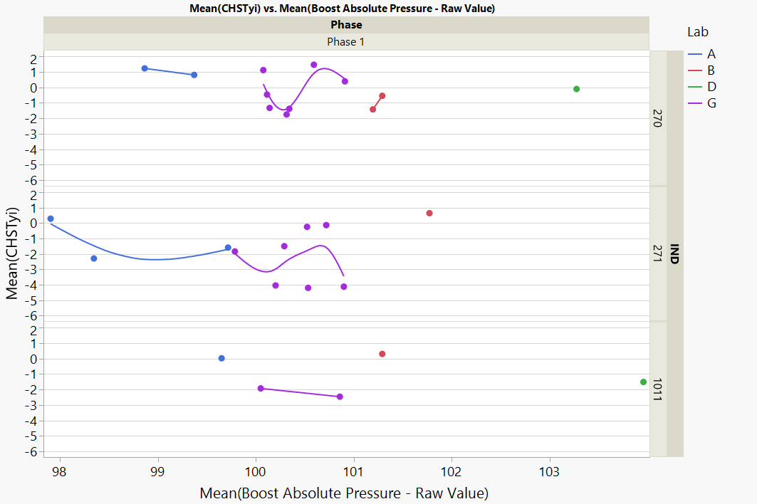
Chst. Vs. Boost Absolute Pressure – Raw Value

Slide 55

Chst. Vs. Turbocharger Wastegate Duty Cycle

Slide 56

Chst. Vs. Actual Intake (A) Camshaft Position

Slide 57

Chst. Vs. Actual Exhaust (B) Camshaft Position

Slide 58

Chst. Vs. Exhaust (B) Camshaft Position Actuator Duty Cycle

Slide 59

Chst. Vs. Charge Air Cooler Temp

Slide 60
Appendix 2
Phase 2 Average Plots

Slide 61

Chst. Vs. Engine Speed

Slide 62

Chst. Vs. Engine Load

Slide 63

Chst. Vs. Coolant Out Temp

Slide 64

Chst. Vs. Oil Gallery Temp

Slide 65

Chst. Vs. Air Charge Temp

Slide 66

Chst. Vs. Inlet Air Temp

Slide 67

Chst. Vs. Inlet Air Pressure

Slide 68

Chst. Vs. Exhaust Backpressure

Slide 69

Chst. Vs. Humidity

Slide 70

Chst. Vs. Coolant Pressure

Slide 71

Chst. Vs. Coolant Flow

Slide 72

Chst. Vs. Blowby Outlet Temp

Slide 73

Chst. Vs. Lambda

Slide 74

Chst. Vs. Barometric Pressure

Slide 75

Chst. Vs. Oil Gallery Pressure

Slide 76

Chst. Vs. Oil Head Pressure

Slide 77

Chst. Vs. Oil Out Temp

Slide 78

Chst. Vs. Exhaust Temp

Slide 79

Chst. Vs. Crankcase Pressure

Slide 80

Chst. Vs. Fuel Pressure

Slide 81

Chst. Vs. Power

Slide 82

Chst. Vs. Pre-Intercooler Air Pressure

Slide 83

Chst. Vs. Ambient Temperature

Slide 84

Chst. Vs. Coolant In Temperature

Slide 85

Chst. Vs. Blowby Heat Exchanger Coolant

Slide 86

Chst. Vs. Boost Pressure

Slide 87

Chst. Vs. Fuel Temperature

Slide 88

Chst. Vs. Fuel Flow

Slide 89

Chst. Vs. Manifold Absolute Pressure

Slide 90

Chst. Vs. Blowby Heat Exchanger Coolant In

Slide 91

Chst. Vs. Ignition Timing Advance for Cyl. #1

Slide 92

Chst. Vs. Absolute Thottle Position

Slide 93

Chst. Vs. Engine Coolant Temp

Slide 94

Chst. Vs. Intake Air Temp

Slide 95

Chst. Vs. Equivalence Ratio (Lambda)

Slide 96
Chst. Vs. Absolute Load Value

Slide 97

Chst. Vs. Intake Manifold Absolute Pressure

Slide 98

Chst. Vs. APP

Slide 99

Chst. Vs. Boost Absolute Pressure – Raw Value

Slide 100

Chst. Vs. Turbocharger Wastegate Duty Cycle

Slide 101

Chst. Vs. Actual Intake (A) Camshaft Position

Slide 102

Chst. Vs. Actual Exhaust (B) Camshaft Position

Slide 103

Chst. Vs. Exhaust (B) Camshaft Position Actuator Duty Cycle

Slide 104

Chst. Vs. Charge Air Cooler Temp

