Slide 1
Chain Wear Precision Matrix Operational Data Plots
Kevin O’Malley
The Lubrizol Corporation
September 9, 2016

Slide 2
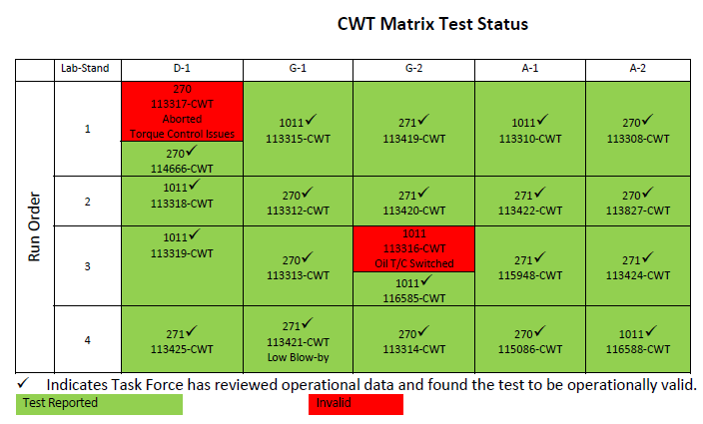
Precision Matrix
20 chain wear tests conducted as a part of the precision matrix
1 post-matrix Lab A (stand 1) test has also been included (testkey 118394)
Table included in Frank Farber’s June 7, 2016
Matrix update

Slide 3
Operational Data Plots
Analytical results are shown followed by operational test parameters
Both the analytical and operational data are each shown in alphabetical order.
For each of the analyticals, the following plots are provided
Each test in its own pane, measurements from samples taken throughout each test, symbols by oil, and data colored by chain wear result
Each lab in its own pane with data colored by chain wear result
Each oil in its own pane with data colored by chain wear result
For each operational parameter, raw operational data are plotted for the phases separately (order: PH1, PH1-2, PH2, PH2-1)
Within each phase, tests are plotted in separate panes with data colored by chain wear result
A plot of all tests is followed by similar plots separated by oil
Plots are shown with cycles overlaid on one another using Step Time as the x-axis as well as the cycles shown concurrently
For each operational parameter, the raw data is summarized by phase (average, median, and standard deviation)
Chain wear is plotted versus the various summarized data for the phases separately

Slide 4
Analytical Plots

Slide 5
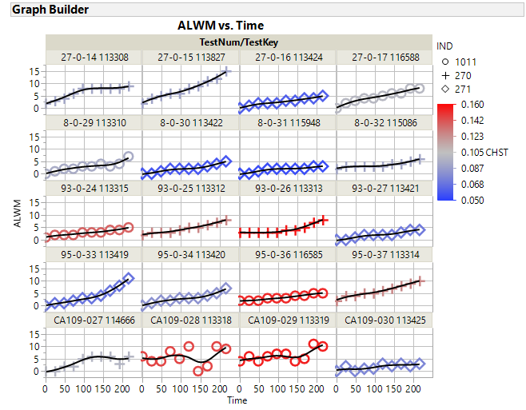

Slide 6
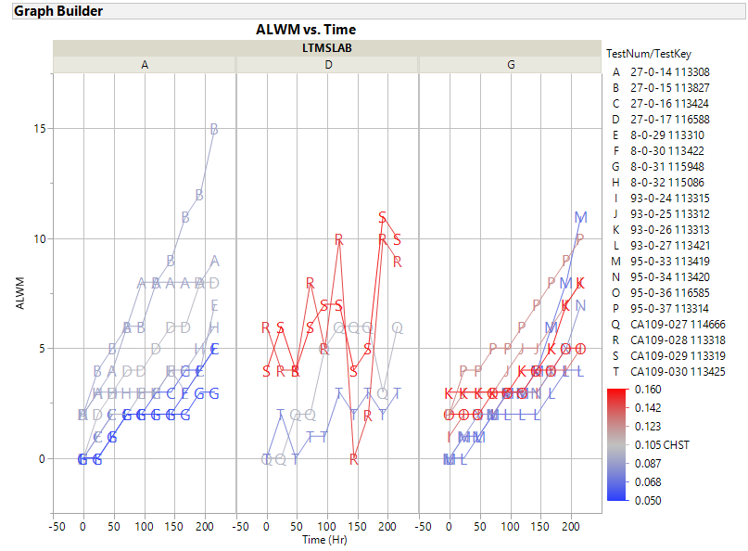

Slide 7
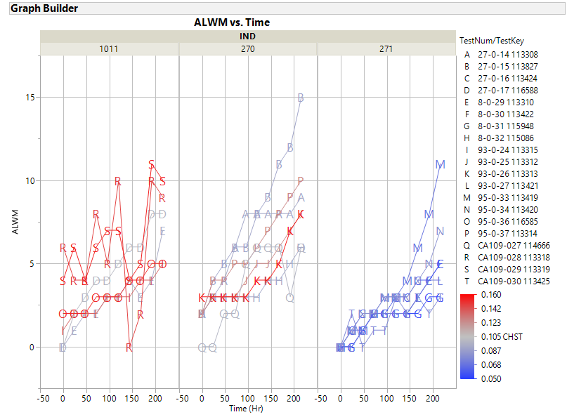

Slide 8
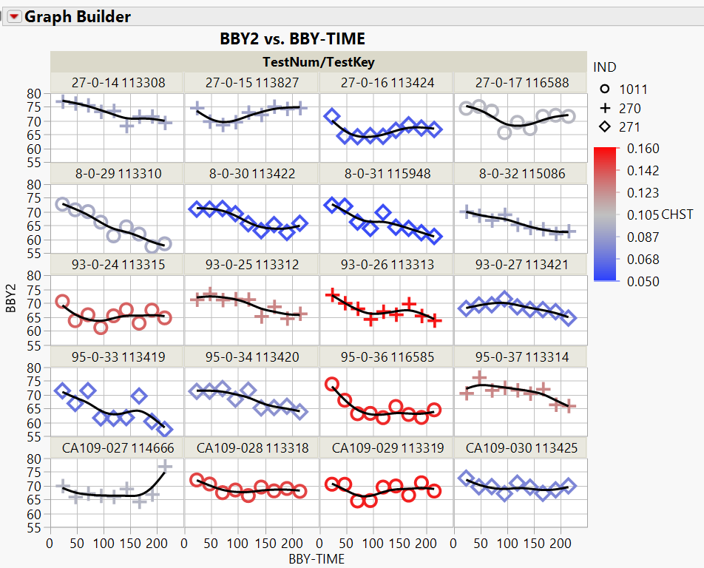

Slide 9
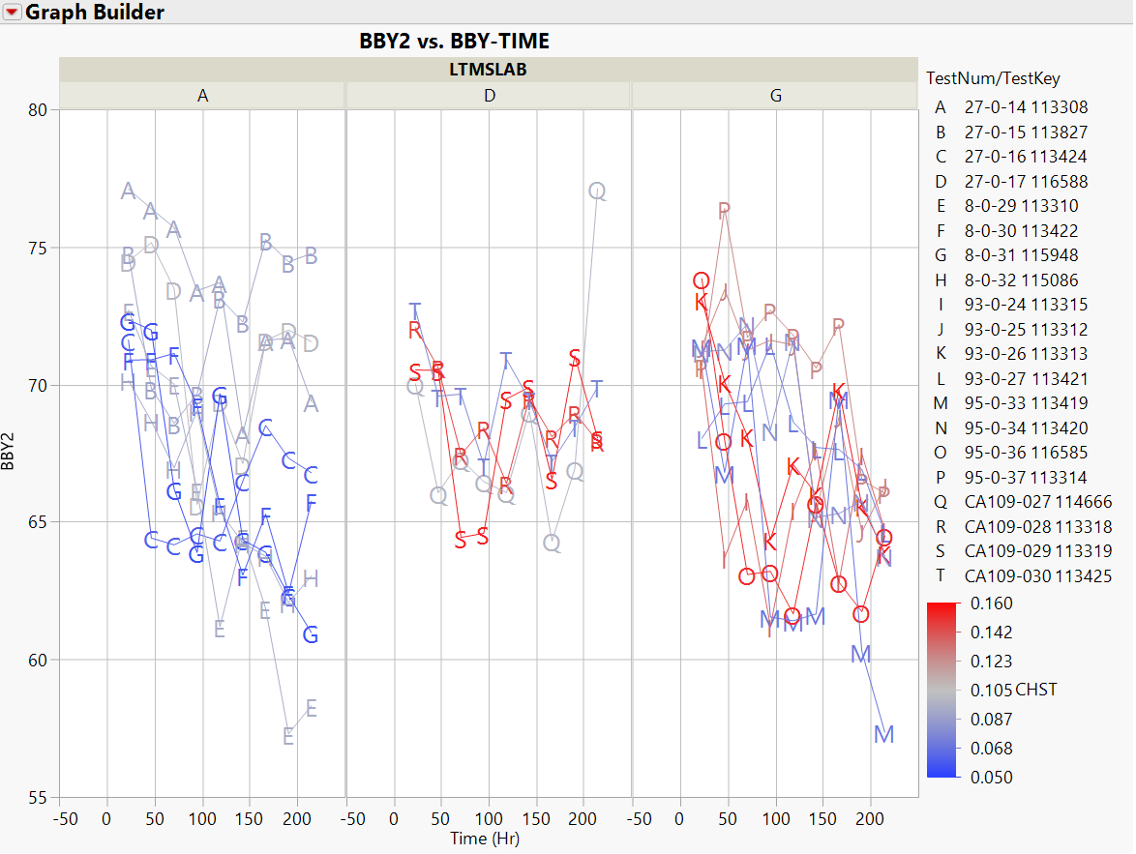

Slide 10
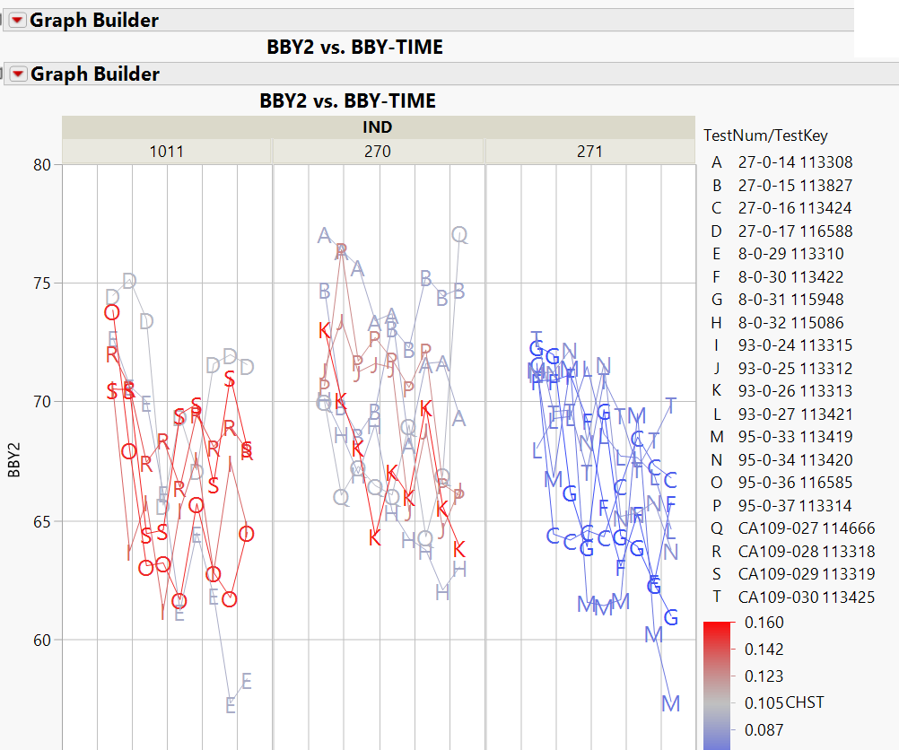

Slide 11
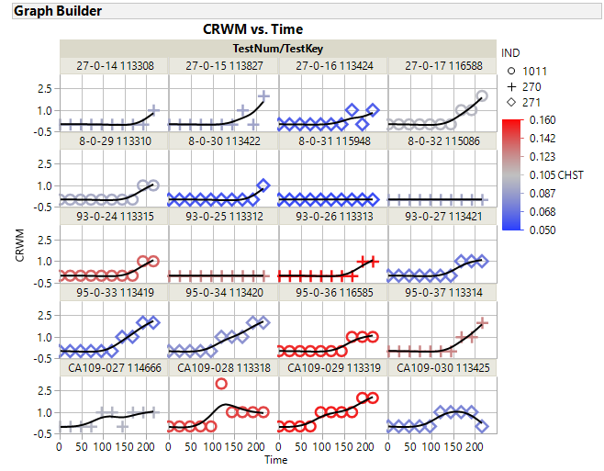

Slide 12
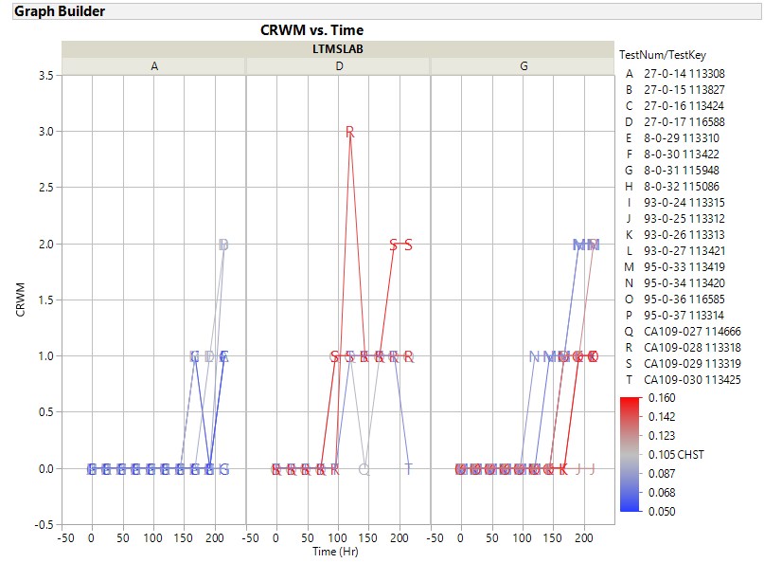

Slide 13
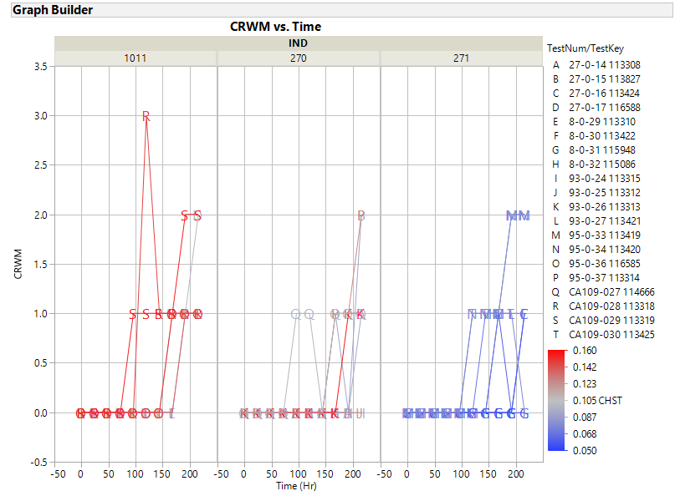

Slide 14
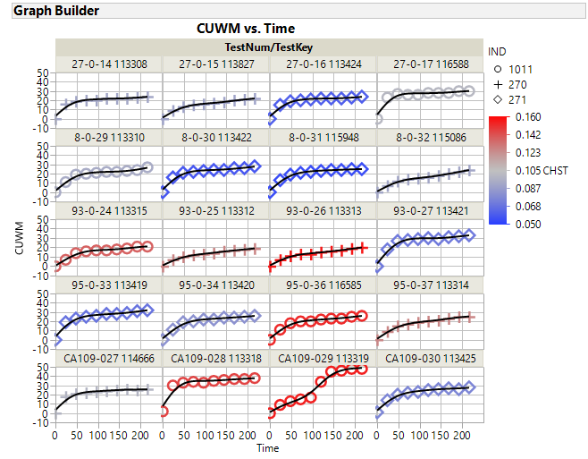

Slide 15
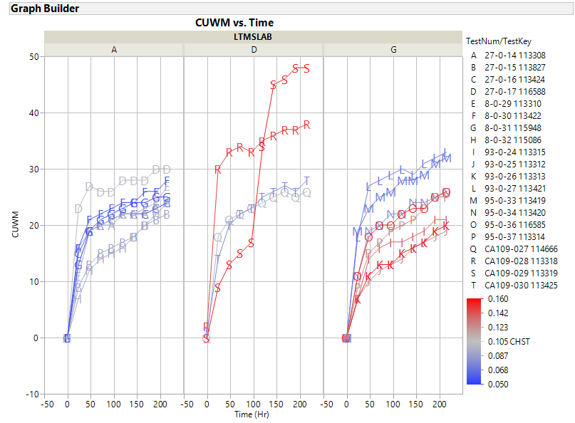

Slide 16
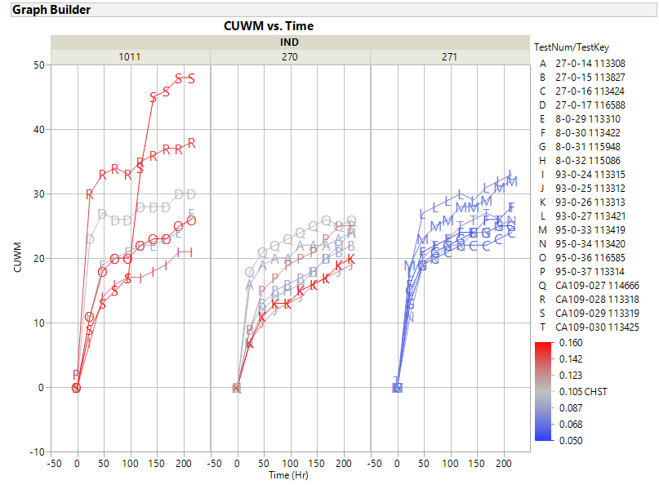

Slide 17
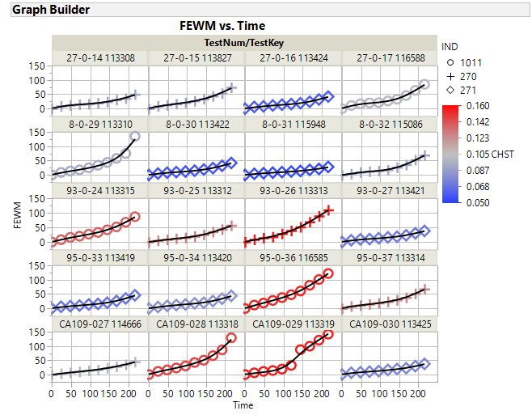

Slide 18
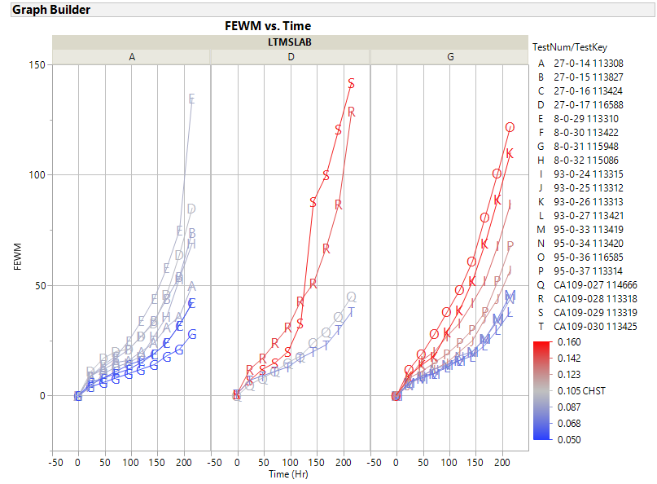

Slide 19
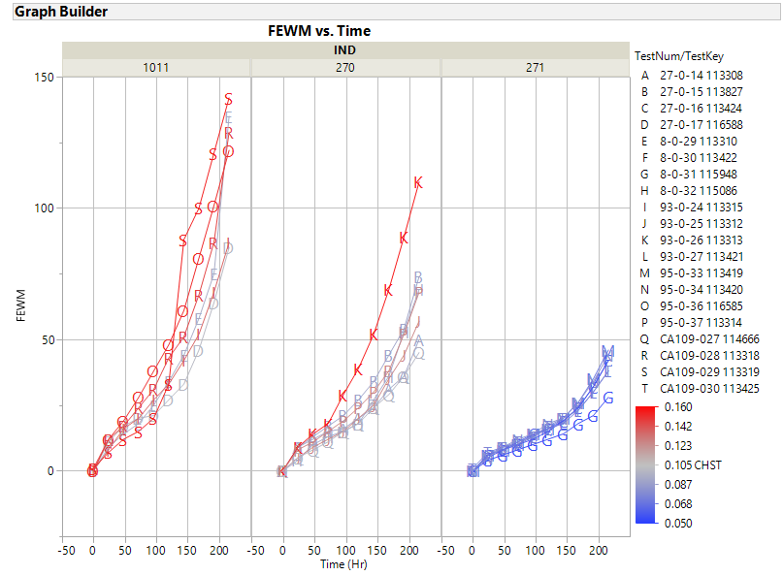

Slide 20
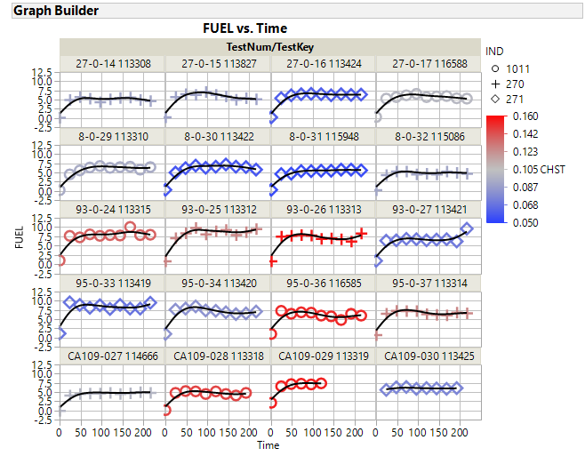

Slide 21
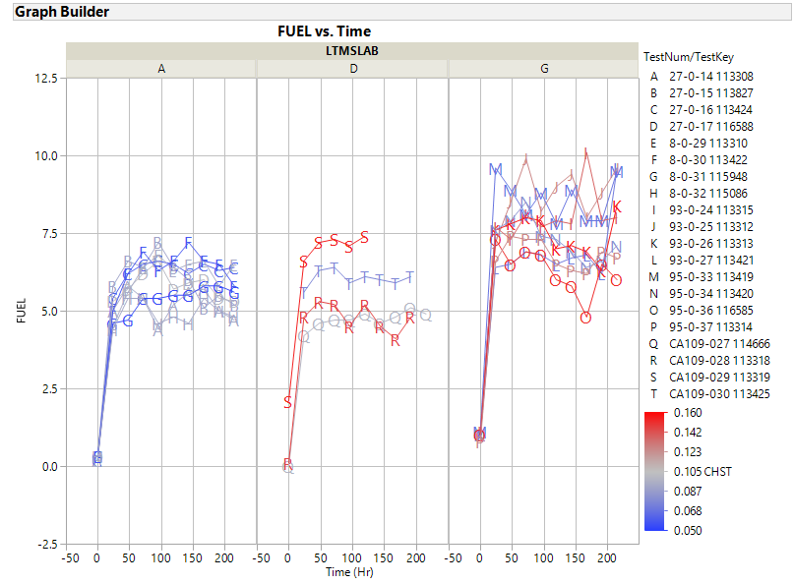

Slide 22
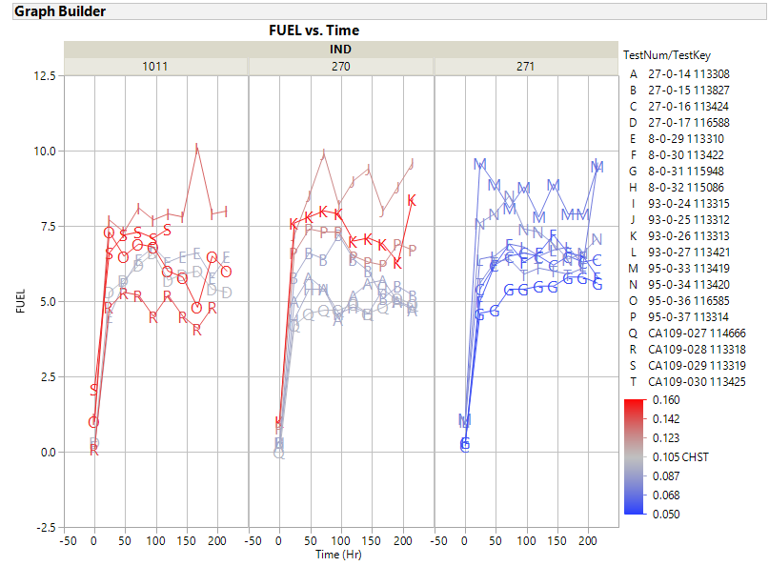

Slide 23
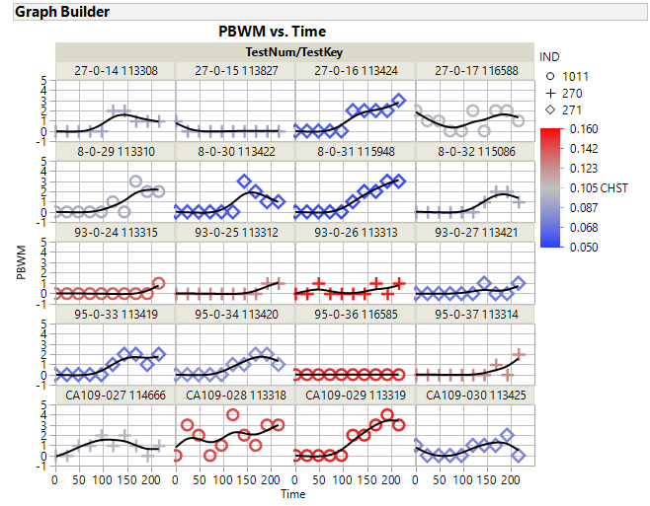

Slide 24
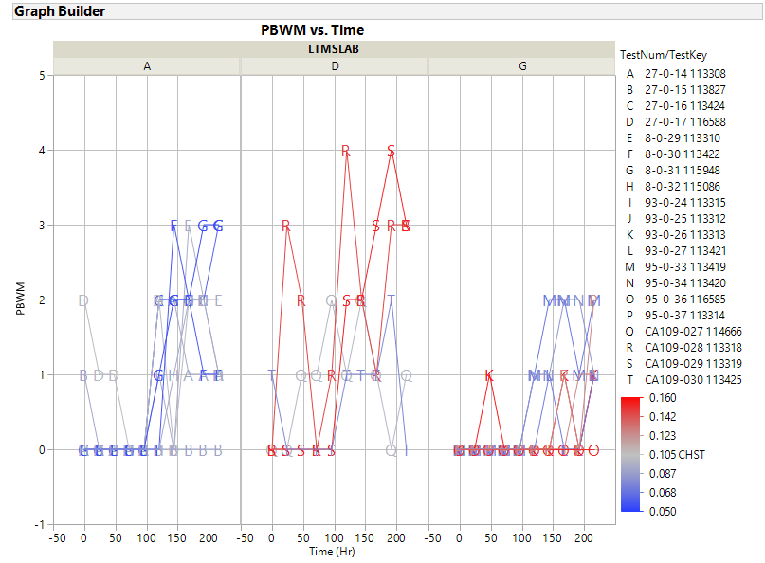

Slide 25
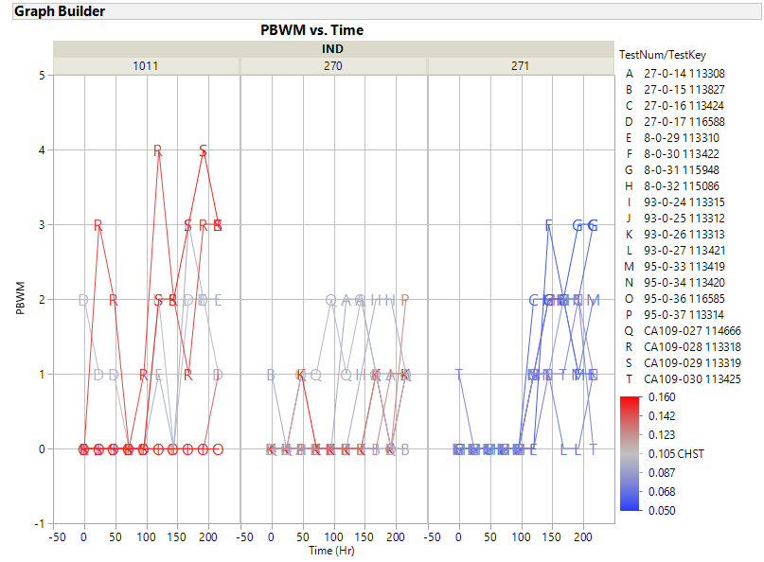

Slide 26
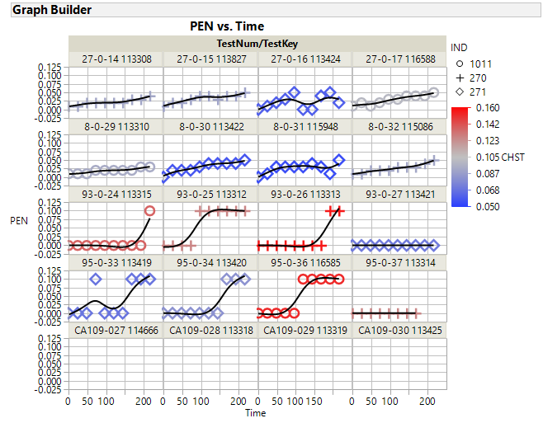

Slide 27
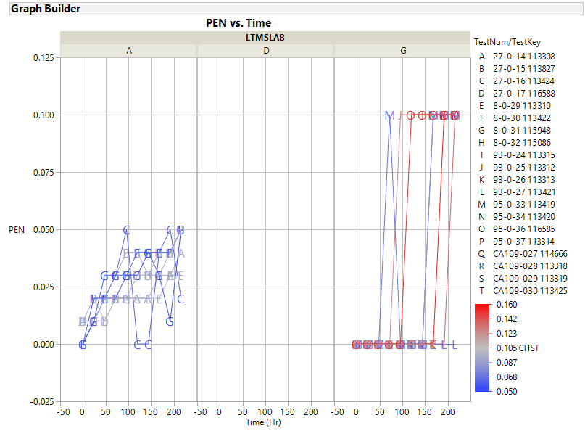

Slide 28
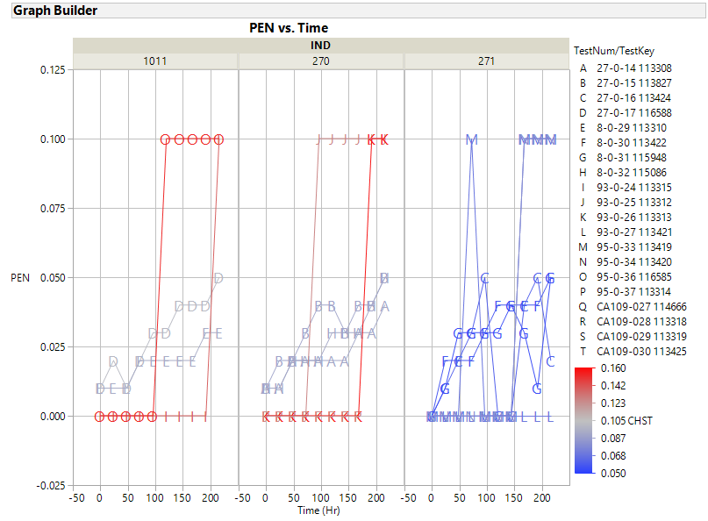

Slide 29
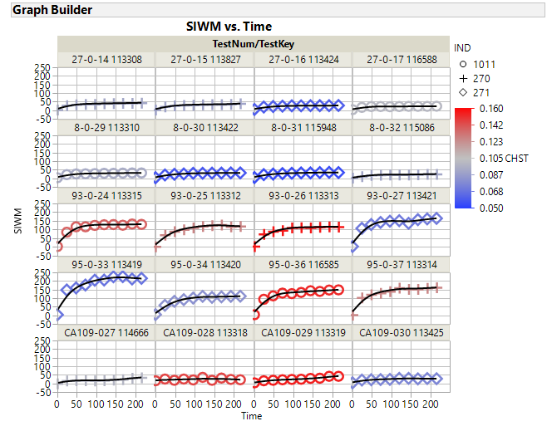

Slide 30
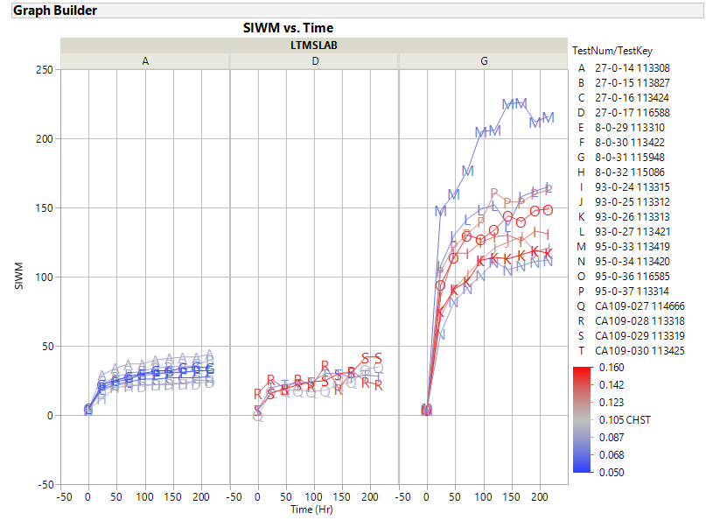

Slide 31
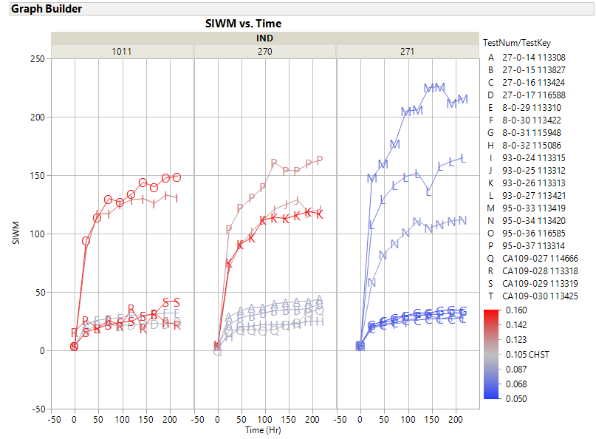

Slide 32
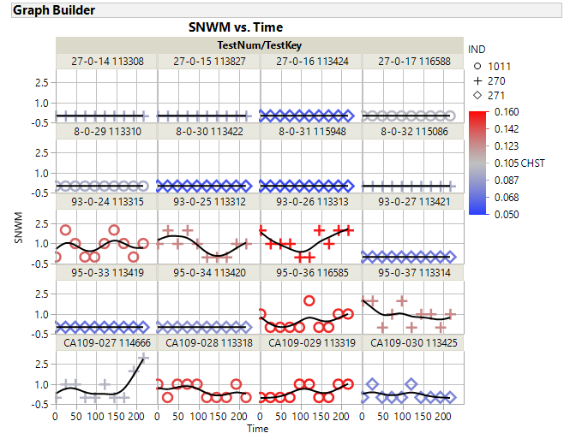

Slide 33
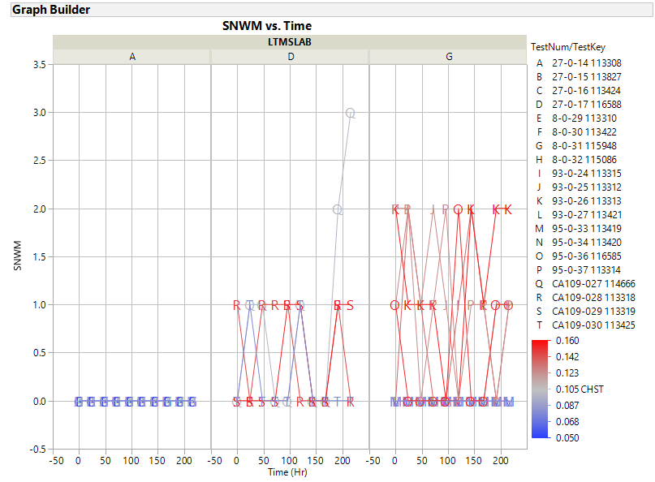

Slide 34
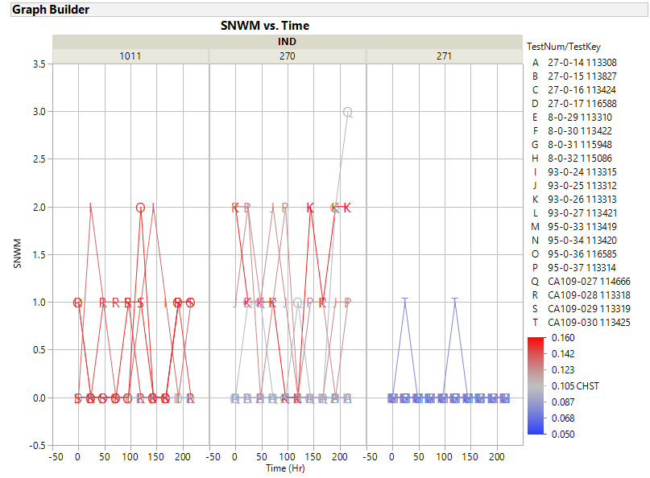

Slide 35
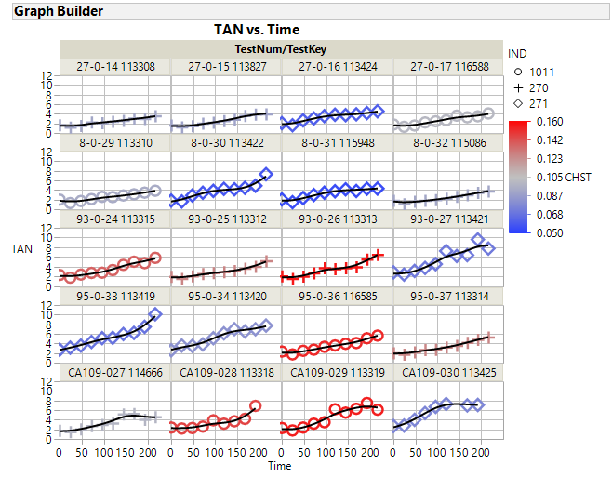

Slide 36
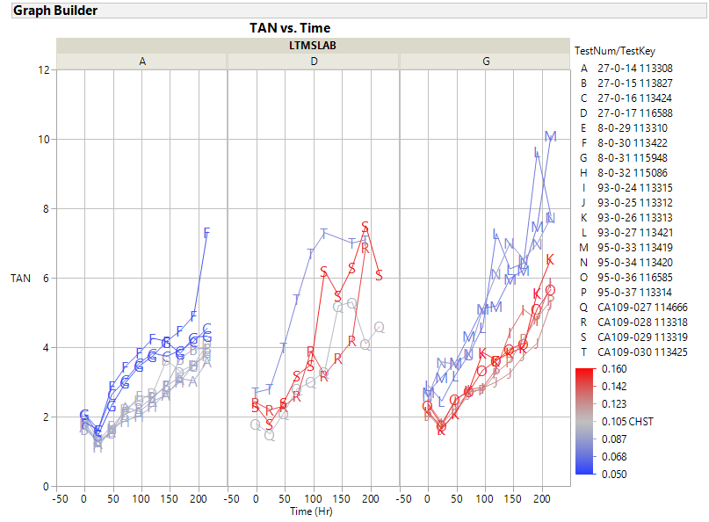

Slide 37
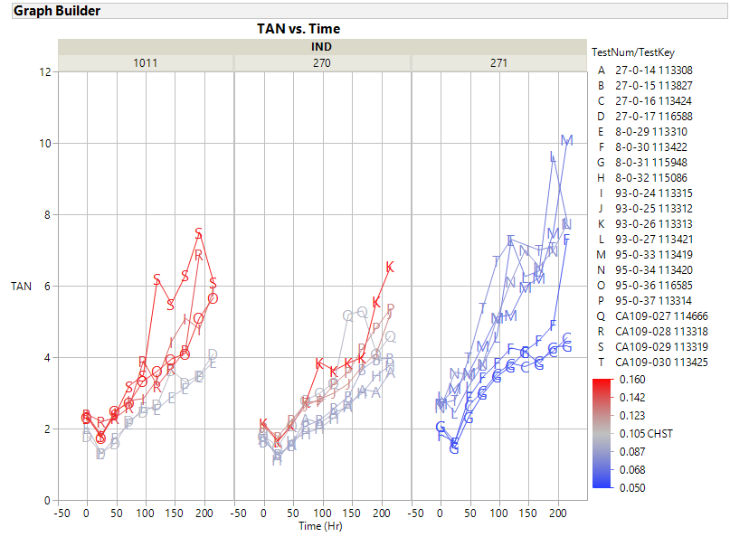

Slide 38
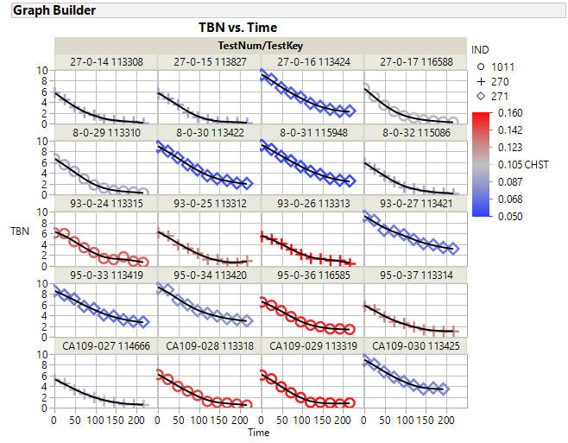

Slide 39
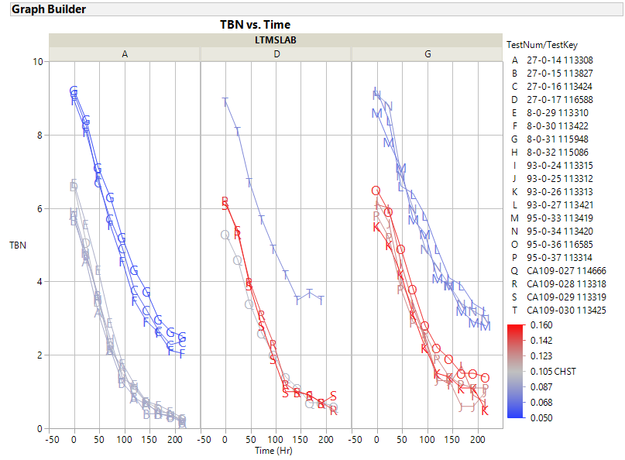

Slide 40
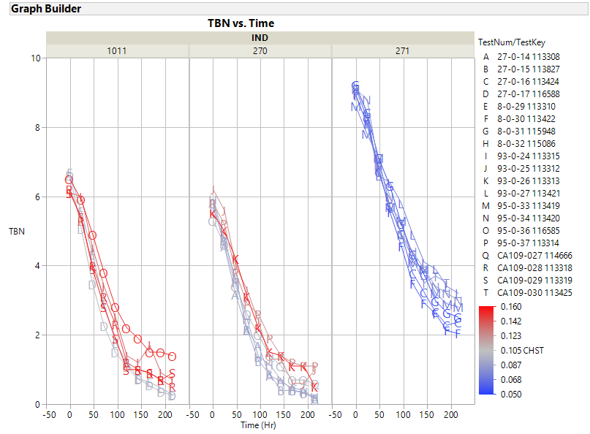

Slide 41
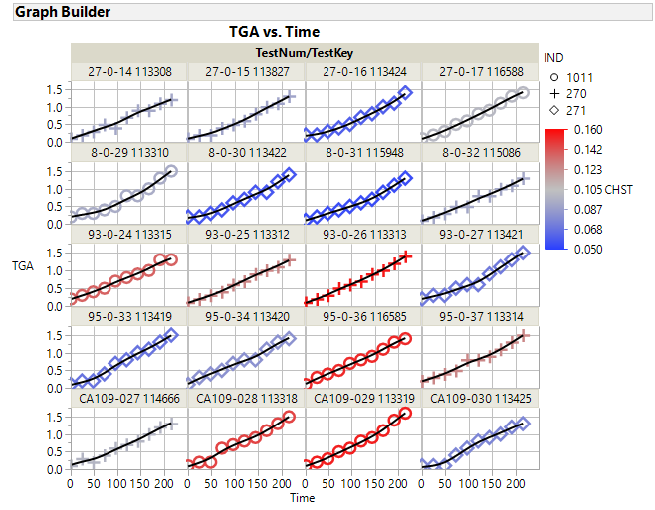

Slide 42
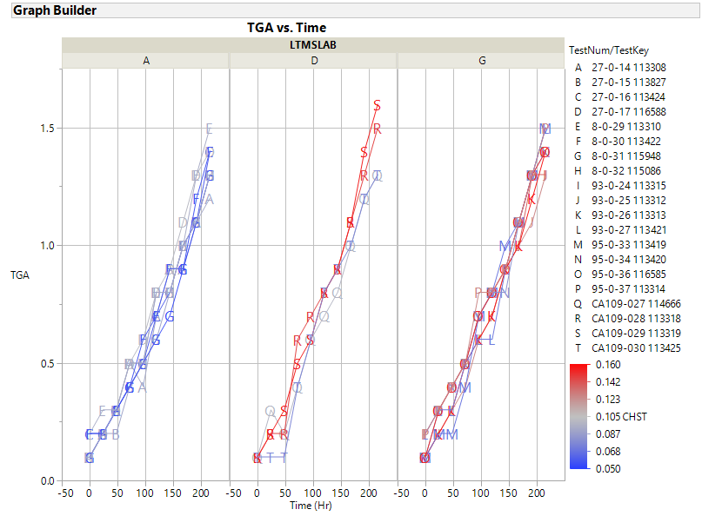

Slide 43
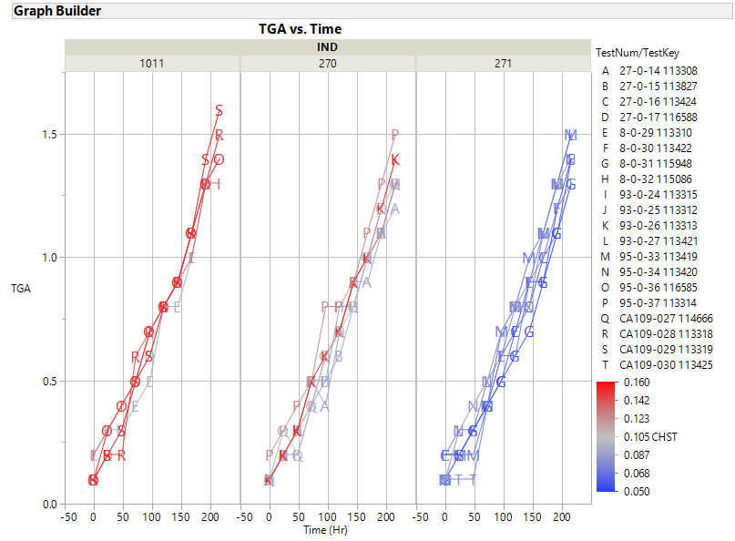

Slide 44
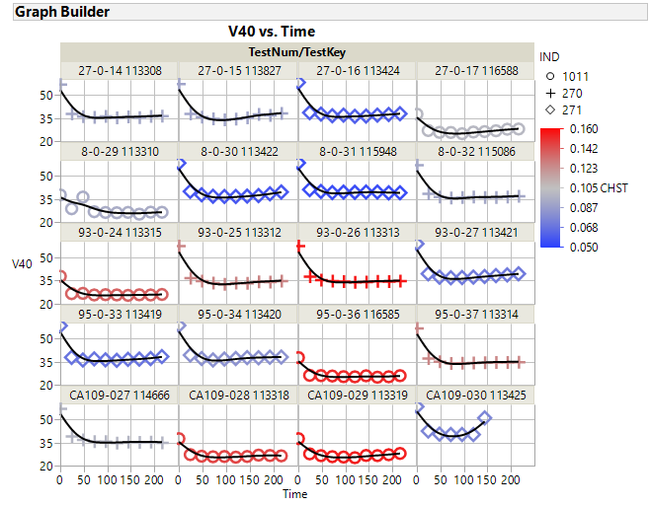

Slide 45
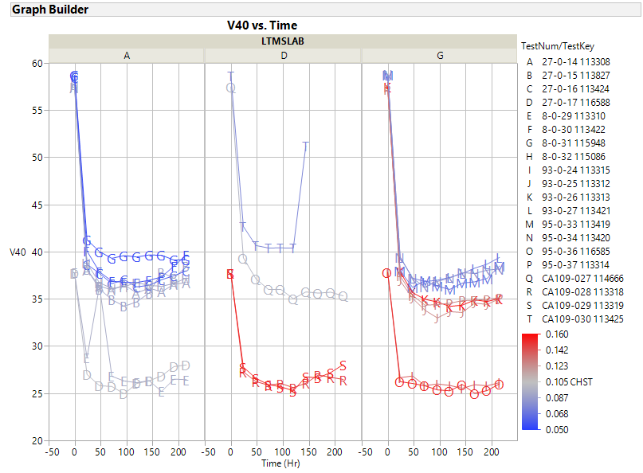

Slide 46
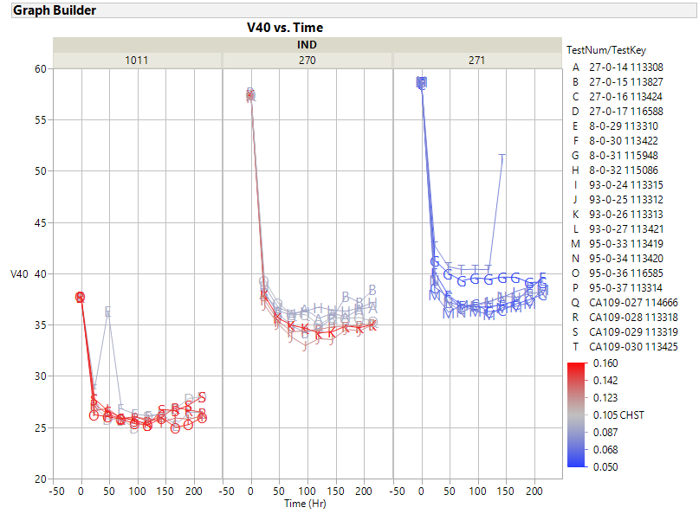

Slide 47
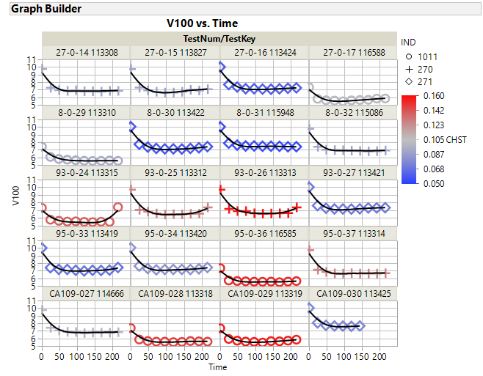

Slide 48
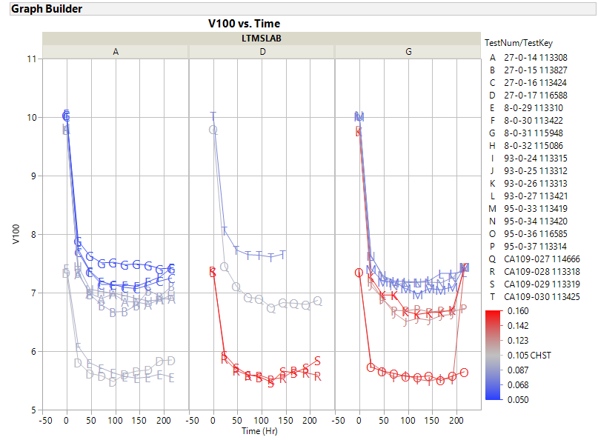

Slide 49
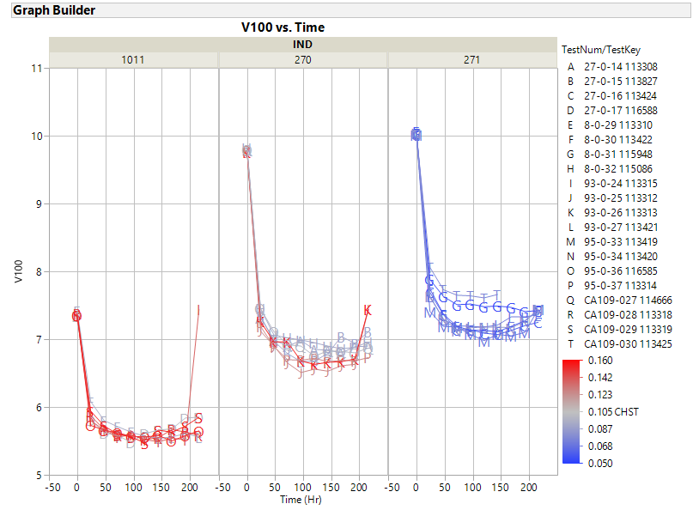

Slide 50
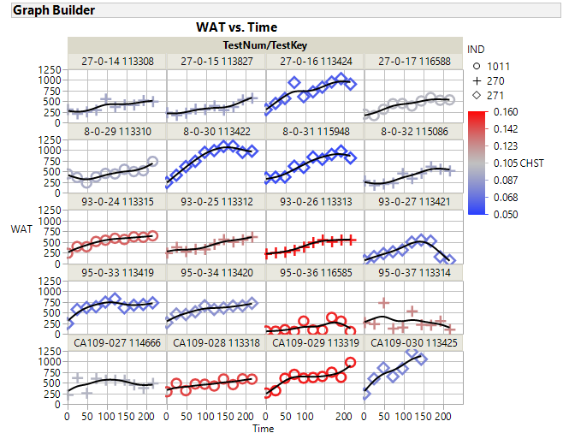

Slide 51
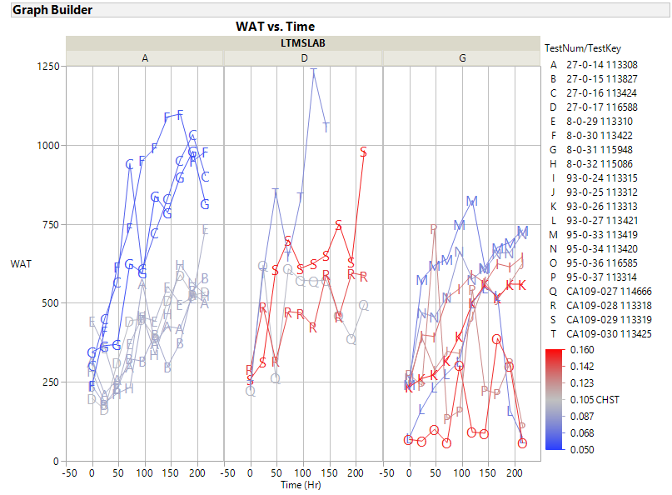

Slide 52
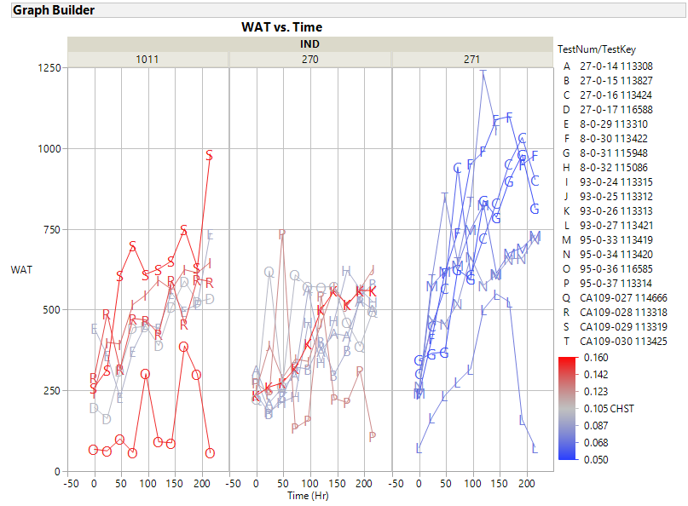

Slide 53
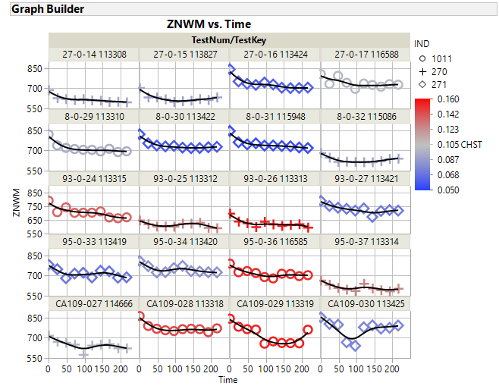

Slide 56
Operational Data Plots

