Slide 1
Chain Wear Precision Matrix Operational Data Plots
Kevin O’Malley
The Lubrizol Corporation
August 2016

Slide 2
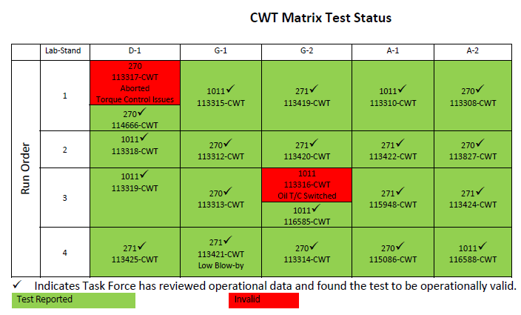
Precision Matrix
20 chain wear tests conducted as a part of the precision matrix
Table included in Frank Farber’s June 7, 2016
Matrix update

Slide 3
Operational Data Plots
Analytical results are shown followed by operational test parameters
Both the analytical and operational data are each shown in alphabetical order.
For each of the analyticals, the following plots are provided
Each test in its own pane, measurements from samples taken throughout each test, symbols by oil, and data colored by chain wear result
Each lab in its own pane with data colored by chain wear result
Each oil in its own pane with data colored by chain wear result
For each operational parameter, raw operational data are plotted for the phases separately (order: PH1, PH1-2, PH2, PH2-1)
Within each phase, tests are plotted in separate panes with data colored by chain wear result
A plot of all tests is followed by similar plots separated by oil
Plots are shown with cycles overlaid on one another using Step Time as the x-axis as well as the cycles shown concurrently
For each operational parameter, the raw data is summarized by phase and also across the entire test (average, median, and standard deviation)
Chain wear is plotted versus the various summarized data for the phases separately

Slide 4
Analytical Plots

Slide 5
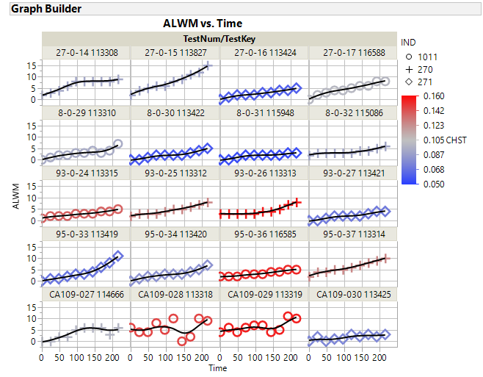

Slide 6
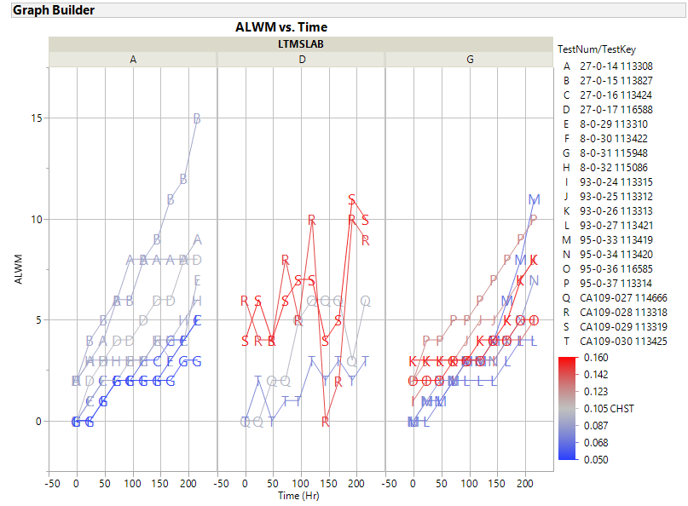

Slide 7
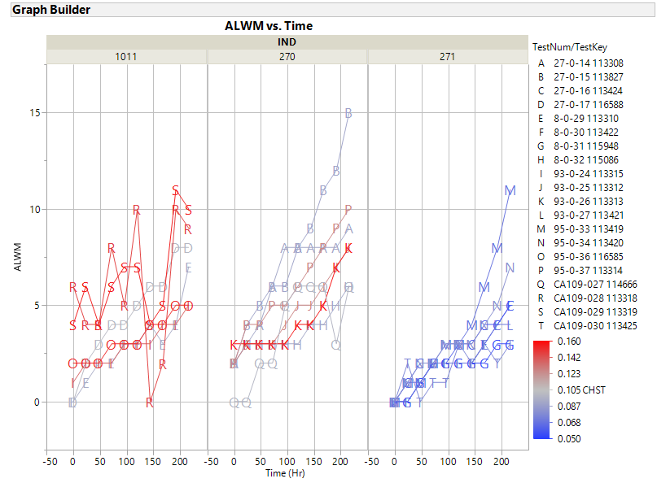

Slide 8
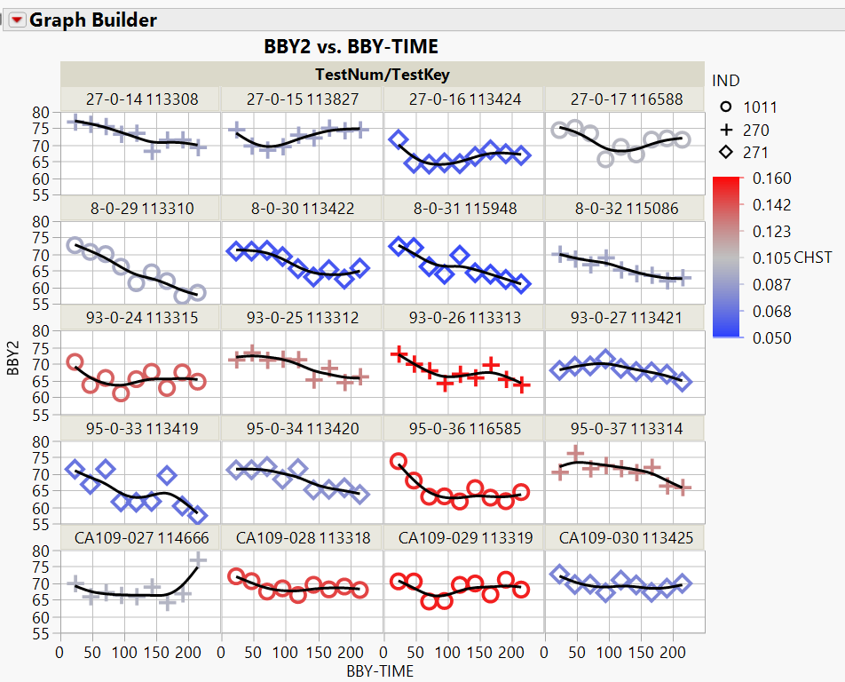

Slide 9
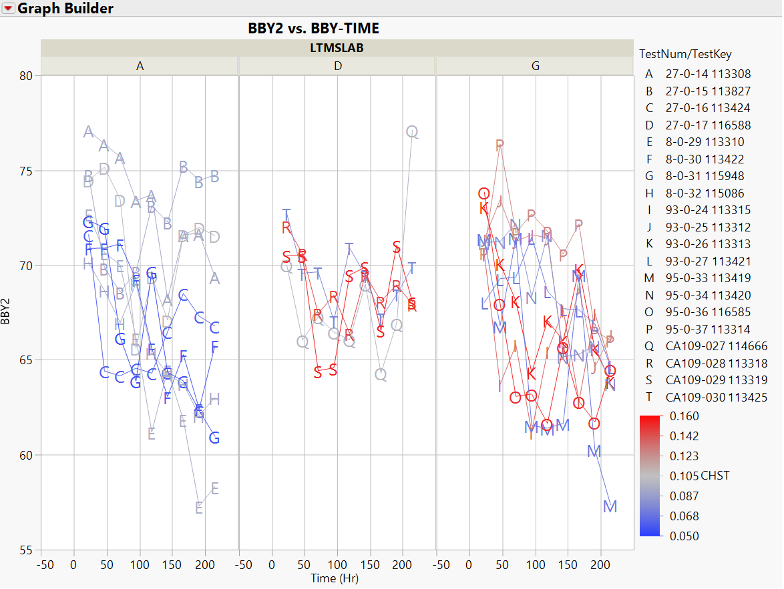

Slide 10
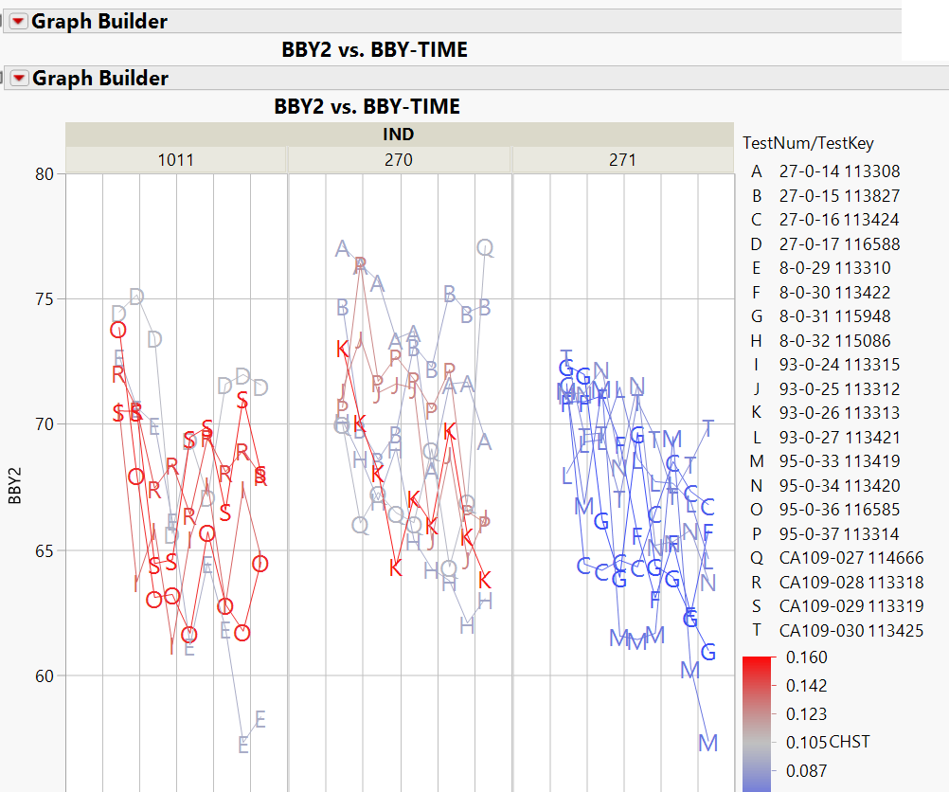

Slide 11
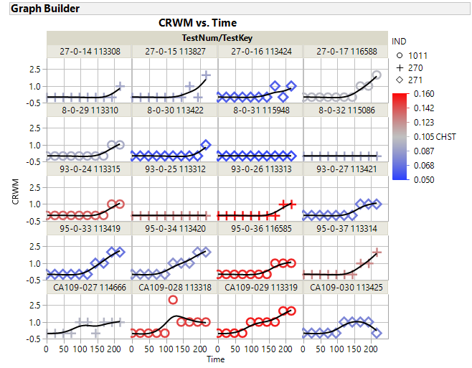

Slide 12
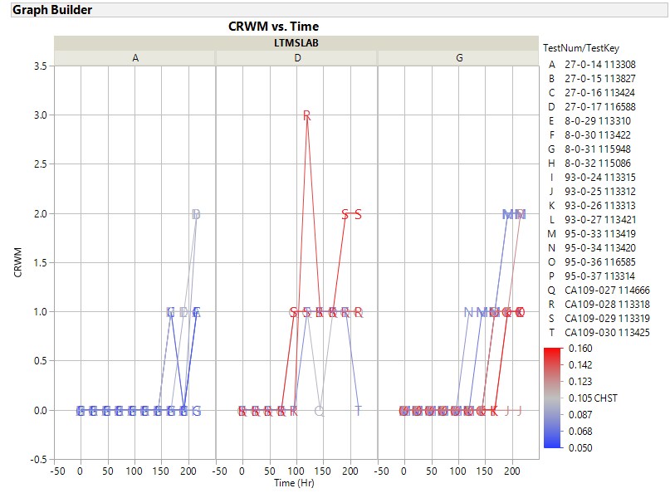

Slide 13
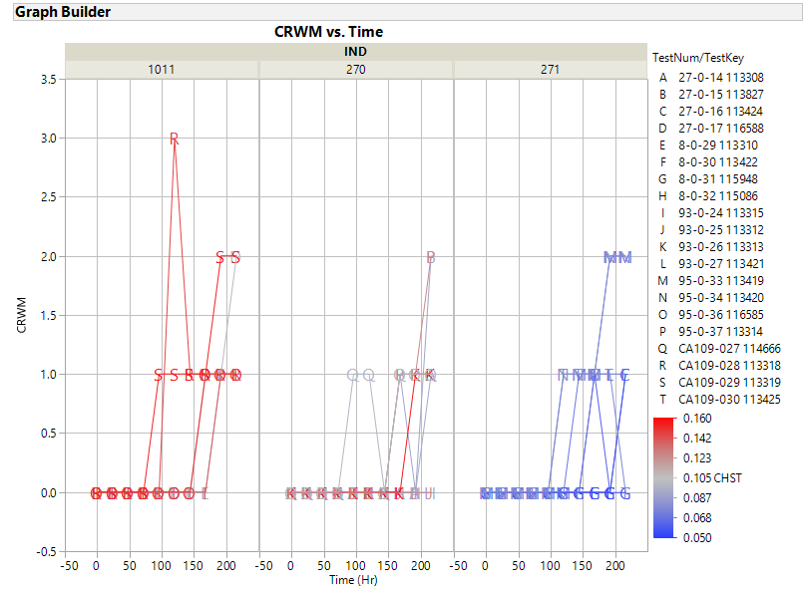

Slide 14
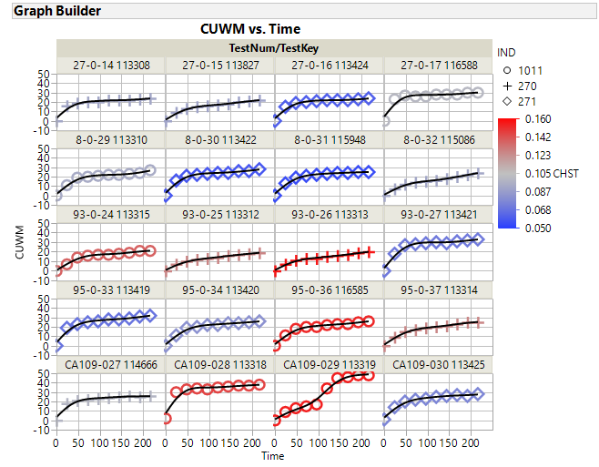

Slide 15
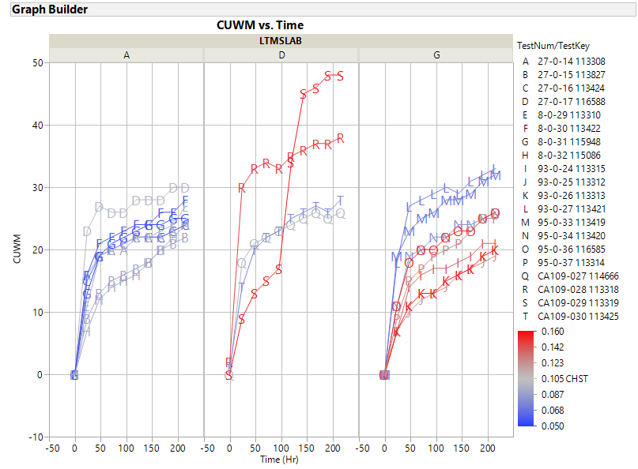

Slide 16
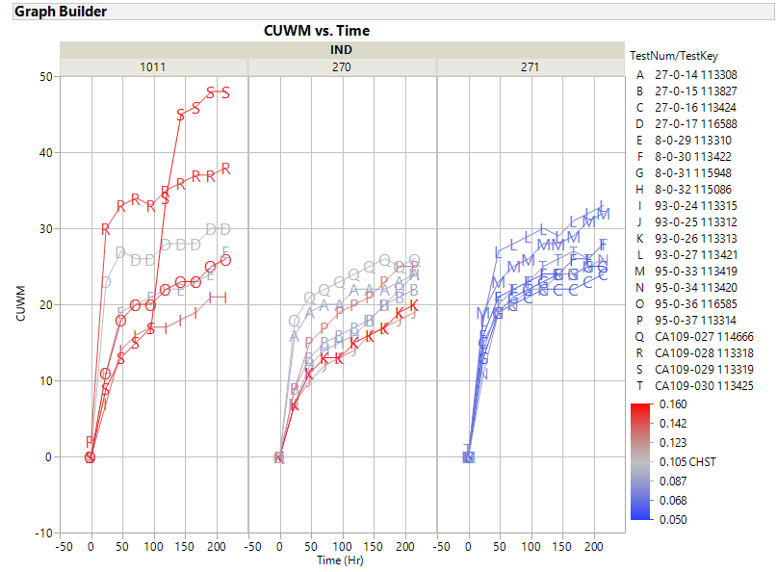

Slide 17
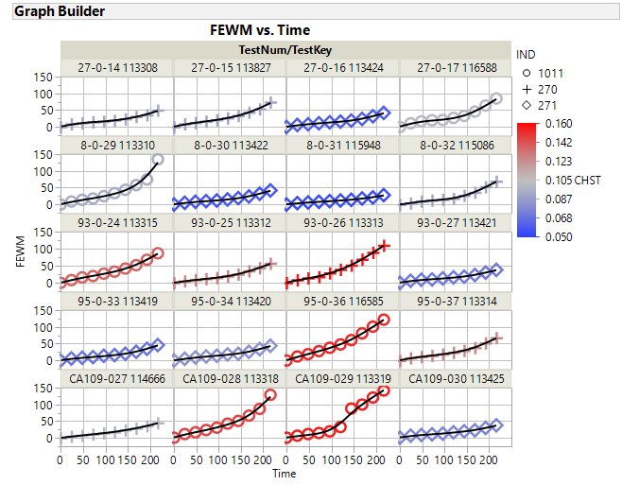

Slide 18
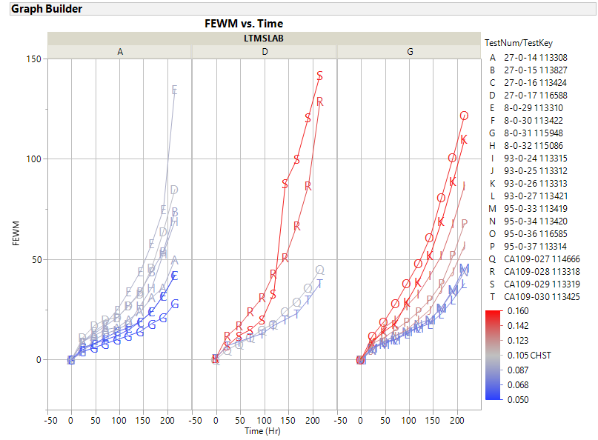

Slide 19
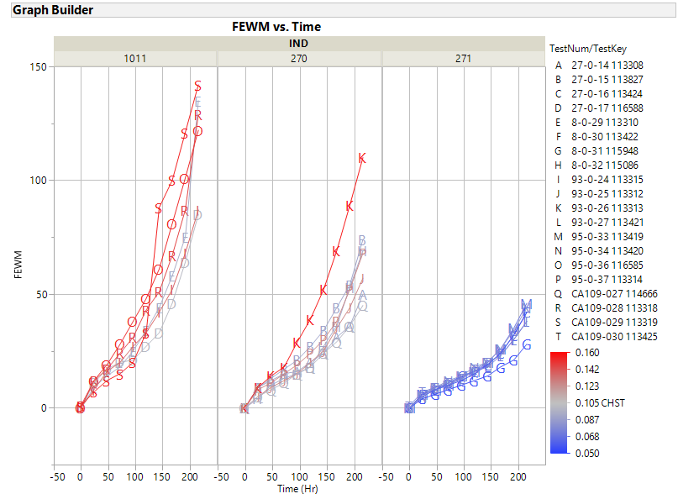

Slide 20
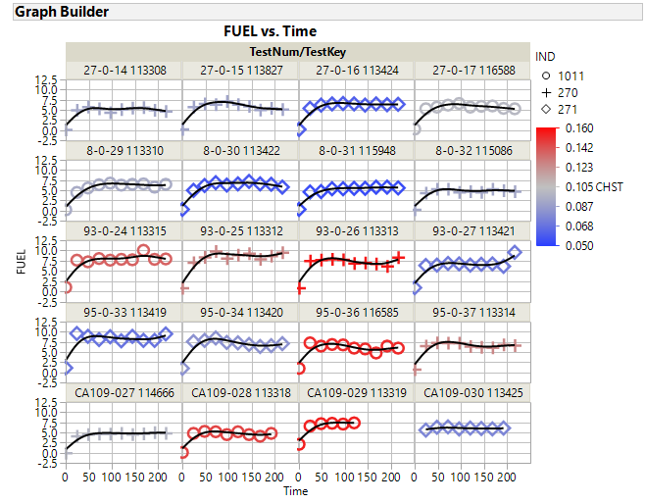

Slide 21
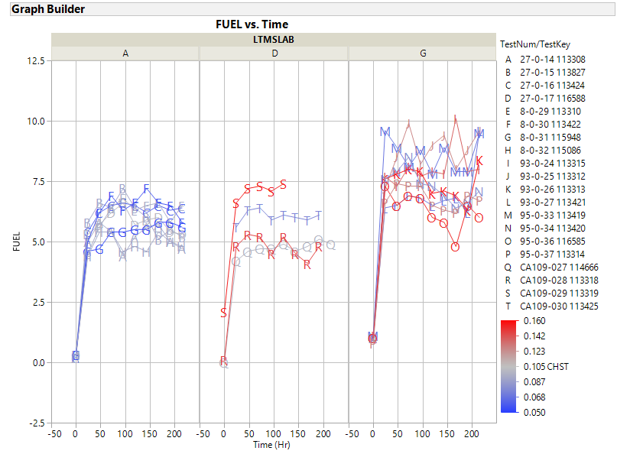

Slide 22
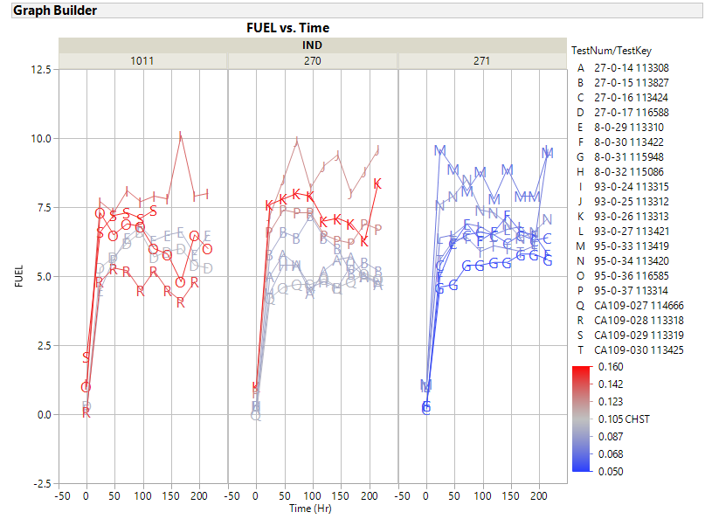

Slide 23
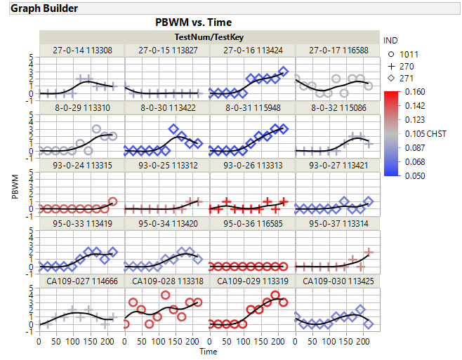

Slide 24
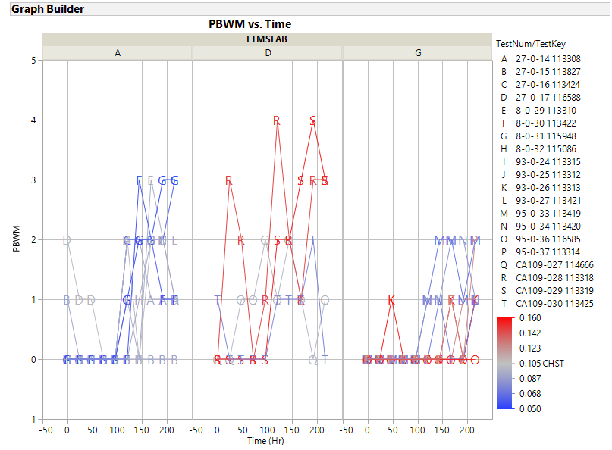

Slide 25
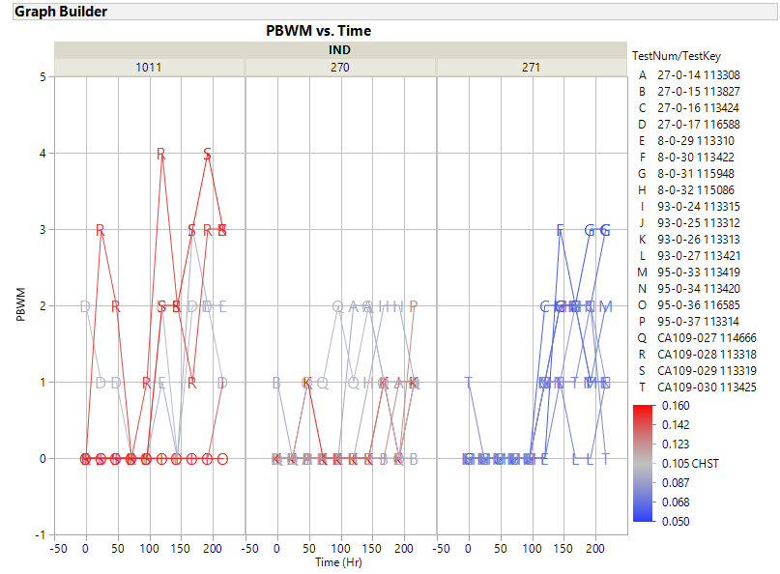

Slide 26
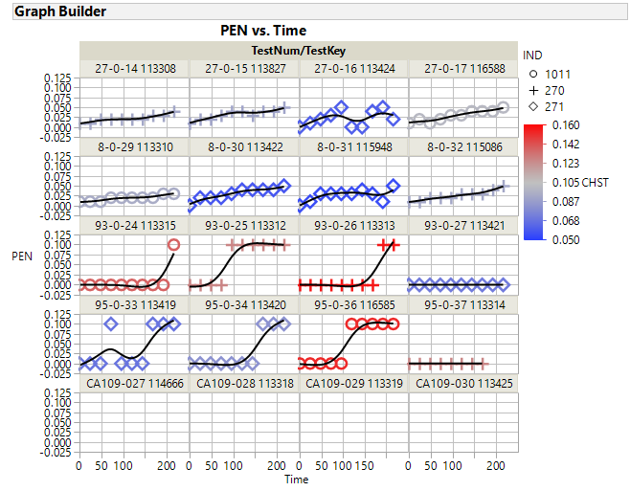

Slide 27
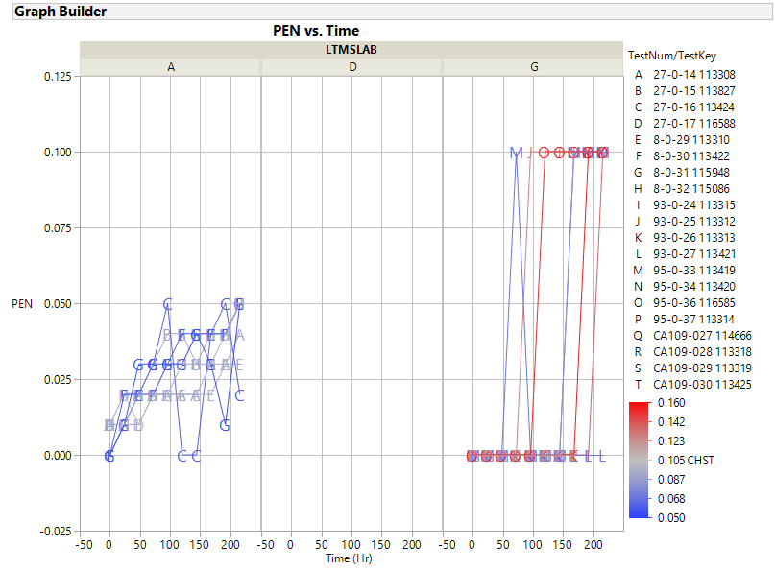

Slide 28
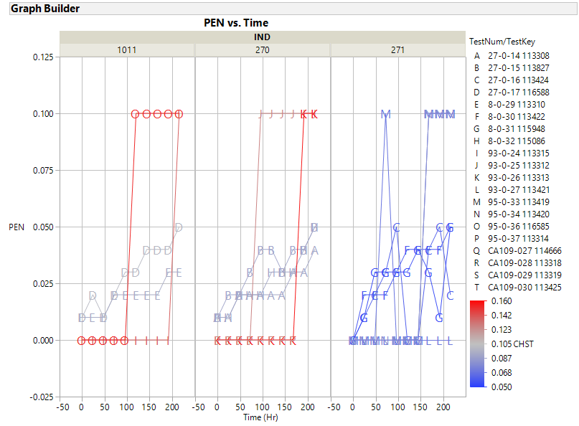

Slide 29
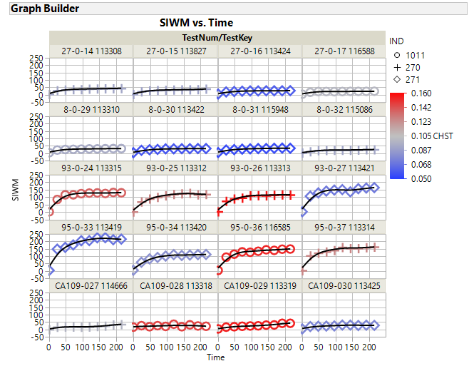

Slide 30
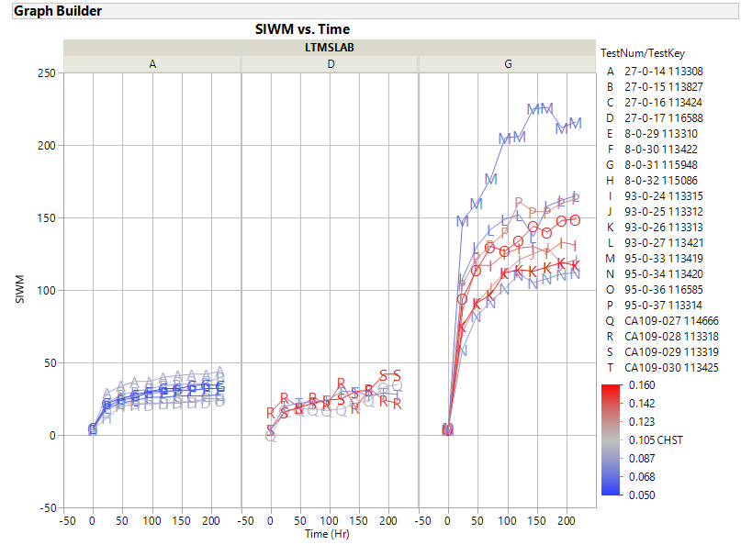

Slide 31
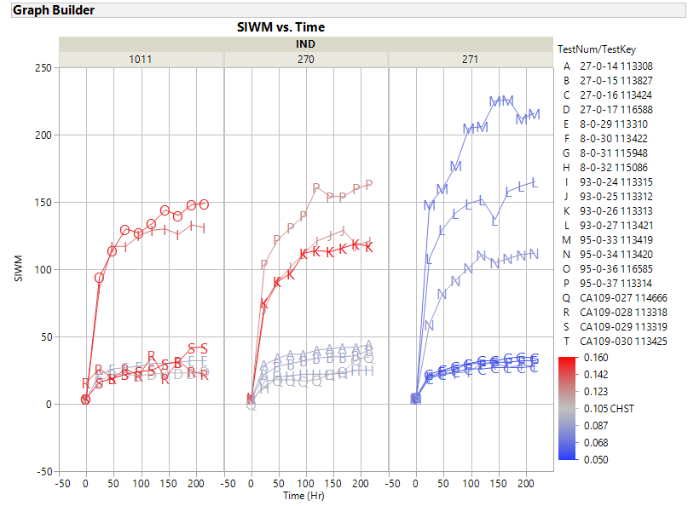

Slide 32
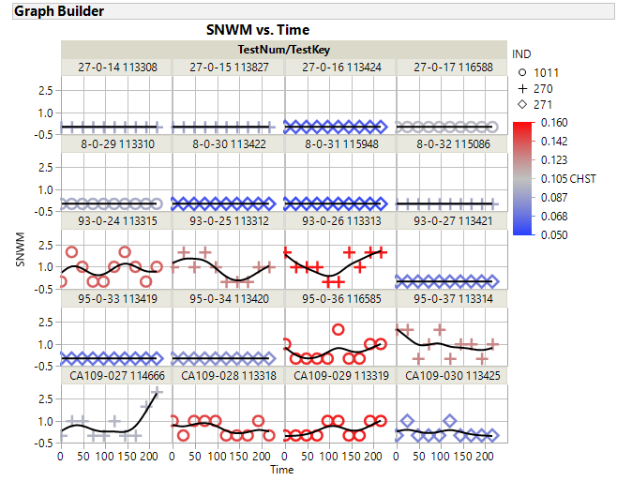

Slide 33
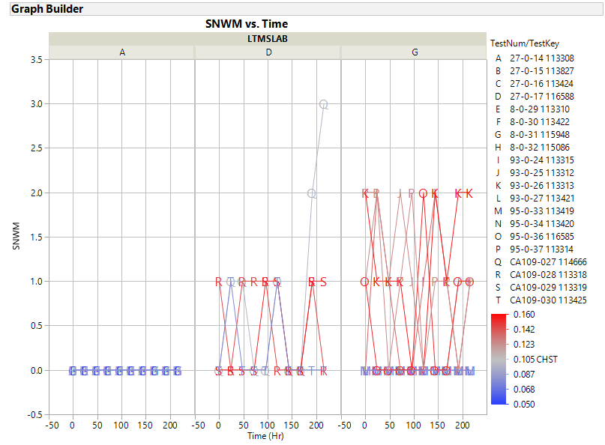

Slide 34
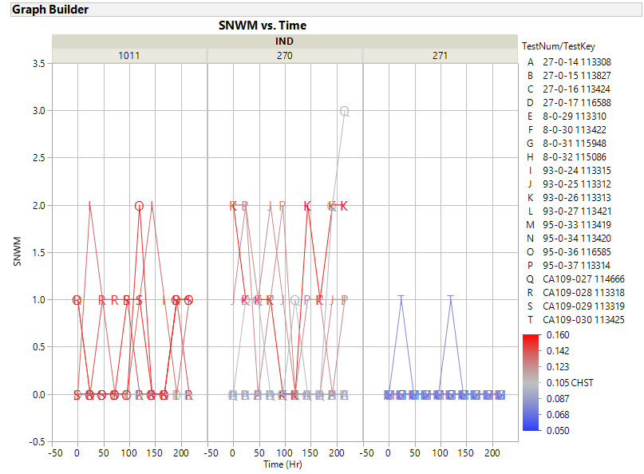

Slide 35
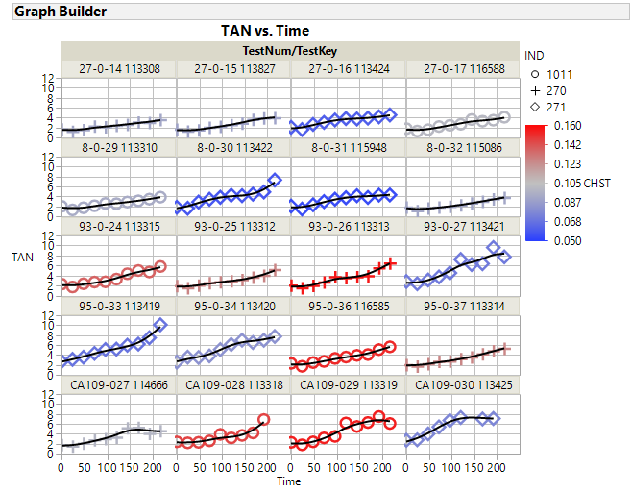

Slide 36
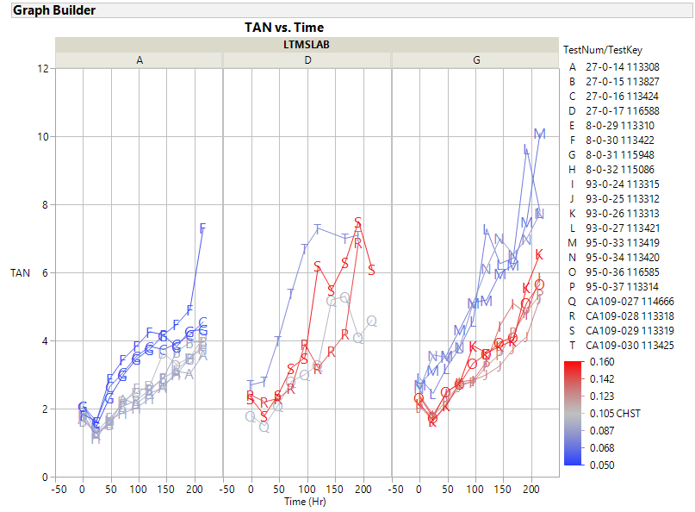

Slide 37
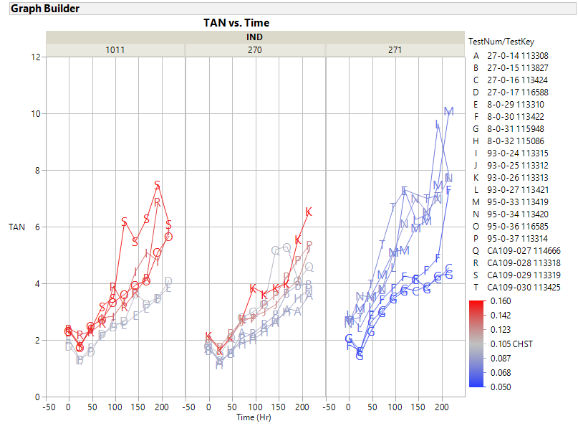

Slide 38
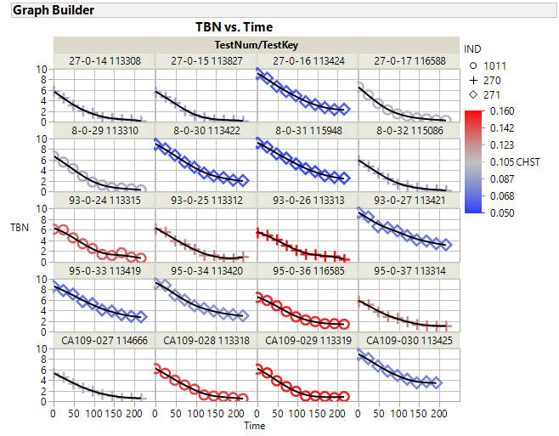

Slide 39
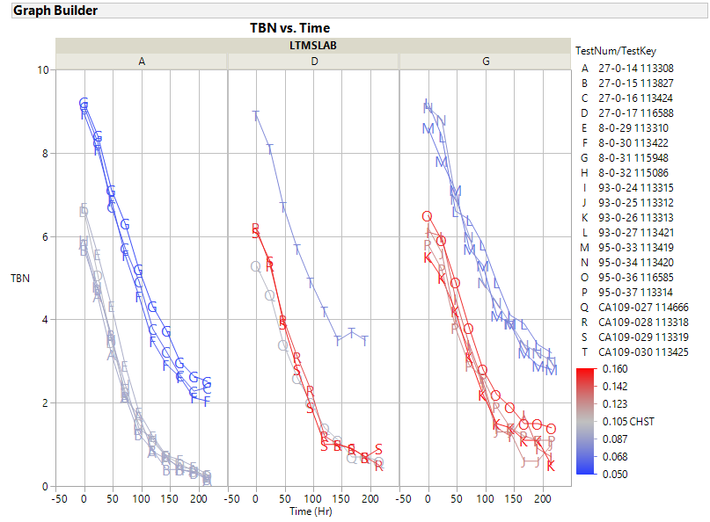

Slide 40
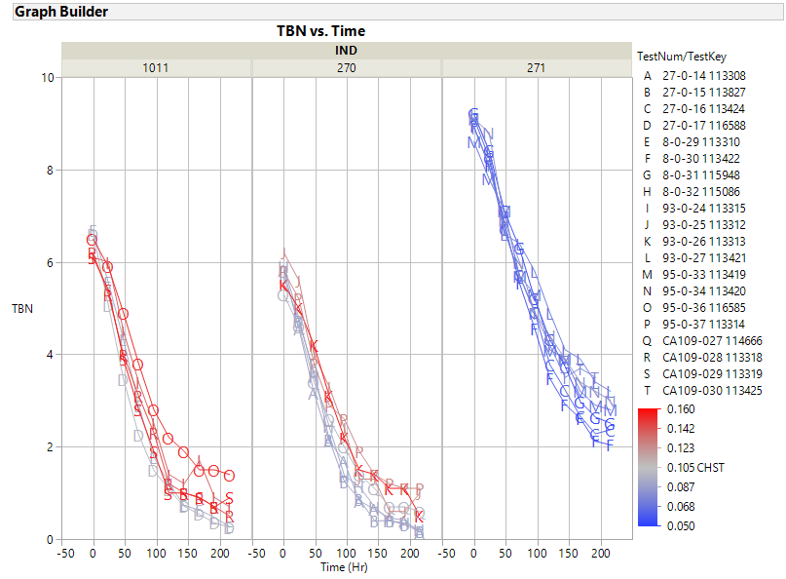

Slide 41
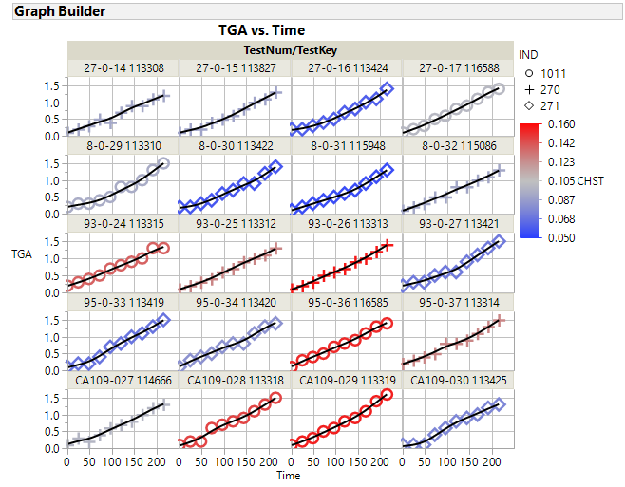

Slide 42
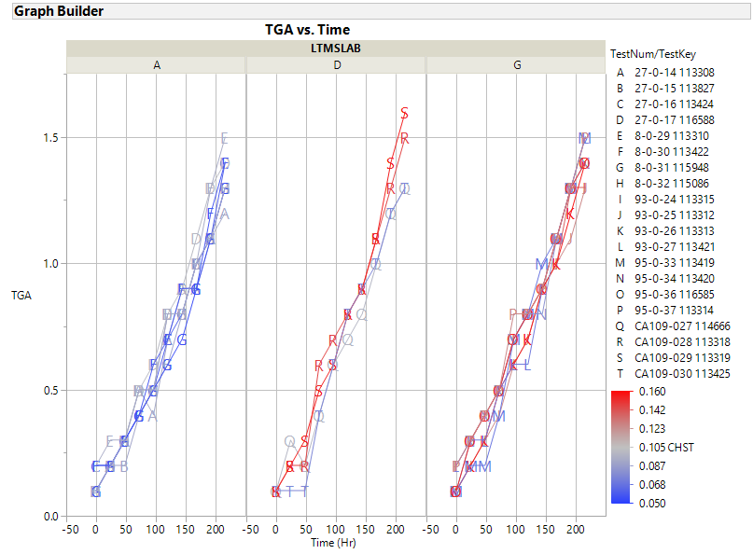

Slide 43
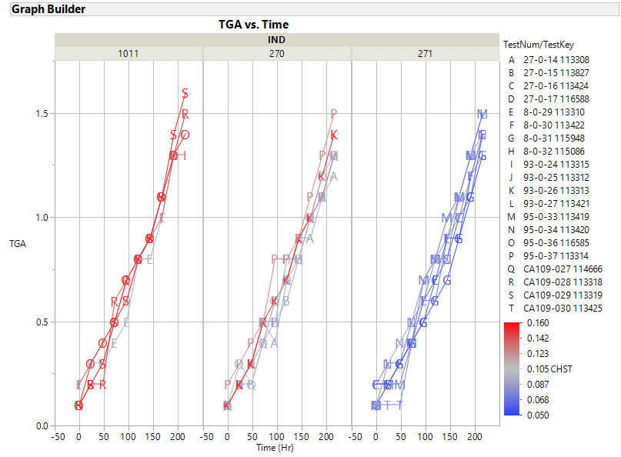

Slide 44
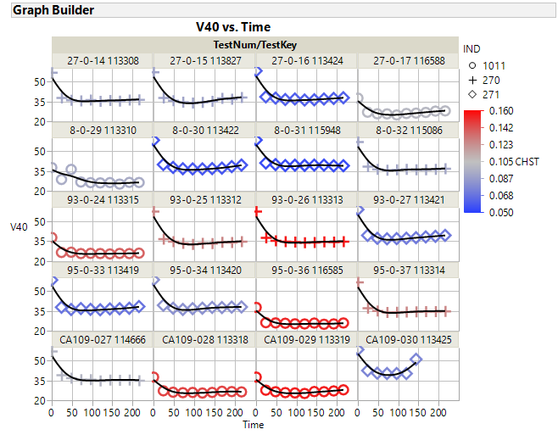

Slide 45
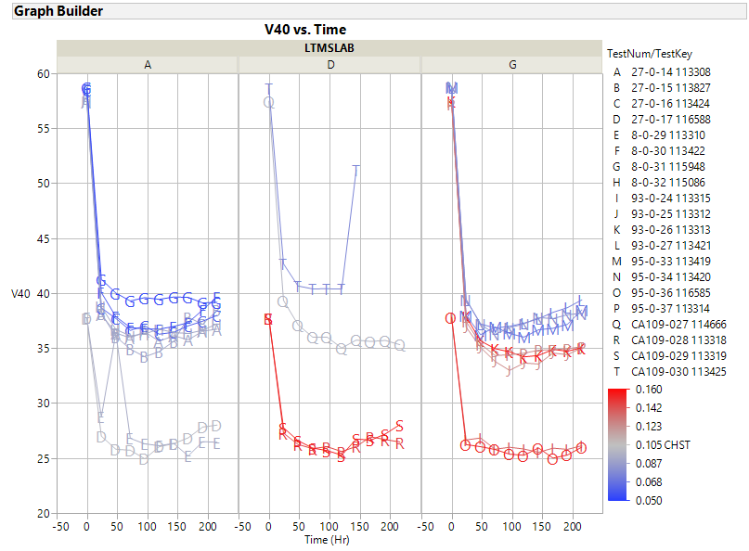

Slide 46
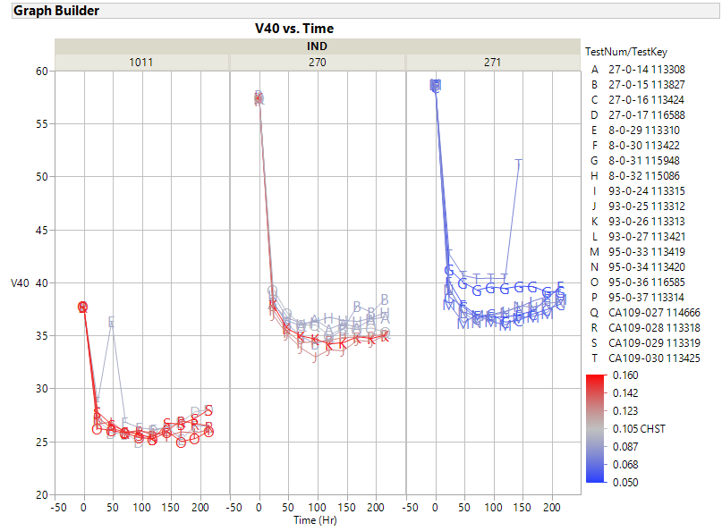

Slide 47
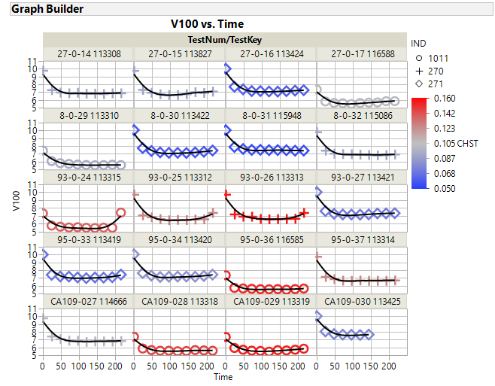

Slide 48
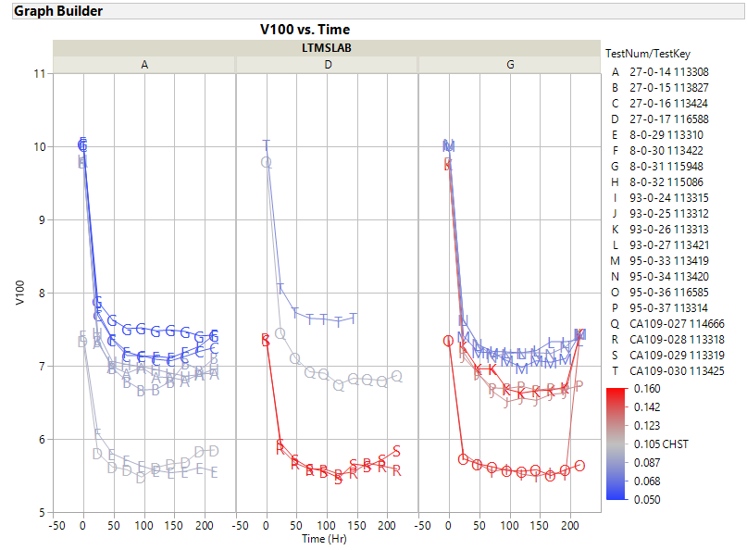

Slide 49
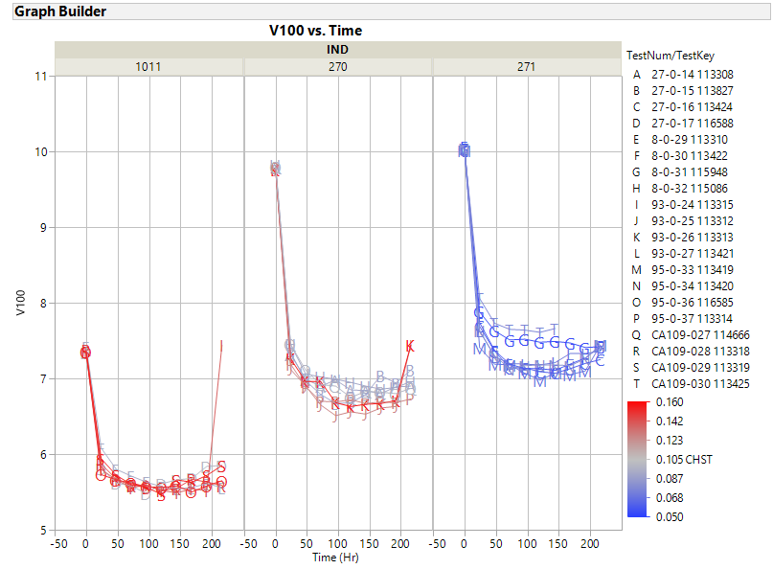

Slide 50
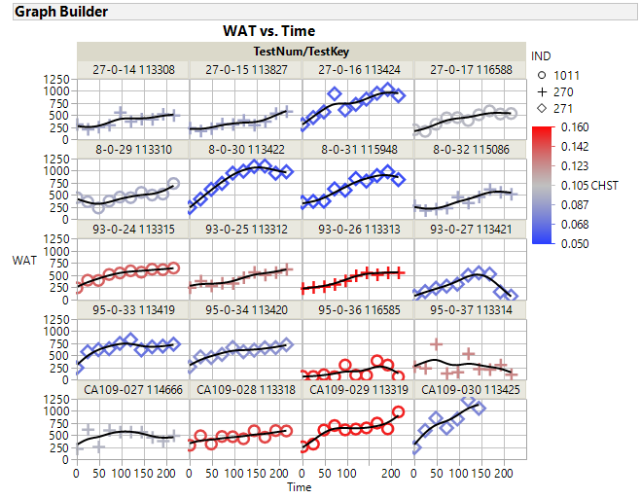

Slide 51
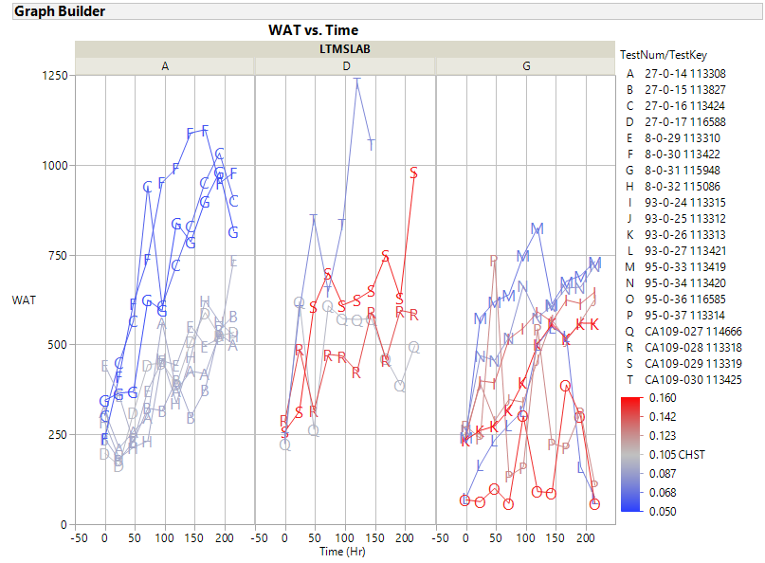

Slide 52
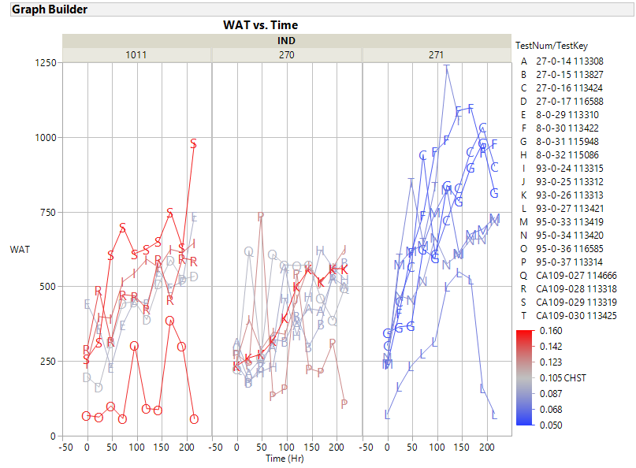

Slide 53
Operational Data Plots

Slide 54
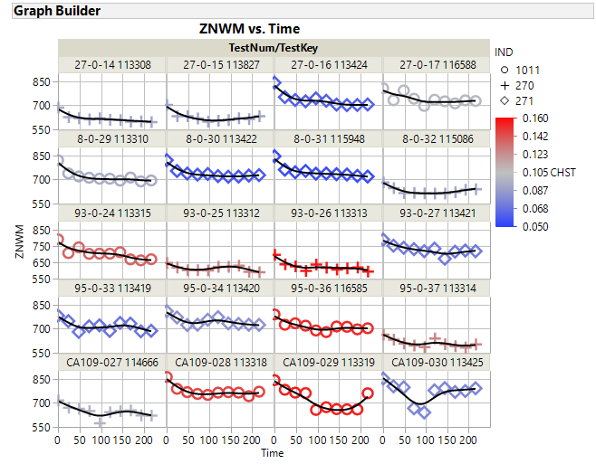

Slide 213
ZOOMED IN

Slide 221
ZOOMED IN

Slide 225
ZOOMED IN

Slide 233
ZOOMED IN

Slide 410
Oil 270

Slide 411
Oil 270

Slide 412
Oil 271

Slide 413
Oil 271

Slide 414
Oil 1011

Slide 415
Oil 1011

Slide 417
Oil 270

Slide 418
Oil 271

Slide 419
Oil 1011

Slide 422
Oil 270

Slide 423
Oil 270

Slide 424
Oil 271

Slide 425
Oil 271

Slide 426
Oil 1011

Slide 427
Oil 1011

Slide 429
Oil 270

Slide 430
Oil 271

Slide 605
Oil 270

Slide 606
Oil 270

Slide 607
Oil 271

Slide 608
Oil 271

Slide 609
Oil 1011

Slide 610
Oil 1011

Slide 612
Oil 270

Slide 613
Oil 271

Slide 614
Oil 1011

Slide 617
Oil 270

Slide 618
Oil 270

Slide 619
Oil 271

Slide 620
Oil 271

Slide 621
Oil 1011

Slide 622
Oil 1011

Slide 624
Oil 270

Slide 625
Oil 271

Slide 626
Oil 1011

Slide 1073
Oil 270

Slide 1074
Oil 270

Slide 1075
Oil 271

Slide 1076
Oil 271

Slide 1077
Oil 1011

Slide 1078
Oil 1011

Slide 1080
Oil 270

Slide 1081
Oil 271

Slide 1082
Oil 1011

Slide 1085
Oil 270

Slide 1086
Oil 270

Slide 1087
Oil 271

Slide 1088
Oil 271

Slide 1089
Oil 1011

Slide 1090
Oil 1011

Slide 1092
Oil 270

Slide 1093
Oil 271

Slide 1094
Oil 1011

Slide 1229
Oil 270

Slide 1230
Oil 270

Slide 1231
Oil 271

Slide 1232
Oil 271

Slide 1233
Oil 1011

Slide 1234
Oil 1011

Slide 1236
Oil 270

Slide 1237
Oil 271

Slide 1238
Oil 1011

Slide 1241
Oil 270

Slide 1242
Oil 270

Slide 1243
Oil 271

Slide 1244
Oil 271

Slide 1245
Oil 1011

Slide 1246
Oil 1011

Slide 1248
Oil 270

Slide 1249
Oil 271

Slide 1250
Oil 1011

