Slide 1
Chain Wear Precision Matrix Operational Data Plots Phases 1 & 2
Kevin O’Malley
The Lubrizol Corporation
October 19, 2016

Slide 2
Overview
Labs identified “erroneous” data after operational data review of Chain Wear Operational Data Plots to Identify Erroneous Data 9-16-16.pptx in September
Plots of Phase 1 and Phase 2 data are shown in the appendix
Data identified as “erroneous” have been removed
Where appropriate, additional plots are included which zoom in on operational parameters to obtain a better view of the data. These are labeled “Zoomed In” on the top of the slides
Slides 3 through 13 summarize lab differences in the level of within-test variability
Slides 14 through 23 highlight operational parameters in which the labs differ in magnitude
Analyses of ramp data are being addressed separately

Slide 3
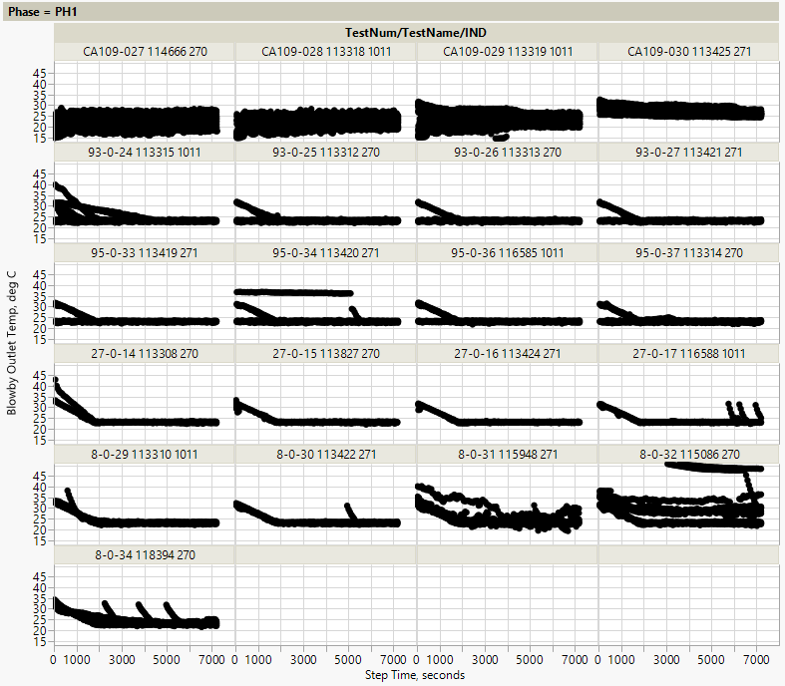
Variability Differences – Ramping in PH1 & PH2
Labs A & G
Phase 1
Labs A and G appear to be ramping at the start of each Phase 1 cycle
This may mean ramping isn’t complete when phase 1 starts
It may also mean that ramp data was included in phase 1 data by accident
The ramping is not observed in every 6th cycle at lab G (cycles 1, 7, 13, etc.)
Cycles are overlaid

Slide 4
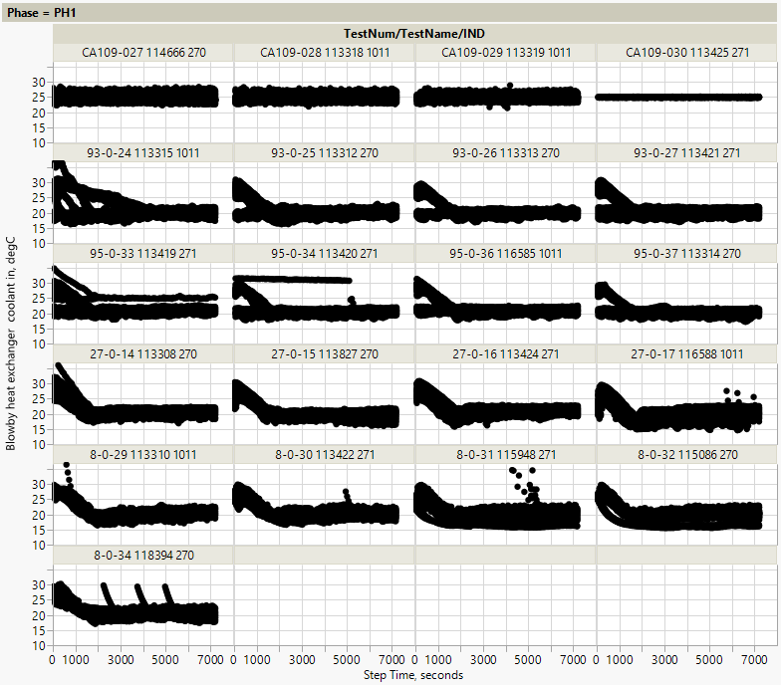
Variability Differences – Ramping in PH1 & PH2
Labs A & G
Phase 1
Labs A and G appear to be ramping at the start of each Phase 1 cycle
This may mean ramping isn’t complete when phase 1 starts
It may also mean that ramp data was included in phase 1 data by accident
The ramping is not observed in every 6th cycle at lab G (cycles 1, 7, 13, etc.)
Note: 1 cycle between 50C & 70C not shown
Cycles are overlaid

Slide 5
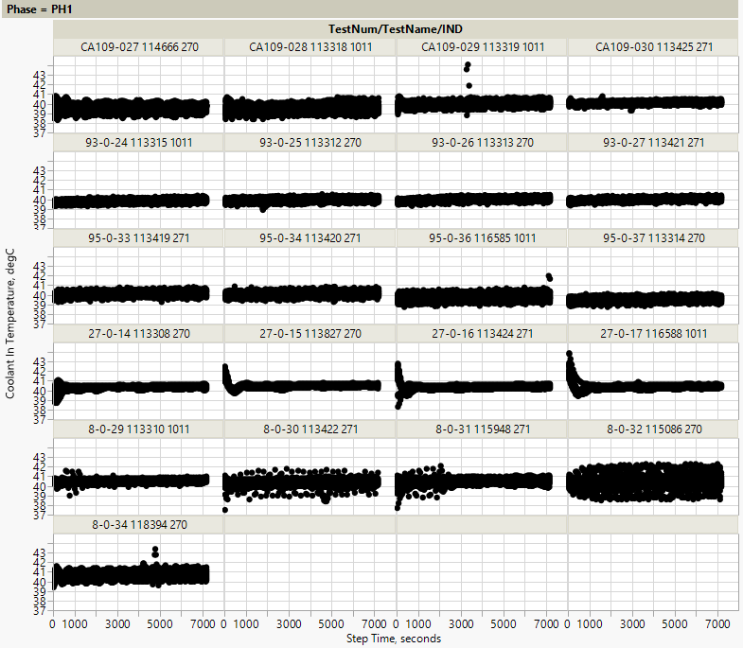
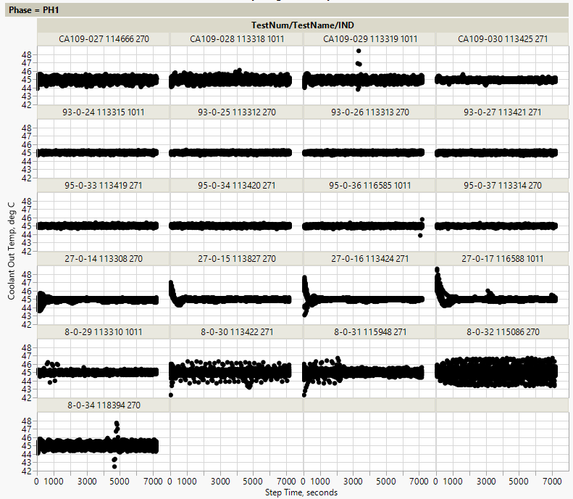
Variability Differences – Ramping in PH1 & PH2
Lab A
Phase 1:
Lab A Stand 27 appears to be ramping at the start of each cycle. This is observed in both coolant in and out temperatures
This may mean ramping isn’t complete when phase 1 starts.
It may also mean that ramp data was included in phase 1 data by accident
Cycles are overlaid on one another

Slide 6
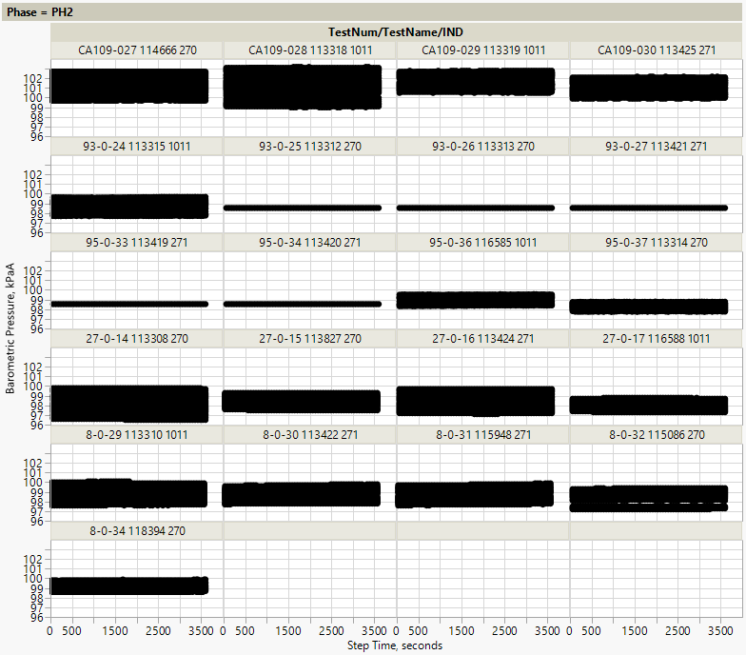
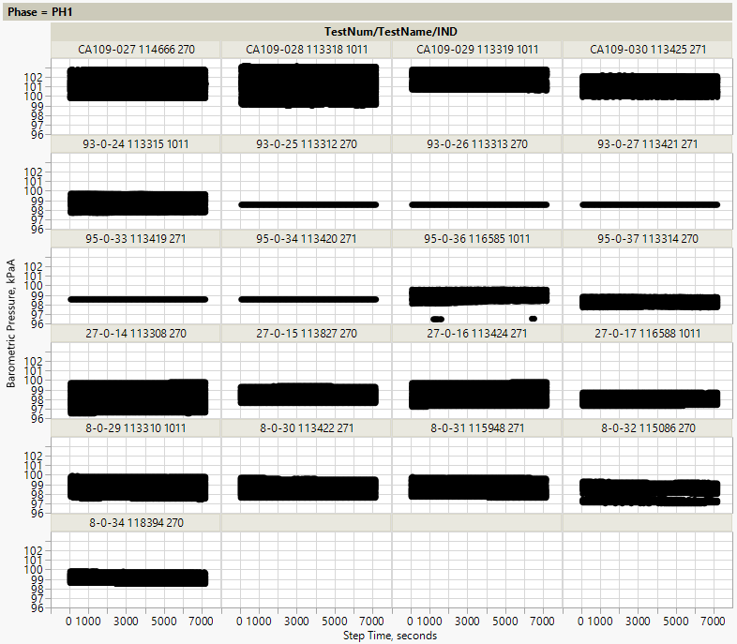
Variability Differences – Cycle to Cycle Consistency
All Labs
Phase 1
Phase 2
Barometric pressure is fairly constant within each cycle.
It’s cycle-to-cycle differences that cause the overall variability to be larger
This is mainly observed in labs D and A, but does show up in a few tests at lab G
Cycles are overlaid on one another

Slide 7
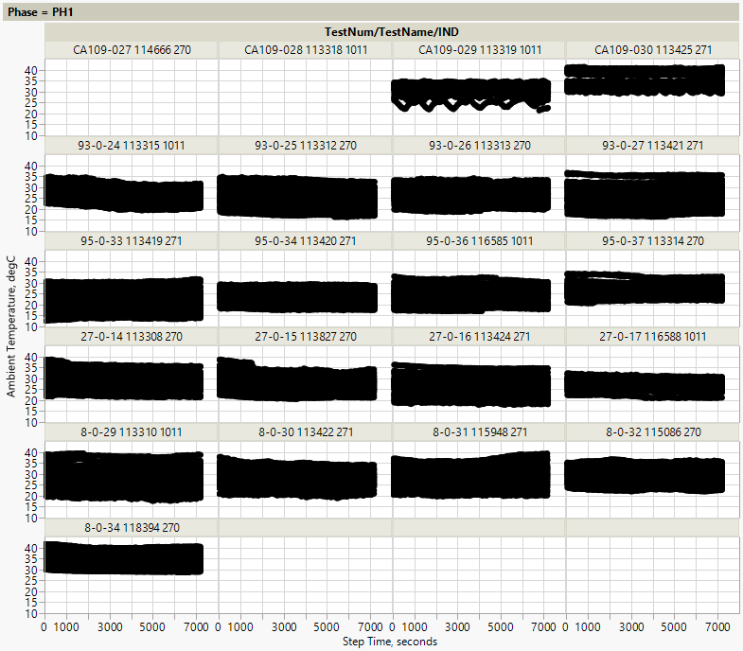
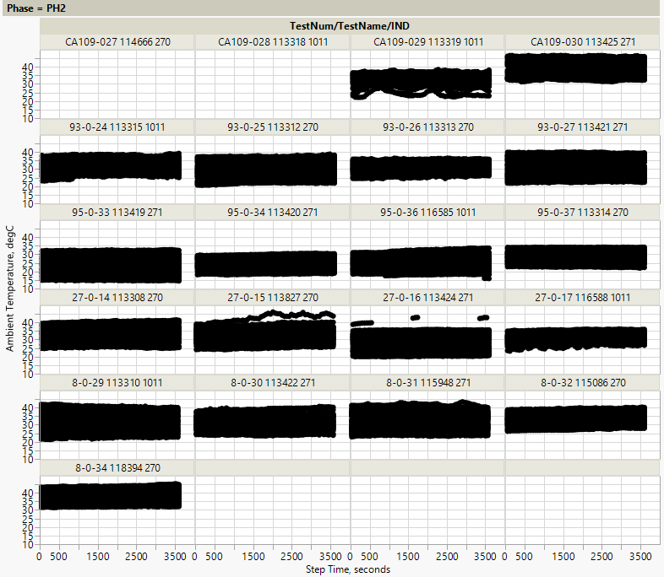
Variability Differences – Cycle to Cycle Consistency
All Labs
Phase 1
Phase 2
Within a cycle ambient temp is fairly consistent
It’s cycle-to-cycle differences that cause the overall variability to be larger
Cycles are overlaid on one another

Slide 8
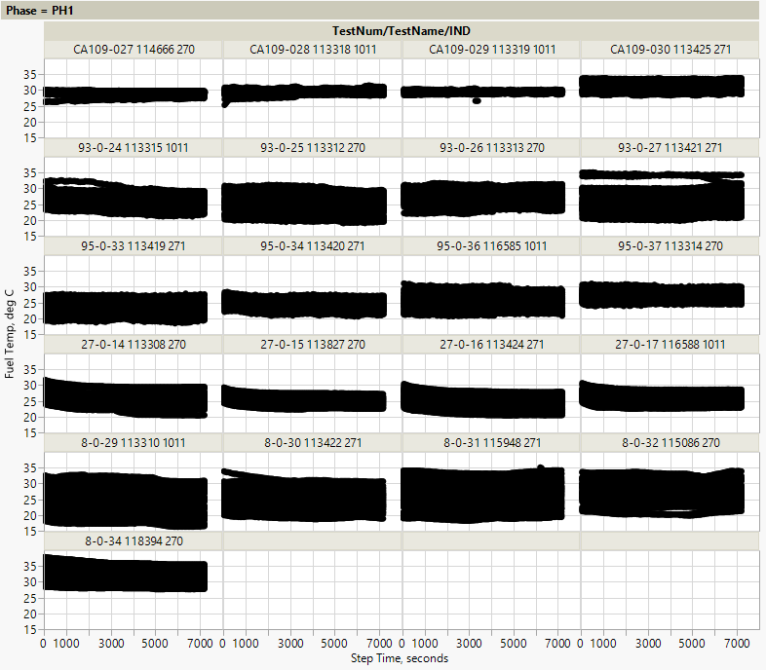
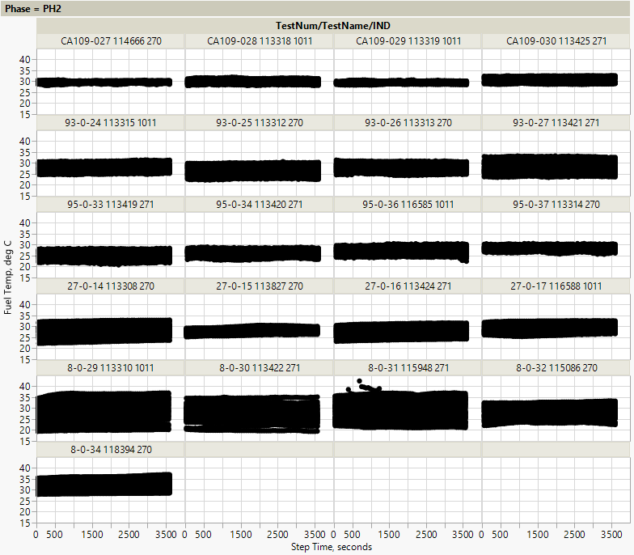
Variability Differences – Cycle to Cycle Consistency
Labs A & G
Phase 1
Phase 2
Within a cycle fuel temp variability is fairly consistent
It’s cycle-to-cycle differences that cause Labs A & G to have higher overall variability
Cycles are overlaid on one another

Slide 9
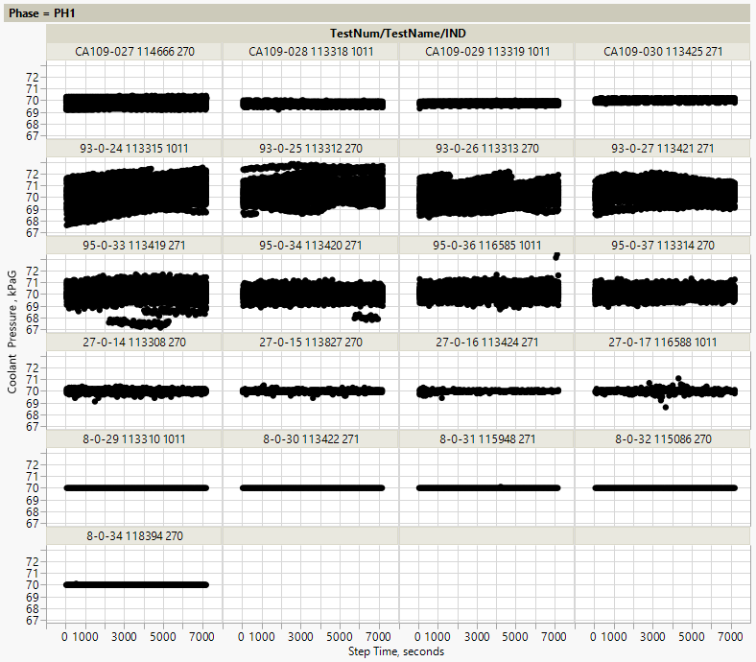
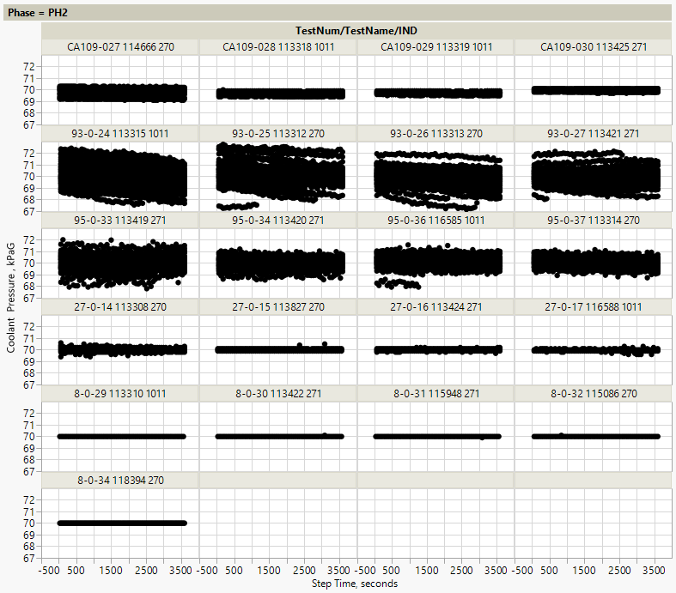
Variability Differences – Cycle to Cycle Consistency
Lab G
Phase 1
Phase 2
Within a cycle coolant pressure variability is small
It’s cycle-to-cycle differences that cause Lab G’s overall variability to be larger than the other labs
Cycles are overlaid on one another

Slide 10
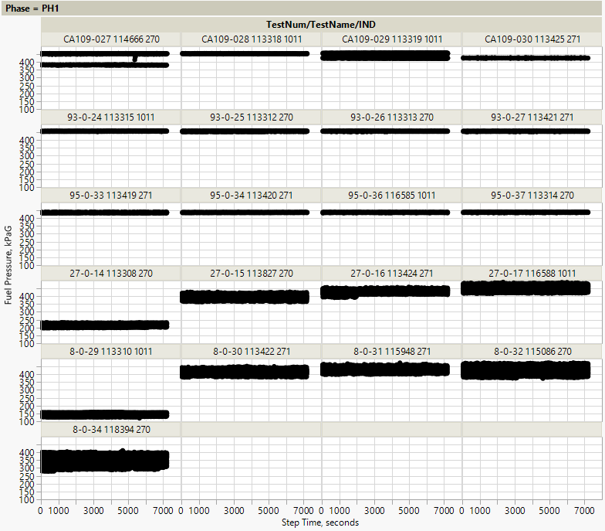
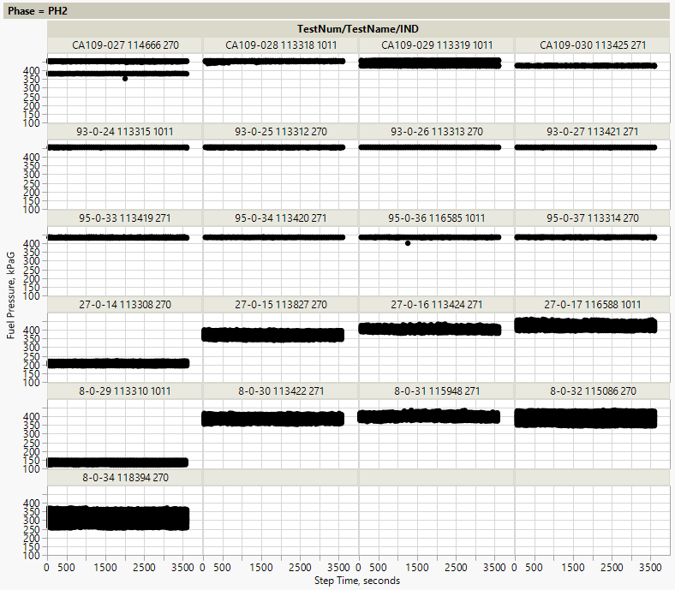
Variability Differences – Cycle to Cycle Consistency
Lab A
Phase 1
Phase 2
Within a cycle fuel pressure variability is fairly consistent
It’s cycle-to-cycle differences that cause Lab A’s overall variability to be larger than the other labs
Cycles are overlaid on one another

Slide 11
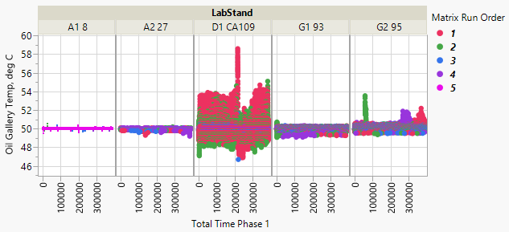
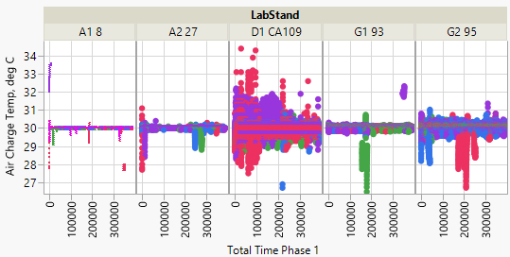
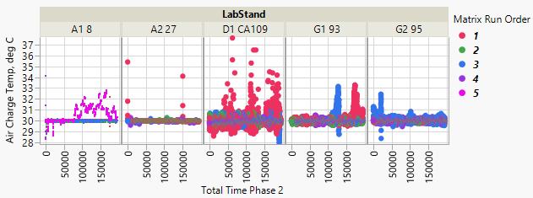
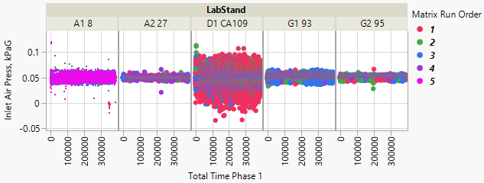
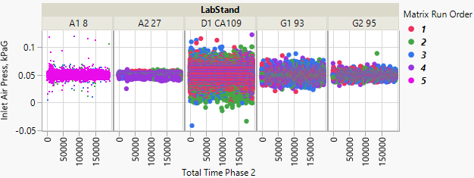
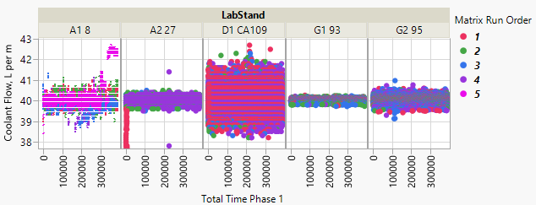
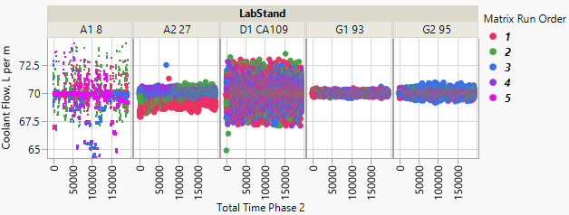
Variability Differences
Lab D
Phase 1
Phase 2
Lab D has lower oil gallery temp variability in their last 2 tests
Higher variability attributed to: 1st and 4th test in Phase 1; 1st test in Phase 2
Most variability in inlet air pressure observed in Lab D tests
Lab D consistently has most variability; A1 variability attributed to cycle-to-cycle consistency
Cycles are shown contiguously

Slide 12
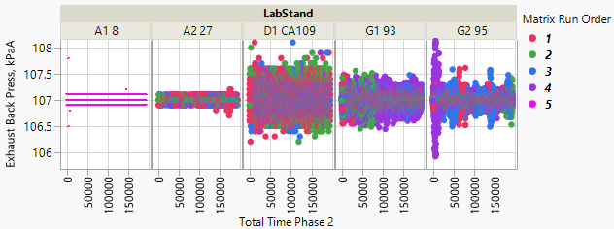
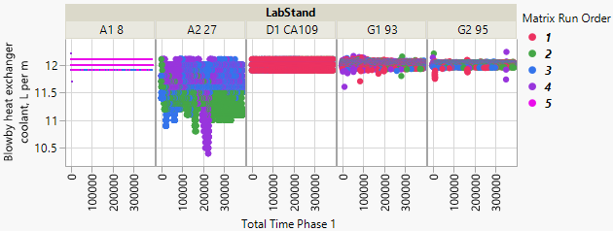
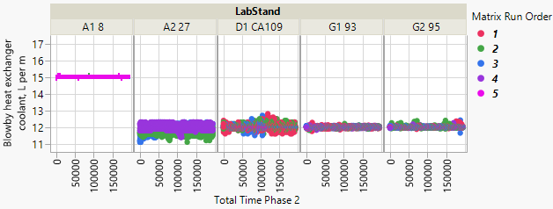
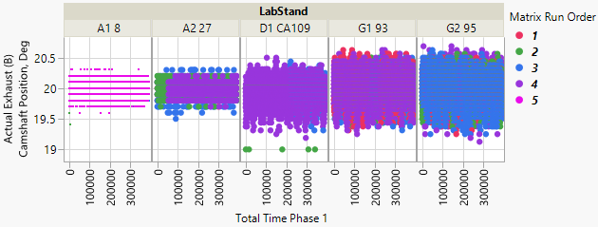
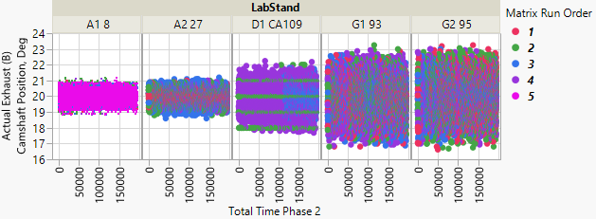
Variability Differences
Lab A
Phase 1
Phase 2
Lab A has the least PH2 exhaust back pressure variability compared to other labs
Stand 27 has higher variability
Lab A has lowest variability in actual exhaust (B) camshaft position
Cycles are shown contiguously

Slide 13
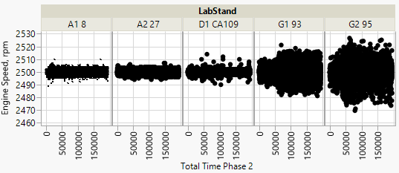
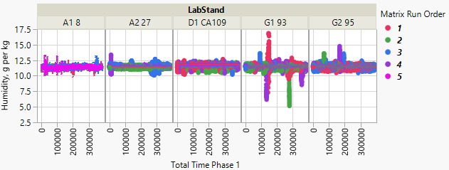
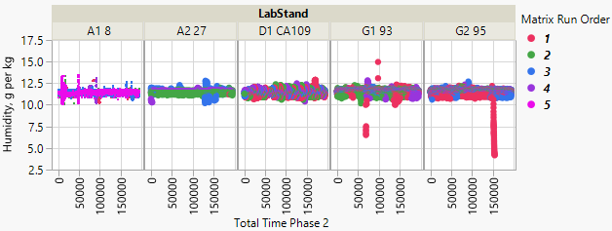
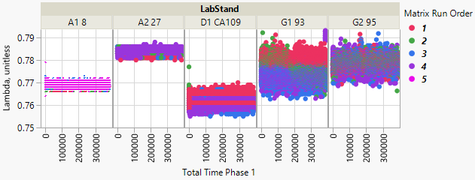
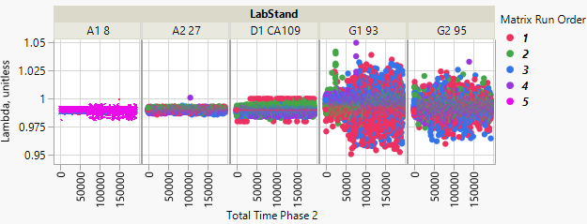
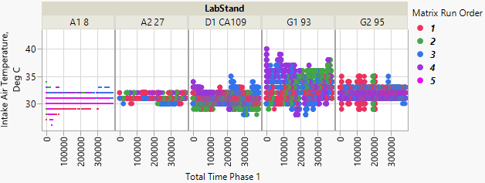
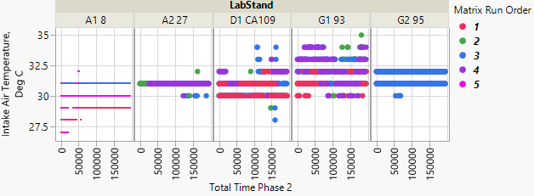
Variability Differences
Lab G
Phase 1
Phase 2
Lab G operates at engine speed 2500 + ~10 to ~20 while the other labs operate at + ~5 to ~10
Increased variability at Lab G due to humidity excursions
Variability in Lambda is higher at Lab G
Intake air temp variability highest in stand 93
Cycles are shown contiguously

Slide 14
Lab Differences
Lab D Control Change
Phase 1
Phase 2
At 30 cycle in Lab D’s 3rd test it appears a control change was made resulting in:
lower fuel pressure
higher boost pressure
higher boost absolute pressure
lower accelerator pedal position
Less variability in blowby outlet temp is observed in 4th test compared to first 3; accompanied by slight change in temp
Cycles are overlaid

Slide 15
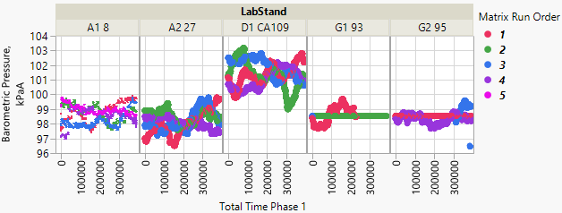
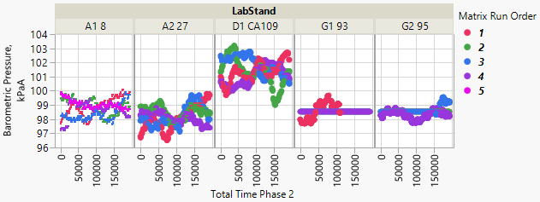
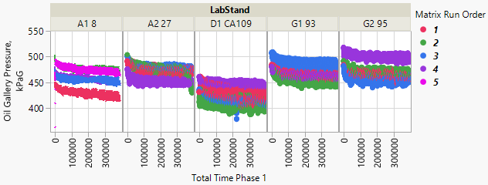
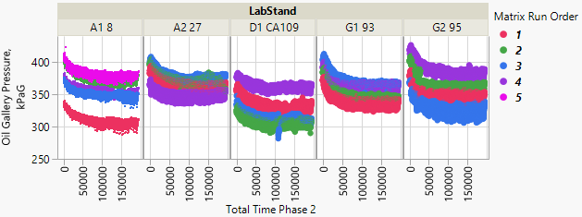
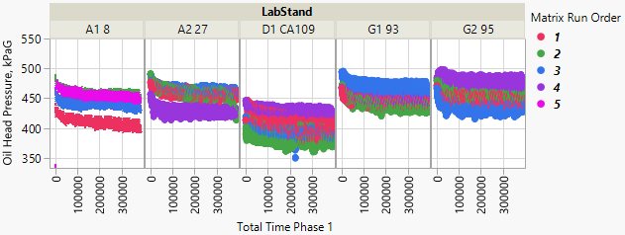
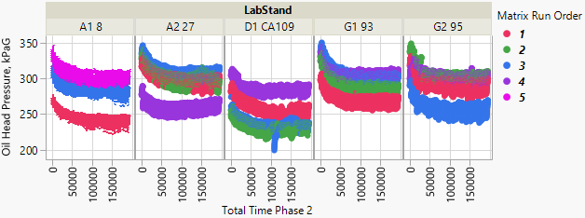
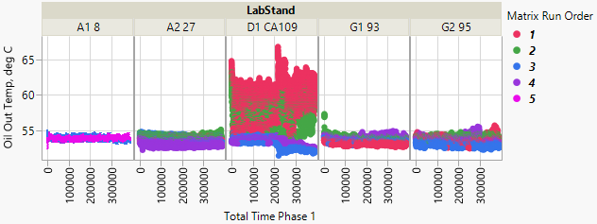
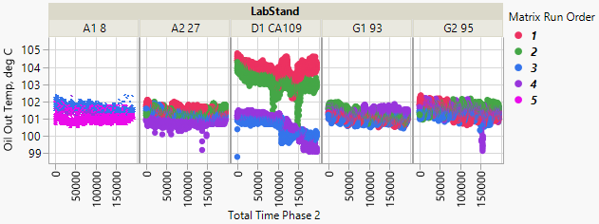
Lab Differences
Lab D
Phase 1
Phase 2
Lab D exhibits higher barometric pressure than other labs
Lab D lower oil gallery pressure;
Lab D 4th test more aligned with other labs;
Lab A stand 8 1st test lower
Lab D lower oil head pressure;
Lab D 4th test more aligned with other labs;
Lab A stand 8 1st test lower;
Lab A stand 27 4th test lower
Lab D fist 2 tests higher oil out temperature
Cycles are shown contiguously

Slide 16
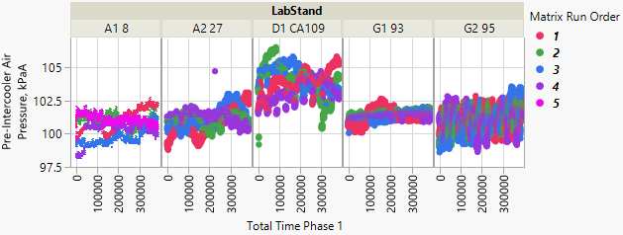
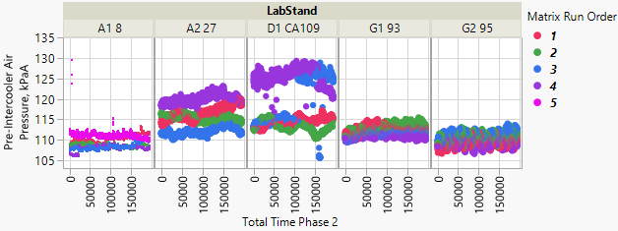
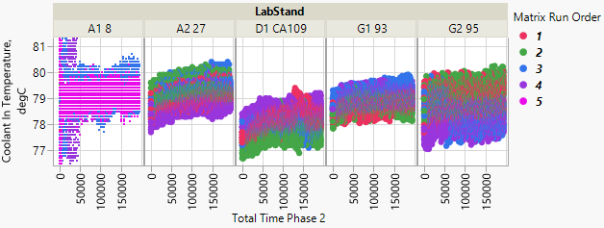
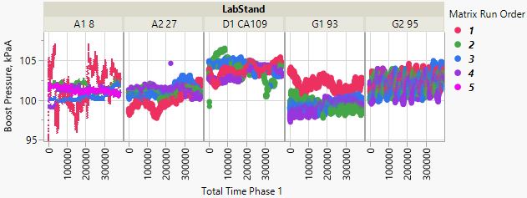
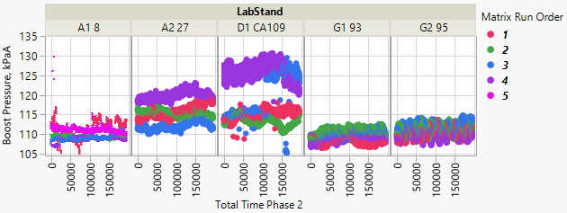
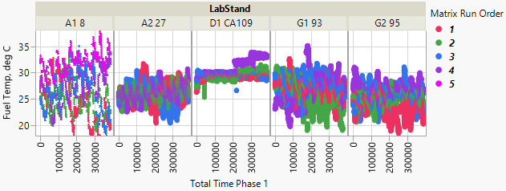
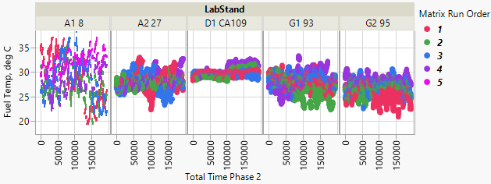
Lab Differences
Lab D
Phase 1
Phase 2
Lab D exhibits higher pre-intercooler air pressure (phase 2: only last 2 tests)
Lab D phase 2 coolant in temp slightly lower
Lab D higher boost pressure (in phase 2 it’s only the last 2 tests);
Note: A27 also higher in phase 2
Lab D operating at upper end of range observed across labs
Cycles are shown contiguously

Slide 17
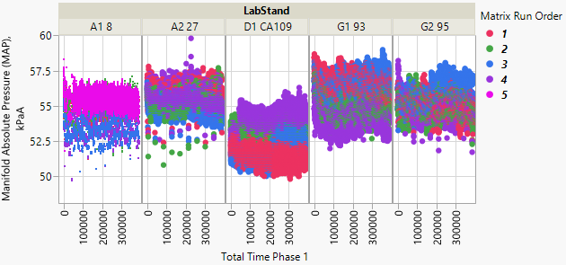
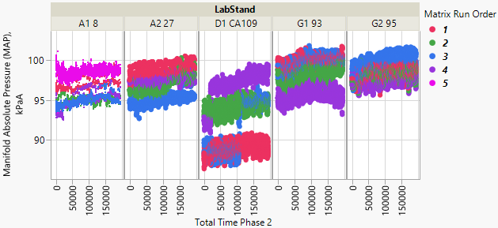
Lab Differences
Lab D
Phase 1
Phase 2
Lab D has lower MAP on some tests
Lab D higher blowby heat exchanger coolant in, on average, in PH1; lower in PH2
Lab D 1st test has lower PH2 ignition timing advance for #1 Cylinder
Cycles are shown contiguously

Slide 18
Lab Differences
Lab D
Phase 1
Phase 2
First 2 lab D tests have lower engine coolant temp; 2nd test in A8 also lower
Lab D generally has higher fuel rail pressure
Cycles are shown contiguously

Slide 19
Lab Differences
Lab A
Phase 1
Phase 2
First test in both stands exhibit lower fuel pressure
A8 has higher Phase 2 blowby heat exchanger coolant l/m
Tests 3 and 4 in stand 8 are slightly lower;
Note: Lab D slightly lower in phase 1
Cycles are shown contiguously

Slide 20
Lab Differences
Lab G
Phase 1
Phase 2
G95 has slightly lower ambient temp
G95 has slightly higher PH2 turbocharger wastegate duty cycle;
Lab D’s 2nd test also higher
Cycles are shown contiguously

Slide 21
Lab Differences
Multiple Labs
Phase 1
Phase 2
Lab D lowest Lambda;
Stands 8 and 27 differ.;
Last 2 tests in stand 93 are lower
Phase 1:
D and G95 lowest exhaust temp
G93 has highest temp
Phase 2:
G highest temp; A27 and D lowest
Phase 1:
G95 slightly higher Crankcase kPaG
Phase 2:
G95 highest pressure; A8 lowest
PH2: A27 and D have lower absolute throttle position
Cycles are shown contiguously

Slide 22
Lab Differences
Multiple Labs
Phase 1
Phase 2
Lab D generally lower abs load value%; Lab G generally higher in PH2
Lab D slightly lower intake manifold abs pressure, especially 1st test PH2
Labs A and G differ;
Labs D & A similar after 30th cycle of 3rd test;
Labs D & G similar prior to 30th cycle 3rd test
PH1: D has highest boost abs pressure and G is slightly higher than A;
PH2: D and A27 highest, G95 and A8 slightly lower than A27
Cycles are shown contiguously

Slide 23
Lab Differences
Multiple Labs
Phase 1
Phase 2
Labs A and D don’t have negative actual intake (A) camshaft position data
Labs G generally has higher exhaust (B) camshaft position actuator duty cycle;
Stands at lab A differ
Cycles are shown contiguously

Slide 24
APPENDIX

Slide 26
ZOOMED IN

Slide 28
ZOOMED IN

Slide 30
ZOOMED IN

Slide 32
ZOOMED IN

Slide 41
ZOOMED IN

Slide 47
ZOOMED IN

Slide 50
ZOOMED IN

Slide 53
ZOOMED IN

Slide 61
ZOOMED IN

Slide 63
ZOOMED IN

Slide 66
ZOOMED IN

Slide 73
ZOOMED IN

Slide 77
ZOOMED IN

Slide 79
ZOOMED IN

Slide 81
ZOOMED IN

Slide 83
ZOOMED IN

Slide 85
ZOOMED IN

Slide 87
ZOOMED IN

Slide 92
ZOOMED IN

Slide 97
ZOOMED IN

Slide 108
ZOOMED IN

Slide 111
ZOOMED IN

Slide 120
ZOOMED IN

Slide 122
ZOOMED IN

Slide 124
ZOOMED IN

Slide 126
ZOOMED IN

Slide 128
ZOOMED IN

Slide 131
ZOOMED IN

Slide 138
ZOOMED IN

Slide 142
ZOOMED IN

Slide 144
ZOOMED IN

